Slide 1



Maryland Phase III WIP
Local Partners Engagement and Communication Strategy
Presented by: Kathy Stecker, MD Dept. of the Environment
October 5, 2017

Slide 2
Jurisdiction-Specific Considerations
What does MDE need? Please tell us:
  Your barriers and obstacles
    Capacity, regulatory, etc.
  Your funding challenges
  Your ideas on streamlined permitting
    What makes sense to you?
  Your successes!
MD Local Partners
Engagement and Communication Strategy

Slide 3
Jurisdiction-Specific Considerations
What do local partners need to do?
  Help develop Maryland’s Phase III WIP
    Report local actions through 2025 and beyond
  Work collaboratively to
    Ensure multiple benefits
    Provide local improvements in water quality
Trading
  New regulations by January 2018
MD Local Partners
Engagement and Communication Strategy

Slide 4
Engagement and Communication Goals
Identify pollution reduction already being done
What can be accomplished by 2025?
Identify any gaps
Strategies to fill any gaps
Funding needs for implementation
Pace of implementation beyond 2025
MD Local Partners
Engagement and Communication Strategy

Slide 5
Target Audiences
Local leaders
  Elected officials
  Agricultural community
Practitioners
  County, municipal, SCD staff
Technical (state/federal agencies, universities)
NGOs
MD Local Partners
Engagement and Communication Strategy

Slide 6
Engaging Practitioners by Sector
Agriculture: MDA coordination
Phase I MS4s: through permit development
  MACo coordination, regular meetings
Phase II MS4s: through permit development
  One-on-one, small groups -- target newly-designated
Unreg. stormwater: one-on-one, WAC
WWTPs: permit development, funding opps
Septic: water and sewer plan review
MD Local Partners
Engagement and Communication Strategy

Slide 7
Key Messages
2025 targets are within reach
Fiscally responsible path to final targets
Local WQ important to local economy
WIP should reflect local priorities, constraints
Conowingo
Establish strategies that extend beyond 2025
MD Local Partners
Engagement and Communication Strategy

Slide 8
Key Messengers/Trusted Sources
MDE staff
MD Department of Agriculture
MD Bay Cabinet
MD Bay Workgroup
MD Association of Counties
MD Municipal League
NGOs
MD Local Partners
Engagement and Communication Strategy

Slide 9
Roles, Resources, and Capacity
What do local governments need from the state?
  To help develop Phase III WIP
  To implement Phase III WIP
MD Local Partners
Engagement and Communication Strategy

Slide 10
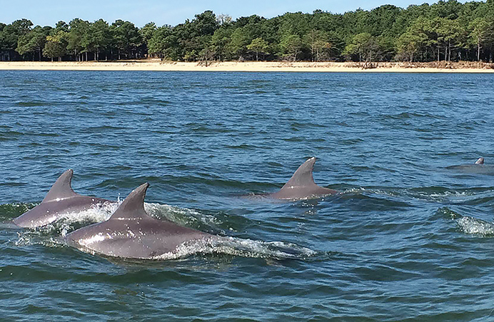
Questions?
Kathy Stecker, MD Dept. of the Environment
kathy.stecker@maryland.gov
410-537-3864
MD Local Partners
Engagement and Communication Strategy

