Slide 1
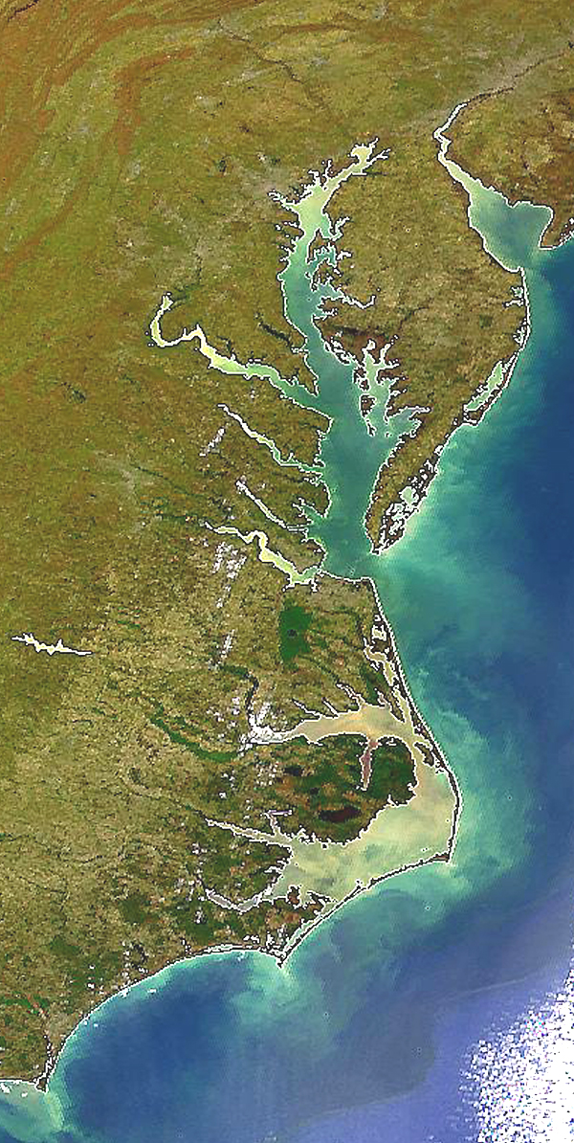

State Profile
Maryland

Slide 2
MD Draft Phase III WIP Planning Targets + Reference Loads
Nitrogen Load
 | No-Action (M lbs) | E3 (M lbs) | 2013 Progress (M lbs) | Phase II WIP (reference) (M lbs) | Draft Phase III WIP Planning Target (M lbs)
MD Eastern Shore | 27.95 | 8.86 | 18.60 | 15.48 | 14.94
MD Patuxent | 7.47 | 2.19 | 3.46 | 3.34 | 3.19
MD Potomac | 35.82 | 10.52 | 17.19 | 17.12 | 15.16
MD Susquehanna | 2.16 | 0.82 | 1.78 | 1.44 | 1.16
MD Western Shore | 37.84 | 6.87 | 14.86 | 9.91 | 10.85
MD Total | 111.24 | 29.20 | 55.89 | 47.27 | 45.30
Phosphorus Load
 | No-Action (M lbs) | E3 (M lbs) | 2013 Progress (M lbs) | Phase II WIP (reference) (M lbs) | Draft Phase III WIP Planning Target (M lbs)
MD Eastern Shore | 2.22 | 0.90 | 1.30 | 1.20 | 1.25
MD Patuxent | 1.15 | 0.17 | 0.30 | 0.28 | 0.30
MD Potomac | 4.05 | 0.61 | 0.96 | 1.02 | 1.07
MD Susquehanna | 0.09 | 0.03 | 0.06 | 0.05 | 0.05
MD Western Shore | 4.09 | 0.70 | 1.29 | 1.01 | 0.94
MD Total | 11.61 | 2.42 | 3.92 | 3.56 | 3.60

Slide 3
MD Nitrogen Loads-Goals, Phase 5.3.2

Slide 4
MD Nitrogen Loads-Goals, Phase 6

Slide 5
MD Nitrogen Change in Level of Effort

Slide 6
MD Phosphorus Loads-Goals, Phase 5.3.2

Slide 7
MD Phosphorus Loads-Goals, Phase 6

Slide 8
MD Phosphorus Change in Level of Effort

Slide 9
MD Nitrogen – Phase 6 Level Of Effort
(NoAction:E3 Reference)

Slide 10
MD Phosphorus – Phase 6 Level Of Effort
(NoAction:E3 Reference)

Slide 11
MD Nitrogen – Phase 6 Loads and Target
Where did the
reductions come from?
1985
2013
Draft Phase III WIP
Planning Target

Slide 12
MD Phosphorus – Phase 6 Loads and Target
Where did the
reductions come from?
1985
2013
Draft Phase III WIP
Planning Target

Slide 13
MD Nitrogen – Phase 6 Scenario Loads and Draft Target

Slide 14
MD Phosphorus – Phase 6 Scenario Loads and Draft Target

Slide 15
Nitrogen – Phase 6 Relative Effectiveness
Effect of Nitrogen Load Reduction on WQ Standard Attainment
A = Above Fall Line B = Below Fall Line

Slide 16
Phosphorus – Phase 6 Relative Effectiveness
Effect of Phosphorus Load Reduction on WQ Standard Attainment
A = Above Fall Line B = Below Fall Line

Slide 17
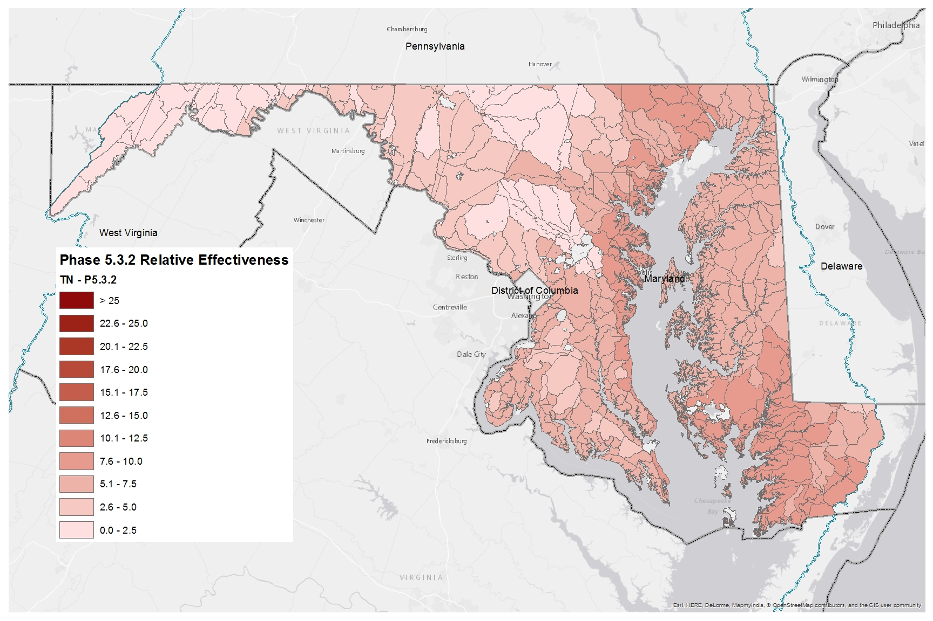
Nitrogen Relative Effectiveness
Phase 5.3.2

Slide 18
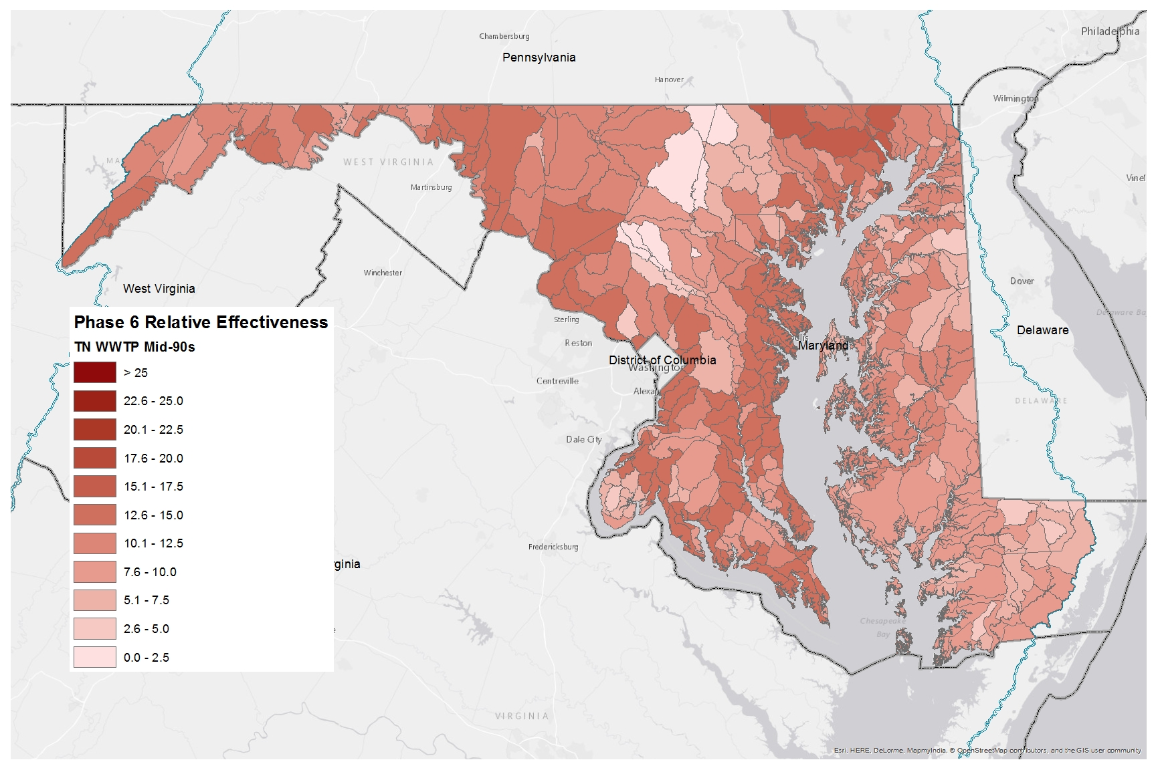
Nitrogen Relative Effectiveness
Phase 6, WWTP, Mid-90s

Slide 19
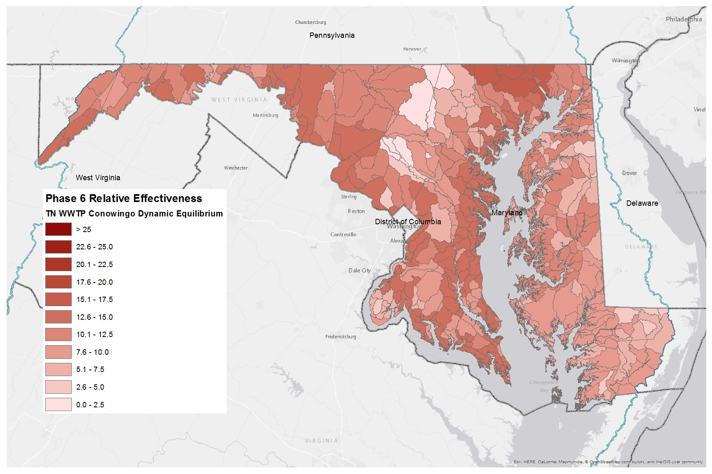
Nitrogen Relative Effectiveness
Phase 6, WWTP, Conowingo Dynamic Equilibrium

Slide 20

Nitrogen Relative Effectiveness
Phase 6, All Else, Mid-90s

Slide 21
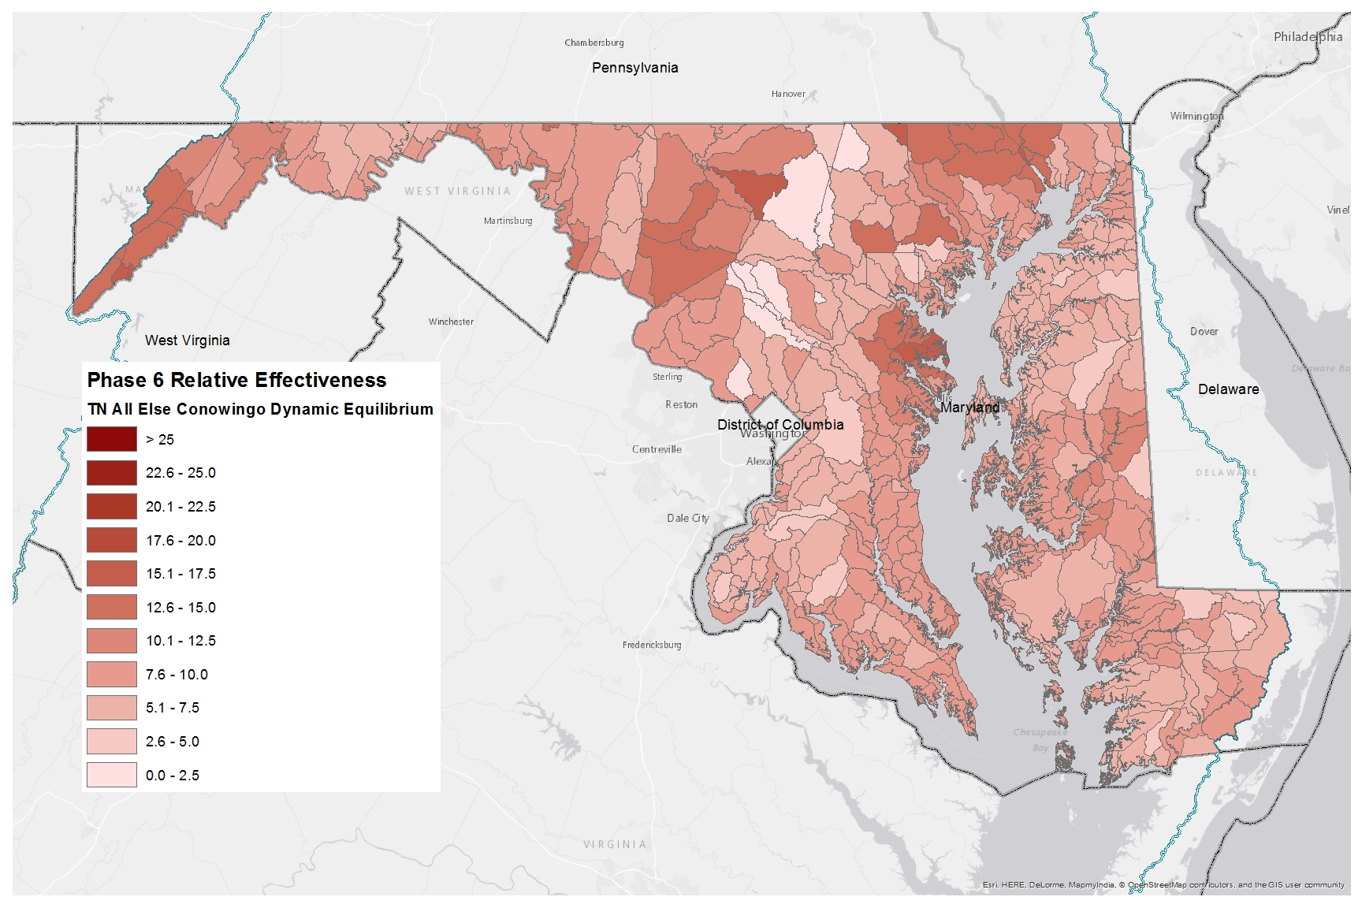
Nitrogen Relative Effectiveness
Phase 6, All Else, Conowingo Dynamic Equilibrium

Slide 22
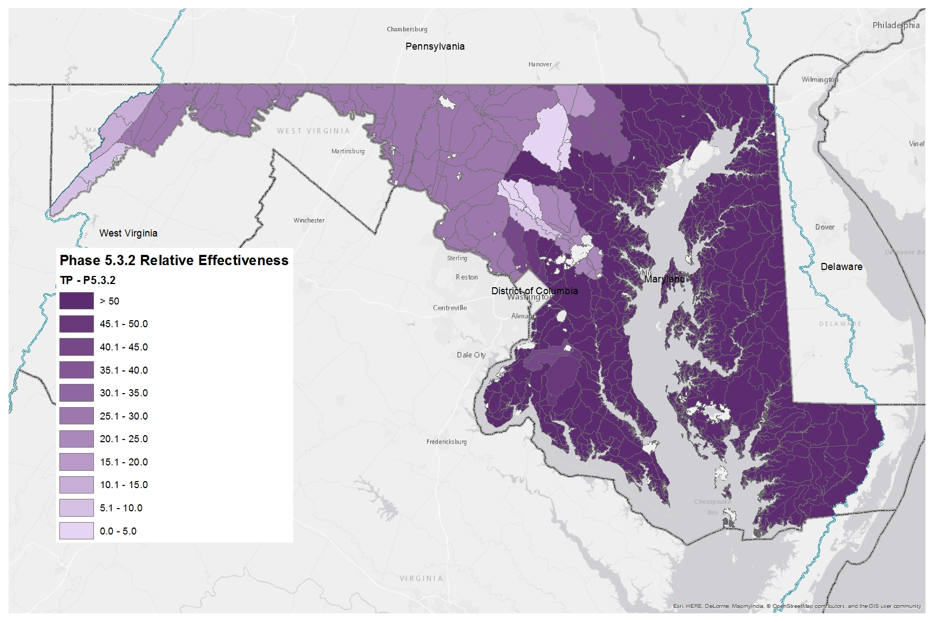
Phosphorus Relative Effectiveness
Phase 5.3.2

Slide 23
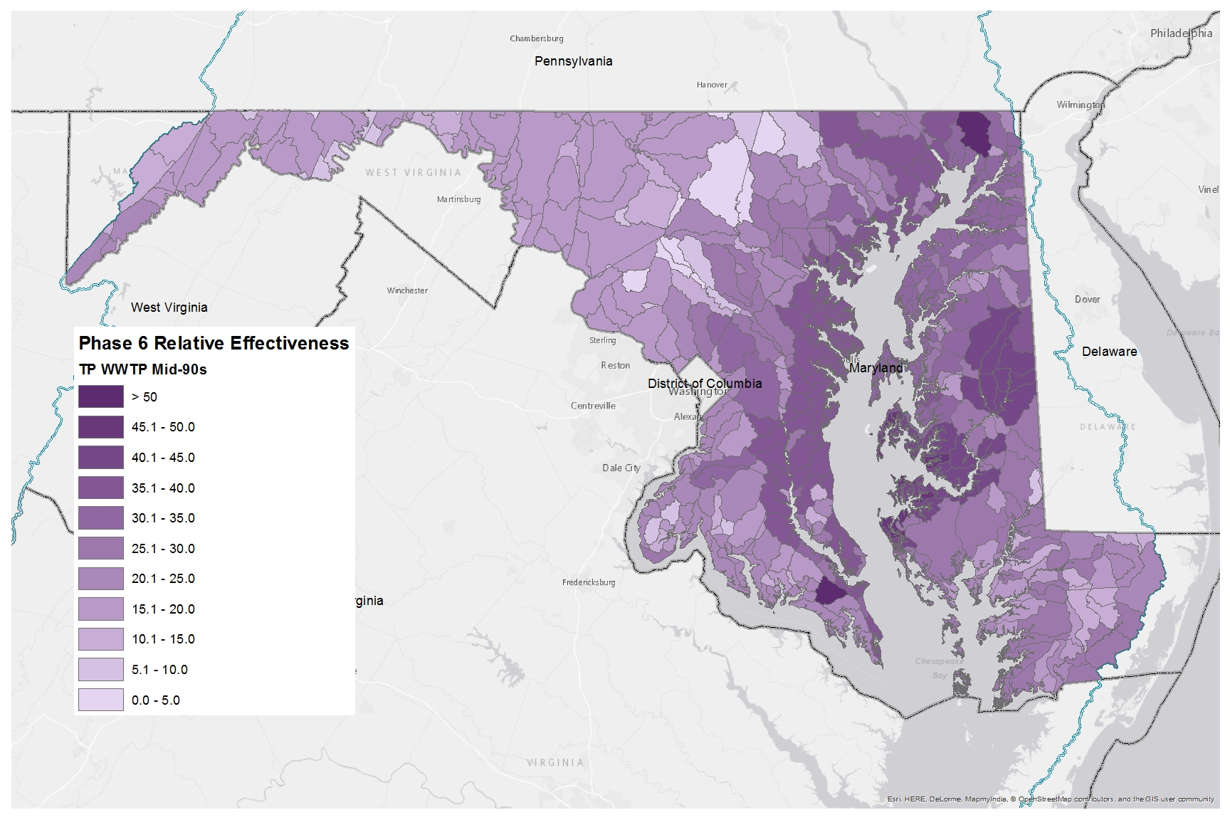
Phosphorus Relative Effectiveness
Phase 6, WWTP, Mid-90s

Slide 24

Phosphorus Relative Effectiveness
Phase 6, WWTP, Conowingo Dynamic Equilibrium

Slide 25
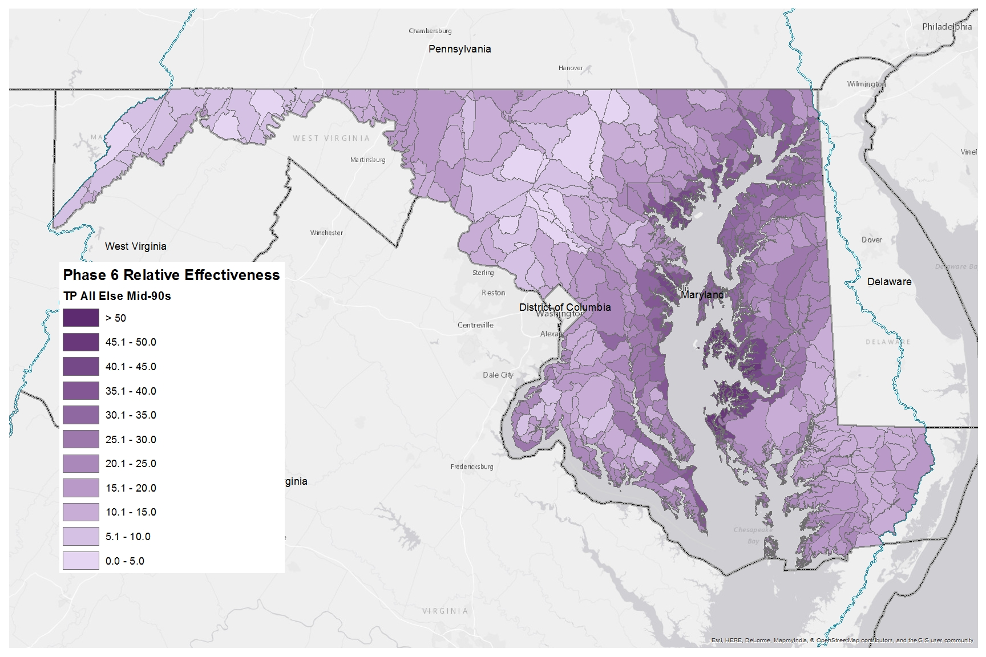
Phosphorus Relative Effectiveness
Phase 6, All Else, Mid-90s

Slide 26
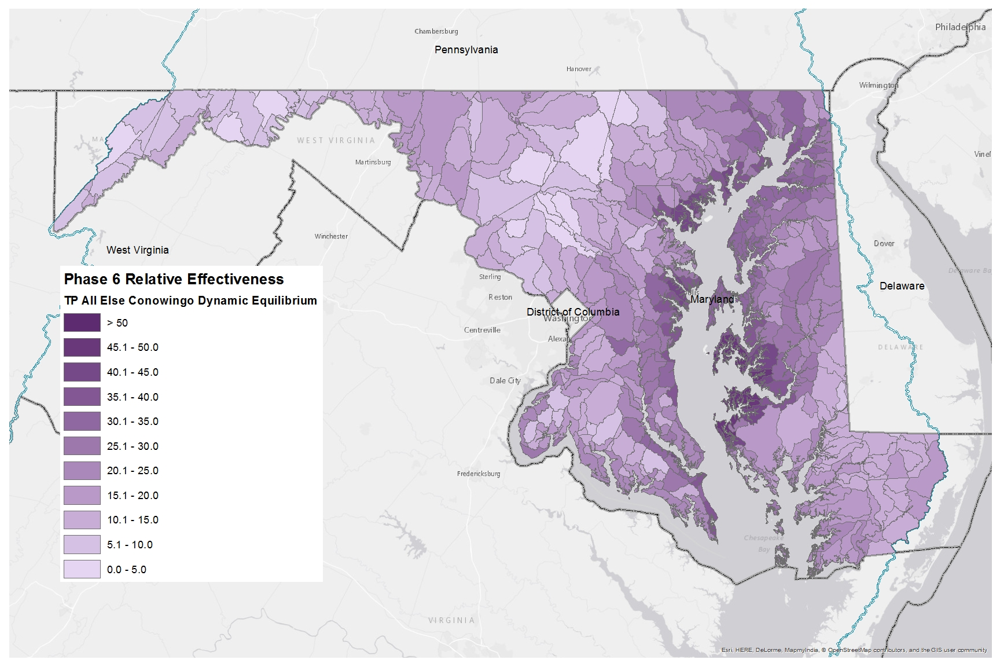
Phosphorus Relative Effectiveness
Phase 6, All Else, Conowingo Dynamic Equilibrium

