Slide 1
Chesapeake Bay TMDL 2017 Midpoint Assessment:
Building the capacity for success in Phase III WIPs
Update for the Citizens Advisory Committee
February 22, 2017

Slide 2
Where Are We Now with the Midpoint Assessment?

Slide 3
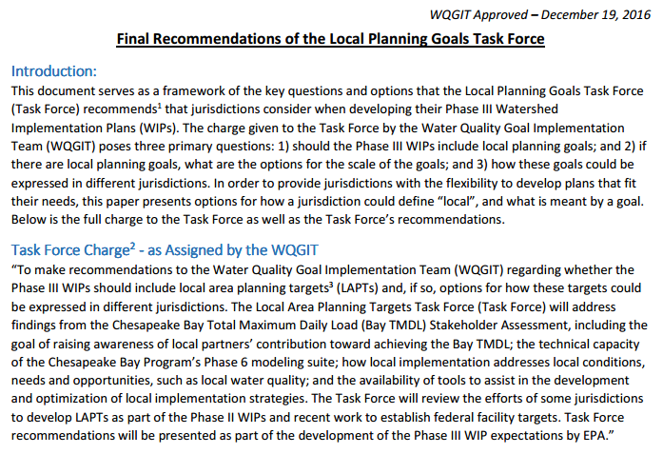
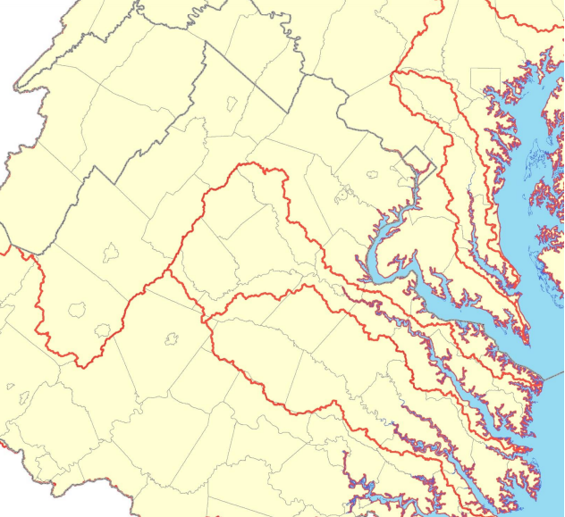
Partnership Approved Local Planning Goal Recommendations

Slide 4
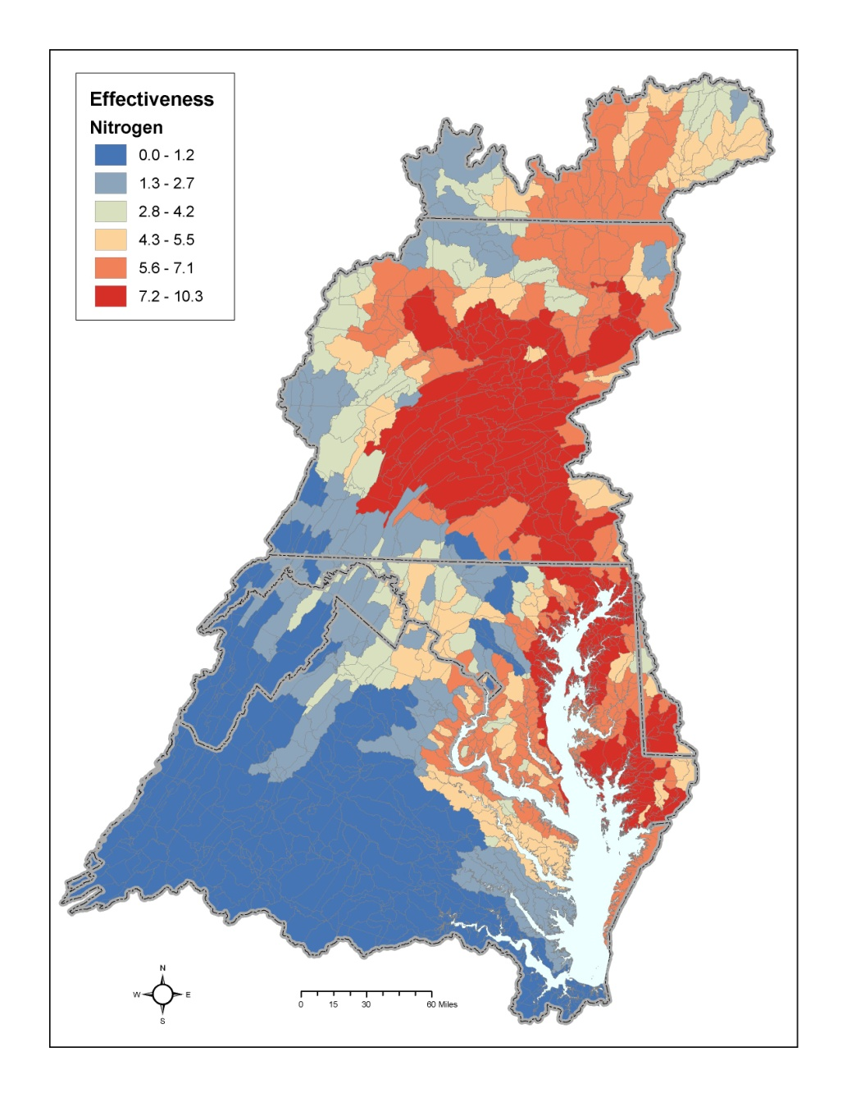
Partnership Approved Methodology for Establishing Phase III WIP Planning Targets

Slide 5
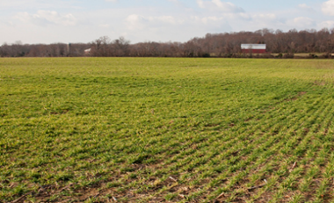
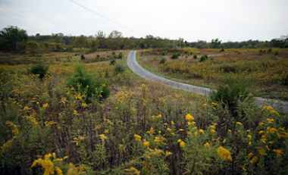
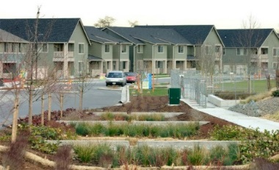
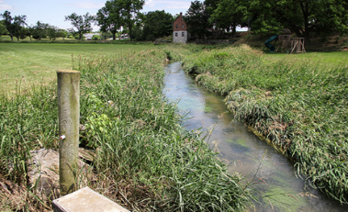
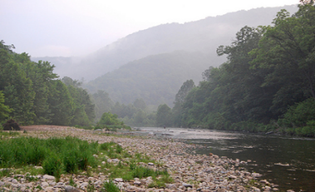
Completed 1 Year Partnership Review of Phase 6 Modeling Tools
Phase 6 Watershed Model Structure
Average Load + Inputs * Sensitivity
Land Use Acres
BMPs
Land to Water
Stream Delivery
River Delivery
*
*
*
Direct Loads
*
*

Slide 6
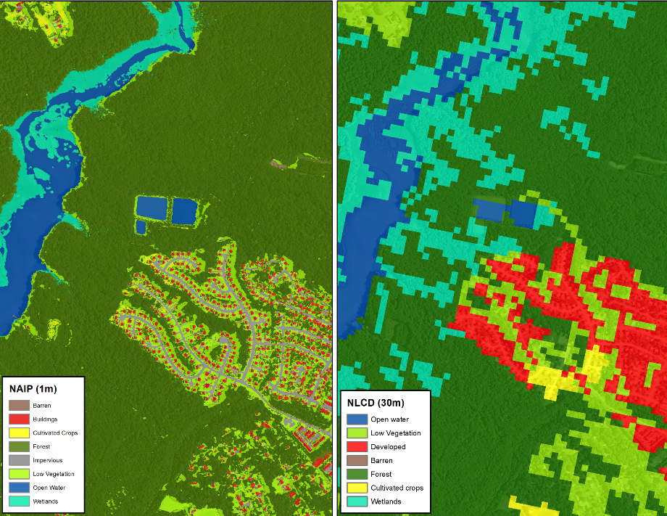
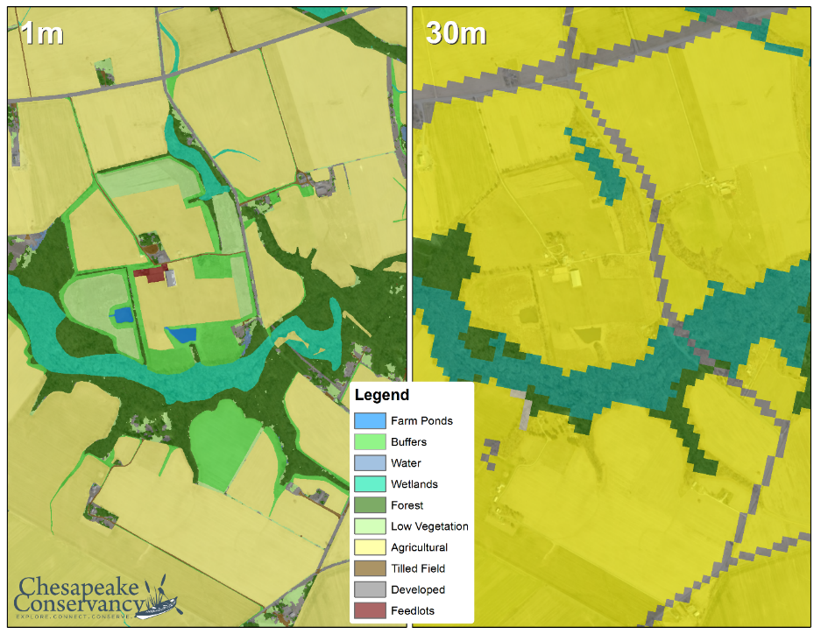
Advanced from 30 Meter to 1 Meter Resolution of Land Cover Basinwide
Phase 6
Phase 5
Phase 6
Phase 5
Urban/Suburban Settings
Rural Settings

Slide 7
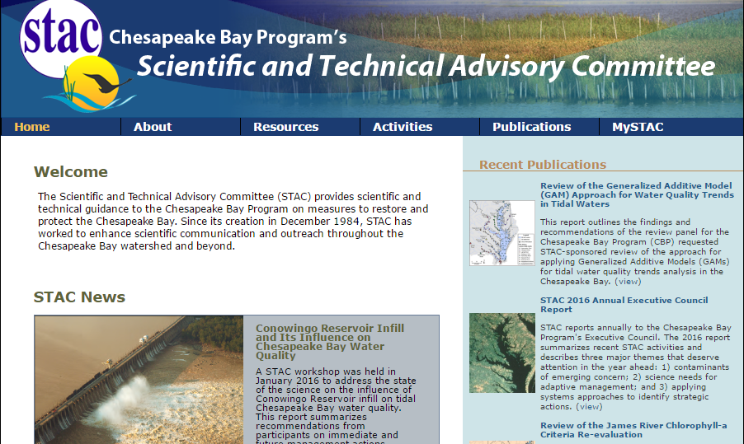
STAC Workshops & Peer Reviews

Slide 8
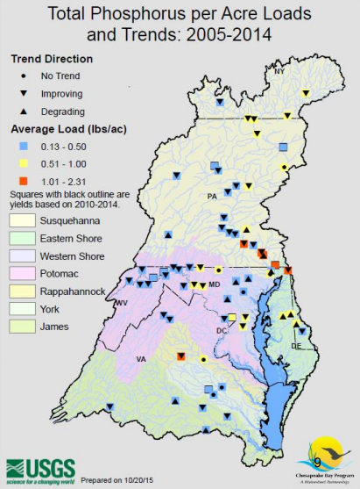
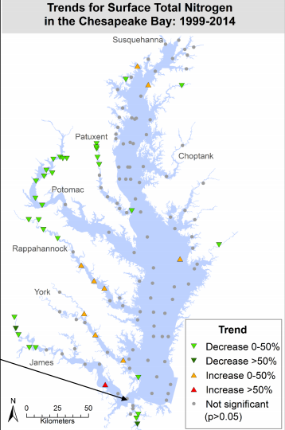
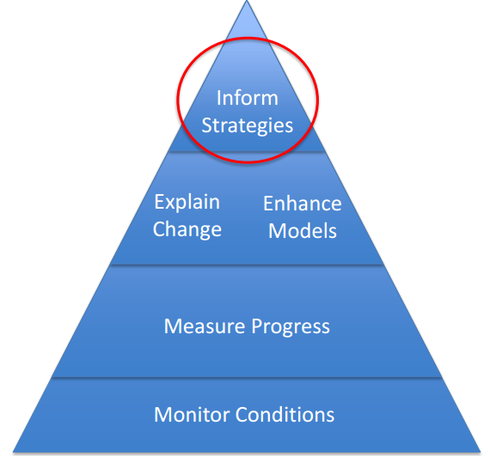
Monitoring Trends to Support Phase III WIPs

Slide 9
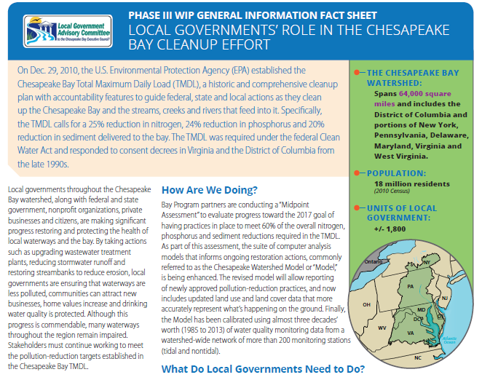
Communications & Engagement

Slide 10
Phase III WIP Expectations: Schedule
Preliminary Draft – June 2016
  EPA solicited Partnership feedback over the summary and early fall and revised document accordingly
Interim Version – January 2017
Final Version – Fall 2017 (anticipated)
  EPA will update document to reflect Partnership policy decisions on how to address Conowingo, climate change and growth

Slide 11
Phase III WIP Expectations – Top 4
Programmatic and numeric implementation commitments for 2018-2025
Strategies for engagement of local, regional and federal partners in implementation
Account for changed conditions: climate change, Conowingo Dam infill, growth
Develop, implement local planning goals below the state-major basin scales

Slide 12
What’s Next for the Midpoint Assessment?

Slide 13
Current Midpoint Assessment Schedule
Midpoint Assessment Deliverable | Current Schedule
Partnership’s fatal flaw review of the suite of Phase 6 models | April – May 2017
Release of draft Phase III WIP planning targets | June 2017
Partnership’s review of draft Phase III WIP planning targets | June – December 2017
EPA releases final Phase III WIP expectations | June 2017
Release of final Phase III WIP planning targets | December 2017
Draft Phase III WIPs due to EPA | August 2018
EPA review and engagement with jurisdictions on feedback of draft Phase III WIPs | August – October 2018
Final Phase III WIPs due to EPA | December 2018

Slide 14
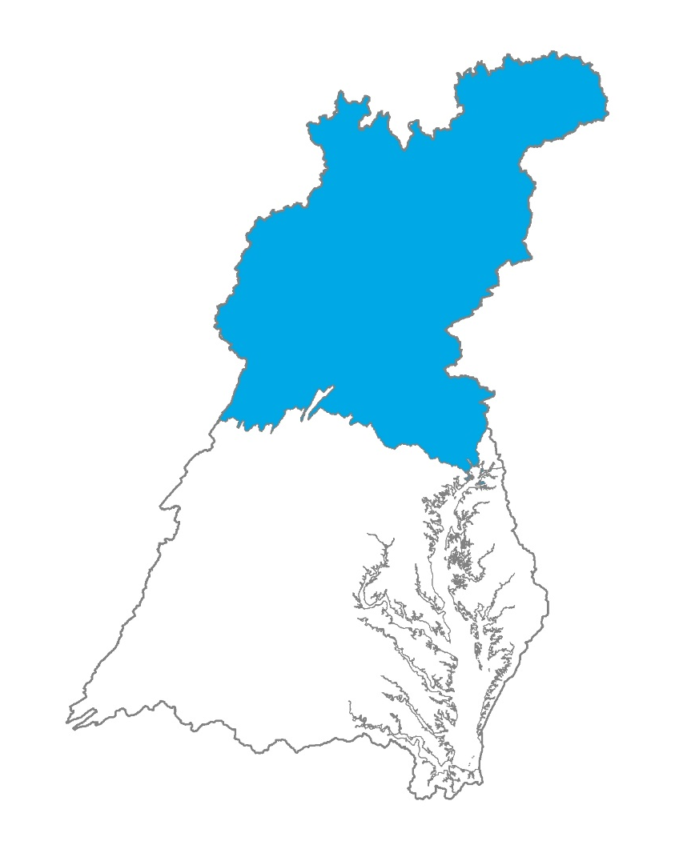
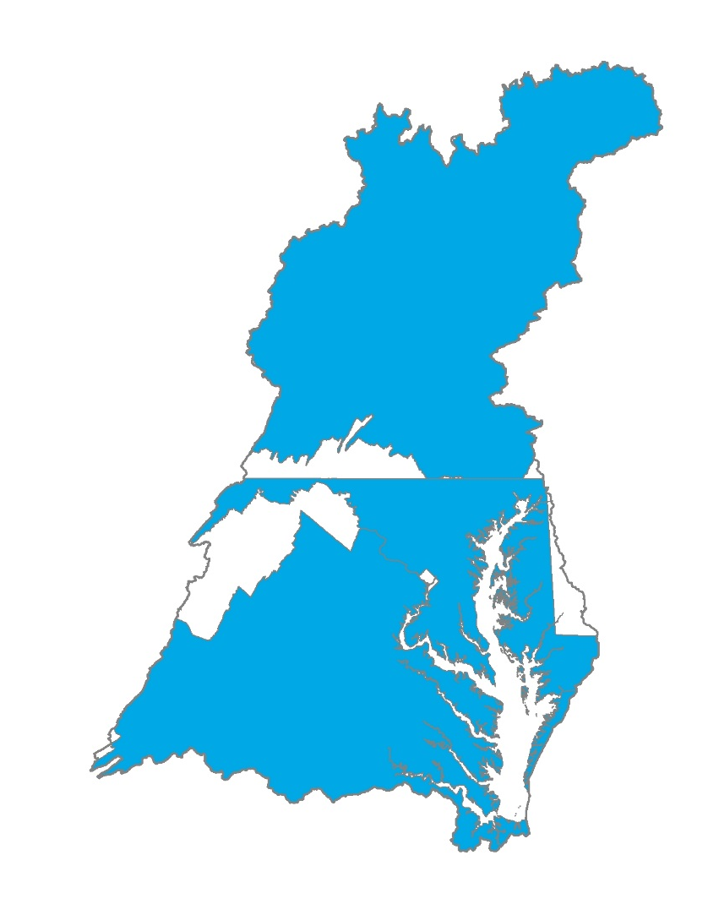
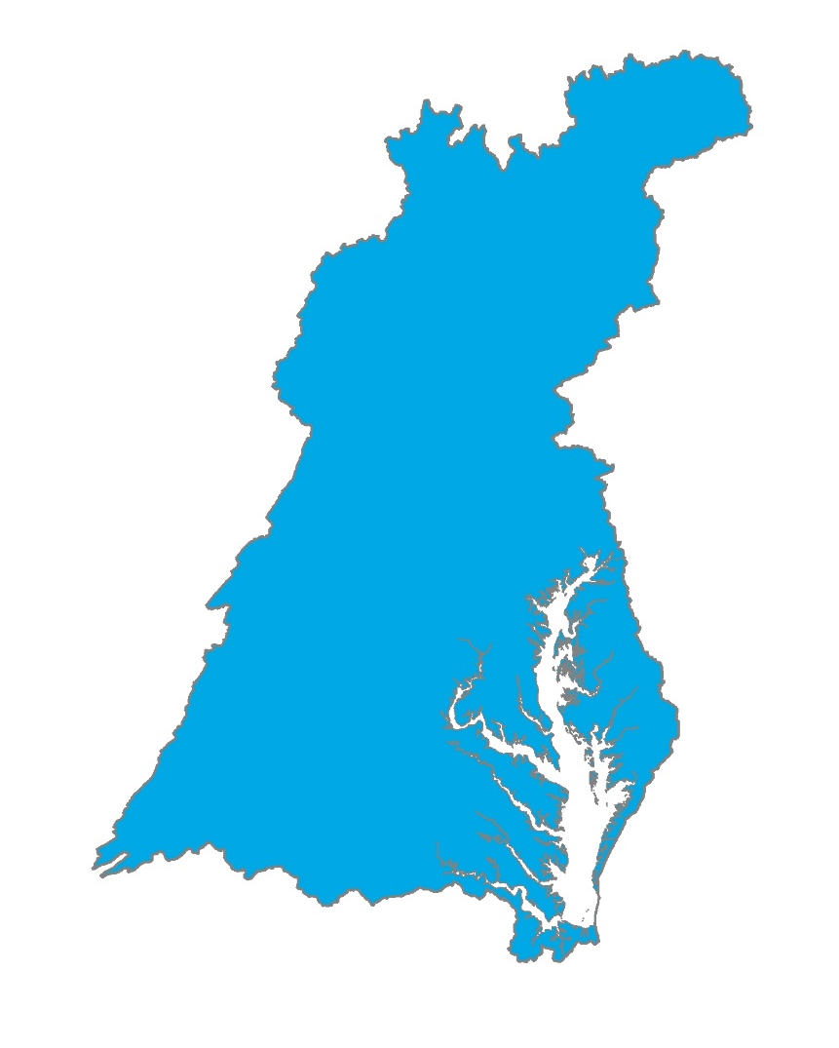
Conowingo Dam Infill Policy Decisions
Who?
How?
Allocation equity rules used in the Bay TMDL
Most cost effective practices and locations
When?
By 2025
Beyond 2025
Post 2025

Slide 15
Climate Change Policy Decisions
The Partnership will decide in 2017 whether to address climate change:
Quantitatively
  AND/OR
Qualitatively

Slide 16

Accounting for Growth
Using 2025 growth projections in Phase III WIPs
2025 growth projection
Load reductions necessary to meet the 2025 Phase III WIP Planning Target (lock box)

Slide 17
Phase III WIP Planning Targets and Accounting for Changed Conditions
Estimated Current Load
Phase III WIP Planning Target
2017
2025

Slide 18
Phase III WIP Planning Targets and Accounting for Changed Conditions
Growth +
Estimated Current Load
Phase III WIP Planning Target
2017
2025

Slide 19
Phase III WIP Planning Targets and Accounting for Changed Conditions
Conowingo +
Growth +
Estimated Current Load
Phase III WIP Planning Target
2017
2025

Slide 20
Phase III WIP Planning Targets and Accounting for Changed Conditions
Climate Change +
Conowingo +
Growth +
Estimated Current Load
Phase III WIP Planning Target
2017
2025

Slide 21
Phase III WIP Planning Targets and Accounting for Changed Conditions
Climate Change +
Conowingo +
Growth +
Estimated Current Load
Phase III WIP Planning Target
2017
2025

Slide 22
“Getting to Yes” on the
Midpoint Assessment
Focus on incremental, consensus decision-making up through the Partnership
Topics fully vetted through webinars and informational briefings to tee up policy decisions to wider partners, stakeholder, public audiences
Principals’ Staff Committee is driving decision-making schedule for the Partnership

Slide 23
Which Midpoint Assessment Policy Decisions Does the CAC Want to Focus on/Want More Information On?

Slide 24

Lucinda Power
Implementation and Evaluation Team Leader
U.S. EPA Chesapeake Bay Program Office
410-267-5722
power.lucinda@epa.gov
www.chesapeakebay.net
www.epa.gov/chesapeakebaytmdl

