Slide 1

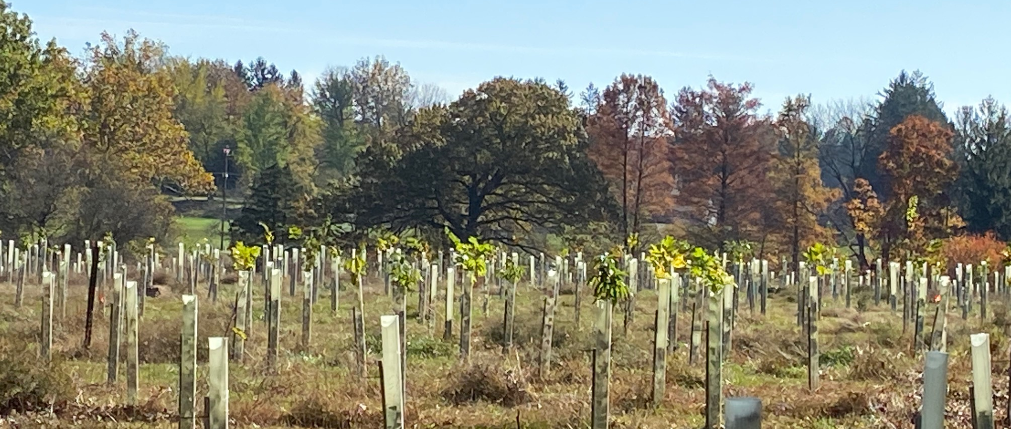
*Photo can be changed, this is only a placeholder.
Be sure to add photo credit
Natural Filters Revolving Loan Fund
Photo Credit: Will Parson/Chesapeake Bay Program
Craig Highfield
Forest Program Director

Slide 2

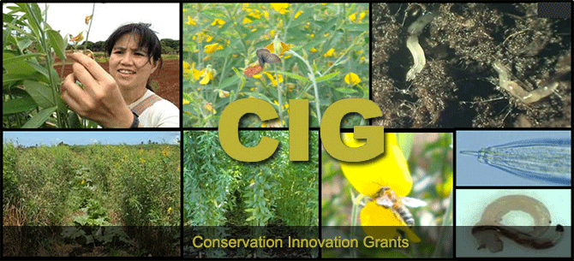
Ecosystem Markets
Virginia Nutrient Trading Program
Maryland Forest Conservation Banking programs

Slide 3
Carroll County Forest Banking Program
No mitigation via “in-lieu fee”
Afforestation banks only
Credit sales average $16,000 per acre
Certified Forest Bank
5.4 acres X $16K = $86,400
Upfront costs to establish a bank:
Surveying / Drafting services: $6950
Implement & maintain (3yrs): $29,211
Easement/title work: $1000
Total $37,161

Slide 5
Scale of the funding gap
Total RFB planting required by 2025: 153,196 acres
Additional implementation funds required to meet WIP3 buffer goals: $735,216,981
Notes:
The implementation cost estimates are from CAST and are averages across the watershed.
These calculations don’t account for existing sources of funding which will help fill the gap
Some progress can be made through re-verifying existing acres that have expired

Slide 6
Natural Filters Revolving Fund – Demand
$588,833,663

Slide 7
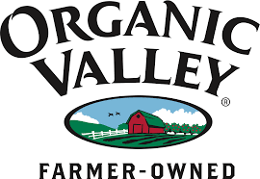


Corporate Sustainability Goals

