Slide 1
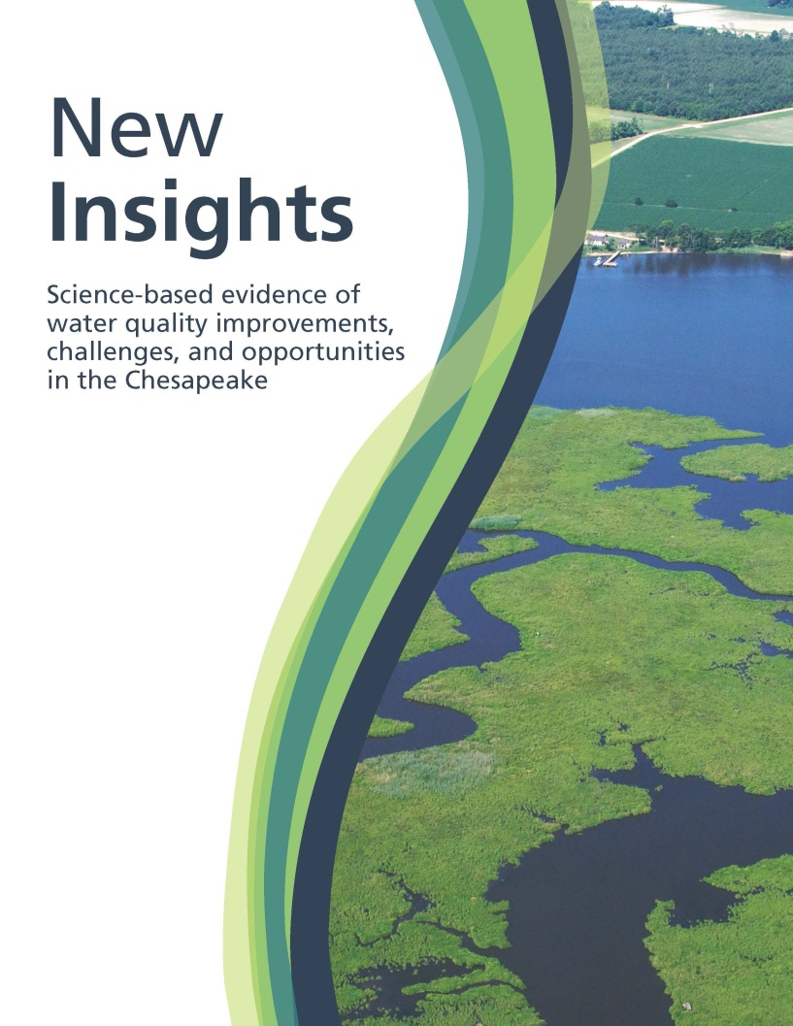




New Insights
Science-based evidence of water quality improvements, challenges, and opportunities in the Chesapeake
Bill Dennison
University of Maryland Center for Environmental Science
Management Effects on Water Quality Trends Workshop
Scientific and Technical Advisory Committee, Chesapeake Bay Program
March 2014
Authors: Christina M. Lyerly, Ana L. Hernández Cordero, Katherine L. Foreman, Scott Phillips and William C. Dennison
Notes:
Today I am presenting research that came out of a collaboration between the Chesapeake Bay Program Partnership and the University of Maryland Center for Environmental Science.
Our report, New Insights: Science based evidence of water quality improvements, challenges and opportunities in the Chesapeake is available online if you would like to take a closer look at any of the information I am presenting today

Slide 2
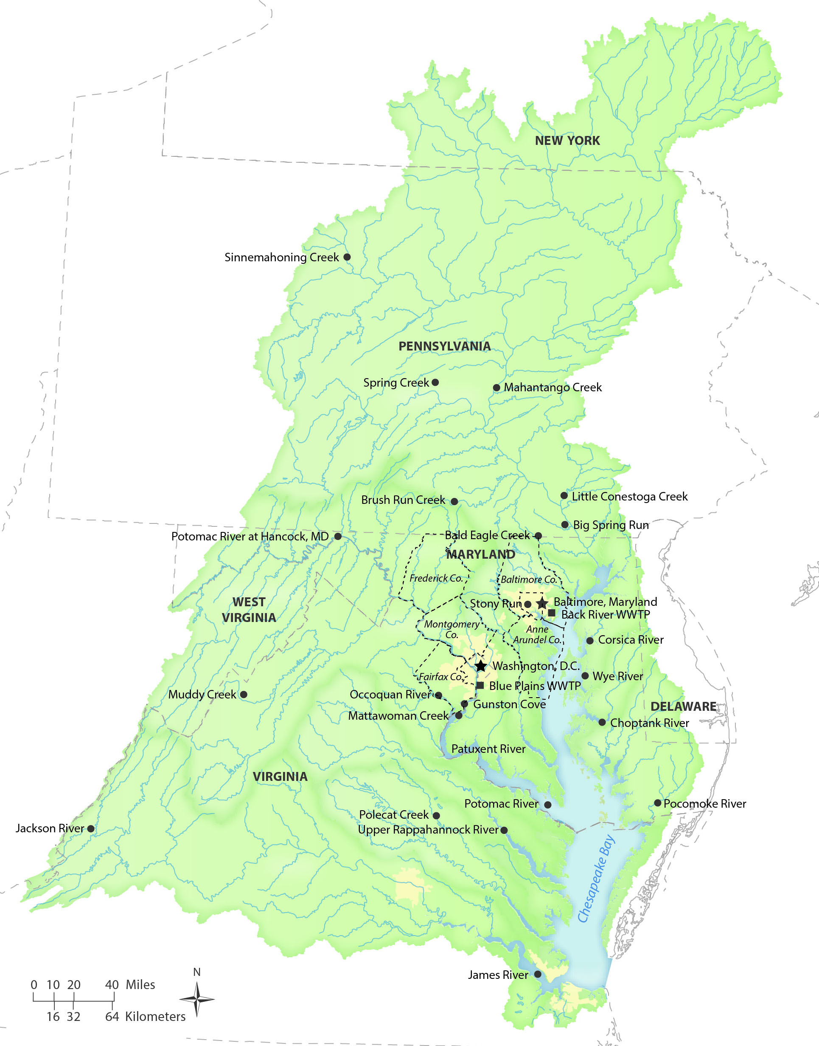
New Insights
Review of over 40 case studies
Seven lessons under three broad categories:
  What’s Working
  Challenges
  Opportunities
Notes:
The report began with a review of over 40 case studies of research that evaluated best management practice effectiveness using water quality monitoring data.
We extracted seven over-arching lessons that could be used to guide water quality managers in future efforts to improve the health of the Bay
We organized the lessons into three broad categories:
What practices have been demonstrated to work
What are some of the challenges that have impeded our progress
And what we need to do address the ongoing challenges faced by the Bay

Slide 3
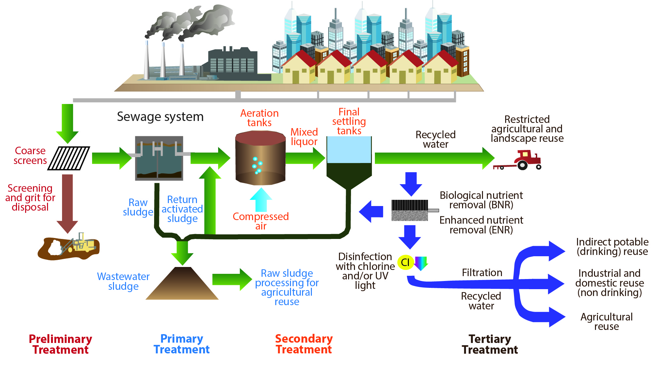
Lesson 1
What’s Working
Upgrades in both nitrogen and phosphorus wastewater treatment result in rapid local water quality improvements
Notes:
The first lesson is that wastewater treatment plant upgrades work.
Technology has advanced so that nutrient loads are reduced to smaller and smaller amounts.
Not all treatment plants in the Bay region are equipped to the level of tertiary treatment, depicted in this diagram. The treatment plants that have yet to be upgraded represent an opportunity to further improve water quality in the Bay

Slide 4
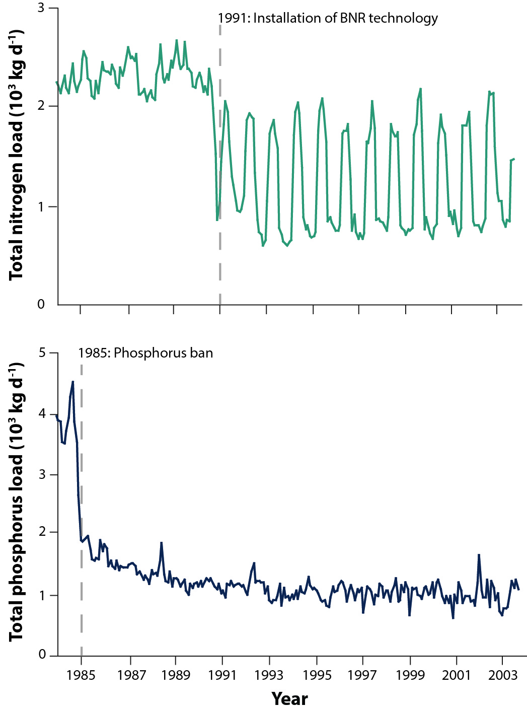
Upgrades to a wastewater treatment plant reduced nutrient loads to the Upper Patuxent River
Lesson 1
Changes in total nitrogen and total phosphorus loads
(1984–2004)
Data from Testa et al., 2008
Notes:
One of our wastewater treatment plant case studies used is the Upper Patuxent River. As seen in the bottom graph, in 1985, phosphorus in laundry detergents were banned, decreasing phosphorus loads to the Bay. Shown in the top graph: In 1991, biological nutrient removal technology was implemented at the wastewater treatment plant, which resulted in decreased nitrogen loads.

Slide 5
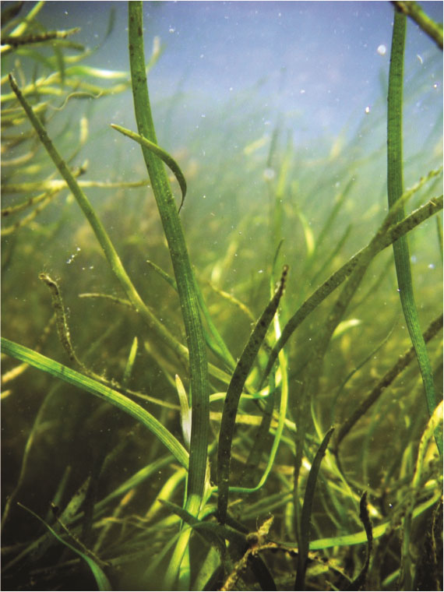
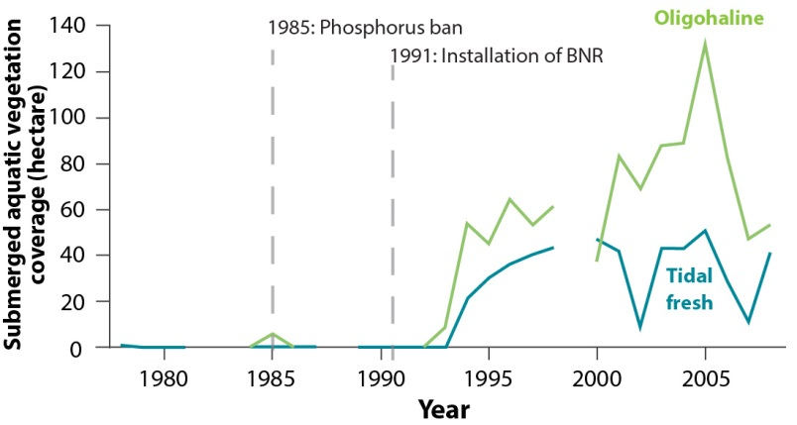
Decreased wastewater treatment plant nitrogen loads to the Upper Patuxent River contributed to a resurgence of submerged aquatic vegetation
Lesson 1
Changes in submerged aquatic vegetation
(1978–2008)
Vallisneria americana (wild celery). Photo © Cassie Gurbisz
Data from Boynton et al., 2008
Notes:
Research revealed that after biological nutrient removal technology was implemented reducing nitrogen loads, submerged aquatic vegetation began to rebound in the Upper Patuxent.
It is interesting to note that SAV did not rebound when only phosphorus loads were decreased. It took both sustained reductions in phosphorus loads and decreases in nitrogen loads to see improvements in underwater bay grasses
This result points to the importance of understanding localized relationships between specific nutrients and biological production

Slide 6
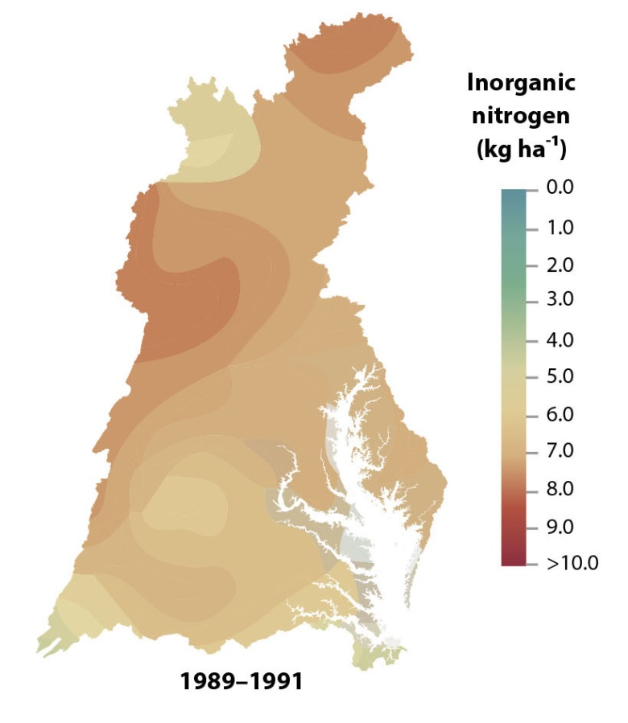
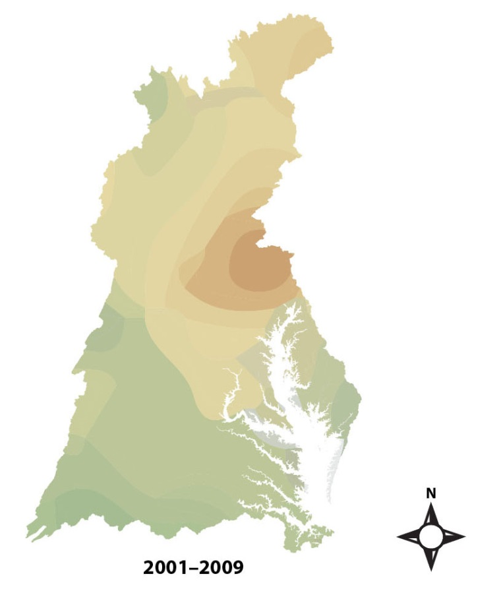
Lesson 2
What’s Working
Improvements in air quality lead to reductions in atmospheric nitrogen deposition
Annual mean wet inorganic nitrogen deposition
US EPA Clean Air Markets: 2009 Results
Notes:
The second lesson is that reductions in nitrogen oxide emissions has resulted in decreases in the atmospheric deposition of nitrogen
Nitrate loads from atmospheric deposition to the Bay watershed have decreased by 30%.

Slide 7
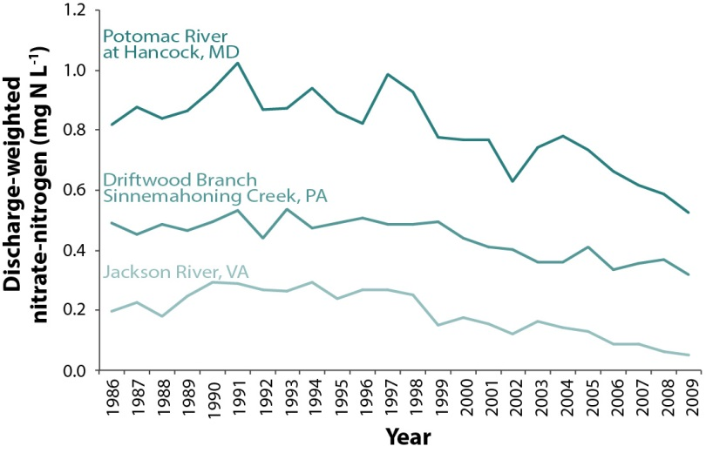
Decreases in atmospheric point source emissions and nitrogen deposition are directly linked to improved surface water quality in 9 mostly-forested subwatersheds
Lesson 2
Changes in nitrate-N concentrations at 3 water quality monitoring stations
(1986–2009)
Data from Eshleman et al., 2013
Notes:
Recent research by Keith Eshleman and colleagues has demonstrated a link between decreased point source emissions and surface water quality improvements
They studied water quality in 9 mostly-forested subwatersheds in the Appalachian region, three of which are depicted on this graph
They found that in all 9 locations, wet atmospheric nitrogen deposition and nitrate concentrations in surface water significantly decreased, and atmospheric deposition strongly predicted observed annual nitrate loads to streams

Slide 8
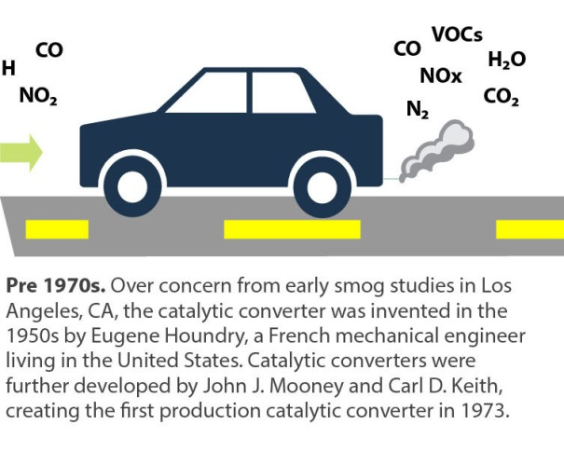
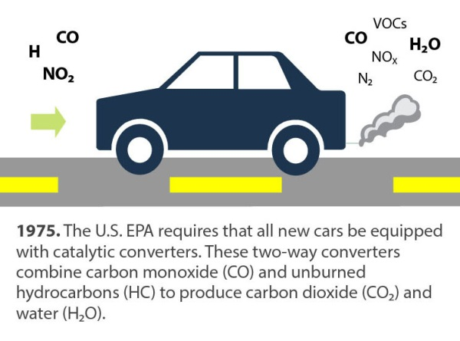
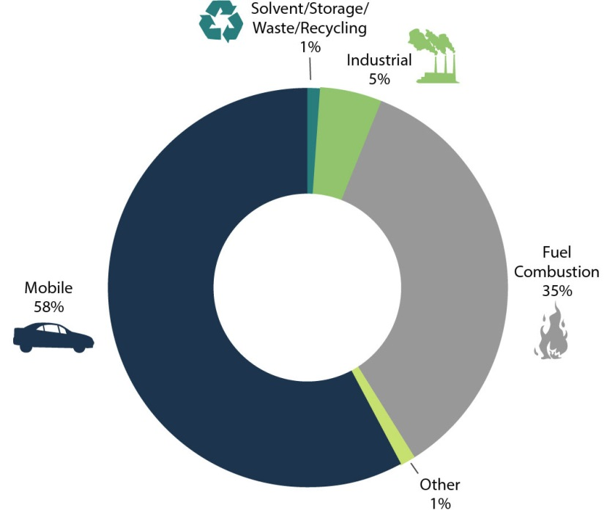
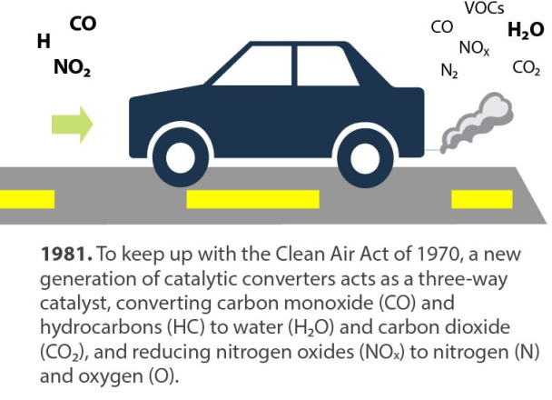
Tighter regulations have decreased vehicle emissions, but the majority of NO_{x} air emissions continue to originate from mobile sources
Lesson 2
U.S. NO_{x} emissions by category (2006)
Adapted from US EPA 2007 Progress Report: Vehicle and Engine Compliance Activities
Notes:
Despite the successes seen from reductions in power plant emissions, atmospheric deposition continues to play an important role in the Bay watershed because of mobile sources of emissions, meaning vehicles
Individual car emissions have decreased due to tighter tailpipe standards and technological upgrades, such as 3-way catalytic converters
However, mobile sources represent the majority of nitrogen oxide emissions and vehicle miles driven have been increasing dramatically
In order to maintain our success to date and to reduce atmospheric deposition to the Bay even further, mobile sources of emissions will need to be targeted

Slide 9
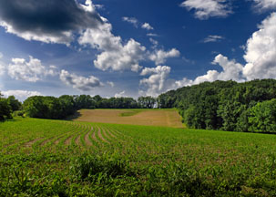
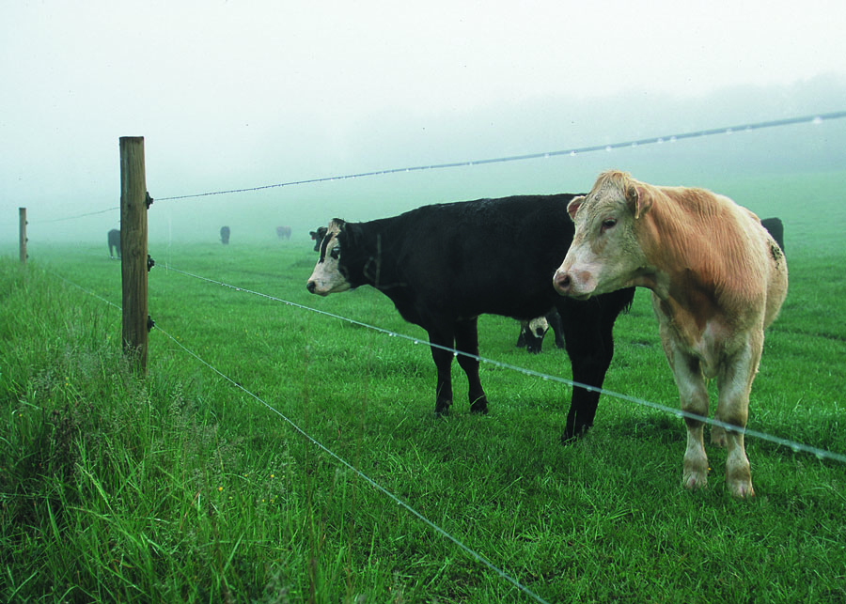
Lesson 3
What’s Working
Reductions of agricultural nutrient sources result in improved stream quality
Cover crops
Livestock exclusion
Waste management
Photo © top left: Nicholas Tonelli, Flickr; top right: Jeff Vanuga, USDA NRCS; bottom: Bob Nichols, USDA.
Notes:
Our last “What Works” lesson encompasses the various agricultural practices that have been demonstrated to reduce nutrient loads and improve water quality.
We focused on three major practices: Cover crops, livestock exclusion and animal waste management

Slide 10
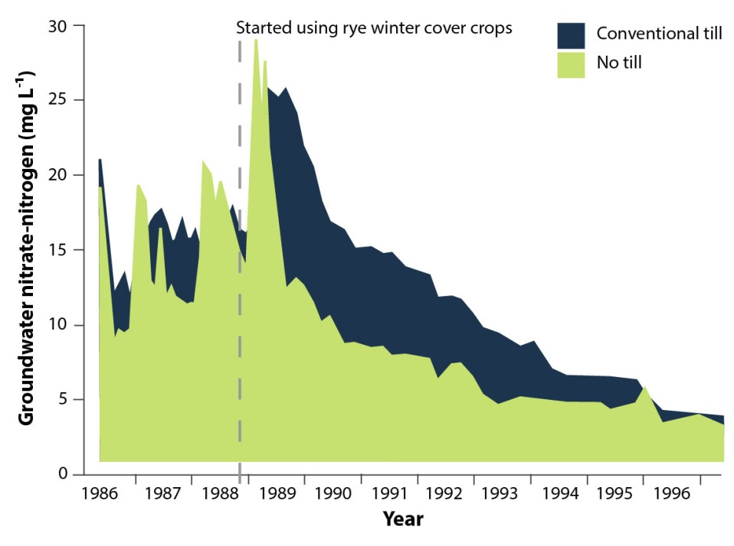
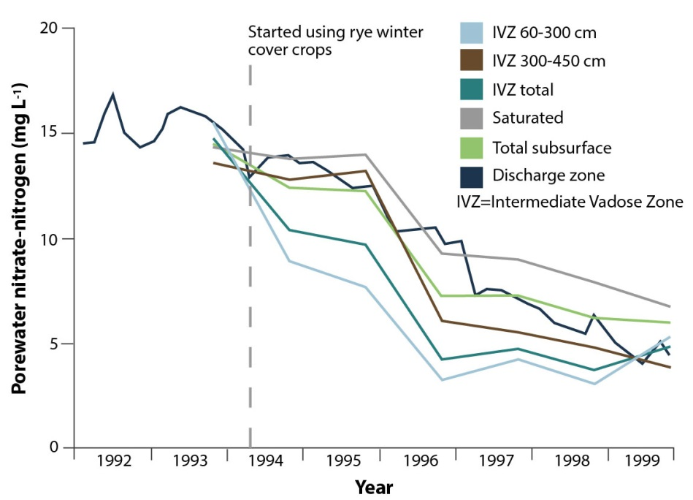
Cover crops planted in the Wye River drainage basin improved water quality
Lesson 3
Changes in groundwater nitrate-N concentrations in 2 agricultural fields
(1986–1998)
Changes in nitrate-N concentrations in different subsurface zones on an agricultural field
(1992–1999)
Data from Staver and Brinsfield, 1995 & 2000
Notes:
A notable case study demonstrating success is the implementation of winter cover crops in the Wye River drainage basin.
As shown an the left, the planting of cover crops in two agricultural fields in 1988 decreased nitrate concentrations in groundwater.
The graph on the right side depicts nitrate concentrations in different subsurface zones on a another farm. Cover crops were implemented in 1994, and nitrate concentrations subsequently decreased in the root zone and underlying aquifer

Slide 11
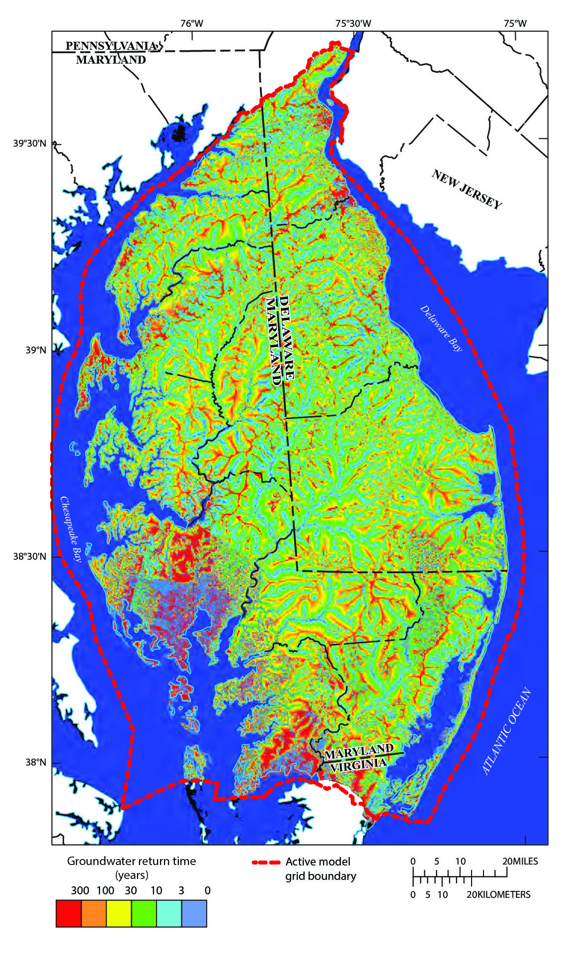
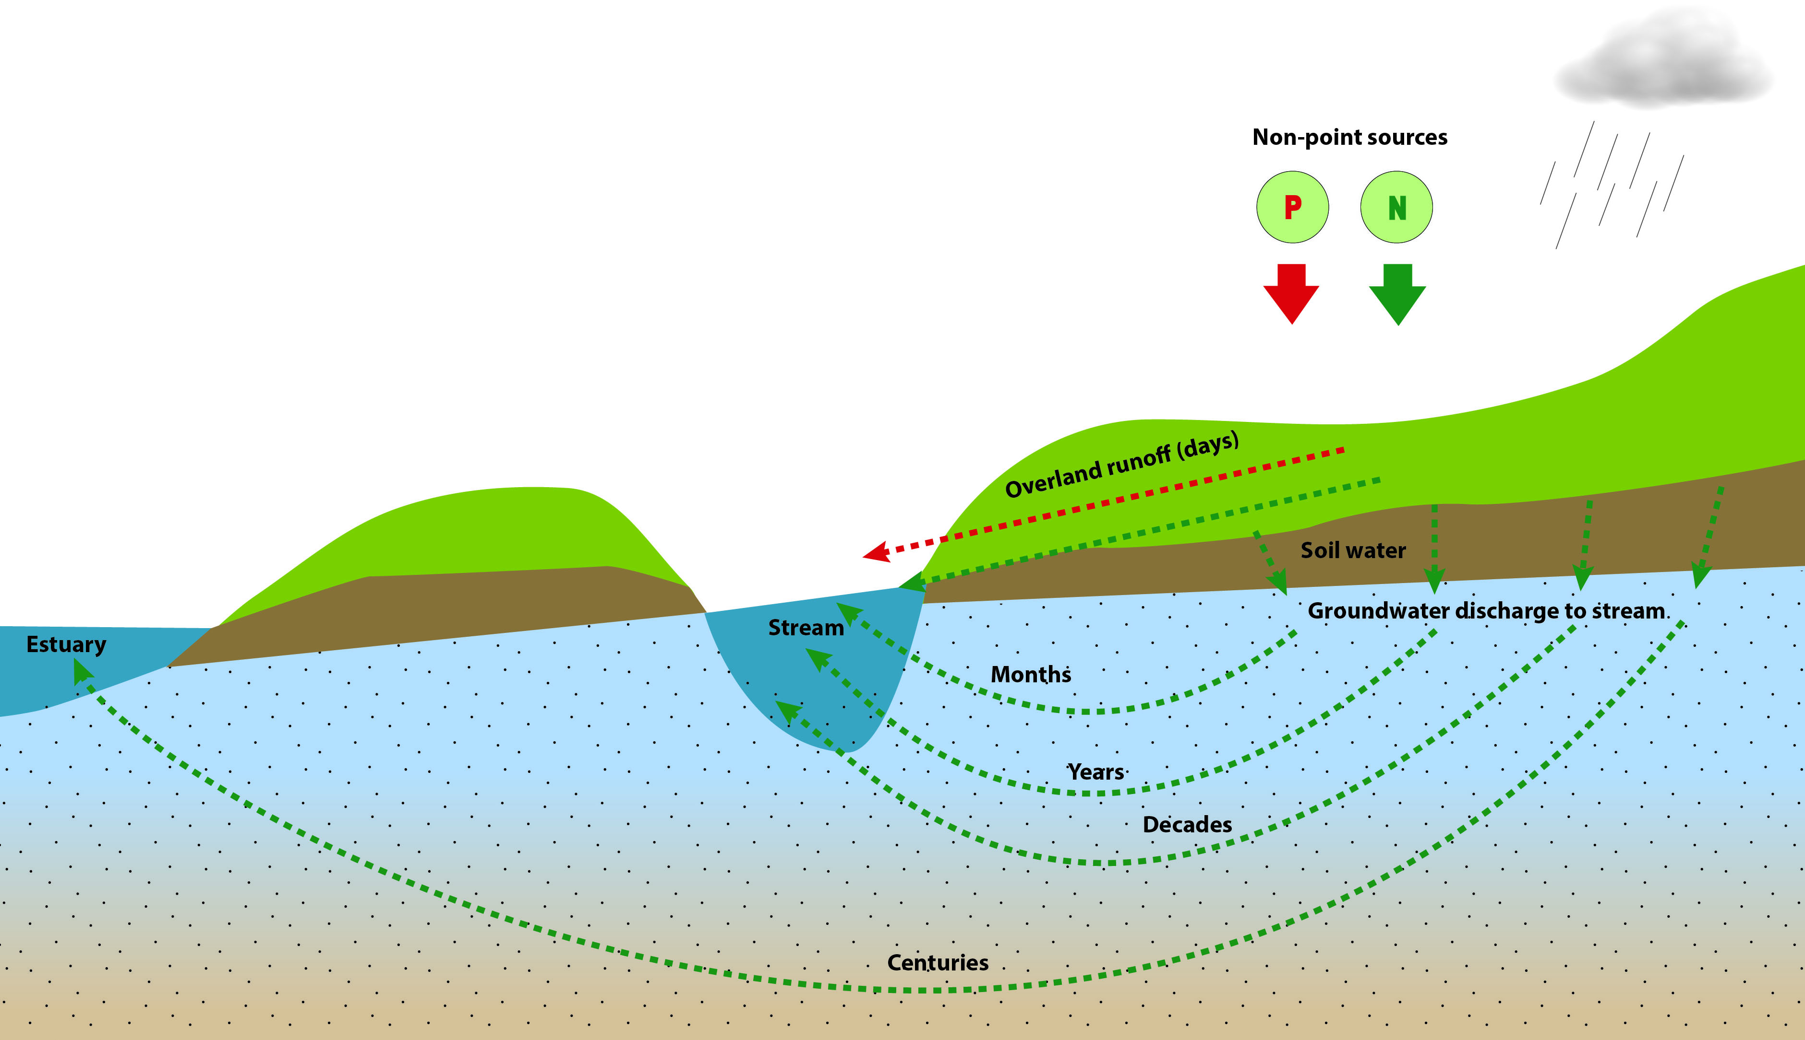
Lesson 4
Challenges
Many practices provide initial water quality improvements in runoff; however, full benefits to stream conditions can be delayed
Simulated return time of groundwater traveling from the water table to its discharge location
Sanford et al., 2012
Notes:
The first of our “challenges” lessons addresses the delays in water quality improvements despite reductions in nutrient loads, which can result groundwater age and sediment storage of phosphorus
Groundwater ages refers to the time it takes for groundwater to move from recharge into the water table to its discharge location into a stream,
Ages can vary from less than a year to more than 100 years.
This can present a significant challenge in knowing how effective a best management practice really is when we are not going to see actual results for years ahead.
On the right is a simulation of different groundwater return times in the Delmarva peninsula.
Having estimates like these can help us prioritize BMP locations as well as manage expectations
Delays can also be caused by sediment storage of phosphorus.
Phosphorus stored in sediments can be gradually released,
We may not see stream water quality improvements until sediment already containing phosphorus moves out of the streams and into the Bay during high flow events.

Slide 12
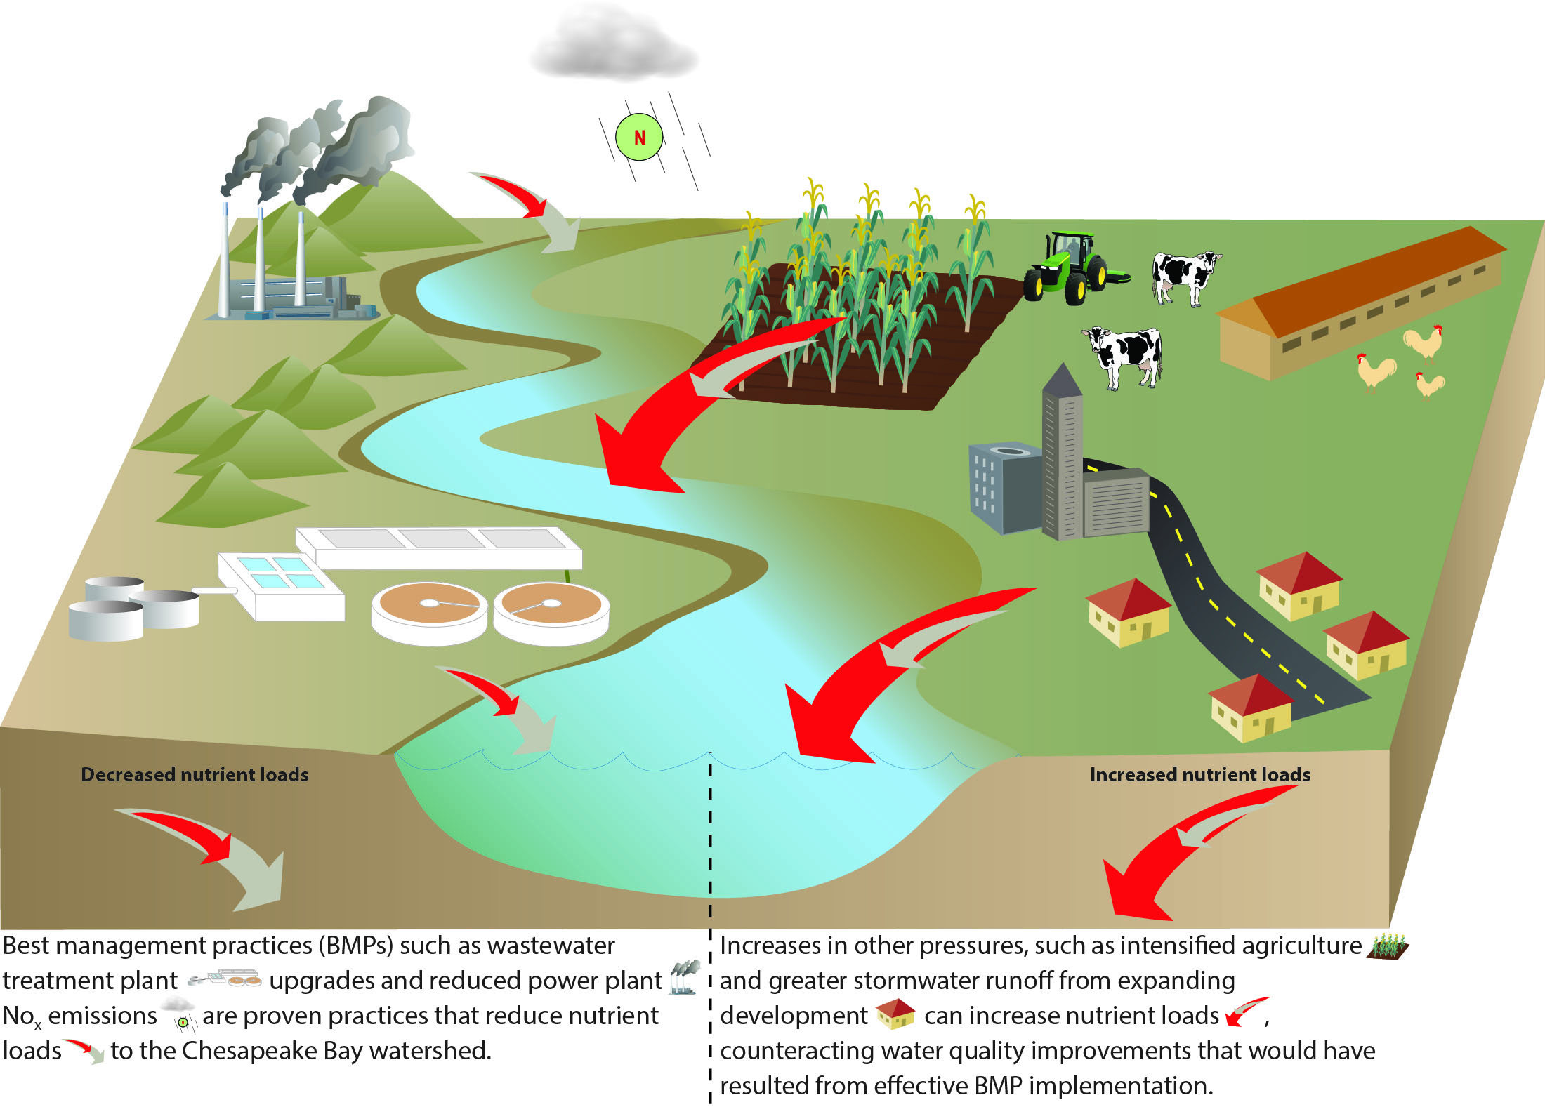
Lesson 5
Challenges
Improvements in water quality can be counteracted by changes in nutrient sources and land-use practices
Notes:
We have seen that some practices reduce nutrient and lead to water quality improvements
Hoever, the BMPs that would have expected to be effective may be counteracted by the changes in nutrient sources and land-use practices

Slide 13
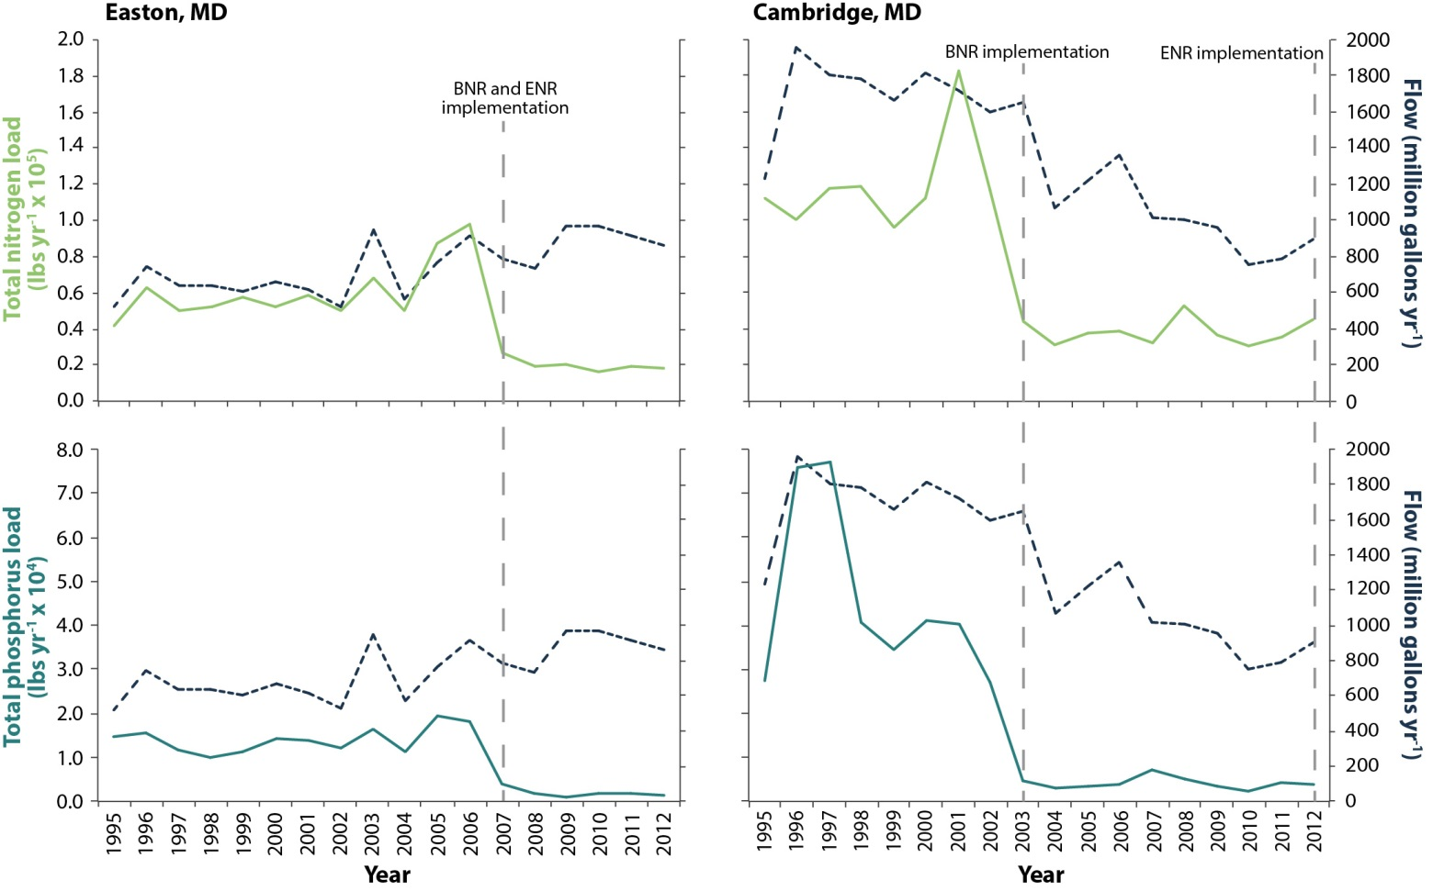
Upgrades to wastewater treatment plants have reduced nutrient loads but water quality remains poor in the upper and middle tidal Choptank River
Lesson 5
Changes in flow and nitrogen and phosphorus loads from the Easton and Cambridge wastewater treatment plants
(1995–2012)
Data from Karrh, 2012
Notes:
For example, the greatest influences on poor water quality in the Choptank River Basin are agricultural activities and increasing population growth
Although by far the greatest land use in the Choptank is agricultural, the population is growing and urban land use is increasing.
The three wastewater treatment plants in the Choptank have been upgraded, leading to decreases in nutrient loads.
This graph depicts the changes in total nitrogen and total phosphorus loads from the treatment plants in Easton and Cambridge. After the plant was upgraded to biological and enhanced nutrient removal technology, loads decreased.
Despite these upgrades, however, water quality still remains poor in the upper and middle tidal Choptank River

Slide 14
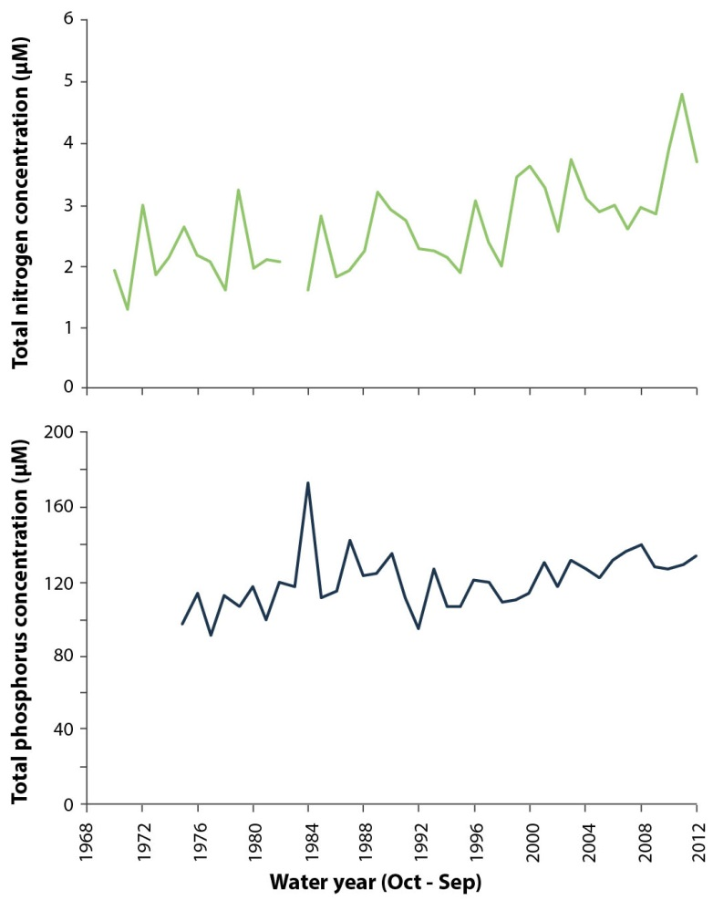
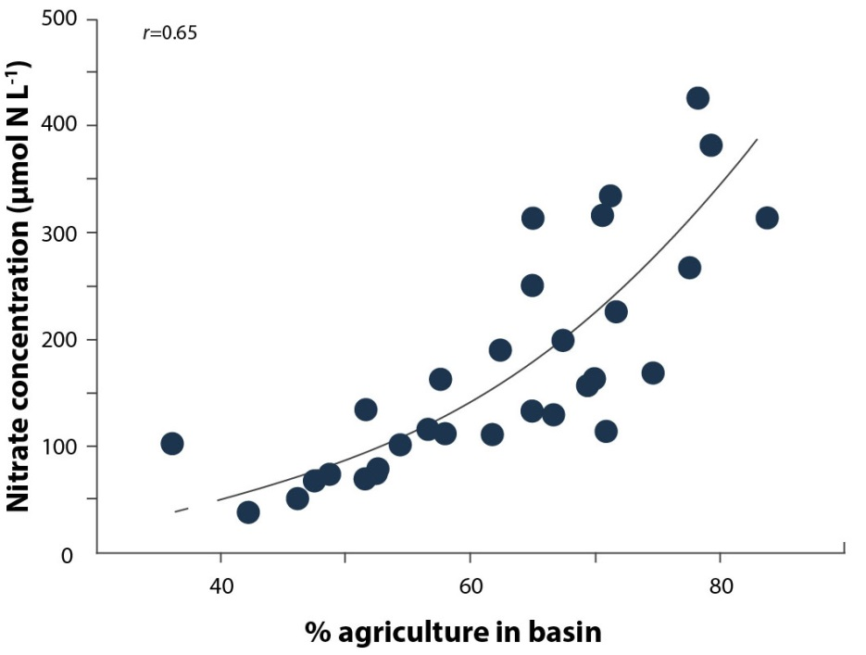
Agriculture is the primary driver of poor water quality in the nontidal Choptank River
Lesson 5
Increases in total nitrogen and total phosphorus at Greensboro water quality monitoring station
(1968–2012)
Greater agricultural land-use is association with increased nitrate concentrations in headwater streams of the Choptank River watershed
Data from Fisher, 2006
Notes:
Agriculture is the main culprit in poor water quality in the nontidal portions of the Choptank River watershed.
57% of land-use in the Choptank River watershed is agricultural
As seen in the graph on the left, greater agriculture land use is associated with increased nitrate concentrations, driven by both increased fertilizer use and the clearing of natural forests and wetlands that protect local waters.
A water quality monitoring station in the Choptank near Greensboro, MD has demonstrated increasing nitrogen (upper right) and phosphorus (bottom right) concentrations

Slide 15
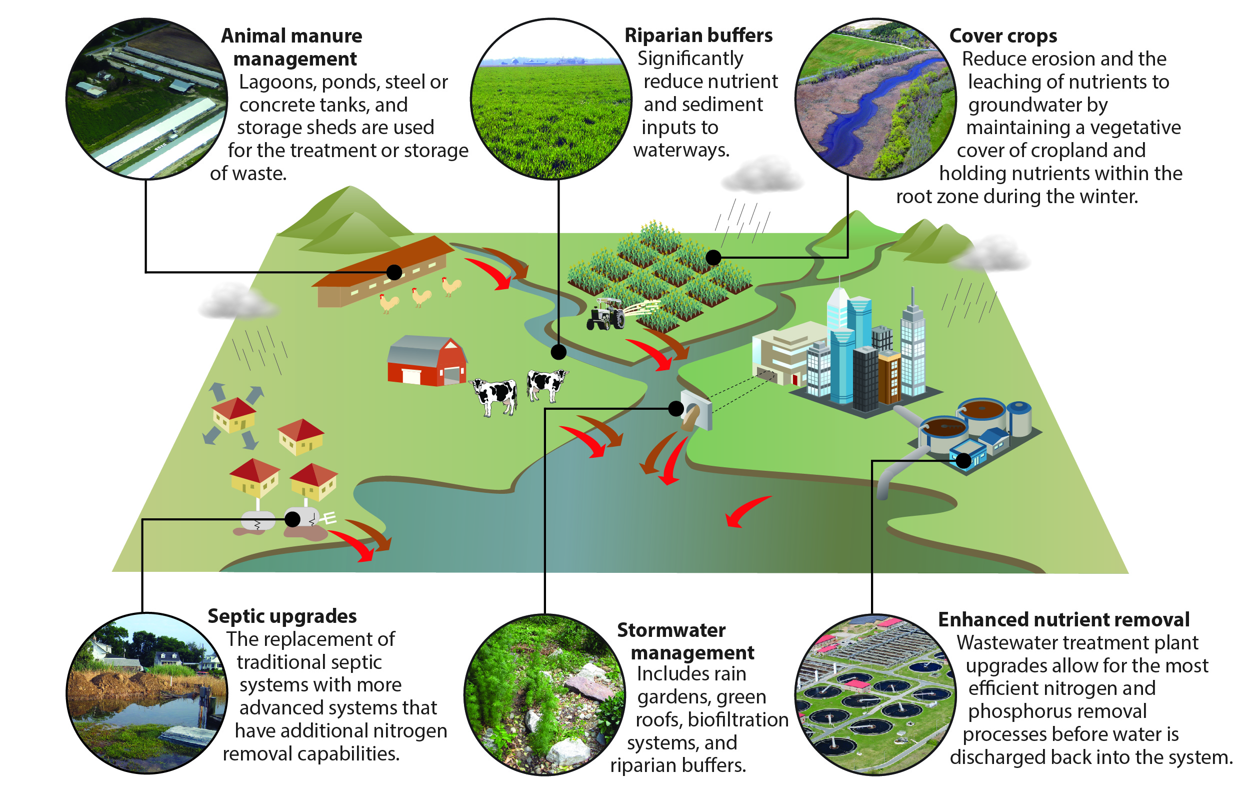
Lesson 6
Opportunities
Observable water quality responses are more likely to occur if A) location specific sources of pollution are identified and B) targeted practices are implemented.
Notes:
Our 6th Lesson launches us into what we need. Our case study review revealed that identifying all nutrient sources and targeting best management practices to those specific sources is needed reach water quality goals.
For example, if nutrient runoff from farms is the dominant source of nutrients, solely upgrading wastewater treatment plants will not result in the load reductions needed to see improvements. Cover crops, waste management, and other ag practices will need to be implemented as well.

Slide 16
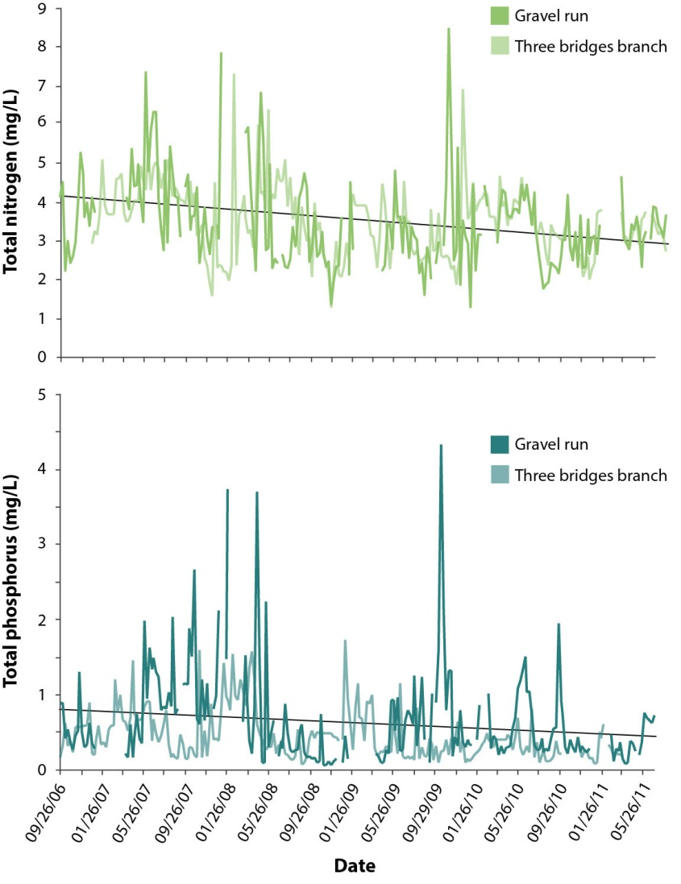
Improvements in nontidal water quality in the Corsica River were observed after aggressive implementation of multiple nutrient reduction practices
Lesson 6
Changes in total nitrogen and total phosphorus concentrations in Three Bridges Branch and Gravel Run
(2006–2011)
Data from Batchelor et al., 2011
Notes:
Our highlighted case study is the nontidal portions of the Corsica River.
The Town of Centerville with partners developed an aggressive restoration plan that targeted both point and nonpoint sources.
A wastewater treatment plant was upgraded. But agriculture was the dominant nutrient source, so they also implemented cover crops, buffers, manure and fertilizer management.
In two of the 3 nontidal monitoring stations, both total nitrogen and total phosphorus have been decreasing since 2007, 2 years after implementation.

Slide 17
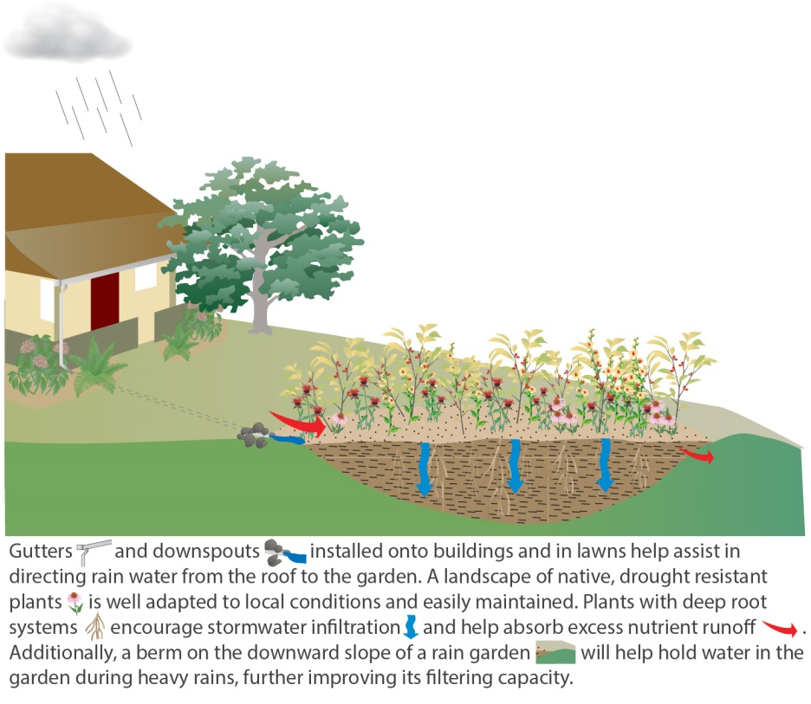
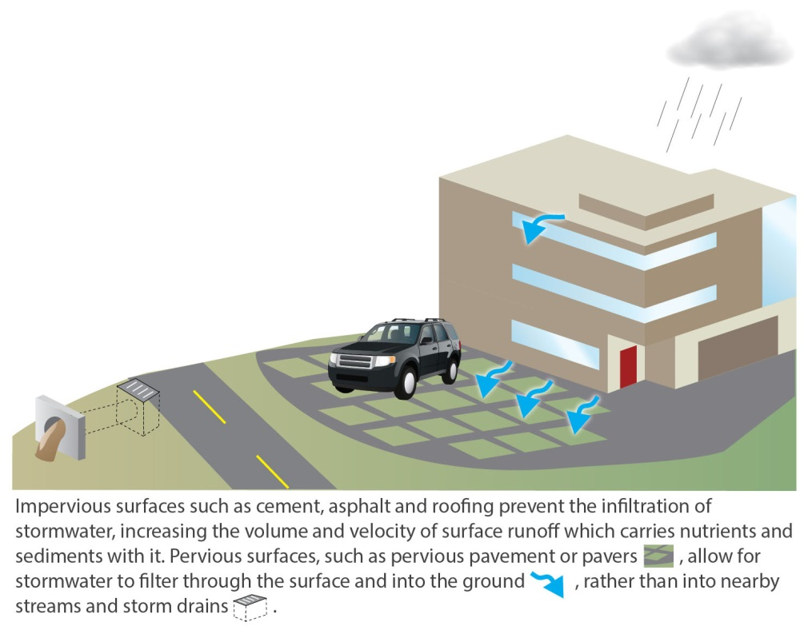
Lesson 7
Opportunities
An array of practices to promote stormwater infiltration and retention are needed in urban and suburban areas
Rain gardens
Pervious surfaces
Notes:
Our last lesson addresses the Chesapeake Bay watershed’s growing population and expanding development.
Stormwater runoff is a significant contributor to pollution in urban and suburban areas,
The population of the Chesapeake Bay watershed is currently 17.5 million, and is projected to reach 20 million in the year 2030.
As urban and suburban development expands, stormwater management becomes increasingly important.
We will need proven and innovative practices to counteract the consequences to water quality
Examples here include rain gardens on the left and pervious surfaces on the right

Slide 18
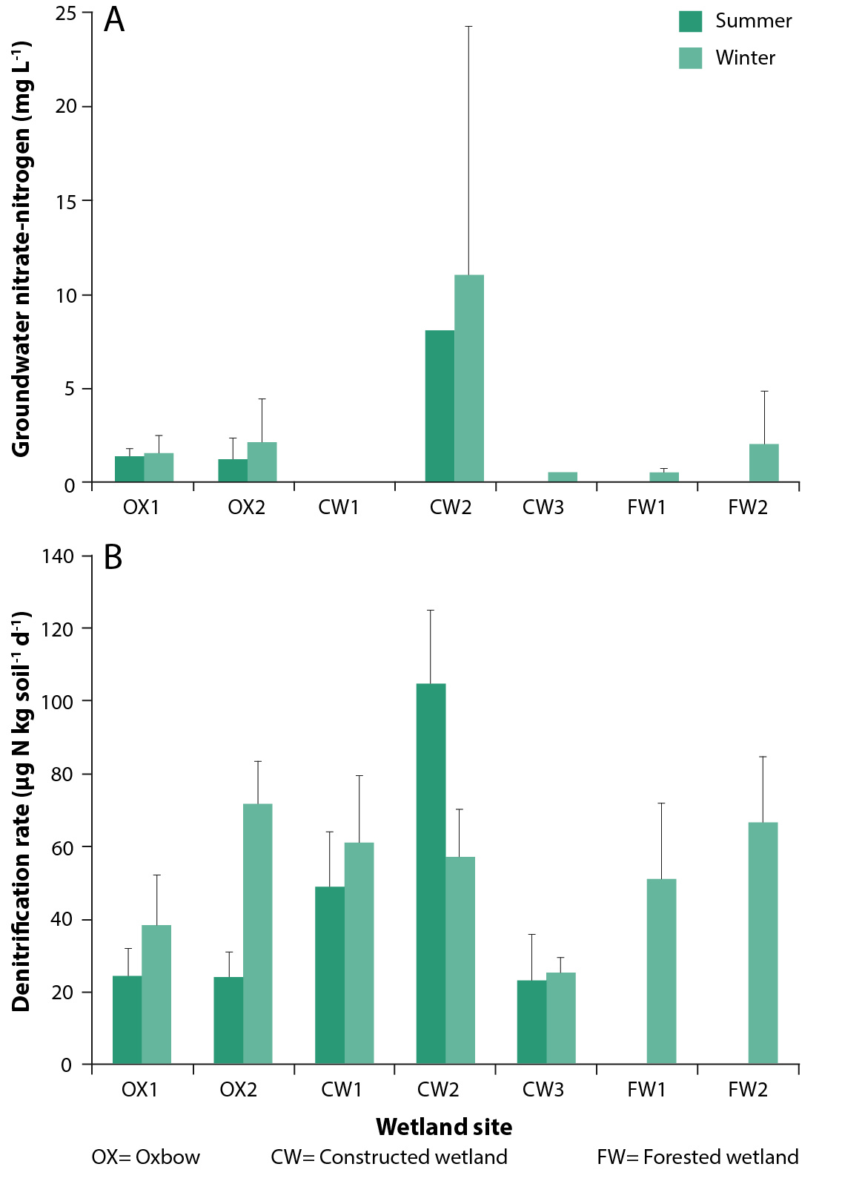
Constructed wetlands in Baltimore, MD demonstrated the potential to reduce nitrate entering streams through stormwater runoff
Lesson 7
Mean groundwater nitrate-N concentrations (A) and denitrification rates (B) in oxbow, forested, and constructed wetlands in Baltimore, MD
Harrison et al., 2011
Notes:
Our case study is research conducted in Baltimore, MD that compared forested wetlands, oxbow wetlands, and constructed wetlands.
The forested and oxbow wetlands primarily received water from nearby streams during high precipitation events
The constructed wetlands were created specifically to receive stormwater from outflows.
Data suggested that constructed wetlands were just as effective in reducing stream nitrate concentrations through denitrification

Slide 19
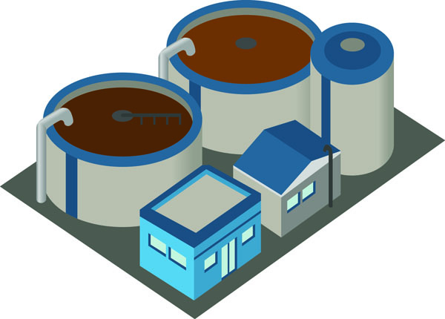

Implications
What is Working
    The Clean Water Act is working
    The Clean Air Act is working
    Multiple practices that reduce agricultural nutrient loads can work
Challenges
    Delays in improvements necessitates patience, persistence and perspiration
    Increased population pressures and unsustainable changes to the landscape can hinder our efforts
Opportunities
    Location matters: practices must be targeted and outcomes measured
    Innovative and proven stormwater management practices should be implemented and testing is needed
Notes:
Our literature review resulted in some key take-aways that should be helpful as we continue to work towards improving the health of the Bay.
We are doing some things right: These include upgrading wastewater treatment plants, decreasing nitrogen air emissions thereby decreasing atmospheric deposition, and implementing some effective ag practices. We need to continue to implement these practices to see further improvements in water quality
We have hit some road bumps. Groundwater ages and nutrient sediment storage can delay water quality responses. This points to our need for long-term monitoring data. Our efforts can also be hindered when increases in stormwater runoff and agricultural nutrient loads counteract our actions.
This brings us to our opportunities moving forward. Location and source of nutrient loads matter. And we are going to need to be creative as a growing population increases pressures on the Bay. We must implement both proven and innovative stormwater management practices to counteract pressures from expanding urban and suburban development. We must continue to monitor our progress and implement adaptive management as new data become available.

Slide 20
Acknowledgements
Thank You
Authors: Christina M. Lyerly, Ana L. Hernández Cordero, Katherine L. Foreman, Scott Phillips and William C. Dennison
Synthesis Team: Thomas E. Jordan (Smithsonian Environmental Research Center), Walter R. Boynton and Caroline Wicks (University of Maryland Center for Environmental Science), Kenneth W. Staver (University of Maryland Wye Research and Education Center), Gary Shenk (U.S. Environmental Protection Agency), Kenneth E. Hyer, Laura Medalie, Scott Phillips and Peter Tango (U.S. Geological Survey), and Carlton Hershner (Virginia Institute of Marine Sciences)
Requested By: Members of the Tidal Monitoring and Analysis Workgroup and Nontidal Water Quality Workgroup, Chesapeake Bay Program
Science Communication, Design, & Layout: Brianne Walshe (University of Maryland Center for Environmental Science)
Report Available at ian.umces.edu/link/newinsights

Slide 21
References
Batchelor, T., C. Decker, F. Digilianardo, J. Dindinger, Q. Forrest et al. 2011. Corsica River Targeted Initiative Progress Report: 2005-2011. Corsica River Initiative, 21 p.
Boynton, W.R., J.D. Hagy, J.C. Cornwell, W.M. Kemp, S.M. Greene, M.S. Owens, J.E. Baker, and R.K. Larsen. 2008. Nutrient budgets and management actions in the Patuxent River Estuary, Maryland. Estuaries and Coasts 31: 623-651.
Eshleman, K.N., R.D. Sabo, and K.M. Kline. 2013. Surface water quality is improving due to declining atmospheric N deposition. Environmental Science & Technology.
Fisher, T.R., J.D. Hagy III, W.R. Boynton, and M.R. Williams. 2006. Cultural eutrophication in the Choptank and Patuxent estuaries of Chesapeake Bay. Limnology and Oceanography, 51: 435-447.
Harrison, M.D., P.M. Groffman, P.M. Mayer, S.S. Kaushal, and T.A. Newcomer. 2011. Denitrification in alluvial wetlands in an urban landscape. Journal of Environmental Quality, 40: 634-646.
Karrh, R. 2012. Choptank, Little Choptank and Honga Rivers Water Quality and Habitat Assessment. Maryland Department of Natural Resources Tidewater Ecosystem Assessment, 68p. Available at: http://mddnr.chesapeakebay.net/eyesonthebay/documents/Choptank%20Summary%20WQ%20and%20H%20Assessment%202012.pdf.
Phillips, S.W. and B.D. Lindsey. 2003. The influence of ground water on nitrogen delivery to the Chesapeake Bay. US Geological Survey Fact Sheet FS-091-03, 6 p.
Sanford, W.E., J.P. Pope, D.L. Selnick, and R.F. Stumvoll. 2012. Simulation of groundwater flow in the shallow aquifer system of the Delmarva Peninsula, Maryland and Delaware. U.S. Geological Survey Open-File Report 2012-1140, 58 p. Available at: http://pubs.usgs.gov/of/2012/1140/pdf/OFR_2012-1140.pdf.
Staver, K. and R. Brindsfield. 1995. Case Study #1: Assessing the impact of changes in management practices on nutrient transport from coastal plain agricultural systems. In 2010 Trust Fund: Water Quality Monitoring Strategy. 3 p. Available at: http://www.dnr.state.md.us/ccp/funding/pdfs/Monitoring_Strategy.pdf.
Staver, K. and R. Brinsfield. 2000. Evaluating changes in subsurface nitrogen discharge from an agricultural watershed into Chesapeake Bay after implementation of a groundwater protection strategy. In 2010 Trust Fund: Water Quality Monitoring Strategy. 3 p. Available at: http://www.dnr.state.md.us/ccp/funding/pdfs/Monitoring_Strategy.pdf.
Testa, J.M., W.M. Kemp, W.R. Boynton, and J.D. Hagy III. 2008. Long-term changes in water quality and productivity in the Patuxent River Estuary: 1985 to 2003. Estuaries and Coasts 31: 1021-1037.
U.S. Environmental Protection Agency Office of Transportation and Air Quality. 2008. 2007 Progress Report: Vehicle and Engine Compliance Activities, EPA-420-R-08-011, 59 p.
U.S. Environmental Protection Agency. 2009. Clean Air Markets 2009 Environmental Results. Available at: http://www.epa.gov/airmarkt/progress/ARP09_3.html. Accessed on April 25, 2013.

