Slide 1
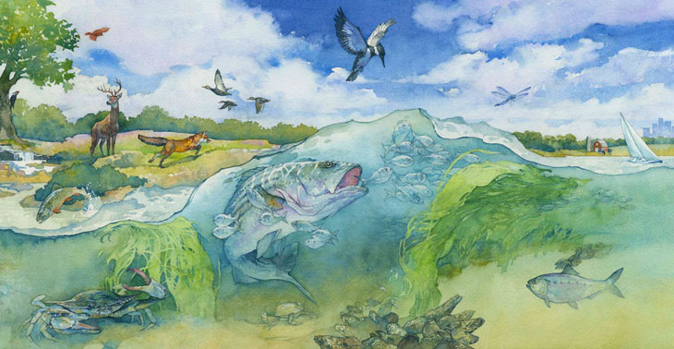

The Bay’s Health & Future: How it’s doing and What’s Next
The Chesapeake Bay Watershed Agreement Management Strategies
Nick DiPasquale, Director
Chesapeake Bay Program Office
Environmental Protection Agency
December 4, 2014
Notes:
Today I will quickly talk about management strategies – the key elements and the process
Feel free to interrupt as I go to ask any questions

Slide 2
How partners are working. . .
Vision
Principles
GOALS
CBP’s Executive Council (EC)
agreed to
Watershed Agreement
GOALS & initial OUTCOMES
OUTCOME
OUTCOME
CBP’s Principals’ Staff Committee (PSC) tracks OUTCOMES ,
ensuring they are measureable & achievable; adapting as needed
OUTCOME
Mgmt.
Strategy
CBP’s Management Board (MB) to manage and track the STRATEGIES, adapting them as necessary over time for success
Mgmt.
Strategy
Mgmt.
Strategy
Notes:
The design of the new Watershed Agreement was to provide a balance between commitment to a particular goal or action and the flexibility required for adaptive management – to learn while you grow
The highest level of commitment, and the hardest to change, are the vision, the principles, the goals and outcomes, and the commitment to the process for establishing and implementing management strategies
New Watershed Agreement includes the overarching GOALS & initial OUTCOMES
Management strategies called for in the new watershed agreement – but not be drafted or finalized
Time is now, and over next 6-8 mos., for input on the development of these strategies
Management strategies will guide the work and will also allow some flexibility to implement the practices that make the most sense for each portion of the watershed.

Slide 3
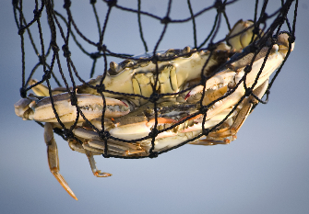
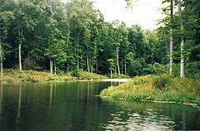
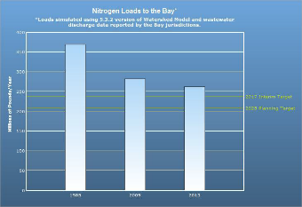
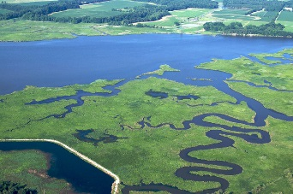
Goals and Outcomes
Sustainable Fisheries Goal Blue Crab Abundance Outcome Blue Crab Management Outcome Oyster Outcome Forage Fish Outcome Fish Habitat Outcome | Vital Habitat Goal Wetlands Outcome Black Duck Stream Health Outcome Brook Trout Fish Passage Outcome SAV Outcome Forest Buffer Outcome Tree Canopy Outcome
Water Quality Goal 2017 WIP Outcome 2025 WIP Outcome Water Quality Standards Attainment and Monitoring Outcome | Toxic Contaminants Goal Toxic Contaminant Research Outcome Toxic Contaminant Policy and Prevention Outcome
Healthy Watersheds Goal Healthy Watersheds Outcome | Stewardship Goal Citizen Stewardship Outcome Local Leadership Outcome Diversity Outcome
Notes:
Specific
Measurable
Attainable
Realistic
Timely

Slide 4
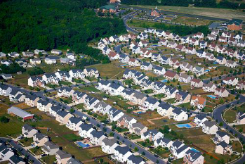

Goals and Outcomes
Land Conservation Goal Protected Lands Outcome Land Use Methods and Metrics Development Outcome Land Use Options Evaluation Outcome | Public Access Goal Public Access Site Development Outcome
Environmental Literacy Student Outcome Sustainable Schools Outcome Environmental Literacy Planning Outcome | Climate Resiliency Monitoring and Assessment Outcome Adaptation Outcome

Slide 5
What’s Next?
Management strategy –
A single document that summarizes the Partnership’s management process and the collective thinking for each outcome or related group of outcomes.

Slide 6
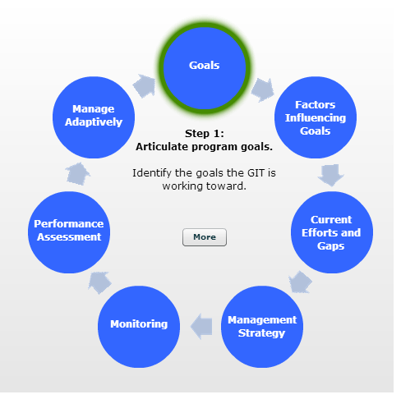
Key Elements of Management Strategies
Executive Summary Outcomes and Baselines Jurisdictions and agencies participating in the strategy Local engagement Factors influencing ability to meet the goal/outcome Current efforts and gaps Actions, tools or technical support needed to empower local government and others | Management Approach Local engagement Monitoring Progress Assessing Progress Adaptively Manage Biennial Workplan A summary of specific commitments, actions and resources each signatory and stakeholder will do to reach the two-year target for an outcome
Notes:
Each management strategy will address the same elements, using a framework based on adaptive management that the PSC originally approved at their May 10, 2011 meeting, adding a couple of key elements to that framework to make it a complete management strategy
This is to allow for a strategy that can be evaluated based on adaptive management principles.
Process to identify factors and rank them by importance (this should be done with whatever amount of science and info is available to you at the time and revise through adaptive management as more is learned) (STAC assistance)
Those key factors that can be managed through the GIT/workgroup or through one or more members of the GIT/workgroup
Those key factors that can be managed by another GIT/workgroup within the Partnership
Those key factors that can’t easily be managed
Current efforts and gaps – what is already happening, and what needs to happen to address the factors, including at the local level for those outcomes that require implementation at the local level to achieve the outcome
Monitoring Progress
Action tracking – Are we taking the actions we agreed to take
Environmental monitoring and tracking (are we on target to meet our outcome)
Assessing progress
Assessing whether actions taken were what we agreed to take
Identifying timeframe one would expect to see changes in environmental conditions based on those actions taken
Ensuring we are on track to taking the actions, and that we were right about the expected changes to environmental conditions

Slide 7
Process for Developing the Management Strategies
GIT funding for MS development and metric development
1st stage – Gathering the Players
  Assigned to GIT/workgroup/Action Team (screen shot of org chart) – each with a chair, a coordinator, and a staffer.
  Letter from Secretary Gill as PSC Chair
  GIT expertise on identifying stakeholders
  Web process for self-identified stakeholders

Slide 8
Process for Developing the Management Strategies
2nd stage – Research/information collection - Each is slightly different.
  Where there is a lot of history with a particular outcome in the CBP partnership, often use more traditional established workgroups to get the work done (e.g. SAV)
  Where the MS requires more investment from stakeholders traditionally outside the CBP partnership (diversity, local leadership), more research and investment in up front understanding may be necessary (focus groups, workshops, etc)
3rd stage – Writing – Who holds the pen? Who is involved?
4th stage – Review – MB/public
5th stage – Edit/improve/release “finalize”

Slide 9


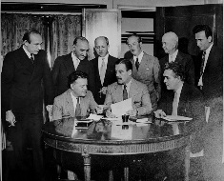
Review and Adoption
Notes:
GITs deliver to Management Board
Management Board Reviews for Completeness
PSC accepts MS and reports to EC at June 2015 meeting
MS are reviewed by GITs biennially, Workplan is updated and changes to overall management strategy or even outcome are identified, particularly as it relates to changing environmental or economic conditions
Considered living documents and development is an ongoing process

Slide 10

Learn more at
www.chesapeakebay.net/
watershedagreement
Join the discussions at
www.chesapeakebay.net/
managementstrategies

