Slide 1
Optimizing design of non-tidal wetland restoration/creation to improve water quality function Greg Noe* Cliff Hupp, Changwoo Ahn, Kristin Wolf, Kurt Moser, Ed Schenk, Ken Krauss, Sara McMillan, Scott Ensign, Dan Kroes, Jaimie Gillespie, Amy Jacobs, Kathy Boomer, Steve Strano *USGS National Research Program, Reston VA Others: USGS, GMU, Champlain College, NPS, Purdue, Aquatic Consultants, TNC, USDA Funding from USGS Chesapeake Science Program, USGS National Research Program, USGS Hydrologic Networks & Analysis Program, USGS Climate and Land Use Change R&D Program, USDA, TNC

Slide 2
Chesapeake wetlands and water quality
Wetland restoration and creation: how do they function, how to build them better
Mitigation
Urban stream
Floodplain restorations
Chesapeake non-tidal ‘natural’ floodplains
Synthesis of wetland WQ rates
Tidal rivers

Slide 3
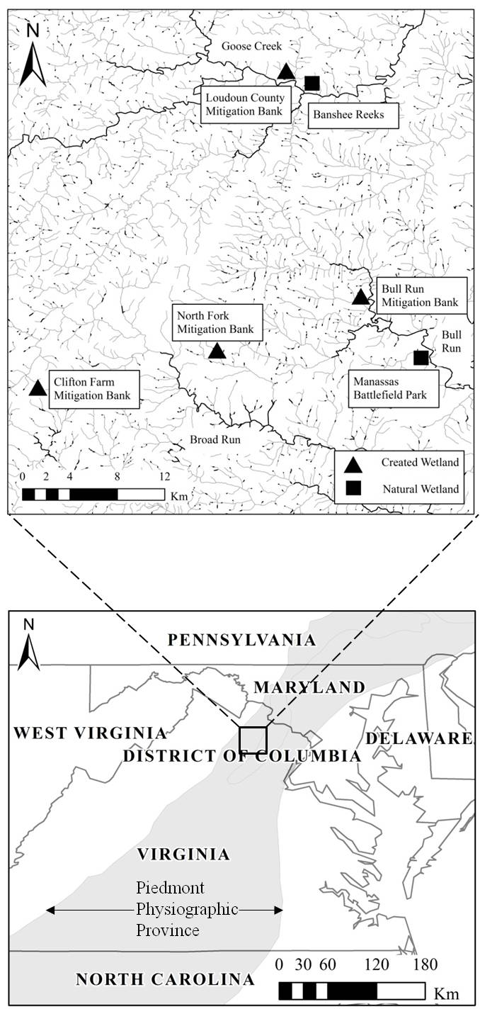
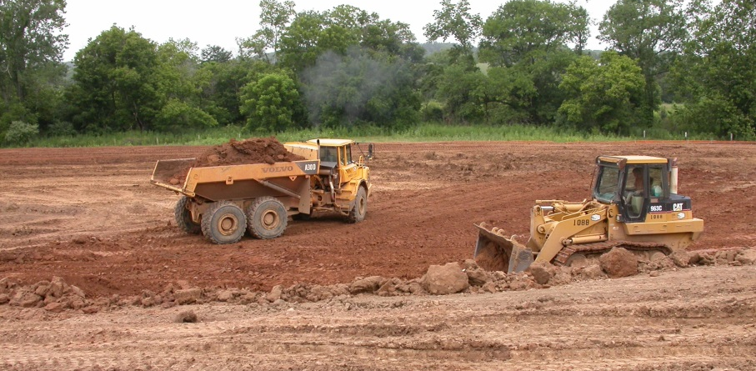
How to optimize retention in created mitigation wetlands
Kristin Wolf, Ph.D., GMU
4 created mitigation bank wetlands
LC: disked vs. undisked
BR: crevasse overflow gradient
NF: stream-connected vs. vernal pool
2 natural reference wetlands
Open, herbaceous, more connected
Forested, less connected
3 yrs old
7 yrs old
10 yrs old
4 yrs old

Slide 4

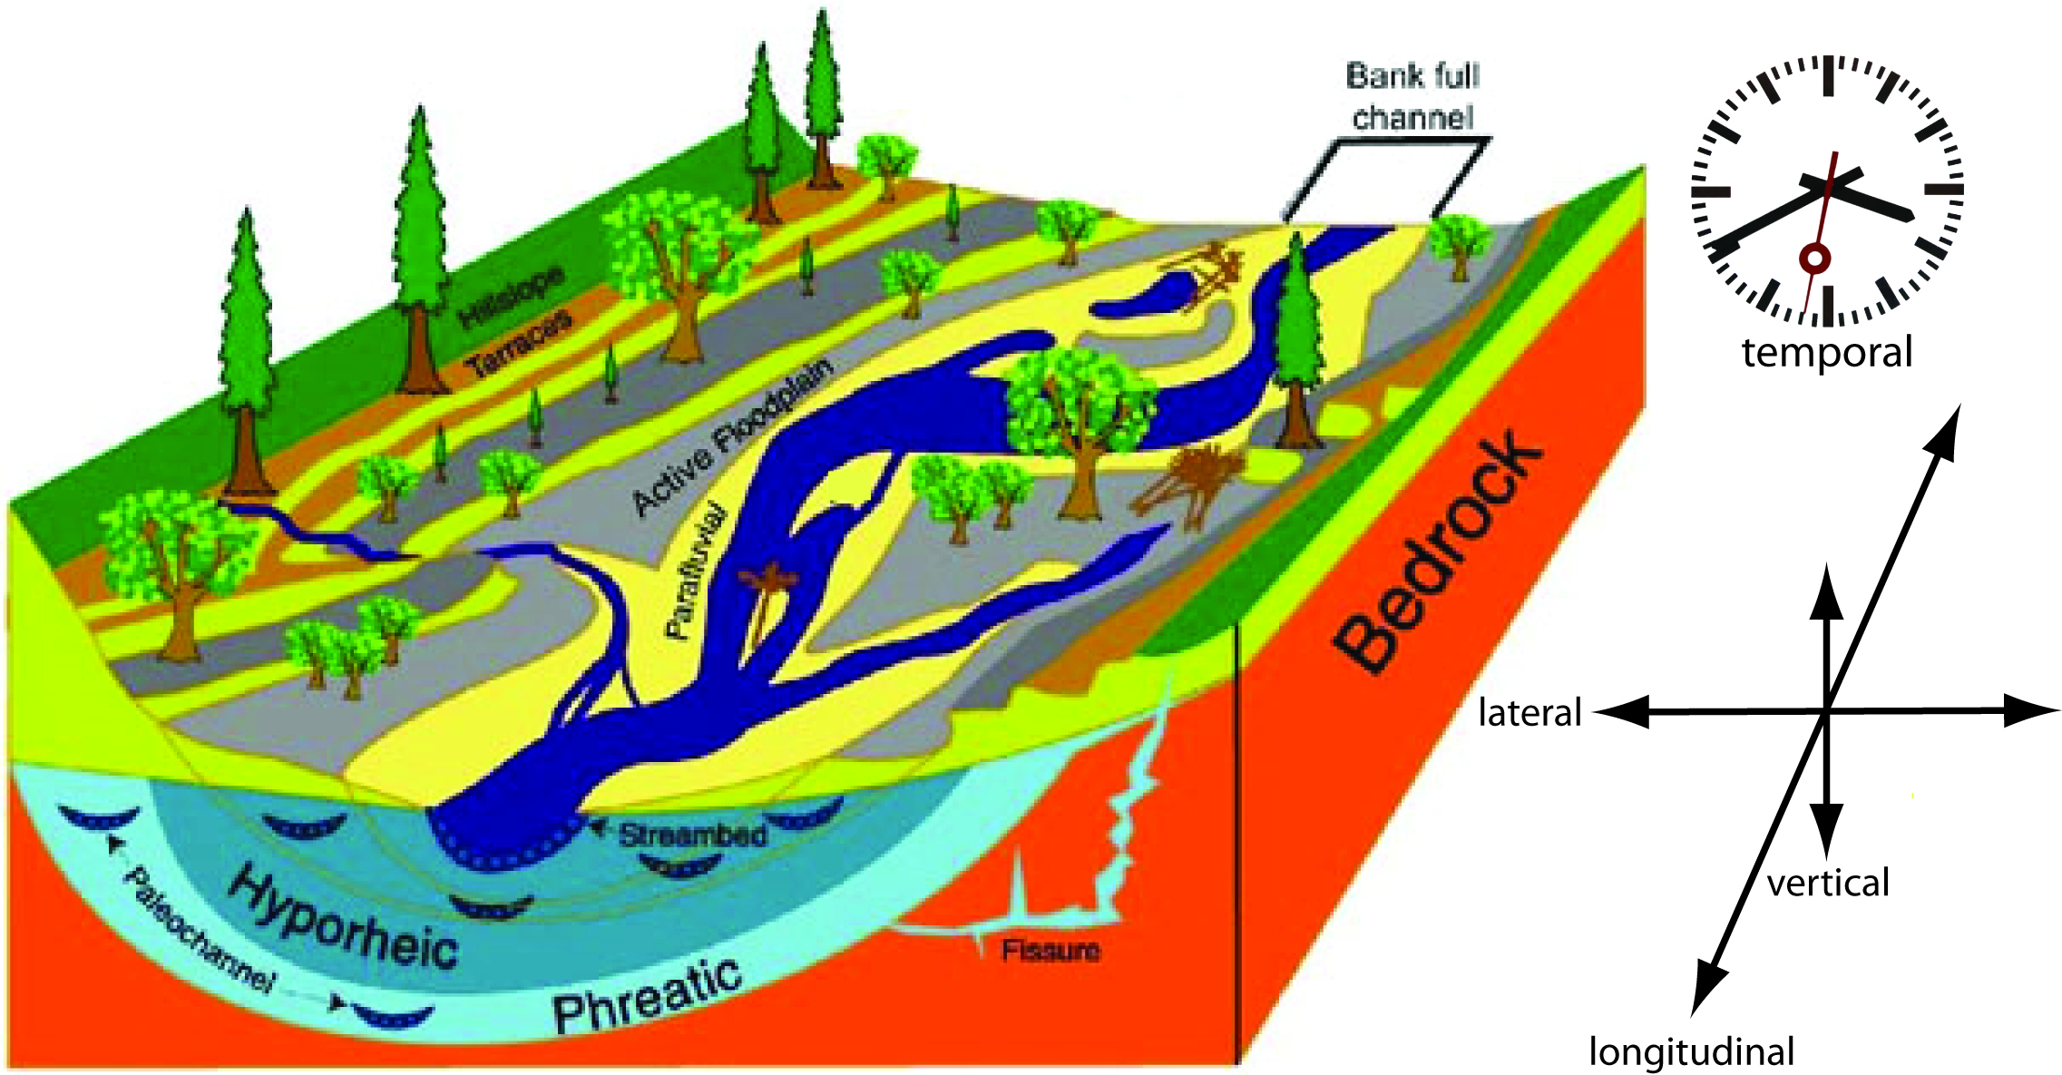
Hydrologic connectivity
Trapping rates:
Disconnected <<< Connected
230 Sediment 2532
1.7 Particulate N 13.2
0.11 Ammonium N 0.26
(all g m⁻² yr-¹)
Wolf, Noe, Ahn. 2013. JEQ.

Slide 5
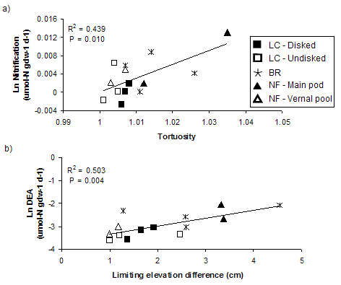

Microtopography
Microtopography
(autogenic and induced)
increases coupled nitrification and denitrification
LC
Wolf, Ahn, Noe. 2011. Ecological Engineering

Slide 6
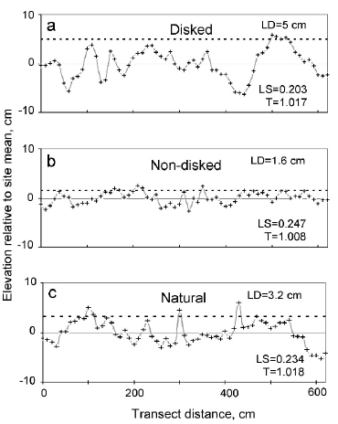
Microtopography
Disking increased
microtopography
Greater microtopography
resulted in:
More plant diversity
More plant richness
More hydrophytic vegetation
Moser, Ahn, Noe. 2007. Wetlands

Slide 7
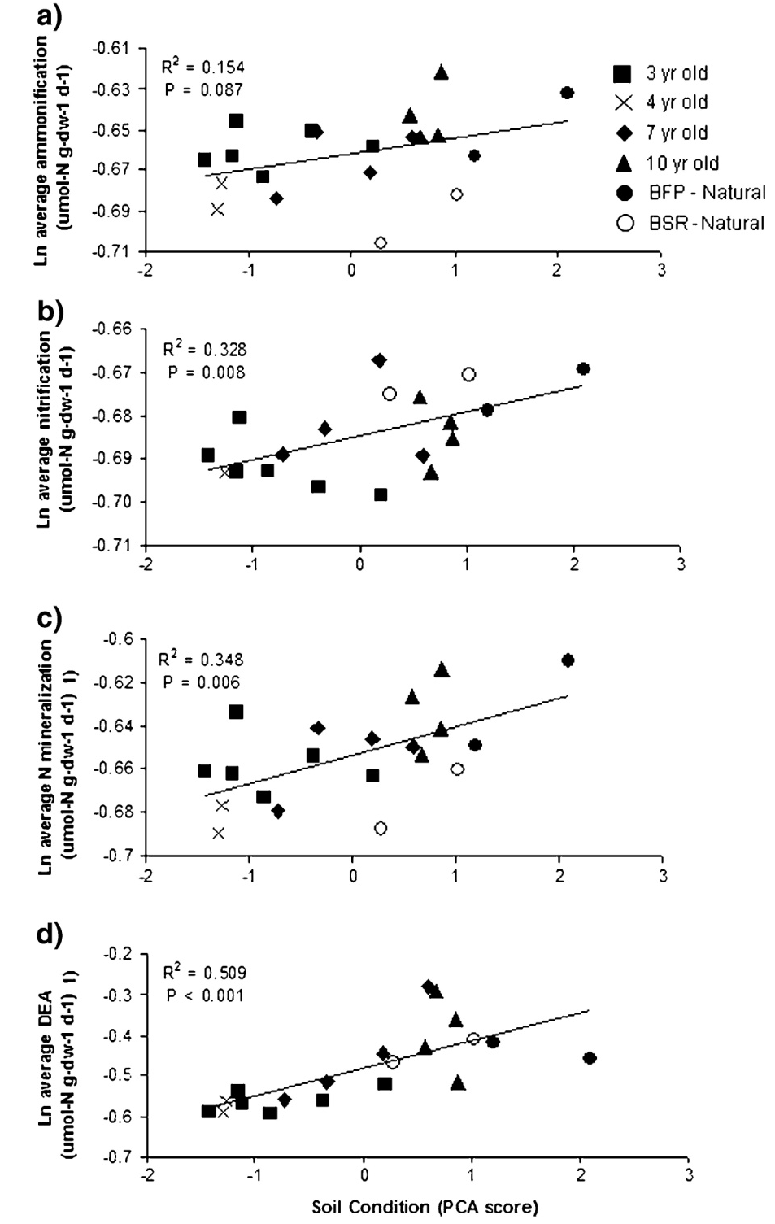
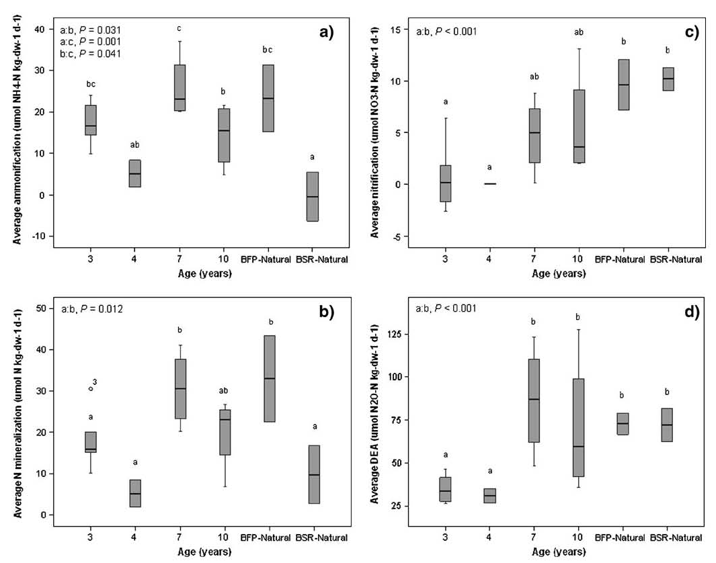
Age
Older wetlands develop soils conducive to coupled denitrification
Wolf, Ahn, Noe. 2011. Wetlands.
Denser ←→ Organic

Slide 8
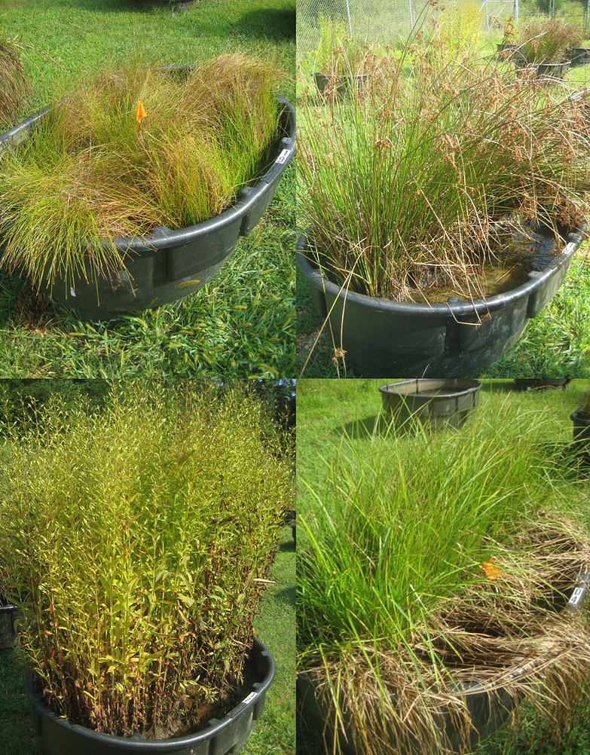
Planting diversity … 2 yr old
Structural Equation Model
C. Ahn
Planting richness decreased denitrification; obligate annual increased denitrification
Korol, Ahn, Noe. 2016. Ecological Engineering.

Slide 9
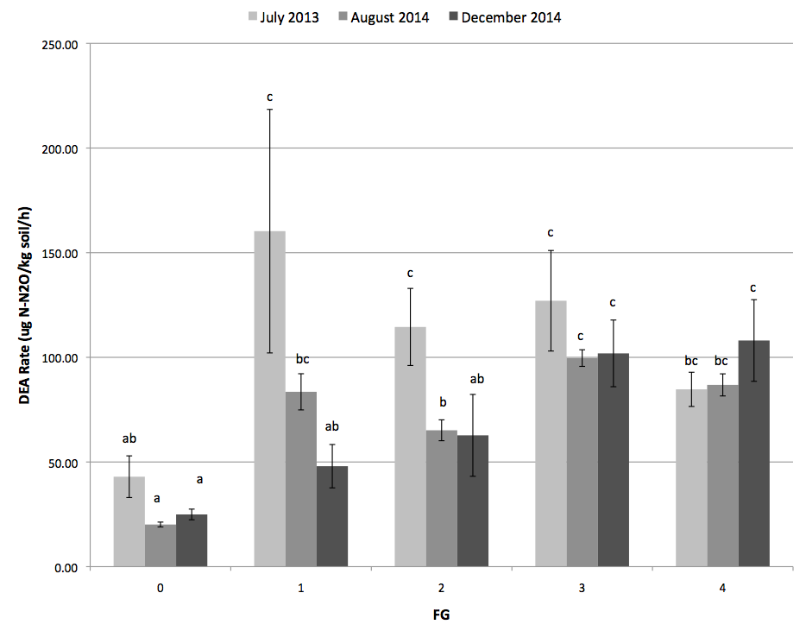
Planting diversity … 3 yr old after disturbance
C. Ahn
Planting richness increased resilience of denitrification following disturbance
Means, Ahn, Noe. 2016. In prep.

Slide 10
How to increase mitigation wetland functions
Connect to stream hydrology
Build microtopography
Let them age
Include annual plants
Plant more diverse

Slide 11
What is WQ function of restored streams? Is nutrient biogeochemistry in restored urban streams driven by floodplain connectivity?
Low benches = reducing conditions, frequent flooding, trap coarse sediment
High benches = oxidizing, infrequent flooding, trap fine sediment and attached nutrients + OM
What is the functional relationship between time of floodplain connectivity and retention?
NH₄⁺
NO₃⁻
OrgN
NO₃⁻
NH₄⁺
N₂
N₂
OrgN
NO₃⁻
NH₄⁺
NH₄⁺
NO₃⁻

Slide 12
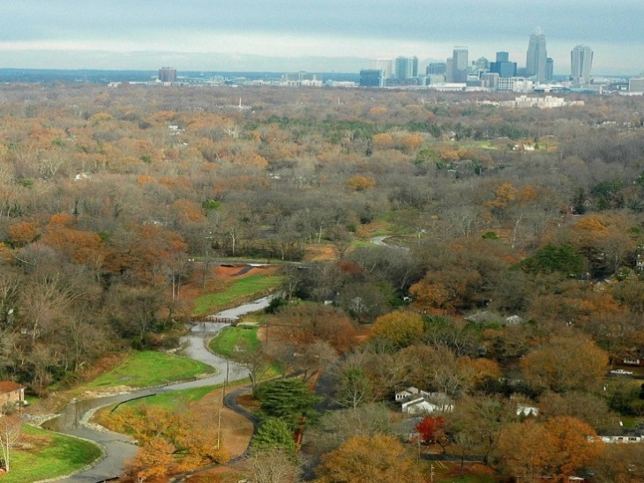
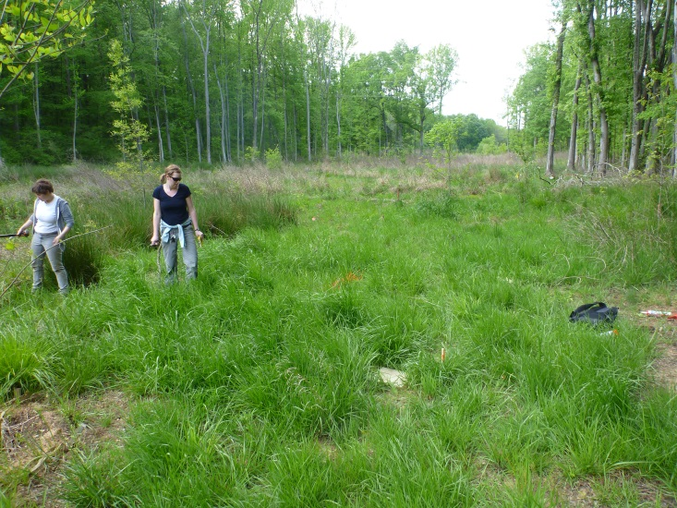
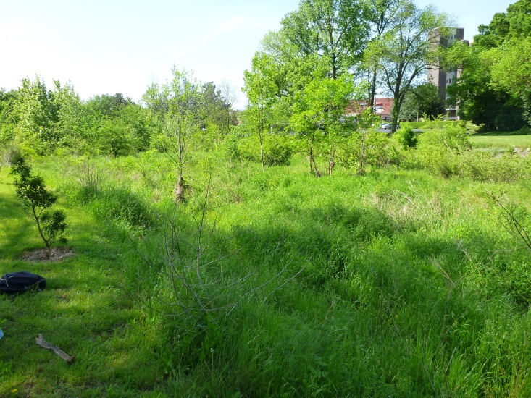
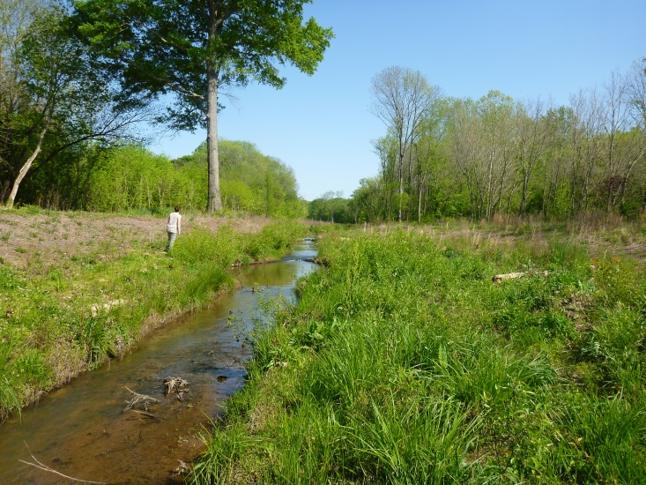
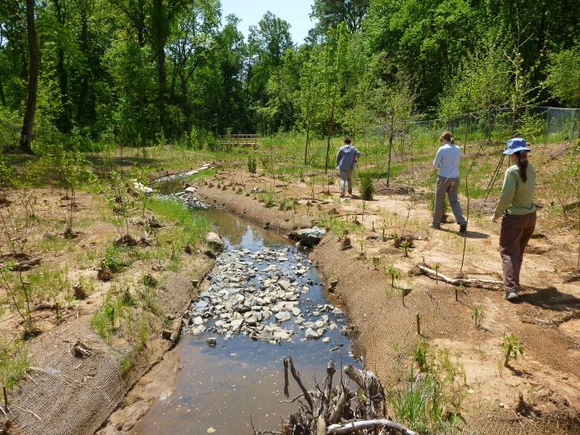
Charlotte NC urban restored stream-floodplains
Stream | Restoration completed | Two-stage channel design | Watershed area (ha) | Imperviousness (%)
Little Sugar Creek at Westfield (LSW) | 2004 | No | 3919 | 41%
Muddy Creek (MC) | 2010 | No | 113 | 28%
Dairy Branch at Sedgefield Park (SP) | 2006 | Yes | 86 | 43%
Torrence Creek (TOR) | 2011 | Yes | 2656 | 20%
Winterfield Tributary (WT) | 2012 | No | 39 | 46%
LSW
MC
SP
Stewart Inc.
TOR
WT

Slide 13
Enhanced sedimentation with greater connectivity
2-stage designs
Those sites that are frequently accessed (e.g., more connected) have potential for greater deposition and trapping of sediment.
Low benches > high benches (p=0.042)
Site differences: p<0.001 (connecting letters)
McMillan and Noe, in prep.
Notes:
Both WT and DB are highly connected based on restoration design. TWO big differences between these sites: (1) age of the restoration project and (2) watershed hydrology = energy of flood pulse.

Slide 14
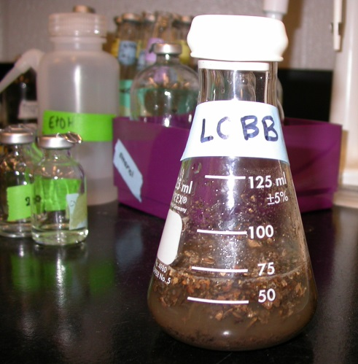
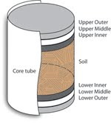
Nutrient cycling in restored urban floodplains
2-stage designs
2-stage designs
McMillan and Noe, in prep.

Slide 15
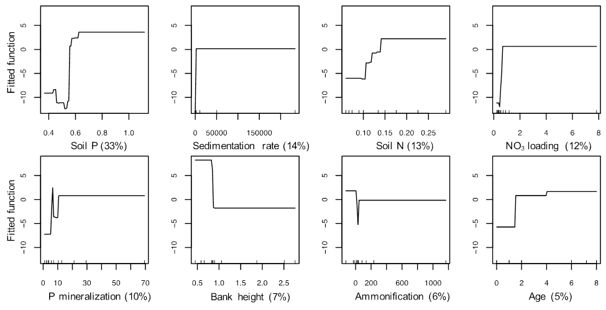
Predictors of biogeochemistry in urban stream-floodplain restoration
Boosted Regression Trees
Sedimentation was greater near channel in narrower, lower floodplains
Soil denitrification increased with greater inputs of sediment and NO₃⁻, greater soil P concentration and P mineralization, and age.
Soil N mineralization increased with age and sediment and PO₄ inputs.
Soil P mineralization increased with PO₄ inputs, smaller watersheds, and greater soil C and N and N mineralization
McMillan and Noe, in prep.
Notes:
Ongoing project and still collecting data, but currently performing multiple regression approach to explain the variability in N transformations as a function of age + hydrologic connectivity + nutrient loading.

Slide 16
How to increase restored stream-floodplain functions
Connect to stream hydrology
Build lower benches (2 stage design)
Let them age

Slide 17
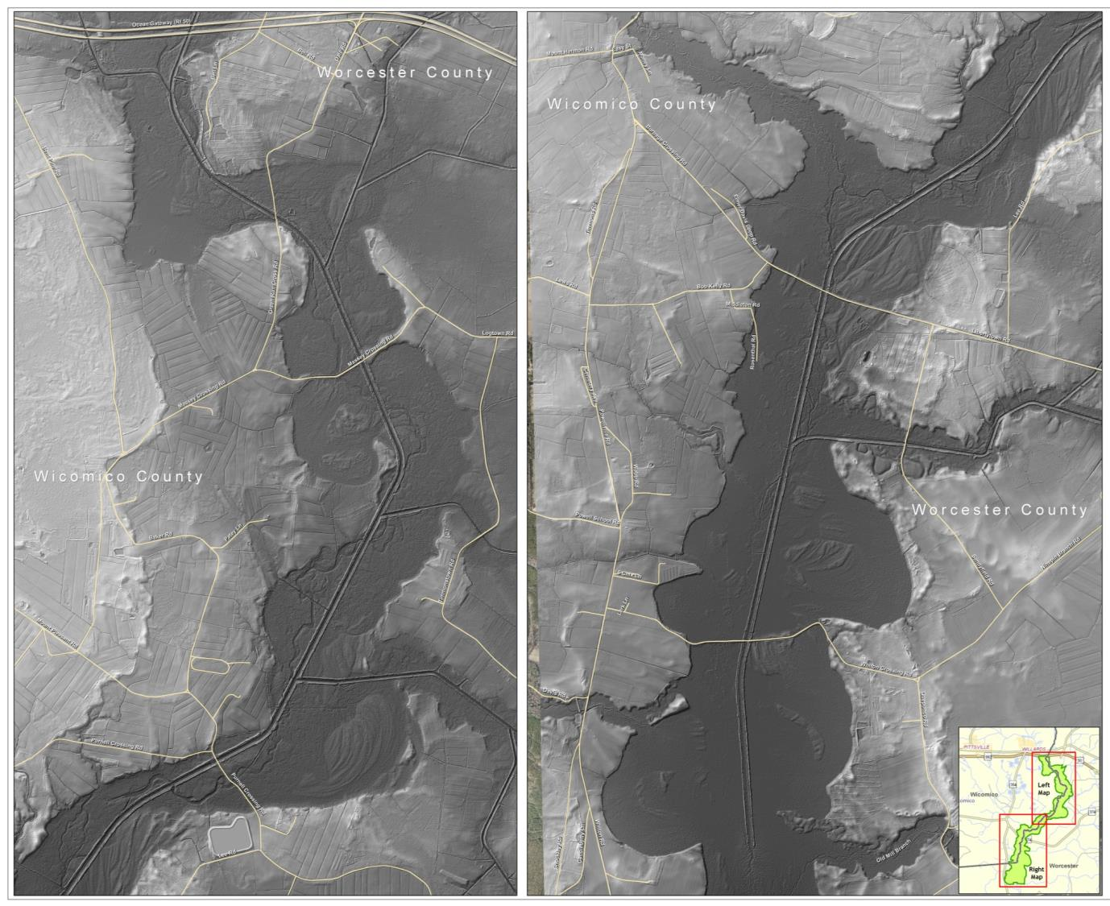
Restoring floodplains: channelized Pocomoke River
Steve Strano, USDA NRCS
Notes:
2011 LiDAR digital elevation model
Used to identify floodplain boundary, spoil levees and existing breaks in levee
Understand drainage network

Slide 18
Existing Condition Storm Flow in Channel
Floodplain Restoration
Storm Flow
Water Surface
Spoil Levee
Floodplain
Spoil Levee
Channel
Steve Strano, USDA NRCS
Notes:
During a storm event, the water surface in the channel rises.
But it can’t spread out into the floodplain because of the levees, so it rises even higher.
Perhaps along a relatively small amount of the bank, the levee is low enough to let some of the storm water enter the floodplain, but it is limited.

Slide 19
Restored Condition Storm Flow in Channel
Floodplain Restoration
Levee has been breached
Storm Flow
Water Surface
Levee Breach
Floodplain
Channel
Steve Strano, USDA NRCS
Notes:
So if you remove some of the levee and create breaches, the rising stormwater can enter the floodplain and spread out.
Because it can spread out into the floodplain at a lower elevation, it doesn’t rise as high.
We install notches in the spoil levee that sit at an elevation just above the existing floodplain surface.
This mimmicks a naturally-occurring levee on large streams and rivers.
When the waters rise in the river, they overtop the bank and collect in the floodplain.

Slide 20
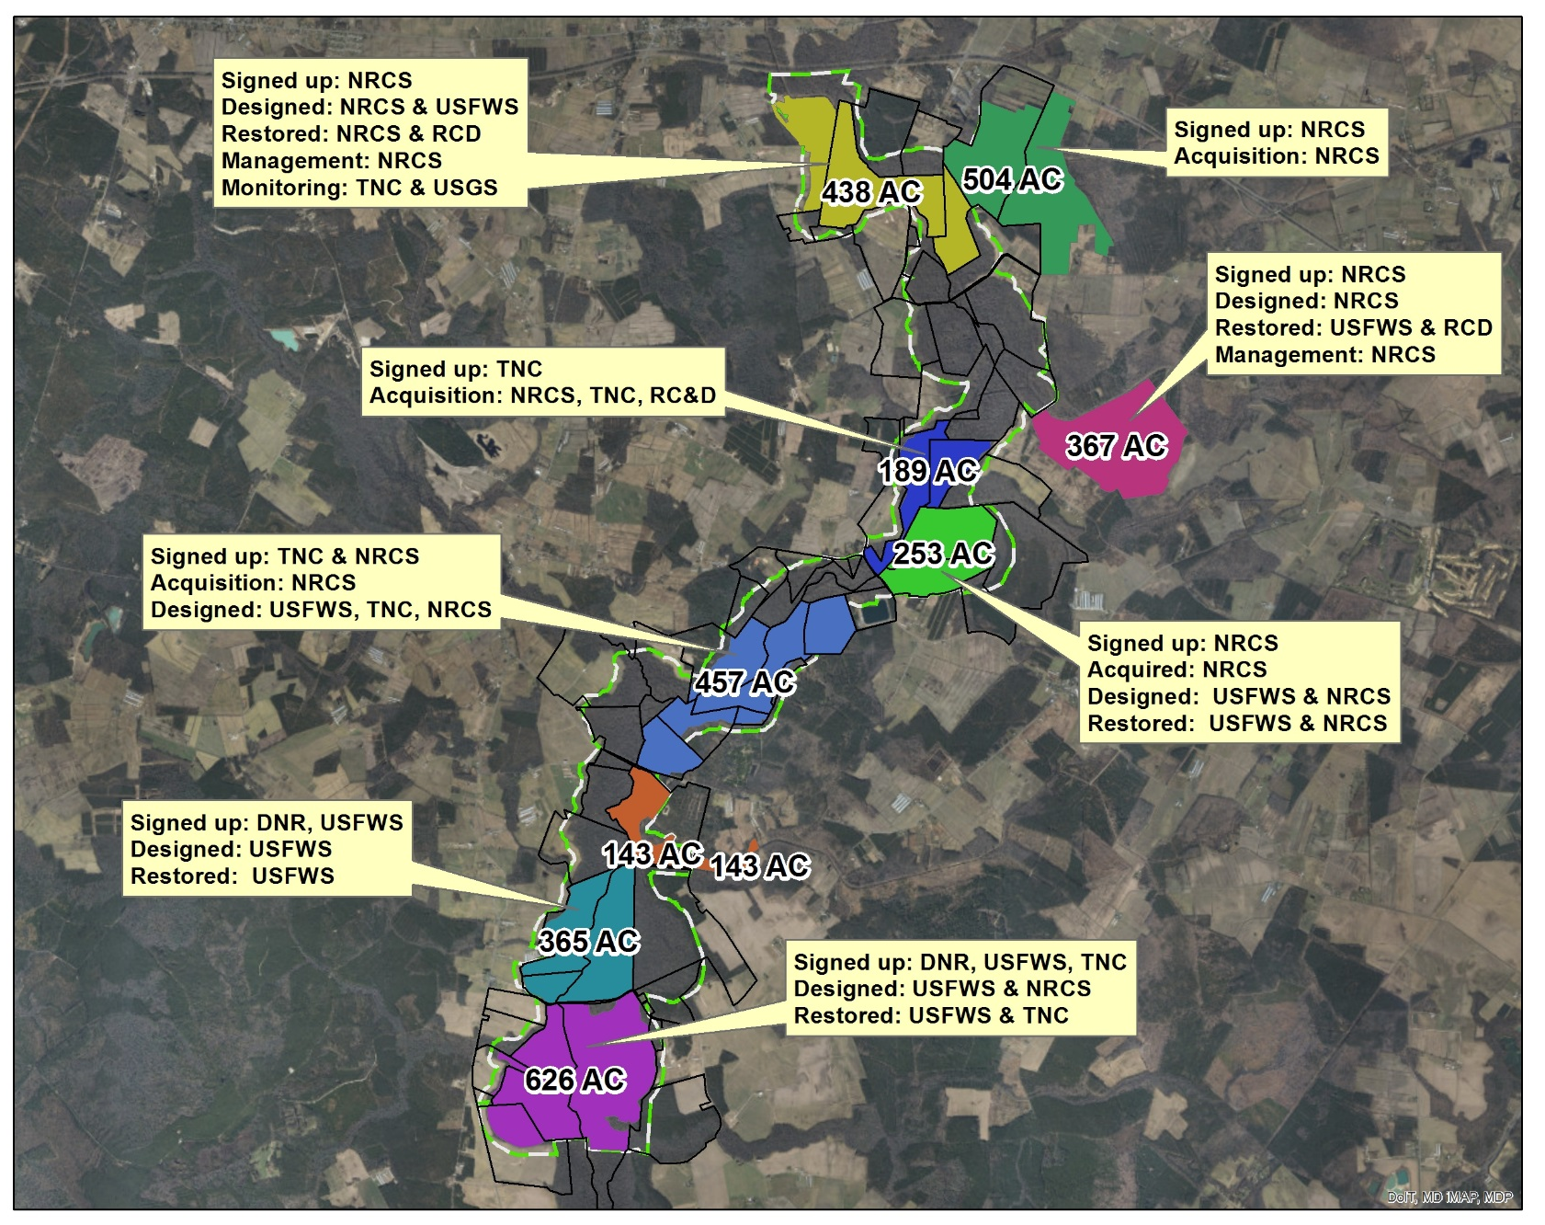
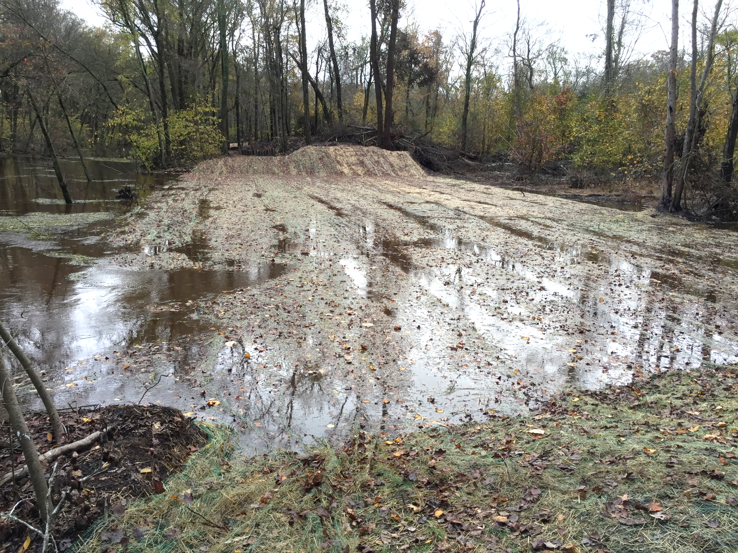
Restoring floodplains: channelized Pocomoke River

Slide 21
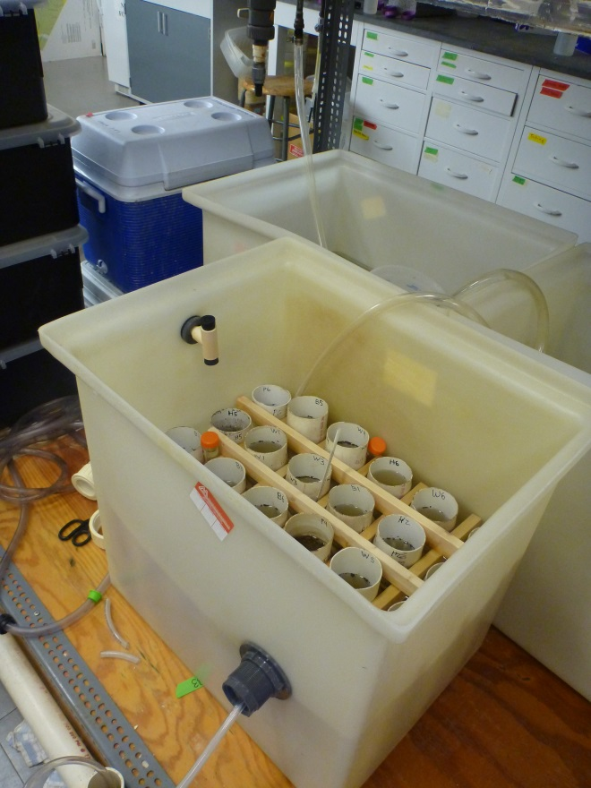
Phosphate release following flooding: aquarium study
Pre-restoration soils over 21 day flood
SRP Flux (mg-P m⁻² d⁻¹) | Mean | SE
Disconnected mainstem (W) | 5.02 b | 2.16
To be restored headwater (H) | 1.20 a | 0.84
To be restored mainstem (B) | 4.73 b | 1.61
Natural mainstem (P) | 0.19 a | 0.14
ANOVA: P=0.028
DOP flux (mg-P m⁻² d⁻¹) | Mean | SE
Disconnected mainstem (W) | -0.02 | 0.03
To be restored headwater (H) | 0.67 | 0.33
To be restored mainstem (B) | 0.22 | 0.09
Natural mainstem (P) | 0.47 | 0.27
ANOVA: P=0.075
Noe et al., in prep.

Slide 22
Inputs and release from soil in situ
PRELIMINARY
 | PO₄ flux (mg-P m⁻² d⁻¹) | NH₄ flux (mg-N m⁻² d⁻¹) | NO₂ flux (mg-N m⁻² d⁻¹) | NO₃ flux (mg-N m⁻² d⁻¹)
Willards input ↓ | 0.78 | 1.27 | 0.04 | 16.40
Willards release ↑ | 0.76 | 1.29 | 0.01 | 16.69
Horsebridge input ↓ | 0.14 | 1.08 | 0.01 | 1.34
Horsebridge output ↑ | 0.23 | 1.05 | 0.01 | 0.52
Harkin-Beaver input ↓ | 0.71 | 1.54 | 0.01 | 26.81
Harkin-Beaver release ↑ | 0.67 | 1.44 | 0.01 | 11.22
Porters input ↓ | 0.56 | 1.06 | 0.17 | 60.81
Porters release ↑ | 0.67 | 1.78 | 0.01 | 7.28
Willards input-release | 0.02 | -0.02 | 0.03 | -0.29
Horsebridge input-release | -0.09 | 0.03 | 0.00 | 0.82
Harkin-Beaver input-release | 0.04 | 0.10 | 0.00 | 15.59
Porters input-release | -0.12 | -0.73 | 0.16 | 53.53
Mainstem
Not restored
Headwater
Restored
Mainstem
Restored
Mainstem
Natural
+ uptake
- release
Noe et al., in prep.

Slide 23
Potential nutrient sedimentation inputs
channelized
connected
~ 1.4 g m⁻² yr⁻¹
Noe & Hupp. 2005. Ecological Applications.

Slide 24
How to reconnect floodplains?
Preliminary P mass balance from Pocomoke floodplain restoration:
g-P m⁻² yr⁻¹
Possible sediment inputs: 1.4
Potential PO₄ release: 0.08
Actual PO₄ release: 0.01 to -0.005
Connect to stream hydrology
(Inputs >> Loss)
Screen potential sites using soil [Al]

Slide 25
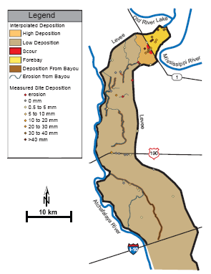
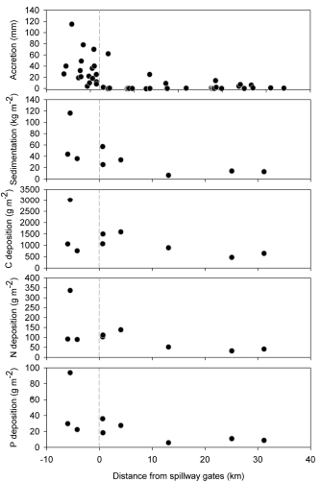
Floodplain diversion
Morganza Spillway opened during 2011 Mississippi River great flood
(Mississippi → Atchafalaya)
Trapped most of sediment sent through Spillway
Trapped 2% of P and 1% of N load of Mississippi River flood
Kroes et al. 2015. Ecological Engineering.

Slide 26
What how to reconnect floodplains?
Connect to stream hydrology
(could have trapped more…)

Slide 27
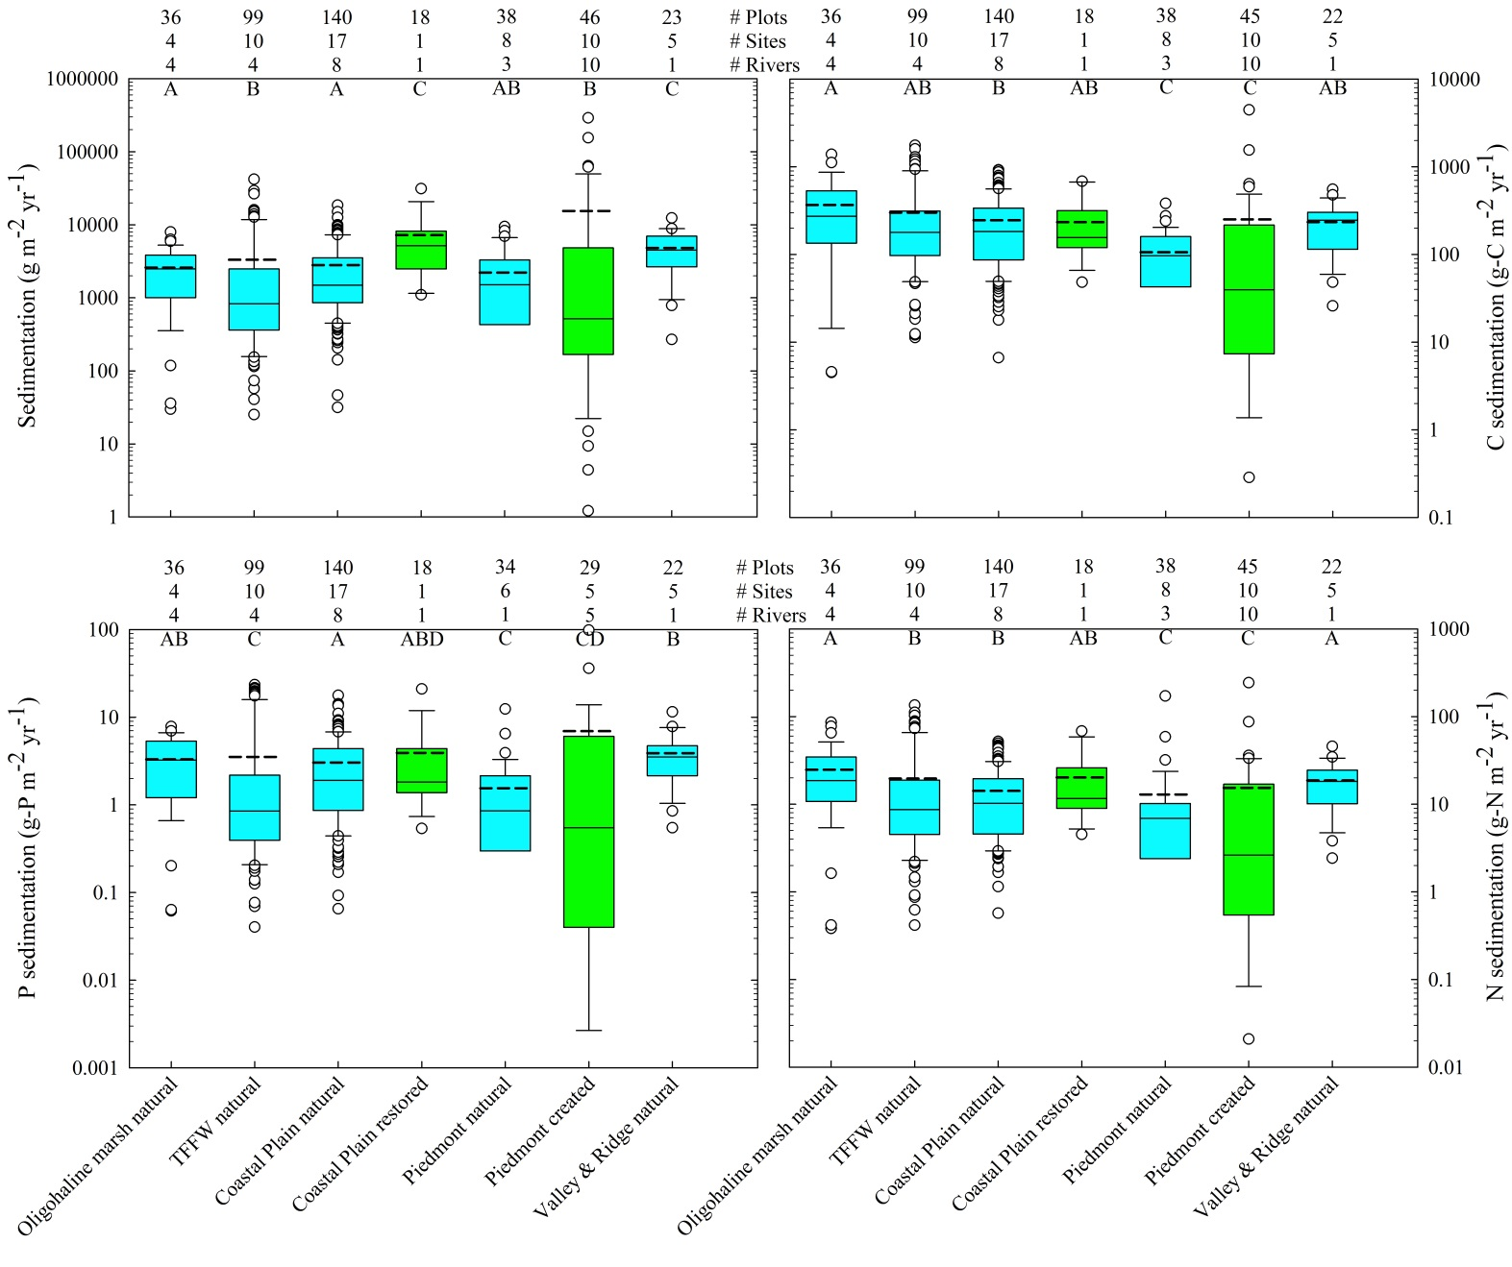
Do restored/created wetlands work like natural wetlands?
Location matters
Grand average
(g m⁻² yr⁻¹)
Sediment: 4155
C: 227
N: 14.7
P: 3.0
n = 473
Noe et al. in prep.
tidal
nontidal
tidal
nontidal

Slide 28
How to increase mitigation wetland functions
To summarize…
Connect to stream hydrology
Build microtopography
Let them age
Include annual plants
Plant more diverse
Screen potential sites for WQ problems

Slide 29
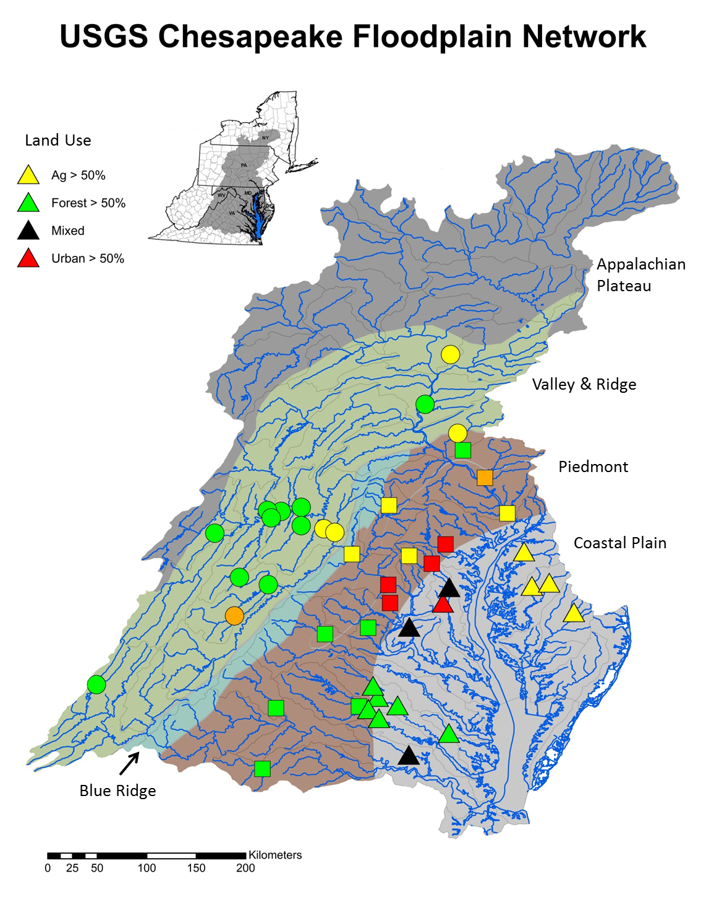
The USGS Chesapeake Floodplain Network: 43 sites
Goal:
Measure, predict, and scale the sediment/N/P fluxes of bank erosion and floodplain deposition for entire Chesapeake watershed
Long-term: dendrogeomorphology
Short-term: pins
Site selection:
Chesapeake NTN load gages
‘unmanaged’ floodplain land use
Unchannelized
Landowner permission

Slide 30
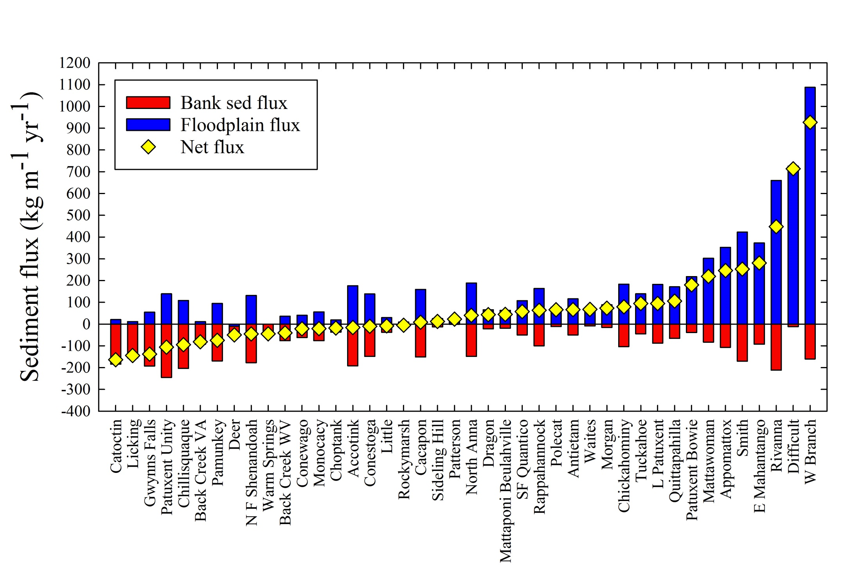
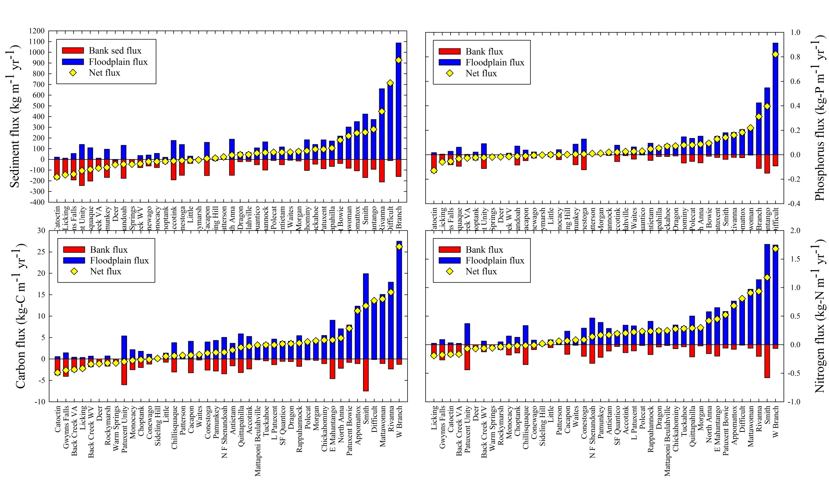
USGS Chesapeake Floodplain Network:
Dendrogeomorphic results all 3 PP
Mean ages of trees:
floodplain = 48 yr
bank = 17 yr root exposed
Sediment
P
median net flux: +32
mean net flux: +74
57% net depositional
median net flux: +0.016
mean net flux: +0.064
64% net depositional
C
N
median net flux: +1.8
mean net flux: +3.4
71% net depositional
median net flux: +0.17
mean net flux: +0.24
69% net depositional

Slide 31
Fluxes are predictable: Watershed + Reach GIS-derived predictors
Stepwise multiple regressions (P-to-enter=0.10):
Sediment: net balance
n=31, R²=0.61, P<0.001
FP_width:Bnk_height β= +
FP_width:Ch_width β= –
K factor erodibility uppersoil β= +
Soil permeability avg β= +
Elevation-Relief Ratio β= –
Nitrogen: net balance
n=31, R²=0.70, P<0.001
ΔDeveloped 2012-1974 β= +
Horton Overland Flow % β= –
K factor erodibility uppersoil β= +
Sed_load_SPARROW β= +
Soil permeability avg β= +
Base Flow Index avg β= –
Phosphorus: net balance
n=31, R²=0.70, P<0.001
ΔDeveloped 2012-1974 β= +
Horton Overland Flow % β= –
K factor erodibility uppersoil β= +
Sed_load_SPARROW β= +
PP: Piedmont β= –
Q50 β= –
Sediment: floodplain flux
n=33, R²=0.70, P<0.001
ΔDeveloped 2012-1974 β= +
Horton Overland Flow % β= –
Bank_avg_angle β= –
Bank_ht β= –
FP_range_elev β= +
PP: Coastal Plain β= +
Power_watershed_Q50 β= +
Nitrogen: floodplain flux
n=33, R²=0.68, P<0.001
ΔDeveloped 2012-1974 β= +
K factor erodibility uppersoil β= +
Soil permeability avg β= +
Bank_avg_angle β= –
Horton Overland Flow % β= –
PPT_avg β= +
Phosphorus: floodplain flux
n=33, R²=0.93, P<0.001
ΔDeveloped 2012-1974 β= +
P_yield_SPARROW β= +
N_appl_rate β= –
NLCD_Ag_2011 β= +
Horton Overland Flow % β= –
Bank_max_angle β= –
Q50_yield β= +
Dam_density β= +
Bnk_height:FP_width β= +
Dam_storage β= +
P_appl_rate β= –
NLCD_Urb_2011 β= +
K factor erodibility uppersoil β= +
Phosphorus: bank flux
n=31, R²=0.55, P=0.002
Land-use Production 1974 β= –
NLCD_Ag_2011 β= +
Elevation-Relief Ratio β= +
PP: Valley & Ridge β= +
Dam_density β= +
Sediment: bank flux
n=31, R²=0.37, P=0.005
Bank_max_angle β= +
PPT_avg β= –
Over_ratio β= +
Nitrogen: bank flux
n=31, R²=0.27, P=0.004
Land-use Production 1974 β= –

Slide 32
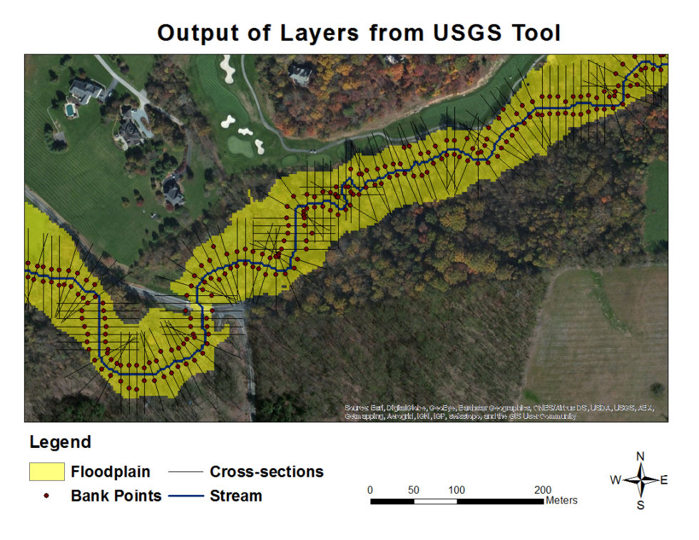
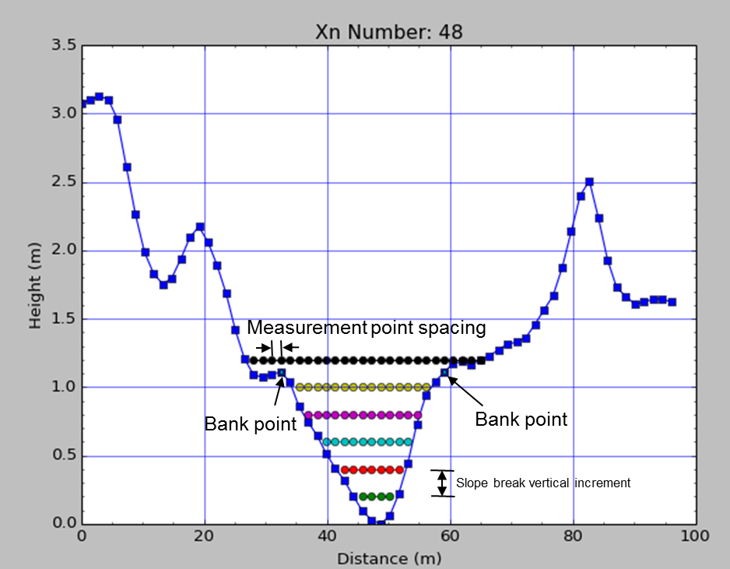
USGS Stream Channel and Floodplain Metric Toolbox v1.3
Bank locations identified based on slope breaks
Notes:
Bank locations are calculated purely on slope break threshold. Assumes minimum elevation is within channel, increases in intervals searching for some horizontal distance within that vertical distance. This is a parameter!! Here “Depth” = “Bank Height”. And actually “Elevation” on y-axis should be “Depth”

Slide 33
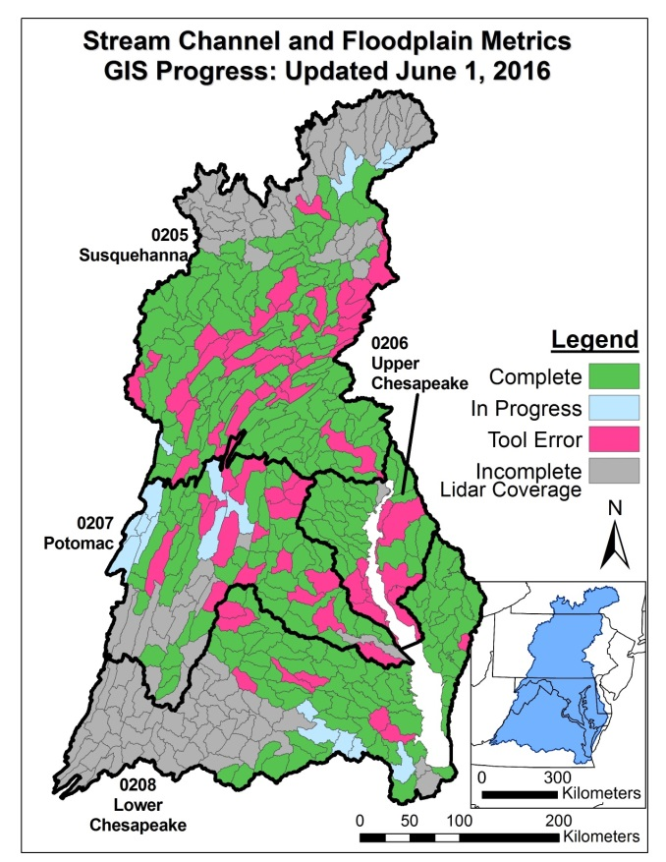
USGS Stream Channel and Floodplain Metric Toolbox v1.3
Fluvial Geomorphic Characteristics
Channel Cross-section Metrics
Bank height (m)
Bank angle (deg)
Channel width
Channel length
Bankfull area
Floodplain width
Floodplain elevation range
Floodplain elevation StdDev
Stream Reach Metrics
Length
Profile slope
Order
Magnitude
Upstream and downstream IDs
Drainage area
Notes:
Bank locations are calculated purely on slope break threshold. Assumes minimum elevation is within channel, increases in intervals searching for some horizontal distance within that vertical distance. This is a parameter!! Here “Depth” = “Bank Height”. And actually “Elevation” on y-axis should be “Depth”

Slide 34
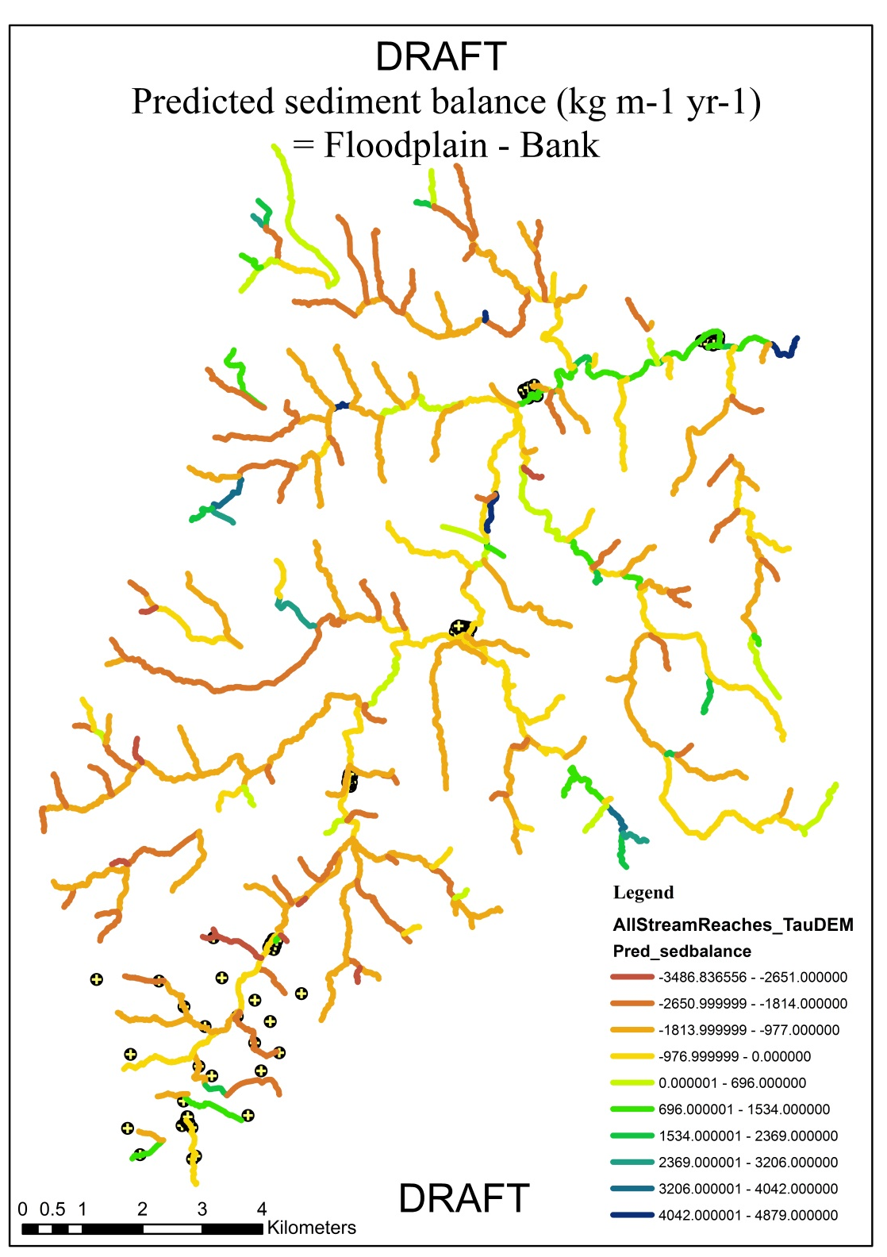
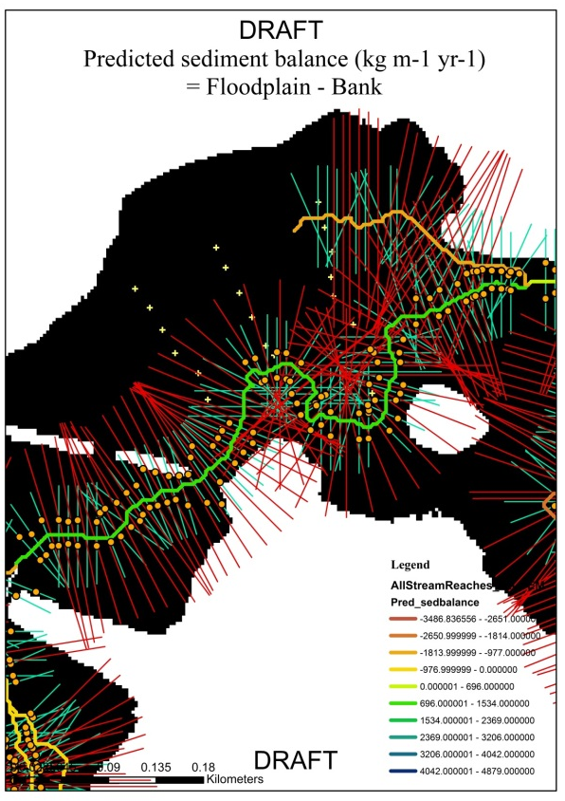
Predicting fluxes:
Difficult Run pilot
Regression
Mainstem X-section
net sediment balance predicted (R²=0.57, P=0.007) by:
Channel width
Floodplain elevation range
DRAFT!
Tool in refinement

Slide 35
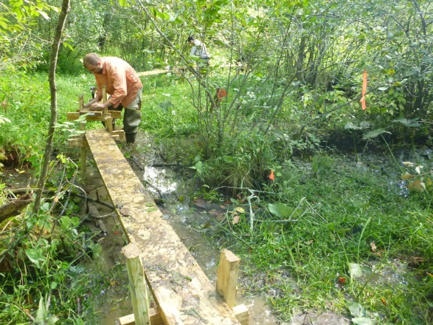
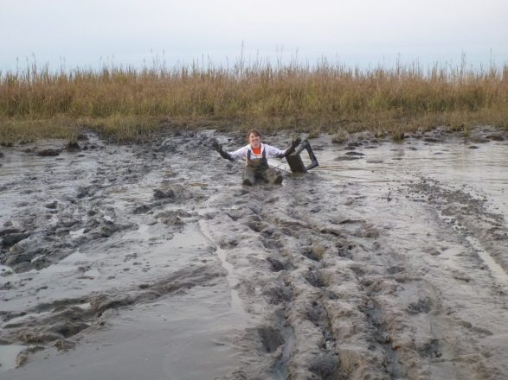
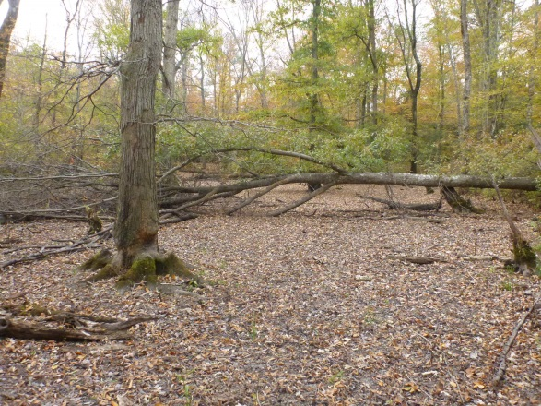
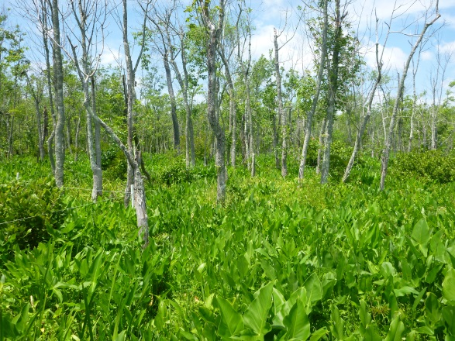
How do watersheds and estuaries control eco-geomorphic responses to sea-level rise?
River
Estuary
Tidal river
Nontidal
Tidal
Freshwater
Oligohaline +
Floodplain
Channel
Bottomland hardwood
Tidal FW swamp
Tidal FW marsh
Oligohaline marsh +

Slide 36
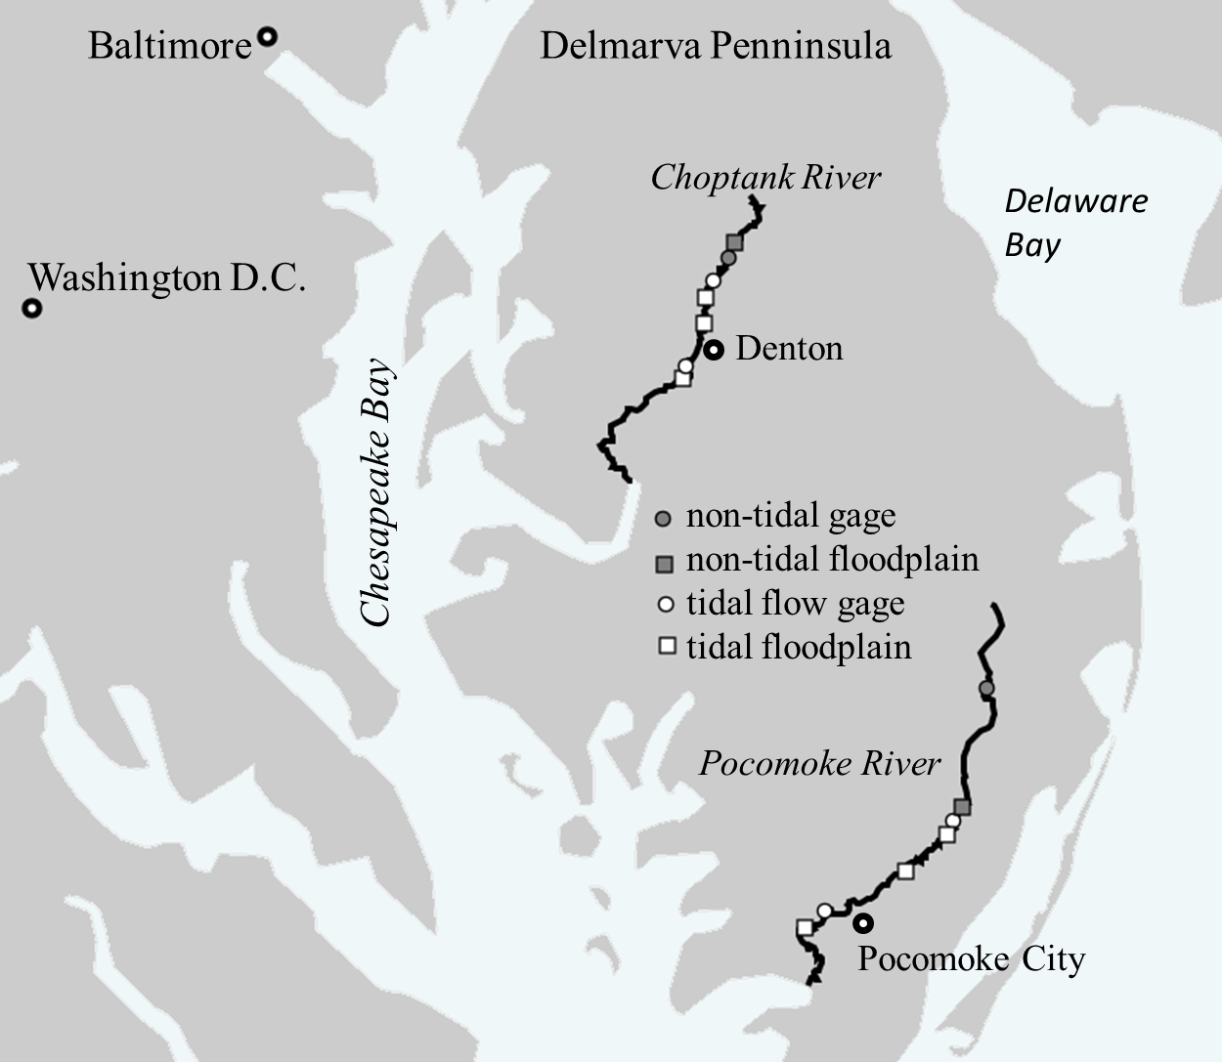
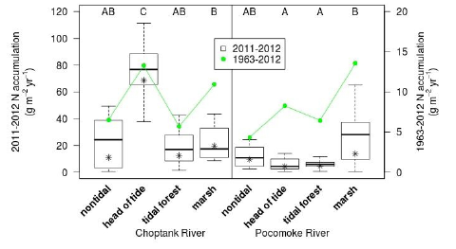
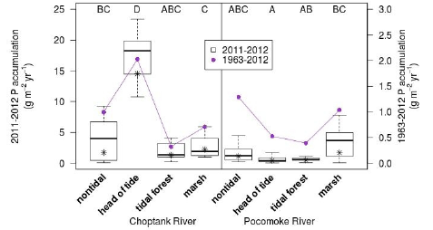
What happens once river loads hit tide?
Wetland sedimentation
Sedimentation rates along Savannah, Waccamaw, Choptank, and Pocomoke rivers suggests that upstream TFFW cast “sediment shadow” on downstream TFFW to ETM
Press release February 17, 2016
Ensign et al. 2015, GRL

Slide 37
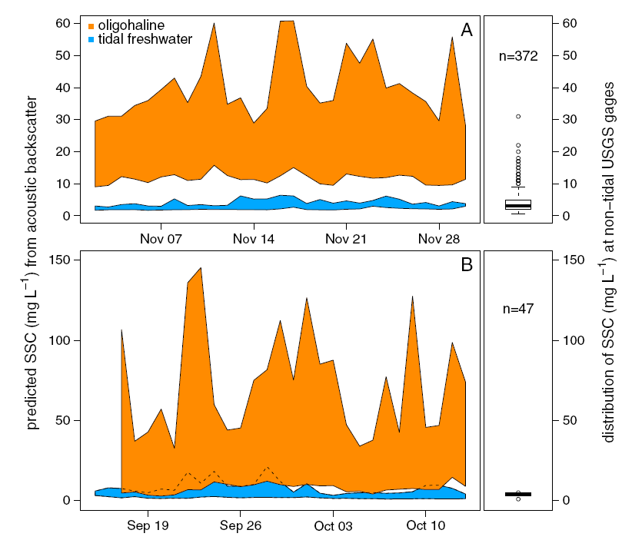
What happens once river loads hit tide?
Channel suspended sediment
Choptank
Ensign et al. 2014,
JGR-ES
Pocomoke

Slide 38
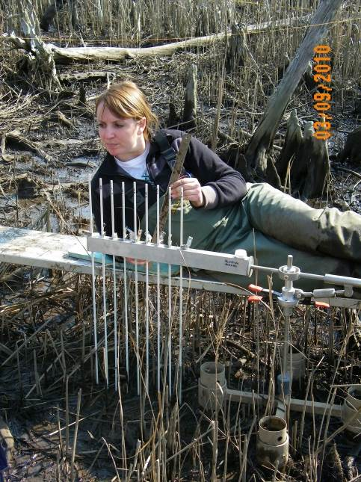
Resilience to sea-level rise
CONSEQUENCES
RSLR Short-term = 0.58 cm y⁻¹
RSLR Long-term = 0.31 cm y⁻¹
Savannah River
Waccamah River
TFFW keeping up with long-term RSLR rates, but…
Oligohaline marsh exceeding RSLR
Stagg et al. 2016, Ecosystems
Notes:
Surface elevation change in the TFFW keeps pace with long-term rates of RSLR (0.31 cm/y). However, comparisons to current, short-term rates of RLSR (0.58 cm/y) show significant deficits on the Savannah river and not the Waccamaw. So the TFFW on the Savannah may be considered marginally resilient to RSLR, whereas the Waccamaw is resilient. In contrast on both rivers, the oligohaline marsh maintains elevation rate equivalence or surplus in all comparisons to RSLR, indicating robust resilience of the oligohaline marsh to RSLR.
93 years for long-term record.
The TFFW on the Waccamaw are resilient to RSLR, likely due to root zone expansion and geologic uplift, which may be a result of local geomorphology. However, as salinity increases on the Waccamaw River, the lower forest shows significant elevation deficits. Vulnerability at this site is likely due to the observed high rate of root zone subsidence which is probably a function of the forest dieback occurring here. But, like the Savannah marsh, the ultimate conversion to a high oligohaline marsh on the Waccamaw results in an elevation surplus.
Synthesis note: although decomposition is greater (faster and more complete) in the marsh sites, processes contributing to elevation loss, including root and rhizome decomposition, are not sufficient to result in overall elevation deficits. Accretion rates in the marsh are high enough to overcome root zone elevation loss.

Slide 39
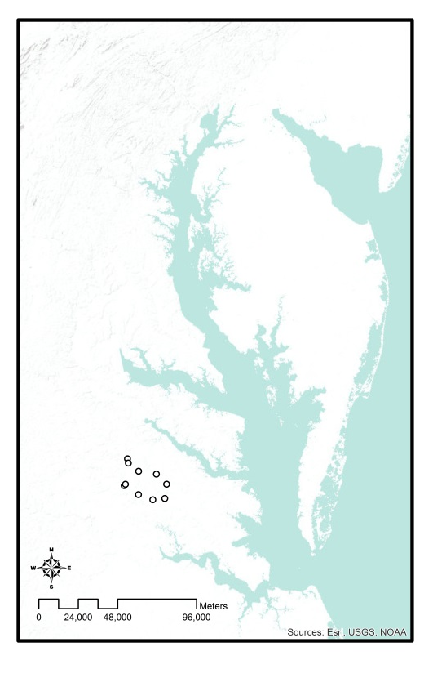
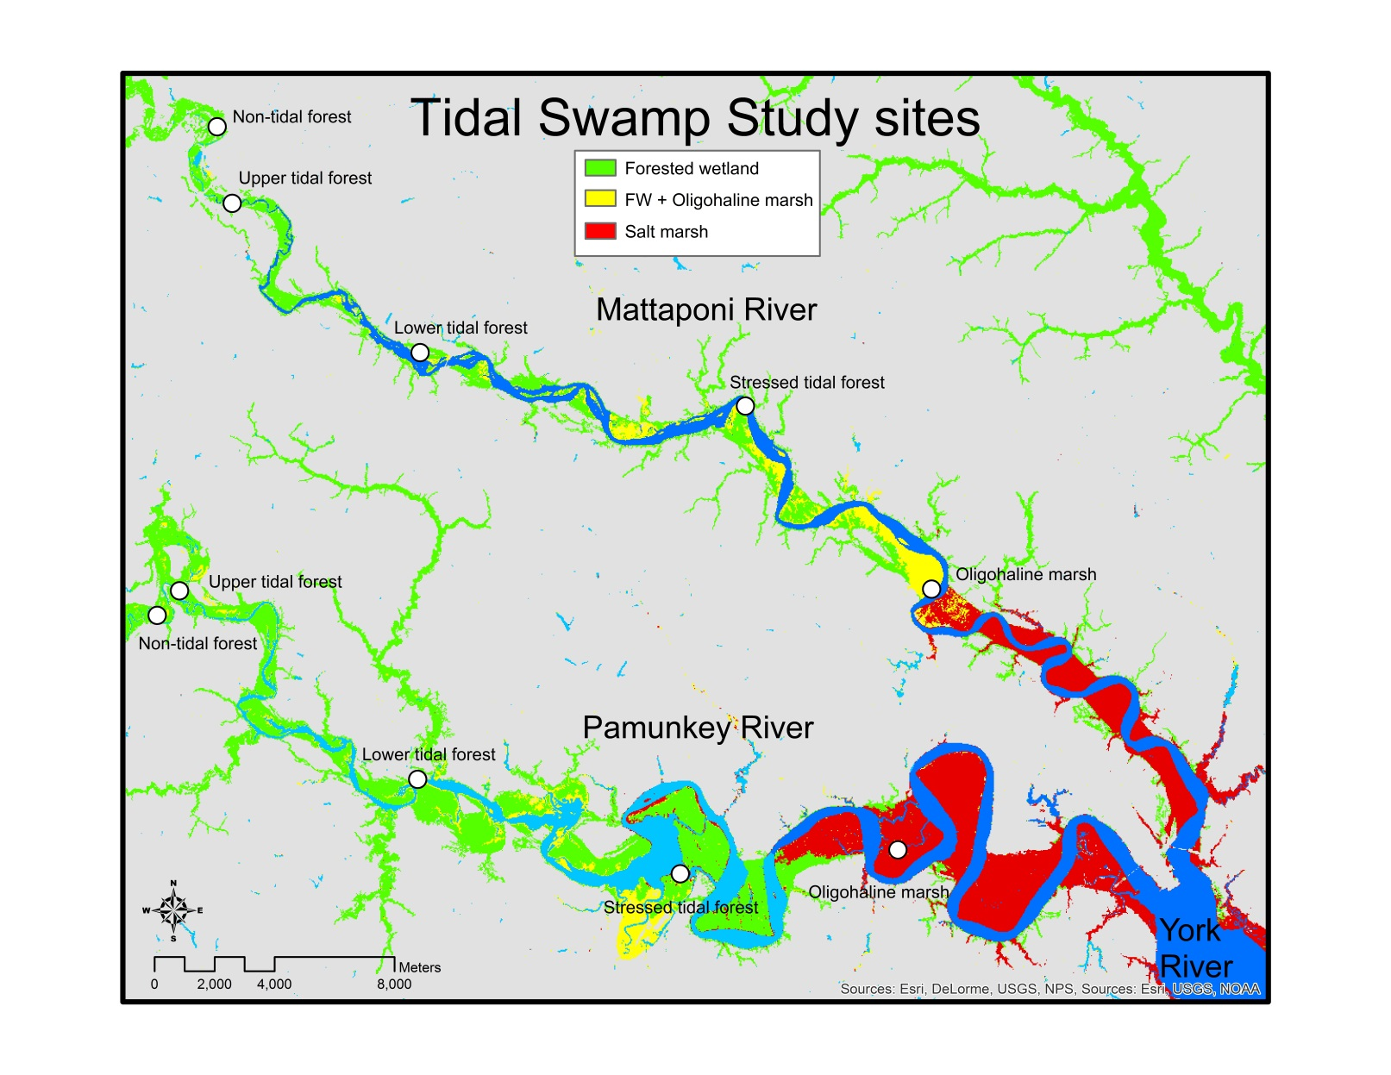
What happens once river loads hit tide?
and does it influence wetland resilience to sea level rise?
Watershed sediment load:
Pamunkey 9X > Mattaponi

Slide 40
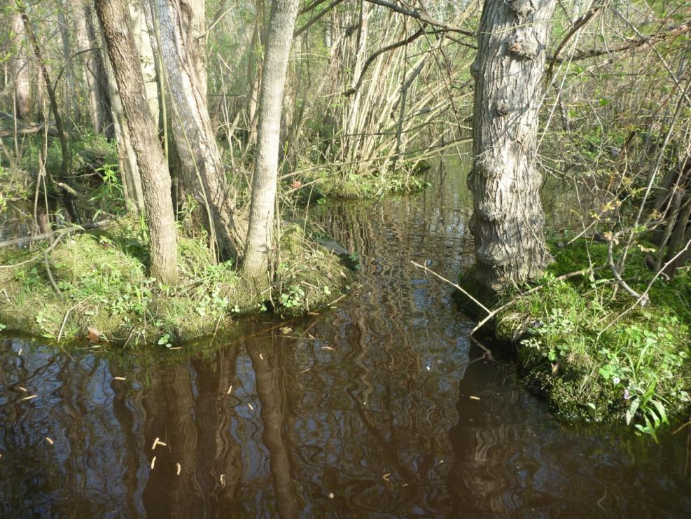
Processes determining elevation change in hummocks and hollows (and TFFW in general)
+1
0
-1
Water level effect on BNEP/root production
Elevation differentiation
Sediment availability effect on accretion
Salinity effect on root production and soil respiration
low
high
Stressor level
Elevation gain
Sedimentation
AG NPP
BG NPP
Measurements:
Processes that create elevation differentiation:
Water velocity
Elevation loss:
Erosion
Root respiration
Microbial respiration
Compaction
Sediment load
Water level
Sediment gain/loss
BNEP
Vegetative productivity
Salt
Alternative e⁻ acceptors
Nutrient availability

Slide 41
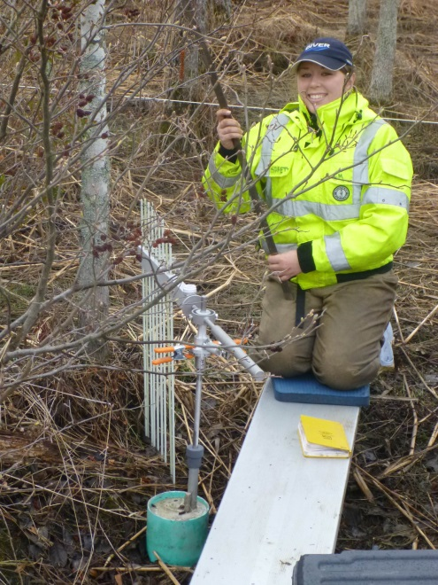
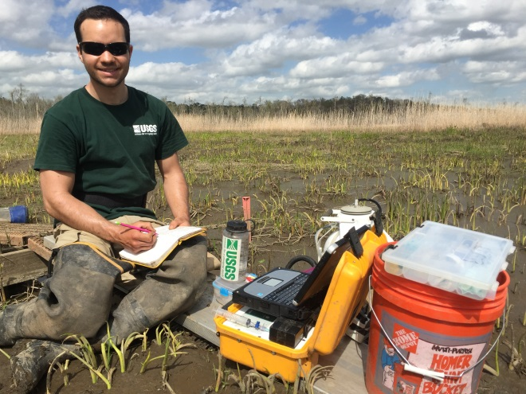
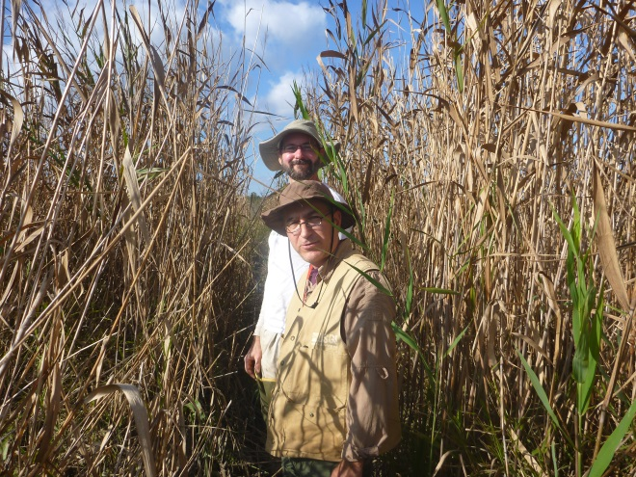
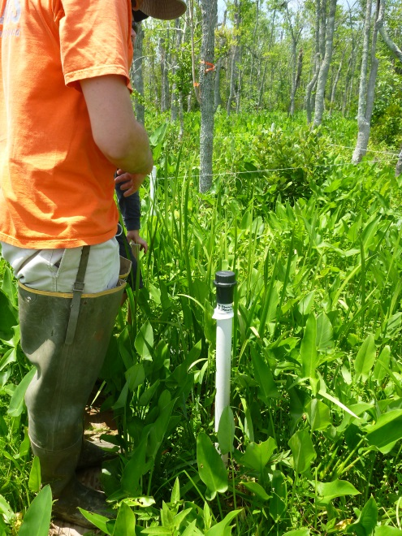
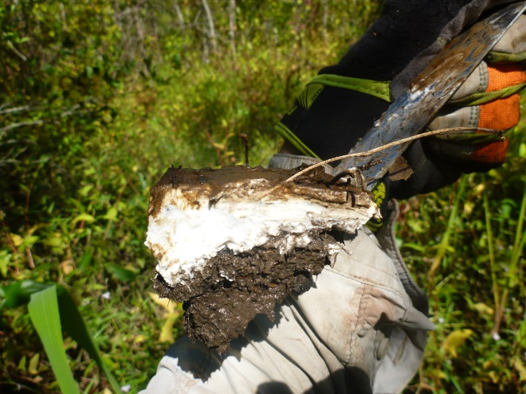
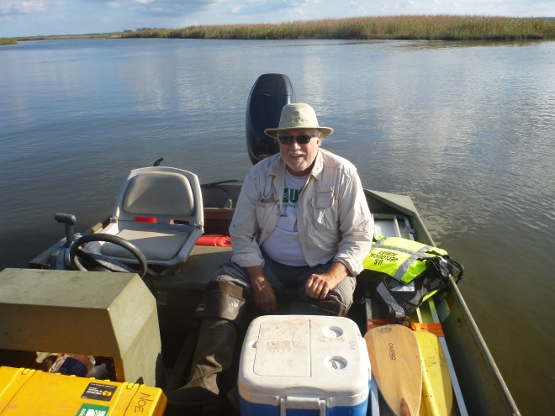
Pamunkey and Mattaponi rivers measurements
5 longitudinal sites each along 2 rivers
Plant community composition
and historic tree growth rate
Deep rod sediment elevation tables
Soil GHG efflux
Water level and conductivity
Channel-floodplain geomorphology
and in-channel sediment availability
Sediment accretion

