Slide 1
Chesapeake Bay Program Diversity Workgroup Announcements
November 19, 2021

Slide 2
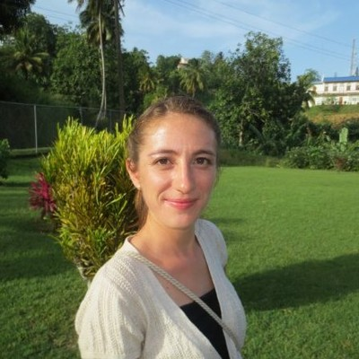
Welcome Allison Ng
Allison has joined the Chesapeake Bay Program Office for a 120-day detail from EPA’s Philadelphia office to help coordinate the Diversity Workgroup.
Allison has a BA in Sociology/Anthropology from Colgate University and an MS in Environmental Studies/Conservation Biology from Green Mountain College.
Since joining EPA in 2016, she has worked on a variety of management support activities including succession planning, retreat facilitation, strategic planning, the Regional realignment, and the relocations.

Slide 3

DEIJ Action Team Update
The DEIJ Strategy Implementation plan has been revised based on public comments
The Principal Staff Committee and Executive Council will review the plan for final approval
HUGE thank you to everyone on the Action Team!

Slide 4

Our Current GIT Funding Project
This project helps the CBP develop a better understanding of the needs, barriers, and priorities of organizations led by and serving historically underrepresented and underserved communities such as communities of color.
Thank you to all the participants and thank you to Gabrielle Roffe for all her hard work on this project!

Slide 5
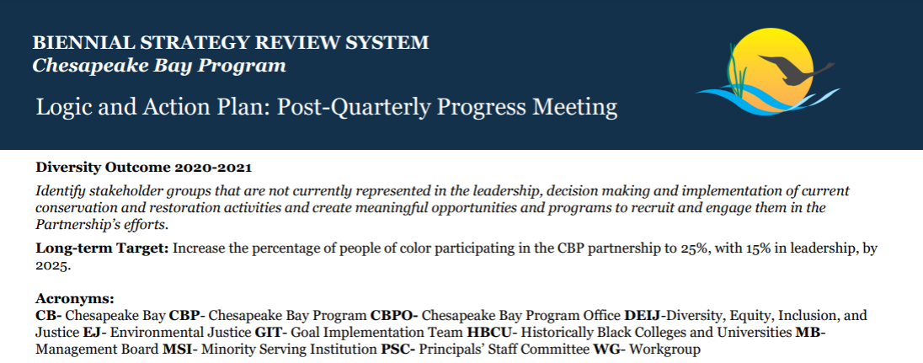
When is the Last Time You Read Our Workgroup’s Workplan?
Today we are talking about The Strategy Review System (SRS)
Our workplan is located on our website
February 2022, we get explain challenges and request action or assistance from the Management Board

Slide 6
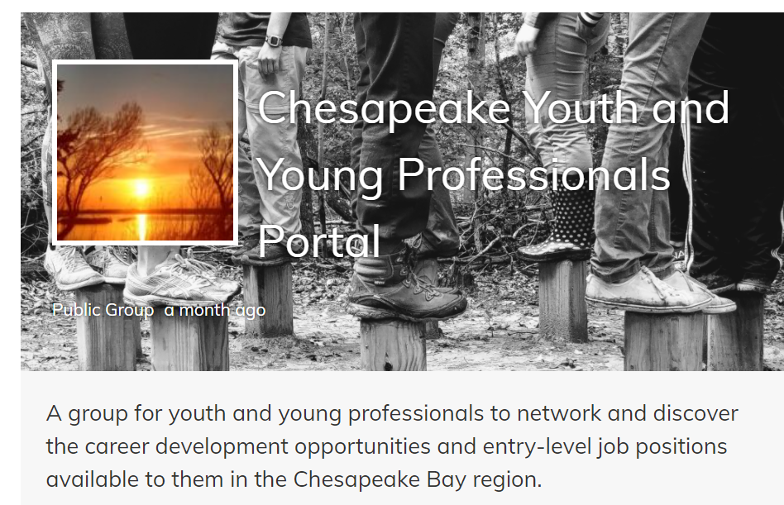
Consider Posting Jobs for Young Professionals on the Portal: https://www.chesapeakenetwork.org/groups/chesapeake-youth-portal/

Slide 7
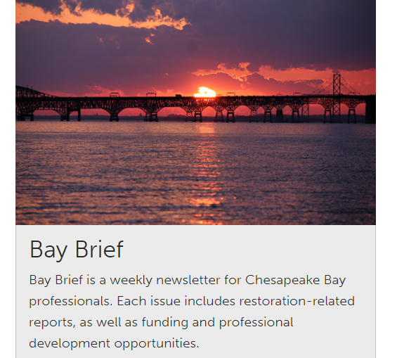
Are you subscribed to the Bay Brief?
https://www.chesapeakebay.net/action/newsletters

Slide 8
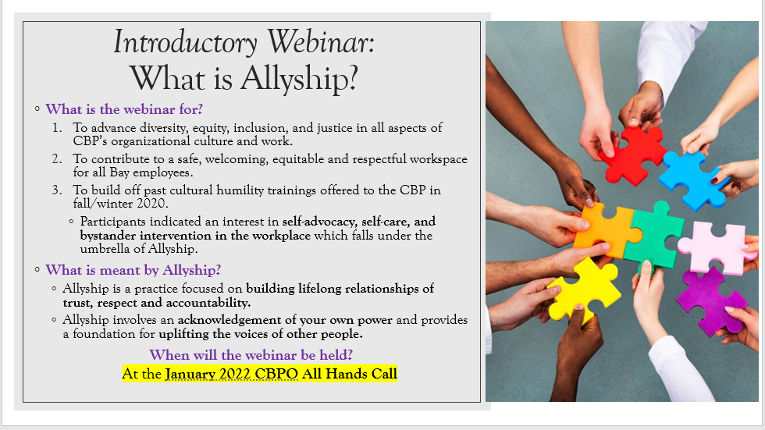
CBPO Diversity and Inclusion Training Series
Coordinated by: Briana Yancy, Vanessa Van Note, and Allison Ng

Slide 9
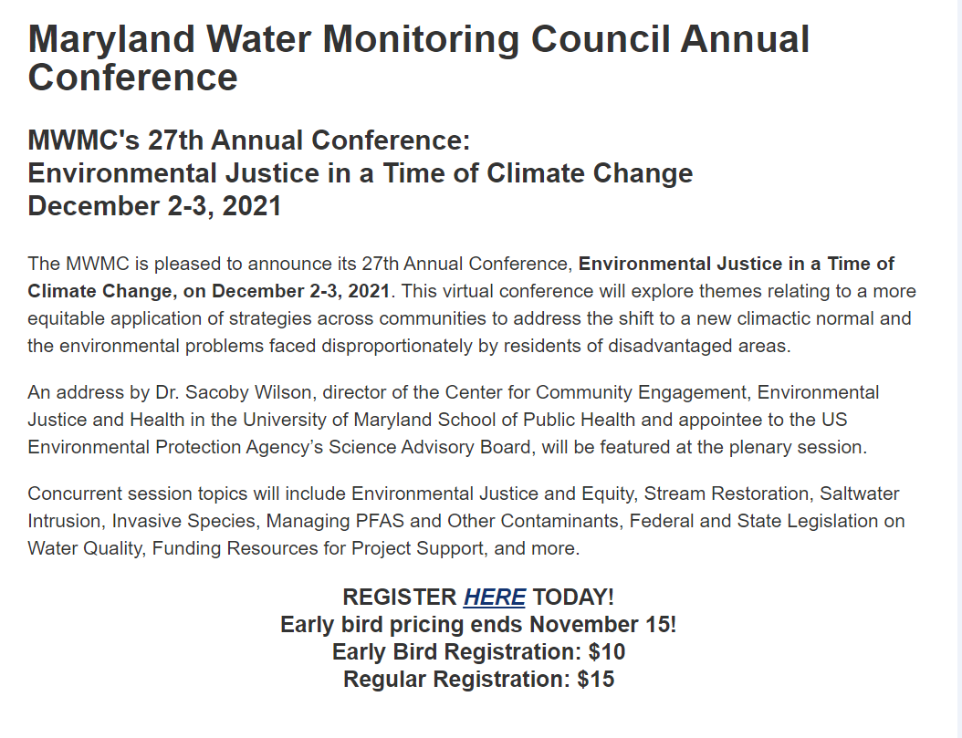
Register Here: https://dnr.maryland.gov/streams/pages/mwmc/conference.aspx

