Slide 1

Management Approaches in 2016-2017 CBP Diversity Workplan
Communications and Outreach
Employment and Professional Engagement
Promoting Environmental Justice
Tracking and Assessment

Slide 2
Highlights of FY 16-17 Progress
Identified key trusted leaders of underrepresented communities
Assisted in development of Tree Canopy communication and outreach targeted to diverse audiences
Monthly Diversity Workgroup Updates
Have reached many professionals of color through workgroup meetings
Initiated Fish Consumption Advisory Project

Slide 3
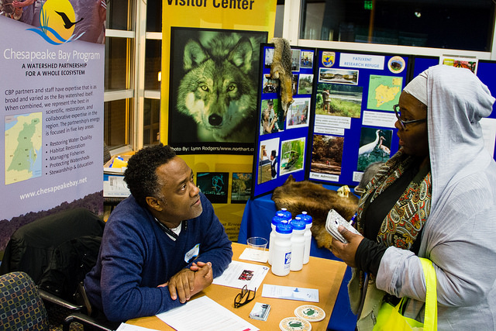
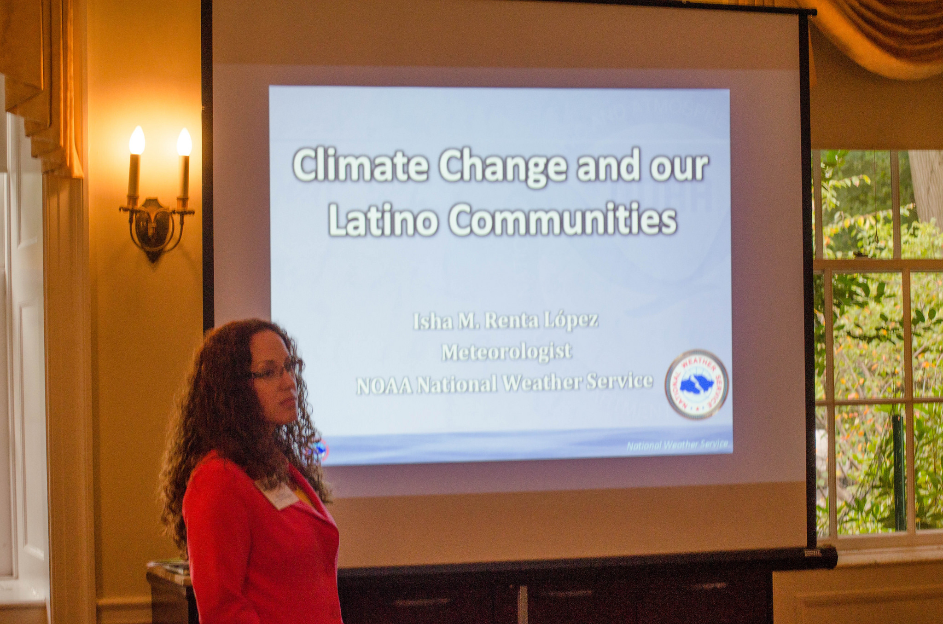
Highlights of FY 16-17 Progress
Have reached many students at outreach events (sign-in count)
Co-hosted multiple environmental career events (e.g., Audubon Naturalist Society, Baltimore Wilderness Coalition, Southeast CARE Coalition) and participated in university career fairs (e.g., Morgan and Coppin State)
Increase outreach to diverse groups for hiring full time employees

Slide 4
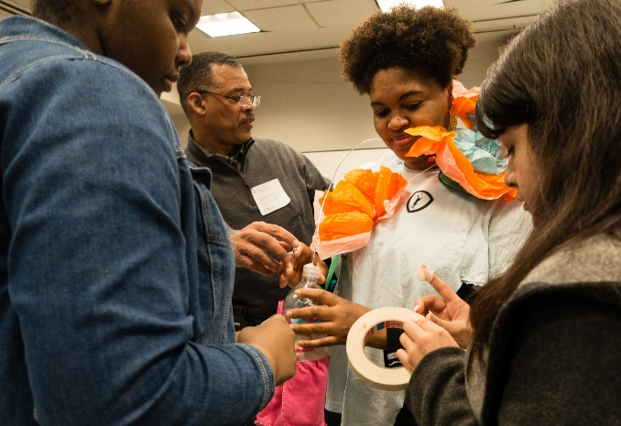
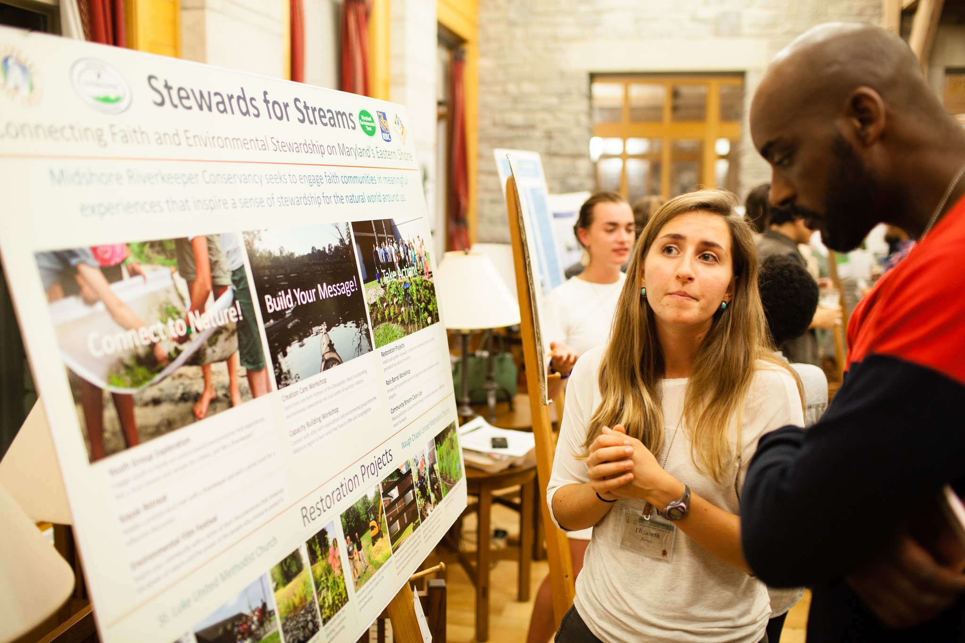
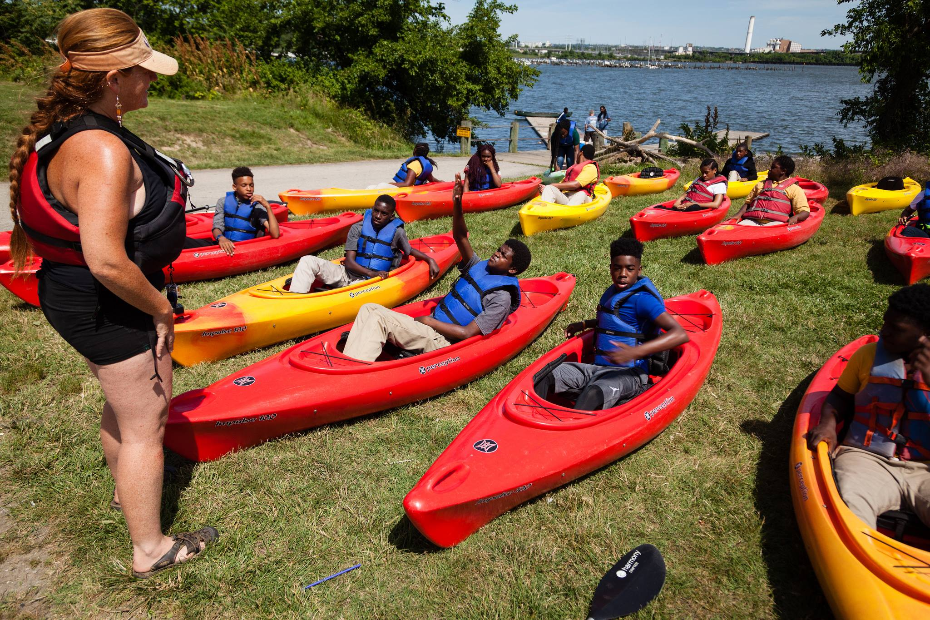
Highlights of FY 16-17 Progress (cont.)
EPA and states incorporating diversity + EJ into their grant guidance, policies and programs
In the process of completing CBP’s: EJ SCREEN - Chesapeake
Conducted a demographic profile of the CBP Partnership in 2016
Established the baseline for diversity at the Chesapeake Bay Program – 13% diversity overall; 3% leadership position

Slide 5
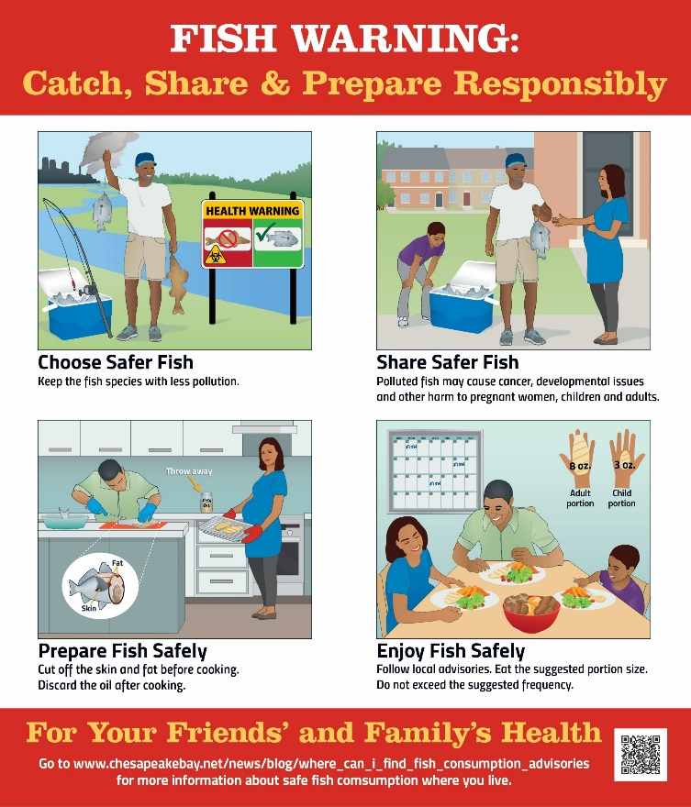
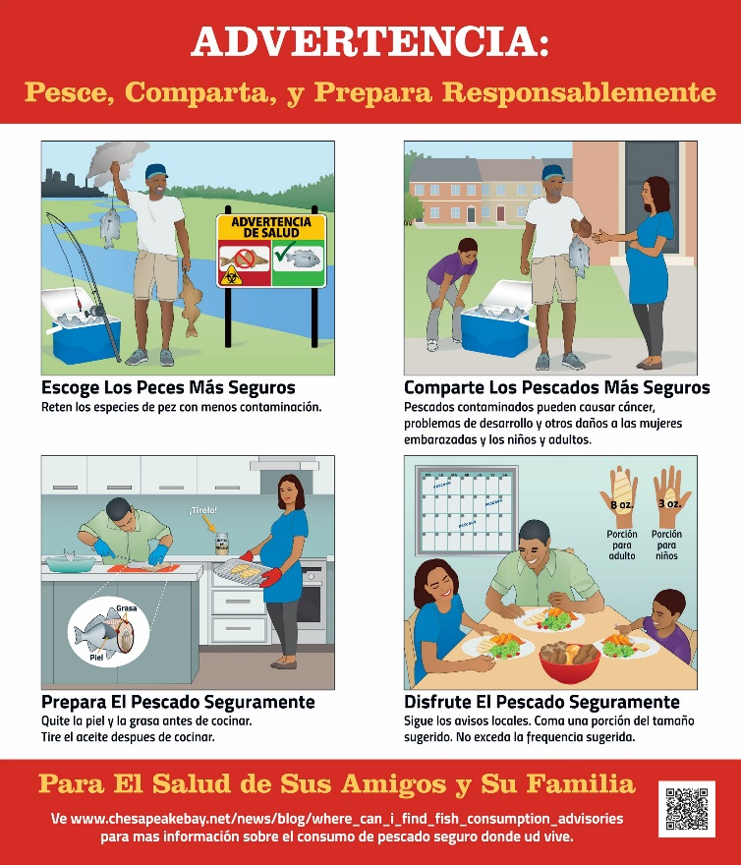
Fish Consumption Advisory Project

Slide 6
2018-2019 Diversity
Establish new Chesapeake Stream Diversity Intern Program (completed)
Complete MOU process with HBCUs within the watershed to strengthen relationships and facilitate more knowledge and talent sharing
Complete the CBP Cultural Competency Training and development tools for Diversity, Equity and Inclusion
Conduct EJ SCREEN training and webinar series for Chesapeake Bay Program and extended partners
Develop communications strategy for the release of the Fish Consumption Advisory infographic
Trees For All Workshop Follow-Up: Identify EJ Tree Canopy Liaisons in desired communities
Continue to identify and engage emerging/existing professionals of color
Set new CBP Diversity targets of 25% (overall) + 15% (leadership) by 2025 (completed)
Will be repeating the profile in 2019 to measure CBP Diversity progress

Slide 7
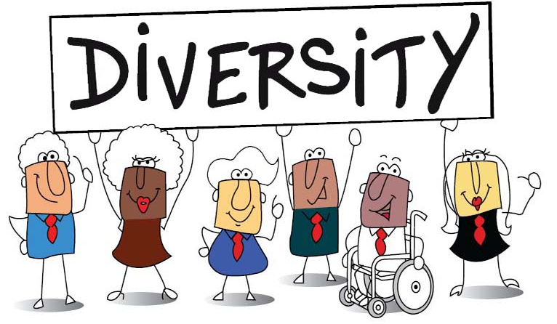
New CBP-Approved Diversity Targets
By 2025, 25% of the total CBP partnership will be people of color.
By 2025, 15% of leadership will be people of color
15% / 25% by 2025!

Slide 8
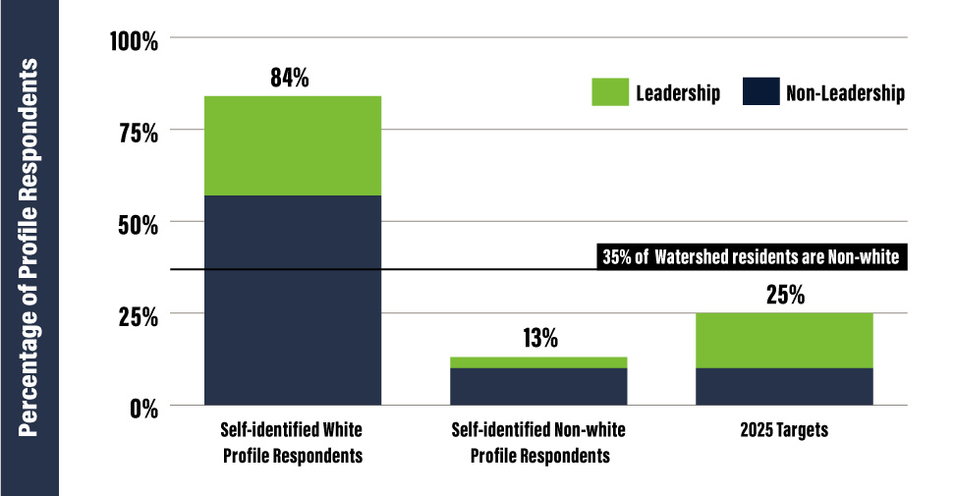

Slide 9












New Partner organizations…and growing

Slide 10
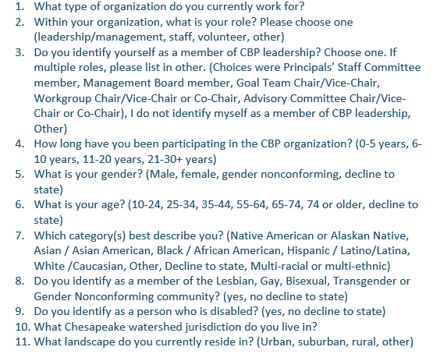
Demographic Profile
*12. Please list all CBP workgroups that you are a member of.

Slide 11
Chair/Vice Chair Search
1-2 year committment
Lead monthly steering committee calls
Lead quarterly workgroup meetings + 2 in-person meetings
Assisted by full-time CBP diversity staffer
Work on special projects with workgroup (e.g. demographic profile, EJ Screen, DEI Assessments)

