Slide 1
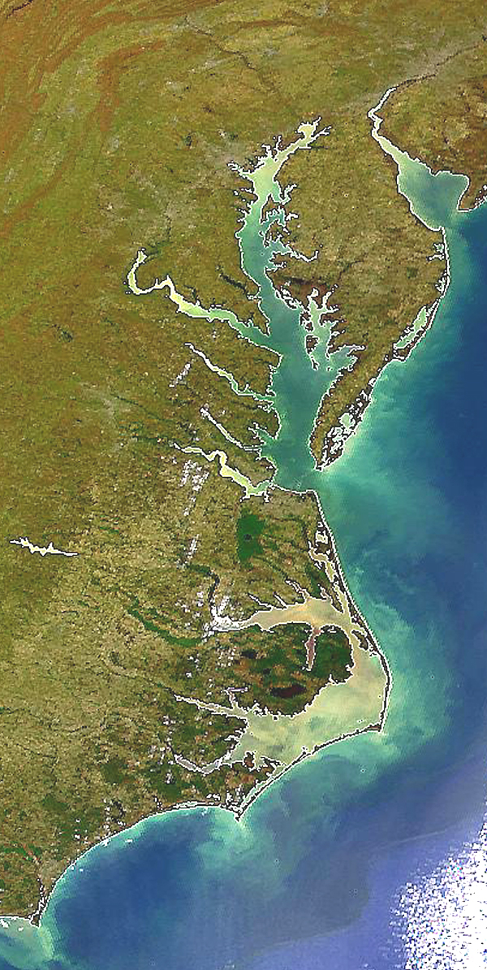

State Profile
New York

Slide 2
NY Draft Phase III WIP Planning Targets + Reference Loads
Nitrogen Load
 | No-Action (M lbs) | E3 (M lbs) | 2013 Progress (M lbs) | Phase II WIP (reference) (M lbs) | Draft Phase III WIP Planning Target (M lbs)
NY Susquehanna | 17.56 | 7.95 | 15.44 | 12.14 | 10.59
Phosphorus Load
 | No-Action (M lbs) | E3 (M lbs) | 2013 Progress (M lbs) | Phase II WIP (reference) (M lbs) | Draft Phase III WIP Planning Target (M lbs)
NY Susquehanna | 1.199 | 0.343 | 0.710 | 0.528 | 0.506

Slide 3
NY Nitrogen Loads-Goals, Phase 5.3.2

Slide 4
NY Nitrogen Loads-Goals, Phase 6

Slide 5
NY Nitrogen Change in Level of Effort

Slide 6
NY Phosphorus Loads-Goals, Phase 5.3.2

Slide 7
NY Phosphorus Loads-Goals, Phase 6

Slide 8
NY Phosphorus Change in Level of Effort

Slide 9
NY Nitrogen – Phase 6 Level Of Effort
(NoAction:E3 Reference)

Slide 10
NY Phosphorus – Phase 6 Level Of Effort
(NoAction:E3 Reference)

Slide 11
NY Nitrogen – Phase 6 Loads and Target
Where did the
reductions come from?
1985
2013
Draft Phase III WIP
Planning Target

Slide 12
NY Phosphorus – Phase 6 Loads and Target
Where did the
reductions come from?
1985
2013
Draft Phase III WIP
Planning Target

Slide 13
NY Nitrogen – Phase 6 Scenario Loads and Draft Target

Slide 14
NY Phosphorus – Phase 6 Scenario Loads and Draft Target

Slide 15
Nitrogen – Phase 6 Relative Effectiveness
Effect of Nitrogen Load Reduction on WQ Standard Attainment
A = Above Fall Line B = Below Fall Line

Slide 16
Phosphorus – Phase 6 Relative Effectiveness
Effect of Phosphorus Load Reduction on WQ Standard Attainment
A = Above Fall Line B = Below Fall Line

Slide 17
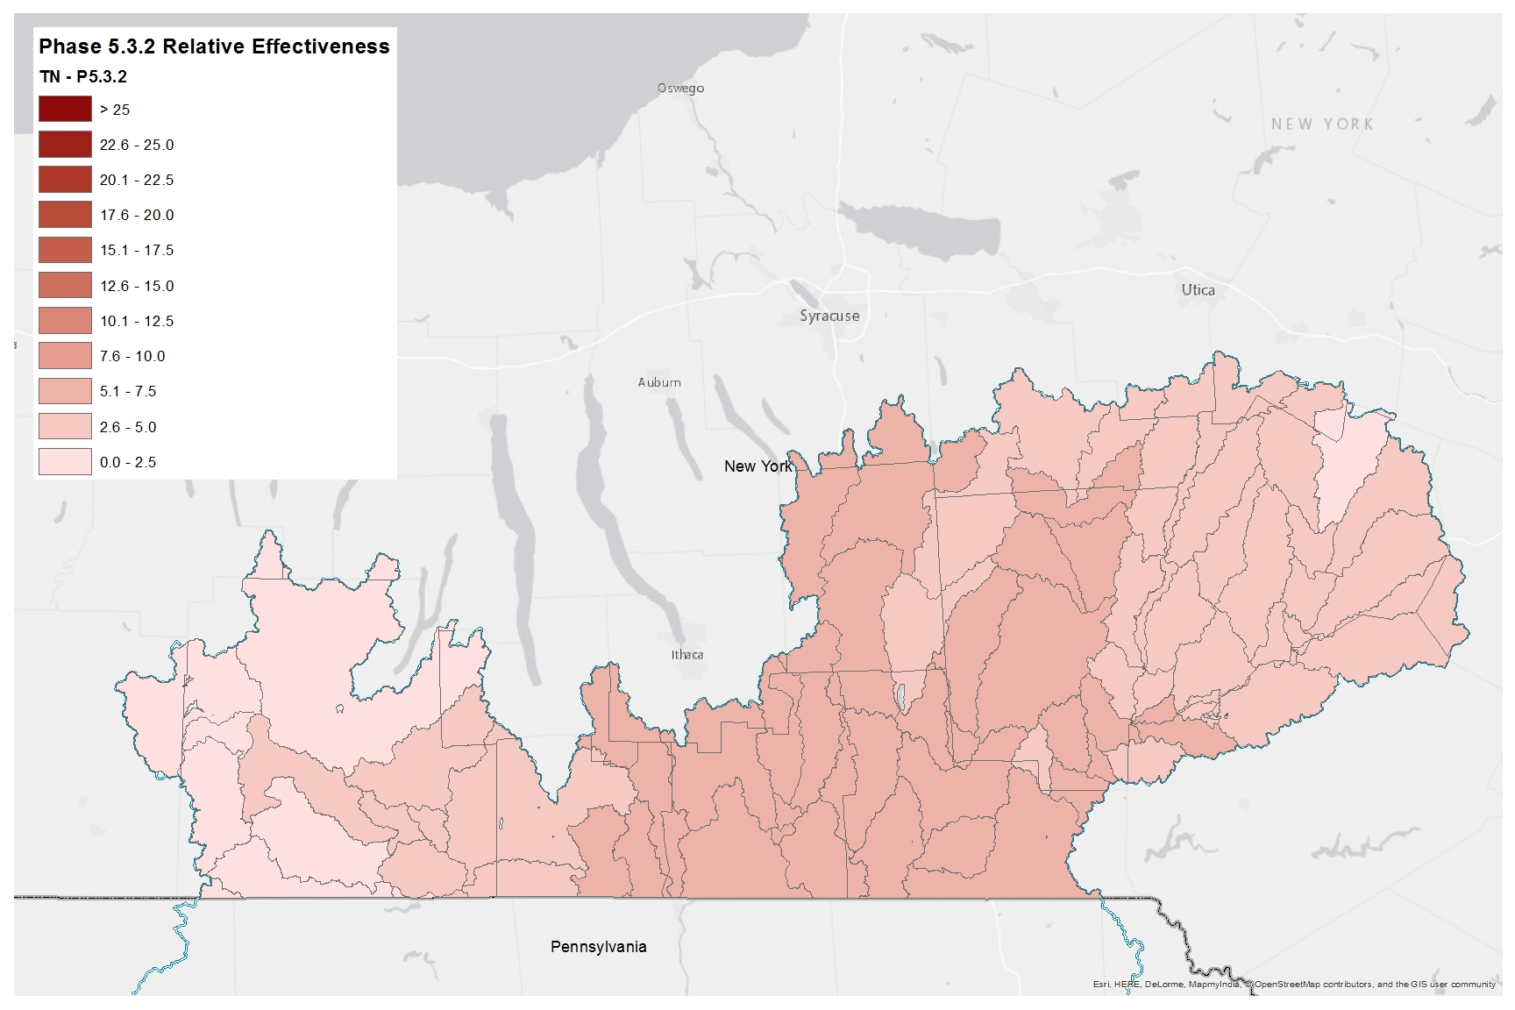
Nitrogen Relative Effectiveness
Phase 5.3.2

Slide 18
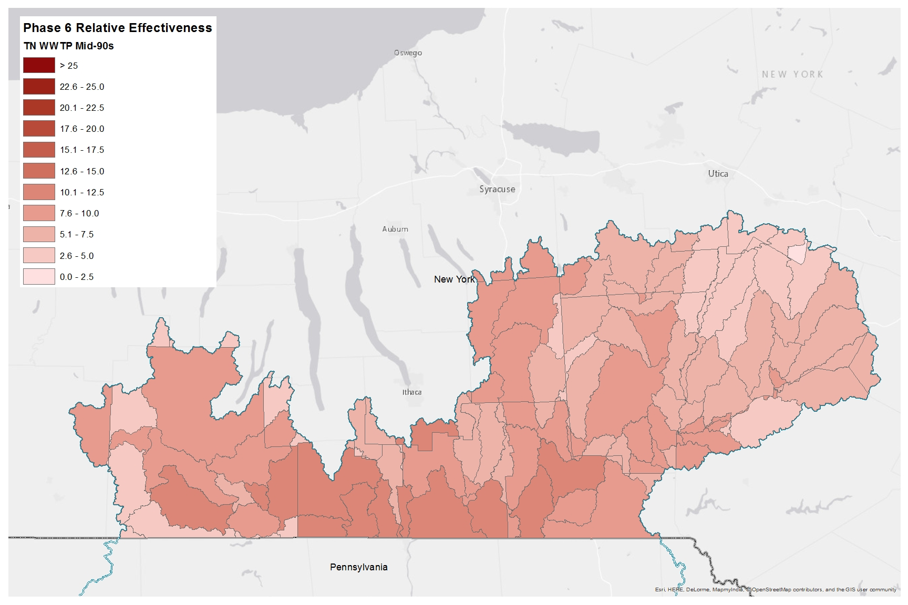
Nitrogen Relative Effectiveness
Phase 6, WWTP, Mid-90s

Slide 19

Nitrogen Relative Effectiveness
Phase 6, WWTP, Conowingo Dynamic Equilibrium

Slide 20
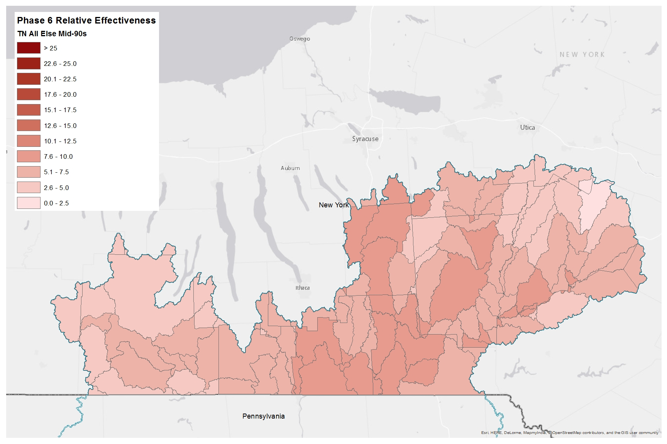
Nitrogen Relative Effectiveness
Phase 6, All Else, Mid-90s

Slide 21
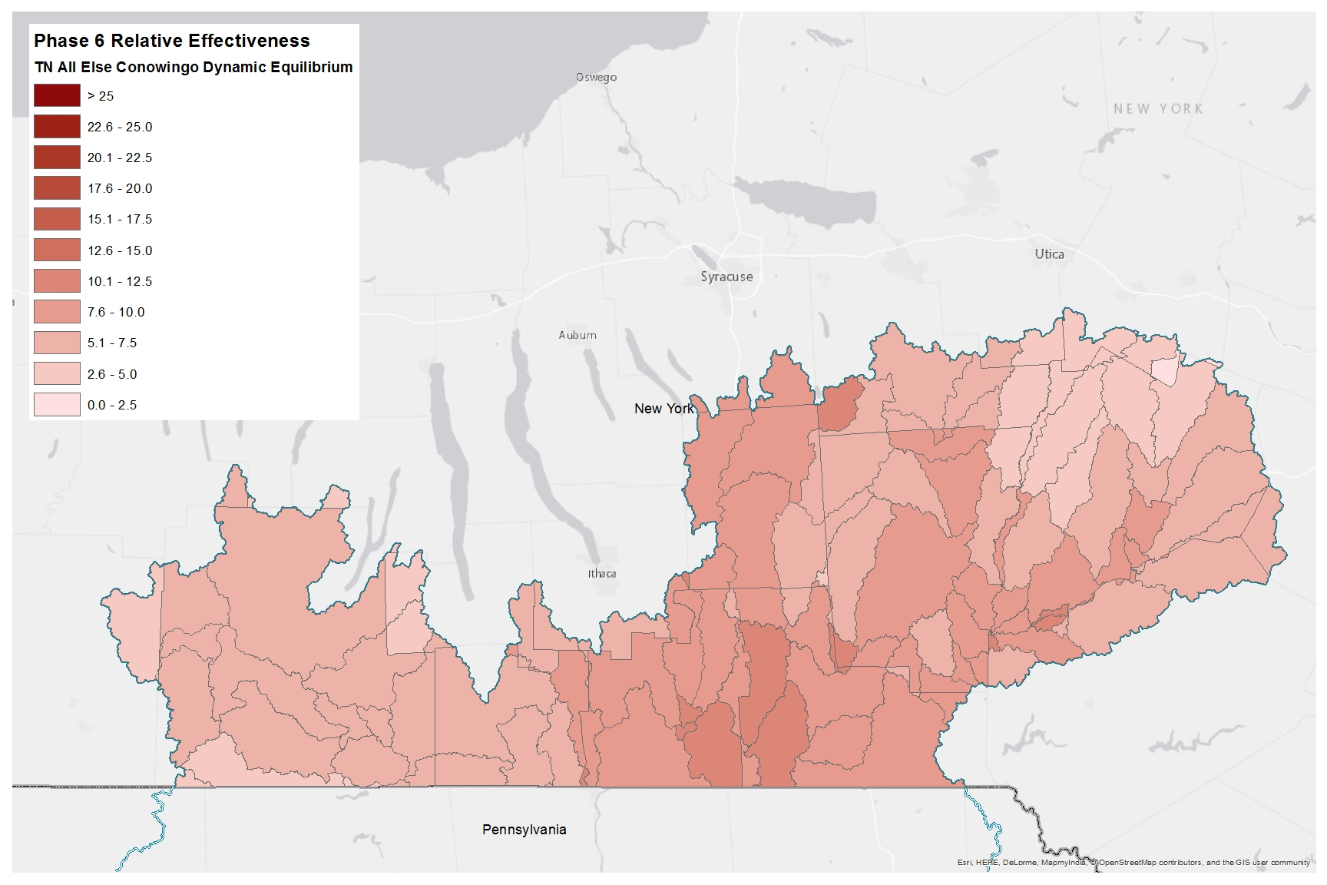
Nitrogen Relative Effectiveness
Phase 6, All Else, Conowingo Dynamic Equilibrium

Slide 22
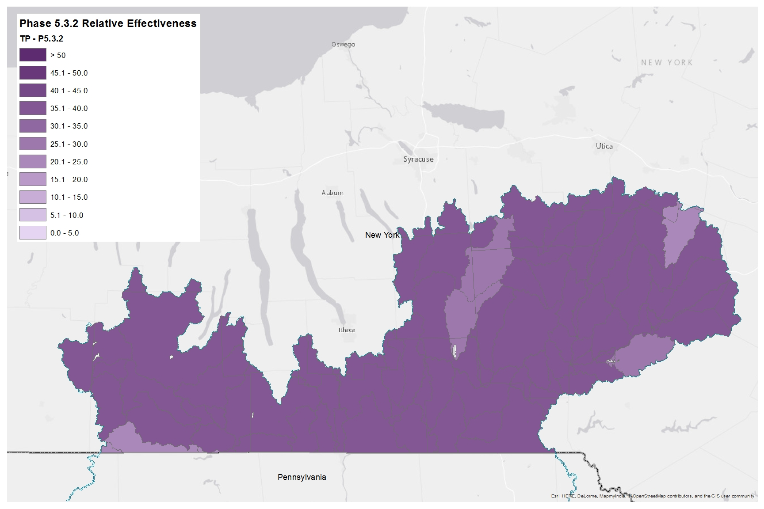
Phosphorus Relative Effectiveness
Phase 5.3.2

Slide 23
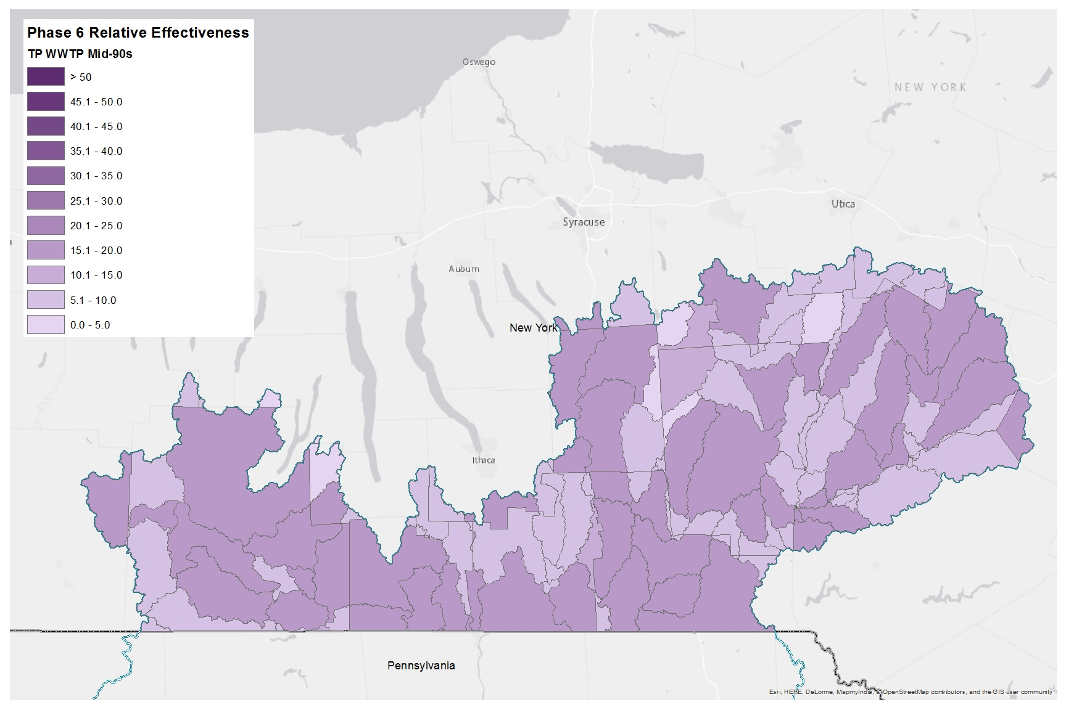
Phosphorus Relative Effectiveness
Phase 6, WWTP, Mid-90s

Slide 24
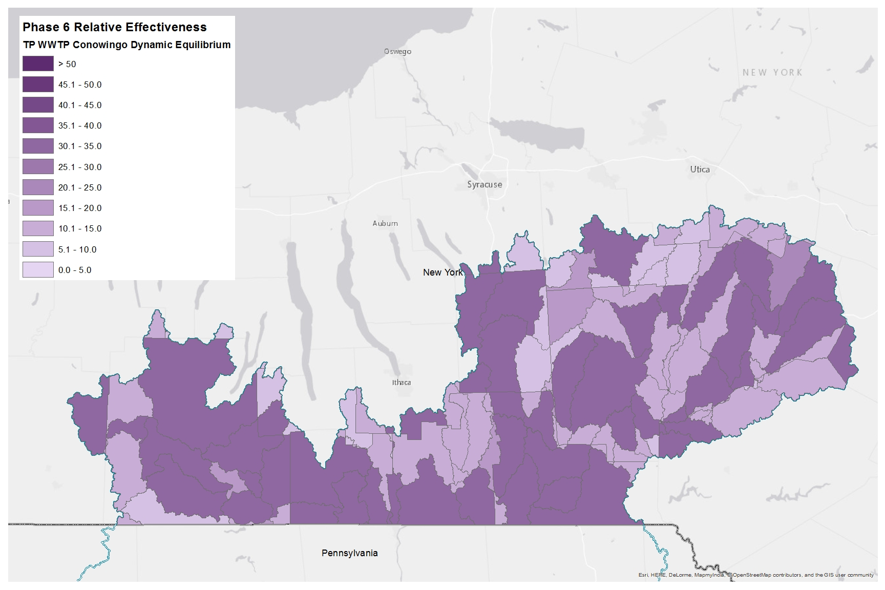
Phosphorus Relative Effectiveness
Phase 6, WWTP, Conowingo Dynamic Equilibrium

Slide 25
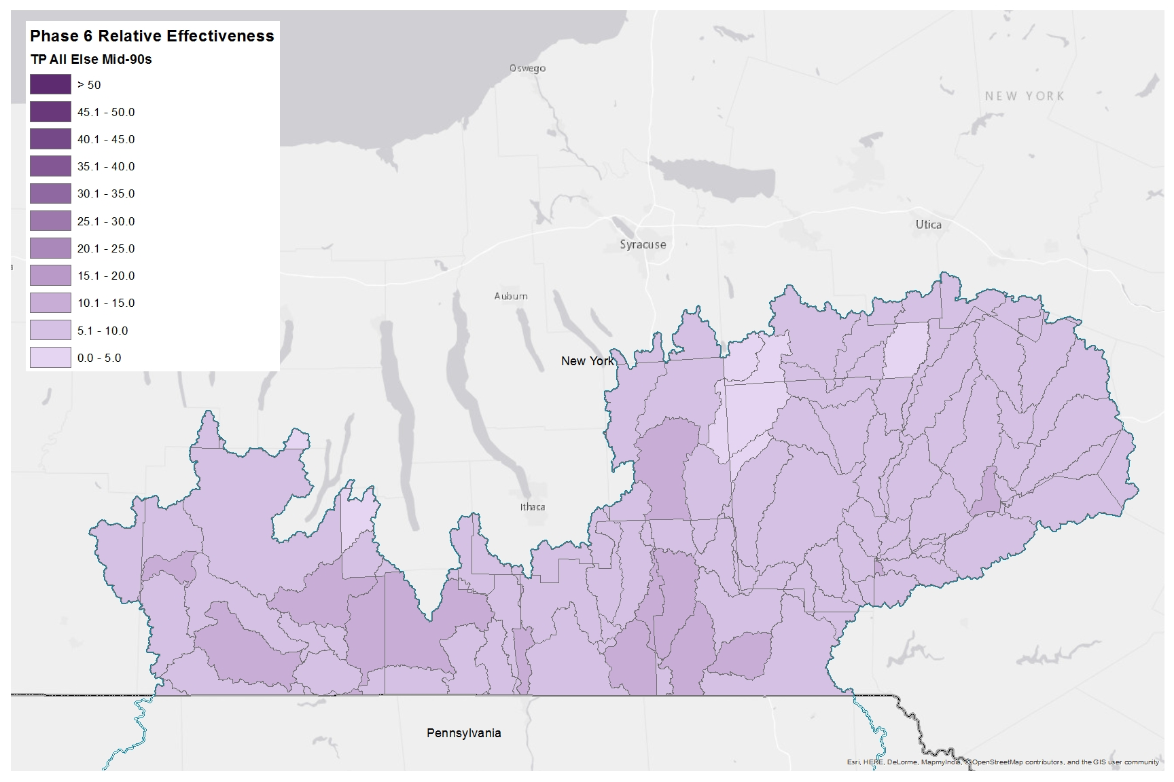
Phosphorus Relative Effectiveness
Phase 6, All Else, Mid-90s

Slide 26
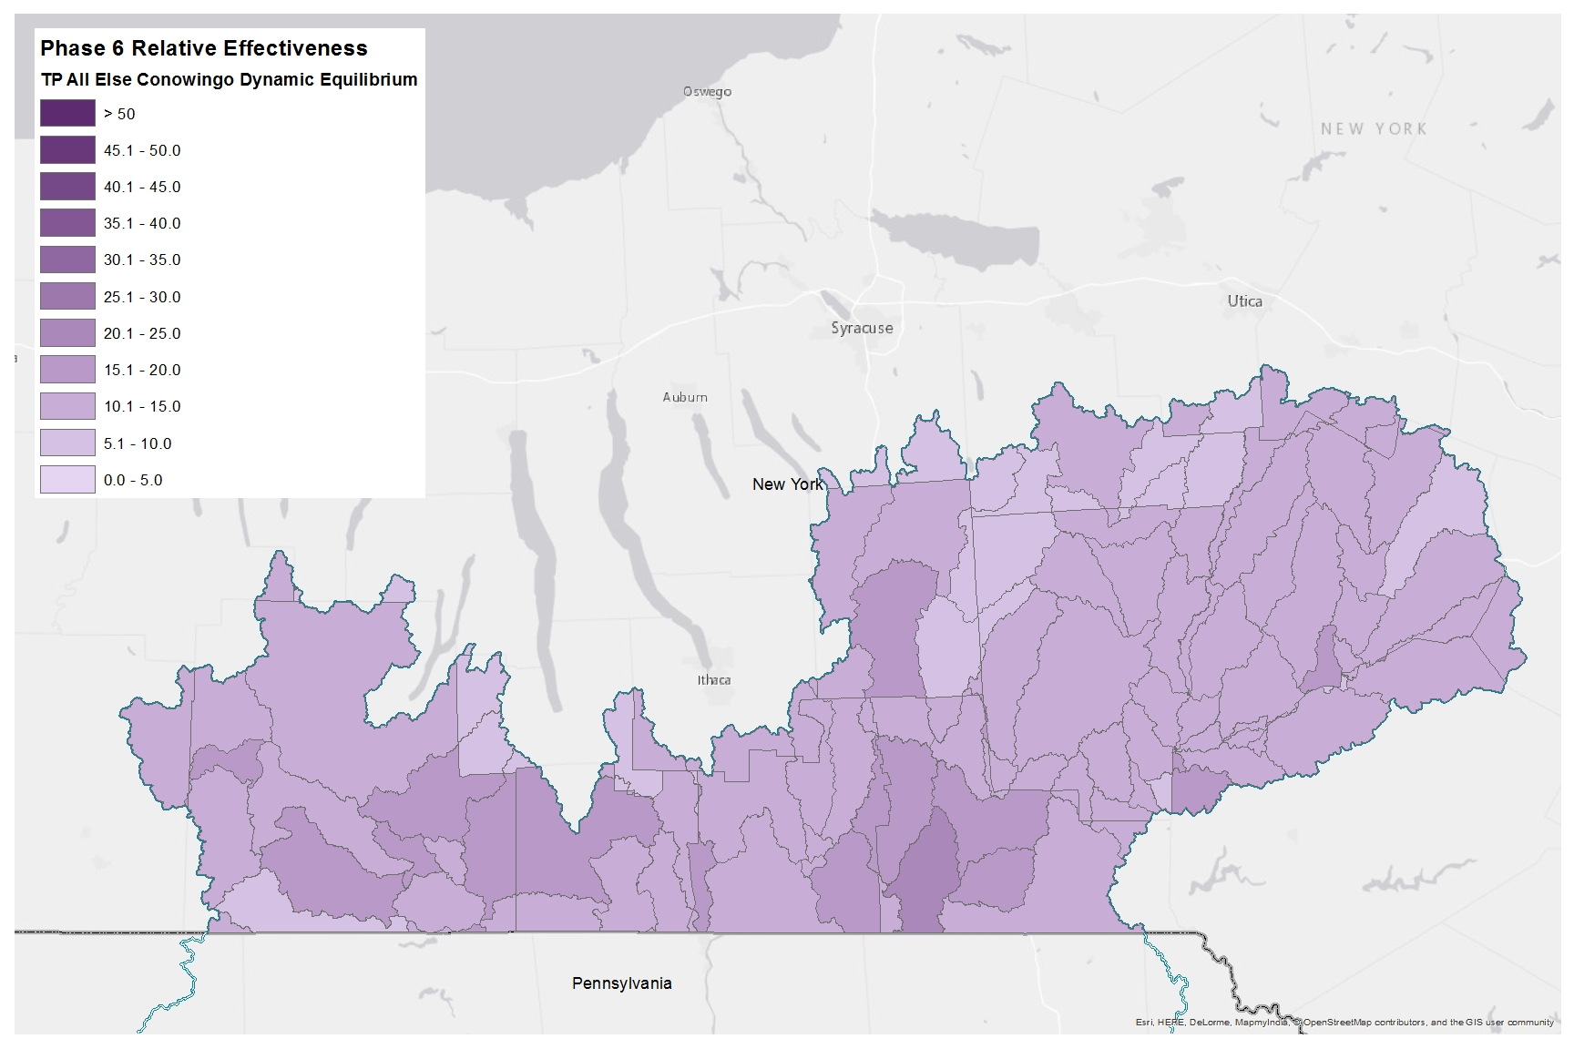
Phosphorus Relative Effectiveness
Phase 6, All Else, Conowingo Dynamic Equilibrium

