Slide 1

Outdoor Learning Network Initiative
CBP Education Workgroup Update - 8/1/19

Slide 2

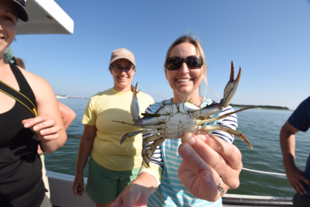
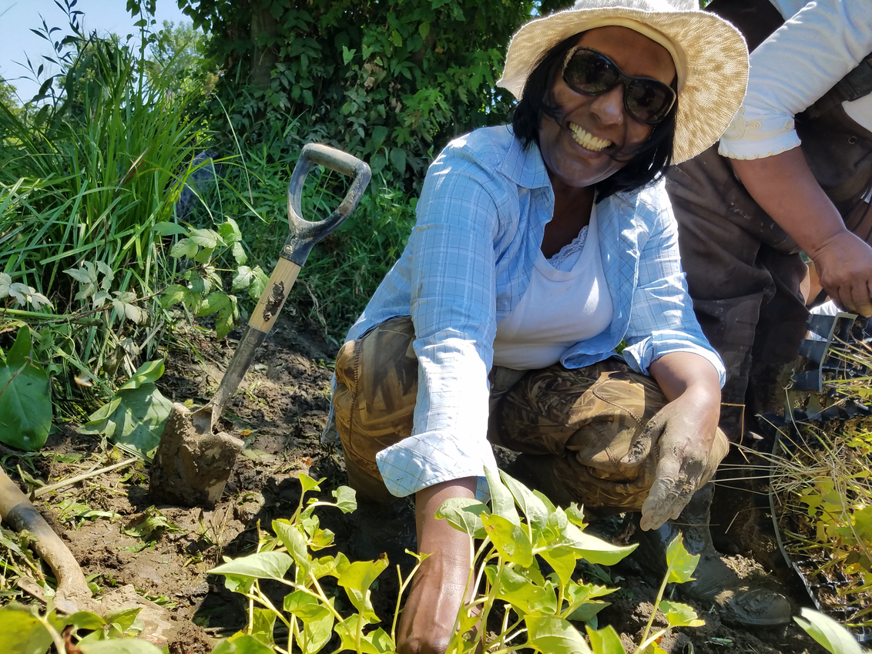
OLNI Concept
Underserved Districts
Collective Impact
C0-Learning
Systemic Curriculum
MWEE Implementation

Slide 3


Network Tiers
OLNI Leadership Team
Backbone Partnership
Local Network

Slide 4
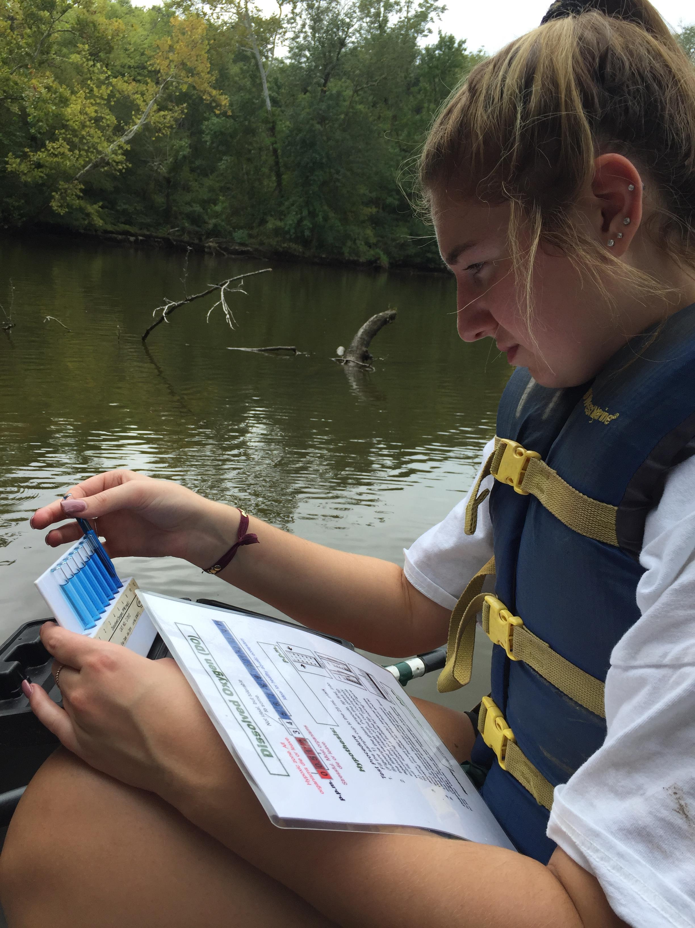
Olni LeadershiP Team
Chesapeake Bay Trust
Chesapeake Bay Foundation
NOAA CBO
Chesapeake Bay Funders Network
(With Direction from Education Workgroup State Dept's of Education)

Slide 5

Collective Impact Approach
Common Agenda
All participants share a vision for change that includes a common understanding of the problem and a joint approach to solving the problem through agreed-upon actions.
Shared Measurement
All participating organizations agree on the ways success will be measured and reported, with a short list of common indicators identified and used for learning and improvement.
Mutually Reinforcing Activities
A diverse set of stakeholders, typically across sectors, coordinate a set of differentiated activities through a mutually reinforcing plan of action.
Continuous Communication
All players engage in frequent and structured open communication to build trust, assure mutual objectives, and create common motivation.
Backbone Support
Staff dedicated to the initiative provides ongoing support by guiding the initiative’s vision and strategy, supporting aligned activities, establishing shared measurement practices, building public will, advancing policy, and mobilizing resources.

Slide 6
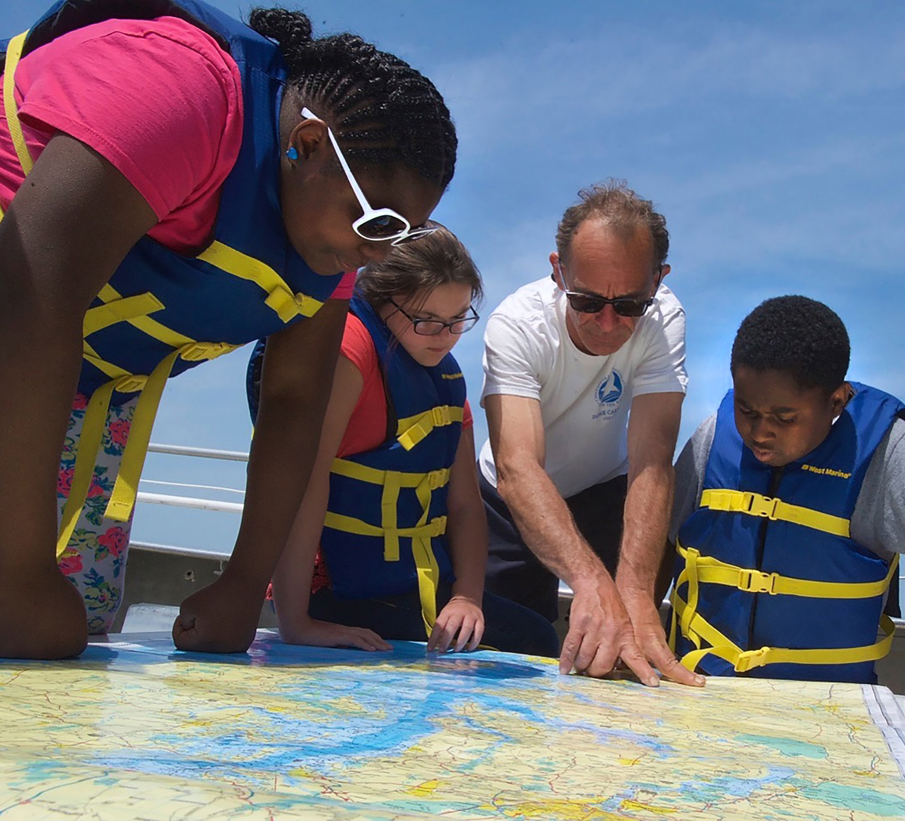
BAckbones and Local Networks
Backbone teams = A lead School System and a lead NGO working together to develop and support the local network
Local Networks = All of the organizations and schools and teachers who will assist in providing MWEEs to students
Backbones and Local networks will be funded and provided with training, expert consulting, and resources buy the OLNI Leadership team

Slide 7
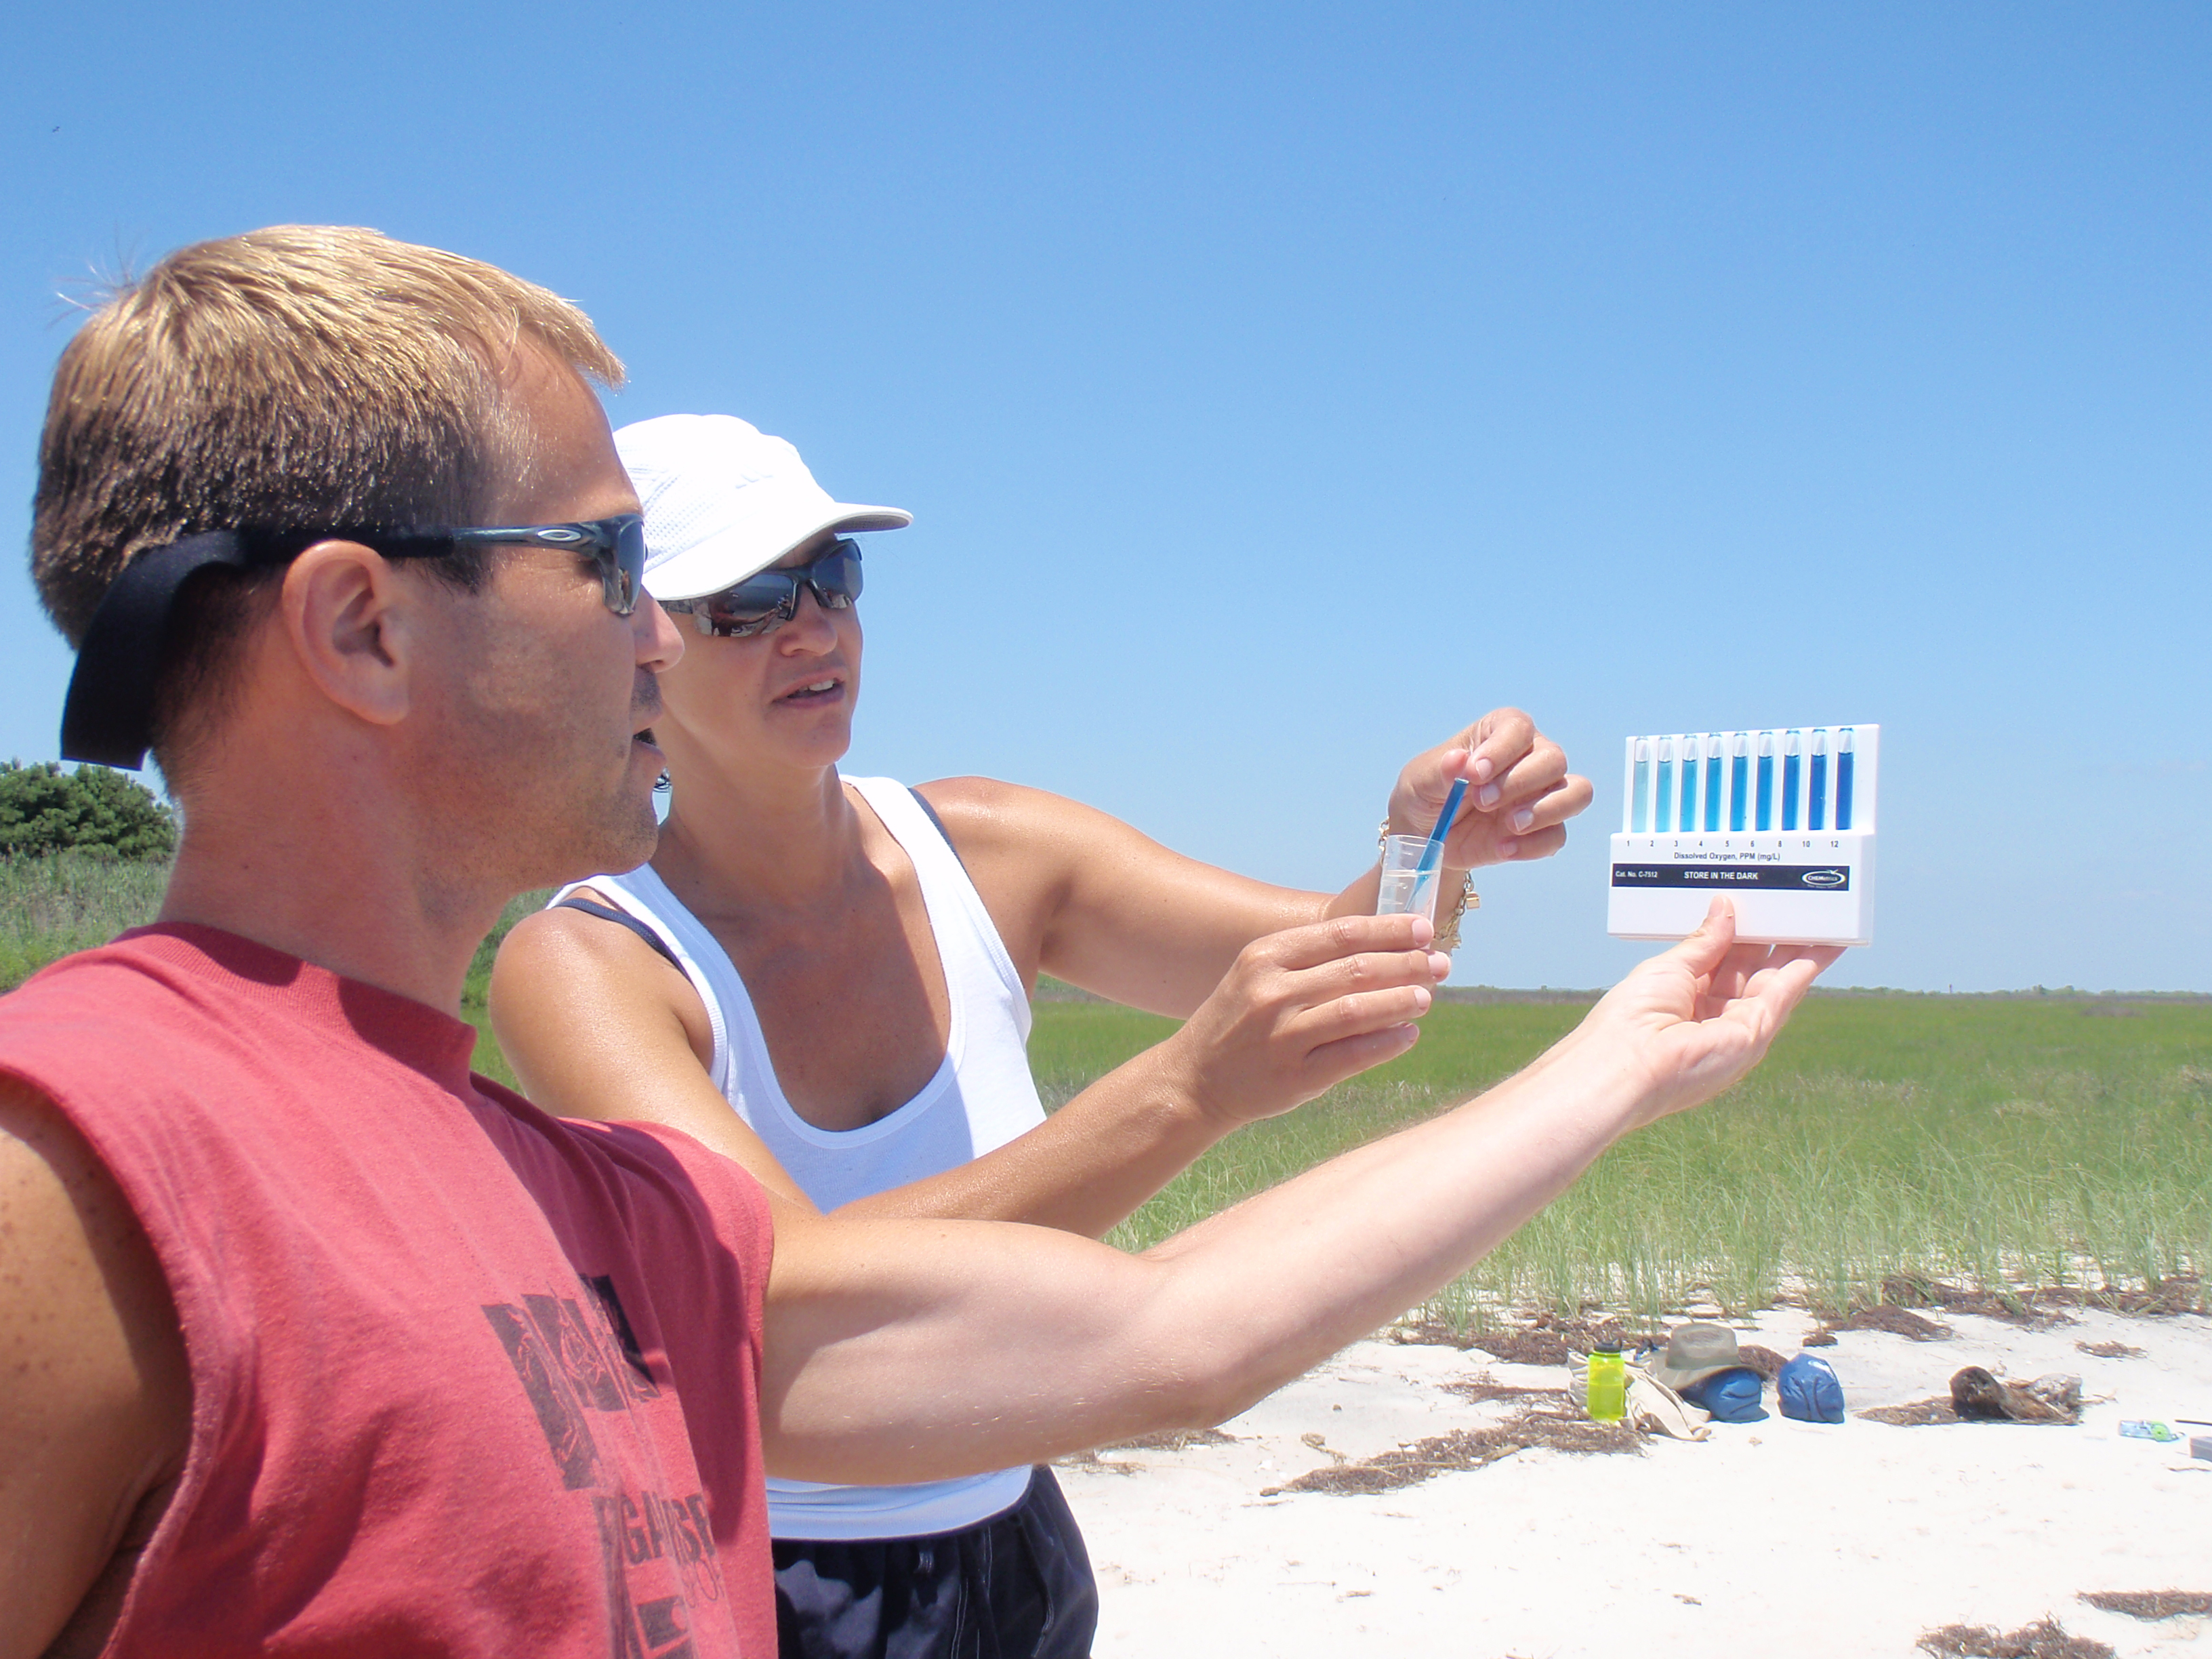
Selection Process
CBT developed a Call for Partners
State Departments of Education and Ed Workgroup members recruited and recommended likely partners
Process balanced need and readiness
Review Committee made final selections

Slide 8
Project Sites (Round 1)
Project #1 = Conestoga Valley , Ephrata and Columbia School Districts with Stroud in Lancaster County, PA
Project #2 = Cacapon Institute Potomac alley Audubon and Experience Learning with Morgan, Berkeley, and Jefferson County School in WV

Slide 9
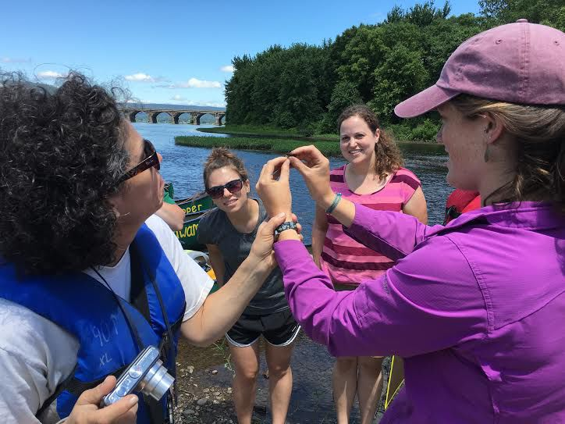
Upcoming work
Train Backbone partners in the CI Model and on MWEEs
Establish local networks
Design Curriculum
Train Lead Teachers – Summer 2020
Plan for Implementation
Pilot Implementation
Connect local networks

Slide 10

Questions
How can we identify other districts that fit this profile and help us equitably grow E-lit in each state?
How can we maximize the value of each project as a model?
What do you want to get out of these initiatives?

