Slide 1
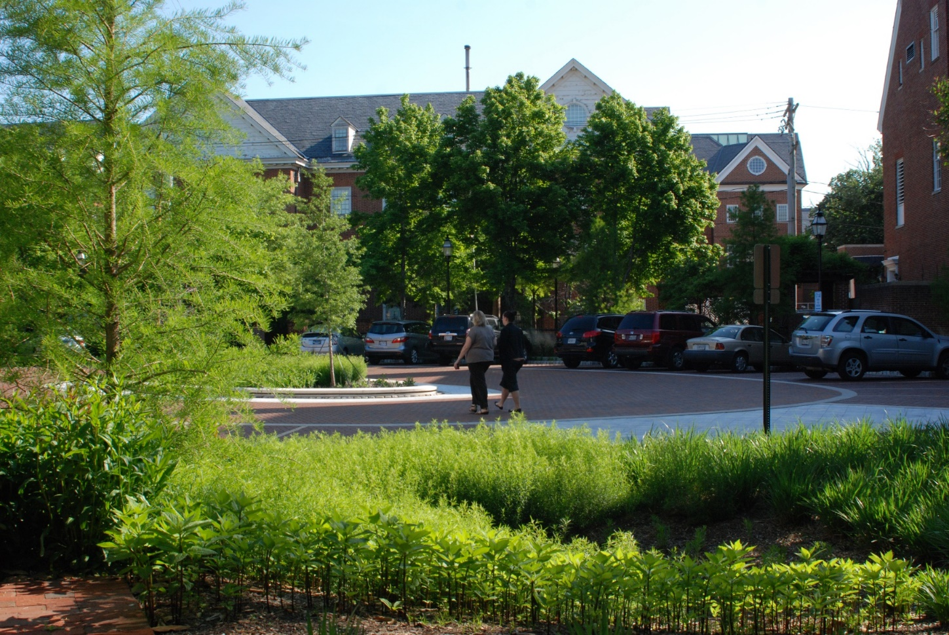
Streamlining Integrated Infrastructure Implementation: Workshop Report
Report Prepared by
Alliance for the Chesapeake Bay
Hirschman Water & Environment, LLC

Slide 2
Planning Team’s Observations:
Capital projects rarely address (or even consider opportunities to address) water quality goals.
The stars need to align for administration, procurement, funding, plan review, permitting, staffing, and schedules – even for a single project – and we need to implement many of them!
Capital project and stormwater staffs (often in different departments) need to seek mutual opportunities, with guidance from the elected officials.
Additional observations …

Slide 3
Defining the Issues
Local Administration and Management Processes aren’t aligned in a way that facilitates efficient implementation of capital and maintenance projects that incorporate green stormwater infrastructure, e.g. streetscape enhancements.
Funding for capital or maintenance projects that incorporate green infrastructure generally comes from multiple sources, driving up administrative costs and resulting in scheduling conflicts that can jeopardize project implementation.
Additional issues …

Slide 4
Preliminary Recommendation Example
Issue: Administrative/management processes aren’t aligned
Recommendation – Local goals and policies can be set by elected officials to promote alignment and streamlining. Tools to help local governments align processes would be helpful, including examples from other communities, checklists, etc.
Recommendation – Opportunities for achieving pollutant reduction should be considered at the front end when developing capital project plans (as an automatic step). Systems to prioritize the best projects can be developed. Provide training on capital improvement planning.

Slide 5
Preliminary Recommendation Example
Issue: Inability to secure funding for green infrastructure results in elimination of GI from capital project.
Recommendation – Secure dedicated funding to cover cost of GI in capital projects. Additional discussion is needed to determine if change is feasible. Options for securing dedicated funding include: 1) Work with funders to develop preferential funding criteria; 2) establish stormwater fees that could be dedicated to implementing the highest priority GI projects.

Slide 6
Final Recommendation Example
Issue: Administrative/management processes aren’t aligned
Recommendation – Opportunities for achieving pollutant reduction should be considered when developing capital project plans. Revised as follows: Capital Improvement Plans should be used to maximize benefits achieved from allocation of resources. Capital project planning guidance and tools should include an evaluation of opportunities for achieving pollutant reduction. Change is possible at the local government and state level. Training on Capital Improvement Planning should be provided to local governments. Goal is to increase the number of communities that develop and adopt CIPs that include an evaluation of opportunities to incorporate green infrastructure.
The American Planning Association is best suited to carry out this recommendation. Other potential partners include the Government Finance Officers Association.
Next steps: Contact American Planning Association to explore current CIP Training Materials and Programs.

Slide 7
Issues That Apply to the Entire Stormwater Universe
Maintenance
Standards for Design, Plants, etc.
Technical expertise in design, construction, maintenance
Politics, resources at larger scales
Regulatory Drivers, BMP crediting, TMDL
OUR ASSUMPTION OF THE STARTING POINTFOR THE AFTERNOON:
Want GI (whatever it is); want better integration/streamlining
Looking for specific process and integration solutions

Slide 8
Sheridan Room – Lots of Burning Issues
Dig Once, Dig Again & Again, OR Don’t Dig at All, DIG?: Integration = more partners & processes = complexity, uncertain timelines; WHAT’S THE SWEET SPOT?
Leveraging Multiple Financing/Funding Strategies: What is proper role for grants & loans, bonds, financing, etc.: timing, pay for feasibility? NOT ongoing maintenance, wean localities off of grants to loans & other sources
Overcoming Obstacles With GI; Is There A Better Way to Make Best Use of Funds?: Planning & prioritization, co-benefits; what are good tools (GIS, policies, checklists, etc.) and is there good access to the tools, breaking down silos; strive for BEST USE OF FUNDS
Commitment: Institutionalizing COMMITMENT: state down to local
Critical Mass: Beyond Town-By-Town approach, regional programs, peer-to-peer learning, dealing with turnover to staff & elected officials

Slide 9
Preliminary Recommendations
What Needs to be Changed?
Is Change Feasible?
What is Needed to Facilitate Change?

Slide 10
Preliminary Recommendations: Critical Mass
Collaboration among localities:
  Authority to collaborate from state; cooperative purchasing; allow economies of scale. Partners: CB Commission, WASHCOG, U.S. Communities (cooperative purchasing), Chesapeake Legal Alliance
  Existing success stories; developing models; what was spark behind collaboration. Partners: Upper Susquehanna Coalition, IMLA (model codes), NARC
  Resources for cost/benefit analysis (acting alone vs. collaborative). Partners: Inspector General’s Office (VA), EFC, Assoc of PDCs (VA)
  Coordinator as single point of contact within region; regional capital improvement planning. GFOA, APA
Political momentum
  Political expectations, similar to flooding, water supply (need to do regionally)
  Educating constituents; taxpayer/ratepayer buy-in

Slide 11
Preliminary Recommendations: Obstacles
Pilot on public property, share experiences & case studies (including problems/failures) through checklist – program to pilot a program. Then scale up. Chesapeake Water Environment Assoc., APWA state chapters,
Standardize data (GIS and other) & make accessible. ESRI, DC open data platform

Slide 12
Preliminary Recommendations: Commitment
What needs to change: Buy in at state, federal, local levels & partnership vs. top-down mandate
Facilitating change:
Messaging from states to localities that explain benefits: health, daily lives, jobs – buy-in & relevance (engage health community). Bay Program, CBFN, Bay Commission
Providing training from state to locals & educating state staff about how to interact with locals. Municipal associations, state chapters, MPOs, training modules for locals, certified public manager programs
States leading by example: tours, etc.
Guidance on codifying changes to strengthen GI
Adding GI to locality infrastructure maps
Ongoing training: GI, stormwater – deal with turnover of staff, elected officials. KEY PEOPLE: City manager, PW Director (get to ICMA, APWA, etc.)

Slide 13
Preliminary Recommendations: Dig
What needs to change: Integrate proper GI practices into every organization concept planning (programmatic) so GI becomes new standard. Not mandate GI with EVERY project, but make sure program allows consideration of GI. Lump with other group on CIP planning
Facilitating change:
Improved communications EARLY in process to integrate stormwater piece, e.g., roadway, new library, etc. Engage public utility commissions. Need to have someone advocating for this (champion).
Where, what, when, why,
Clearinghouse of projects, deadline for getting projects into hopper

Slide 14
Preliminary Recommendations: Funding
Incentivize integrated CIPs that include GI (pre-requisite for funding, or ID funding sources to do the planning). This is intended to address the issues with timing of grants and other issues that are due to lack of long-term planning.
ID funding strategy for implementation – DOT, revolving loans, local utility fees. Can’t rely on grants alone
Toolkits, case studies of financing (already out there)
Coordination between funding agencies (Bay Funders Network)
Business investment open door to federal $, such as HUD
www.gfoa.org ; they also provide some technical assistance
Weight grants to award higher points for projects that have GI (DOT Tiger, PA Parks)
Award or recognition for communities that have taken risk of integrating GI, maybe taken loan

Slide 15
Problem Statement
Only recently has stormwater infrastructure (e.g., pipes, inlets, quality and quantity treatment practices) begun to be considered a full part of municipal infrastructure, alongside roads, water lines, sewer, utilities (gas, electric), etc. This recognition of stormwater infrastructure is quite variable among Chesapeake Bay localities. However, as communities across the watershed face the challenge of complying with MS4 permits and TMDL plans, significant capital investments in stormwater infrastructure will be required. One option to address these challenges is to integrate stormwater infrastructure (especially green infrastructure) with other capital projects for roads, utilities, parks, schools, and other projects in order to streamline the process and achieve more cost-effective solutions. However, before this approach can be successful, administrative, procurement, funding and financing, staffing, and operational systems need to be adapted to optimize the process.

Slide 16
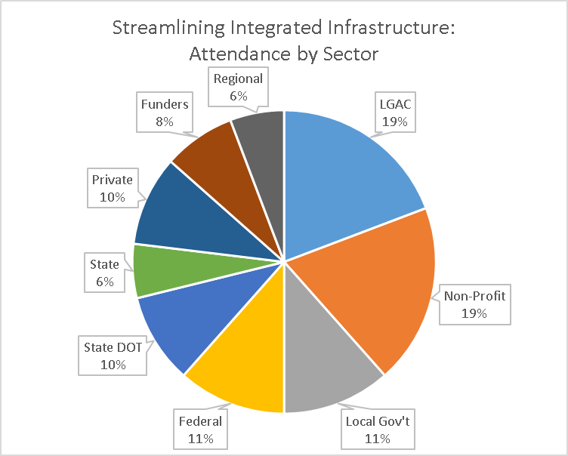
Representation of 52 Workshop Attendees

Slide 17
Issues Identified by Participants
Funding & Financing
Qualified Personnel & Available Guidance
Municipal Processes & Commitment
Planning, Prioritizing & Feasibility
Regional Collaboration & Peer-to-Peer Networking

Slide 18
Strategies and Recommendations
Municipal process, planning, feasibility, and prioritization
  Tools and increased communication and coordination
  Changing or enhancing municipal codes, policies and processes
  Staffing
  Policies at higher levels
Pooling resources and regional collaboration
  Platform for peer-to-peer learning
  GI regional expert
  Cooperative/regional programming
Funding and financing
  Local options
  Funding agencies

Slide 19
Table 3.1 Recommendations for Municipal Processes, Planning & Prioritization Organized as increasing levels of sophistication
1. Tools & Increased Communication & Coordination | Identify and engage partners When communicating, clearly establish purpose, need, and context for GI; Identify & quantify co-benefits Be sure to educate elected officials, keeping the message simple and compelling Develop some type of “plug and play” tool that makes it simple to understand and communicate to public works or CIP staff how GI can be integrated when infrastructure is built or repaired Add GI sites to GIS and infrastructure maps available to the public (regionally?)
2. Changing or Enhancing Municipal Codes, Policies & Processes | Identify and change local codes and policies that present impediments for GI Adopt policies to at least consider GI with all departmental concept and CIP planning Develop a watershed plan that identifies and prioritizes specific GI projects Develop procedures to identify and prioritize candidate GI projects Build a feasibility step into project planning Ensure all projects have maintenance agreements with a duration of at least 10 years
3. Staffing | Have a “GI champion” Provide ongoing training to deal with staff turnover Provide in-house training, career advancement, and other incentives to build capacity for long-term GI maintenance Potential opportunity for shared regional positions
4. Policies at Higher Levels | Work with the CBP and states to send stronger signals and rewards for local GI implementation

Slide 20
Table 3.2 Recommendations for Pooling Resources & Regional Collaboration Organized as increasing levels of regional collaboration
1. Platform for Peer-to-Peer Learning | A platform for practitioners to share case studies, lessons learned, credible guidance, and other resources Regional tours, awards, recognitions Some prefer that this NOT be another website Shared GIS and data were also noted, with the example of DC’s open data platform
2. GI Regional Expert | Local entities within a region could pool resources, supplemented by grants, to retain the services of a regional expert This could also be operated through an existing regional entity, such as a soil & water district, regional planning agency, or similar consortium It was pointed out that this model already exists for other governmental functions
3. Cooperative/regional programming | Cooperative programming for funding, GIS, project identification and prioritization, CIP planning, procurement and purchasing, project management, and other functions directly related to implementation

Slide 21
Table 3.3 Recommendations for Funding & Financing: Local to Higher Levels
1. Local Options | Existing dedicated funding through stormwater utilities, but many do not. Some communities have opted to dedicate a certain percent of general fund revenues to a stormwater fund (e.g., Fairfax County, VA). More widespread use of these tools will be important in the future. Communities should consider state revolving funds (e.g., PENNVEST) to supplement grants Consider partnering with state DOTs to jointly fund projects of mutual benefit Consider Community Based Public Private Partnerships (CBP3) and other strategies to leverage business investment. Make use of resources through the Government Finance Officers Association (GFOA), Environmental Finance Center (EFC), and others
2. Funding Agencies | Examine current funding strategies to achieve better alignment with local CIP cycles. Ensure proper use of some funds for feasibility and watershed planning. Many infrastructure grant programs exist at the state and federal levels (e.g., DOT Tiger, PA Parks), but could be better “weighted” to provide extra incentives to incorporate GI into capital projects

Slide 22
Final Recommendations
Do preliminary recommendations seem reasonable/doable?
Is further work needed to develop recommendations?
Who is best suited to carry out each recommendation?
What are the Next Steps?

