Slide 1
Finalization of Phase 6 Land Use Database, version 2
Peter Claggett, Fred Irani, Quentin Stubbs, Renee Thompson, and Howard Weinberg
October 22, 2015
Scientific and Technical Advisory Committee
Quarterly Meeting and Retreat
Rose Haven, Maryland

Slide 2
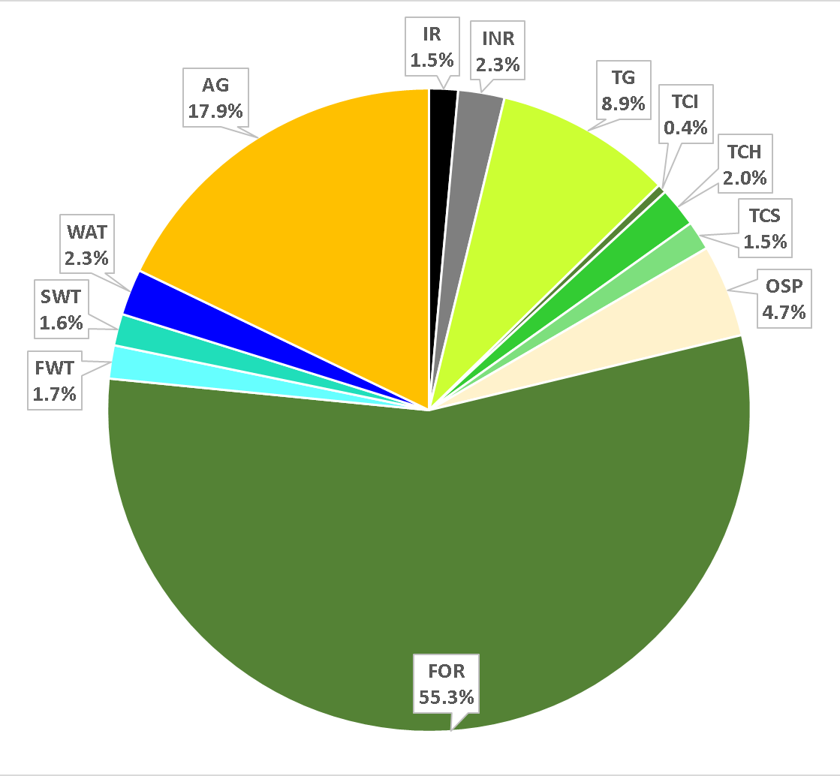
Phase 6 Land Use v2 (pre-Ag Census)

Slide 3
Steps
Merge local and regional land use datasets for 2011.
Implement hierarchical rules to reconcile datasets.
Summarize land uses within Federal Macro-agency parcels and Non-federal portions of LRSEGs.
Estimate rural residential impervious and turf grass acres.
Incorporate Maryland data.
Mass balance LRSEG acres.
Backcast to 1984, Forecast to 2013.
Proportionally allocate land uses to regulated areas.
Fit the Census of Agriculture

Slide 4
Reconcile percentages of land uses at pixel level
Combine 10m rasters of counties, federal lands, CSOs, MS4s, and 15 “land uses”: > 20 million records
IR (impervious roads)
INR (impervious non-roads)
TCIR (tree canopy over roads)
TCINR (tree canopy over other impervious)
TCH (tree canopy over herbaceous)
TG (turf grass)
OSP (open space)
FOR (forest)
WTT (tidal wetland)
WTF (non-tidal floodplain wetland)
WTO (non-tidal other wetland)
WAT (open water)
DEV (developed areas)
CROP (cropland)
PAST (pasture)

Slide 5
Implement Hierarchical Rules (coded in SQL and FORTRAN)
Impervious Surfaces
IR – TCIR = IR_adj
INR – TCINR = INR_adj
If (IR_adj + TCIR + INR_adj + TCINR) > 100, reduce INR_adj and TCINR values proportionally in new fields INR_adj2 and TCINR_adj so that the sum of these land uses <= 100.
Water
If (IR_adj + TCIR + INR_adj2 + TCINR_adj + WAT) > 100, reduce WAT in new field WAT_adj so that the sum of these land uses <= 100.
Wetlands
If (WTF + WTO + WTT) > 100, reduce WTT in new field WTT_adj so that the sum of these land uses <= 100.
If (IR_adj + TCIR + INR_adj2 + TCINR_adj + WAT_adj + WTF + WTO+ WTT_adj) > 100, reduce WTF, WTO, and WTT_adj proportionally in new fields WTF_adj, WTO_adj, and WTT_adj2.
Forests
If (IR_adj + TCIR + INR_adj2 + TCINR_adj + WAT_adj + WTF_adj + WTO_adj + WTT_adj2 + FOR) > 100, reduce FOR in new field FOR_adj so that the sum of these land uses <= 100.

Slide 6
Implement Hierarchical Rules (coded in SQL and FORTRAN)
Turf Grass
For all pixels where DEV = 1,
Add CROP and PAST fractions to TG in new field TG_adj.
Add TCH fractions to new field TCT
If (IR_adj + TCIR + INR_adj2 + TCINR_adj + WAT_adj + WTF_adj + WTO_adj + WTT_adj2 + FOR + TCT + TG_adj) > 100, reduce TCT and TG_adj proportionally in new fields TCT_adj and TG_adj2 so that the sum of these land uses <= 100.
For all pixels where DEV = 0,
Add TG fractions proportionally to CROPLAND and PASTURE in new fields Crop_adj and Past_adj.
Add TCH fractions to new field TCS
If (IR_adj + TCIR + INR_adj2 + TCINR_adj + WAT_adj + WTF_adj + WTO_adj + WTO_adj2 + FOR + TCS + CROP_adj + PAST_adj) > 100, reduce just TCS in new field TCS_adj.
Open Space
If the sum of all adjusted fields including OS < 100, then add the difference proportionally to all land uses with values > 0 including OS, saved as new field OS_adj.

Slide 7
Estimate Rural Residential Impervious and Turf
Calculate the total number of housing units outside areas classified as “developed” = THU10_unDEV
THU10_unDEV * (Average impervious acres per rural residential lot) = Rural residential impervious.
(THU10_unDEV * (Average rural residential lot size¹) * (LRSEG proportion of herbaceous vegetation within 100m of roads)) – (Rural residential impervious) = Rural residential turf grass.
¹ Avg. rural lot size in MD = 2.24 acres
Impervious Acres per Lot
Median | Suburban | Rural
DC | 0.073 | 0.177
DE | 0.116 | 0.149
MD | 0.135 | 0.177
NY | 0.095 | 0.113
PA | 0.077 | 0.148
VA | 0.085 | 0.150
WV | 0.076 | 0.109
All States | 0.094 | 0.140

Slide 8
Incorporate Maryland P6 Land Use Data
MDE and MDP provided 2011 land use acreage estimates for federal and non-federal portions of LRSEGs for all counties in Maryland except: Somerset, St. Mary’s, Worcester, Washington, and Garrett. Data were provided for the following land uses.
IR
INR
TCI
TCT
TCS
TG
FOR
WTF
WTO
WTT (not used)
CBPO supplemented these data with information on:
OSP
WAT
WTT
CROP
PAST

Slide 9
Mass Balance Total Acres per LRSEG
If sum of all land uses > LRSEG area, reduce Open Space and Forest proportionally.
Add Maryland land use data.
If sum of all land uses > LRSEG area, reduce all land uses proportionally.
Outside Maryland, add rural residential turf grass and impervious.
If sum of all land uses > LRSEG area, reduce rural residential turf grass and impervious fractions using proportions of original turf grass and impervious non-road acreages.
Agricultural area = LRSEG area – (sum of all adjusted land uses + tidal wetlands)

Slide 10
Backcast Land Uses to 2006, 2001, 1992, and 1984
Estimate absolute change in Total Housing Units
Estimate proportion of Total Housing Units that are single detached
Estimate average residential lot size for single-detached houses
Calculate percent change in:
Residential land use
Forest/tree canopy cover
Agricultural land cover
Adjust land use acreages to reflect historic conditions:
IR_06 =
IR_11 + (IR_11 * (% Δ Residential) * (Proportion of IR associated with INR)
INR_06 =
INR_11 + (IR_11 * (% Δ Residential))
TG_06 =
TG_11 + (TG_11 * (% Δ Residential))

Slide 11
Backcast Land Uses to 2006, 2001, 1992, and 1984
TCIR_06 =
TCIR_11 + (TCIR_11 * (% Δ Residential) * (Proportion of IR associated with INR)
TCINR_06 =
TCINR_11 + (TCIR_11 * (% Δ Residential))
TCT_06 =
TCT_11 + (TCT_11 * (% Δ Residential))
TCS_06, OSP_06, AG_06 =
TCS_11 + (TCS_11 * (% Δ Agriculture) * (Proportion of TCS_11 to sum of TCS, OSP and AG))
FOR_06 =
FOR_11 + (FOR_11 * (% Δ Forest)) + (Δ Tree Canopy Classes 2011 – 2006)
WTF, WTO, and WAT held constant through time.
If sum of all 2006 land uses > LRSEG area, reduce TCT, TCS, OSP, FOR, and AG proportionally.

Slide 12
Steps
Merge local and regional land use datasets for 2011.
Implement hierarchical rules to reconcile datasets.
Summarize land uses within Federal macro-agency parcels and non-federal portions of LRSEGs.
Estimate rural residential impervious and turf grass acres.
Incorporate Maryland data.
Mass balance LRSEG acres.
Backcast to 1984, Forecast to 2013.
Proportionally allocate developed land uses to regulated areas (e.g., CSS and MS4s) keeping CSS acreages constant through time by adjusting open space fraction.
Fit the Census of Agriculture

Slide 13
Fit the Census of Agriculture
Interpolate land use acreages to Census years: 1982, 1987, 1992, 1997, 2002, 2007, 2012.
Distribute all crops reported in the Census from counties to LRSEGs based on the proportion of a County’s agricultural area within each LRSEG.
If land use acres + Census of Agriculture > LRSEG acres
Subtract acres sequentially (if needed) from: open space, non-regulated tree canopy, forest, non-CSS developed land uses, and agriculture (non-animal feeding space).

