Slide 1
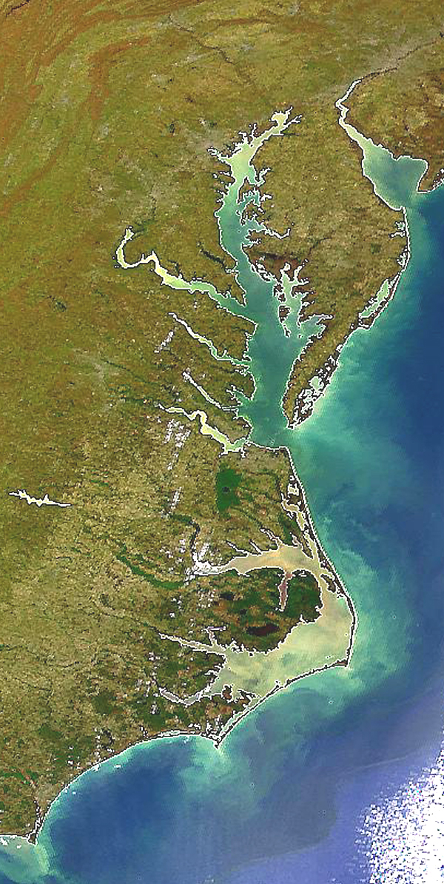

State Profile
Pennsylvania

Slide 2
PA Draft Phase III WIP Planning Targets + Reference Loads
Nitrogen Load
 | No-Action (M lbs) | E3 (M lbs) | 2013 Progress (M lbs) | Phase II WIP (reference) (M lbs) | Draft Phase III WIP Planning Target (M lbs)
PA Eastern Shore | 0.81 | 0.29 | 0.63 | 0.43 | 0.45
PA Potomac | 11.04 | 4.08 | 8.11 | 5.39 | 6.06
PA Susquehanna | 127.82 | 48.05 | 90.51 | 63.99 | 66.65
PA Western Shore | 0.04 | 0.01 | 0.03 | 0.02 | 0.02
PA Total | 139.71 | 52.32 | 99.28 | 69.82 | 73.18
Phosphorus Load
 | No-Action (M lbs) | E3 (M lbs) | 2013 Progress (M lbs) | Phase II WIP (reference) (M lbs) | Draft Phase III WIP Planning Target (M lbs)
PA Eastern Shore | 0.05 | 0.02 | 0.03 | 0.02 | 0.03
PA Potomac | 0.72 | 0.19 | 0.40 | 0.32 | 0.35
PA Susquehanna | 6.70 | 1.46 | 3.27 | 2.76 | 2.69
PA Western Shore | 0.00 | 0.00 | 0.00 | 0.00 | 0.00
PA Total | 7.47 | 1.67 | 3.70 | 3.10 | 3.07

Slide 3
PA Nitrogen Loads-Goals, Phase 5.3.2

Slide 4
PA Nitrogen Loads-Goals, Phase 6

Slide 5
PA Nitrogen Change in Level of Effort

Slide 6
PA Phosphorus Loads-Goals, Phase 5.3.2

Slide 7
PA Phosphorus Loads-Goals, Phase 6

Slide 8
PA Phosphorus Change in Level of Effort

Slide 9
PA Nitrogen – Phase 6 Level Of Effort
(NoAction:E3 Reference)

Slide 10
PA Phosphorus – Phase 6 Level Of Effort
(NoAction:E3 Reference)

Slide 11
PA Nitrogen – Phase 6 Loads and Target
Where did the
reductions come from?
1985
2013
Draft Phase III WIP
Planning Target

Slide 12
PA Phosphorus – Phase 6 Loads and Target
Where did the
reductions come from?
1985
2013
Draft Phase III WIP
Planning Target

Slide 13
PA Nitrogen – Phase 6 Scenario Loads and Draft Target

Slide 14
PA Phosphorus – Phase 6 Scenario Loads and Draft Target

Slide 15
Nitrogen – Phase 6 Relative Effectiveness
Effect of Nitrogen Load Reduction on WQ Standard Attainment
A = Above Fall Line B = Below Fall Line

Slide 16
Phosphorus – Phase 6 Relative Effectiveness
Effect of Phosphorus Load Reduction on WQ Standard Attainment
A = Above Fall Line B = Below Fall Line

Slide 17
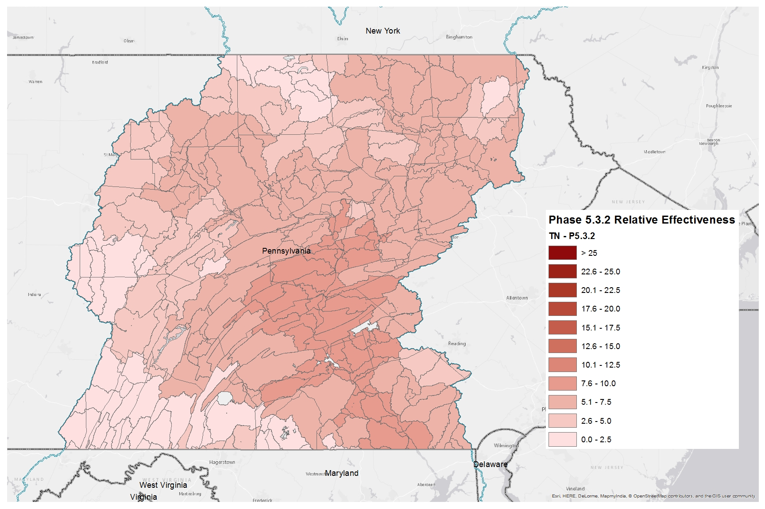
Nitrogen Relative Effectiveness
Phase 5.3.2

Slide 18
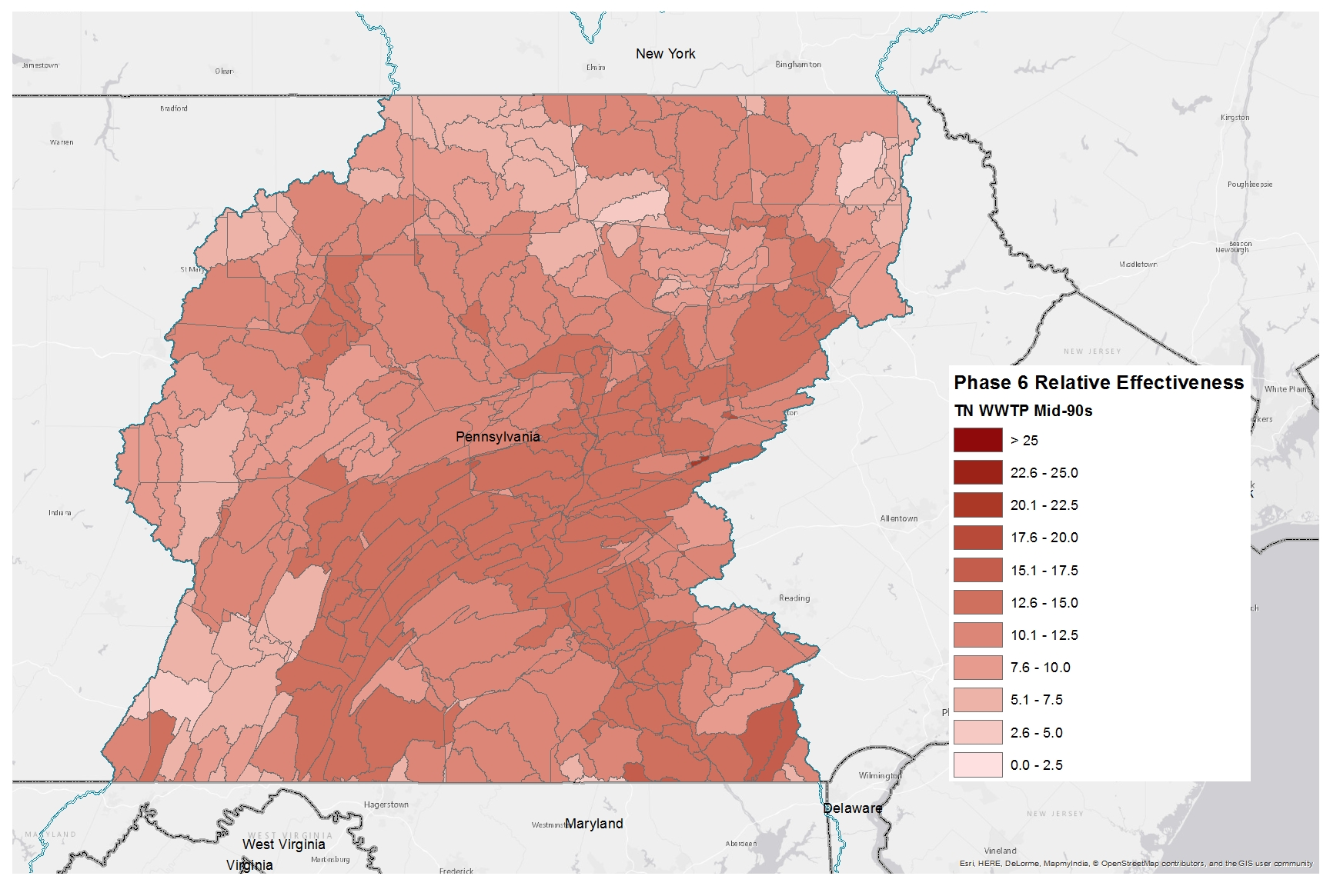
Nitrogen Relative Effectiveness
Phase 6, WWTP, Mid-90s

Slide 19
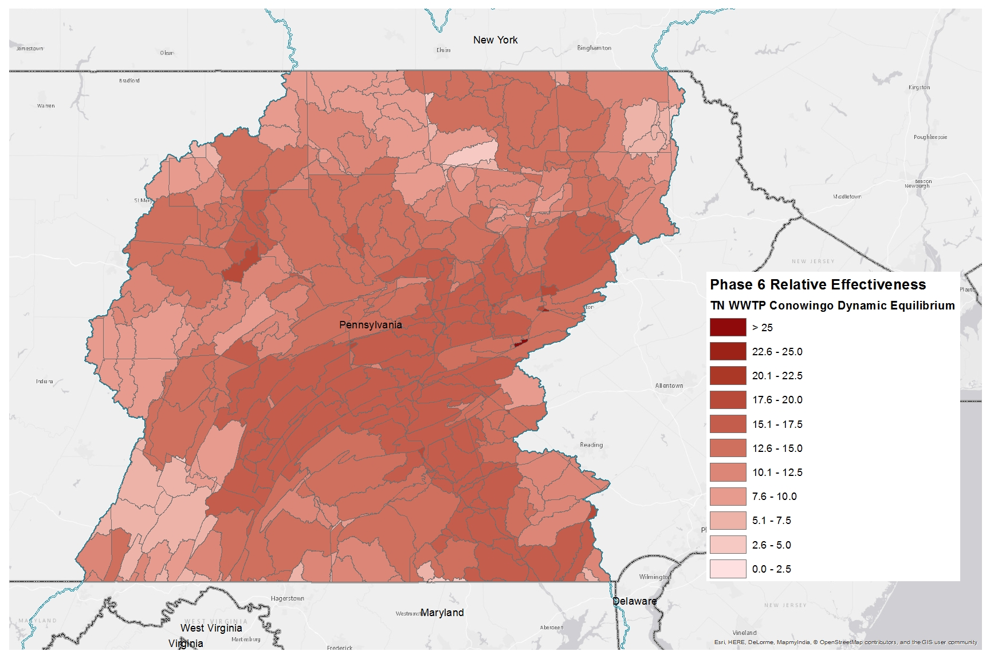
Nitrogen Relative Effectiveness
Phase 6, WWTP, Conowingo Dynamic Equilibrium

Slide 20
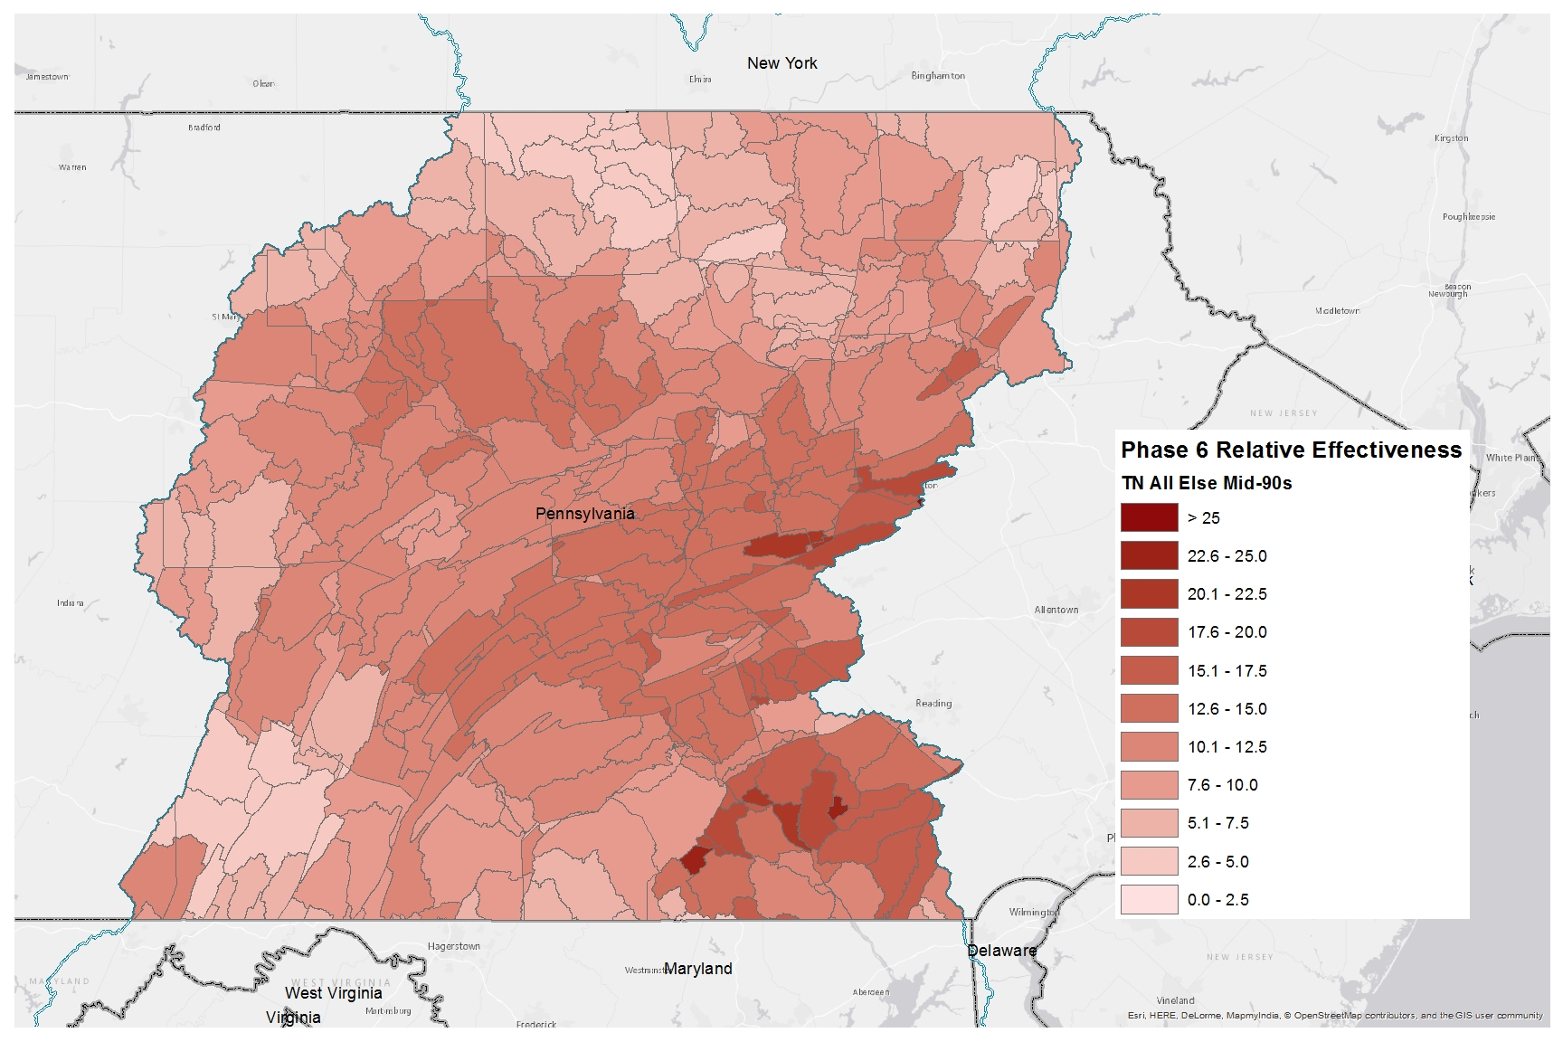
Nitrogen Relative Effectiveness
Phase 6, All Else, Mid-90s

Slide 21
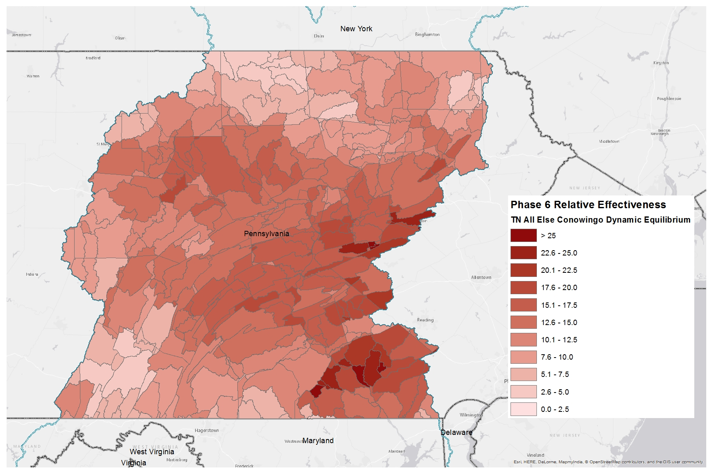
Nitrogen Relative Effectiveness
Phase 6, All Else, Conowingo Dynamic Equilibrium

Slide 22
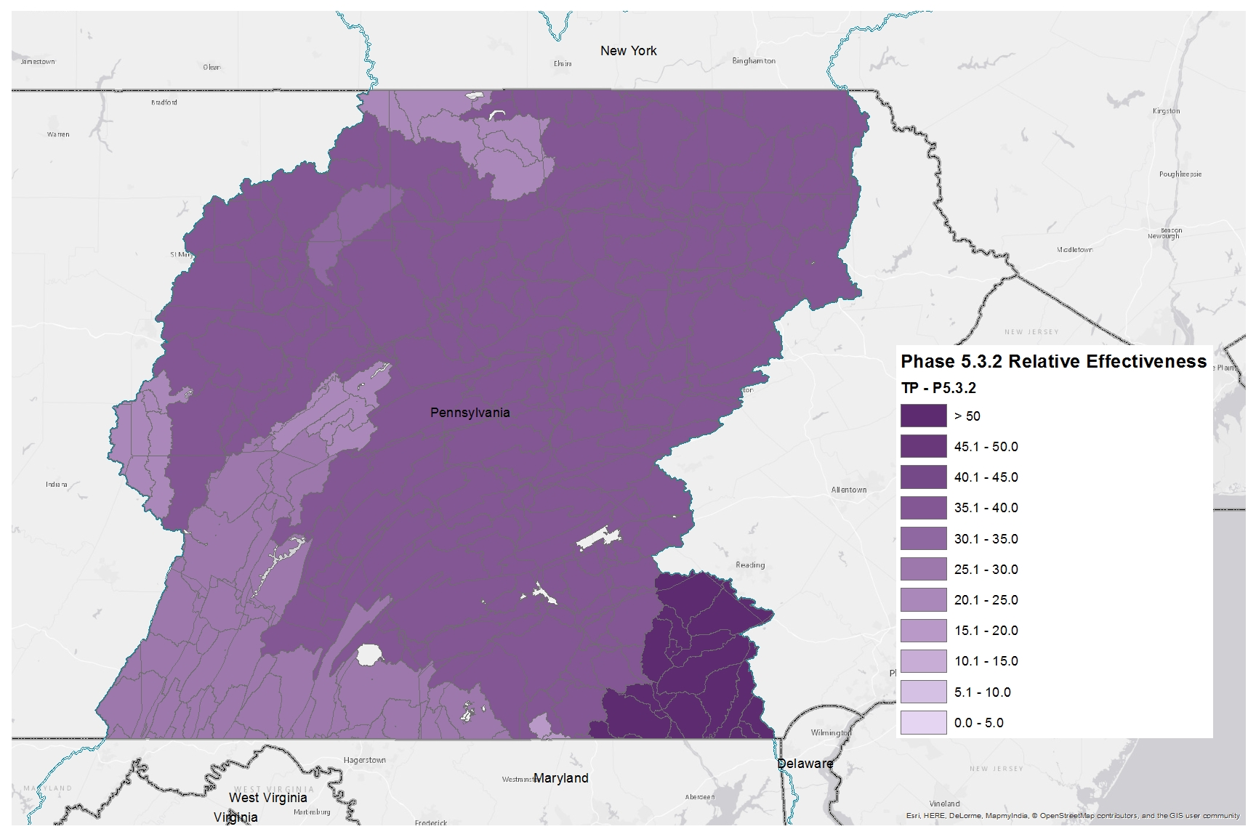
Phosphorus Relative Effectiveness
Phase 5.3.2

Slide 23
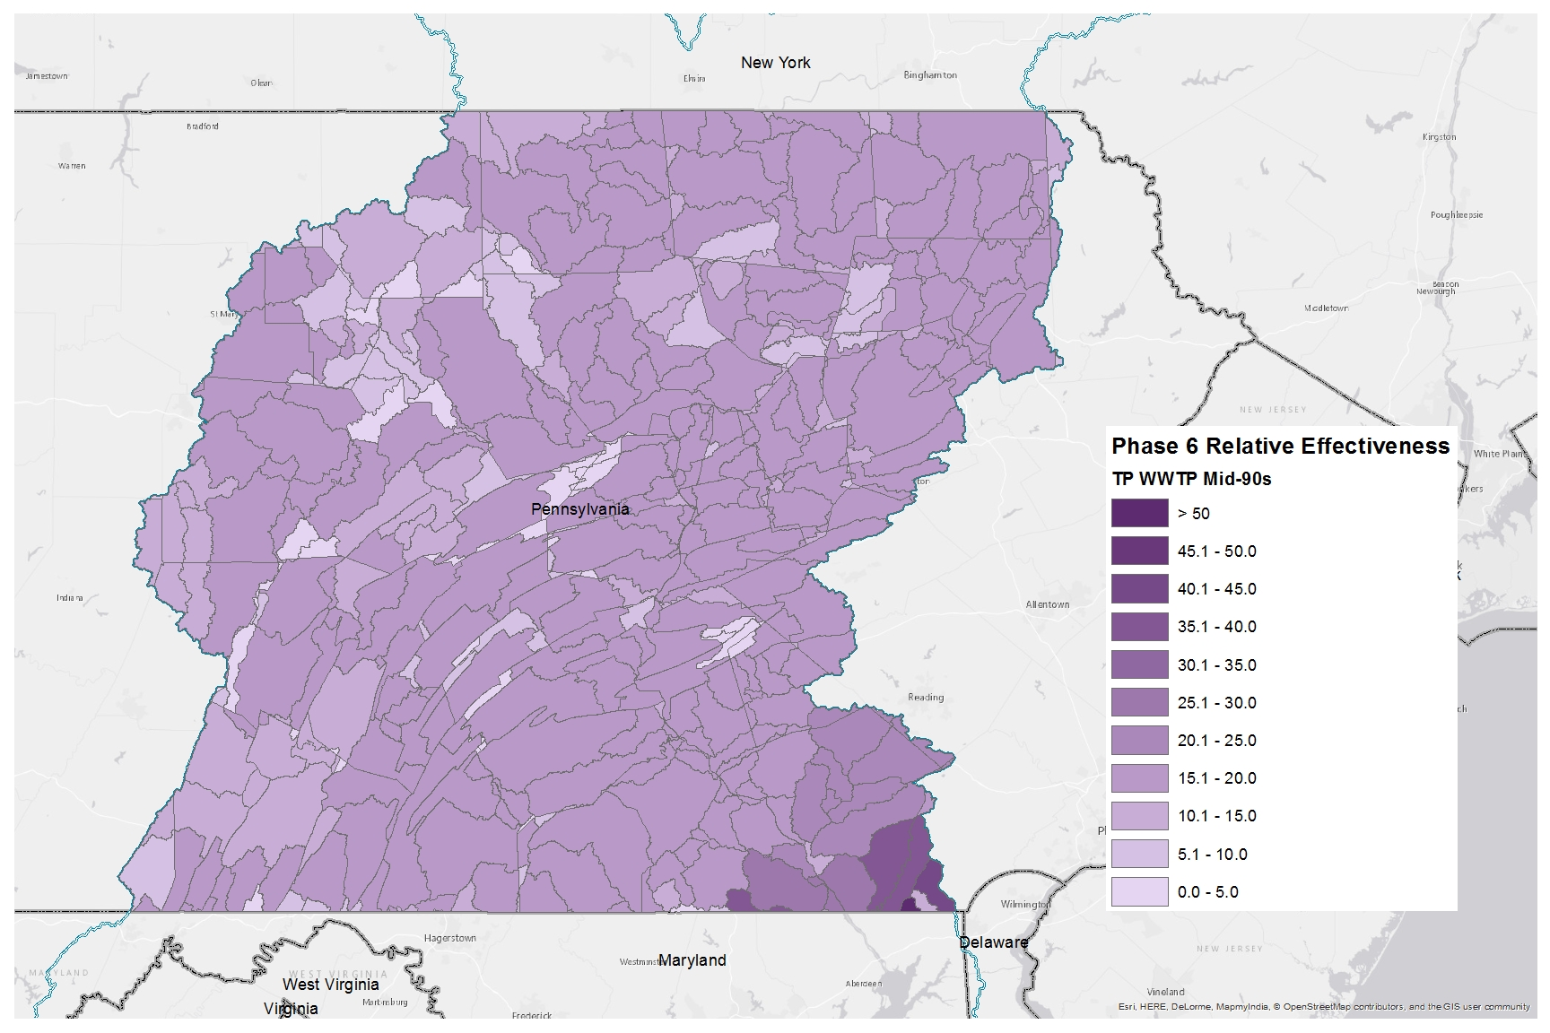
Phosphorus Relative Effectiveness
Phase 6, WWTP, Mid-90s

Slide 24
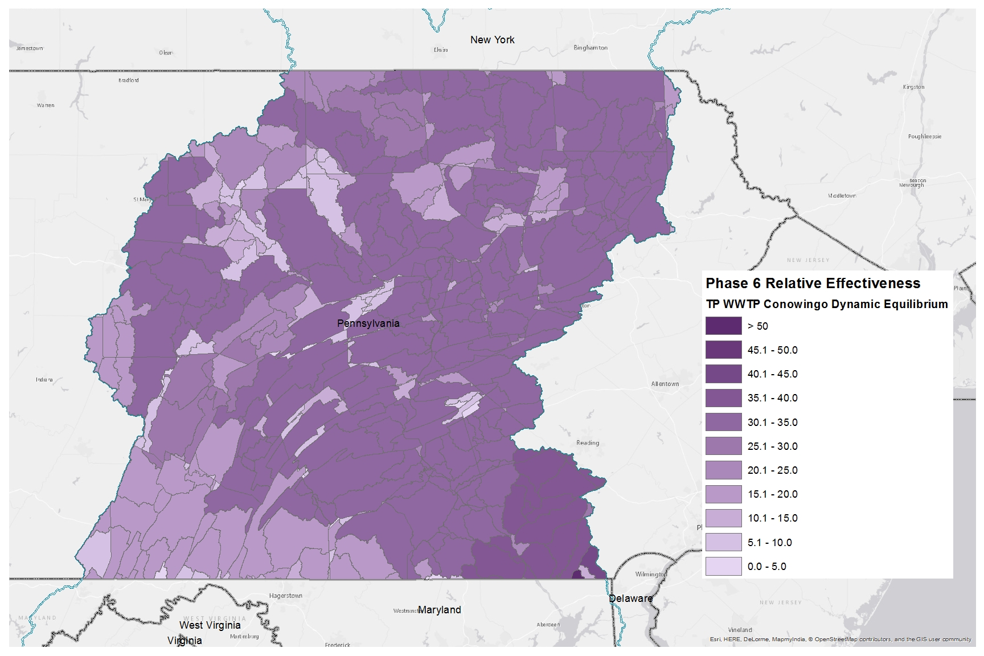
Phosphorus Relative Effectiveness
Phase 6, WWTP, Conowingo Dynamic Equilibrium

Slide 25
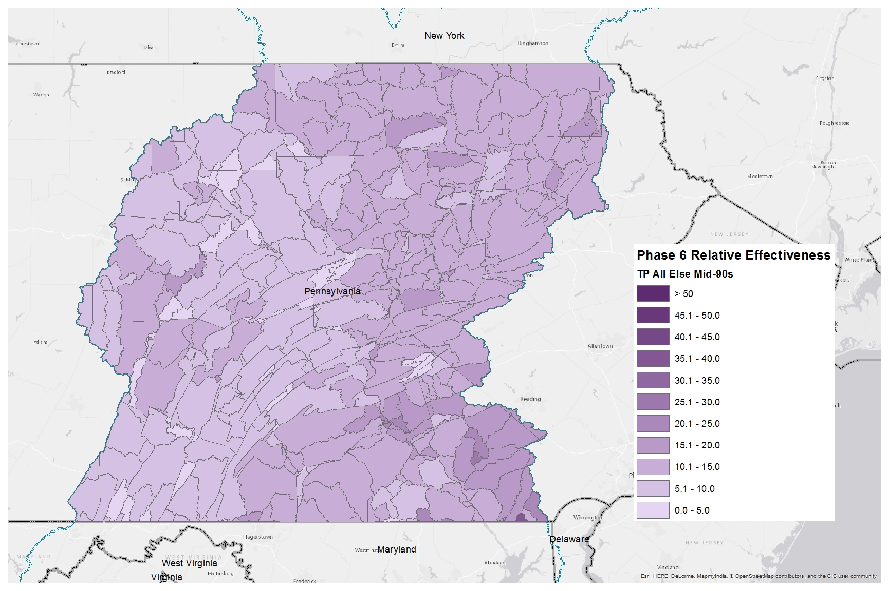
Phosphorus Relative Effectiveness
Phase 6, All Else, Mid-90s

Slide 26
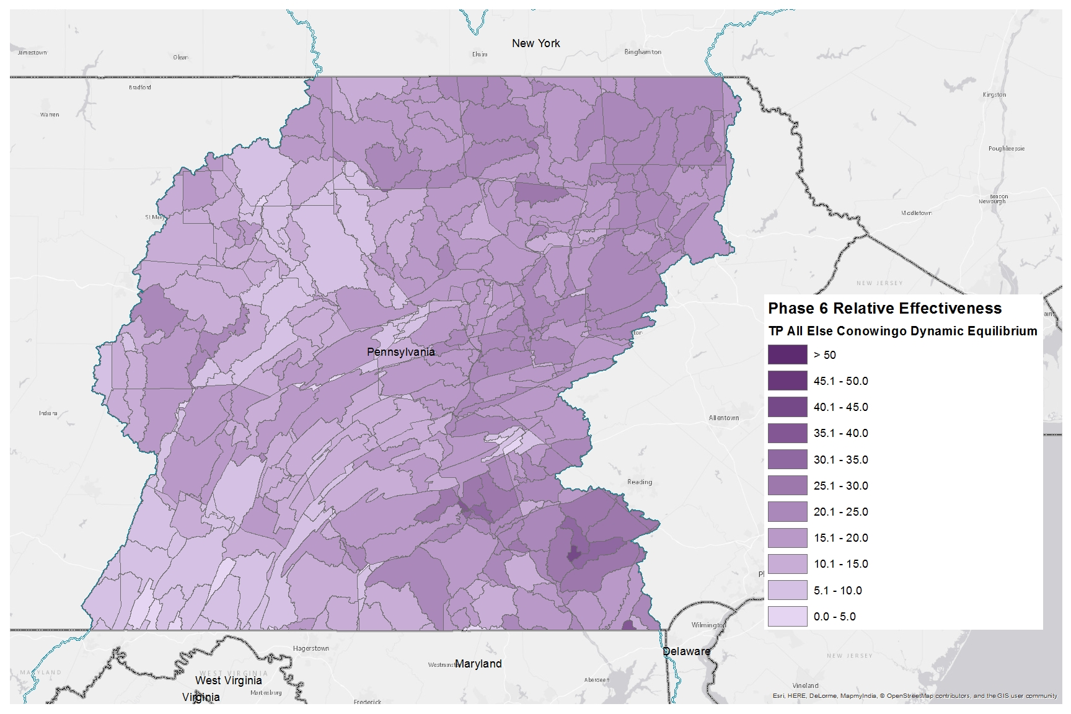
Phosphorus Relative Effectiveness
Phase 6, All Else, Conowingo Dynamic Equilibrium

