Slide 1
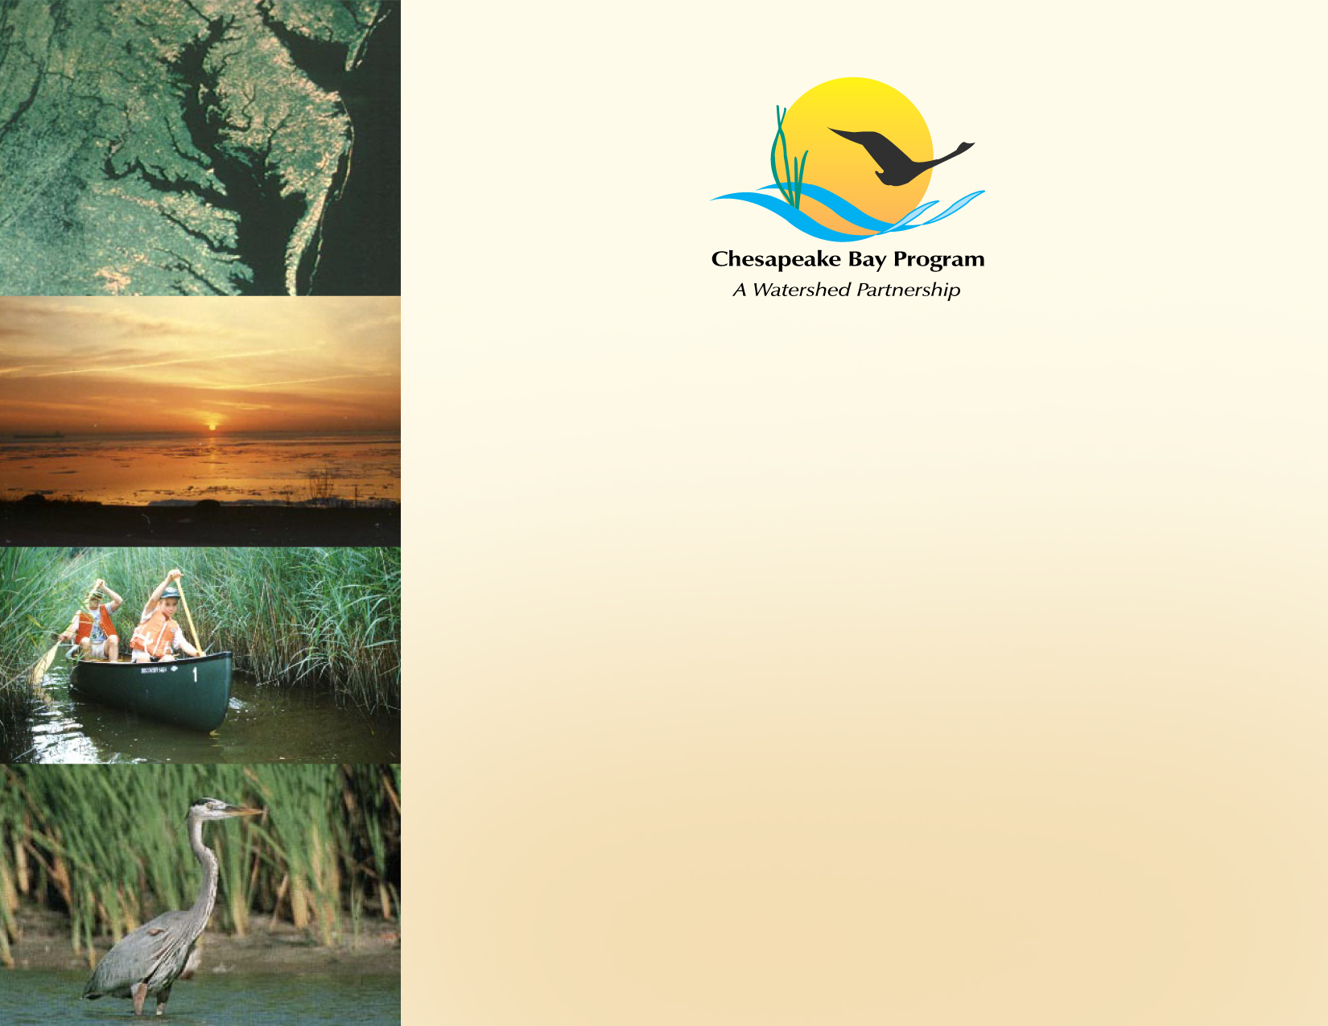
Land Use Metrics & Methods Outcome
Management Strategy
Peter Claggett
U.S. Geological Survey
December 4, 2014

Slide 2
2014 Bay Agreement’s Land Conservation Goal:
Conserve landscapes treasured by citizens in order to maintain water quality and habitat; sustain working forests, farms and maritime communities; and conserve lands of cultural, indigenous and community value.
Land Use Methods & Metrics Development Outcome:
Continually improve the knowledge of land conversion and the associated impacts throughout the watershed.
By 2016, develop a Chesapeake Bay watershed-wide methodology and local level metrics for characterizing the rate of farmland, forest and wetland conversion, measuring the extent and rate of change in impervious surface coverage and…
quantifying the potential impacts of land conversion to water quality, healthy watersheds and communities.
Launch a public awareness campaign to share this information with citizens, local governments, elected officials and stakeholders.

Slide 3
Elements:
Assess rate of conversion of forests, wetlands, and farmland.
Monitor changes in impervious surfaces.
Quantify impacts of land conversion on:
  Water quality
  Healthy watersheds
  Communities
Communicate results to the public, elected officials, and CBP partners.

Slide 4
Technical Issues:
What exactly are we monitoring? Loss? Loss & Gain?
Spatial scale? (e.g., small watersheds, counties, municipalities)
Frequency? (e.g., annual, 2-3 years, 5-7 years)
Accuracy?
Baseline? (fixed or variable?)

Slide 5
Questions?
  Which elements are most relevant to local governments?
  How accurate do the data need to be?
  Are local governments already tracking land conversions?
  How should this information be communicated to local governments? In what format?
  What support is needed to ensure the data are relevant to local government decisions?

