Slide 1
Development Trends and Forecasts in the Chesapeake Bay Watershed
Peter Claggett, Fred Irani, Quentin Stubbs, and Renee Thompson
April 30, 2015
Disclaimer: These data are preliminary and are subject to revision. They are being provided to meet the need for timely ‘best science’ information. The assessment is provided on the condition that neither the U.S. Geological Survey nor the United States Government may be held liable for any damages resulting from the authorized or unauthorized use of the assessment.

Slide 2
Presentation Outline
Why forecast future growth?
How we do it?
Role and importance of scenarios.
Results and model assumptions.
Assessing “vulnerability”.

Slide 3

  Future Watershed Population
By 2050, the population of the watershed may increase by 30% (~ 5 million persons)

Slide 4
Single-Unit Building Permits (e.g., detached and attached homes)

Slide 5
Multi-Unit Building Permits (e.g., apartments, condominiums)

Slide 6
  The Bay TMDL
Implementation of actions to restore the Bay are planned to take 10 more years (2015 – 2025).
Ecosystem responses to those actions may take decades due to groundwater lag times and other factors.
By 2050, the population of the watershed may increase by 30% (~ 5 million persons); and
EPA expects that ALL new or increased loadings of nitrogen, phosphorous and sediments will be offset by reductions and credits generated by other sources.

Slide 7
  Chesapeake Bay Land Change Model v3a
Population Projections
Total Housing
Demand
Employment Projections
Historic
Infill
Patterns
Potential
Infill
Development
Historic
Development
Patterns
Residential Land Demand
Commercial Land Demand
Unprotected and Developable?
Unprotected and Developable?
Residential Probability
Commercial Probability
Iterative & Stochastic
Road Gravity
Road Gravity
Resid. Land Use Factor
Comm. Land Use Factor
Residential Development
Commercial Development
Present
Land Cover
Future Land Cover
Summary Unit (watersheds or unprotected forests)
Future Development Statistics
Notes:
Accessibility = peak travel times for single-occupancy vehicles between transportation modeling zones.

Slide 8
CBLCM v3a Assumptions
Urban growth is driven by exogenous estimates population and employment growth…
Growth is constrained at the county-level…
Growth attracts growth…
Residential and commercial development becomes more dense over time, increasing the most near urban areas and staying roughly constant in rural areas.
Historic “Infill” rates are held constant.
No spillover of growth from one county to another. If available land is limited, excess demand is assumed to be accommodated via infill.

Slide 9
Under-detection of Land Cover Change
(aka “Infill Development”)
Infill/ redevelopment = amount of development occurring within urban areas on either small vacant or already developed parcels.
Given observed growth in housing and the highest expected housing densities associated with each urban Census block, estimate expected amount of land cover change from 2000 - 2010?
Assess observed amount of land cover from 2000 – 2010?
The difference between expected and observed developed land cover change = infill/redevelopment area
Infill/redevelopment area (acres) * highest expected density (housing units/ acre) = housing units associated with infill/redevelopment.
Infill/redevelopment housing / Total housing change = Infill rate (2000 – 2010)

Slide 10
Residential & Employment Growth (Howard County, MD)
Population (2010): 287,085
Population (2030): 357,100¹
Change: 70,015 persons
Average households size (2010): 2.72
Average households size (2030): 2.72
Households in 20XX = ((Total Population – Group Housing Population) / Average Household Size)
Future Residential Housing Demand = 25,527 households
Employment (2010): 189,584²
Employment (2030): 259,400³
Change: 69,816 jobs
Future Employment Demand = 69,816 jobs
¹ MD Department of Planning, July 2014
² Bureau of Economic Analysis: total full and part-time employment (CA25N)
³ MD Department of Planning, March 2014

Slide 11
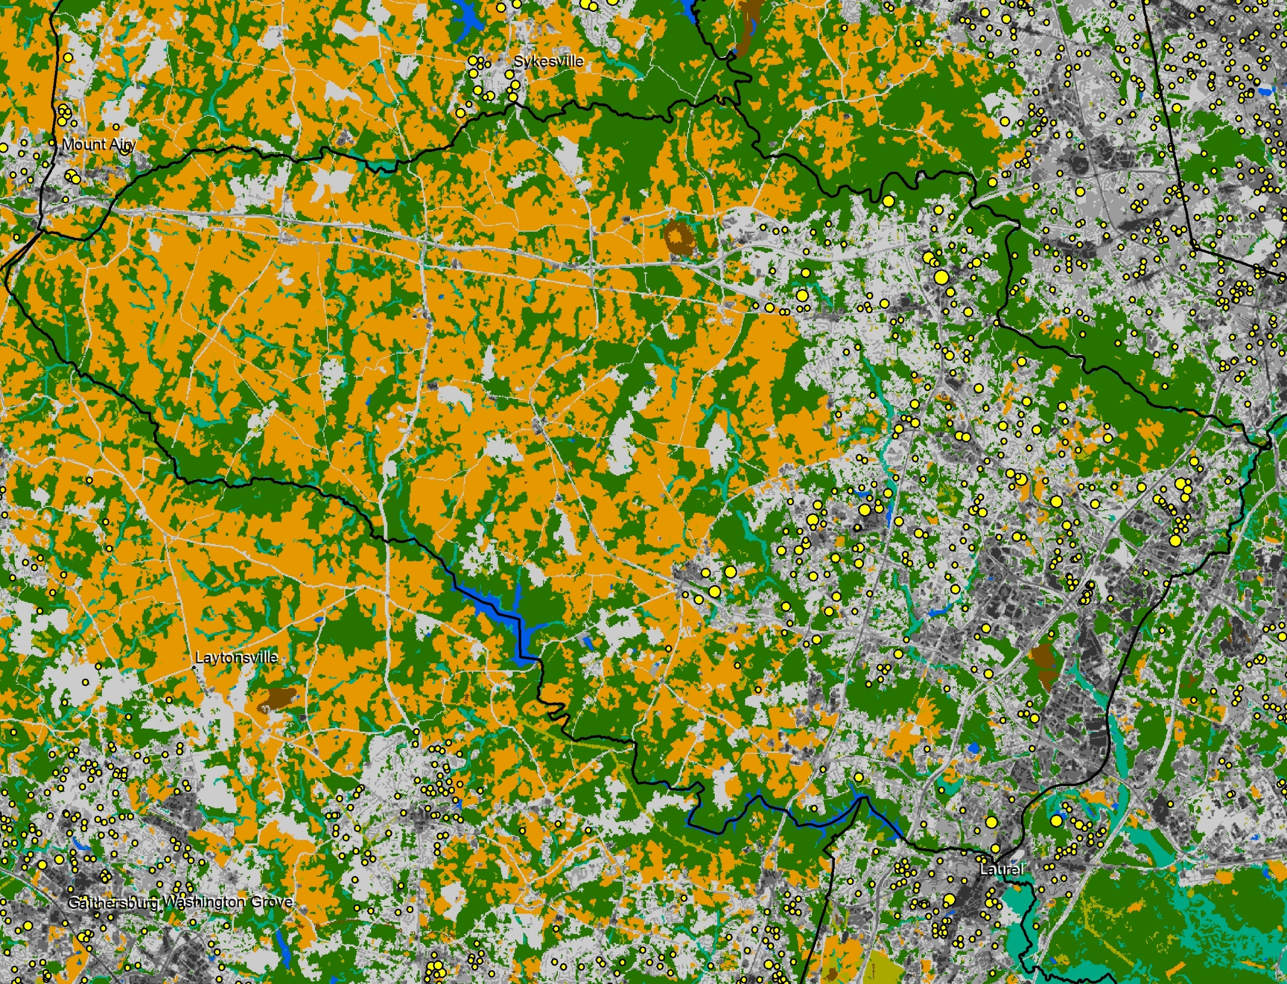
Under-detection of Land Cover Change in Howard County
(aka “Infill”)
Infill Rate in Howard County (2000 – 2010) = 37%
Disclaimer: These data are preliminary and are subject to revision. They are being provided to meet the need for timely ‘best science’ information. The assessment is provided on the condition that neither the U.S. Geological Survey nor the United States Government may be held liable for any damages resulting from the authorized or unauthorized use of the assessment.

Slide 12
Housing and Employment Demand Resulting in Greenfield Development
Future Residential Housing Demand * (1- Infill Rate) = 16,018 households
Future Employment Demand * (1-Infill Rate) = 43,810 jobs
Forest and farm area converted to development depend on:
Future housing and employment demand;
Land available for development;
Residential and commercial densities in areas where growth is forecast to occur;
Spatial distribution of forest and farmland.

Slide 13
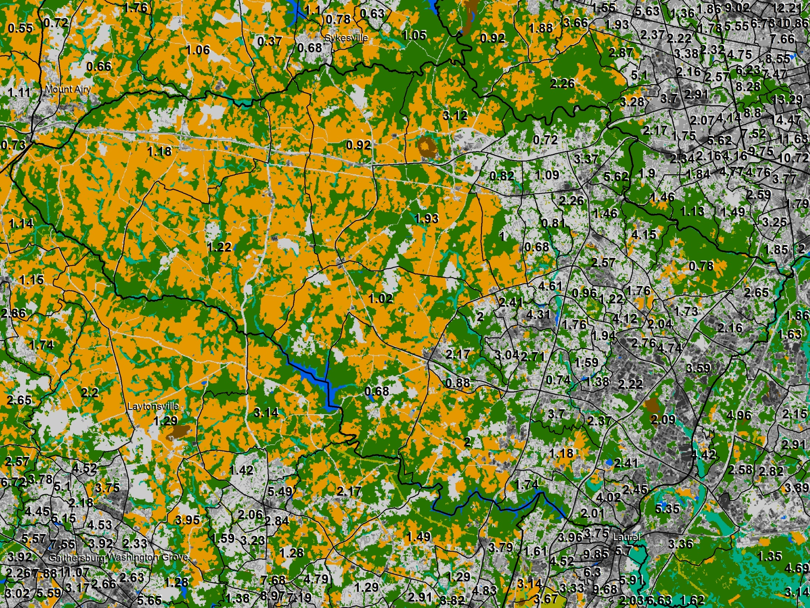
2010 Housing Densities (units per acre)
MDP Households per Residential Acre = .62

Slide 14
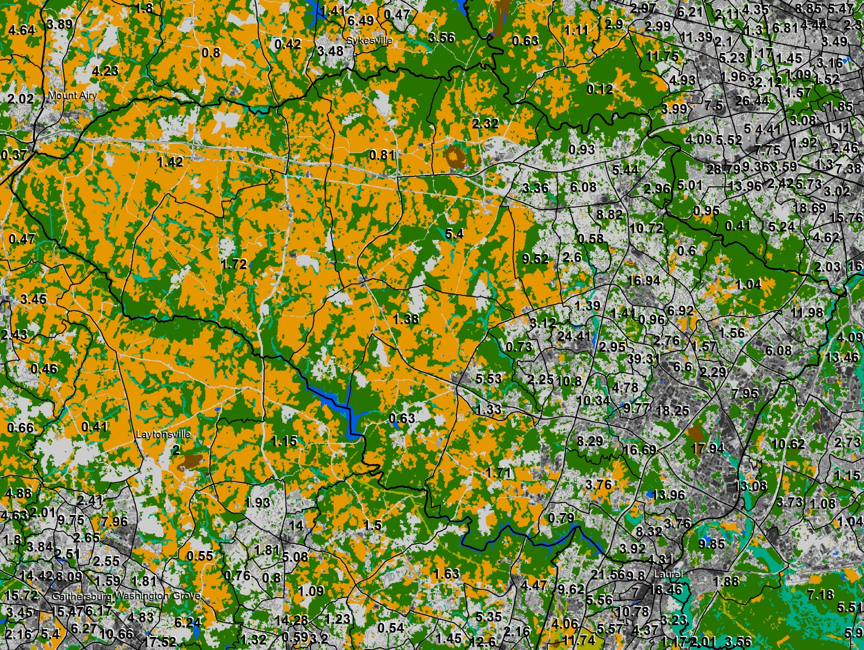
2010 Employment Densities (units per acre)
MDP Jobs per Commercial Acre = 4.15

Slide 15
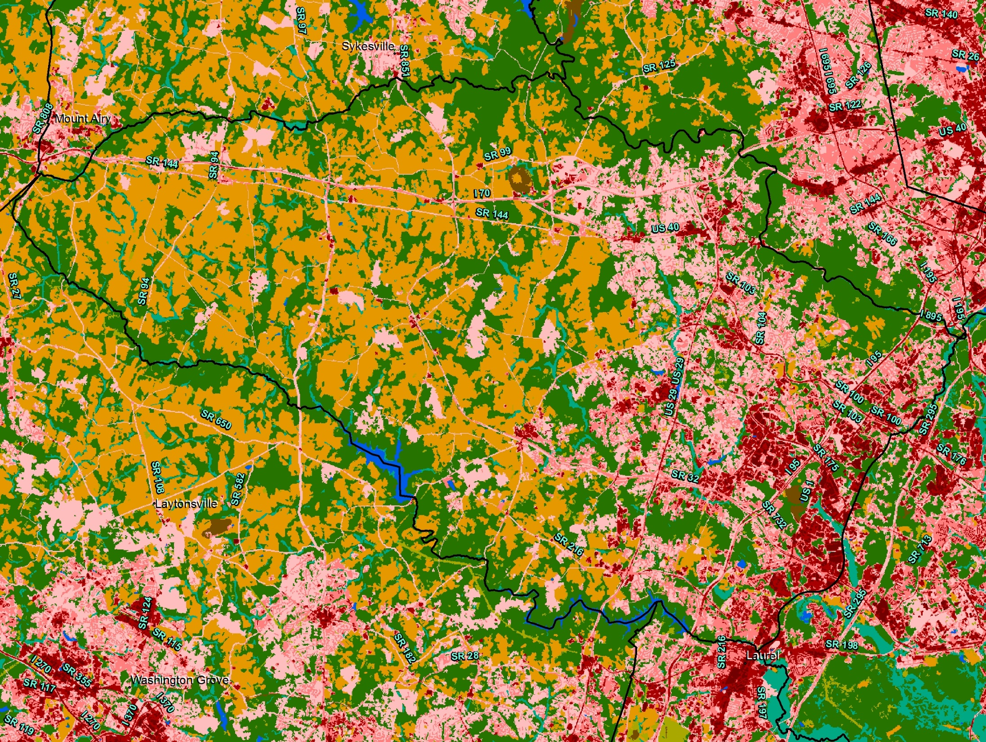
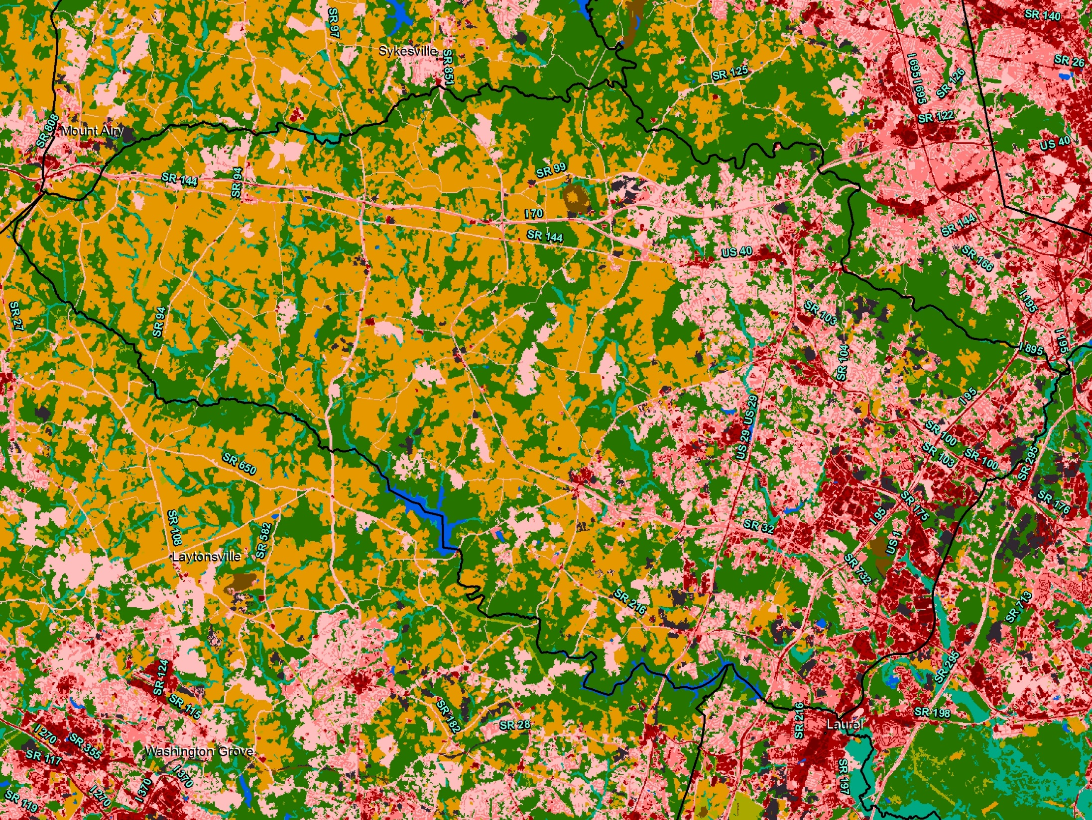
New Development (2000 – 2010)

Slide 16
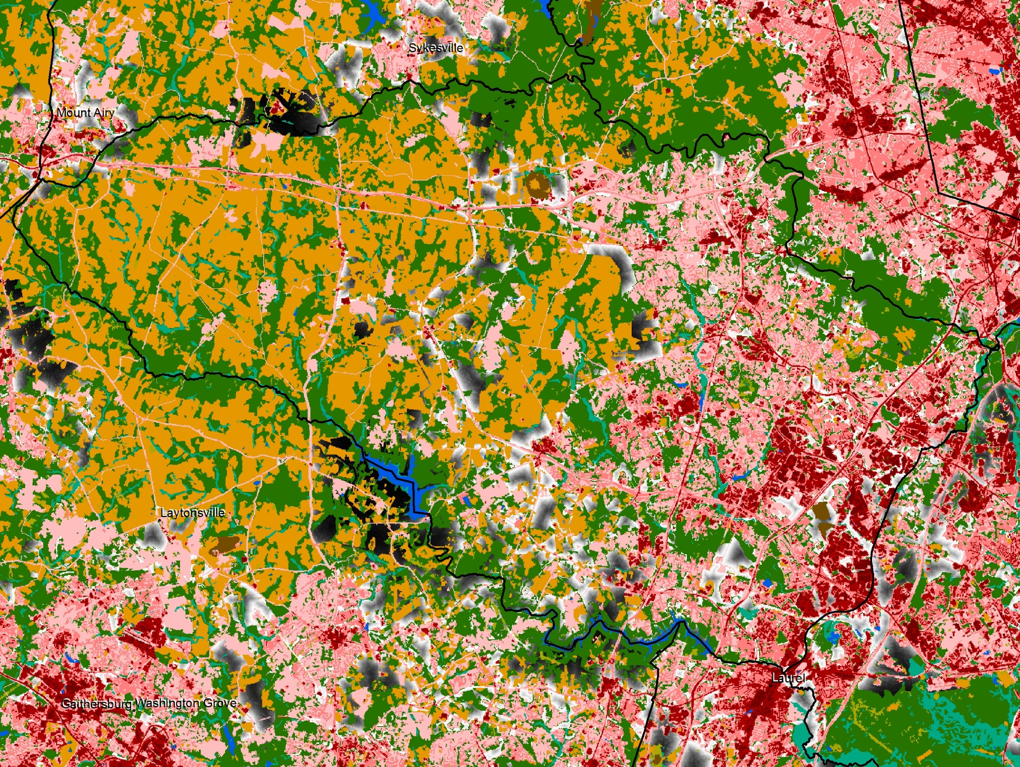
Probability Surface
Inputs
Percent slope
Proximity to urban areas
Proximity to growth in 2000’s
Auto accessibility
R² = 0.822

Slide 17
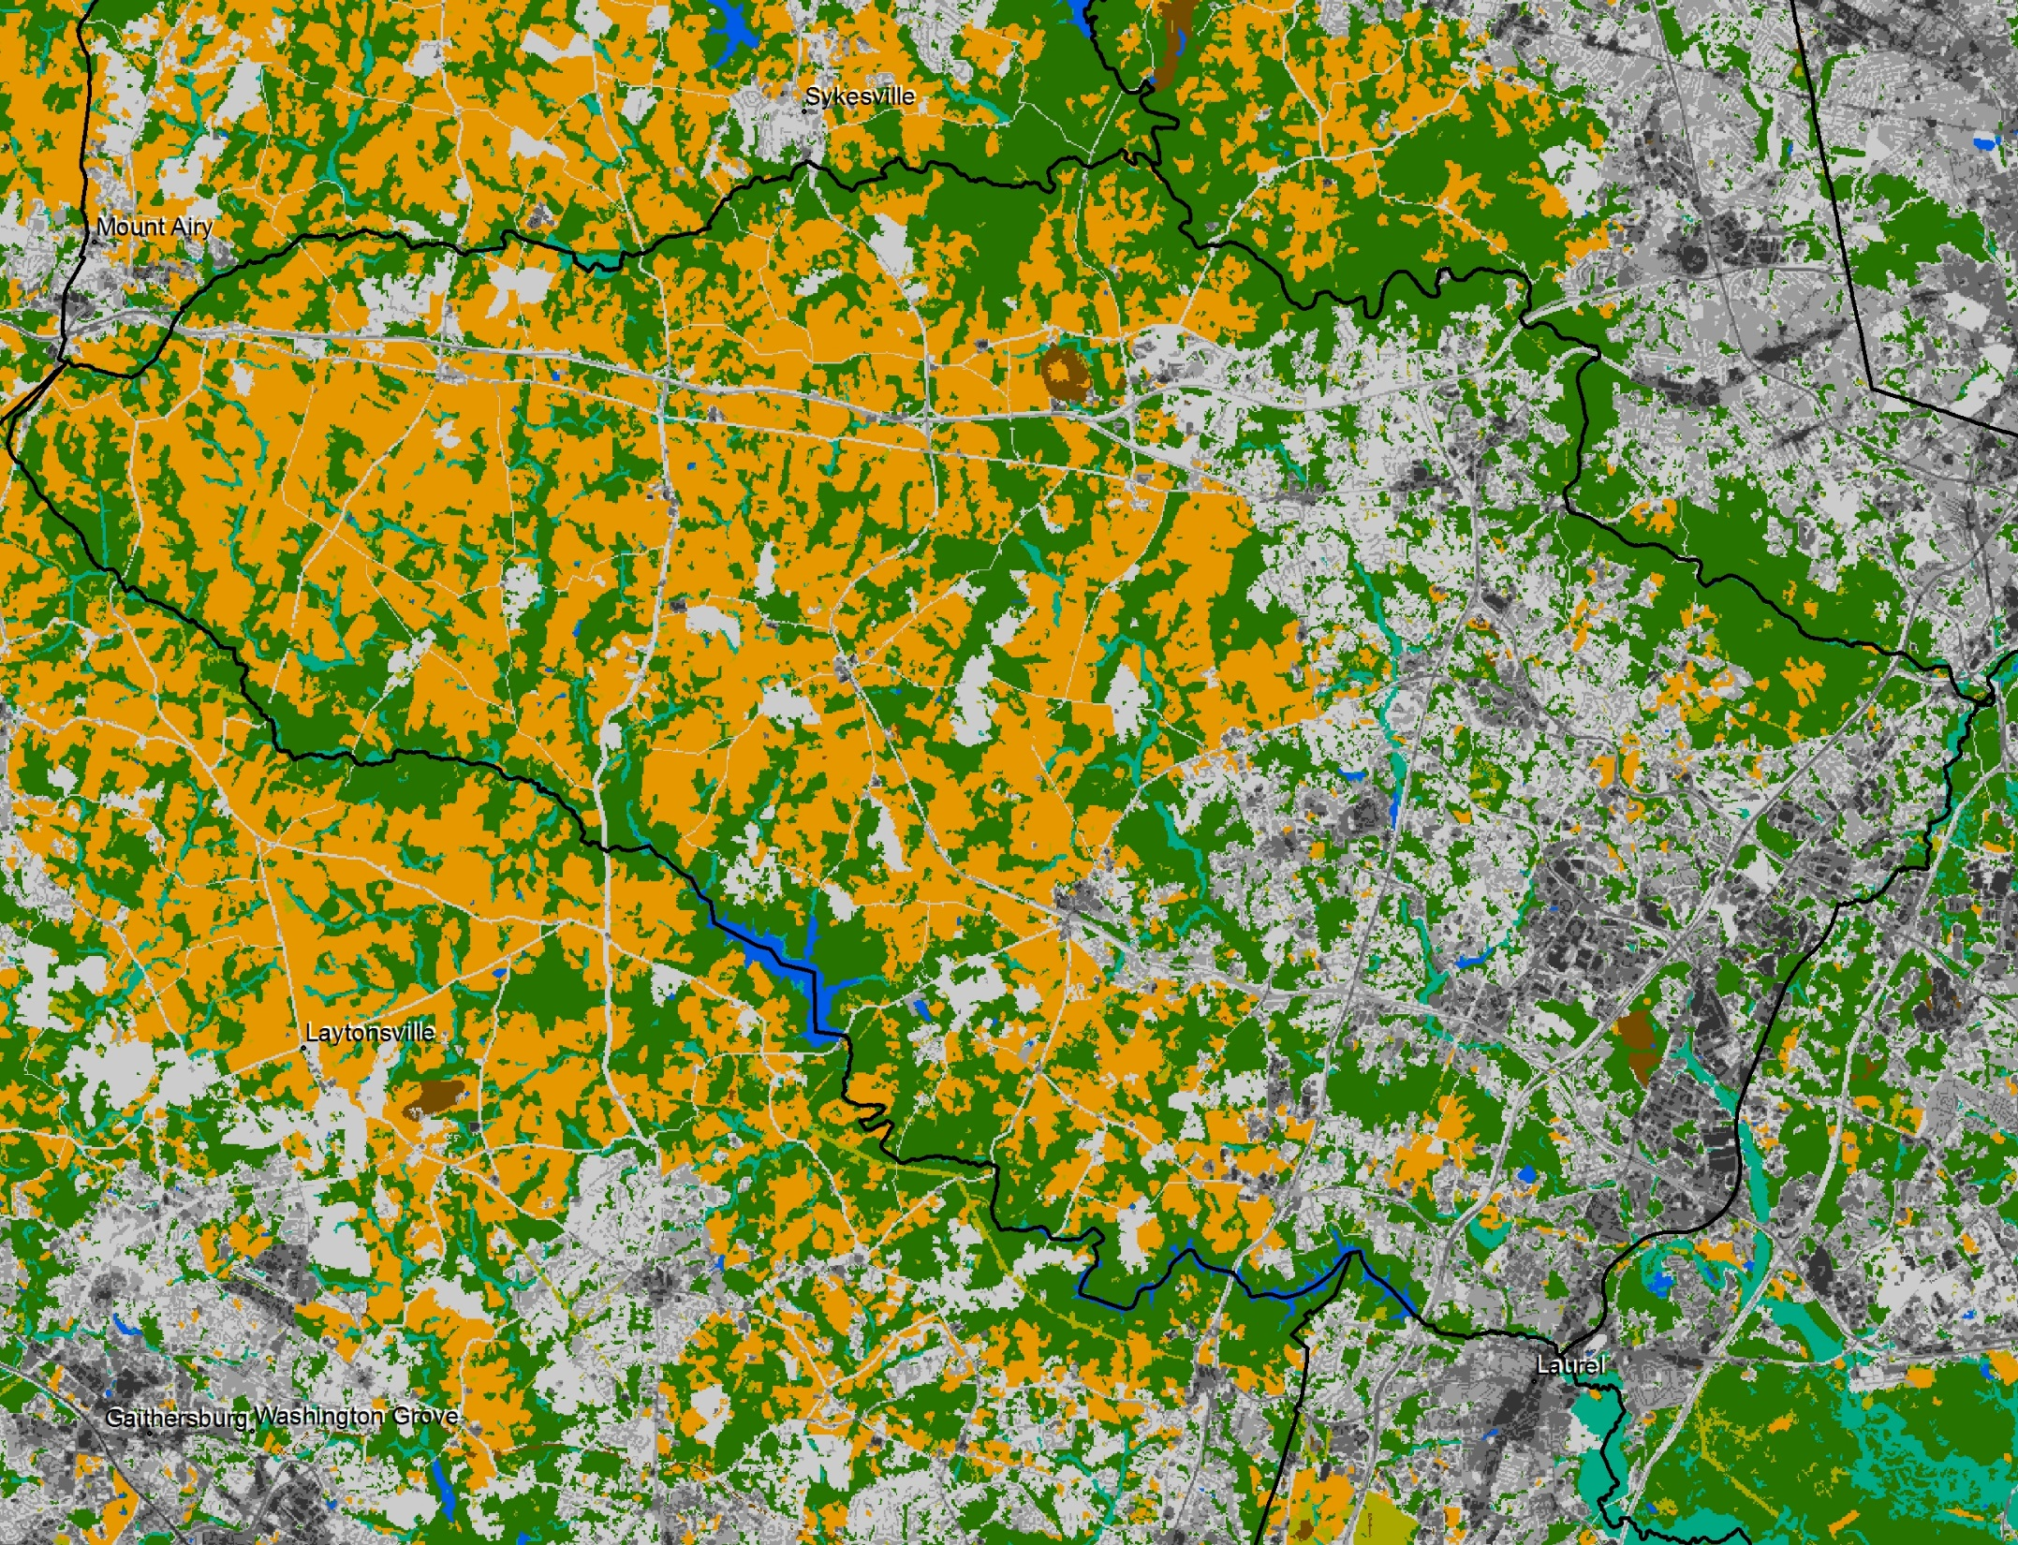
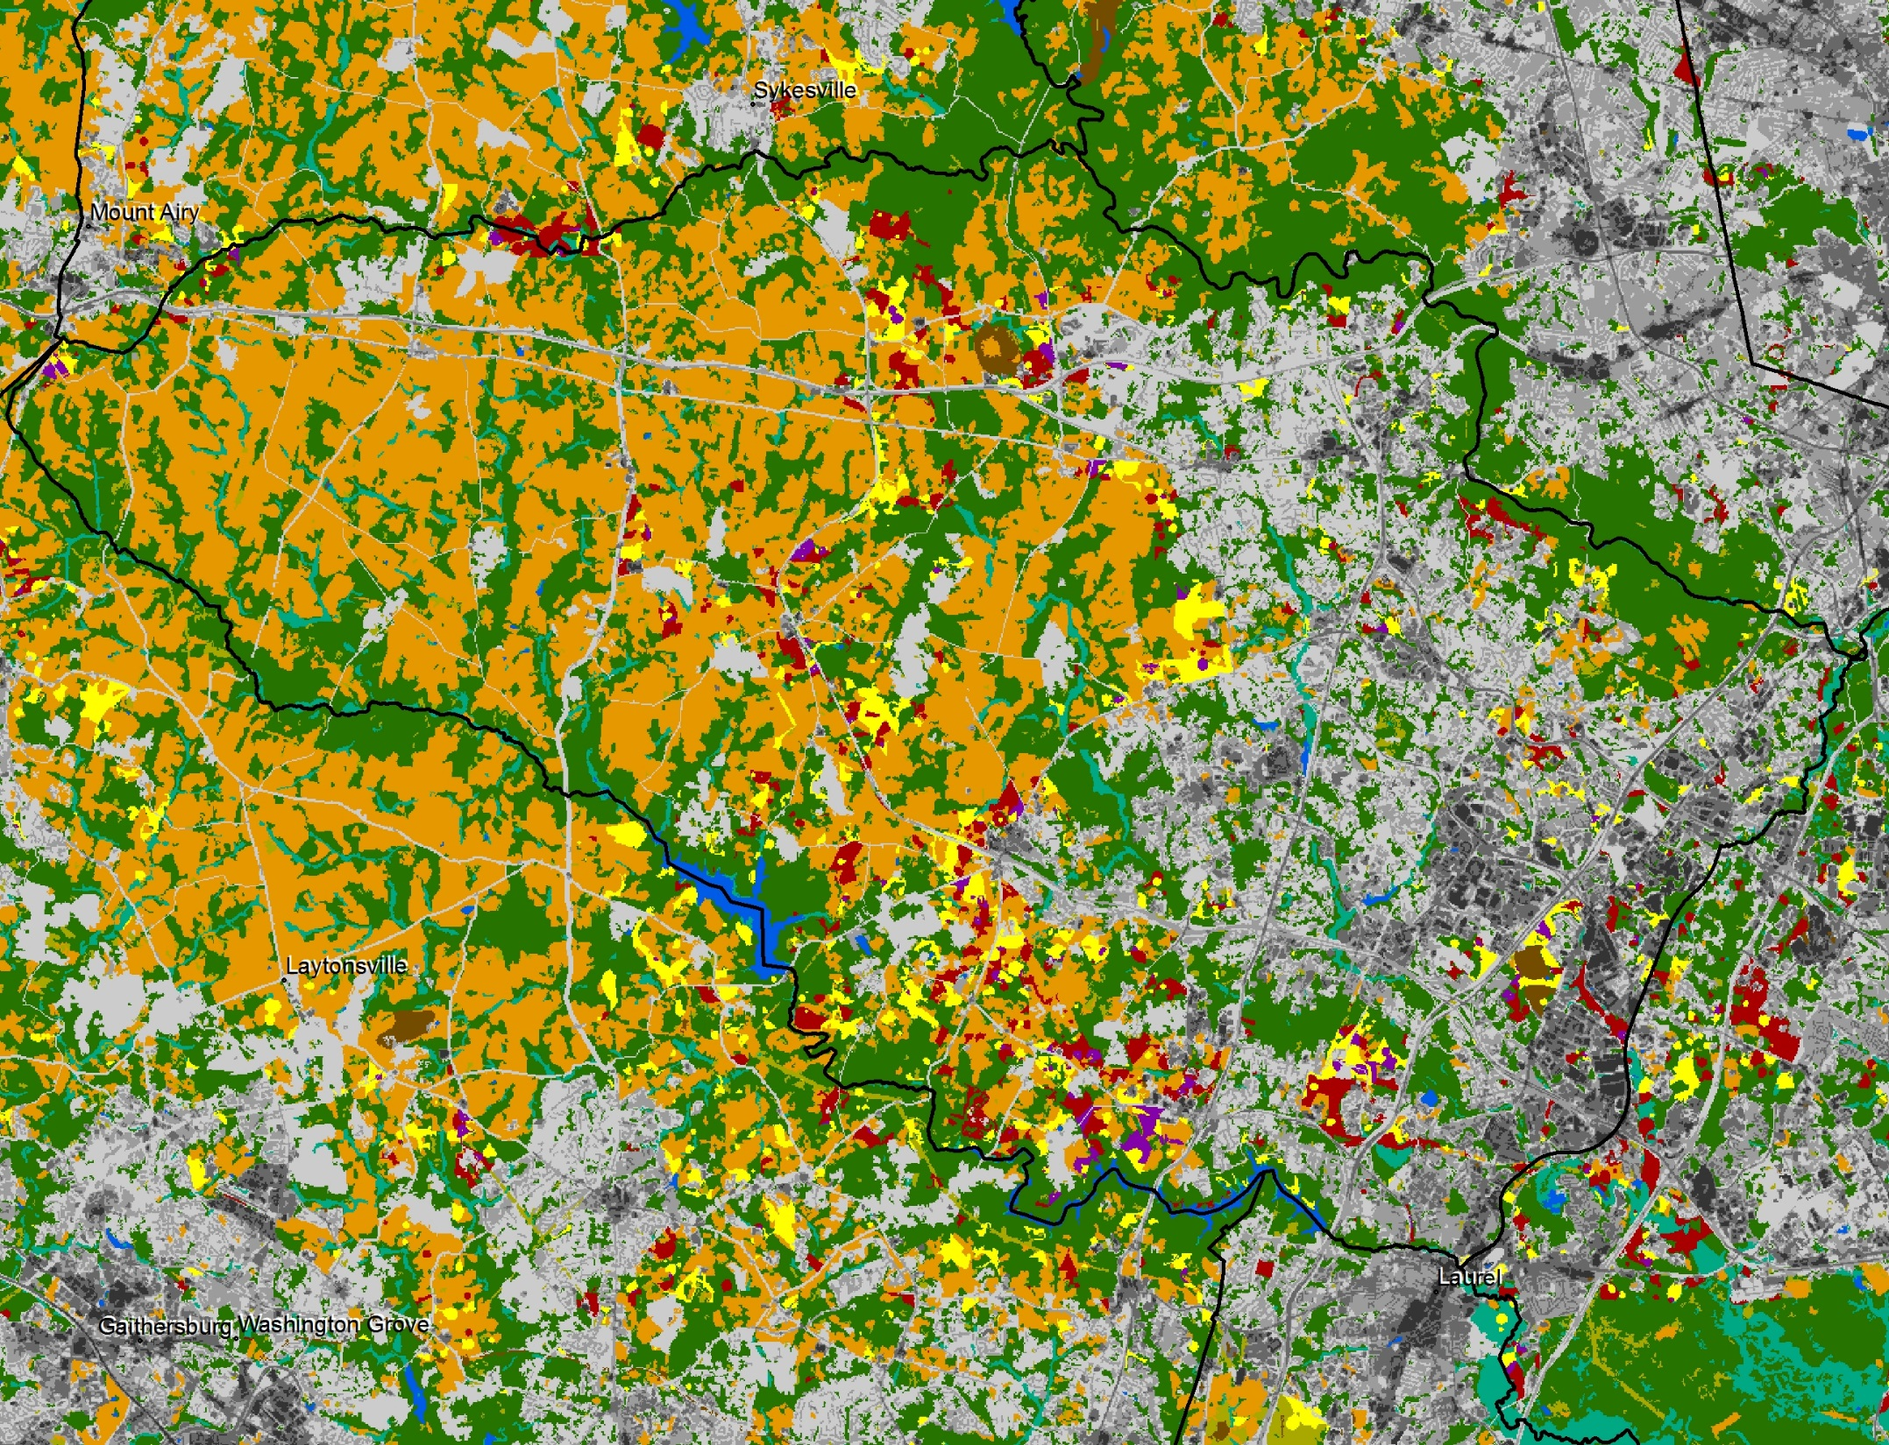
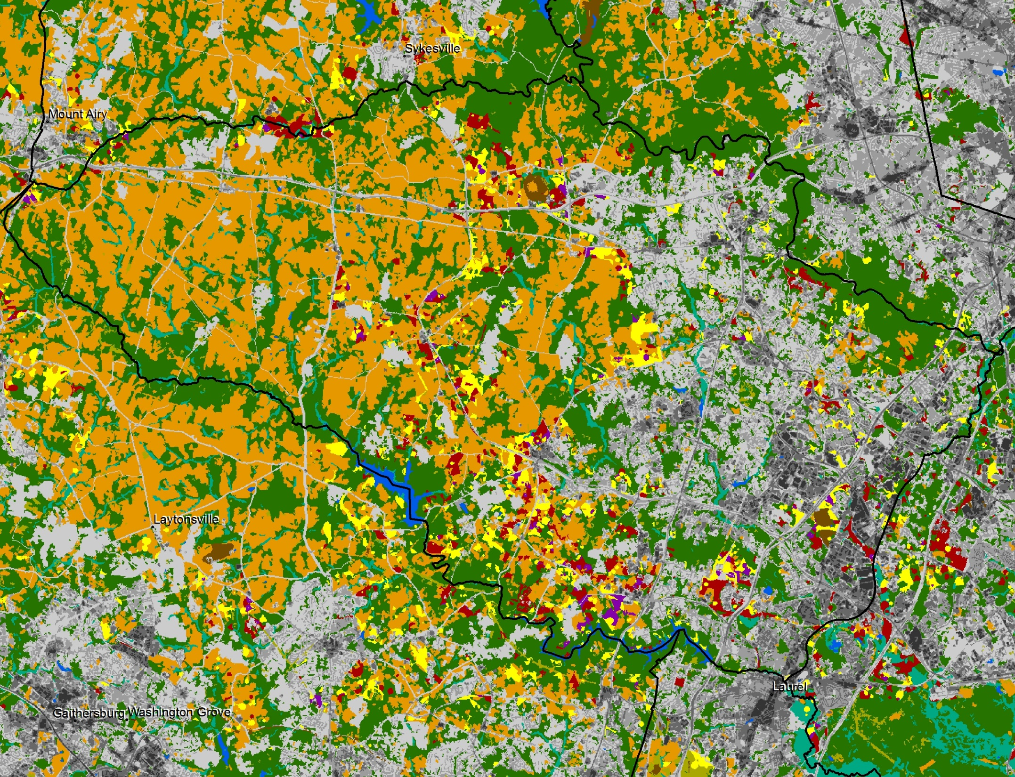

09-22-14 Run
2010 Land Cover
2020 Land Cover
2025 Land Cover
2030 Land Cover

Slide 18
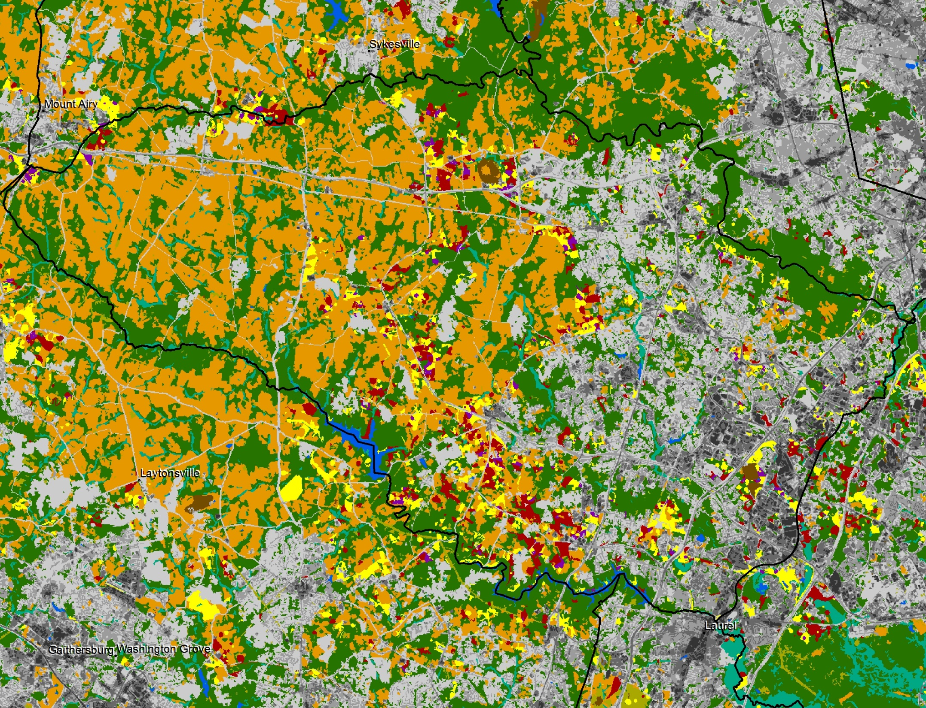
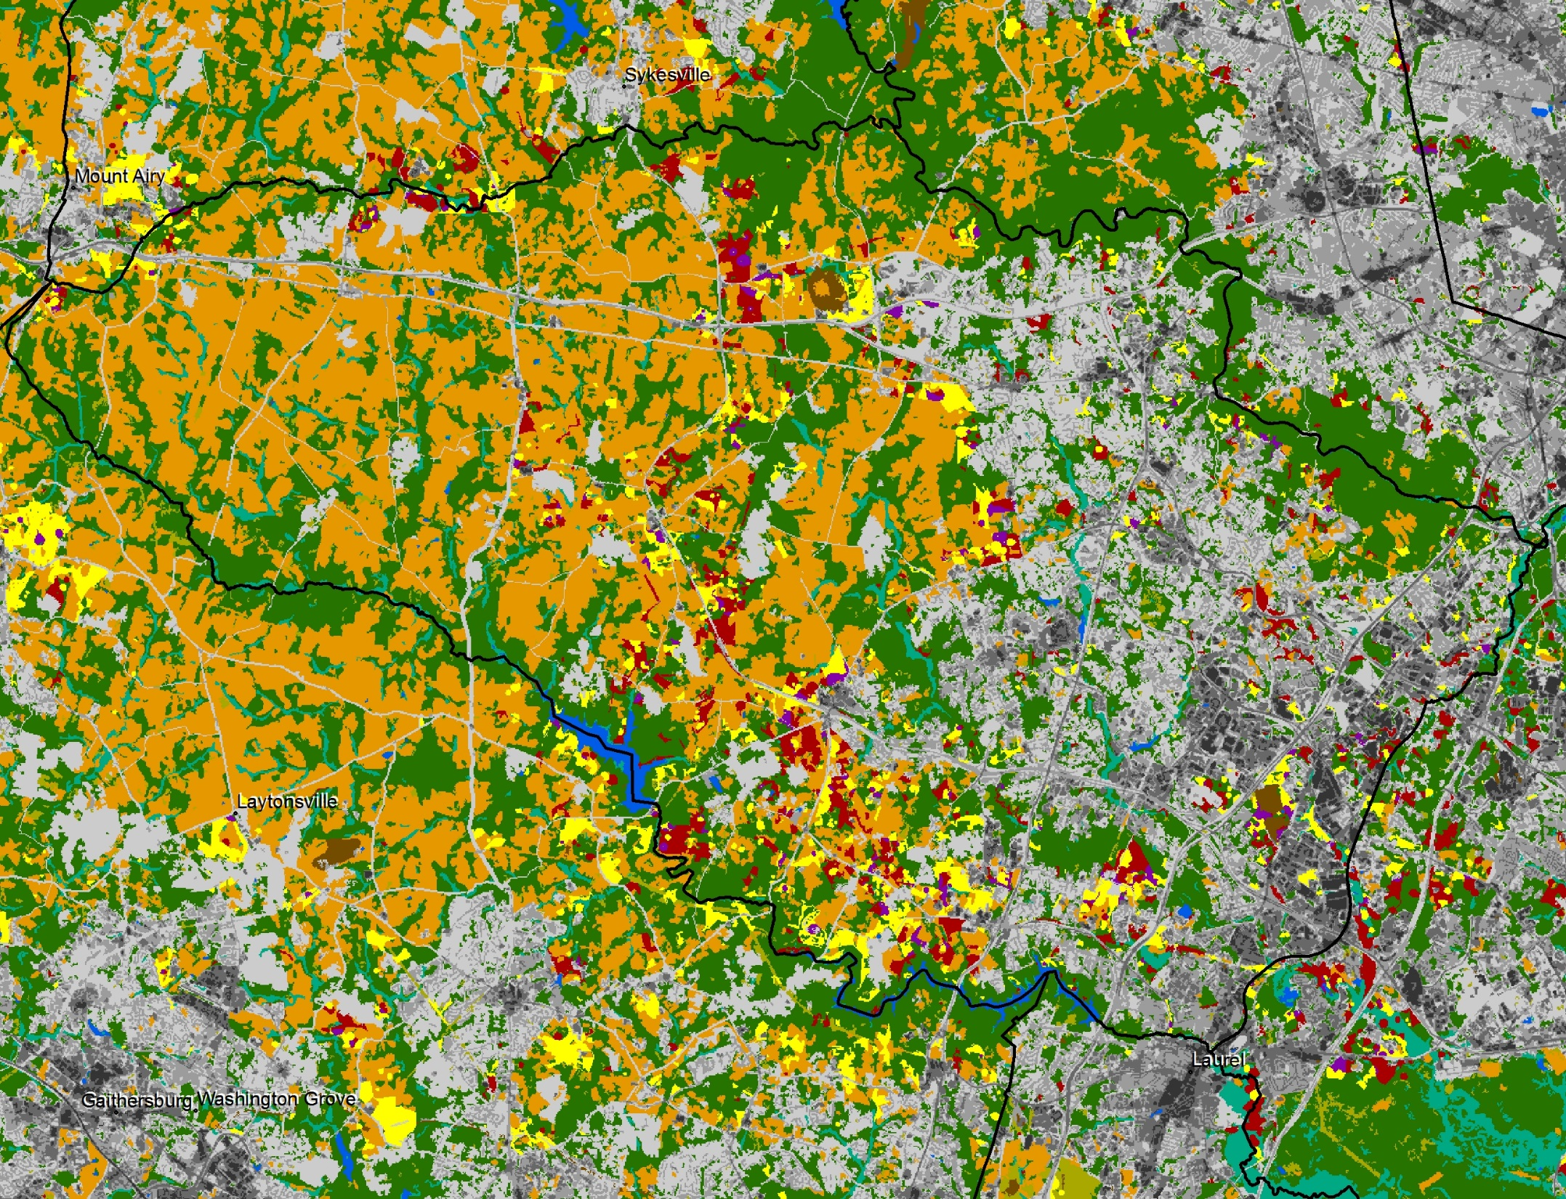
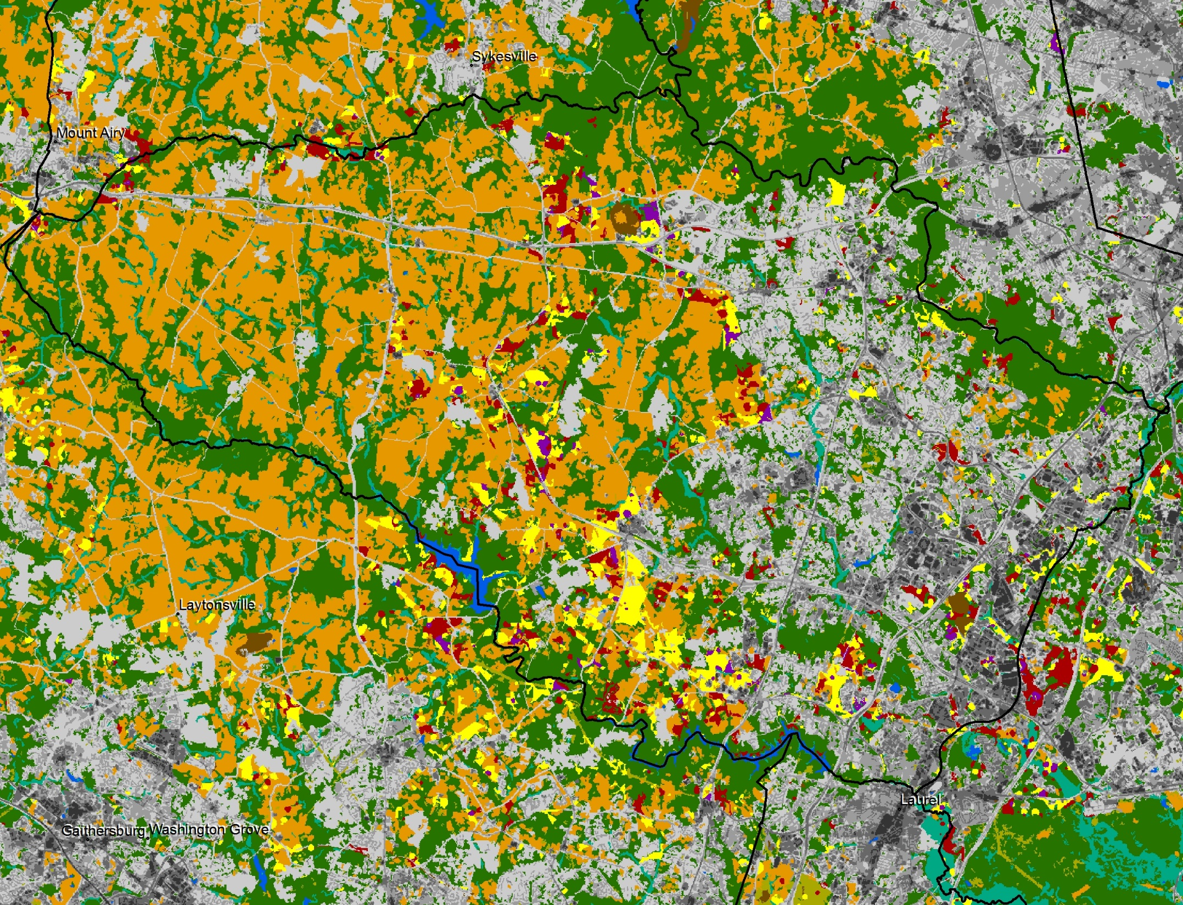
2030 v2 Land Cover
2030 v3 Land Cover
2030 v4 Land Cover
09-22-14 Run

Slide 19
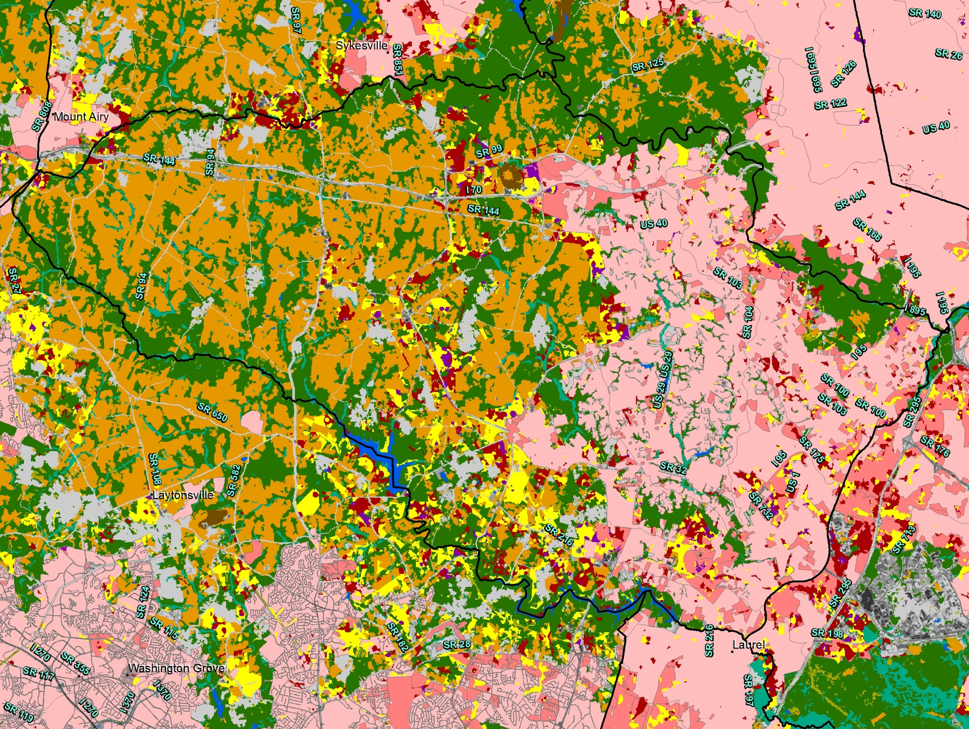
4x growth in 2030 (iterations 1-4) overlaid on sewer service areas

Slide 20
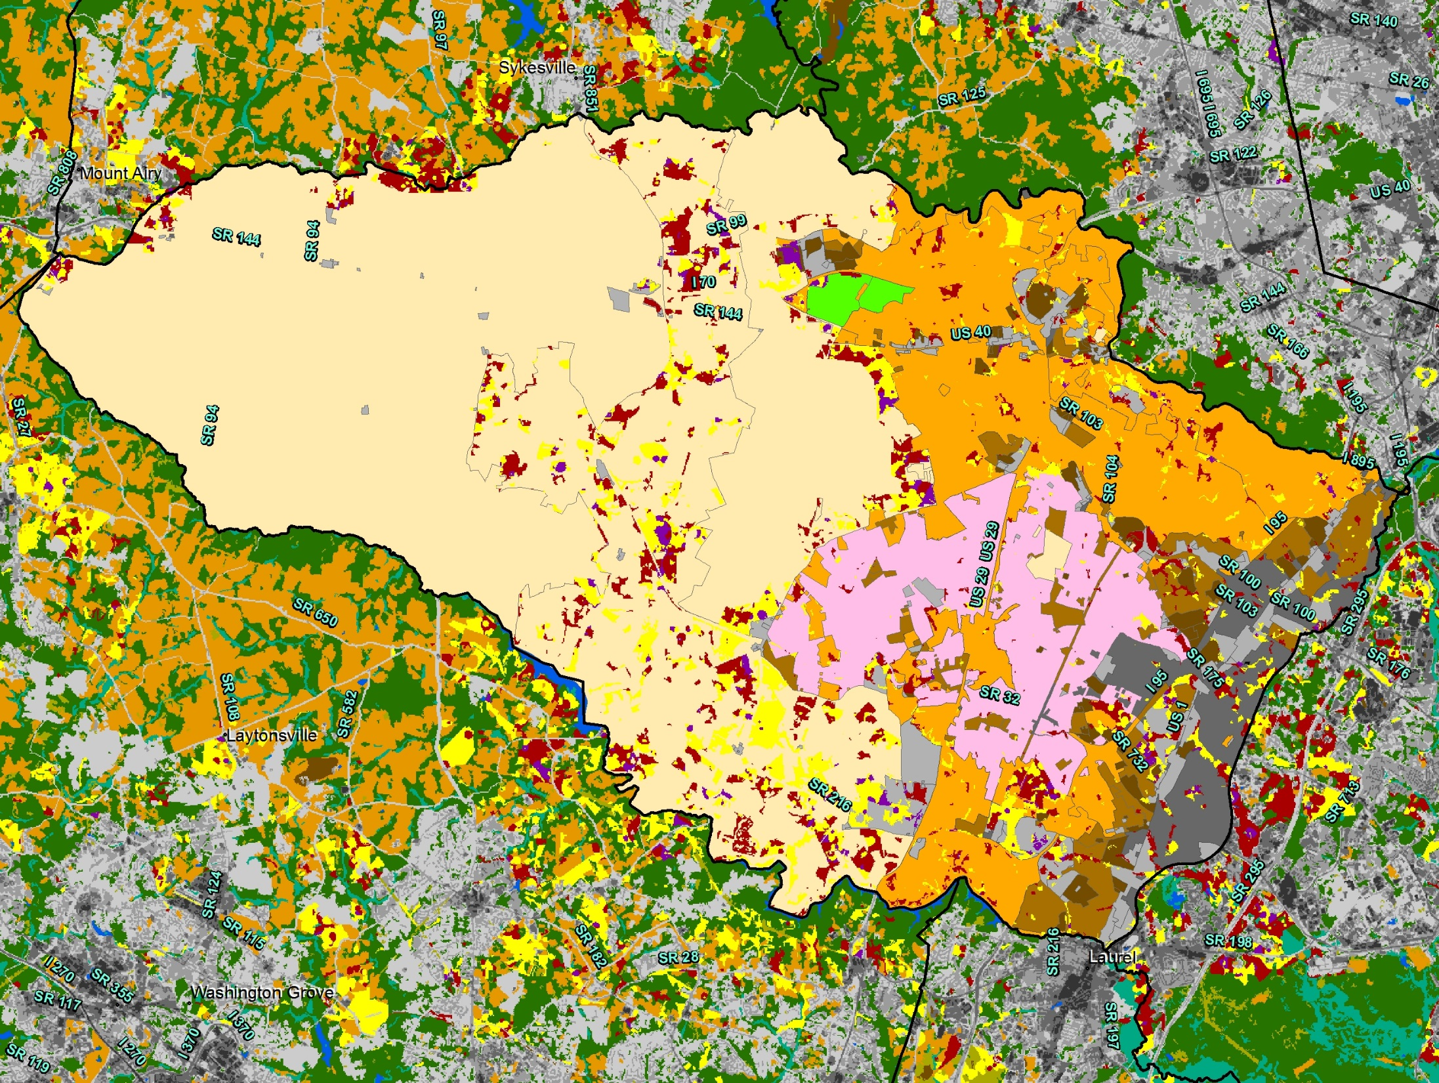
4x growth in 2030 (iterations 1-4) overlaid on current zoning

Slide 21
Nutrient and Sediment Land Use Loads
Example: What is the total nitrogen load from a new 100-acre residential development on a parcel of fully developable land that is currently 50% forest (conserved), 50% farmland, 100% on septic and has a potential density of 0.5 dwelling units per acre.
Impervious and pervious developed area of parcel:
0.5 units/acre = 2 acre lots
100 acres/ 2-acre lots = 50 households
10.6% impervious¹ * 100 acres = 10.6 acres impervious & 89.4 acres pervious
Pre-development load:
  Farmland area (50 acres) * farmland TN load (17.6 lbs/acre/yr) +
  Forest area (50 acres) * forest TN load (3.5 lbs/acre/yr)
  1 household * septic² TN load (7.01 lbs/household/yr)
  = 887 TN lbs/yr
Post-development load:
  Impervious area (10.6 acres) * impervious TN load (13.2 lbs/acre/yr) +
  Pervious area (39.4 acres) * pervious TN load (8.5 lbs/acre/yr) +
  Forest area (50 acres) * forest TN load (3.5 lbs/acre/yr)
  50 households * septic² TN load (7.01 lbs/household/yr)
  = 1,000 TN lbs/yr
  Net change: + 113 TN lbs/yr (+363 TN lbs/yr without forest conservation)
¹ Cappiella and Brown, 2001
² Assumes 65% efficiency of septic systems

Slide 22
Nutrient and Sediment Loading Coefficients

Slide 23
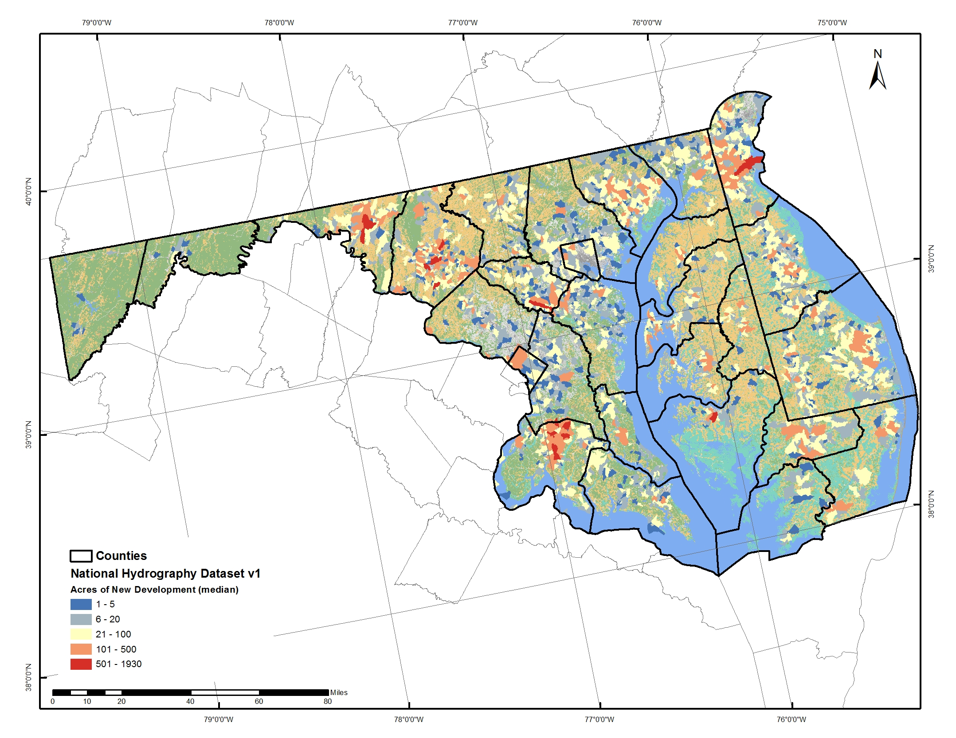
New Development
2010 - 2030
Disclaimer: These data are preliminary and are subject to revision. They are being provided to meet the need for timely ‘best science’ information. The assessment is provided on the condition that neither the U.S. Geological Survey nor the United States Government may be held liable for any damages resulting from the authorized or unauthorized use of the assessment.

Slide 24
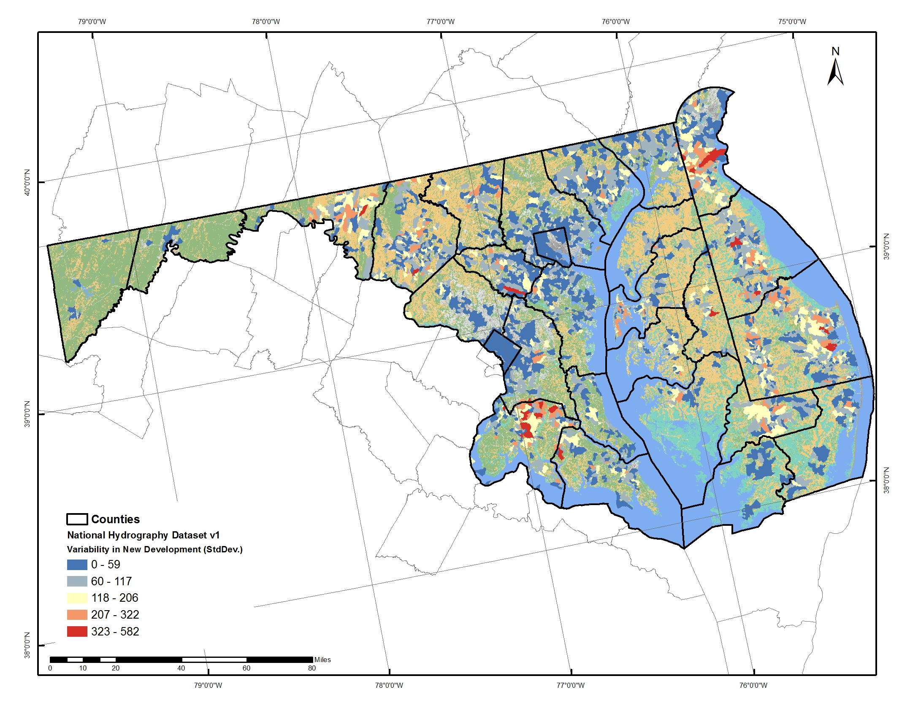
Variability in Forecast
2010 - 2030
Disclaimer: These data are preliminary and are subject to revision. They are being provided to meet the need for timely ‘best science’ information. The assessment is provided on the condition that neither the U.S. Geological Survey nor the United States Government may be held liable for any damages resulting from the authorized or unauthorized use of the assessment.

Slide 25
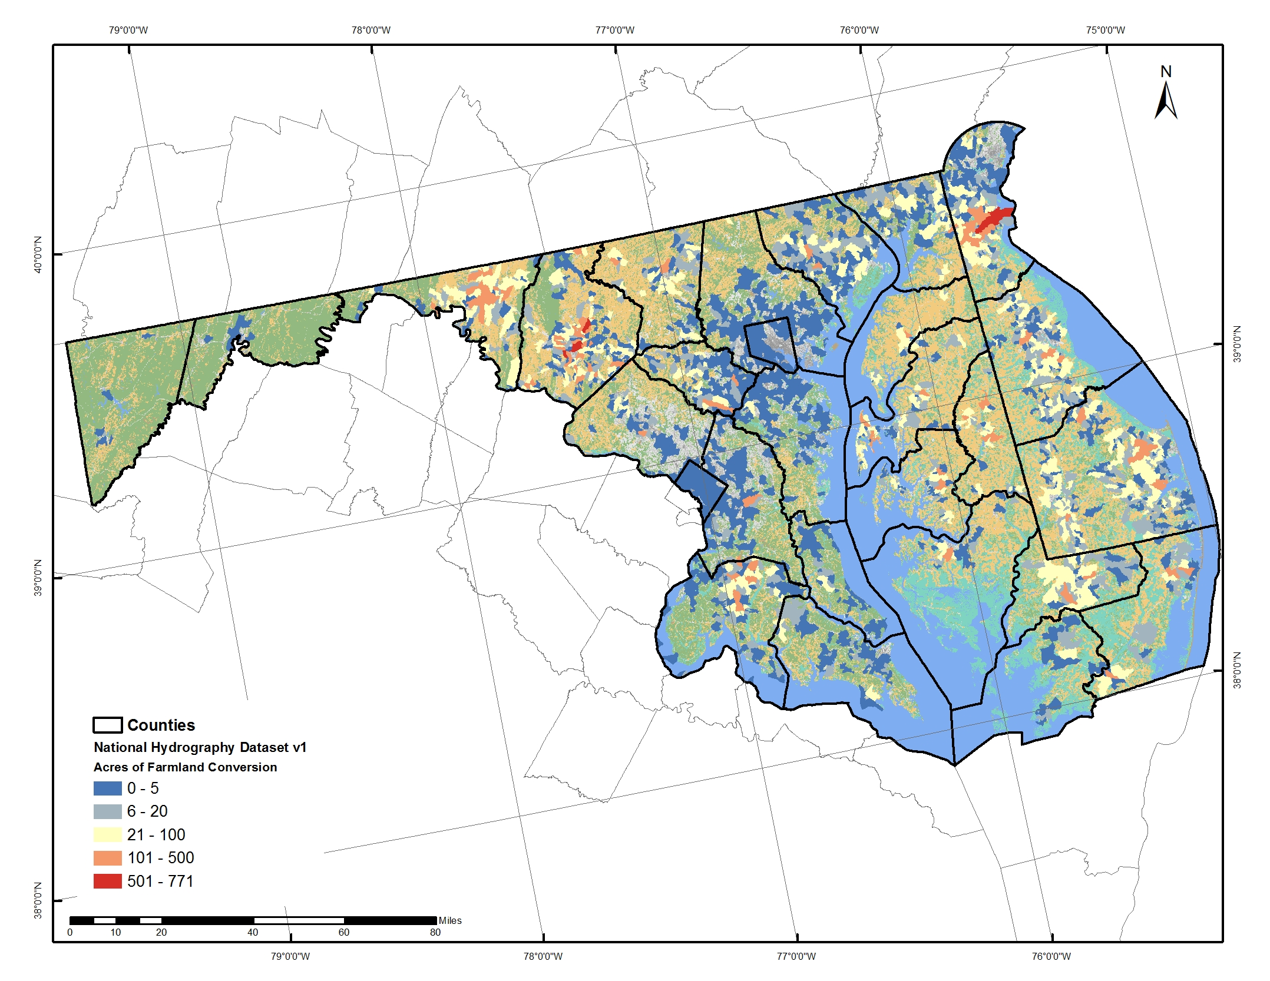
Farmland Conversion
2010 - 2030
Disclaimer: These data are preliminary and are subject to revision. They are being provided to meet the need for timely ‘best science’ information. The assessment is provided on the condition that neither the U.S. Geological Survey nor the United States Government may be held liable for any damages resulting from the authorized or unauthorized use of the assessment.

Slide 26
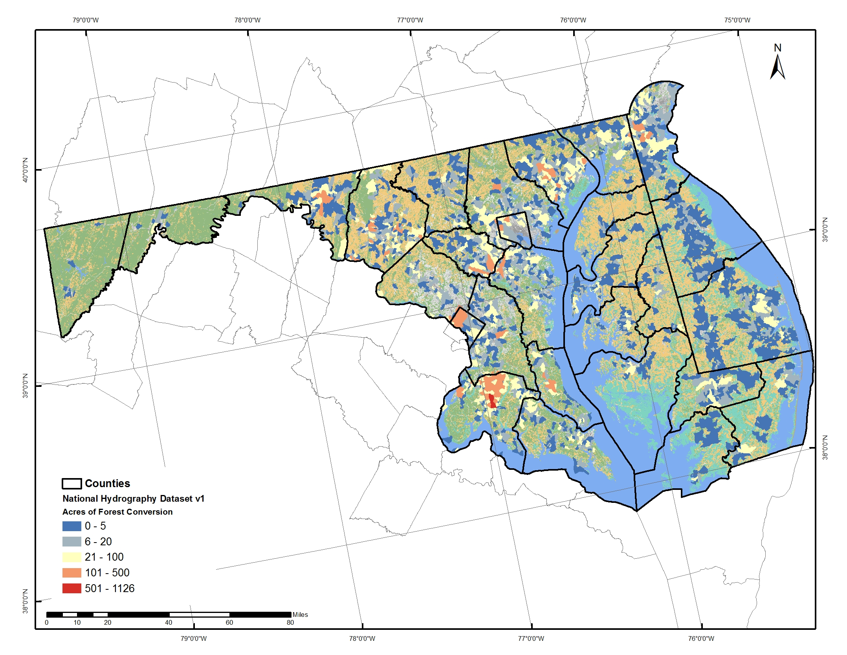
Forest Conversion
2010 - 2030
Disclaimer: These data are preliminary and are subject to revision. They are being provided to meet the need for timely ‘best science’ information. The assessment is provided on the condition that neither the U.S. Geological Survey nor the United States Government may be held liable for any damages resulting from the authorized or unauthorized use of the assessment.

Slide 27
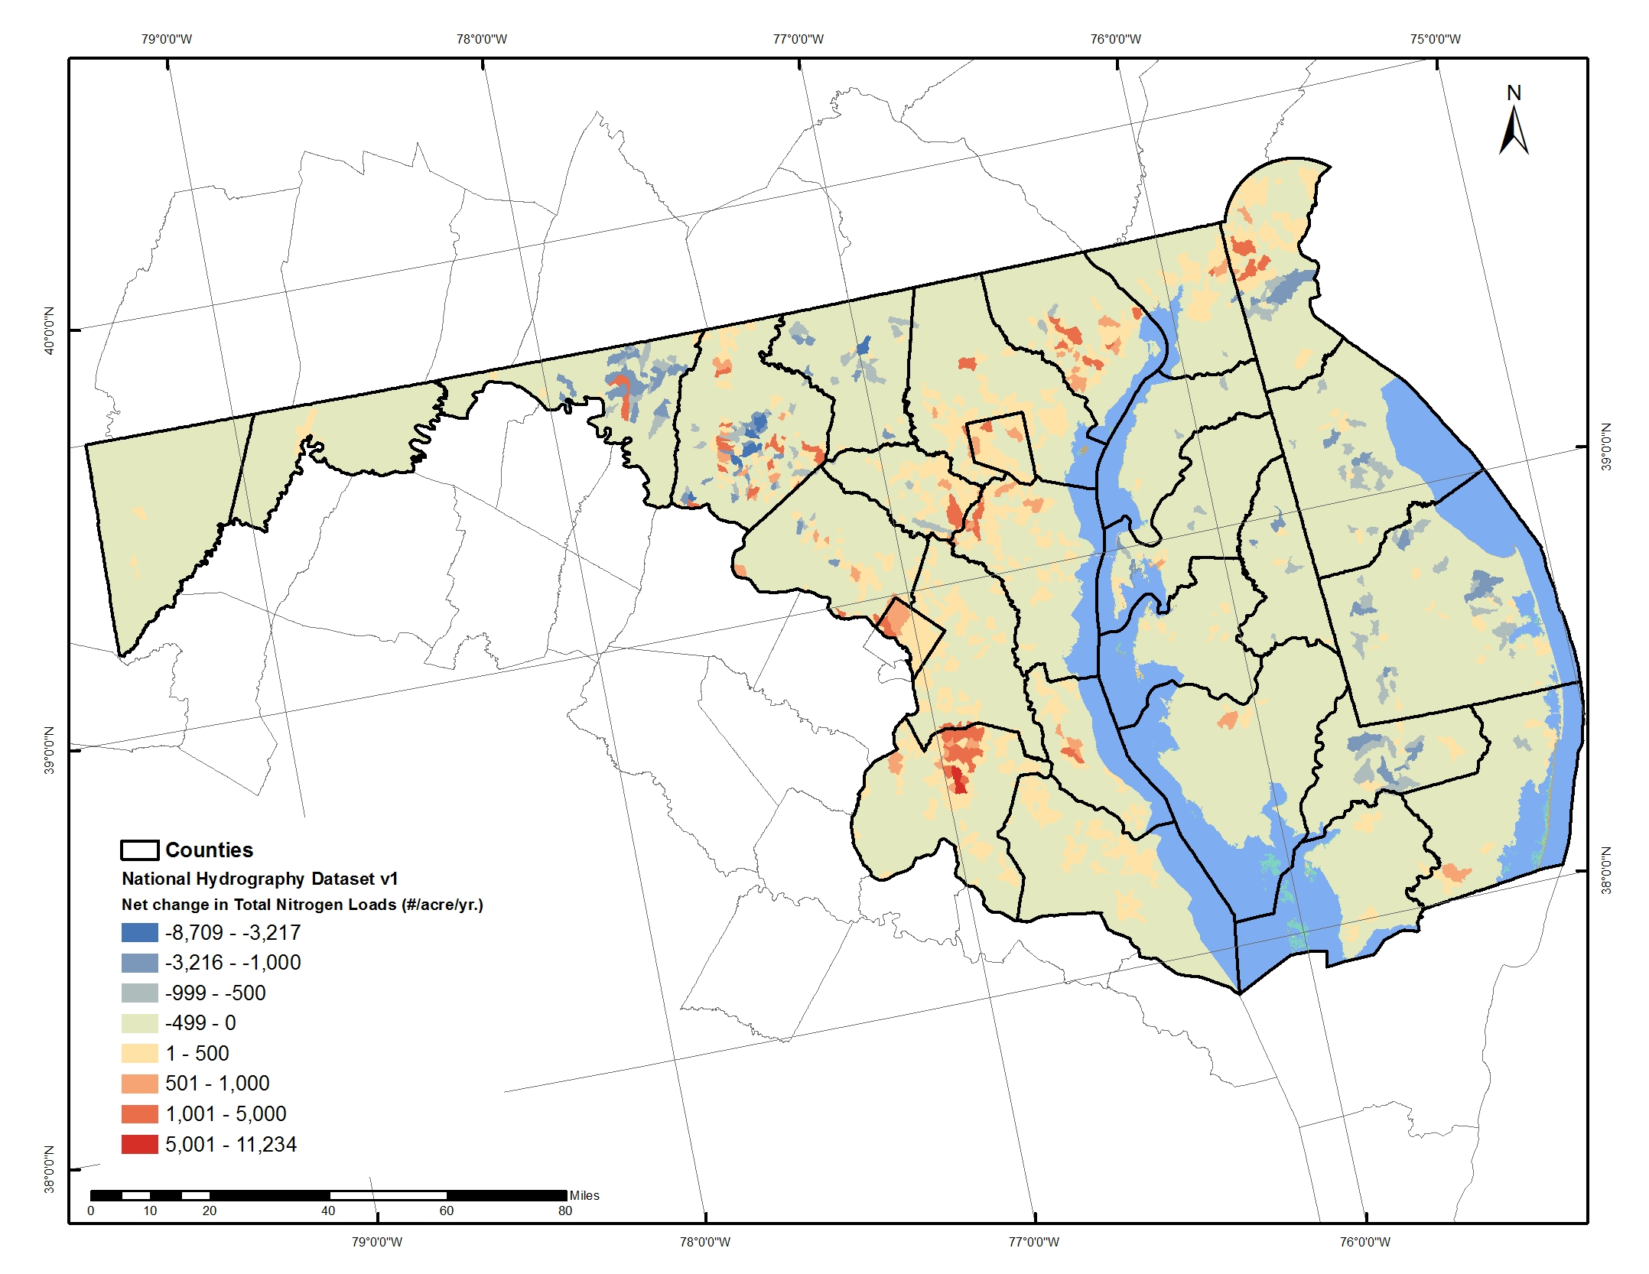
Total Nitrogen (#s/year)
2010 - 2030

Slide 28
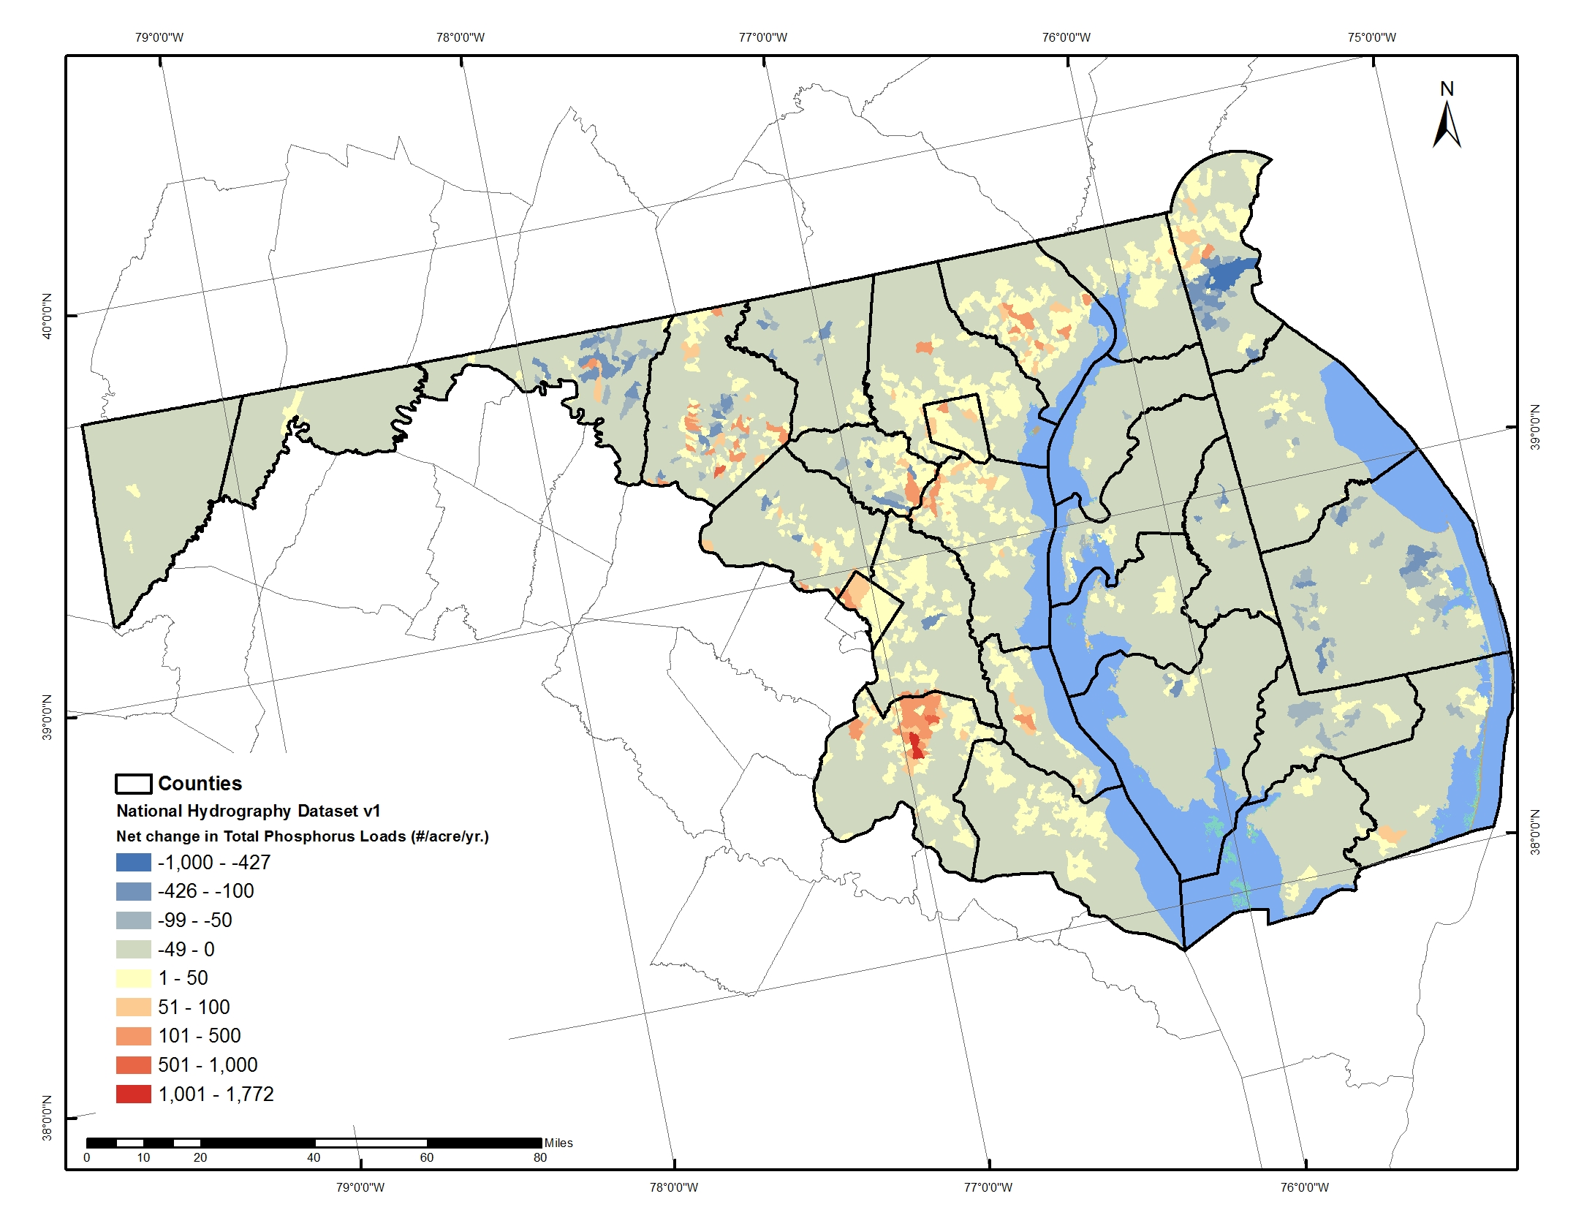
Total Phosphorus (#s/year)
2010 - 2030

Slide 29
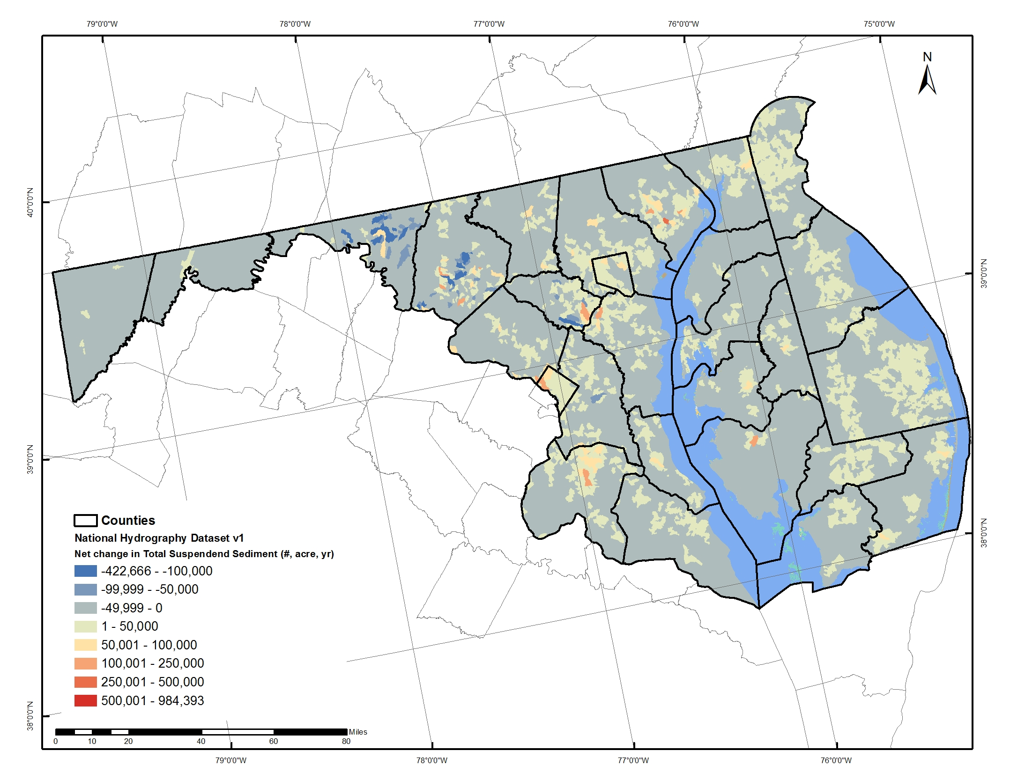
Total Suspended Sediment (#s/year)
2010 - 2030

Slide 30
Potential Alternative Future
Scenarios
Strong
Infill &
Redevelopment
Smart Growth
+
Conservation
Based on preliminary analyses:
Infill/ redevelopment more effective than conservation in reducing total amount of disturbance. Conservation only option for ensuring the best-of-the-best habitat remains in perpetuity.
Rural Down-zoning
Land-Use
Planning
TREND
Conserve
Farming & Green
Infrastructure
Laissez-
Faire
Weak
Weak
Land Conservation
Strong
Disclaimer: These data are preliminary and are subject to revision. They are being provided to meet the need for timely ‘best science’ information. The assessment is provided on the condition that neither the U.S. Geological Survey nor the United States Government may be held liable for any damages resulting from the authorized or unauthorized use of the assessment.

Slide 31
Assessing Vulnerability to Development 2.0
What is the likelihood and magnitude of forest loss for each unprotected patch of forest? Under a range of scenarios?

Slide 32
Crediting Conservation in the TMDL
(following REDD convention)
Set the Phase III WIPS on a 2025 land use.
Estimate the probable amount of forest conversion to development (e.g., 75% probability of 100 acres conversion).
Estimate the change in N,P, and TSS loads from conversion.
  = potential amount of “avoidance” that could be credited.
Estimate the change in probability and acreage of conversion due to conservation, enforced zoning, incentivized infill, and other scenarios.
Translate change in probability and acreage to a credit for avoided loads under each scenario.

Slide 33
Peter Claggett, Geographer
U.S. Geological Survey
pclaggett@usgs.gov
pclagget@chesapeakebay.net

