Slide 1

Phase 6 Land Use
Co-Chairs:
Karl Berger, Metropolitan Washington Council of Governments
Jennifer Tribo, Hampton Roads Planning District Commission
Coordinator:
Peter Claggett, U.S. Geological Survey

Slide 2
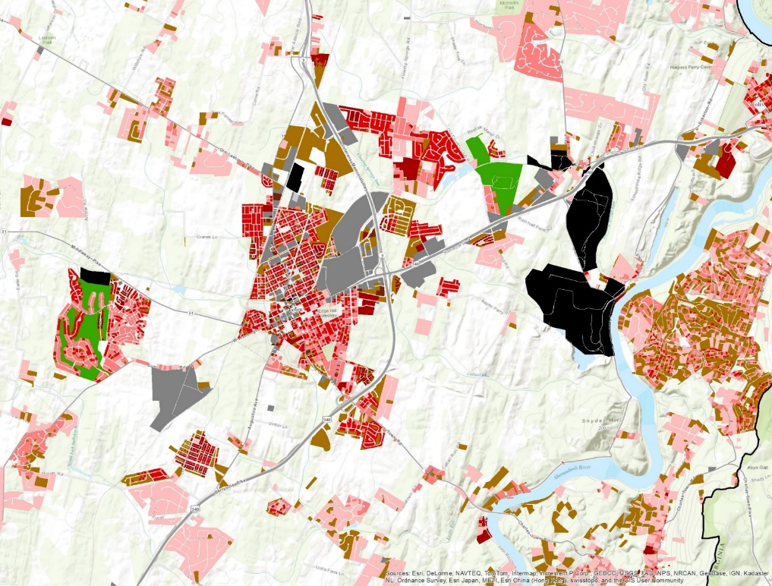
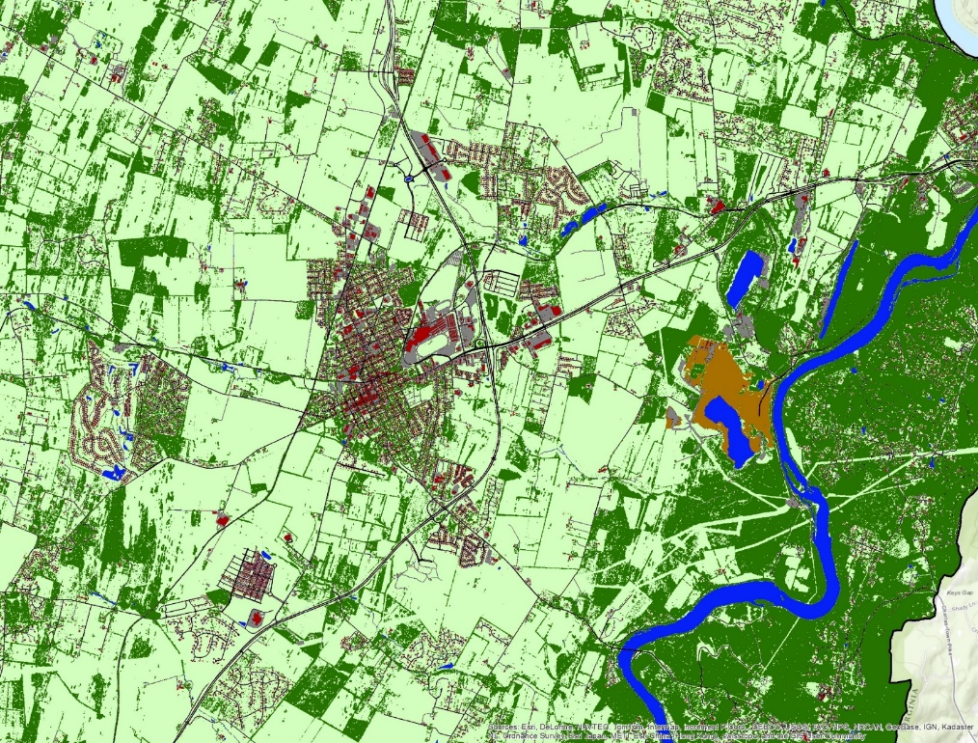
Building a 2012 Phase 6 Land Use Raster Database:
Land Use
Land Cover

Slide 3
Proposed Developed Phase 6 Land Uses
Developed
Developed
Impervious
Pervious
Construction
Extractive
Roads
Other
(e.g. Buildings, parking lots, etc.)
Tree Canopy
Open Space
Turf
Level I
Level II
Level III

Slide 4
Proposed Developed Phase 6 Land Uses
Developed
Phase 6
Roads
Buildings, parking lots, etc.
Turf grass
Tree canopy*
“Open space”
Construction
Extractive
Phase 5.3.2
Impervious surfaces
Turf grass (pervious)
Construction
Extractive
* provisional, pending further work on loading differences and model fitness

Slide 5
Proposed Developed Phase 6 Land Uses
Agriculture
Agriculture
Commodity Crops
Hay and Legume forage
Specialty and
Other Crops
Farmsteads
Corn
Soybeans
Alfalfa and other legumes
Non-legume forage
Pasture and pastured Cropland
Small Grains
Vines
Low Cover
High Cover
Animal
Non-animal
Level I
Level II
Level III

Slide 6
Proposed Agricultural Phase 6 Land Uses
(from Ag Workgroup and Ag Modeling Subcommittee)
Agriculture
Phase 6
Corn
Soybeans
Small grains
Alfalfa
Non-legume forage
Pasture
Vines
Low cover specialty
High cover specialty
Impervious CAFO & AFO farmsteads
Impervious non-animal farmsteads
Pervious CAFO & AFO farmsteads
Pervious non-animal farmsteads
Phase 5.3.2
Hightill w/ & w/o manure
Lowtill with manure
Nutrient management hightill w/ & w/o manure
Nutrient management lowtill
Alfalfa
Hay w/ & w/o nutrients
Nutrient management alfalfa
Nutrient management hay
Pasture
Nutrient management pasture
Nursery
AFOs
CAFOs
Degraded riparian pasture

Slide 7
Proposed Developed Phase 6 Land Uses
Natural
Natural
Forests
Wetlands
Water
(non-tidal)*
Undisturbed
Harvested
Tidal emergent
Fresh emergent
Non-tidal woody
Disturbed
(e.g. insects, fire, etc.)
Level I
Level II
Level III

Slide 8
Proposed Natural Phase 6 Land Uses
Natural
Phase 6
Forests
Harvested forest
Disturbed forest
Tidal emergent wetlands
Fresh emergent wetlands
Non-tidal woody wetlands
Water*
Phase 5.3.2
Woody/open
Harvested forest
Water
* Will expand water coverage to include 1:24K National Hydrography Dataset waterbodies and possibly Landsat derived “persistent” water features.

Slide 9
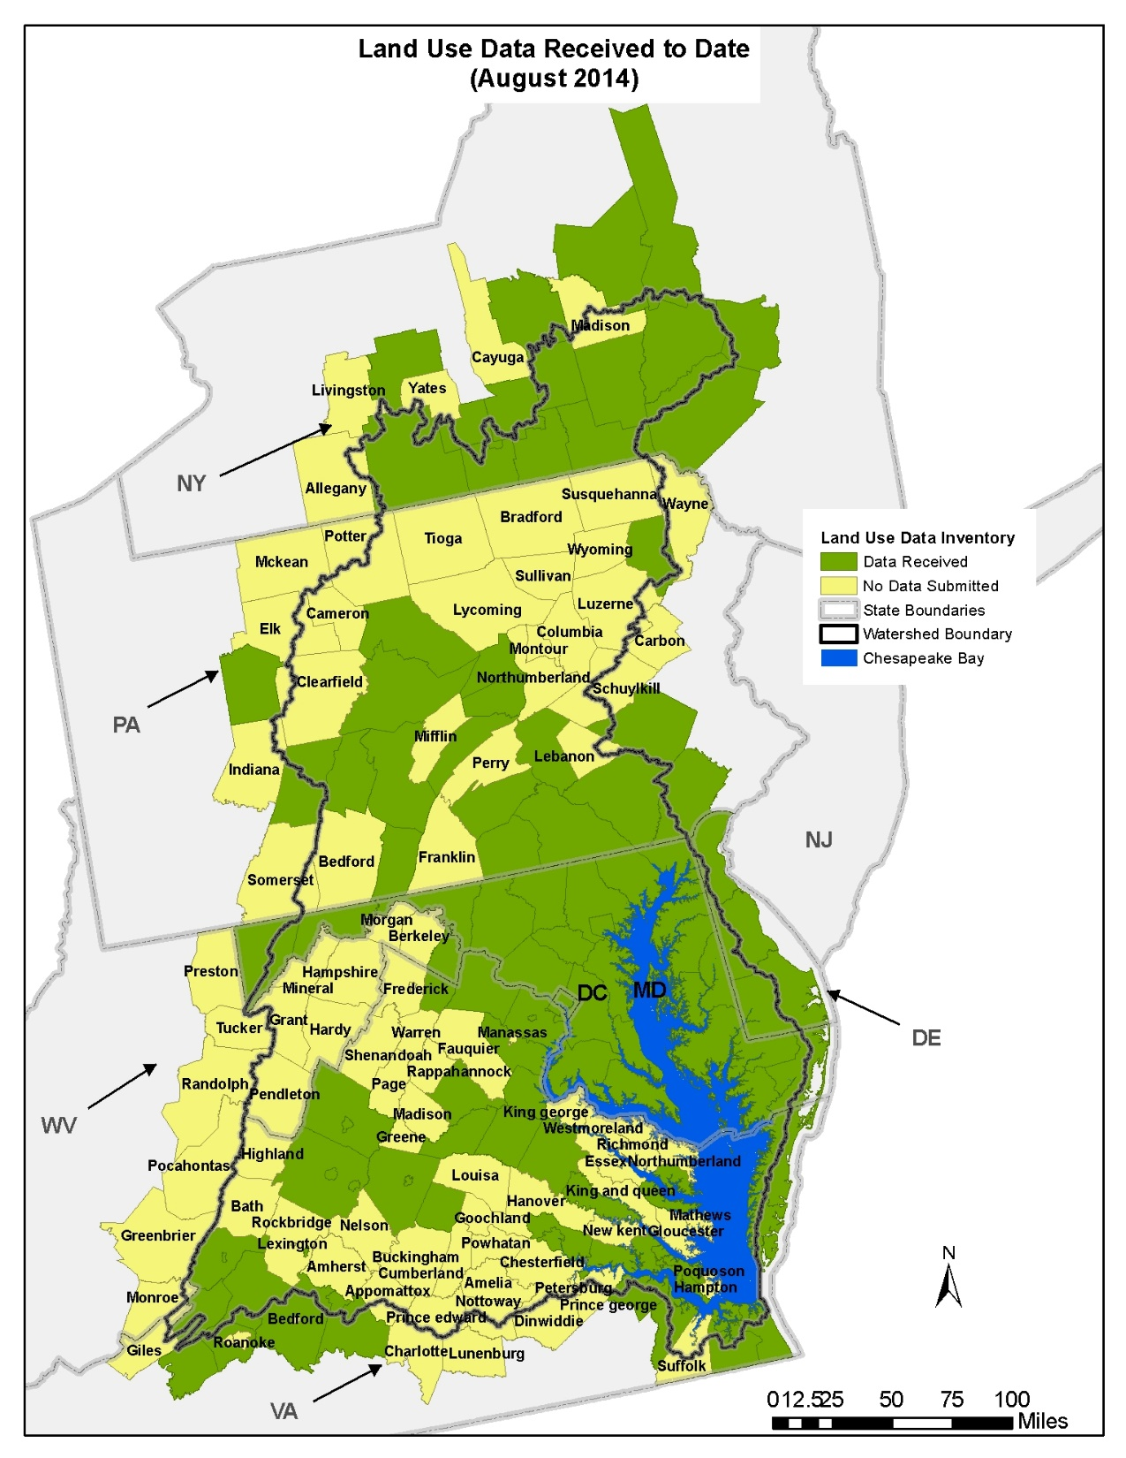

Slide 10
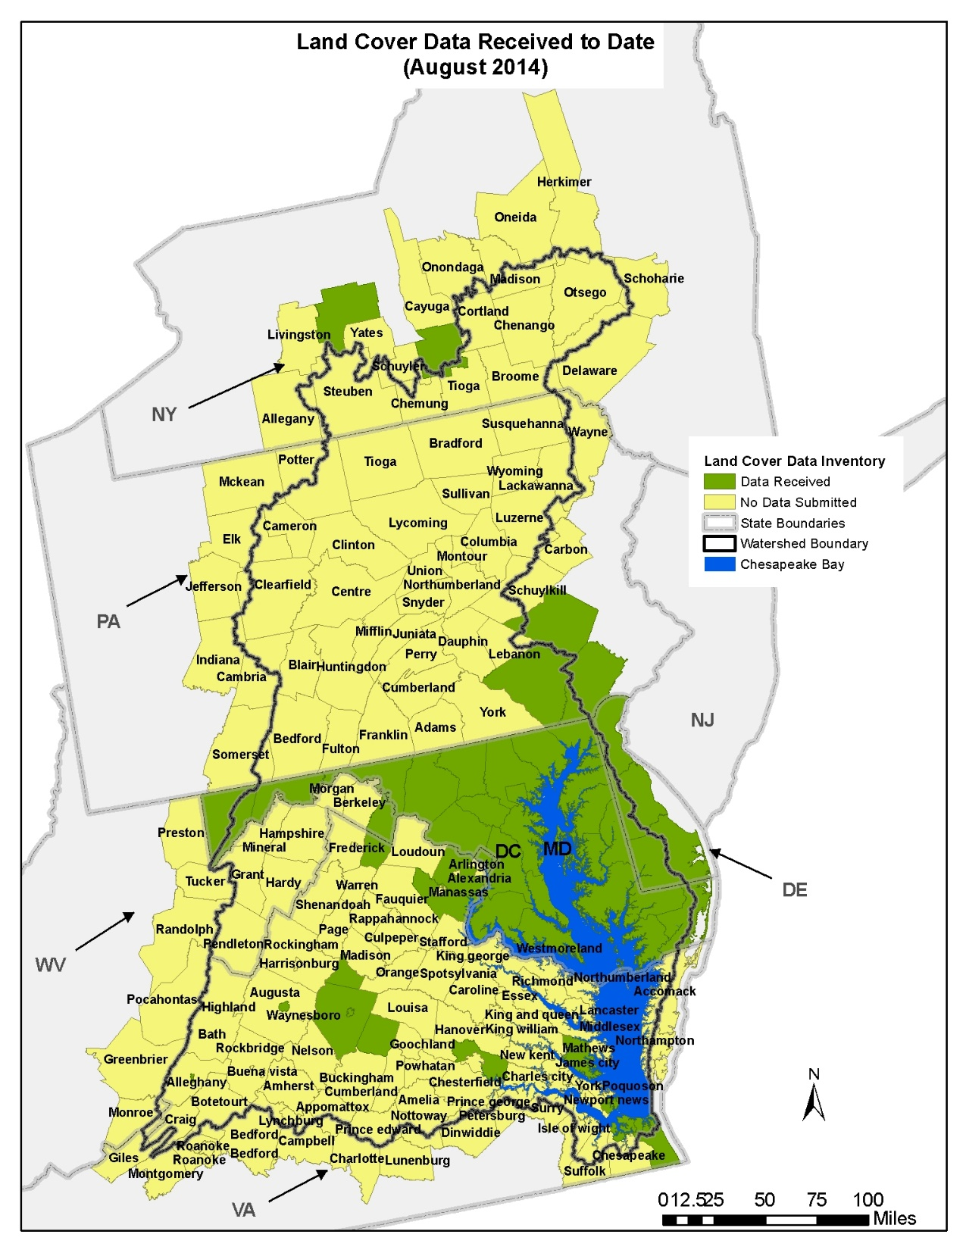

Slide 11
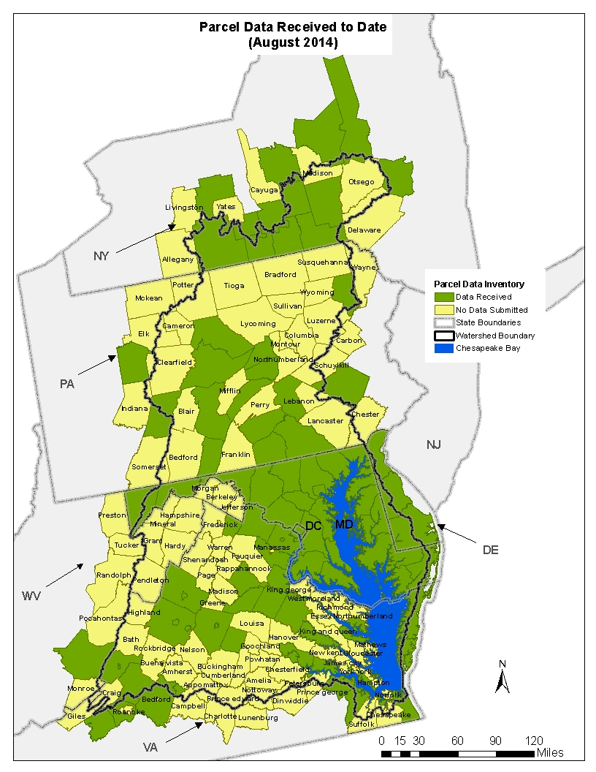

Slide 12
Questions?

