Slide 1
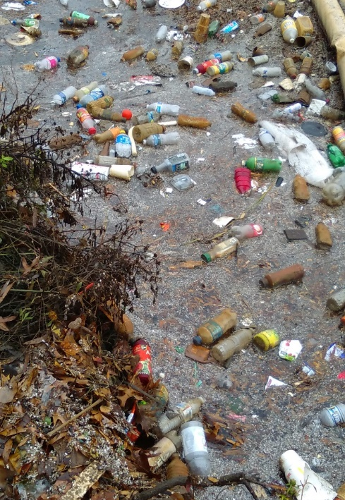
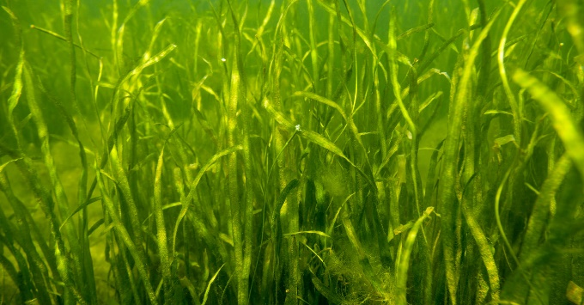
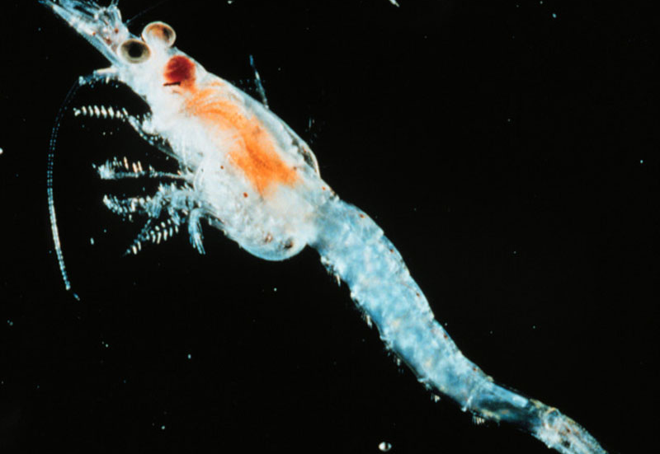
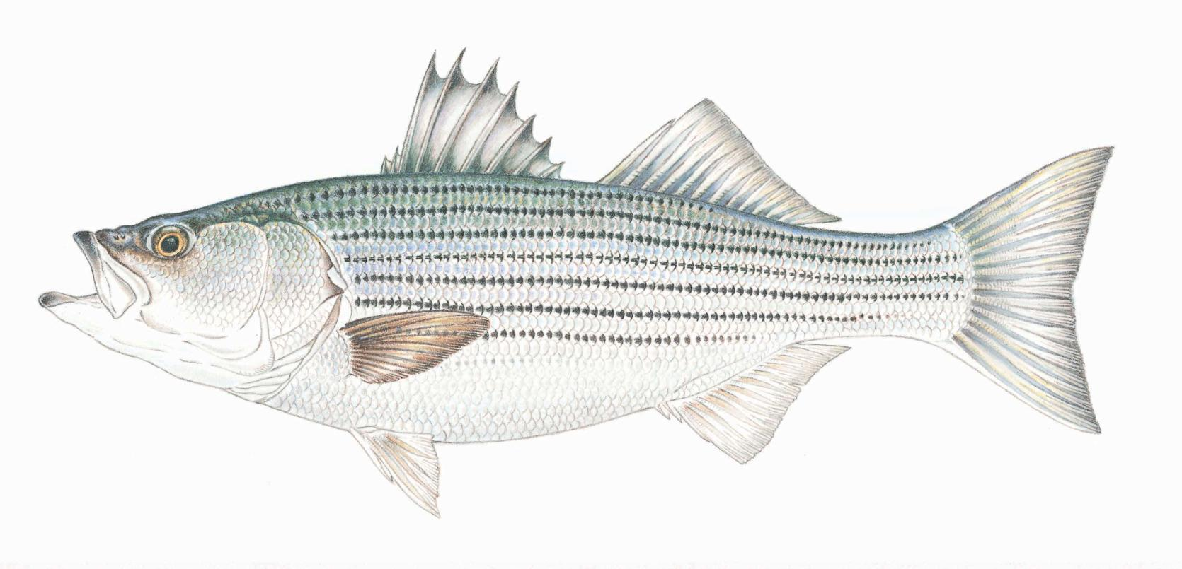
MICROPLASTICS ECOLOGICAL RISK ASSESSMENT: Phase II Model
Bob Murphy, Jennifer Flippin- Tetra Tech Center for Ecological Sciences
Ryan Woodland, Univ. of Maryland, Chesapeake Biological Laboratory

Slide 2
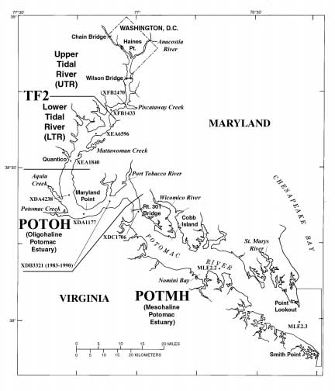
Model Input and Criteria for Inclusion Potomac River Striped Bass 0-2YO¹
Literature Review
Potomac River data
Chesapeake Bay/other tributary studies
Other Atlantic Coast
Global
¹ See draft for description of 3YO

Slide 3
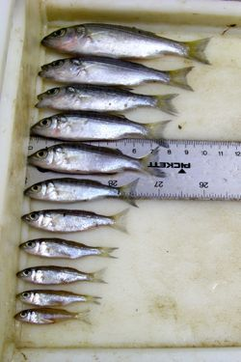
Model Development
Biological endpoints of potential interest
Qualitative food web interactions that could lead to microplastic intake by Striped Bass;
Semi-quantitative food web interaction scenarios for Striped Bass living in different salinity regimes.

Slide 4
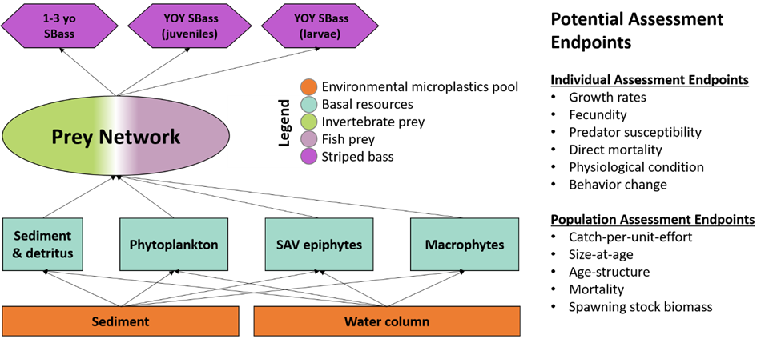
Biological Endpoints

Slide 5
Model Development
Biological endpoints of potential interest
Qualitative food web interactions that could lead to microplastic intake by Striped Bass;
Semi-quantitative food web interaction scenarios for Striped Bass living in different salinity regimes.

Slide 6
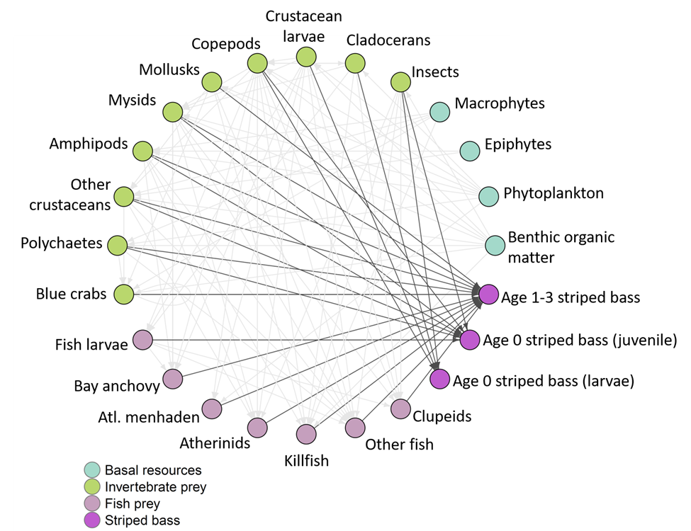
Qualitative food web interactions

Slide 7
Model Development
Biological endpoints of potential interest
Qualitative food web interactions that could lead to microplastic intake by Striped Bass;
Semi-quantitative food web interaction scenarios for Striped Bass living in different salinity regimes.

Slide 8
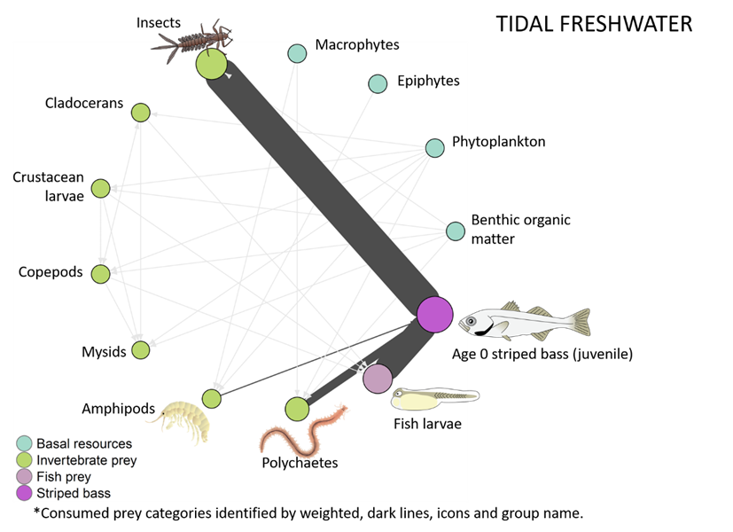
Semi-quantitative food web interaction
Data from Boynton et al 1981

Slide 9
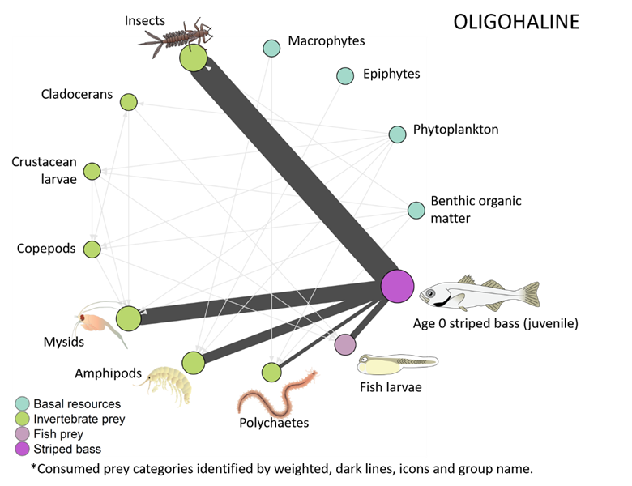
Semi-quantitative food web interaction
Data from Boynton et al 1981

Slide 10
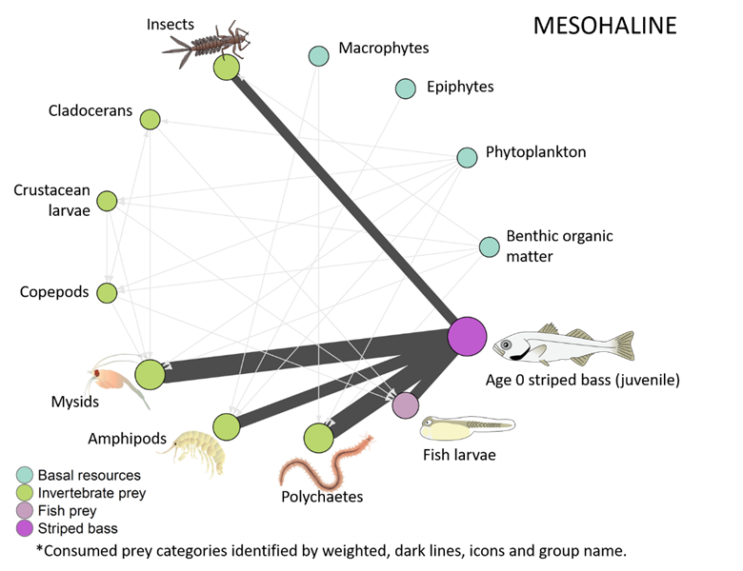
Semi-quantitative food web interaction
Data from Boynton et al 1981

Slide 11
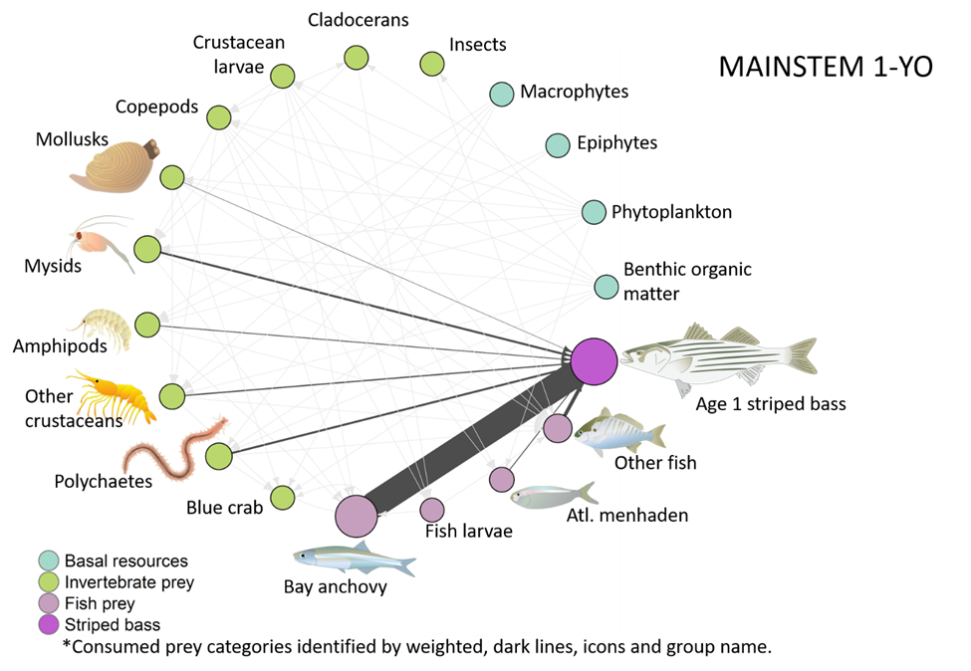
Baywide diet: 1YO
Data from Ihde et al, 2015

Slide 12
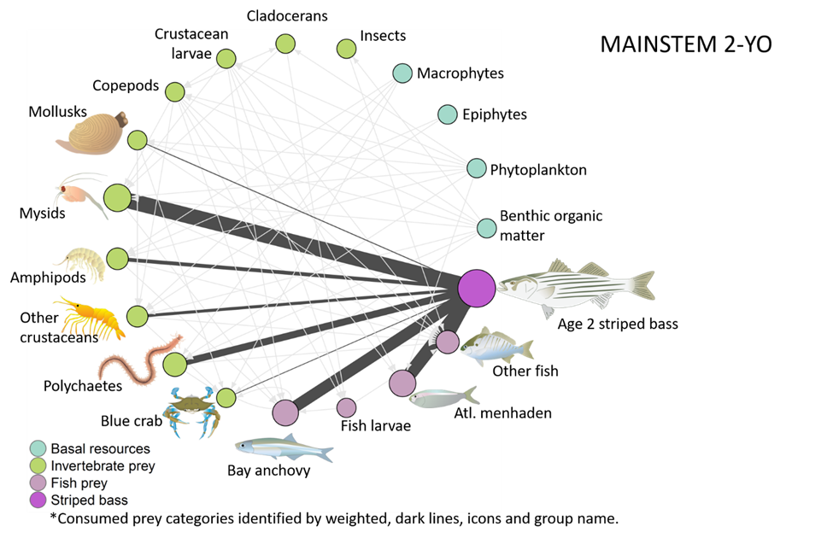
Baywide diet: 2YO
Data from Ihde et al, 2015

Slide 13
Microplastic pathways
Major Taxa | Confirmed MP presence or consumption? (Y/N) | Location | Citation | Notes
Habitat
Macrophytes (includes SAV and wetlands) | Y | (SAV) Caribbean; UK, Korea; Washington, DC; (wetlands)South Africa; multiple | (Goss et al. 2018, Reynolds and Ryan 2018, Murphy 2019, Townsend et al. 2019, Cozzolino et al. 2020, Huang et al. 2020, Jones et al. 2020) | Macrophytes include a combination of SAV and wetlands given similar roles for microplastic adherence
Epiphytes | Y | Caribbean; | (Goss et al. 2018, Seng et al. 2020) | Found in epiphytes on seagrass
Benthic organic matter | Y | St. Lawrence River; Washington DC; | (Castaneda et al. 2014, Murphy 2020)
Phytoplankton | Y | Laboratory; | (Long et al. 2015, Shiu et al. 2020) | Diatoms; aggregation of cells on MPs
Invertebrate Prey
Insects | Y
Crustacean larvae | Y | Laboratory | (Jemec et al. 2016, Gambardella et al. 2017, Woods et al. 2020) | Lobsters; barnacle nauplii;
Cladocerans | Y | Laboratory | (Martins and Guilhermino 2018, Jaikumar et al. 2019, Woods et al. 2020) | Freshwater regions
Copepods | Y | Laboratory; Pacific Ocean | (Cole et al. 2015, Desforges et al. 2015)
Amphipods | Y | Laboratory | (Jeong et al. 2017, Mateos Cárdenas et al. 2019) | Jeong et al proposed an adverse outcome pathway for microplastic exposure that covers molecular and individual levels.

Slide 14
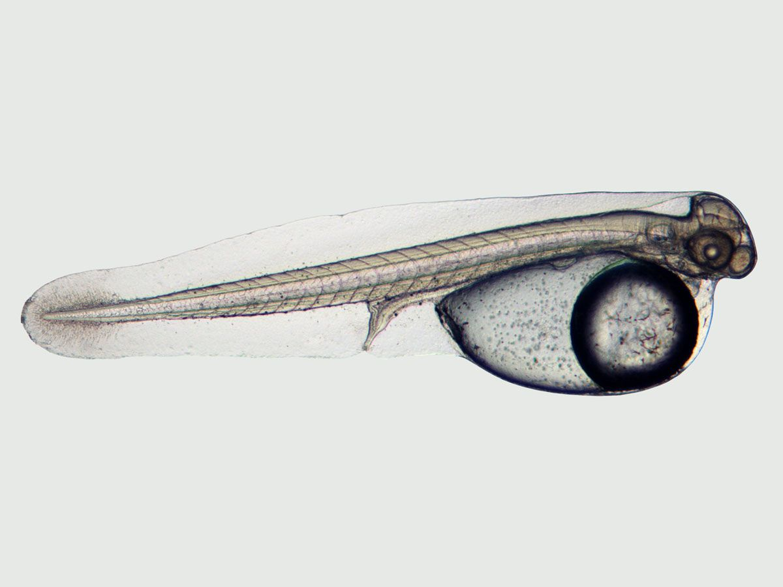
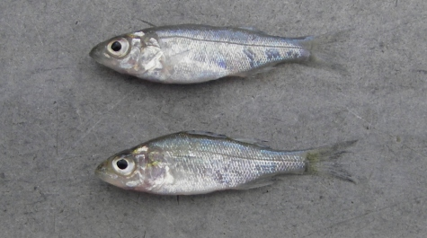
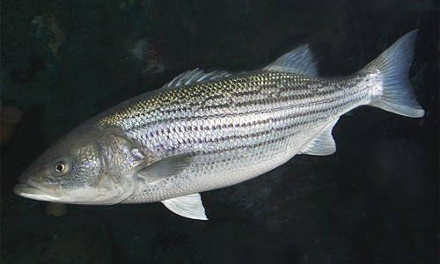
Next Steps
Incorporating comments/recommendations
Quantifiable network development

