Slide 1
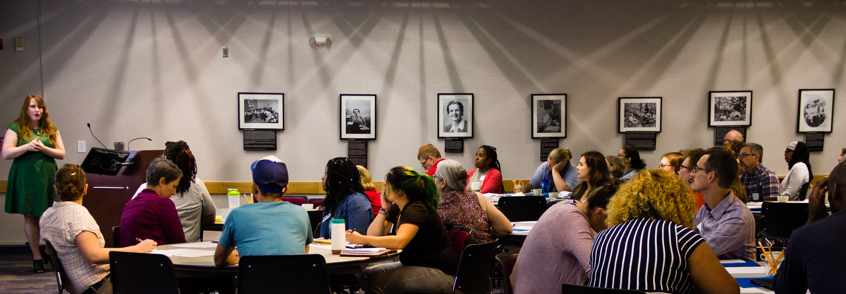
Planning for 2020 Conferences

Slide 2
Deadlines and Costs
Trusted Source | Jurisdiction | 2020 Conferences and Meetings | Dates | Proposal Due Date | Estimated Costs
Maryland Municipal League | MD | Summer Conference | June 28 - July 1 | August 2019 | $1,000
Pennsylvania State Association of Township Supervisors | PA | Annual Conference | May 3 - 6 | September 2019 | $750
Pennsylvania Municipal League | PA | Spring Sustainability Conference | June 9 | February 2020 | $500
Pennsylvania Municipal League | PA | Fall Sustainability Conference | November | February 2020 | $500
Pennsylvania State Association of Boroughs | PA | Fall Conference | October 16 - 18 | February 2020 | $500
Maryland Association of Counties | MD | Summer Conference | August 19 - 22 | April 2020 | $1,000
County Commissioners Association of Pennsylvania | PA | Annual Conference | August 16 - 19 | Rolling | $500

Slide 3
Accepted 2020 Proposals
Maryland Municipal League (MML) – Summer Conference (June 2020)
  Climate Resilience – Environmental Finance Center, Harry Hughes Center
Pennsylvania State Association of Township Supervisors (PSATS) – Annual Conference (May 2020)
  Understanding Your Community’s Stormwater Obligations

Slide 4
Upcoming 2020 Proposals
Pennsylvania Municipal League (PML) – Spring/Fall Sustainability Summit
  Stormwater
  Tree canopy
Maryland Association of Counties (MACO) – Summer Conference
  Planning for clean water
  Tree canopy
Pennsylvania State Association of Boroughs (PSAB) – Fall Conference
  Infrastructure maintenance and stormwater
  Tree canopy
County Commissions Association of Pennsylvania (CCAP) – Annual Conference
  Land use planning impacts on floodplains
  Role of counties in WIP implementation
  Outdoor recreation industry and natural resource protection

Slide 5
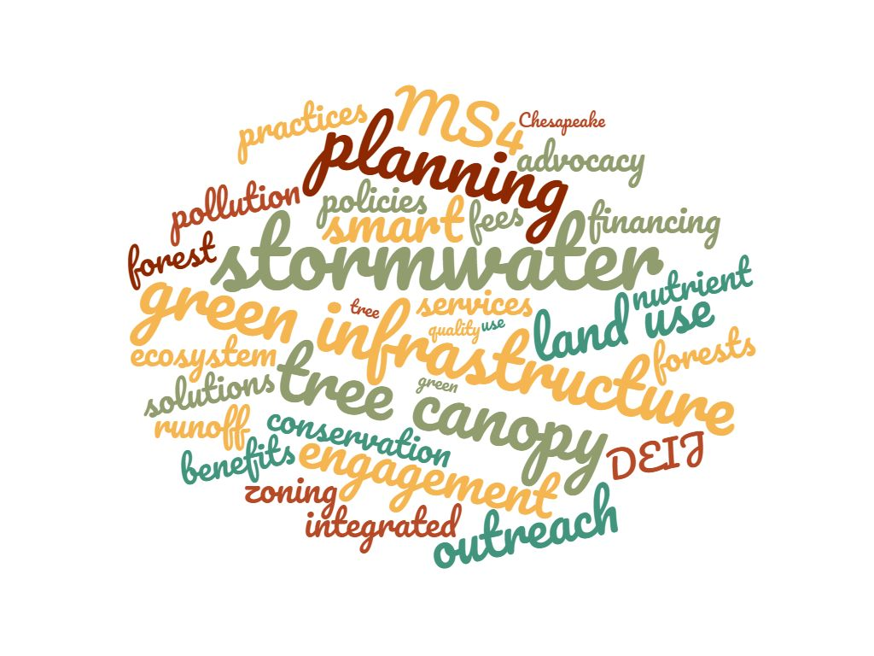
LLWG Capacity – Survey Results
16 participants
87.5% have capacity for 1 – 2 presentations per year
Multiple participants mentioned that they could also recommend speakers

Slide 6
THANK YOU!

Slide 7
If the costs of presenting were covered, would it be easier for you to present?

Slide 8
Support for LLWG Presenters
What: Travel reimbursement (mileage, hotel, registration, meals etc.) of up to $500/speaker/event
Who: Active LLWG members who present at trusted source events
How: 1) Before the event, complete pre-approval worksheet and send to Laura 2) After the event, complete reimbursement worksheet, compile receipts and send to Laura
Full details → Expense Reimbursement Policy

