Slide 1

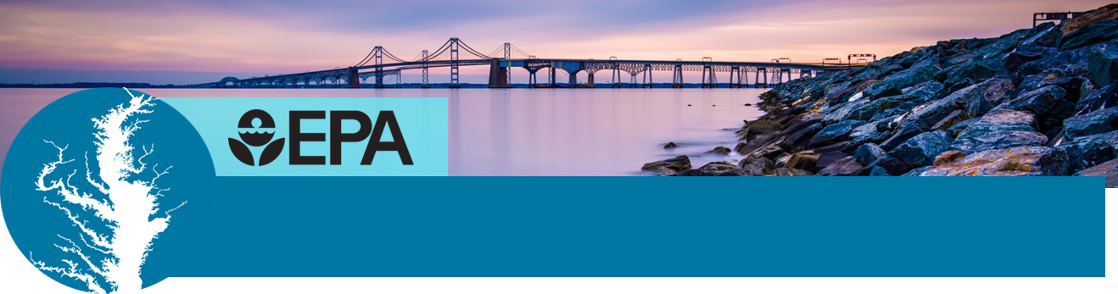


Chesapeake Bay Restoration
What is a Watershed Implementation Plan?
Lucinda Power, Implementation & Evaluation Team Leader
EPA Chesapeake Bay Program Office
November 8, 2017

Slide 2
What’s driving the WIPs?
Recent Bay Program “Drivers”
Chesapeake Bay Foundation Settlement Agreement with EPA – May 2010
Bay TMDL (Total Maximum Daily Load) – December 2010
All CBP Jurisdictions participating and sets goals and planning targets for 2017 and 2025
Chesapeake Bay Watershed Agreement 2014
10 Broad Goals, 31 Well-defined Outcomes
Headwater state are full partners

Slide 3


Bay TMDL Accountability Framework Starts with Watershed Implementation Plans
1. Watershed
Implementation
Plans identify
nutrient and sediment targets that meet water quality standards.
2. 2-Year
Milestones
with programmatic and pollutant reduction commitments
3.Track and
Assess
Progress
implementing WIPs and milestones
4. Federal Actions
if insufficient
Watershed Implementation Plans or 2-year milestones

Slide 4
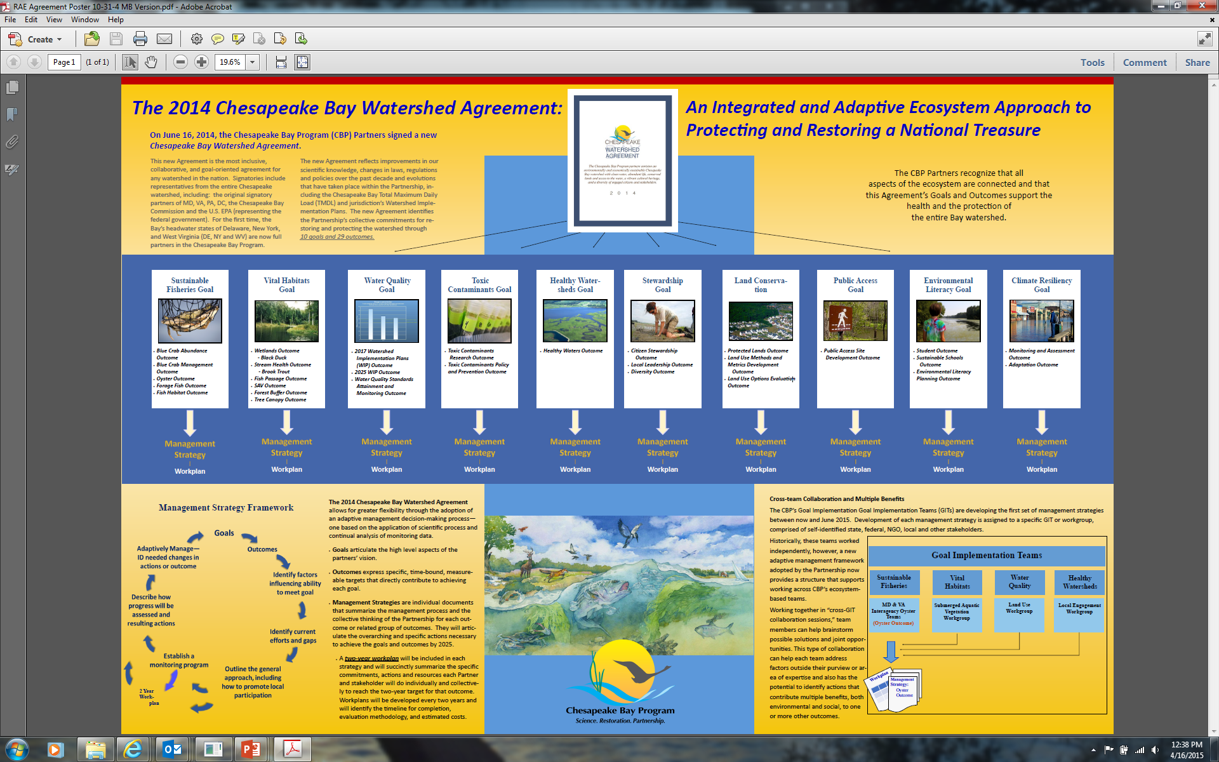
Our Goals

Slide 5
2017 & 2025 WIP Outcomes
By 2017, have practices and controls in place that are expected to achieve 60 percent of the nutrient and sediment pollution load reductions necessary to achieve applicable water quality standards compared to 2009 levels
By 2025, have all practices and controls installed to achieve the Bay’s dissolved oxygen, water clarity/submerged aquatic vegetation and chlorophyll a standards as articulated in the Chesapeake Bay TMDL document.

Slide 6
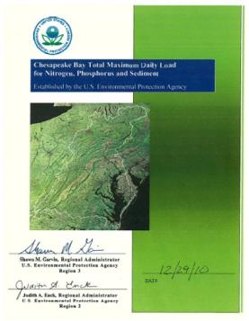
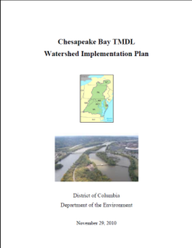
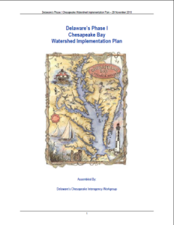
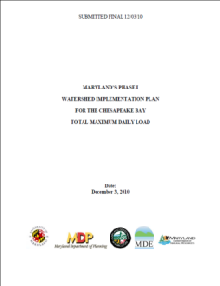
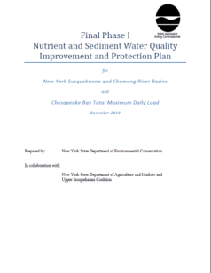
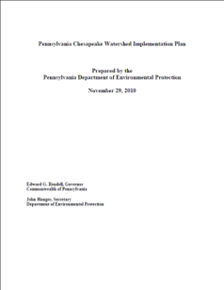
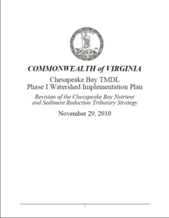
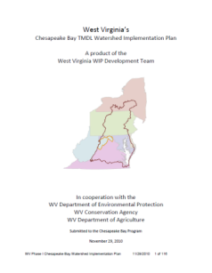
Chesapeake Bay TMDL
2010 Chesapeake Bay TMDL Based on the & Bay Jurisdictions’ Watershed Implementation Plans

Slide 7
Elements of a WIP: A Roadmap to Achieve Water Quality Standards
Phase I WIP and Phase II WIPs were developed and submitted to EPA in 2010 and 2012, respectively.
These documents focused on the following elements:
Interim and final N, P, and SED Target Loads
Current Loading Baseline and Program Capacity
Account for Growth
Gap Analysis
Tracking and Reporting Protocols
Contingencies
Appendix w/ Detailed Targets & Schedule

Slide 8
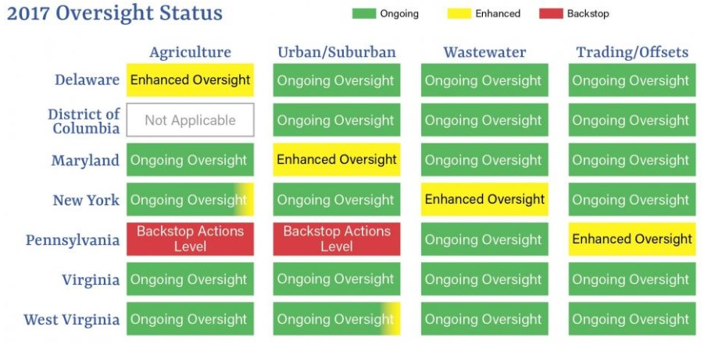

Slide 9
What’s Different in Phase III WIPs?
Programmatic and numeric implementation commitments for 2018-2025
Strategies for engagement of local, regional and federal partners in implementation
Account for changed conditions: climate change, Conowingo Dam infill, growth
Develop, implement local planning goals below the state-major basin scales
Use of Phase 6 suite of modeling tools, expanded monitoring and trends data
Consideration of co-benefits of BMPs

Slide 10
Midpoint Assessment
Revised Schedule
December 19-20, 2017 PSC Retreat
PSC meeting to make final decisions on how to address Conowingo Dam and climate change in the Phase III WIPs; approval of the Phase 6 suite of modeling tools; accounting for growth; and release of the draft Phase III WIP planning targets for 4-month Partnership review
December 22, 2017 – April 20, 2018
Partnership review of the draft Phase III WIP planning targets
Release of Final EPA Phase III WIP Expectations (late January 2018)
May 7, 2018
Release of the final Phase III WIP planning targets
February 8, 2019
Draft Phase III WIPs posted on jurisdictions’ websites for partner and public stakeholder review
June 7, 2019
Final Phase III WIPs posted on jurisdictions’ websites

Slide 11

Learn more at
www.chesapeakebay.net/
www.epa.gov/chesapeakebaytmdl

