Slide 1
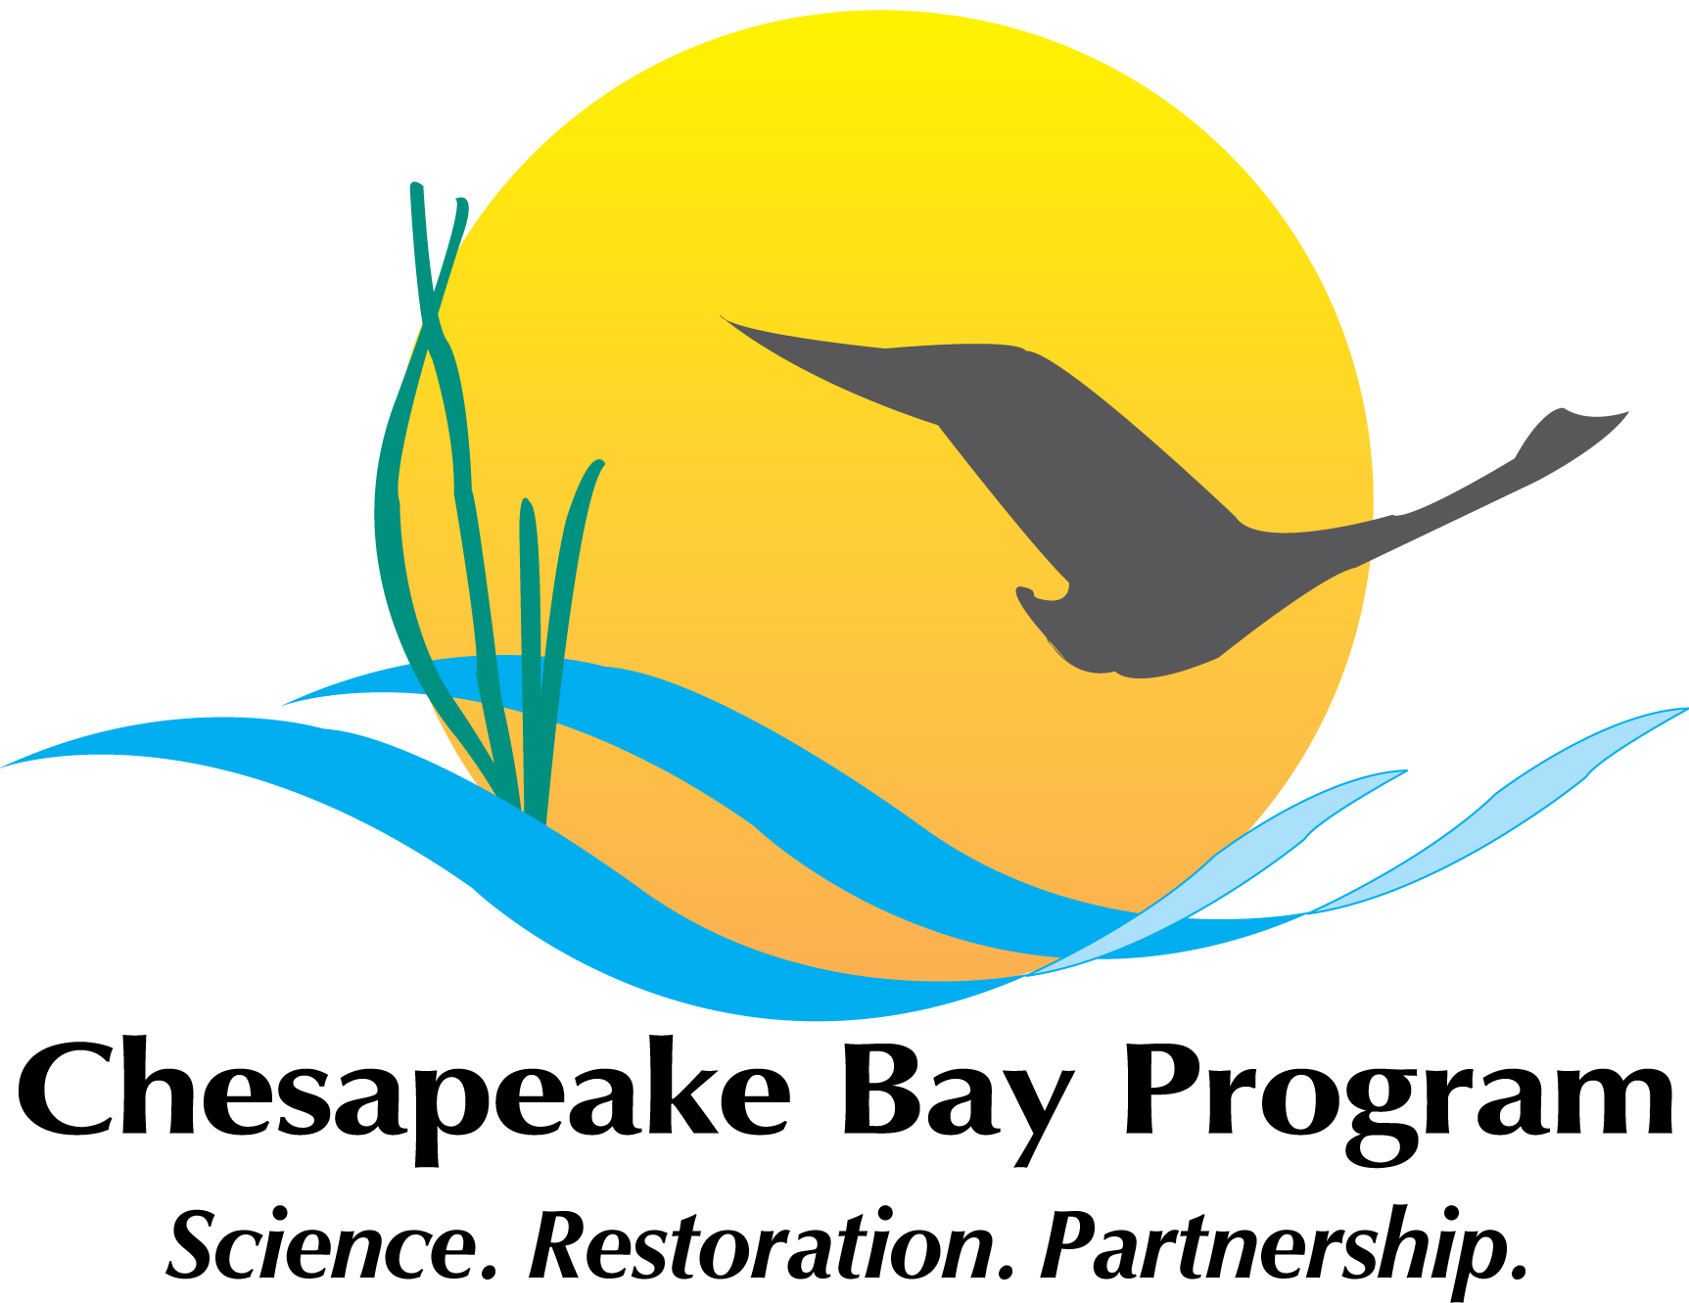
Let’s Talk About Source Reduction!!!
MATT ROBINSON
Watershed Protection Division
DC Department of Energy and Environment
& Chair, Chesapeake Bay Program
Plastic Pollution Action Team
Notes:
This will be a brief overview of DC’s participation in a multi-jurisdictional effort to address trash in the Anacostia River.
Trash is not one of the pollutants that total maximum daily loads, or TMDLs, have been traditionally developed for.
However, given the regulatory framework that a TMDL provides for addressing various sources for trash, I hope to illustrate to everyone here today how it has been used to effectively address trash in local waterways in DC.

Slide 2

Is it time?
From the 2020 Management Board Charge to the PPAT:
“Monitor policy advances at the state and federal level that could potentially impact, advance or complement [the PPAT’s work] to inform the science strategy and to identify potential policy or management options that could be utilized for source reduction strategies.”
From the 2021 PSC Directive to the PPAT:
“The PPAT should work on a plastic pollution source assessment and reduction strategy.”
Strong Interest Expressed at Fall 2021 Chesapeake Bay Commission Meeting:
Very interested in “low hanging fruit” policy and management options.
Interested in learning more about what federal funding sources are available to address plastic pollution (e.g. 2021 infrastructure bill, 2019 SOS Act 2.0).
@DOEE_DC
Notes:
Now, how do we implement a trash TMDL?
Well, in DC, two major policy pieces are pushing compliance:
The 2012 iteration of our MS4 permit required the District to have the tools on the ground, by 2017, to capture or remove 103,188 lbs of trash per year from the Anacostia River watershed. That is the equivalent of the MS4 point source load.
Per the NPDES permit for the combined sewer system, DC Water is required to implement a multi-year long term control plan for reducing the frequency of overflows from the combined sewer system. These are commonly known as combined sewer overflows. They are in the process of implementing a multi-year, multi-billion dollar to construct underground tunnels to capture this overflow and hold it for eventual piping to blue plains for treatment.

Slide 3
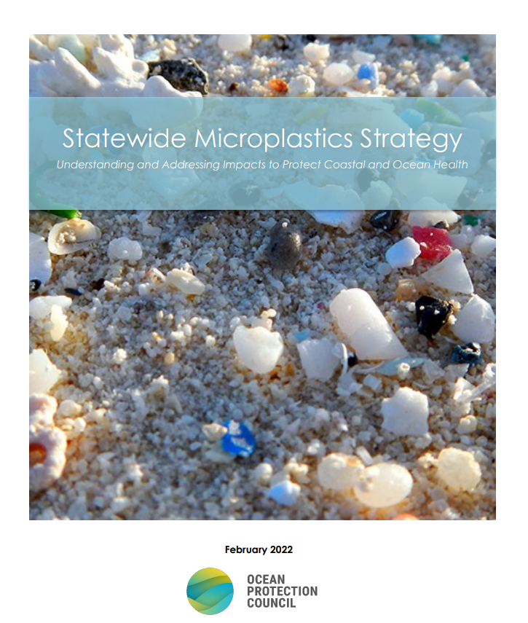
2022 California State Microplastics Strategy
Two Trach approach:
Solutions – Pursue solutions the state will act upon now while the scientific knowledge of microplastics specific to California further develops.
Science to Inform Future Action – Invest in and advance scientific knowledge of microplastics to develop and refine future solutions.
“These two paths, taken together, reinforce and enhance each other. Immediate actions allow the state to move with the urgency this moment calls for, while future solutions are made possible only by advancing scientific knowledge.”
@DOEE_DC
Notes:
Now, how do we implement a trash TMDL?
Well, in DC, two major policy pieces are pushing compliance:
The 2012 iteration of our MS4 permit required the District to have the tools on the ground, by 2017, to capture or remove 103,188 lbs of trash per year from the Anacostia River watershed. That is the equivalent of the MS4 point source load.
Per the NPDES permit for the combined sewer system, DC Water is required to implement a multi-year long term control plan for reducing the frequency of overflows from the combined sewer system. These are commonly known as combined sewer overflows. They are in the process of implementing a multi-year, multi-billion dollar to construct underground tunnels to capture this overflow and hold it for eventual piping to blue plains for treatment.

Slide 4
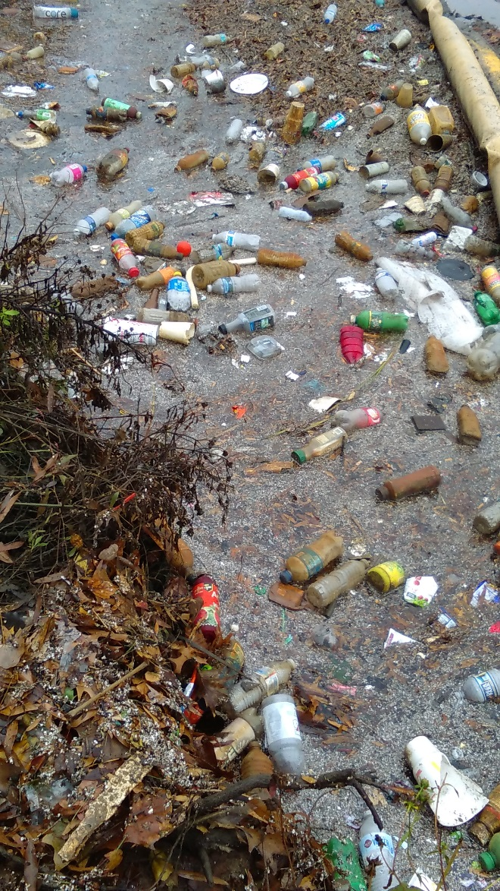
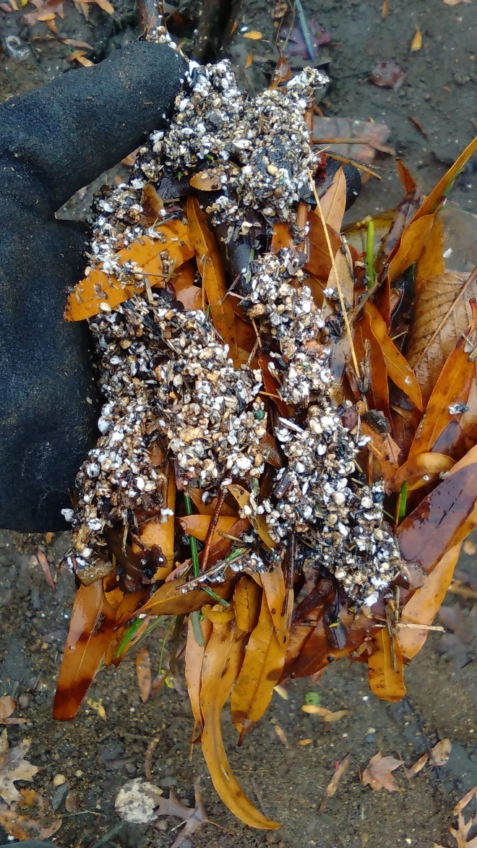
2022 California State Microplastics Strategy
Justification for implementing solutions NOW:
CA Ocean Protection Council Advisory Board urged the state to take a precautionary approach to microplastics management to curb introduction of microplastics into the environment.
The strategy recognizes that once microplastics have entered the environment it is difficult, if not impossible, to remove them.
Strategy calls on California to take a series of immediate, “no regrets” actions.
Polystyrene particles in the Anacostia River (photo by Masaya Maeda, Anacostia Watershed Society, 2017)
@DOEE_DC
Notes:
Now, how do we implement a trash TMDL?
Well, in DC, two major policy pieces are pushing compliance:
The 2012 iteration of our MS4 permit required the District to have the tools on the ground, by 2017, to capture or remove 103,188 lbs of trash per year from the Anacostia River watershed. That is the equivalent of the MS4 point source load.
Per the NPDES permit for the combined sewer system, DC Water is required to implement a multi-year long term control plan for reducing the frequency of overflows from the combined sewer system. These are commonly known as combined sewer overflows. They are in the process of implementing a multi-year, multi-billion dollar to construct underground tunnels to capture this overflow and hold it for eventual piping to blue plains for treatment.

Slide 5
What Types of Solutions?
Three Broad Categories:
Pollution Prevention - to eliminate plastic waste at the source, defined as the product, material, or industry from which microplastics originate. Strategies to achieve pollution prevention can include the elimination of specific products and materials through financial incentives to encourage product innovation and waste reduction; identifying alternate product actions, including alternate sourcing and design; and, where necessary, product and material prohibitions.
Pathway intervention - to intervene within specific pathways, such as stormwater or wastewater, that mobilize microplastics from a specific source into California waters.
Outreach & education - to engage impacted communities, raise awareness of microplastic pollution, and facilitate behavior, policy, systemic, and environmental change. Education campaigns and K-12 curriculum changes should be pursued as a targeted, strategic complement to other solutions that directly prevent and reduce plastic production, use, and waste.
@DOEE_DC
Notes:
Now, how do we implement a trash TMDL?
Well, in DC, two major policy pieces are pushing compliance:
The 2012 iteration of our MS4 permit required the District to have the tools on the ground, by 2017, to capture or remove 103,188 lbs of trash per year from the Anacostia River watershed. That is the equivalent of the MS4 point source load.
Per the NPDES permit for the combined sewer system, DC Water is required to implement a multi-year long term control plan for reducing the frequency of overflows from the combined sewer system. These are commonly known as combined sewer overflows. They are in the process of implementing a multi-year, multi-billion dollar to construct underground tunnels to capture this overflow and hold it for eventual piping to blue plains for treatment.

Slide 6
Examples of Pollution Prevention
Product & Material Regulations
Implement the statewide requirement that single-use foodware and condiments be provided only upon request.
Enact comprehensive statewide plastic source reduction, reuse, and refill goals by 2023.
Economic Strategies
Identify Extended Producer Responsibility (EPR) strategies for recycling or disposal of plastic packaging and foodware by 2022.
Promote, or otherwise require, the sale and use of ENERGY STAR condenser dryers and washing machines with filtration rates of 100 microns or smaller and develop a program to incentivize post-market retrofits or purchases through rebates and other mechanisms by 2024.
Identifying & Advancing Product Alternatives
Convene representatives from targeted industries (e.g., vehicle tires, textiles, agriculture, foodware and packaging, and/or fisheries & aquaculture) and scientific experts to identify alternative products and other sector-specific plastic pollution prevention strategies by 2023.
@DOEE_DC
Notes:
Now, how do we implement a trash TMDL?
Well, in DC, two major policy pieces are pushing compliance:
The 2012 iteration of our MS4 permit required the District to have the tools on the ground, by 2017, to capture or remove 103,188 lbs of trash per year from the Anacostia River watershed. That is the equivalent of the MS4 point source load.
Per the NPDES permit for the combined sewer system, DC Water is required to implement a multi-year long term control plan for reducing the frequency of overflows from the combined sewer system. These are commonly known as combined sewer overflows. They are in the process of implementing a multi-year, multi-billion dollar to construct underground tunnels to capture this overflow and hold it for eventual piping to blue plains for treatment.

Slide 7
Examples of Pathway Interventions
Stormwater
Promote the multiple benefits of green infrastructure by prioritizing LID retrofit projects for existing development that generate or have the potential to generate microplastic loading in receiving waters beginning in 2022.
Prioritize the interception of trash and plastic debris with trash receptacles and trash services in ‘trash hot spots’ (high use beaches, recreational areas, & encampments adjacent to waterways) outside of the scope of the statewide Trash Provisions beginning in 2022.
Wastewater
Based on the results of existing studies regarding microplastic removal efficacy in wastewater treatment plants, further promote recycling of tertiary-treated wastewater that would otherwise be discharged to the ocean beginning in 2022. by 2023.
@DOEE_DC
Notes:
Now, how do we implement a trash TMDL?
Well, in DC, two major policy pieces are pushing compliance:
The 2012 iteration of our MS4 permit required the District to have the tools on the ground, by 2017, to capture or remove 103,188 lbs of trash per year from the Anacostia River watershed. That is the equivalent of the MS4 point source load.
Per the NPDES permit for the combined sewer system, DC Water is required to implement a multi-year long term control plan for reducing the frequency of overflows from the combined sewer system. These are commonly known as combined sewer overflows. They are in the process of implementing a multi-year, multi-billion dollar to construct underground tunnels to capture this overflow and hold it for eventual piping to blue plains for treatment.

Slide 8
Examples of Pathway Interventions
Aerial Transport
Engage with underserved or communities disproportionately burdened by environmental injustice to ensure inclusion in decision-making processes, and to identify and pursue immediate solutions to reduce plastic and microplastic pollution beginning in 2022.
Promote industry engagement and outreach to advance sector-specific microplastic pollution prevention strategies by 2024.
@DOEE_DC
Notes:
Now, how do we implement a trash TMDL?
Well, in DC, two major policy pieces are pushing compliance:
The 2012 iteration of our MS4 permit required the District to have the tools on the ground, by 2017, to capture or remove 103,188 lbs of trash per year from the Anacostia River watershed. That is the equivalent of the MS4 point source load.
Per the NPDES permit for the combined sewer system, DC Water is required to implement a multi-year long term control plan for reducing the frequency of overflows from the combined sewer system. These are commonly known as combined sewer overflows. They are in the process of implementing a multi-year, multi-billion dollar to construct underground tunnels to capture this overflow and hold it for eventual piping to blue plains for treatment.

Slide 9
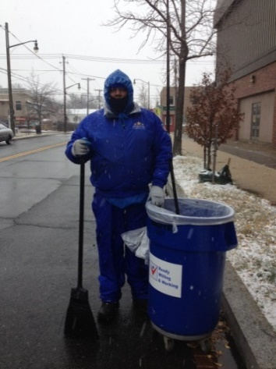
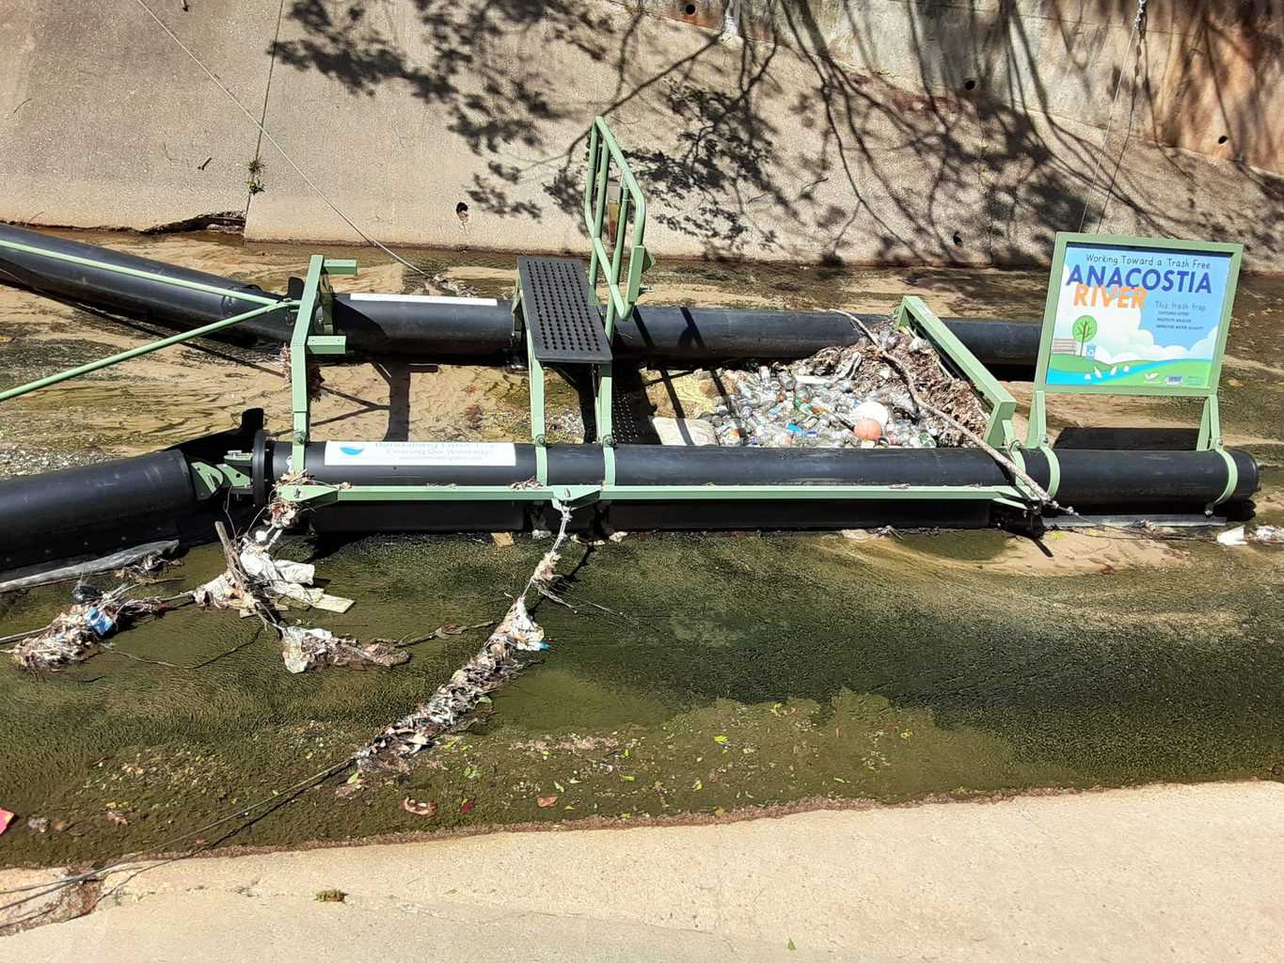
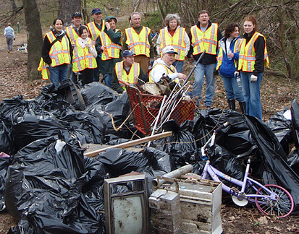
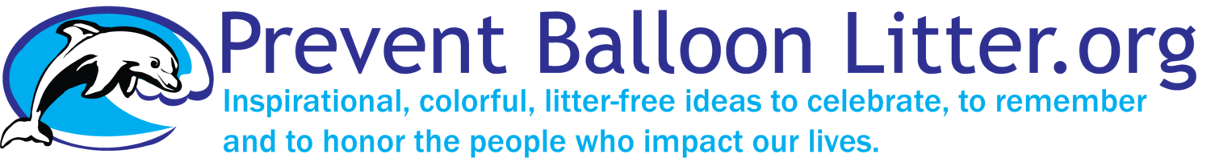
Policy Approaches
Current Best Management Practices Being
Implemented in the Watershed
Innovative policies – Bag Law, Foam Ban, Straw Ban – DC, MD, DE, VA Counties
Illegal dumping enforcement
Trash traps – DC, MD
Large trash cleanups – Every jurisdiction
Department of Small and Local Business Development Clean Teams Program – DC
Enhanced Street Sweeping Programs – DC, MD, Others maybe?
MARCO Balloon Litter Campaign - MD, VA, DE, NY, NJ
@DOEE_DC
Notes:
For many of you this picture might be of particular interest. Trash negatively impacts aquatic vegetative habitat in DC.
The trash in this picture comes from a stormwater outfall which enters this restored wetland along the Anacostia River in DC, just across the river from RFK stadium.
This site has also been retrofitted with a trash trap.

Slide 10
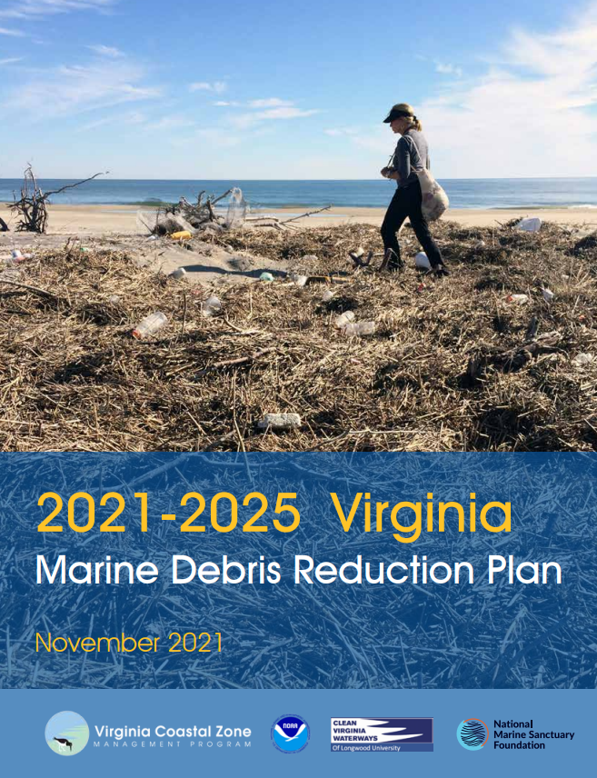
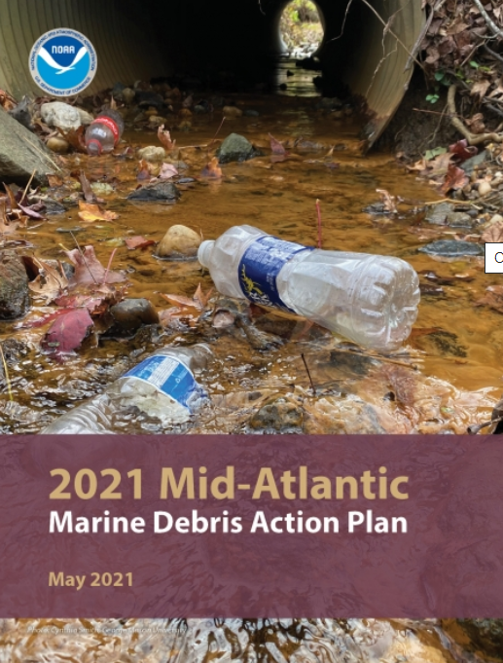
Policy Approaches
Current Implementation Plans for Chesapeake Bay Watershed Jurisdictions
2021-2025 VA Marine Debris Reduction Plan – establishes a comprehensive framework for strategic action and identifies priorities to reduce the impacts of marine debris on Virginia’s coasts, people, and wildlife.
2021 NOAA Marine Debris Action Plan – Voluntary, collaborative effort of 96 organizations in DE, MD, NJ, NY, VA, and DC.
@DOEE_DC
Notes:
For many of you this picture might be of particular interest. Trash negatively impacts aquatic vegetative habitat in DC.
The trash in this picture comes from a stormwater outfall which enters this restored wetland along the Anacostia River in DC, just across the river from RFK stadium.
This site has also been retrofitted with a trash trap.

Slide 11
Policy Approaches
BIG QUESTION…
Can we seriously start talking about source reduction?
@DOEE_DC
Notes:
For many of you this picture might be of particular interest. Trash negatively impacts aquatic vegetative habitat in DC.
The trash in this picture comes from a stormwater outfall which enters this restored wetland along the Anacostia River in DC, just across the river from RFK stadium.
This site has also been retrofitted with a trash trap.

