Slide 1
Conservation Innovation: Using New Technologies to Identify Landscape Scale Conservation and Restoration Priorities
Chesapeake Conservancy

Slide 2
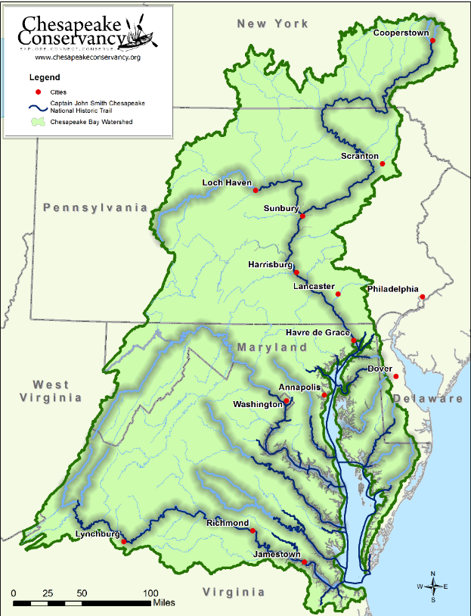





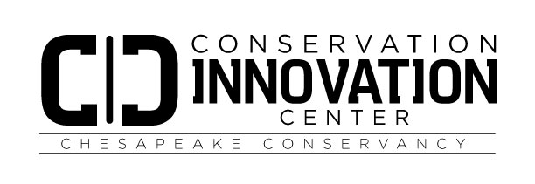






Establishing Partnerships to Advance Conservation Science

Slide 3
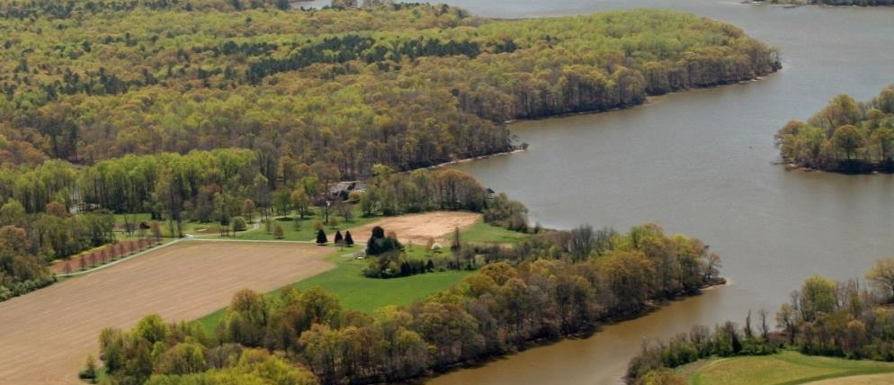
Precision Conservation:
High-Resolution Landscape Analysis in the Chesapeake Bay

Slide 4
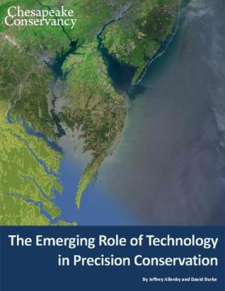
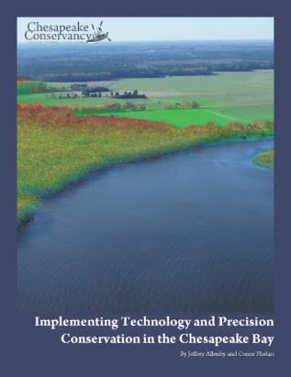
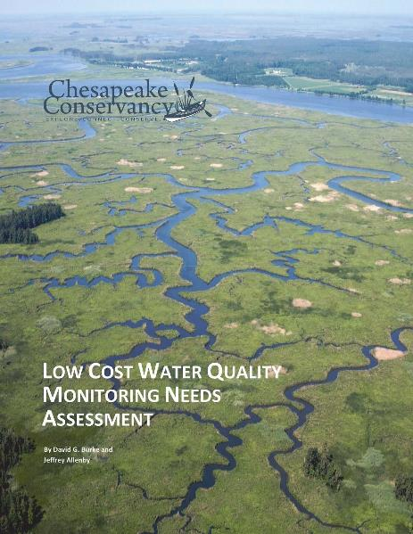
Precision Conservation Landscape Analysis
“Getting the right practices, in the right places, at the right scale, at the right time and making sure they are working”

Slide 5
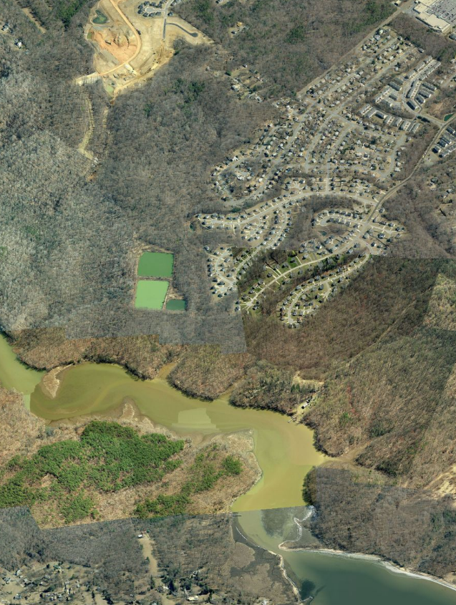
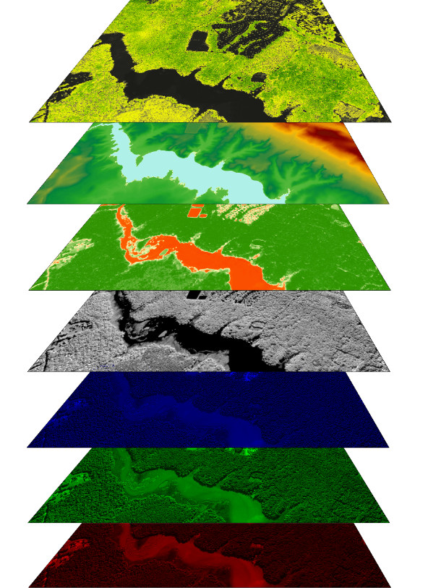
The Need for Precision Conservation
We are using remote sensing and GIS modeling to generate new data that allow us to identify priorities for conservation and restoration at the parcel-scale
High-resolution Land Cover Classification
Concentrated Flow Path Analysis
nDSM
nDTM
NDVI
NIR
Blue
Green
Red

Slide 6
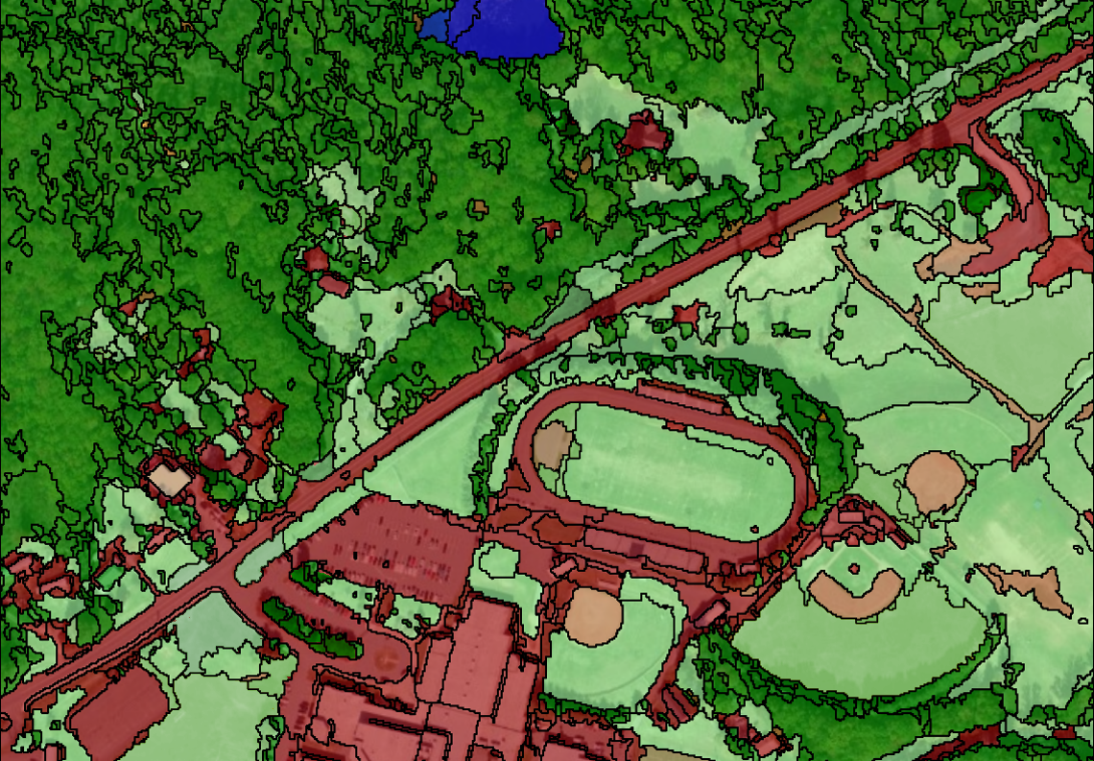
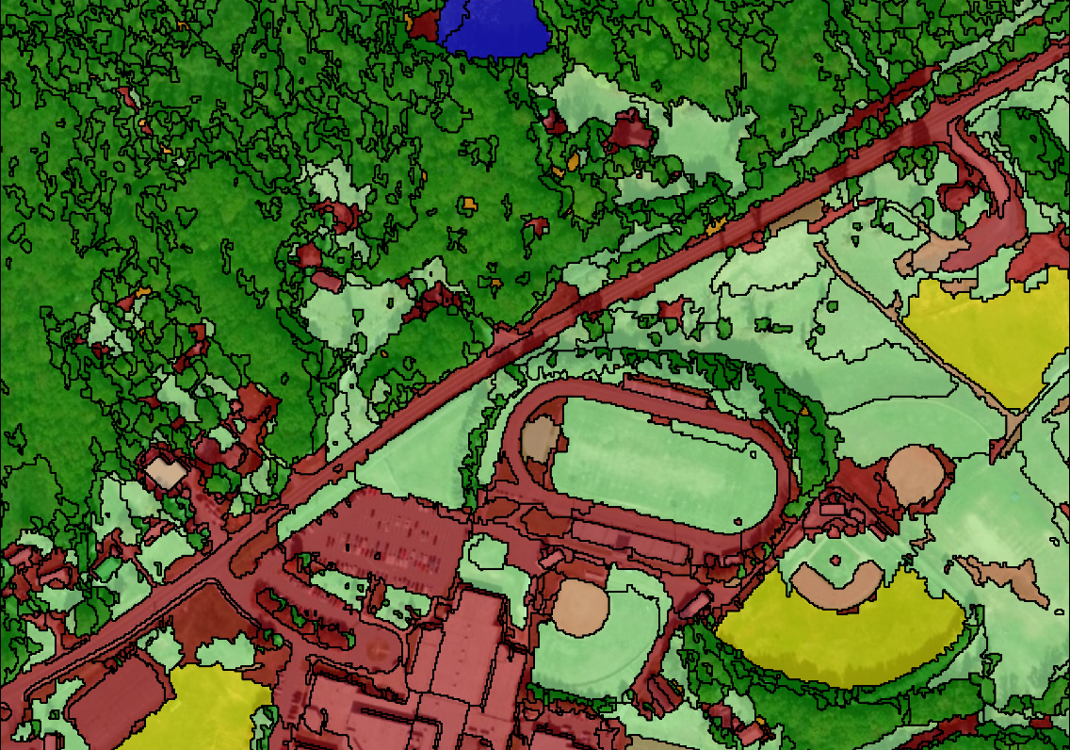
High-resolution Land Use Classification
2-stage process:
Initial semi-automated feature extraction in ENVI
Manual reclassification to improve overall accuracy (~95% accuracy)
Currently incorporates LiDAR data but we have an alternate method that still produces high accuracy data for areas where LiDAR has not been collected (WV)

Slide 7
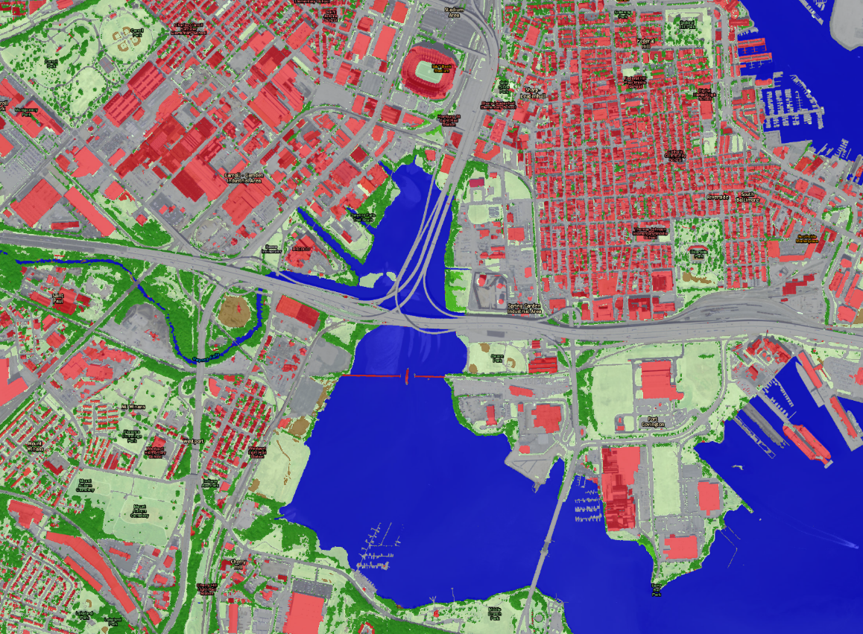
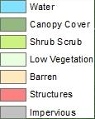
High-resolution Land Cover Classification
Water
Emergent Wetlands*
Tree canopy
Scrub-shrub
Herbaceous/Grass
Barren
Impervious surfaces- Roads*
Impervious surfaces- Other*
Impervious surfaces- structures
Impervious surfaces- obscured by tree canopy*
* Classes will be extracted by intersecting leaf-off classification and planimetric data with leaf-on classification data

Slide 8
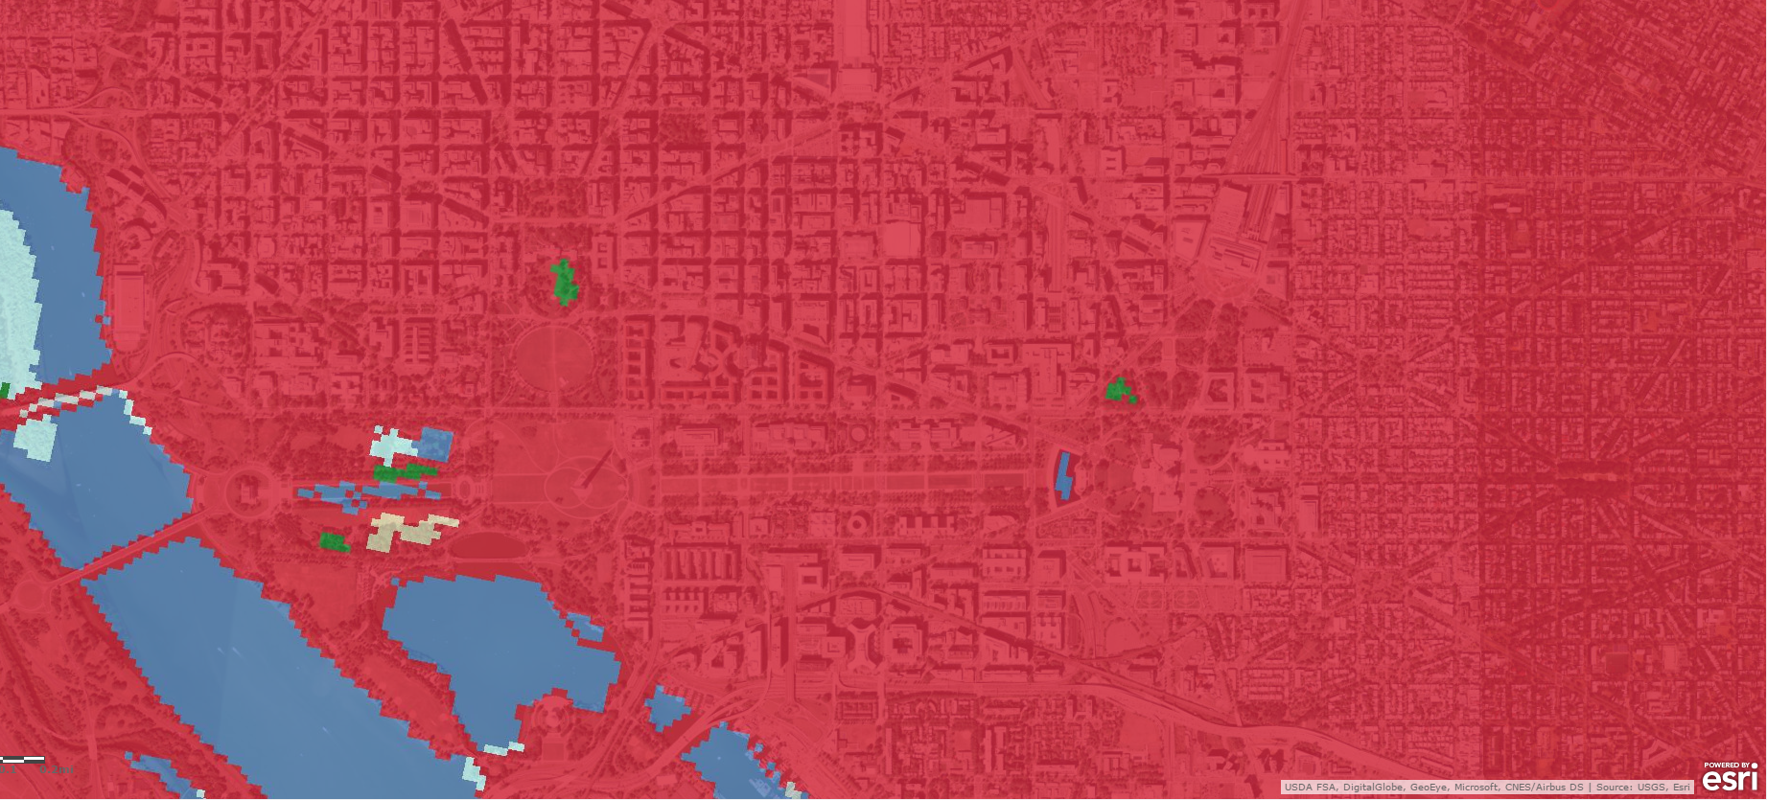
High-resolution Land Cover Classification

Slide 9
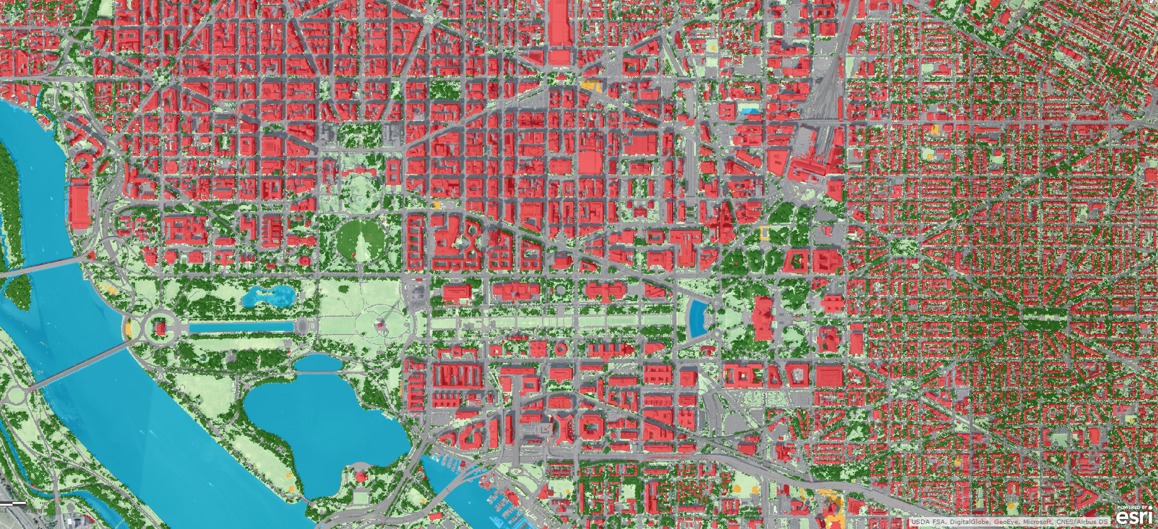
High-resolution Land Cover Classification

Slide 10
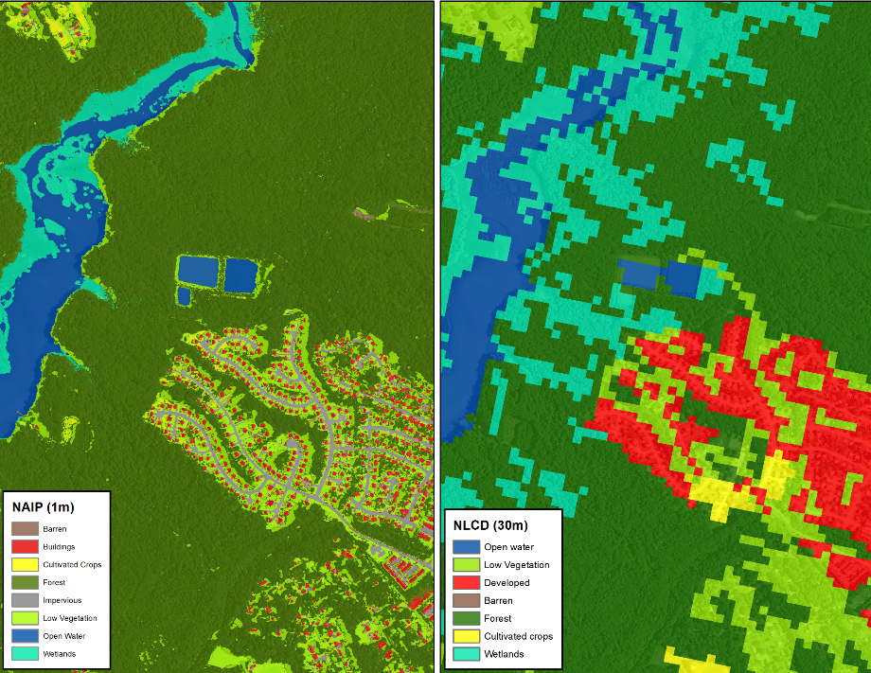
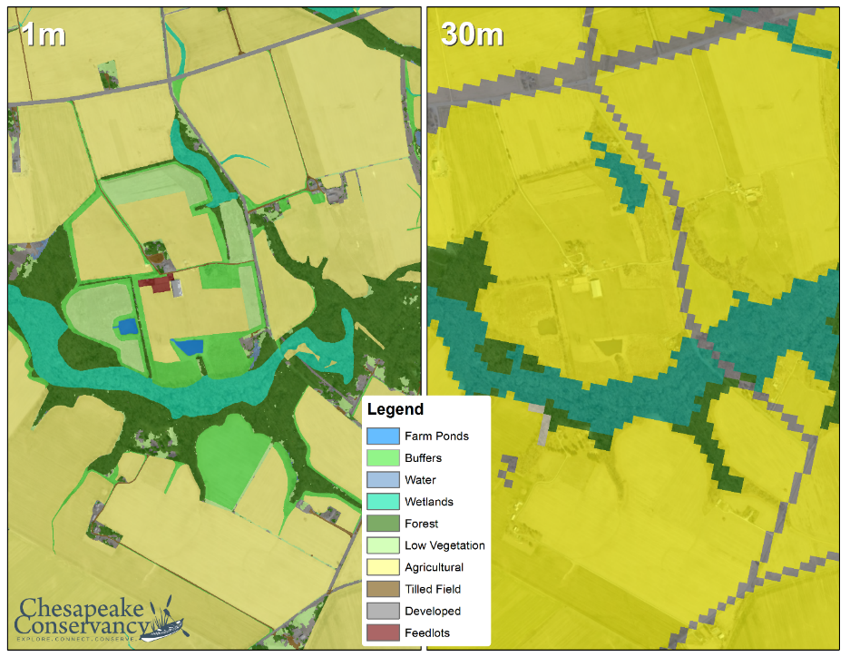
High Resolution Land Cover Data
A
Urban/Suburban Settings
B
C
Rural Settings
D

Slide 11
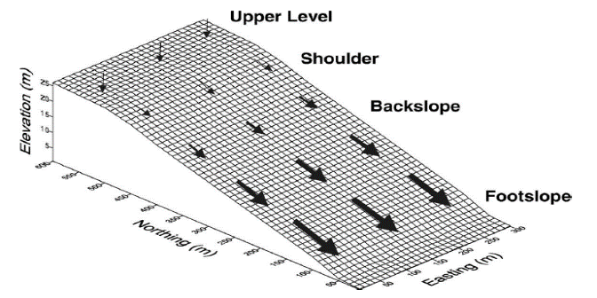
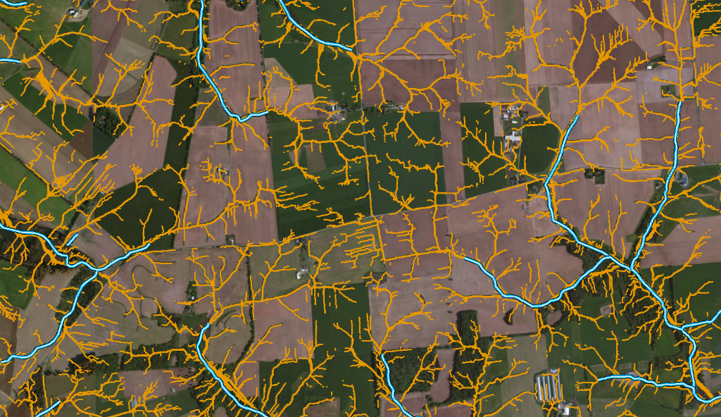
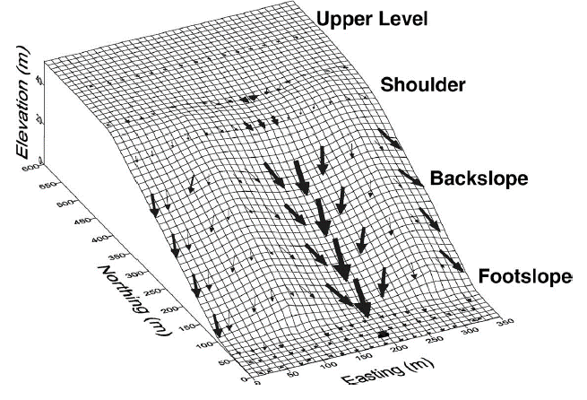

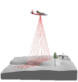
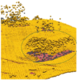

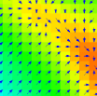


Concentrated Flow Path Analysis
Pennock 2003

Slide 12
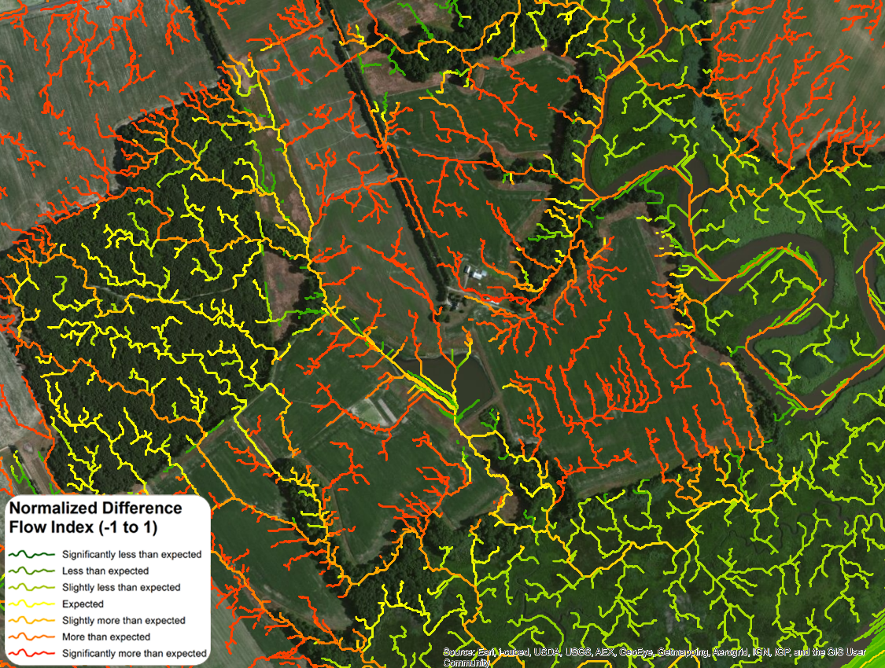
Normalized Difference Flow Index (NDFI)
Compares a weighted and unweighted flow accumulation to identify high-functioning landscapes that are a priority for conservation (lower NDFI) and underperforming landscapes that are a priority for restoration (higher NDFI)

Slide 13
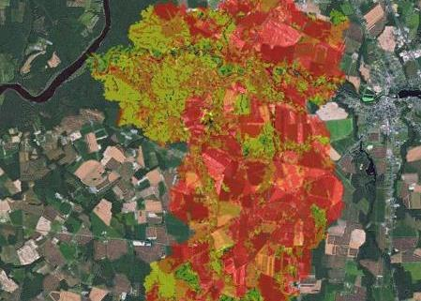
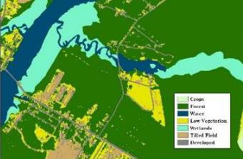
Conservation and Restoration Prioritization
We are improving targeting for:
Identifying or comparing potential projects in a high-priority watershed
Working with a willing landowner to locate a potential project where it will have the greatest impact on water quality
Education and outreach to landowners to help them understand what they can do reduce the impact of their land and improve ecosystems

Slide 14
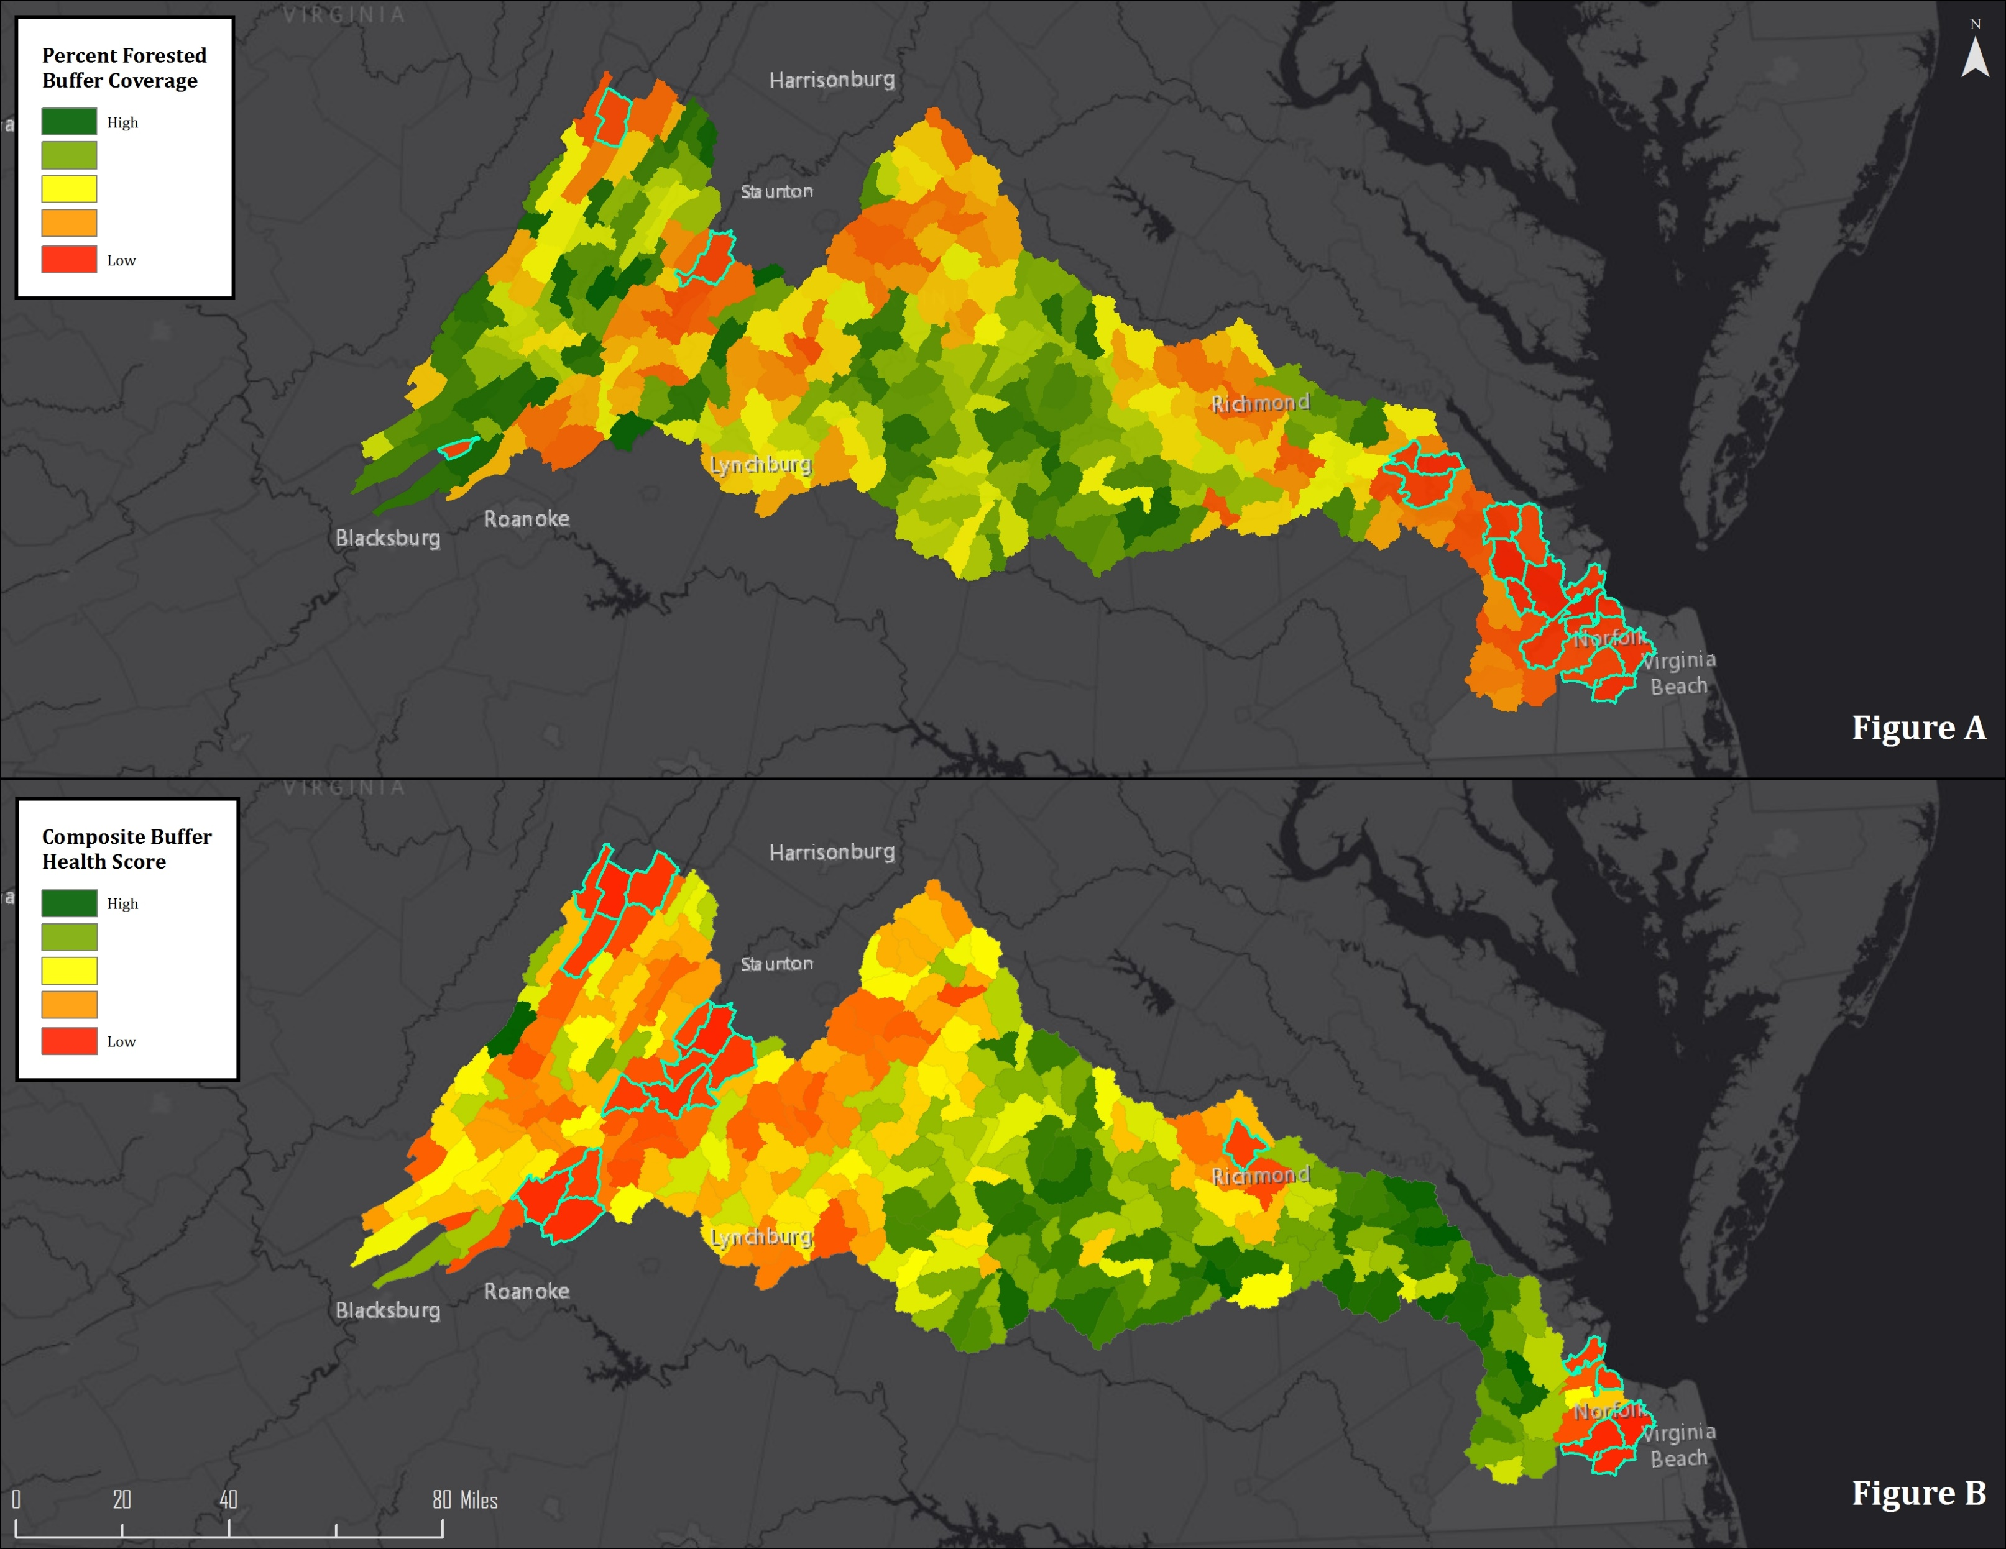
Identifying Regional Conservation and Restoration Priorities
Ian Plant

Slide 15
Identifying Regional Conservation and Restoration Priorities
Ian Plant

Slide 16
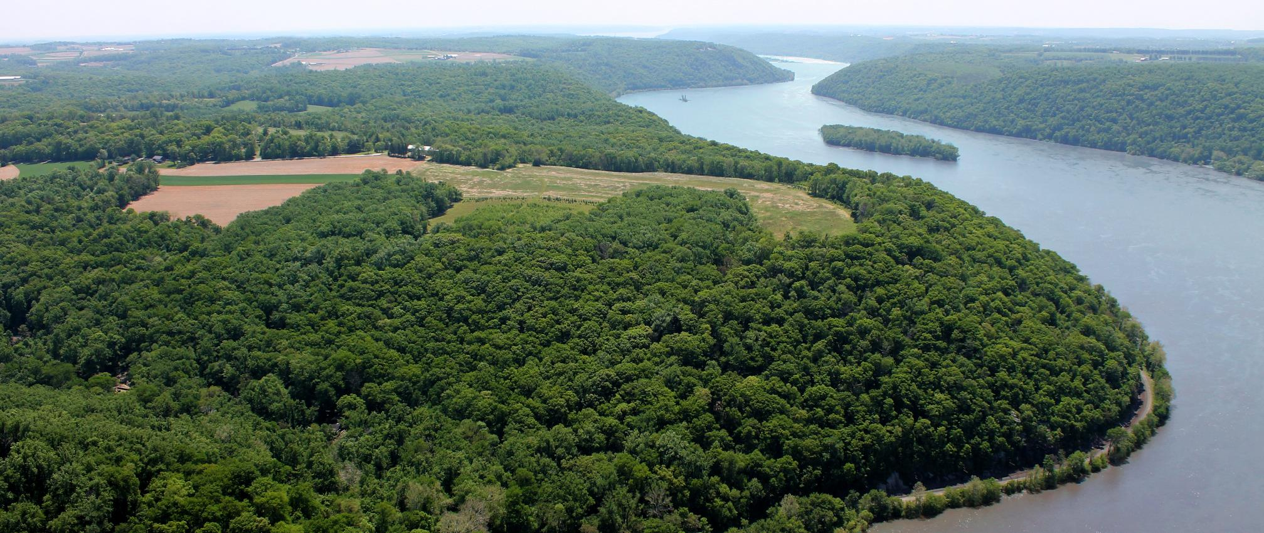
Potential benefits for the Chesapeake Bay Program’s Goal Implementation Teams
Ben Fertig

Slide 17
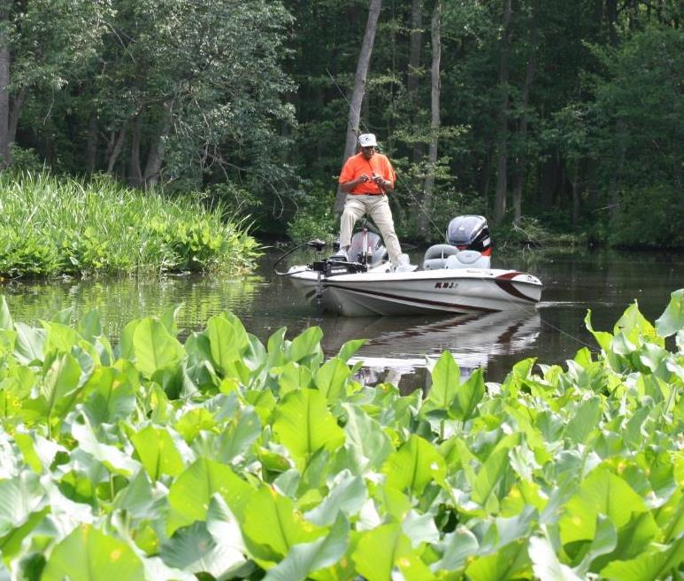
Sustainable Fisheries
(GIT 1)
Improve the characterization of edge-of-shore habitats (e.g. wetlands, riparian corridors)
Increase the predictive modeling capabilities of river and stream suitability for migratory fish habitat and spawning

Slide 18
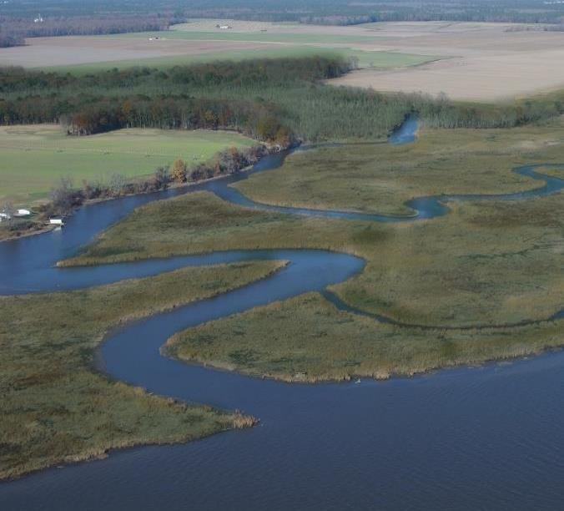
Habitats (GIT 2)
Create more detailed habitat connectivity models and identify priorities for habitat restoration
Establish a baseline for critical habitat and track development pressure and fragmentation of core habitats to prioritize conservation
Monitor success and implementation of restoration efforts across entire landscapes (e.g. increased riparian buffers, wetland restoration, etc.)

Slide 19
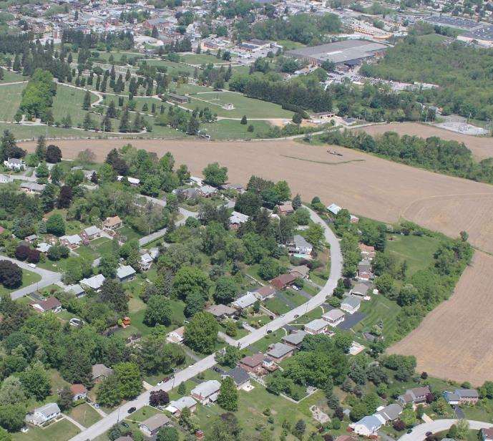
Water Quality (GIT 3)
Increase the accuracy of modeling efforts by providing better estimates of landscape composition (e.g. impervious surface percentage)
Identify specific landscapes (often at the parcel scale) that are priorities for restoration or BMP implementation

Slide 20
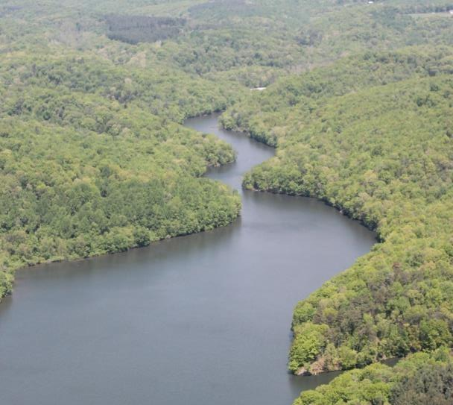
Healthy Watersheds (GIT 4)
Calculate and track natural landscape condition metrics (e.g. riparian buffer attainment, ecological connectivity, headwater stream condition, etc.)
Establish a highly accurate baseline to track changes in impervious surface and natural landscape coverage in high-functioning sub-watersheds
Identify specific high-functioning landscapes that are priorities for conservation because they are providing water quality benefits

Slide 21
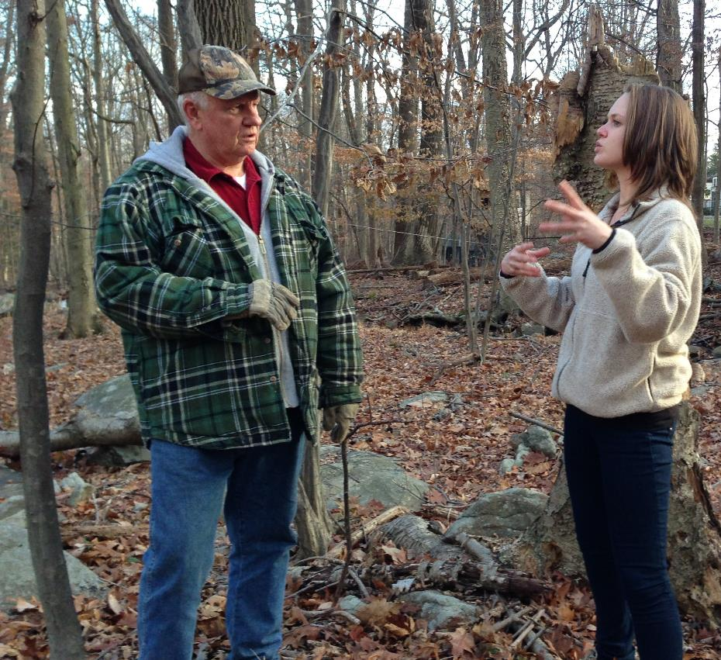
Stewardship (GIT 5)
Target outreach and education efforts and identify tangible actions landowners could take to reduce the impact of their land (e.g. install BMPs) or conserve high-functioning landscapes (e.g. conservation easements)
Create individualized reports for land owners detailing the land use composition of their properties and how they fit into the watersheds in which they are located (e.g. showing that they have critical habitat)
Appalachian Mountains Joint Venture

Slide 22
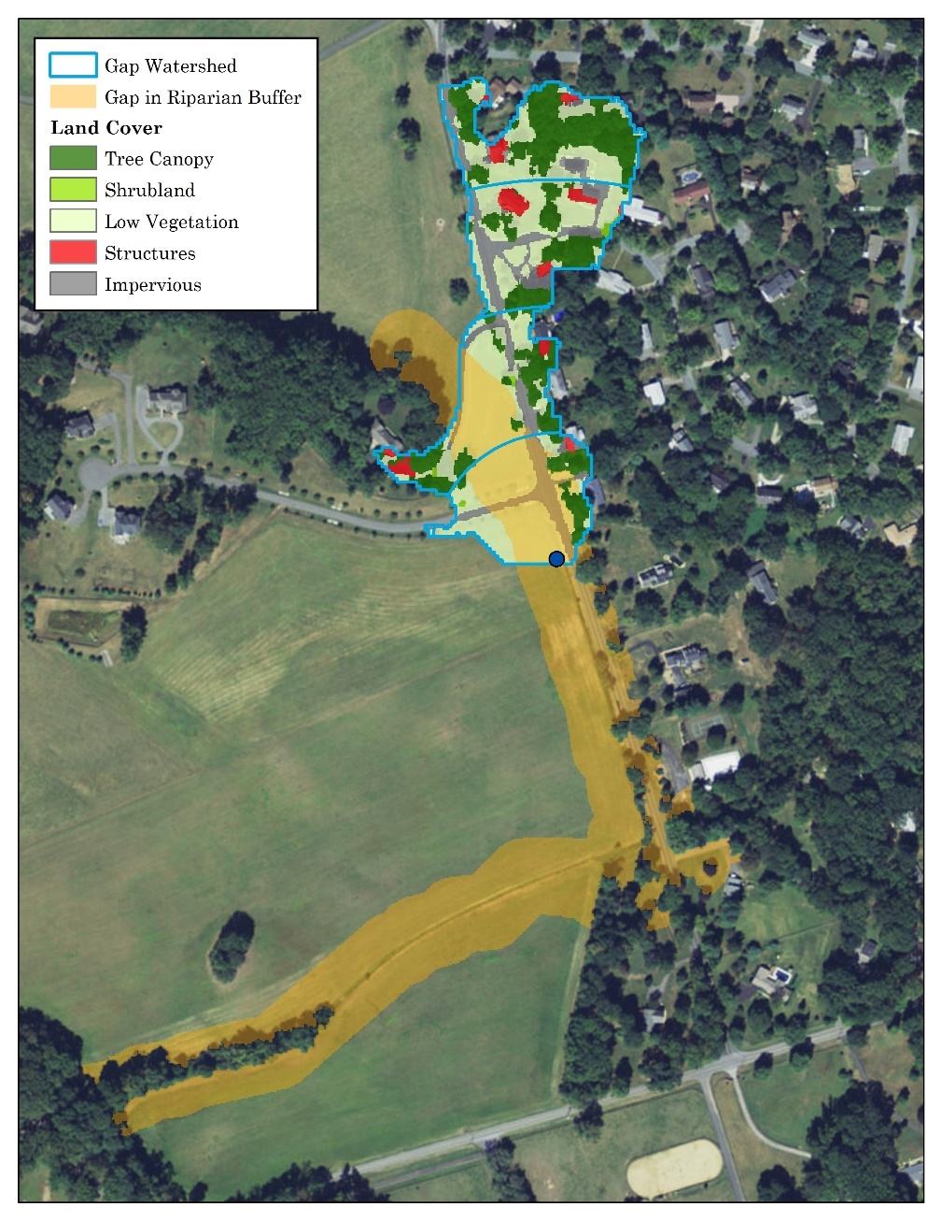
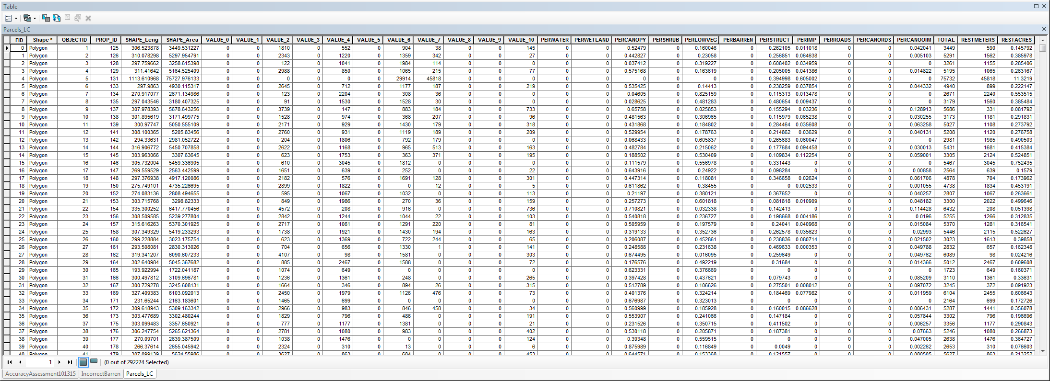
Identifying Potential Restoration Projects to Enhance Connectivity and Water Quality
Iterative process that is calculating all gaps in natural riparian buffers (forest, wetlands, etc.) along CFPs draining at least 23.5 acres
Processessing gaps as we generate land cover data
Ian Plant

Slide 23
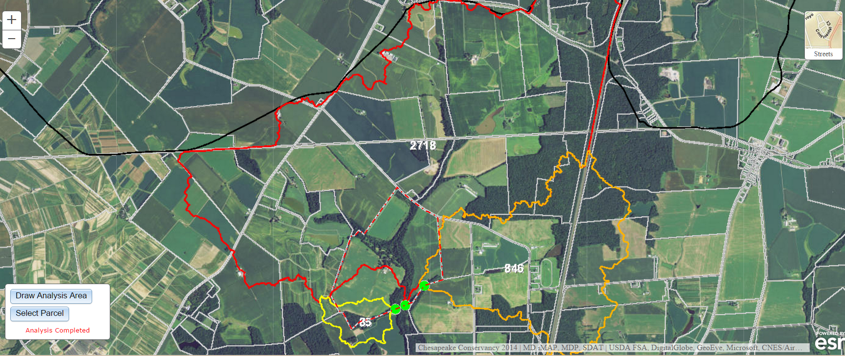
Identifying “Hotspots” and Targeting Outreach and Education

Slide 24
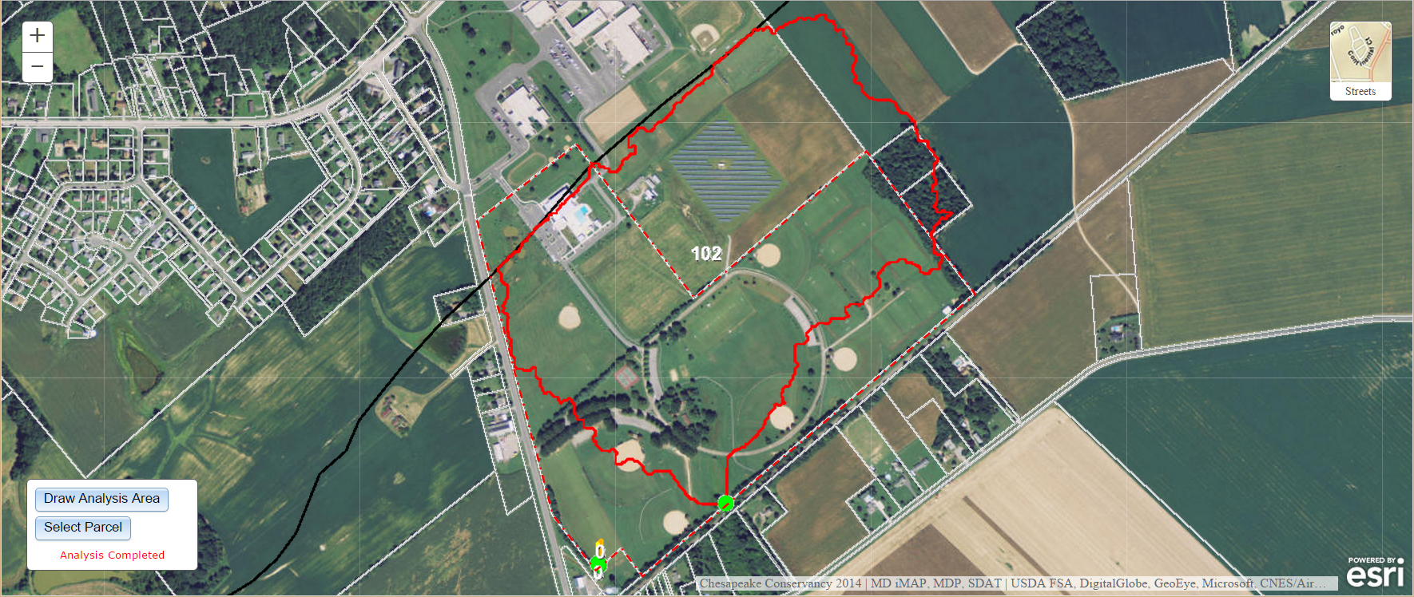
Working with Land Owners to
Enhance Restoration Work

Slide 25
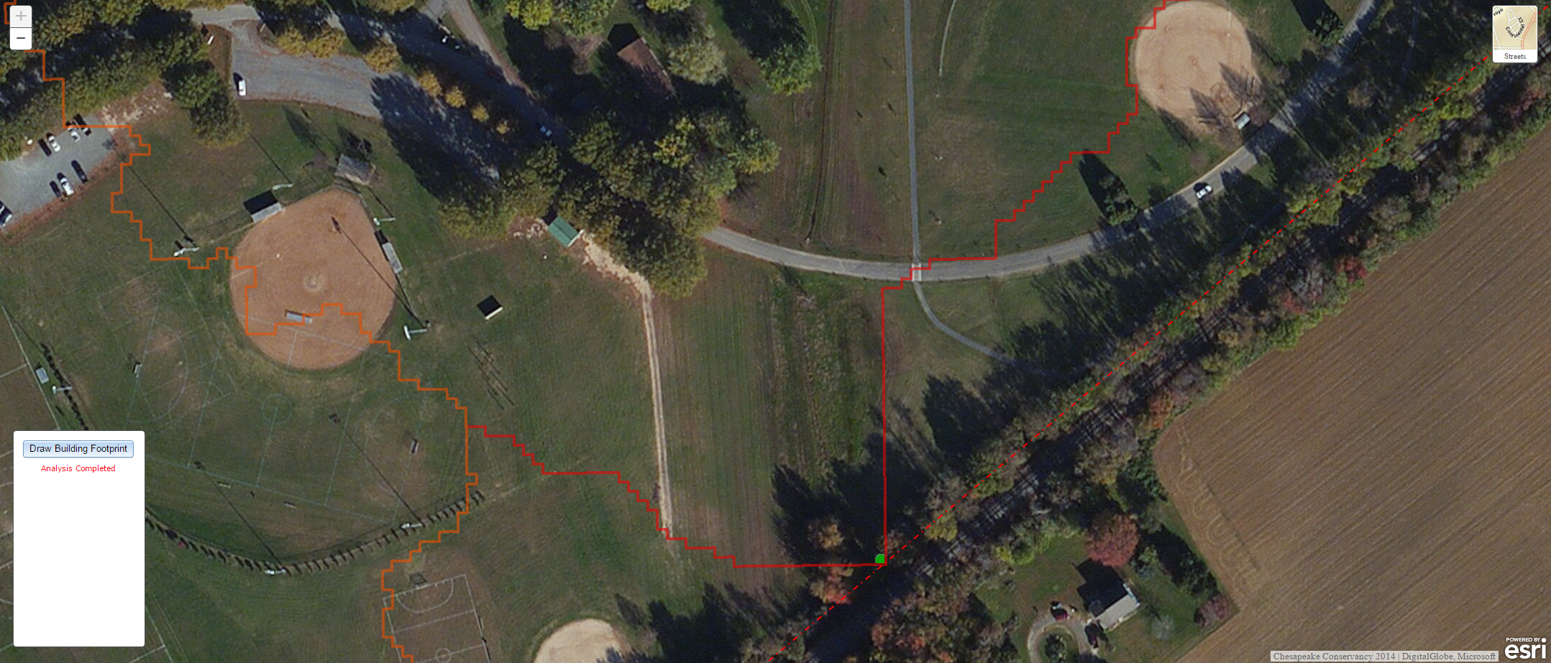
Working with Land Owners to
Enhance Restoration Work
Ian Plant

Slide 26
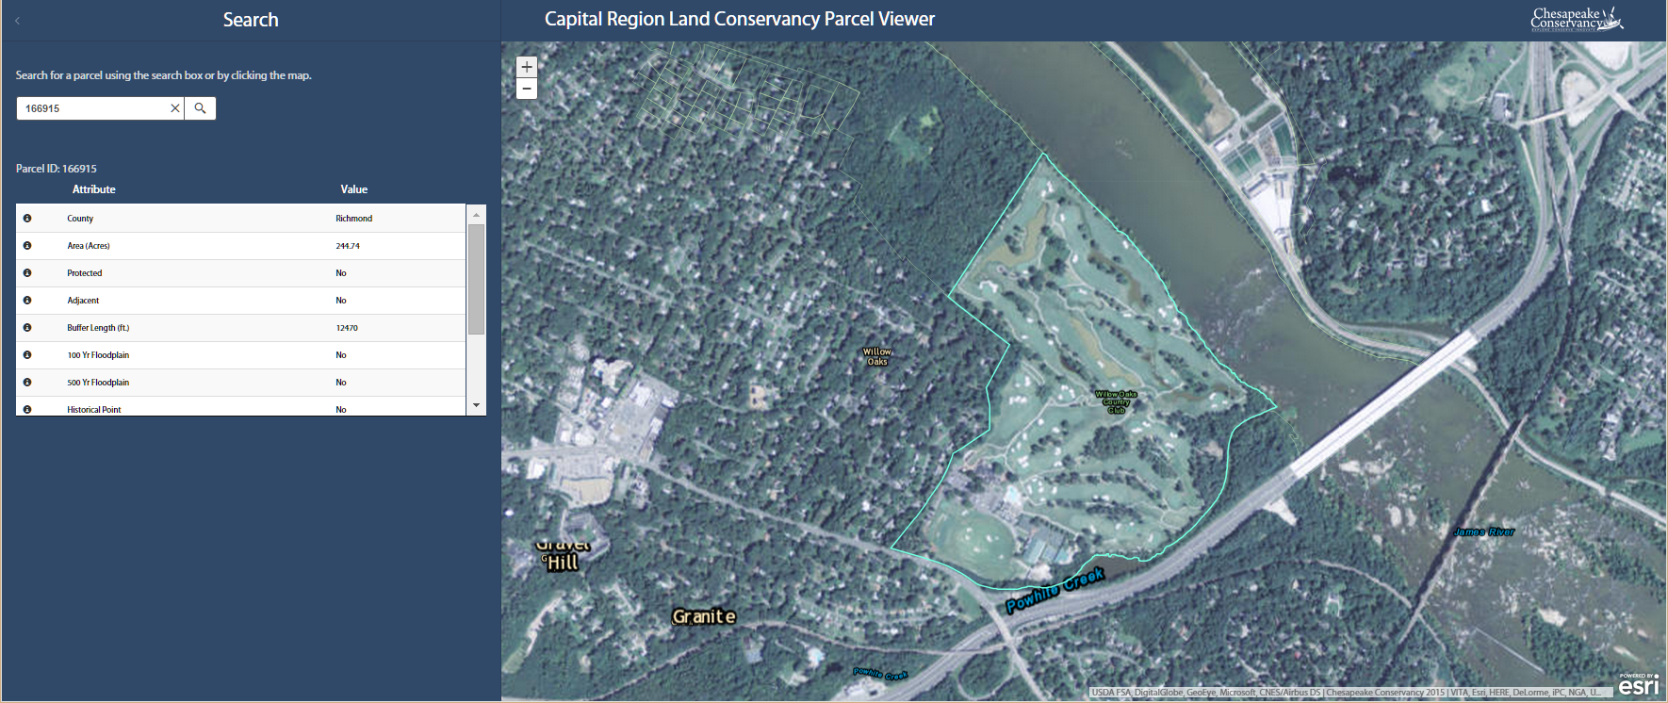
Making Planning and Prioritization Tools Accessible to Local Partners
Ian Plant

Slide 27
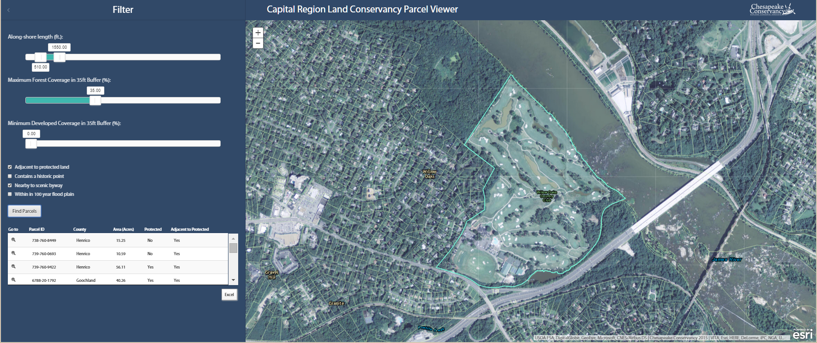
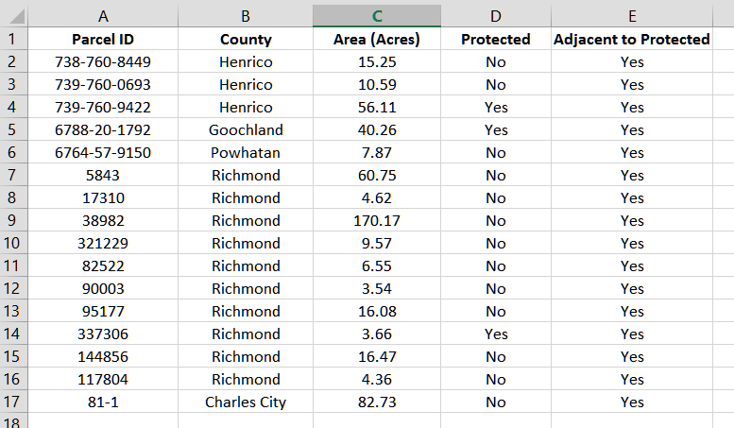
Making Planning and Prioritization Tools Accessible to Local Partners
Ian Plant

Slide 28
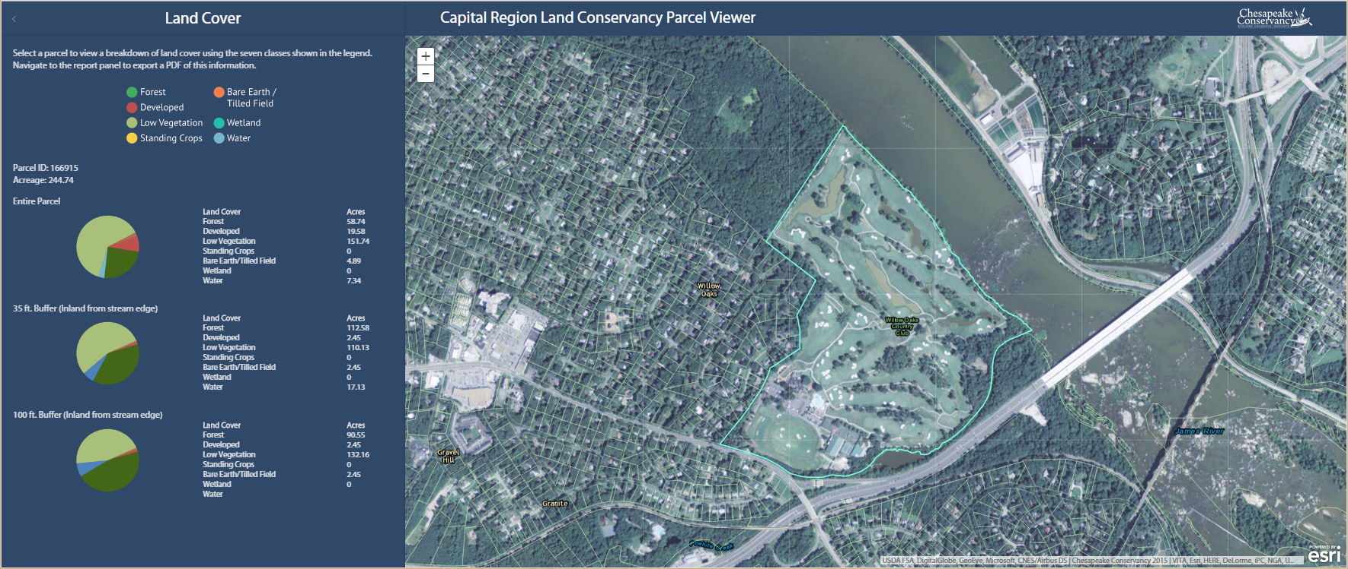
Making Planning and Prioritization Tools Accessible to Local Partners
Ian Plant

Slide 29
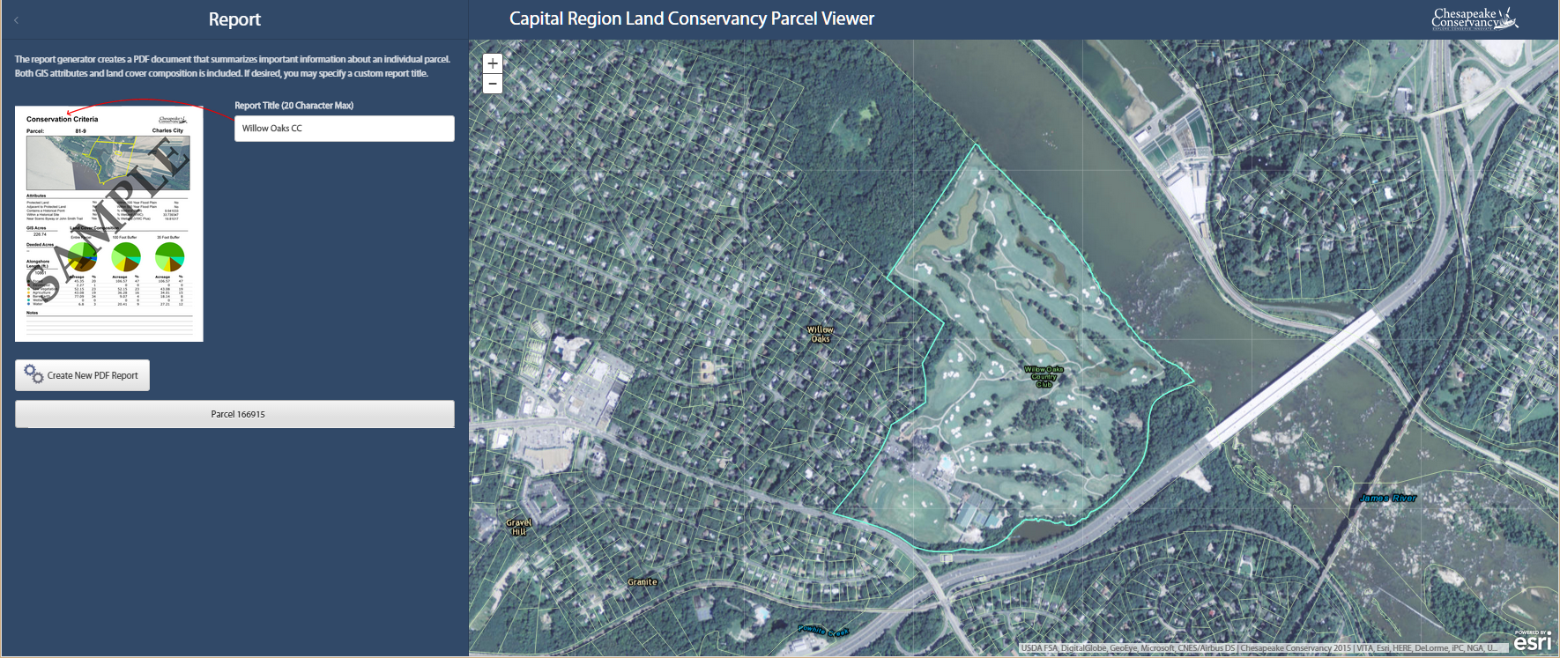
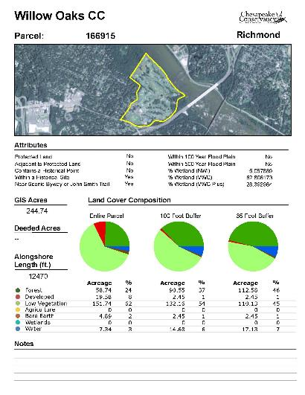
Making Planning and Prioritization Tools Accessible to Local Partners
Ian Plant

Slide 30
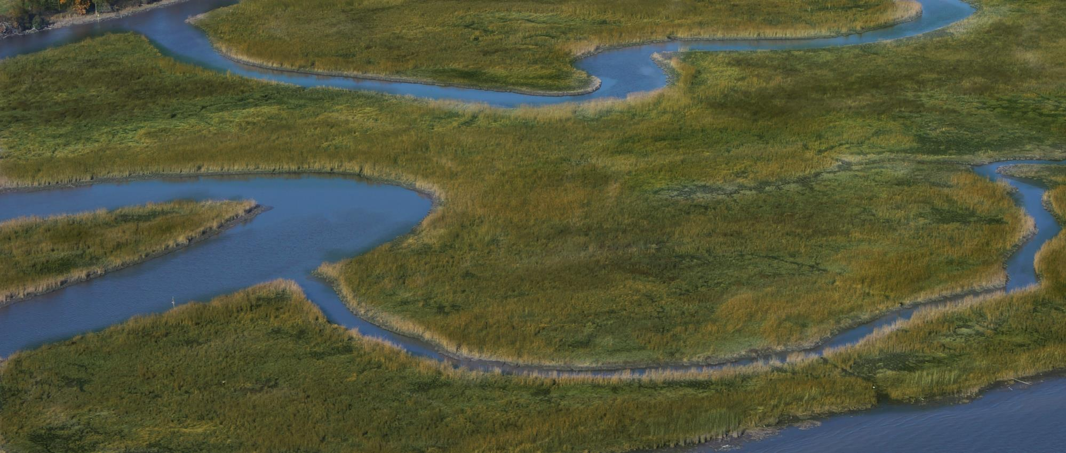
Questions and Discussion
Contact:
Jeffrey Allenby
jallenby@chesapeakeconservancy.org

