Slide 1
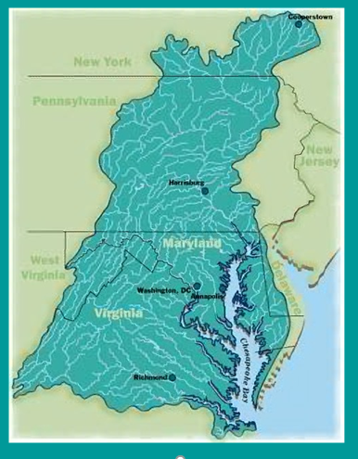
CBPO Program Update
CAC Meeting
December 5, 2021
Jim Edward
Deputy Director, EPA/CBPO

Slide 2
OVERVIEW
FY 20/21 CBP Budget Highlights
DEIJ Action Team Update
Response to CAC Recommendations
to Executive Council

Slide 3
FY 2020 Chesapeake Bay Program Budget Funding Categories*
 | FY 2020 Enacted Budget (Dollars in thousands)
Program Operations & Support | $5,169
Partnership & Data Management Support | $13,000
WQ Monitoring Grants | $5,240
TMDL Implementation & Analysis | $2,017
Reporting & Accountability | $2,612
Permit Review and Rule Development, Guidance & Implementation | $916
Enforcement | $1,672
Small Watershed Grant Program | $9,000
Innovative Nutrient Sediment Reduction Grants | $9,000
State Implementation Grants | $36,374
Chesapeake Bay Funding Totals | $85,000
AGENDA
*Funding categories used in annual congressional justification

Slide 4
FY 2020 Chesapeake Bay Program Budget
Funding by Category
>70% to Grants

Slide 5
Looking Ahead to FY 2021
America’s Conservation Enhancement Act (P.L. 116-188)
Signed into law October 30th, 2020
Authorizes EPA Chesapeake Bay Program at $90 M in FY 2021
Incremental increases to $92 M by FY 2025
Current budget authority is provided by Continuing Resolution through December 11, 2020.
House FY 2021 Appropriations Bill:
Increases funding for Chesapeake Bay Program Office from FY 2020 level of $85M by $5.5M, to $90.5 M
The increase in funding is split among the following grants: SWG, INSWR, and Most Effective Basins Grants
Senate FY 2021 Appropriations Bill:
Maintains Chesapeake Bay Program Office funding at FY 2020 level of $85 M

Slide 6
DEIJ Action Team Update
First Action Team Meeting held on November 6, 2020
Co-Chairs selected:
-- Jeff Seltzer, DC, DOEE, Deputy Director, Natural Resources Administration
-- Maryem Karad, VA, Assistant Secretary for Natural Resources
Three Subgroups formed; biweekly meetings thru February
December 17 PSC Meeting Update:
-- Recommending 2025 end date for implementation plan
-- Discuss Funding Options for CAB
-- Discuss outreach strategy for early input into plan development

Slide 7
Preliminary Response to CAC Recommendations to EC
CAC Recommendations:
#1. Public Health: “We encourage you to consider a multi-disciplinary approach to environmental health by engaging your environmental and public health agencies together to discuss creating an integrated system that can track crucial information about the environment and how it relates to public health across all communities.”
ACTION: The jurisdiction partners agreed to explore possible approaches with their public health agencies and return to the MB to discuss possible actions. Those recommended actions would be explored with CAC to confirm they meet expectations.
In addition, the Diversity Workgroup will explore this issue and the DEIJ Action Team will also consider how to address public health in the drafting of the DEIJ implementation plan. The Fisheries GIT, the Toxic Contaminants Workgroup and the Chesapeake Conservation Partnership have also begun to explore these issues as they relate to their own efforts. Tools such as EJSCREEN and the CBP Diversity and Equity Dashboard can also help the partnership to address this.
#2. Compliance and Enforcement: “We encourage you to maintain your agency compliance staff and prioritize equitable enforcement of regulations in an effort to not lose ground on water quality progress and honor the public duty to protect human and ecological health. In anticipation of economic impacts of the pandemic, as one example among many, communities with Municipal Separate Storm Sewer Systems (MS4) regulations could experience significant financial restraints on future implementation of their permits, but compliance support will prevent backsliding.”
FURTHER DISCUSSION: This is considered a request directly to EPA, the states and DC and therefore not something the Bay Program Partnership can address as a whole.

Slide 8
Preliminary Response to CAC Recommendations to EC
#3. Restoration Economy: “We encourage the Chesapeake Bay Program to track and report the number of federal, state and local jobs associated with its funding to demonstrate the dual power of watershed protection and restoration economy.”
ACTION: Wendy O’Sullivan volunteered to review National Park Service models of tracking the number of federal, state and local jobs supported by funding to develop a system of tracking and estimating the number of jobs created by CBP funding.
ACTION: The Budget and Finance Working Group (BFWG) will discuss ways to track the impact of CBP funds on the broader economy including jobs directly supported by funds and local economies that benefit from CBP dollars. Chantal Madray will add this to October 2020 BFWG Agenda.
Update: Charlie Stek participated in the Oct 28 BFWG Meeting to present and discuss the restoration economy recommendation. MD DNR will look into the methodology they have used for this for Chesapeake and Coastal Bays Programs. EPA/CBPO will reach out to the EPAHQ NCEE to further explore methologies for doing this work.

Slide 9
Farewell and Thank You CAC Members!
#ItWasAGoodRun
#SeeYouRoundtheShed!
#BayStrong
bayrunner9@gmail.com
or
jim.edward@baylandesign.com
Cell: 443-440-7777

Slide 10

