Slide 1

Conowingo Watershed Implementation Plan (CWIP) CWIP Steering Committee, Chesapeake Bay Program
Conowingo Watershed Implementation Plan (CWIP)- Citizens Advisory Committee (CAC) Meeting
Center for Watershed Protection, Chesapeake Conservancy, the University of Maryland Sea Grant Extension Program, and the Harry R. Hughes Center for Agro-Ecology
Notes:
ERIC OR KELSEY

Slide 2
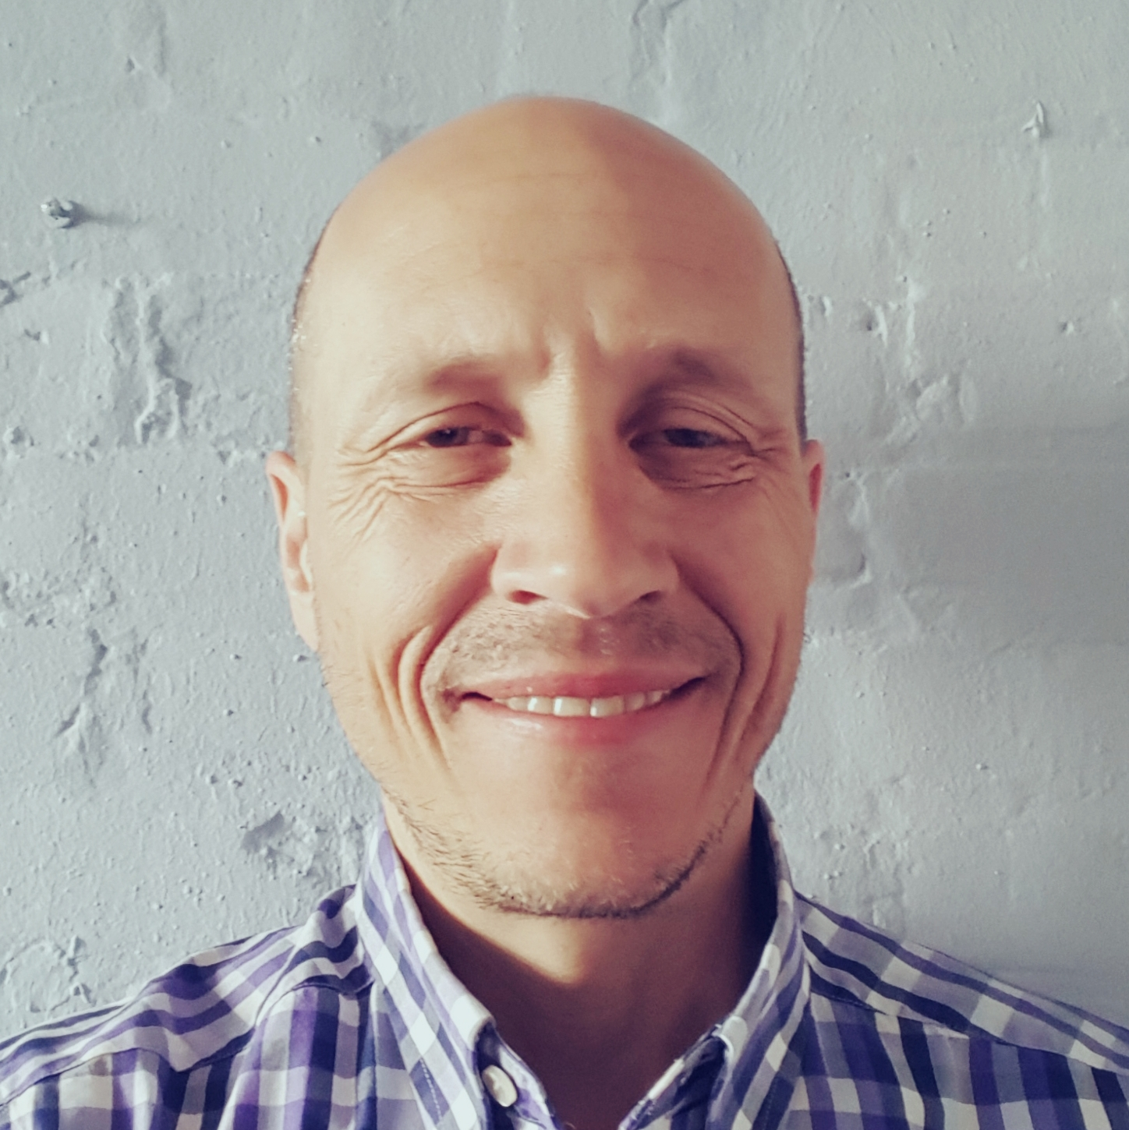
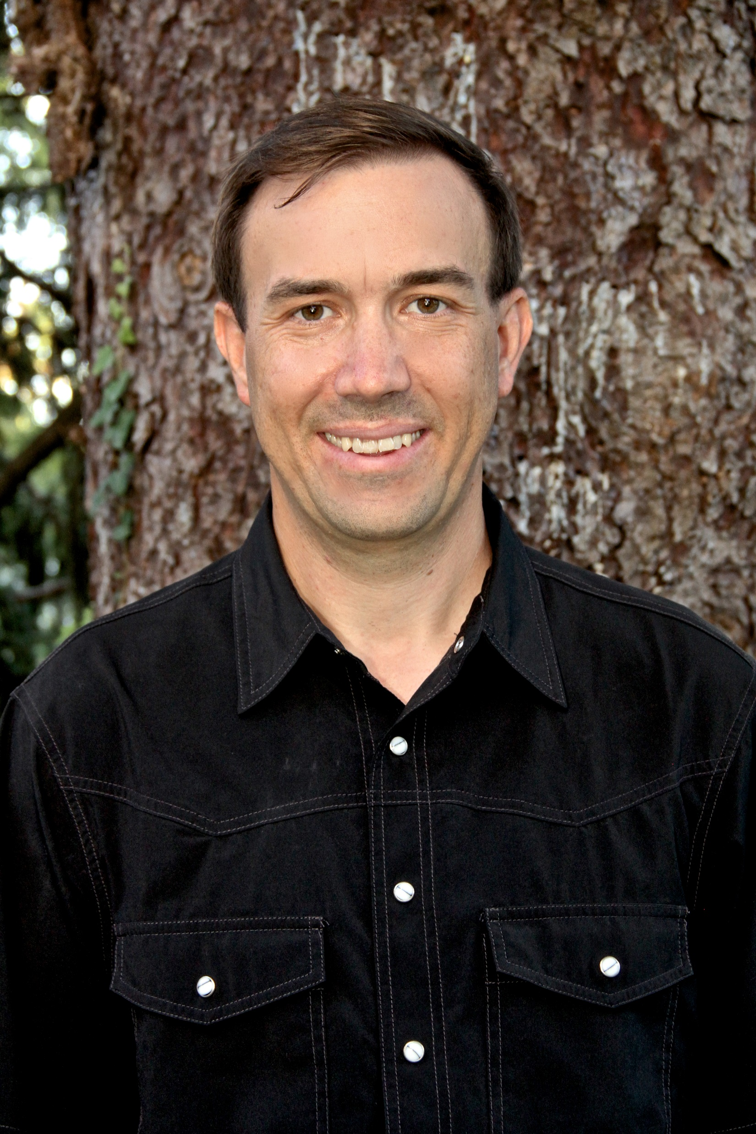
Introduction to the Speakers
Matt Rowe
Conowingo WIP Steering Committee Co-Chair, Maryland Department of the Environment
Bryan Seipp
Senior Project Manager,
Center for Watershed Protection
Notes:
ERIC OR KELSEY

Slide 3
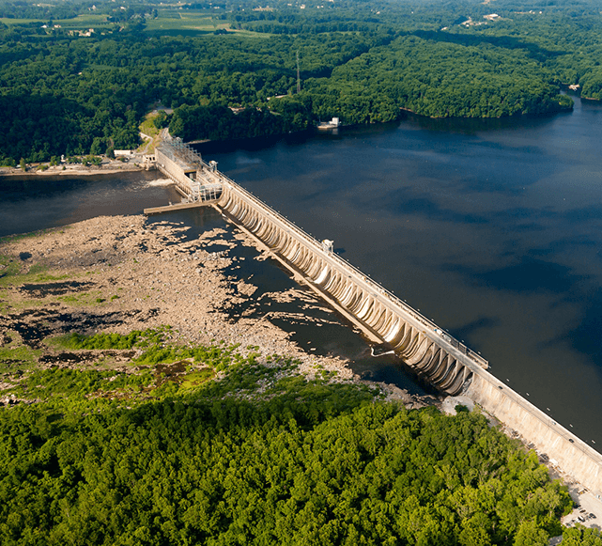
Outline
CWIP Background
CWIP Implementation Geography
CWIP Targeted BMPs
Will Parson, Chesapeake Bay Program
Notes:
ERIC OR KELSEY

Slide 4
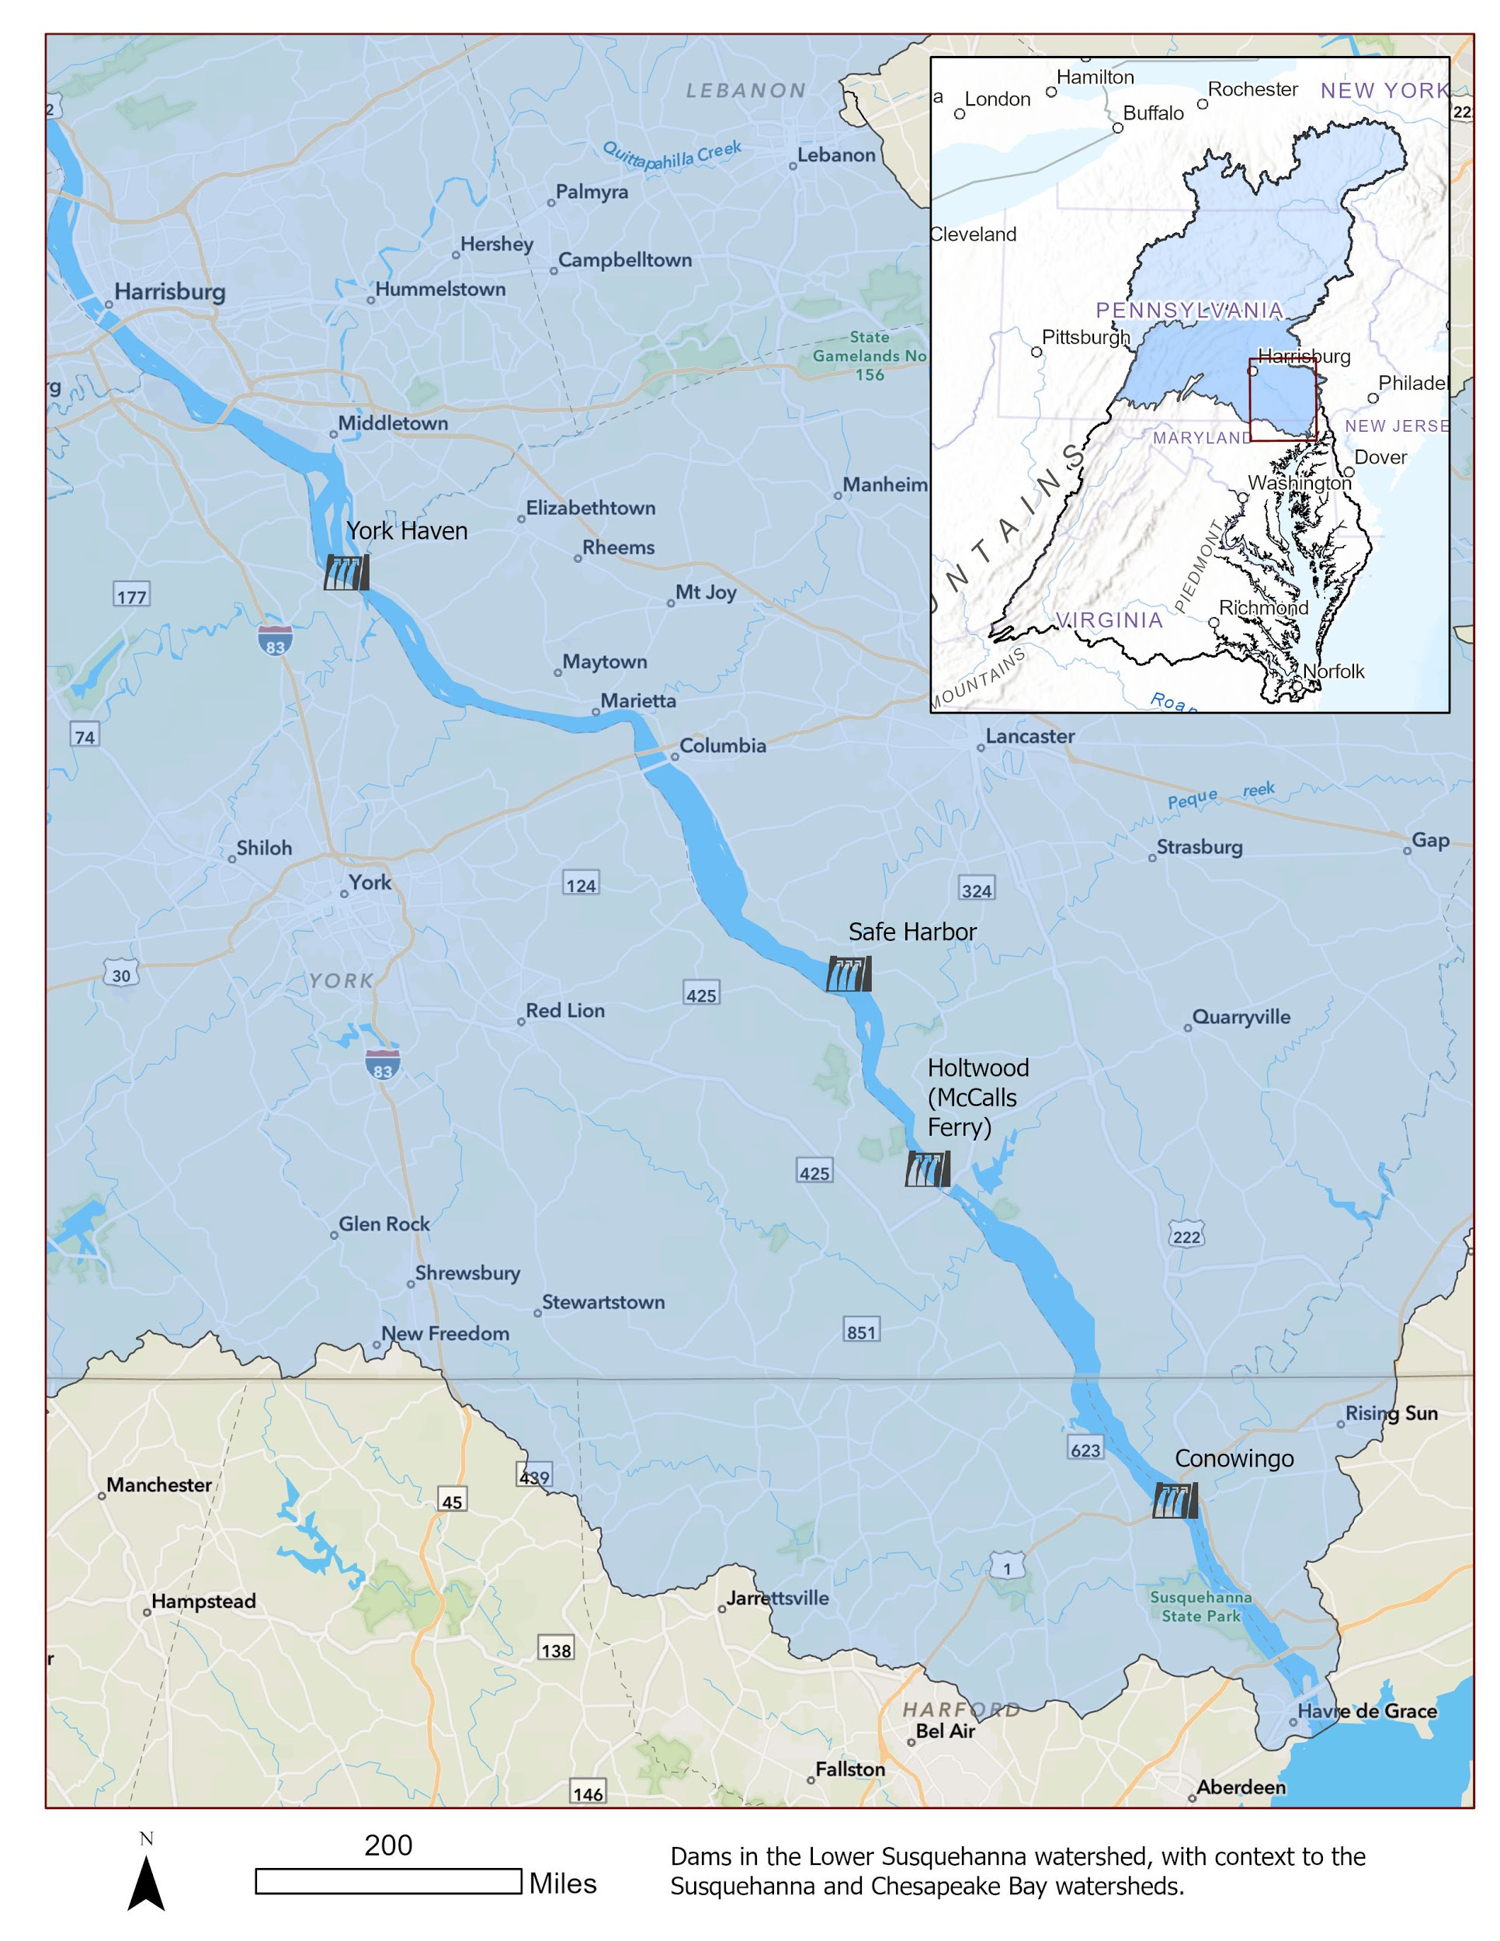
CWIP Background: The Need
The Conowingo Dam and Reservoir:
built in 1928, owned and operated by Exelon Corp.
historically trapped and stored sediment
A 2015 study by U.S. Army Corps of Engineers & Maryland Dept. of the Environment:
reservoir has reached dynamic equilibrium, no longer trapping sediment & associated nutrients
After implementing Chesapeake Bay Total Maximum Daily Load (Bay TMDL) and Phase III WIPs, additional reductions needed:
6 million pounds of nitrogen and
0.26 million pounds of phosphorus
Notes:
ERIC OR KELSEY

Slide 5
CWIP Background: Roles and Responsibilities
CWIP Leadership
Environmental Protection Agency: Evaluate the CWIP; provide biennial evaluations of the progress toward attaining CWIP goals in consultation with the PSC and determine if adjustments are necessary; issue a Request for Applications for the third-party grantees and administer the cooperative agreements; provide technical staff and contractor support.
CWIP Steering Committee: Consists of a representative from each Bay jurisdiction—Delaware, the District of Columbia, Maryland, New York, Pennsylvania, Virginia and West Virginia—and the Chesapeake Bay Commission. Solicit comments on the CWIP from stakeholders; develop the CWIP with EPA staff and grantee support; guide the development of a CWIP financing strategy and implementation.
CBP Principals’ Staff Committee: Approve the final draft CWIP for submittal to EPA and the CBP partnership for review and comment; approve the final CWIP; Review the progress of the CWIP Steering Committee in the development and implementation of the CWIP.
Notes:
ERIC OR KELSEY

Slide 6
CWIP Background: Roles and Responsibilities
CWIP Implementation Team (CIT)
The CWIP Implementation Team (CIT) is currently divided into three EPA funded activities:
Activity 1: Facilitate Development and Implementation of the CWIP and Associated Two-Year Milestones Center for Watershed Protection (lead grantee), Chesapeake Conservancy; University of Maryland Sea Grant Extension; Harry R. Hughes Center for Agro-Ecology.
Activity 2: Develop and Propose a Comprehensive CWIP Financing Strategy and Associated Implementation Plan Chesapeake Bay Trust (lead grantee), Center for Global Sustainability/School of Public Policy at the University of Maryland; Throwe Environmental, LLC; others.
Activity 3: Tracking, Verifying, and Reporting Implementation of CWIP and Two-year Milestones Chesapeake Conservancy (lead grantee), The Commons, Center for Watershed Protection.
Notes:
ERIC OR KELSEY

Slide 7
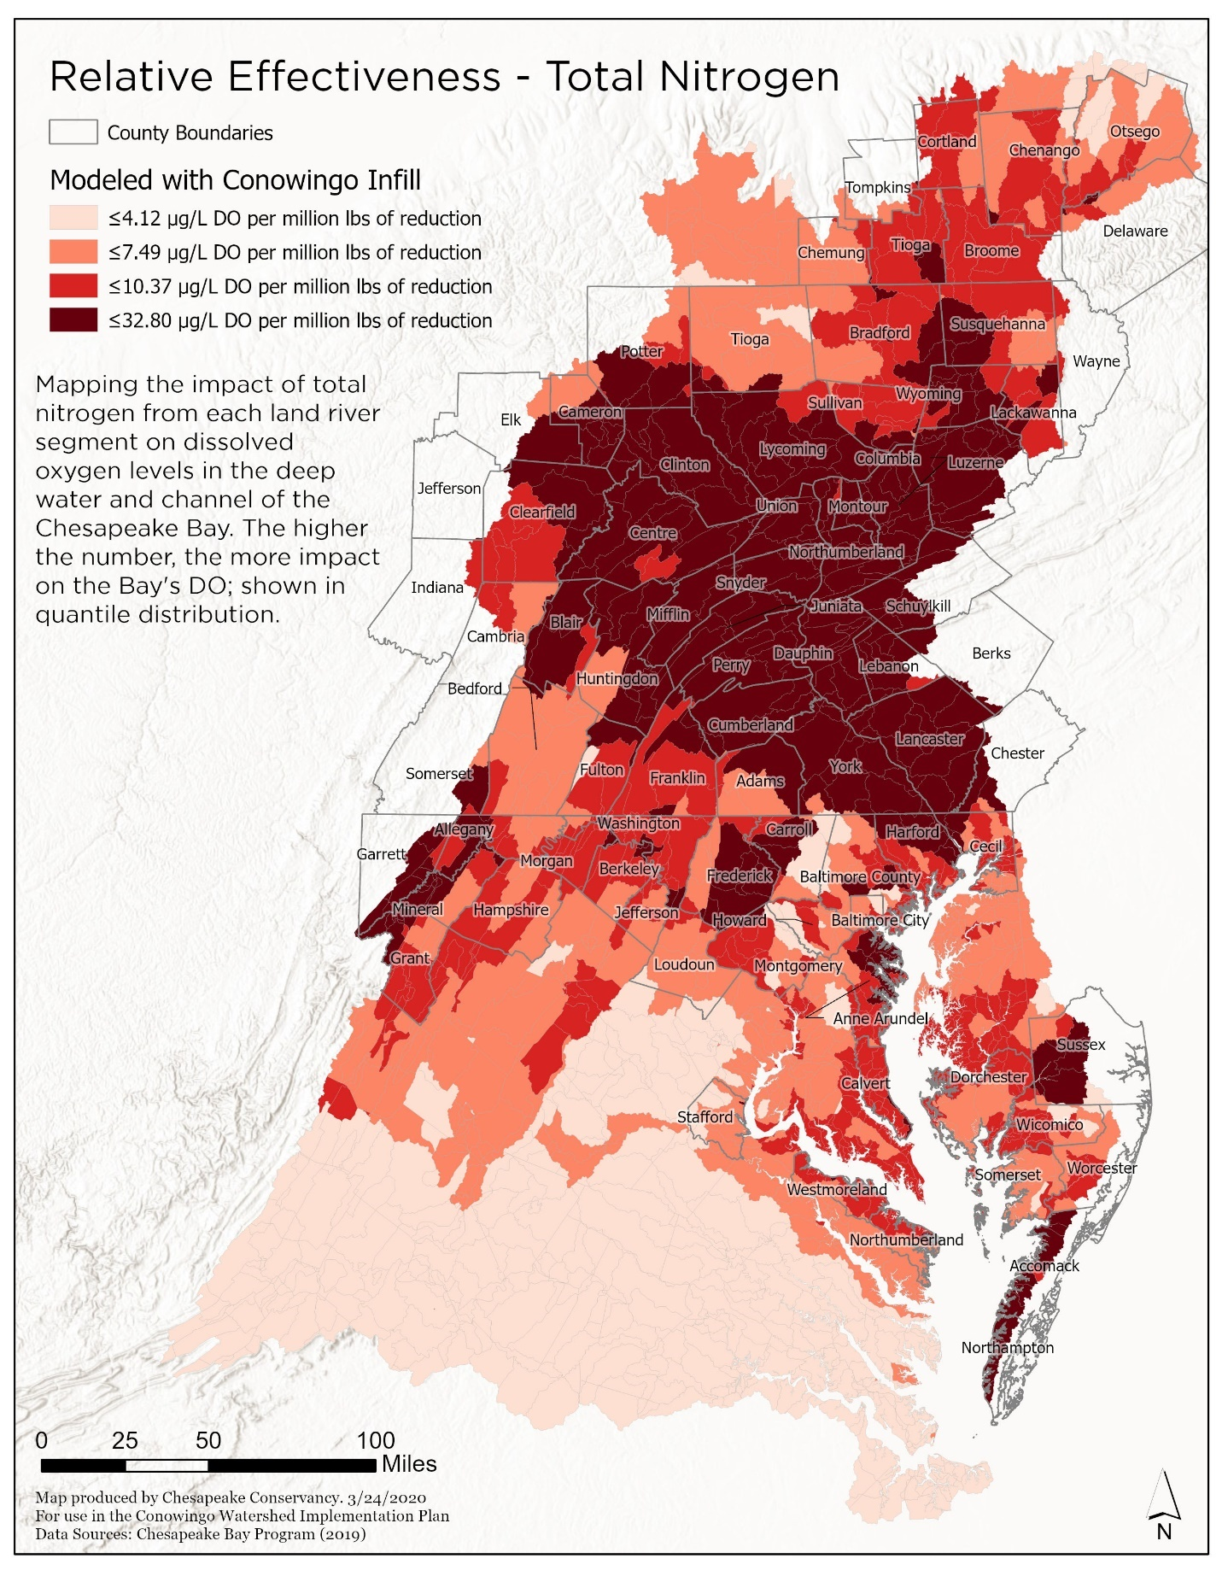
Primary CWIP Strategy: Most Effective locations
BMP implementation targeted to the most effective Susquehanna River sub-basins. (referred to as Land-River Segments, or LRSs)
Most effective LRSs based on greatest nitrogen reduction to increase the Bay’s dissolved oxygen.
Notes:
BRYAN
CARLY - 1 lb of N on the landscape, impact on DO in the Bay
how hard it is for that N to be delivered down to the bay
what impact does it have when it gets to the bay
This is where the model loads come from

Slide 8
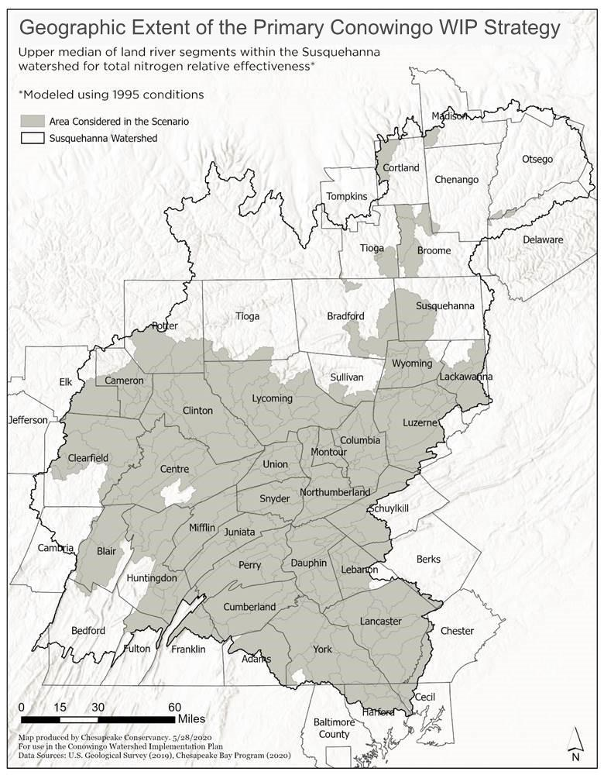
Primary CWIP Strategy: Summary
Geographic Extent | Above-the-median, nitrogen-effective Land-River Segments (LRSs) within the Susquehanna Basin
BMP Sector(s) | Agricultural + Urban
States Involved | Maryland, Pennsylvania, New York
Nitrogen Reduction | 6.7 Million pounds/year
Total Annualized Cost | $53.3 Million/year
Cost Per Pound | $8
Notes:
BRYAN

Slide 9
Primary CWIP Strategy: Primary CWIP BMPs
BMP selection based on:
Nitrogen reduction efficiency
Application in Susquehanna River Basin
State-level cost-effectiveness provided by BMPs for urban and agricultural practices
Notes:
BRYAN
N effectiveness as the primary pollutant of concern, as Bryan mentioned earlier.. N primary pollutant for determining efficiency cost effectiveness
We wanted to select BMPs that were applicable in SRB, we tried to avoid practices that removed farmland from production
Which is why we considered both urban and ag practices
All of these things considered

Slide 10
Primary CWIP Strategy: BMPs Implemented across entire geography
Practice | Duration | Unit | Amount
Agricultural Practices
Nutrient Application Management Core Nitrogen | annual | Acres | 223,000
Nutrient Application Management Rate Nitrogen | annual | Acres | 624,000
Nutrient Application Management Placement Nitrogen | annual | Acres | 207,000
Nutrient Application Management Timing Nitrogen | annual | Acres | 626,000
Conservation Tillage | annual | Acres | 216,000
High Residue Tillage | annual | Acres | 48,000
Low Residue Tillage | annual | Acres | 10,000
Prescribed Grazing | cumulative | Acres | 84,000
Forest Buffers | cumulative | Acres in Buffers | 20,000
Wetland Restoration | cumulative | Acres | 12,000
Grass Buffers | cumulative | Acres in Buffers | 21,000
Soil and Water Conservation Plan | cumulative | Acres | 113,000
Manure Incorporation | annual | Acres | 189,000
Barnyard Runoff Control | cumulative | Acres | 600
Urban Practices
Urban Forest Planting | cumulative | Acres | 49,000
Urban Forest Buffers | cumulative | Acres | 17,000
Notes:
CARLY - These are the BMPs that were selected for the Primary CWIP strategy and the associated implementation targets to reach the 6.7M reduction goal
You can see by the extent of the area, we’re relying largely on different ag management practices while trying to minimize taking land out of production
The modelling is not about why and how, but more about how much
Deb will talk about how the modelling process and how it brought us to this level of implementation

Slide 11
Primary CWIP Strategy: Modelled load reductions & implementation goals
Nitrogen (N) Load Reduction (Millions of Pounds) for the Primary CWIP Strategy
STATE | Sector | Baseline | Primary CWIP Strategy | N Reduction
MD | Agriculture | 0.85 | 0.68 | 0.17
 | Developed | 0.35 | 0.35 | 0.00
 | Natural | 0.26 | 0.26 | 0.01
 | Septic | 0.19 | 0.19 | 0.00
 | MD Total | 1.67 | 1.49 | 0.18
NY | Agriculture | 5.62 | 5.50 | 0.12
 | Developed | 1.52 | 1.52 | 0.01
 | Natural | 2.97 | 2.96 | 0.01
 | Septic | 0.19 | 0.19 | 0.00
 | NY Total | 12.39 | 12.26 | 0.13
PA | Agriculture | 39.20 | 33.51 | 5.69
 | Developed | 13.98 | 13.34 | 0.64
 | Natural | 16.51 | 16.42 | 0.09
 | Septic | 1.66 | 1.66 | 0.00
 | PA Total | 79.29 | 72.87 | 6.41
TOTAL | Total | 93.35 | 86.62 | 6.72
Exceeds N reduction target by 700,000 lbs
95% load reduction in Pennsylvania
89% load reduction from agricultural sector
Notes:
DEB
purpose of modelling-make sure level of implementation would achieve N reduction
We did not meet Phosphorus target
This scenario exceeded; majority is happening in PA - almost 95% total load;
tried to achieve equity across urban/ag, but most of the land is in ag sector

Slide 12
Implementation
Existing state cost-share programs
Existing Organizations with Financing Capacity
Performance-Based Contracting
Notes:
BRYAN

Slide 13
CWIP Finance Strategy
Phase 1: Evaluation and Due Diligence. Evaluate existing financing capacities across the watershed, identify innovative financing processes from other parts of the country, and draft the structure of a new Conowingo WIP financing system and process. The proposed financing strategy will be complete by the end of December 2020.
Phase 2: Initial Program Launch and Implementation. Launch the implementation and investment process at scale, thereby providing an opportunity to identify the strengths and weaknesses of the proposed system. Occurring in 2020-2021.
Phase 3: Complete Financing System Implementation. Course adjustments and establish the permanent Conowingo financing system. Occurring in 2021-2022, will be designed to e
Notes:
BRYAN

Slide 14
Contingencies
The Draft CWIP identifies the following contingencies:
Reevaluate Priority Watersheds
Expand the List of BMPs
Dredging
Reassigning Loads

Slide 15
Challenges/Opportunities
Refine cost estimates and get a better understanding of technical assistance costs to achieve implementation goals.
Consider the feasibility, costs and reductions associated with annual versus structural practices.
Engage the public to ground-truth the modelled primary implementation scenario/geography for feasibility.
Consider and resolve tracking, accounting and crediting issues as they relate to jurisdictional WIPs
Notes:
BRYAN

Slide 16
Public Comment Period
How to provide public comment Subject: CWIP Public Comment email: cwip@chesapeakebay.net Public comments will be compiled into a report for review by the PSC and CWIP Steering Committee. Comments will be addressed and considered in the development of the final draft CWIP. | How to contact us with questions Subject: CWIP Questions email: cwip@chesapeakebay.net Emails with the subject CWIP Questions will not be documented formally as Public Comment. Chesapeake Bay Program website: https://www.chesapeakebay.net/issues/conowingo_dam
Notes:
ERIC OR KELSEY

Slide 17
CWIP
CWIP Steering Committee, Chesapeake Bay Program
Going forward
Phase I: Draft CWIP
Oct. 14th: Start public review period for the draft CWIP
Jan. 20th, 2021: Close of draft CWIP public comment period
Early 2021: Revise draft based on comments
2021: PSC, CWIP Steering Committee review and approve final CWIP
Phase 2: Milestone Planning (2021 - 2022)
Phase 3: Estimated Implementation (2022 – 2025)
Speaker Contact Information Bryan Seipp Senior Project Manager Center For Watershed Protection bts@cwp.org www.cwp.org Matt Rowe Assistant Director, Water and Science Administration Maryland Department of the Environment matthew.rowe@maryland.gov
Presentation template by SlidesCarnival.
Notes:
ERIC OR KELSEY

