Slide 1

STAC Perspectives and Agenda
Andy Miller, Chair
Chesapeake Bay Program Scientific and Technical Advisory Committee
LGAC and CAC Quarterly Meetings
December 4, 2020

Slide 2
Chesapeake Bay STAC – who are we and what do we do?
37 volunteers from academic institutions, public agencies and NGOs representing every jurisdiction in the Bay watershed partnership
Supported by the professional staff of the Chesapeake Research Consortium and working in collaboration with the Chesapeake Bay Program staff and others
Last year our members contributed time with an estimated cumulative value of more than $500,000 in service to the watershed partnership
We provide scientific and technical advice through technical reports and position papers, reviews of CBP programs and projects, organization of technical workshops and workshop reports, and direct interaction with the Chesapeake Bay Program
We carry out reviews both to meet programmatic needs and to identify emerging issues of concern to the watershed partnership
We don’t get directly involved in policy but we do offer policy-relevant recommendations

Slide 3
A few key points from the Executive Council presentation
This spring there were conversations among the leaders of the three Advisory Committees and there was a paragraph with common language in each of our three letters to the Executive Council
Our main objective was to
remind the leadership of our long history of providing guidance and support
offer our continued support for the watershed partnership during this time of public-health and economic crisis, and
request that we be consulted about important decisions
We also spoke in support of the Chesapeake Bay Program’s Diversity, Equity, Inclusion and Justice Statement; STAC is currently involved in its own internal discussions and planning to make progress on this important issue

Slide 4
Some recent and forthcoming products
September 2019 report on Revisiting Coastal Land-Water Interactions: The Triblet Connection
October 2019 report on Microplastics in the Chesapeake Bay and its Watershed, some of whose recommendations have already led to action by relevant working groups within the Bay Program;
February 2020 report on Increasing Effectiveness and Reducing the Cost of Nonpoint Source BMP Implementation: Is Targeting the Answer?;
March 2020 workshop report on Assessing the Environment in Outcome Units: Using Eutrophying Units for Management, characterizing nutrient species for their relative impacts rather than focusing only on total N and P;
A March 2020 workshop on Incorporating Freshwater Mussels in the Chesapeake Bay Partnership is in preparation for publication and will also make recommendations about research needs and the potential role of freshwater mussels in the Bay restoration effort
Four other workshop reports published June 2019-2020, five new workshops planned for the current fiscal year with a new RFP about to be released for FY22

Slide 5
Additional ongoing work
Two science synthesis projects on challenges associated with achieving Bay restoration goals under a changing climate:
Investigating impacts of climate change and eutrophication on dissolved oxygen in shallow waters of Chesapeake Bay;
Examining climate-change impacts on watershed processes, nutrient delivery, and BMP performance
Both to be delivered in 2021
Ongoing STAC-wide effort: Comprehensive Evaluation of System Response to measures taken to meet water quality standards, incorporating watershed processes, estuarine dynamics and living resources – report expected by the end of 2021

Slide 6
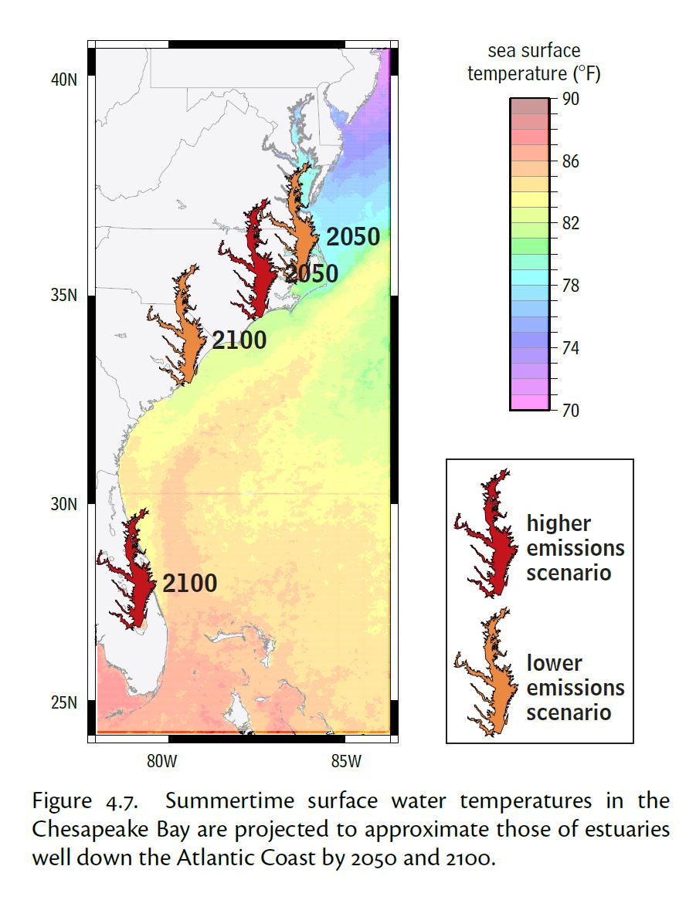
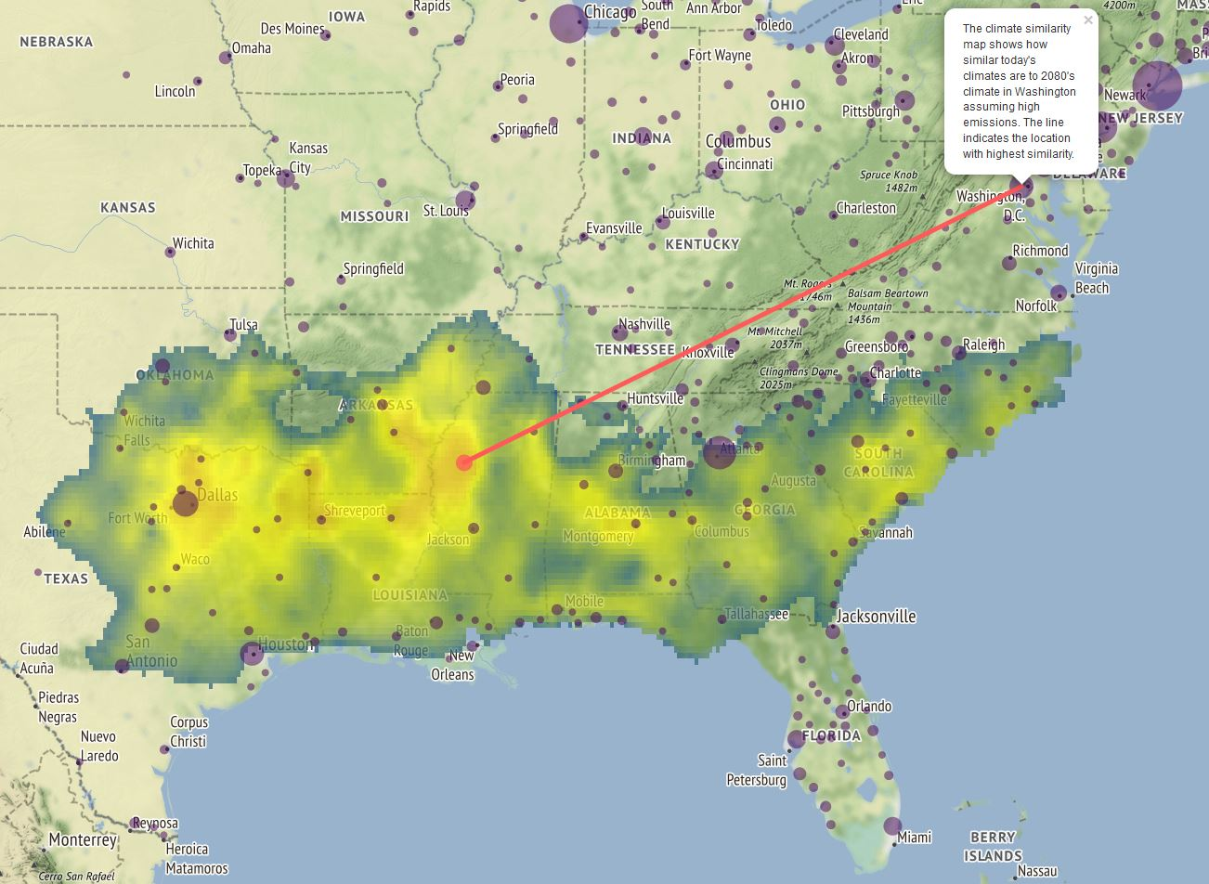
The future Chesapeake Bay: chasing a moving target
Future Urban Climates project – Washington, D.C. in 2080 resembles Greenwood, Mississippi of 2020
Global Warming in the Free State, 2008

Slide 7
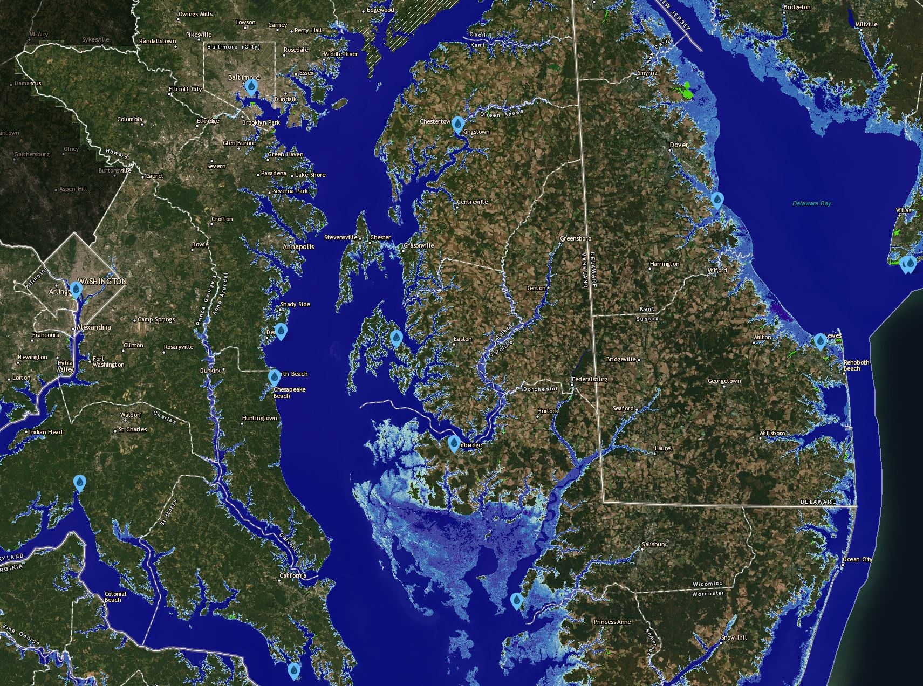
Ongoing and future migration of the land-water boundary
NOAA Sea-Level
Rise Viewer
Chesapeake Bay in 2080: intermediate forecast of +3.12 ft

Slide 8
STAC Request for Input on COVID-19 Impact on Partnership Outcomes
We are hoping for input from across the watershed partnership to help us define the scope of a series of mini-workshops to identify impacts, changing dynamics, and novel insights from COVID-19
We will use these findings to host several short-form 90-minute discussions to inform current and future efforts to reach management targets for the Bay
Some of these topics may be of particular interest to CAC and LGAC; STAC does not need to take the lead on all of these and would be happy to collaborate
We have created an online survey to solicit interest:
https://www.surveymonkey.com/r/HRCK7XD
Timing: January-April 2021?

Slide 9
STAC Request for Input on COVID-19 Impact on Partnership Outcomes
STAC has done some recent brainstorming on this issue and here are some examples of impacts we identified for discussion:
Change in nutrient load from shifts in atmospheric deposition and water use/wastewater treatment (PWS vs septic, etc.)
Altering human behavior, altering living resources: change in water quality, habitat, ability to assess progress
Changing fishing pressure (less restaurant demand, less commercial, more recreational→ overall decreased pressure on fish populations?)
Disruption to agricultural production: disruption in agricultural supply chain that resulted in destruction of crops/flocks/herds, milk dumping

Slide 10
STAC Request for Input on COVID-19 Impact on Partnership Outcomes
More topics:
Increased visitation/use/impact of public/outdoor spaces for recreation, esp. in urban areas (Potomac, more); environmental justice/who has access
Loss of some monitoring data and increased monitoring expenses due to social-distancing protocols
Public health effects, unemployment and loss of tax revenues for regulatory enforcement, BMP installation, water quality monitoring
Are CAC and LGAC interested in participating in or taking the lead on any of these topics? Are there other topics that should be added to the list?

Slide 11
The questionnaire:
STAC Request for Input on COVID-19 Impact on Partnership Outcomes
STAC has begun brainstorming on this issue and below are some examples of impacts we have identified for discussion. From the list below, please rank the highest priority ideas for further discussion. (listed items are on previous slides)
Are any important impacts on the Bay missing from this list?
What risks, changes in the Bay, and learning opportunities do you see in the short and long-term due to COVID-19?
Are there any individuals or groups that would be important to include for any of the above topics?
Your name and affiliation

