Slide 1

Agriculture Workgroup Mid-Point Assessment Priorities
Water Quality Goal Implementation Team Meeting
Fairfield, Pennsylvania
October 22-23, 2012

Slide 2
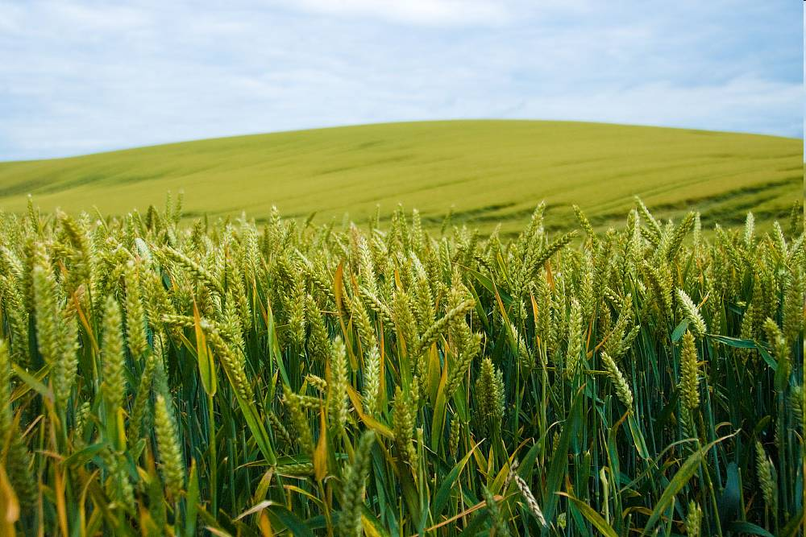




Mark Dubin
Agricultural Technical Coordinator
University of Maryland Extension-College Park
College of Agriculture and Natural Resources
USDA-NIFA Mid-Atlantic Water Program
mdubin06@umd.edu
EPA Chesapeake Bay Program Office
mdubin@chesapeakebay.net

Slide 3
AgWG Mid-Point Priorities
Agriculture Workgroup (AgWG) comprised of representatives from federal, state and local agencies, agricultural and environmental non-governmental organizations, and academic institutions from across the watershed, nationally and internationally
One of the largest (if not the largest) organizations with the Chesapeake Bay Program partnership (approximately 150+ members)

Slide 4
AgWG Mid-Point Priorities
Mid-Point Assessment priority comments received from six Bay jurisdictions, the Chesapeake Bay Commission, as well as agricultural and environmental NGO’s in September.
Priority comments organized into five main categories and finalized on October 11th during the AgWG monthly meeting.

Slide 5
AgWG Mid-Point Priorities
Priority 1
  Modeling Baseline/Input Data Assumptions/Needs
Priority 2
  Scenario Builder and Chesapeake Bay Program Modeling Suite Transparency, Accuracy, and Confidence
Priority 3
  Establishment and Update of BMP Definitions and Efficiencies
Priority 4
  Model Data Processing
Priority 5
  Chesapeake Bay Program TMDL and WIP/Milestones Policy

Slide 6
