Slide 1

Prioritizing Equity for Climate Resilience
JaLeesa Tate, CFM
State Hazard Mitigation Officer/
Branch Manager
RIC

Slide 2
Why Isn’t Equity Prioritized?
Complex issue
Lack of diversity during decision making
Perception of other issues and challenges being more crucial
Not knowing where to begin
And more

Slide 3
Things to Consider
What makes your community unique
Diversity
Cultural
Historic practices and policies
Empowering vs. engaging
Are citizens part of the decision making process?
Is feedback incorporated into plans and policies?
Personal accountability
What role do you play?
How can you pull from your lived experiences?
Transparency
Is information readily available?
Are all citizens able to access information?

Slide 4
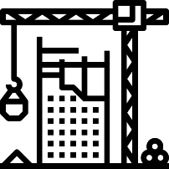


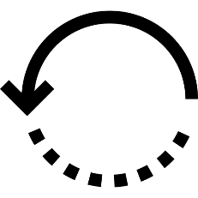

MEMA’s Multi-pronged Approach to Climate Resilience
Hazard
Mitigation
Partnerships
Risk Analysis
DRRA
Legislation/
Policy
Education/
Outreach

Slide 5
Hazard Mitigation
Standardized scoring criteria for projects
All County Emergency Management Directors participated in a listening session to shape the criteria
Provided transparency
Added criteria to rank projects based on social vulnerability
Prioritized community-based projects over asset based projects
Greater benefit across community
Equitable distribution of public funds

Slide 6
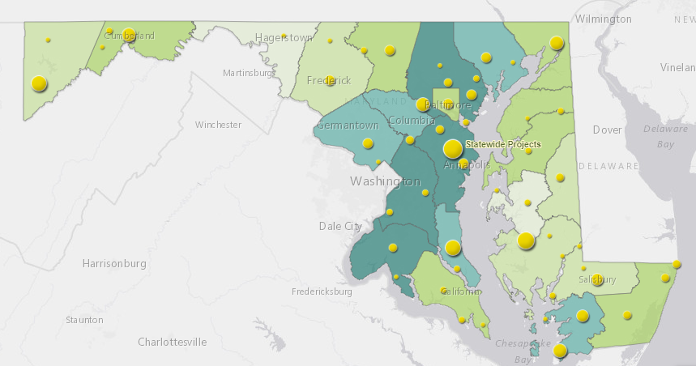
Hazard Mitigation
Informed ourselves on how resources and funding have historically been distributed.

Slide 7
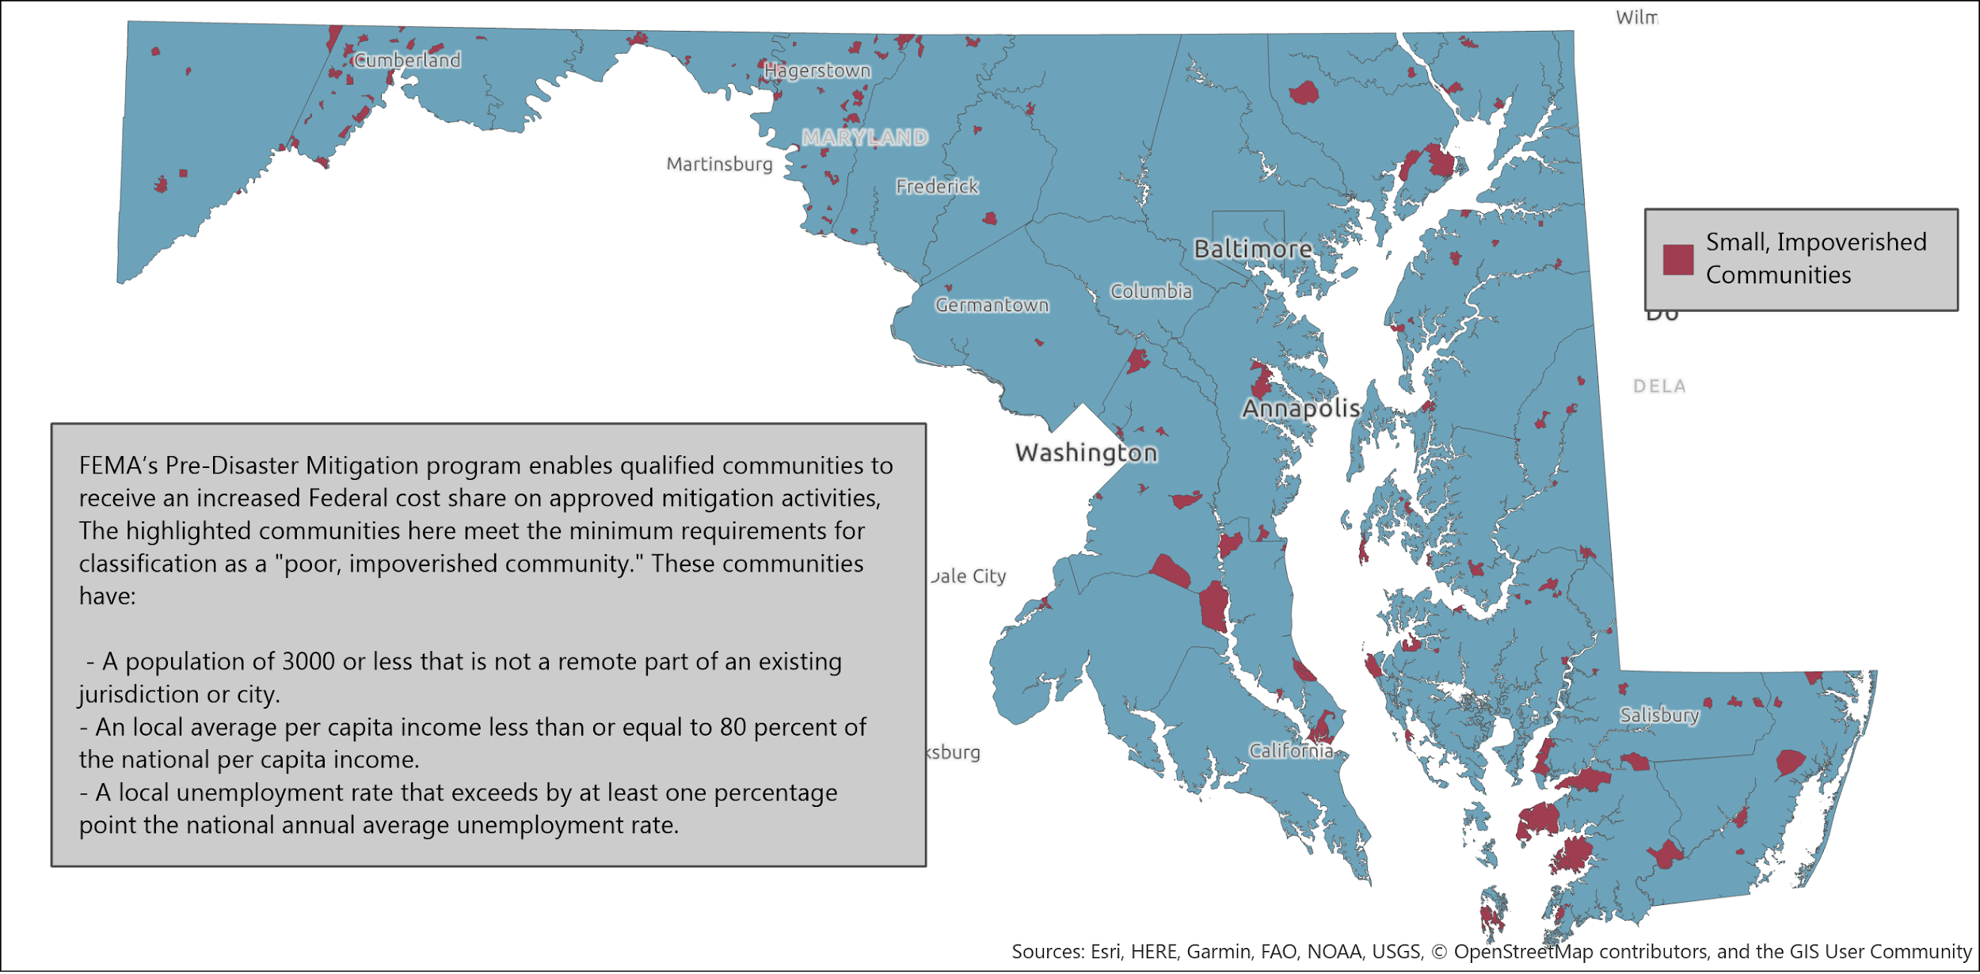
Hazard Mitigation
Identified ‘small, impoverished communities’ as defined by FEMA.
Eligible for an increased Federal contribution for projects

Slide 8
Policy and Legislation
HMGP
Incorporated equity into State Hazard Mitigation Plan.
Developed equity focused goals and actions
Newly created Resilient Maryland Revolving Loan Fund
Low cost loans to communities
Greater flexibility
Hazard Mitigation Assistance (HMA)
BRIC
FMA

Slide 9
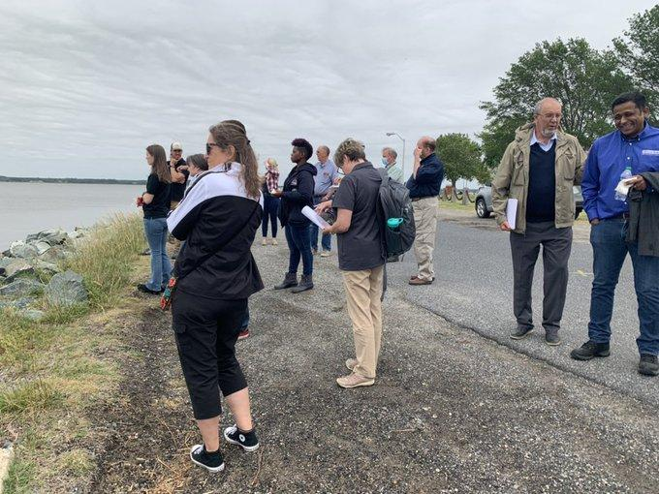
Partnerships
Seeking non-traditional partnerships
The Nature Conservancy
Eastern Shore Land Conservancy
Shore Rivers
Multi-agency coordination
Project reviews
Leveraging funding
Providing subject matter expertise

Slide 10
Education and Outreach
Increasing outreach with local jurisdictions
Quarterly webinars with all subrecipients
In-person site visits
Regional workshops
Local preparedness events
Community Organization meetings
Building community buy-in from beginning to end
Developing co-beneficial community amenities
Whole Community is vitality important
Multi-generational
Places of worship
Renters and Homeowners

Slide 11
Hazard Mitigation Planning and Risk Analysis
Encouraging the Planning process to be a continual effort
Ensuring assessments, goals, and actions are not homogeneous
Providing granular data to communities so they are able to prioritize actions based on their actual risk
Capturing data for all events regardless of scale, magnitude, geographic extent
Hazards
Location
Extent
Historic Occurrences
Future Probability
Assets
Population
Built Environment
Natural Environment
Economy
RISK

Slide 12
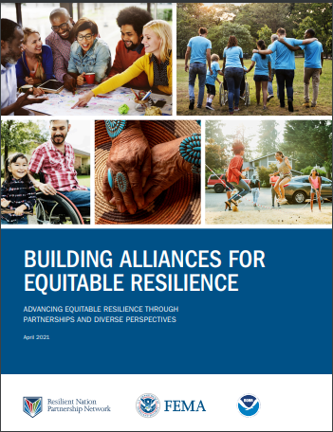
Building Alliances For Equitable Resilience
“Achieving equity requires understanding that everyone is not starting in the same place, everyone doesn’t have access to the same resources, and everyone doesn’t have the same life experiences.”
“People who lack diversity in perspective will not develop equitable policies, perform equitable planning, or create equitable programs that will benefit, rather than harm, the most vulnerable groups and communities.”
Building Alliances for Equitable Resilience

Slide 13
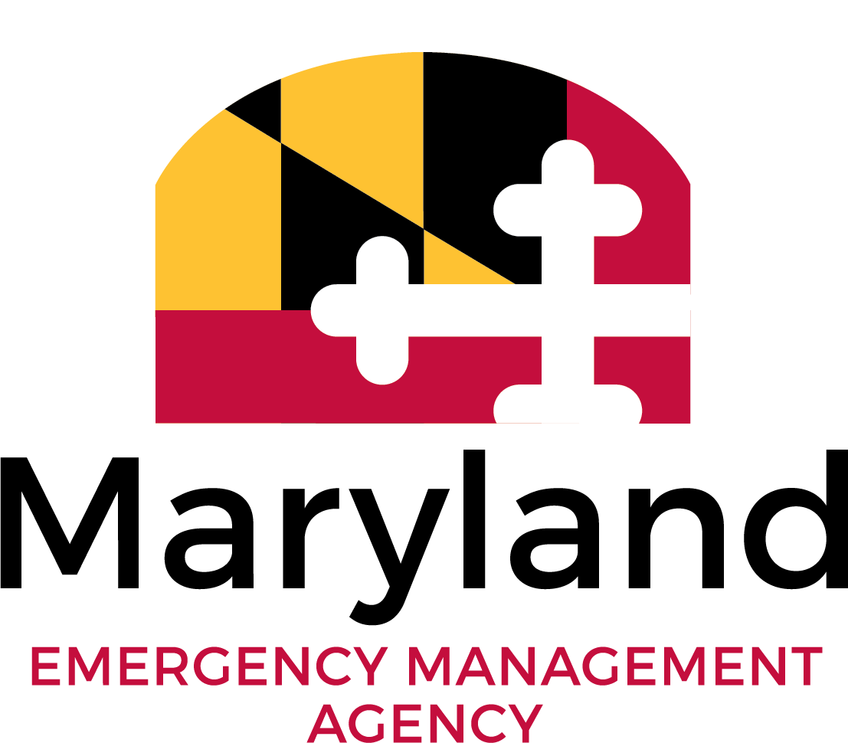
The mission of the Maryland Emergency Management Agency is to proactively reduce disaster risks and reliably manage consequences through collaborative work with Maryland’s communities and partners.
mitigation.mema@maryland.gov

