Slide 1
Progress Toward the Chesapeake Bay Watershed Agreement
A Presentation to the Citizens’ Advisory Committee | May 24, 2017

Slide 2
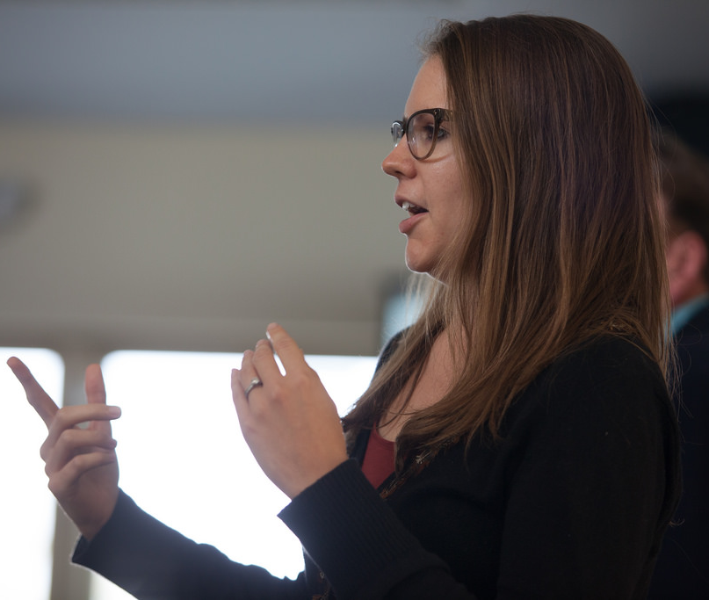
Hello!
I’m Laura Free
Indicators Coordinator
U.S. Environmental Protection Agency

Slide 3

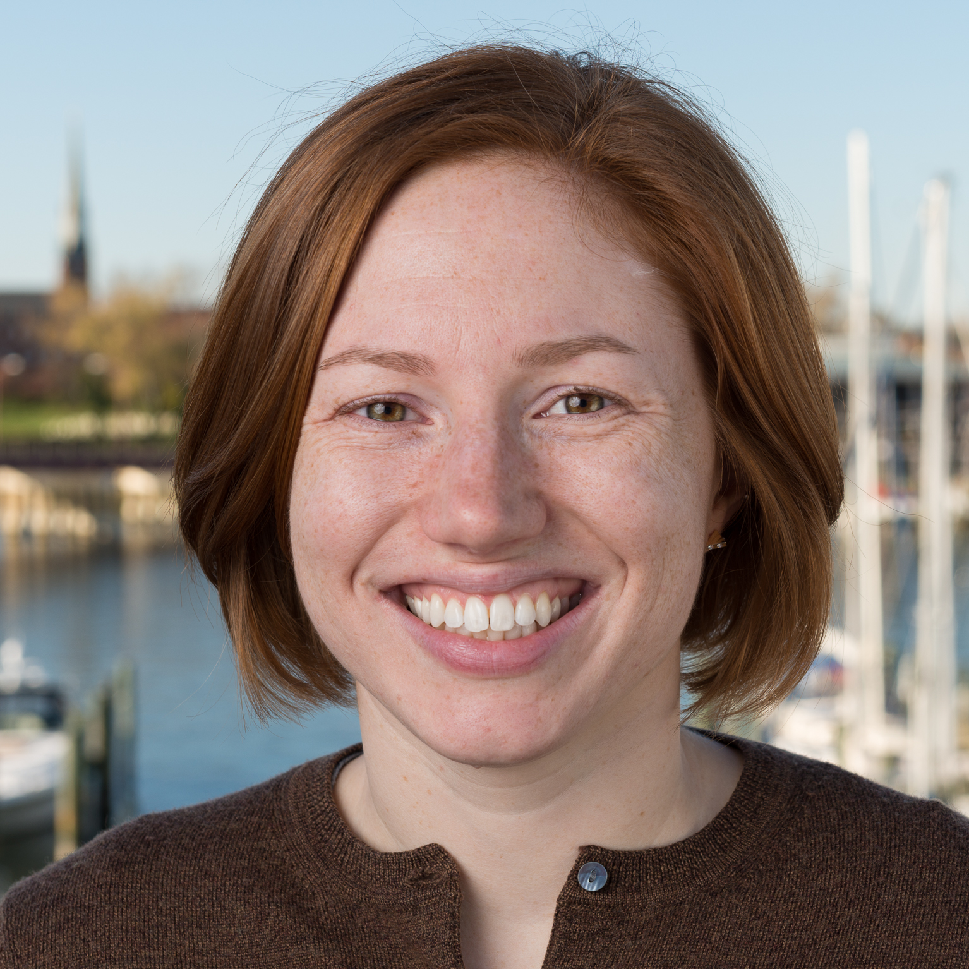
… and Welcome!
I’m Catherine Krikstan
Web Content Strategist
University of Maryland Center for Environmental Science

Slide 4
Notes:
As many of you are aware, the Chesapeake Bay Watershed Agreement was signed in 2014 by the governors of the 6 watershed states, the mayor of DC, the chair of the Chesapeake Bay Commission, and the Administrator of the EPA, on behalf of coordinating federal agencies.

Slide 5
Goals
Sustainable Fisheries
Vital Habitats
Water Quality
Toxic Contaminants
Healthy Watersheds
Stewardship
Land Conservation
Public Access
Environmental Literacy
Climate Resiliency
Notes:
The agreement commits partners to a set of interrelated goals to advance the restoration, conservation and protection of the Bay, its tributaries and the lands that surround them.

Slide 6
How do we track progress toward the Chesapeake Bay Watershed Agreement?
Notes:
Today, we want to show you how our partnership tracks progress toward the Chesapeake Bay Watershed Agreement.

Slide 7

Notes:
The Chesapeake Bay Program has a suite of environmental health, restoration and stewardship indicators to help track our progress toward our outcomes.
These indicators represent a mass collection of data and information that support our decision-making and communications needs.

Slide 8
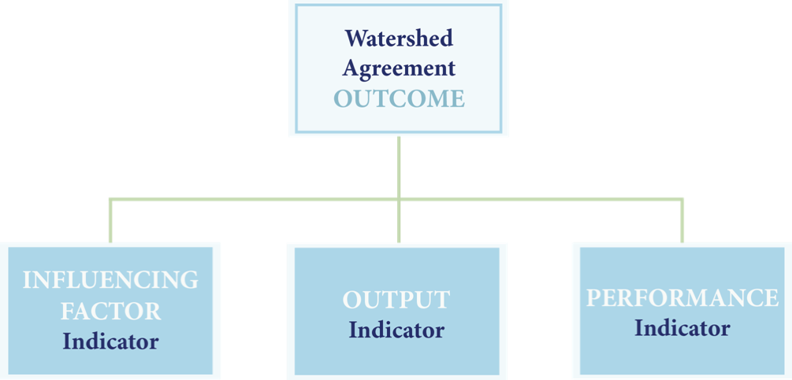
Indicators Framework
Notes:
Some indicators—known as Influencing Factors—track the factors that impact the achievement of our OUTCOMES. Other indicators—known as Output indicators—track whether we are accomplishing the commitments outlined in our management strategies and work plans. And still other indicators—known as Performance indicators—track whether we are achieving the outcome we have committed to.
These three types of indicators can be arranged into a framework—or conceptual model—for each of our outcomes. While this framework has not been fully filled out for each outcome, its continued evolution is supported by the Status and Trends Workgroup.

Slide 9
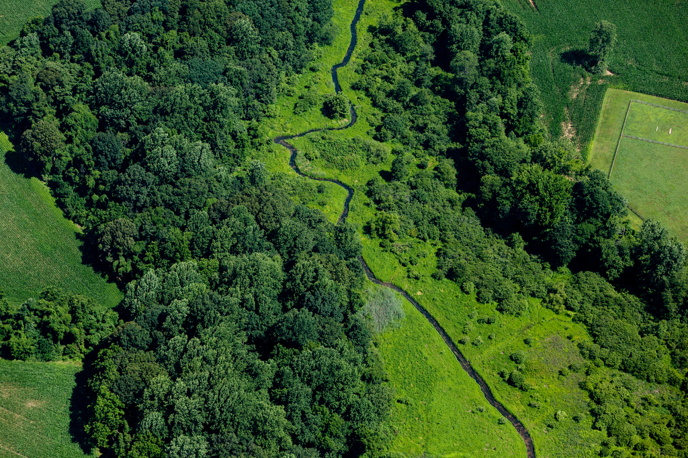
Notes:
During our presentation, Laura and I will offer a high-level look at our progress:

Slide 10
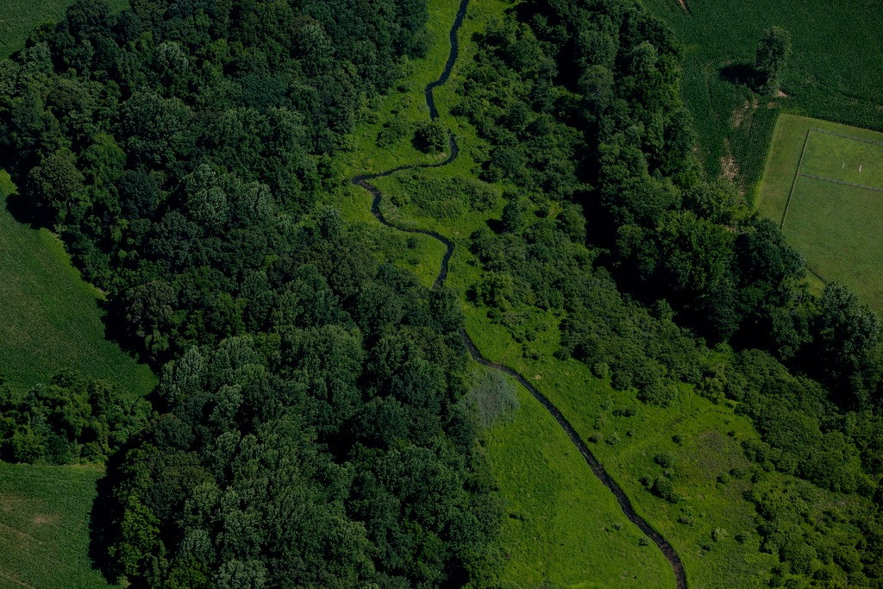
In a general sense, where are we succeeding?
Where are we falling short?
What common factors have contributed to our being ahead or behind?
Notes:
In a general sense, where are we succeeding? Where are we falling short? What common factors have contributed to our being ahead of or behind schedule in putting our management strategies and work plans in place?

Slide 11
Quarterly Review Sessions
Healthy Watersheds
Aquatic Life
Water Quality
A Culture of Stewardship
Next-generation Stewards
Climate Change and Resiliency
Local Action
Notes:
These seven themes will guide our discussion. These themes, cohorts or collections of outcomes were designed to bring related outcomes together. They will also guide the partnership’s recently established Biennial Strategy Review System, and will cue discussion between the Management Board and Goal Implementation Teams at the most appropriate times.

Slide 12

Notes:
It is important to note that for some of our outcomes, we have a wealth of performance data. For others, data collection has only just begun. And for others, we are still working to determine what kind of performance indicators should be used. But a “missing” performance indicator does not mean progress is not taking place! In fact, important work is furthering all of our commitments at all levels of the partnership. Please visit ChesapeakeProgress.com for more information about the outcomes we may not be able to cover in great depth today.

Slide 13
Healthy Watersheds
1

Slide 14
Notes:
Healthy watersheds begin with healthy streams, and bring resilience to a region in the form of clean water, critical habitat and social and economic benefits.

Slide 15
Notes:
Jurisdictions have set their own definitions of healthy waters and watersheds, and a map of state-identified healthy waters and watersheds is available on ChesapeakeProgress. These datasets will serve as the baseline from which we assess watershed health and measure progress toward this outcome.

Slide 16
Notes:
Just as we must protect healthy watersheds, we must protect stream health.

Slide 17
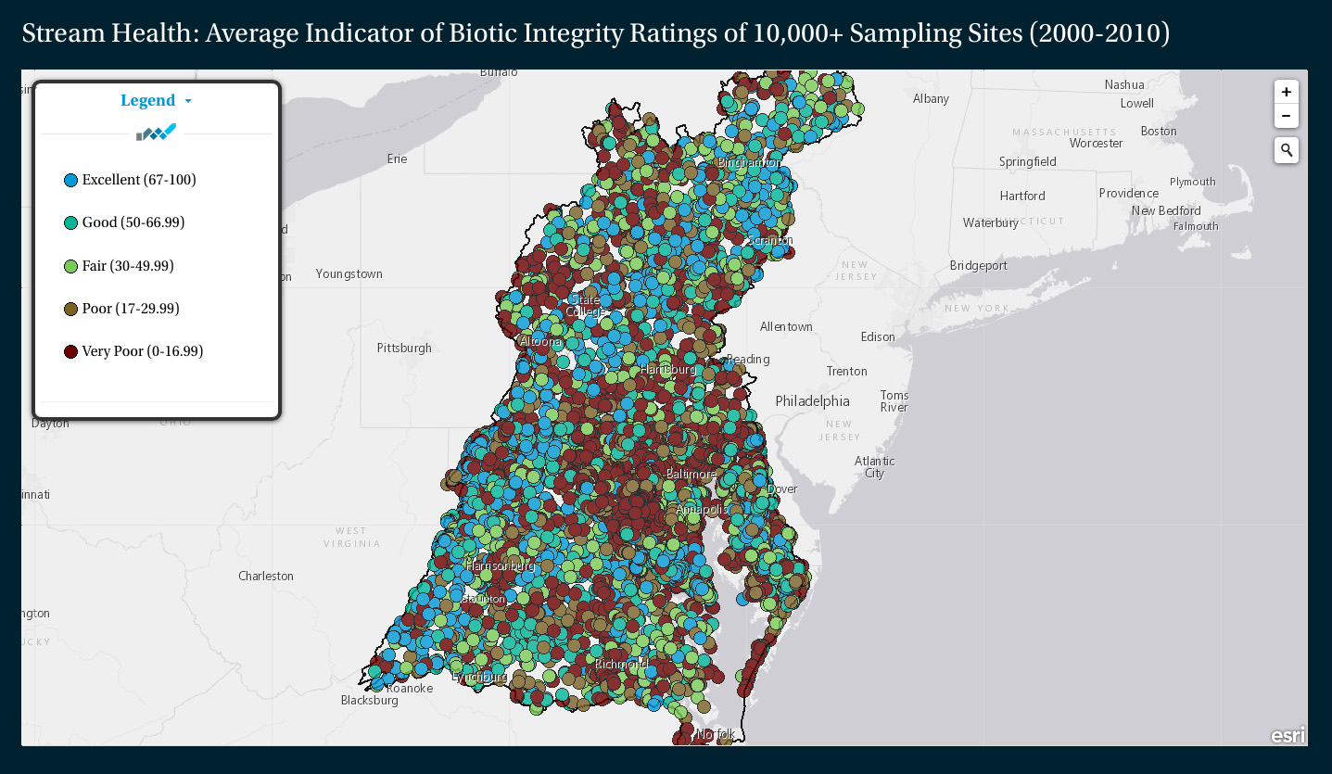
Notes:
Over the last decade, thousands of samples have been collected to help us determine the health of streams in the region.

Slide 18
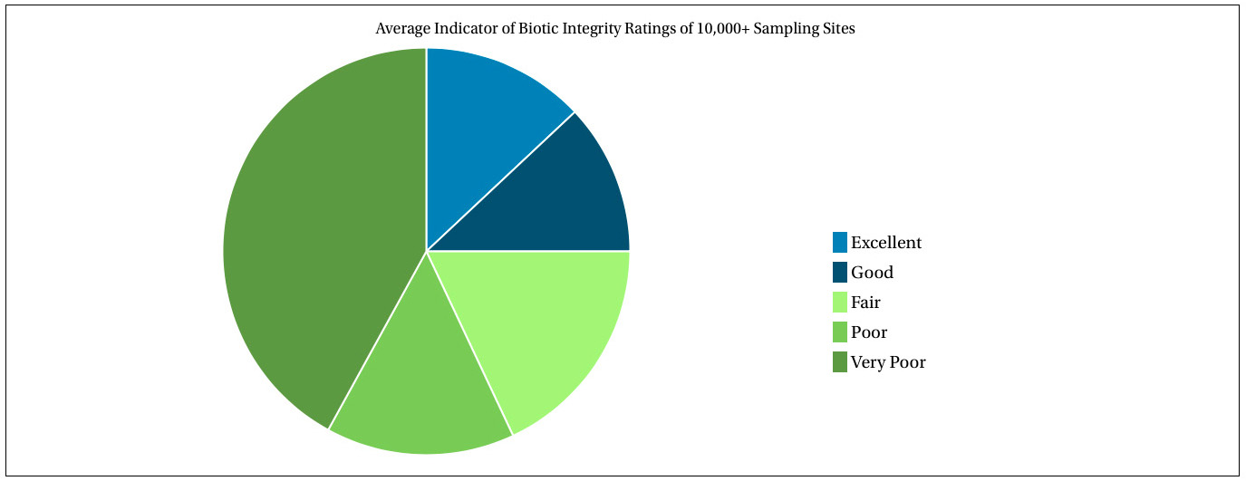
Stream Health, 2000-2010
Notes:
Of the streams sampled between 2000 and 2010, about 40 percent were ranked in excellent, good or fair condition and about 60 percent in poor or very poor condition. Experts are working to refine this indicator and gather more recent data.

Slide 19
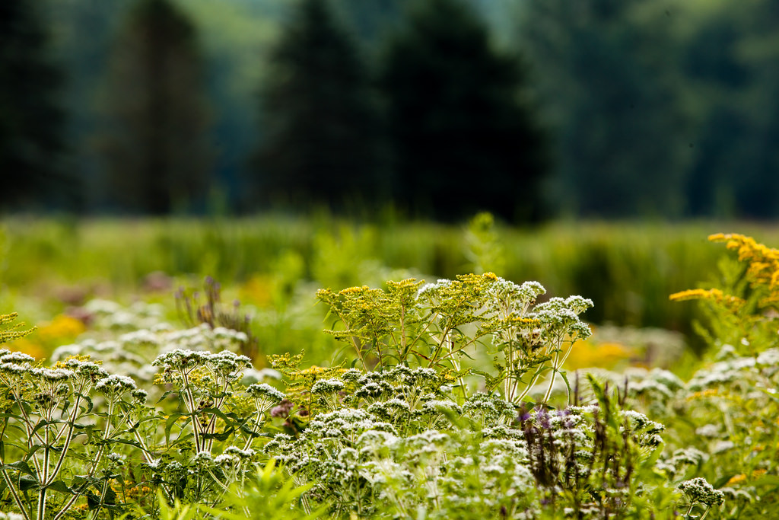
Notes:
We safeguard streams and rivers by removing the dams, culverts and other barriers that inhibit their flow and by protecting the lands around them from development.

Slide 20
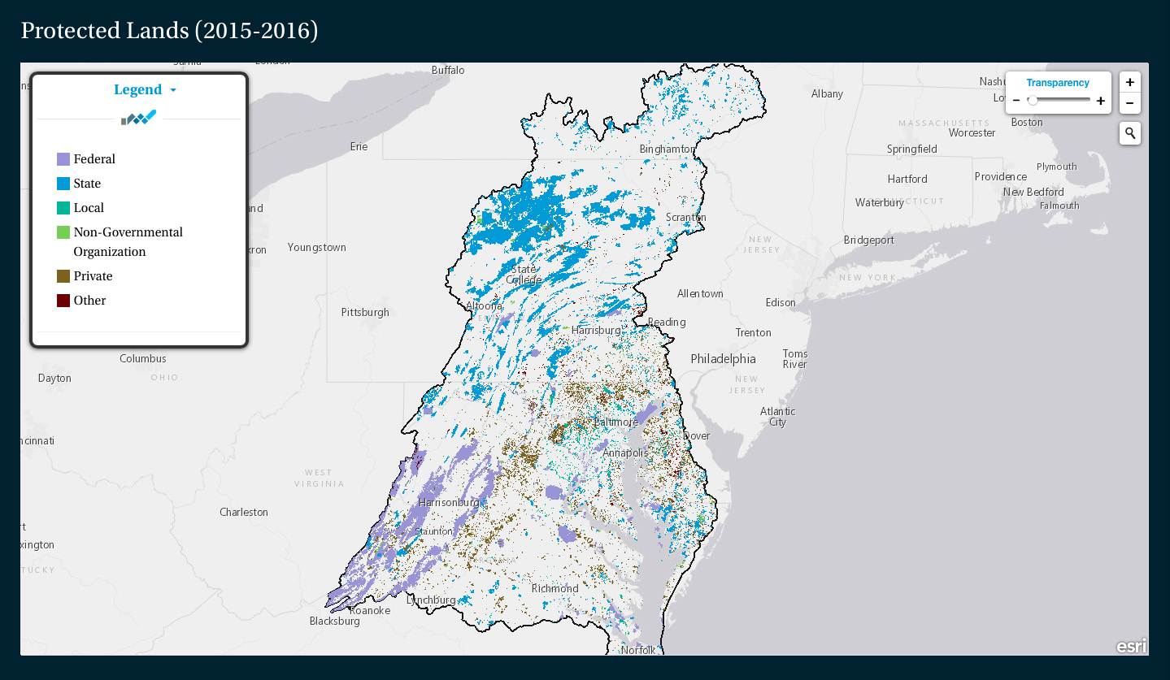
Notes:
Over the last six years, just over one million acres of land in the watershed have been permanently protected from development.

Slide 21
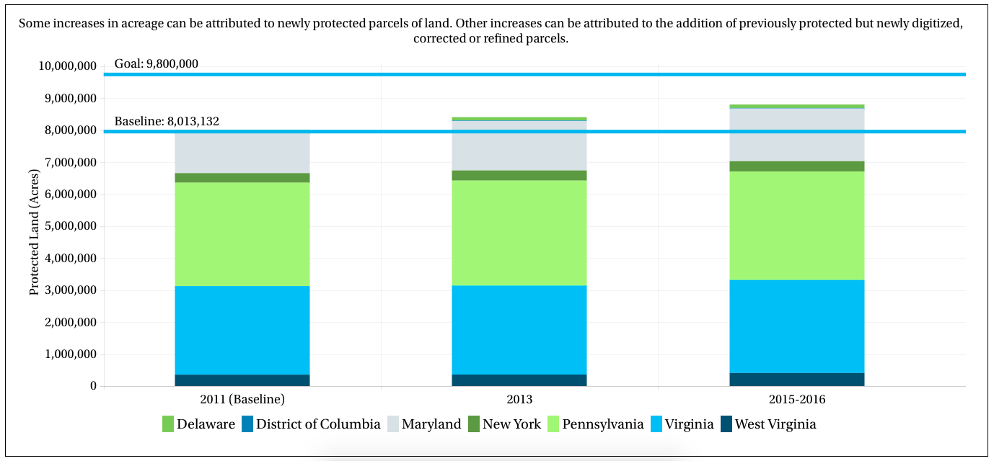
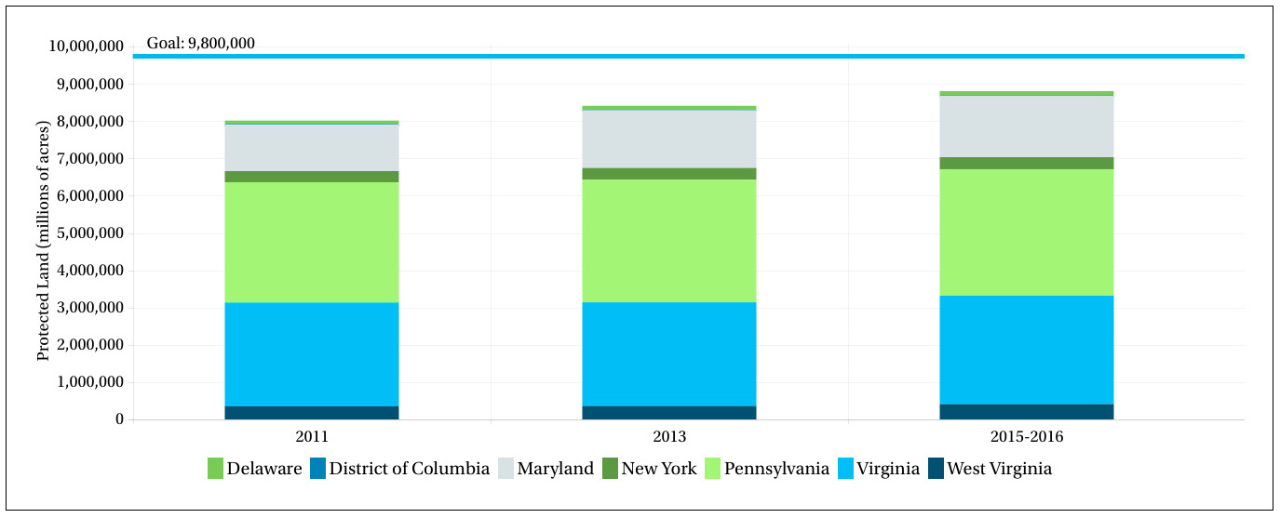
Protected Lands (By Jurisdiction), 2011-2015/2016
Notes:
This marks an achievement of 50 percent of our conservation goal and brings the total amount of protected land in the watershed to 8.8 million acres.

Slide 22
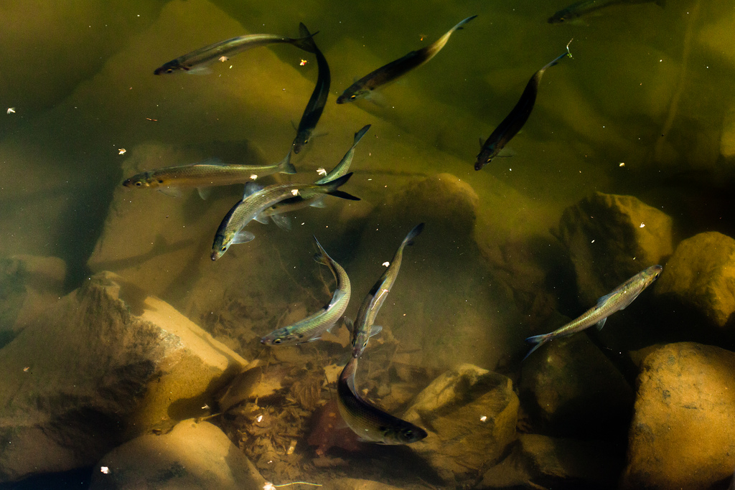
Notes:
Over the last five years, 1,126 miles of streams have been opened to fish passage.

Slide 23
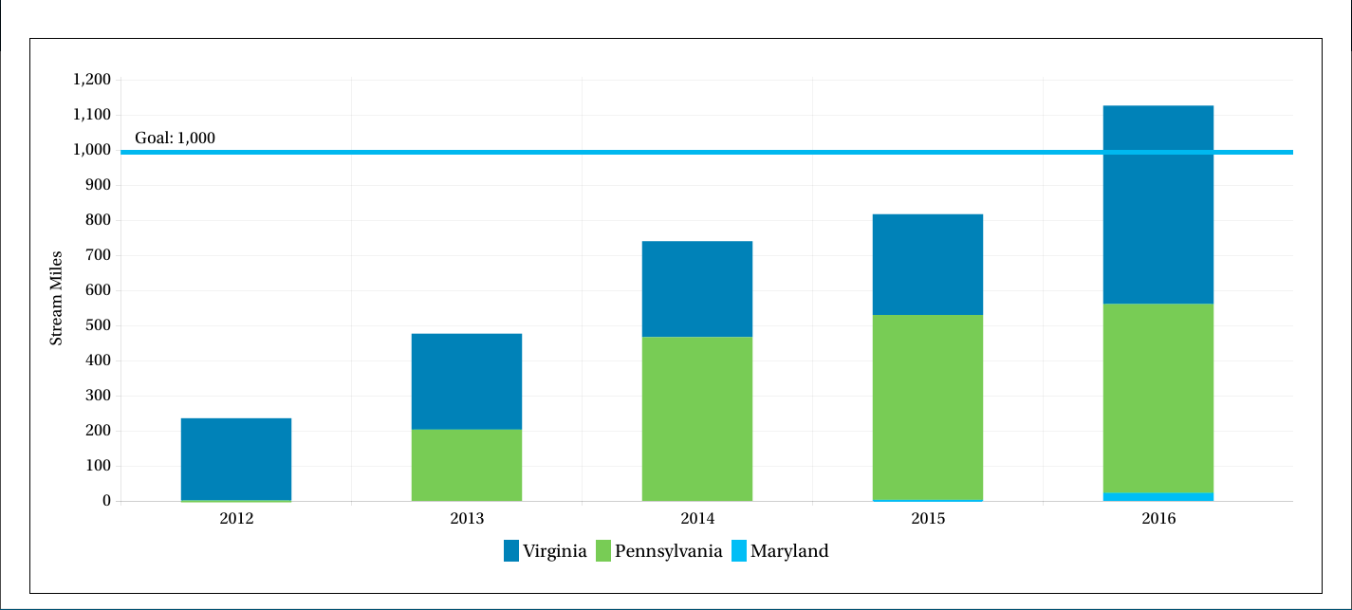
Stream Miles Opened to Fish Passage (Cumulative), 2012-2016
Notes:
This total includes 565 miles in Virginia and 538 miles in Pennsylvania, and surpasses the 1,000-mile goal.

Slide 24
Notes:
The environmentally sensitive brook trout is one of the species whose health will be supported by continued progress toward our Fish Passage outcome, and the same decision-support tool that has helped us restore fish passage will help us restore populations of brook trout. Government agencies, research institutions and non-governmental organizations continue to identify and protect priority habitat, target stream restoration and increase the watershed’s recently defined area of “wild brook trout only” habitat.

Slide 25
Influencing Factors
Notes:
Several common factors could affect our continued progress toward the outcomes in the Healthy Watersheds cohort. During our most recent Quarterly Progress Meeting—the first to take place in the Biennial Strategy Review System process—the importance of identifying common factors in our work across outcomes became clear.

Slide 26
Influencing Factors
Knowledge
Support
Capacity
Notes:
For example: A number of outcomes within the Healthy Watersheds cohort depend on the knowledge and support of lawmakers, landowners, local government officials and members of the public, as well as the knowledge and capacity of government agencies and NGOs.

Slide 27
Notes:
Progress toward the Healthy Watersheds Outcome, for example, will depend on ensuring local government officials know where healthy watersheds are located, which are vulnerable to degradation and how their status is changing over time. Progress toward the Fish Passage Outcome will also depend on reaching this audience, and helping them understand the benefits of dam removal. It's possible that cross-outcome coordination could strengthen efforts to reach this common audience.

Slide 28
Influencing Factors
Funding
Science and Research
Partner Coordination
Notes:
Several outcomes also depend on the availability of funding; new science and research; and the alignment of goals, priorities and resources among Chesapeake Bay Program partners.

Slide 29
Notes:
Progress toward the Fish Passage, Stream Health and Protected Lands outcomes could be impacted by limited financial resources. It's possible that teams could learn from one another in their search for innovative approaches to financing on-the-ground science, restoration and protection.
Because we have not yet held Quarterly Progress Meetings for the rest of the outcomes we plan to discuss today, we will not be able to explore the factors that influence progress toward these outcomes at the same level of detail we have given to the Healthy Watersheds cohort. However, we will touch on the factors that have already been listed in management strategies and work plans so you have an idea of what issues might be critical to understand and address in order to ensure further progress.

Slide 30
Aquatic Life
2
Notes:
The second theme that we'll look at this year is Aquatic Life.

Slide 31
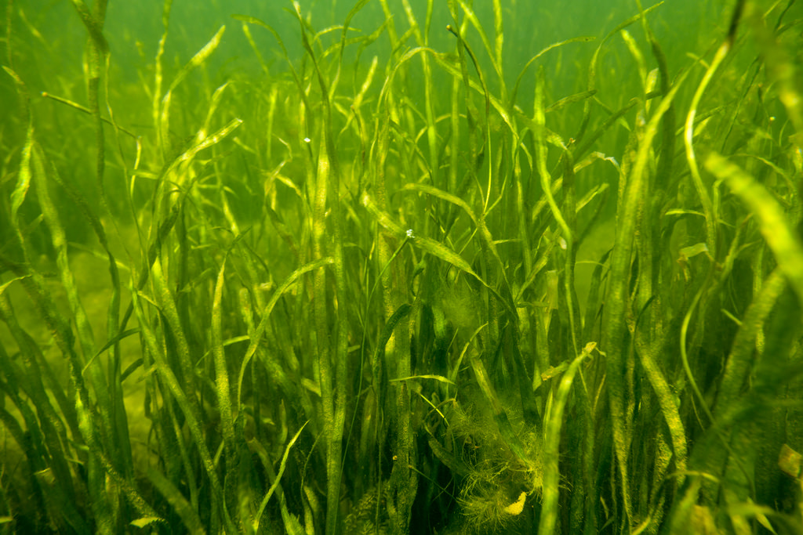
Notes:
Underwater grasses provide food and shelter to fish and wildlife, add oxygen to the water, absorb nutrient pollution and reduce shoreline erosion.

Slide 32
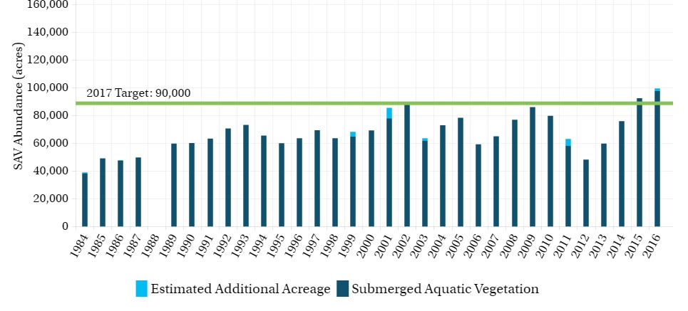
Submerged Aquatic Vegetation (SAV) Abundance, 1984-2016
Notes:
In 2015, more than 92,000 acres of underwater grasses grew in the Chesapeake Bay. This surpasses our 2017 restoration target two years ahead of schedule and marks a 50 percent achievement of our goal.

Slide 33
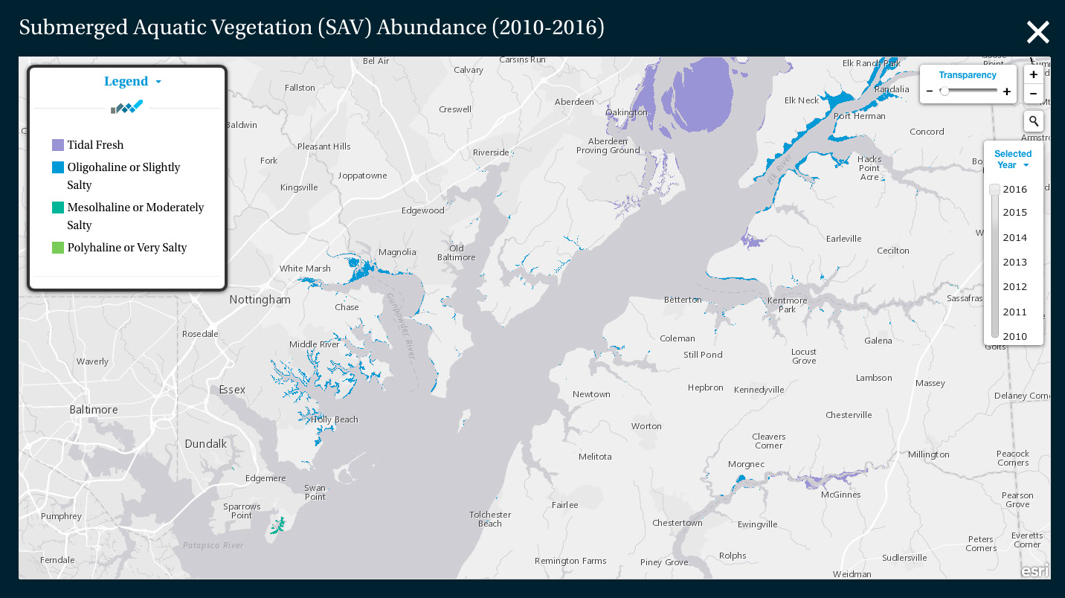
Notes:
We attribute this boost in bay grasses to the growth of several different species in different geographic zones of the Bay:t he recovery of wild celery and other species in the upper Bay, a modest recovery of eelgrass in the lower Bay and the continued expansion of widgeon grass in the mid-Bay. Because widgeon grass is a “boom and bust” species whose abundance can rise and fall from year to year, experts have advised cautious optimism.

Slide 34
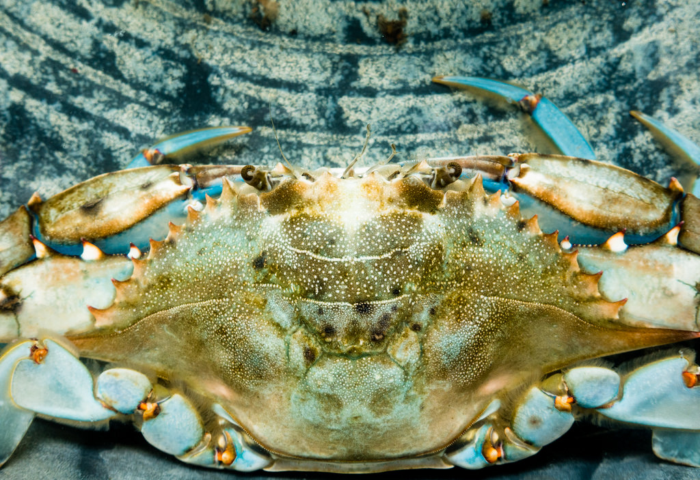
Notes:
If we see continued growth in these underwater grass beds, we could see improvements in the wider ecosystem and in the abundance of some fish and shellfish species.

Slide 35
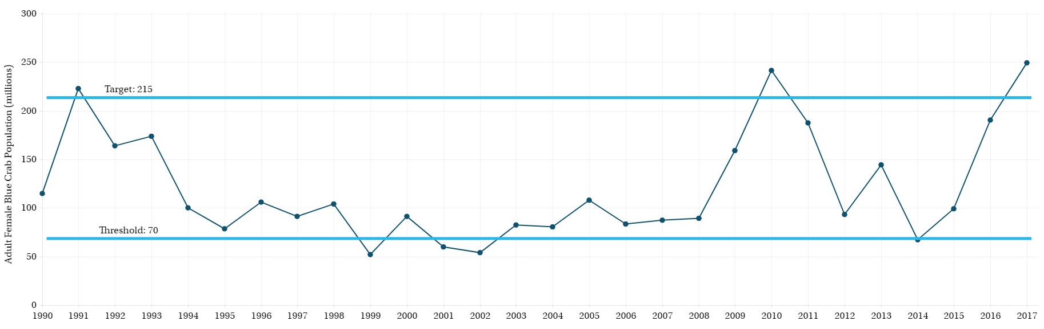
Adult Female Blue Crab Abundance, 1990-2017
Notes:
Blue crabs rely on bay grasses for nursery habitat and refuge from predators. ADD text from script. This number is above the 70 million threshold and above the 215 million target that would support a sustainable blue crab stock.

Slide 36
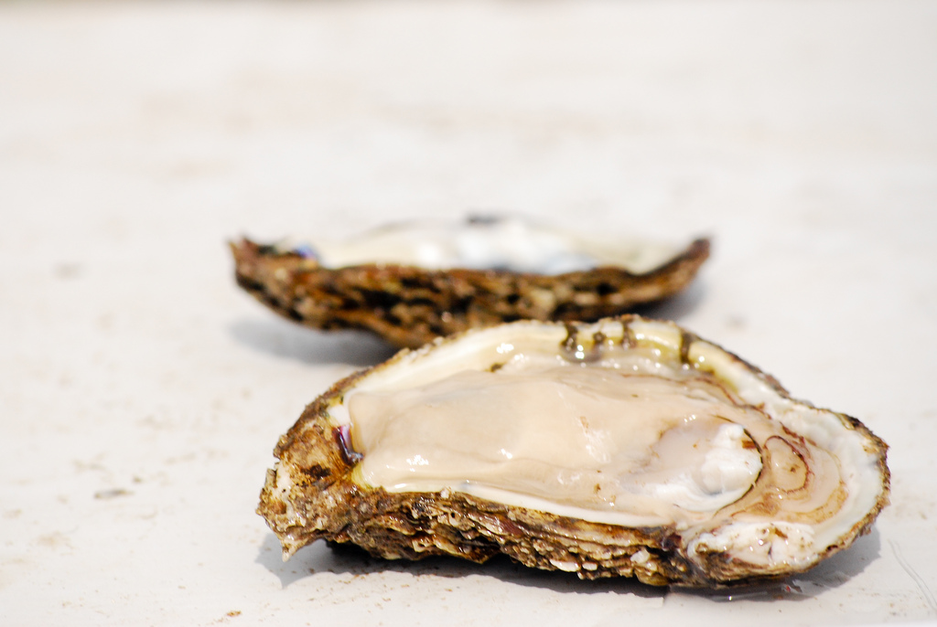
Notes:
We protect, restore, and sustain these aquatic resources by improving water quality and managing our own land use, urban and suburban development, and harvest pressure. These same actions will help us restore native oyster reefs to tributaries in Maryland and Virginia.

Slide 37
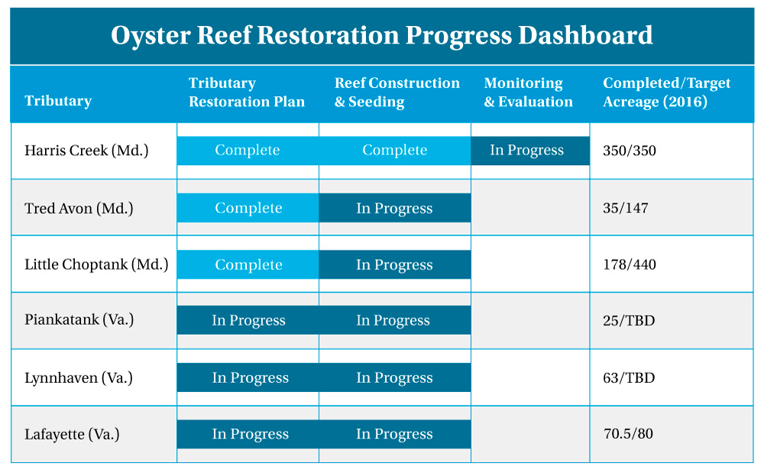
Notes:
Six tributaries have been selected for restoration, each at a different level of progress. In Maryland, almost 440 acres of oyster reefs are considered “complete”; in Virginia, almost 350 acres of oyster reefs are considered the same. Some of these reefs have undergone restoration following the adoption of the Watershed Agreement, while others have undergone previous restoration work or already meet our criteria for a restored reef.

Slide 38
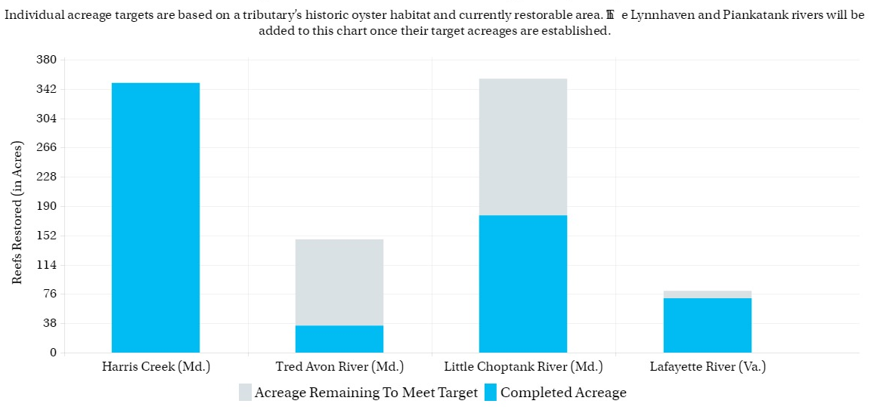
Oyster Restoration, 2016
Notes:
As of October 2016, about 510 acres of oyster reefs remain to be restored.
Restoration targets for the Piankatank and Lynnhaven are being finalized, and four more tributaries will be selected for restoration.

Slide 39
Influencing Factors
Use Conflict
Science and Research
Funding
Ecological Stressors
Notes:
Progress toward a number of the outcomes in the Aquatic Life cohort could depend on use conflict around aquatic habitat; new science and research; the availability of funding; and ecological stressors, including population growth, development, and associated land use conflicts, habitat loss and fragmentation, water quality and climate change.

Slide 40
Water Quality
3

Slide 41
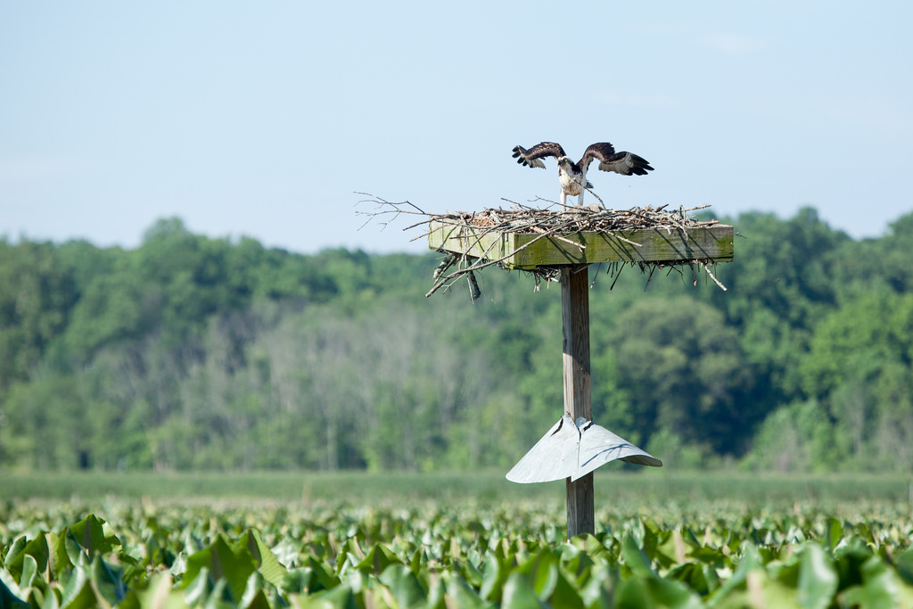
Notes:
Strong fisheries and stable habitats can only exist if our water is clean. Clean water depends on our ability to curb nutrient pollution, sediment pollution and toxic contaminants.
Image: Chesapeake Bay Program

Slide 42
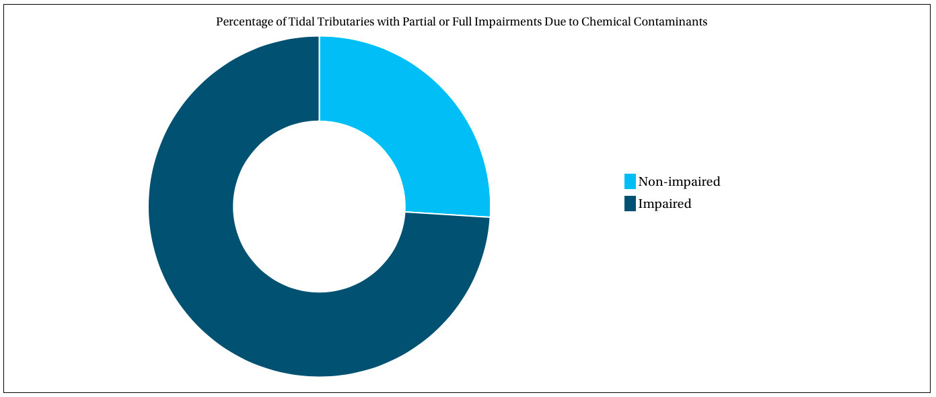
Tidal Waters Impaired by Toxic Contaminants, 2012
Notes:
According to our most recent data, 74 percent of the tidal Chesapeake Bay is partially or fully impaired by toxic contaminants.

Slide 43
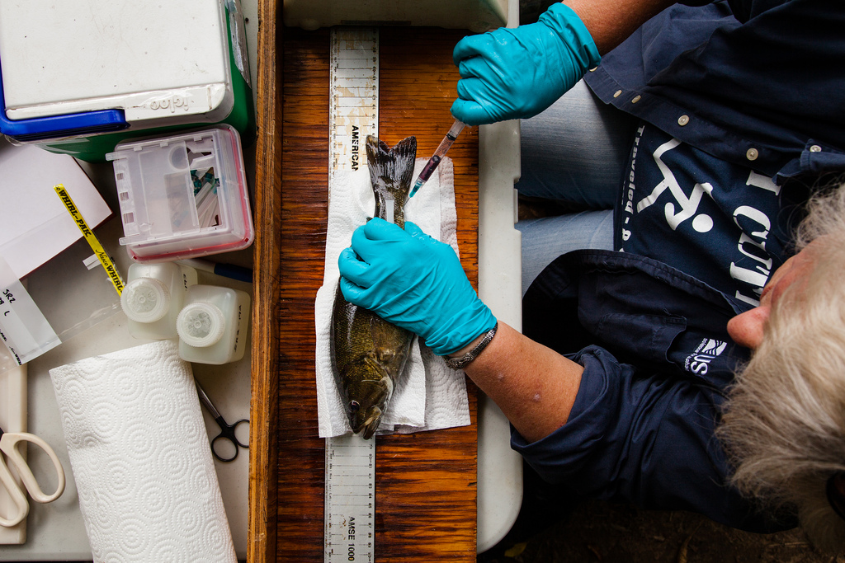
Notes:
PCBs and mercury are particularly problematic, and have led to the issuance of consumption advisories that indicate when, where and which species of fish are unsafe to eat.

Slide 44
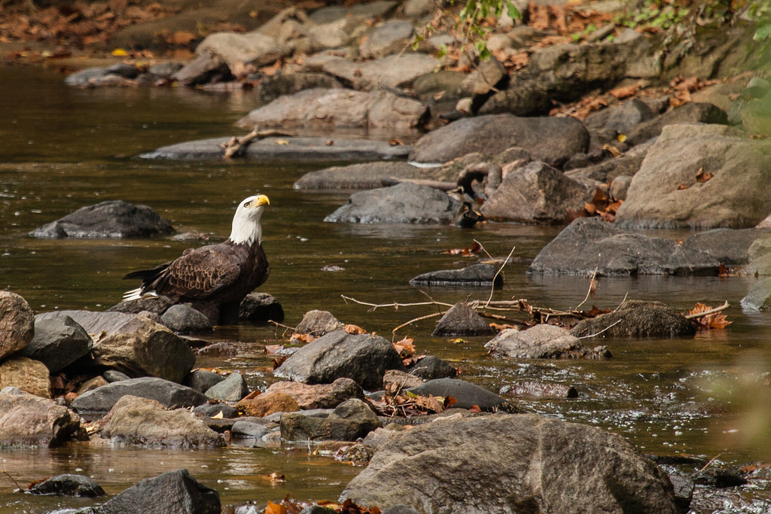
Notes:
Our most recent water quality monitoring data show that below-average nutrient and sediment loads entered the Bay in 2015.
Image: Chesapeake Bay Program

Slide 45
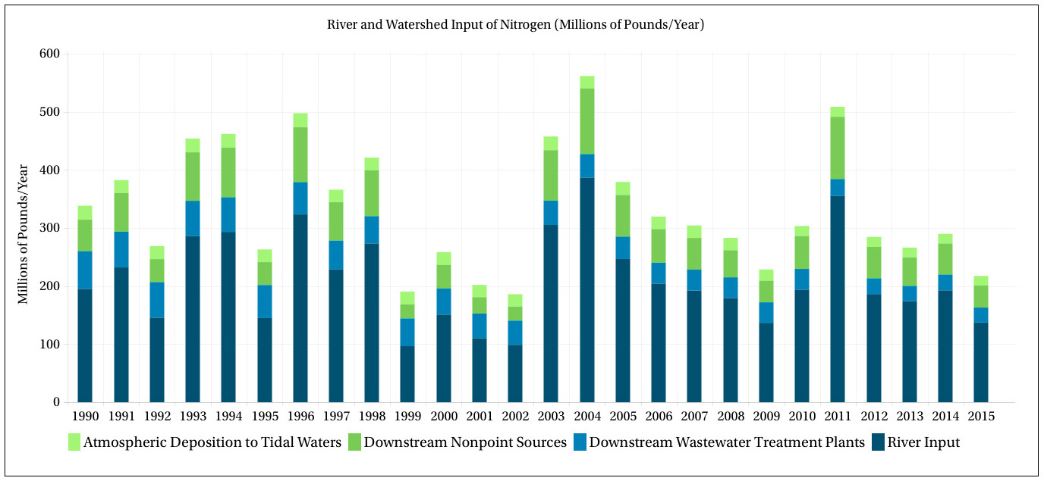
Nitrogen Loads to the Chesapeake Bay, 1990-2015
Notes:
Between 2014 and 2015, nitrogen loads fell 25 percent.

Slide 46
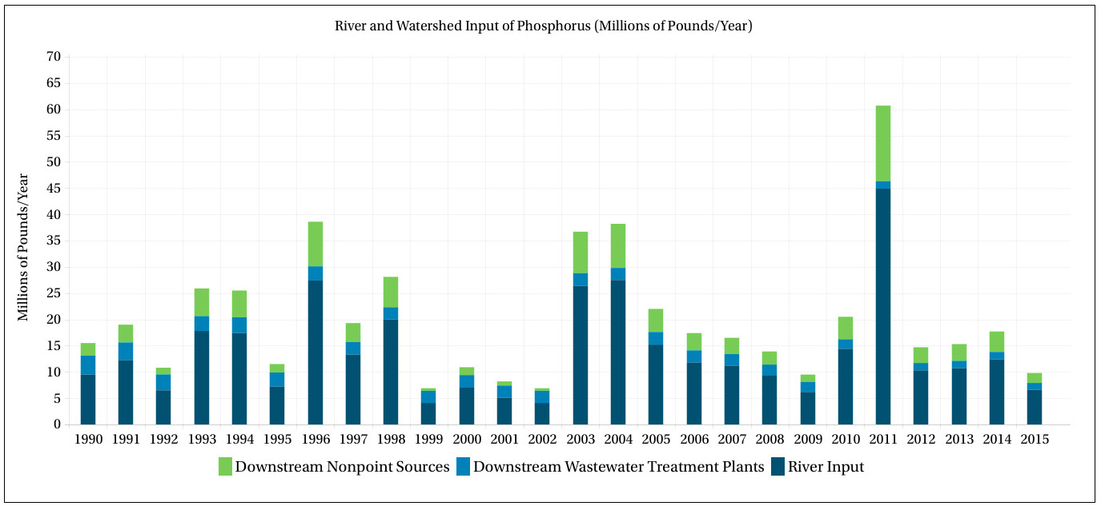
Phosphorus Loads to the Chesapeake Bay, 1990-2015
Notes:
Phosphorus loads fell 44 percent.

Slide 47
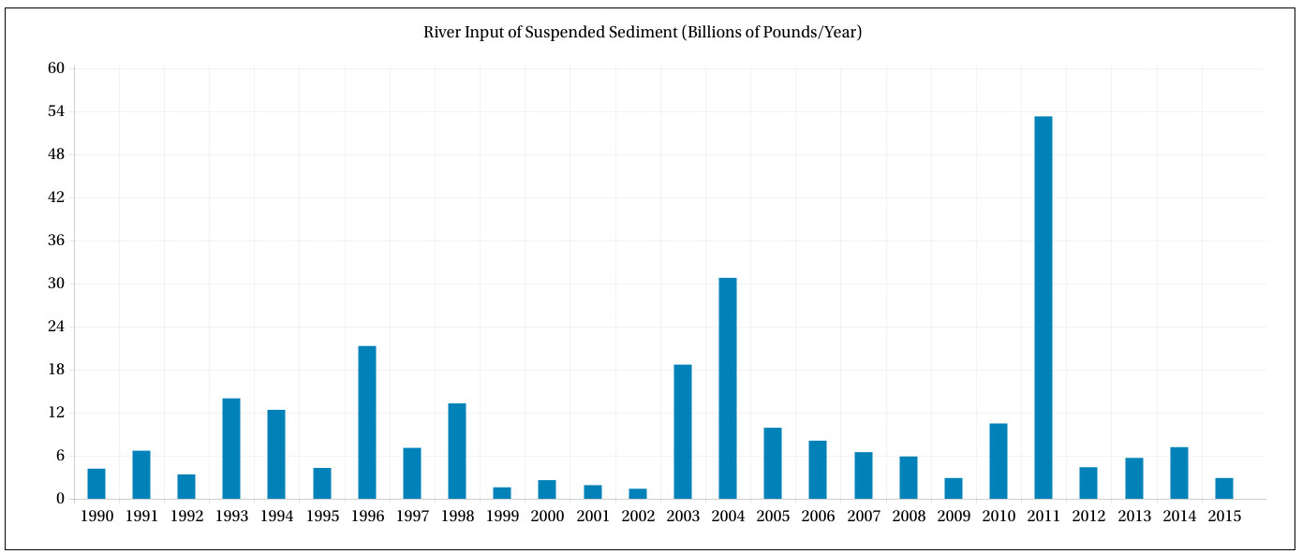
Sediment Loads to the Chesapeake Bay, 1990-2015
Notes:
Sediment loads fell 59 percent.

Slide 48
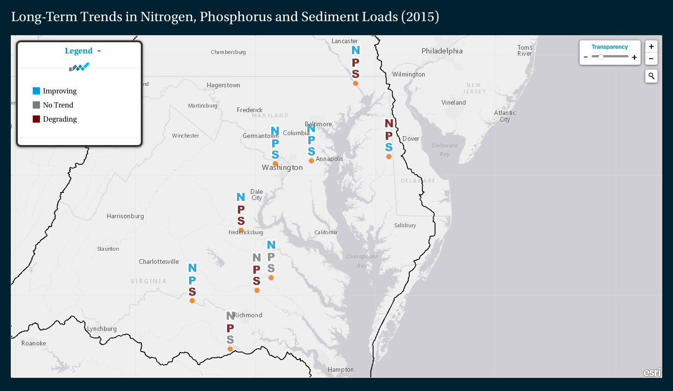
Notes:
Because a large portion of pollution loads enters the Bay from the rivers within its watershed, we track loads and trends at nine River Input Monitoring stations. In some cases, long-term pollution trends reflect our work to improve water quality: long-term trends in nitrogen—indicated here by a blue "N"— are improving at six stations. Long-term trends in phosphorus and sediment are more variable, and short-term trends show less improvement.

Slide 49
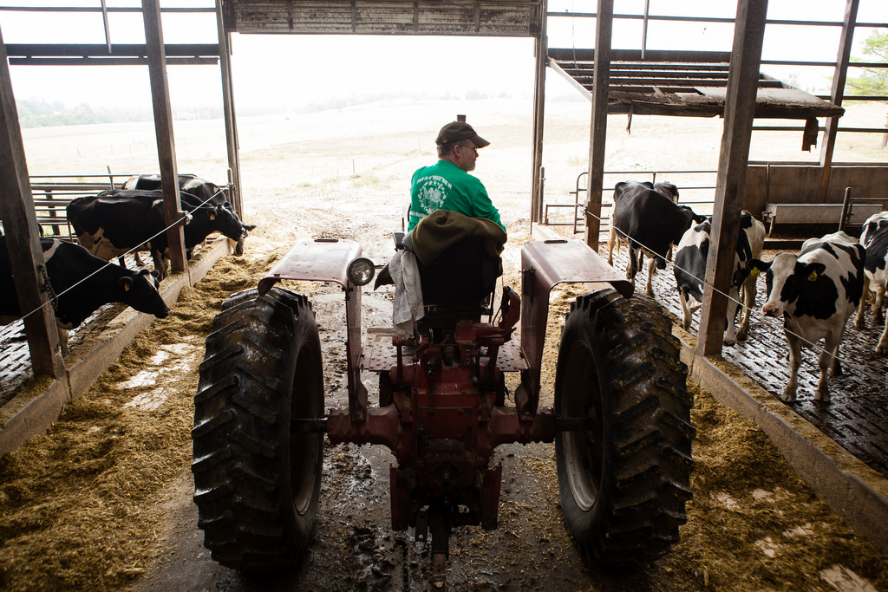
Notes:
Dry weather and below-average river flow played a big role in the pollution drop observed between 2014 and 2015. So, too, did local efforts to reduce pollution, which states report as part of our work to track progress toward the TMDL. Some of the most effective pollution-reducing work includes reductions of nutrients in the wastewater sector and the increased implementation of agricultural conservation practices.
Image: Will Parson/Chesapeake Bay Program

Slide 50
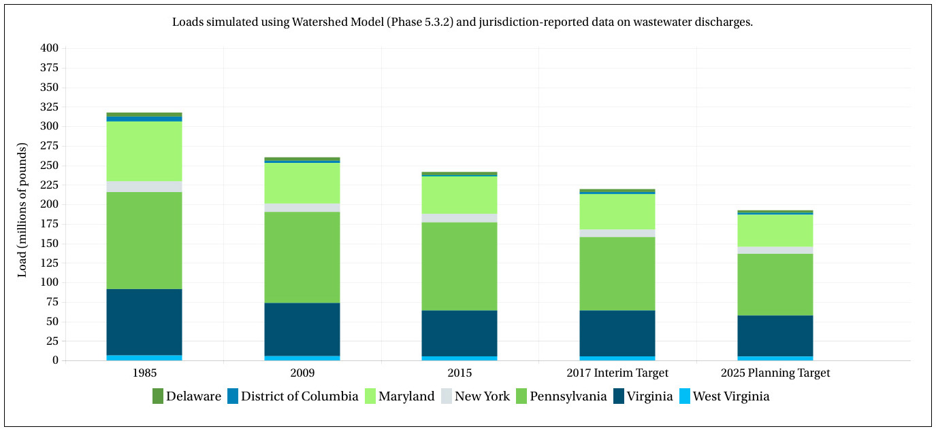
Nitrogen Loads to the Chesapeake Bay by Jurisdiction
Notes:
Our Watershed Model shows that pollution controls put in place over the last six years have lowered nitrogen loads eight percent...

Slide 51
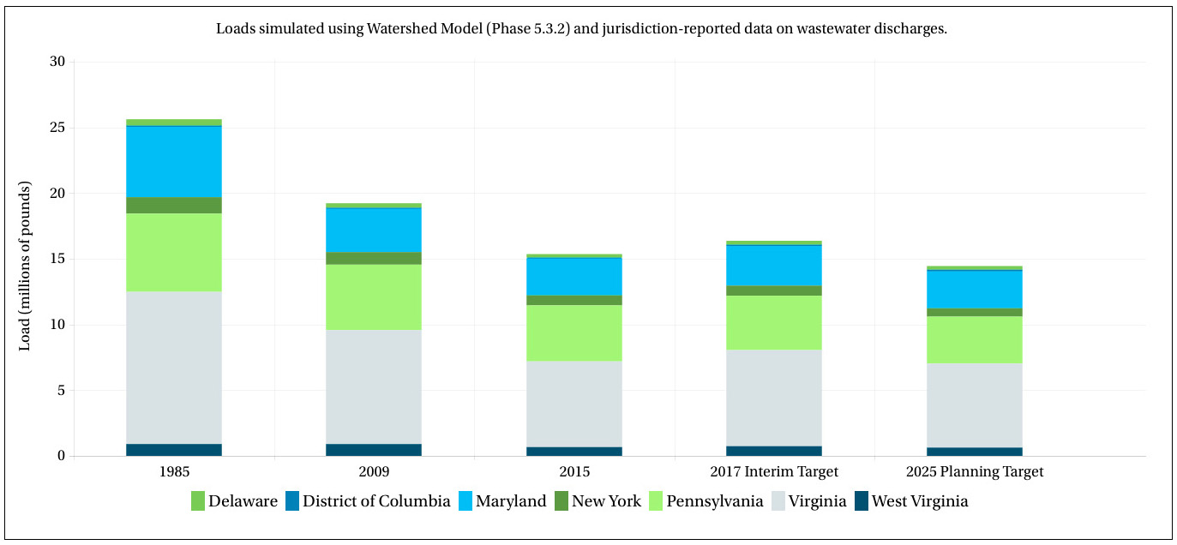
Phosphorus Loads to the Chesapeake Bay by Jurisdiction
Notes:
… phosphorus loads 20 percent...

Slide 52
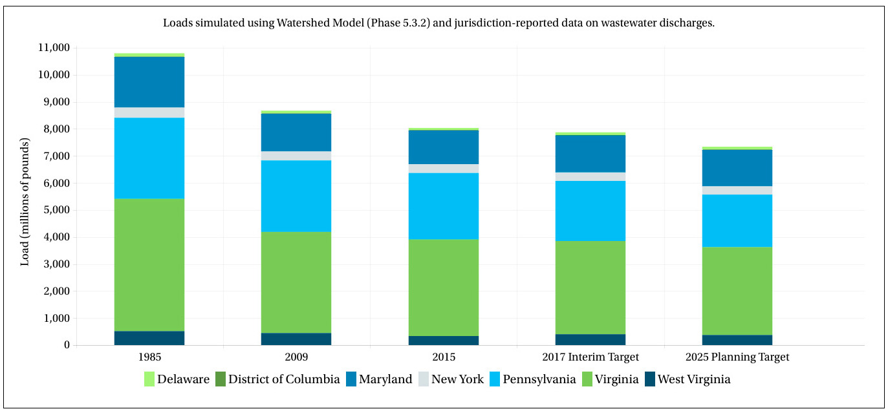
Sediment Loads to the Chesapeake Bay by Jurisdiction
Notes:
...and sediment loads seven percent.

Slide 53
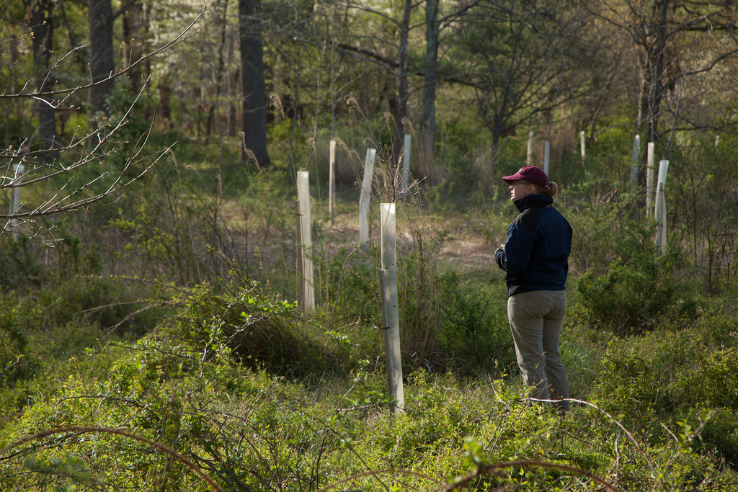
Notes:
Not all pollution reducing practices are being put in place at the rate we may have anticipated.
Forest buffers stabilize stream banks, prevent pollution from entering waterways and provide food and habitat to wildlife. Planting forest buffers is one of the most cost-effective best management practices in the region--

Slide 54
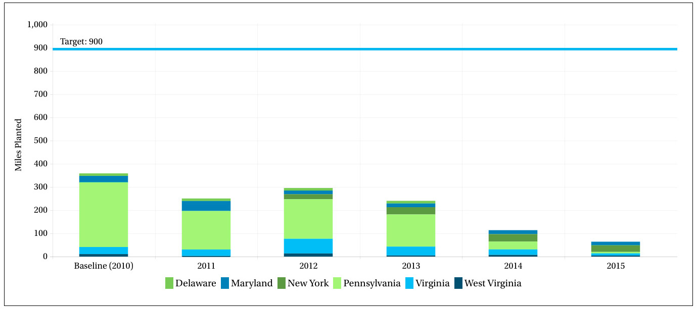
Forest Buffers Planted (Annually), 2010-2015
Notes:
--but planting rates reached their lowest total of the last 16 years in 2015 and have only once in the past two decades met the 900-mile annual goal.
Complex factors are at play, including a lack of coordination among agencies and insufficient assistance for farmers and landowners. To meet these challenges, our partners are working to improve the coordination and delivery of forest buffer programs; align forest buffer programs with land management programs; and make existing forest buffer programs more appealing.

Slide 55
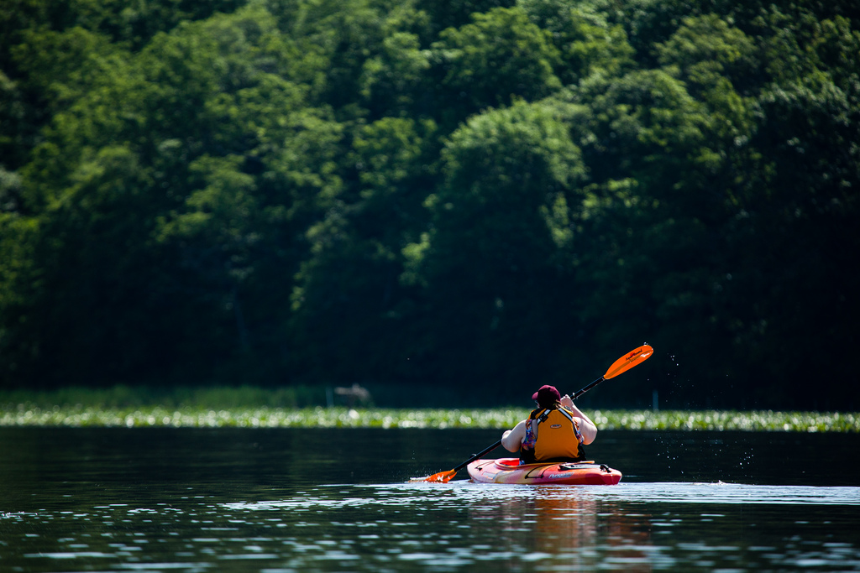
Notes:
If best management practices are the foundation of pollution-free waterways, clean water is the foundation of healthy Chesapeake Bay.
Image: Chesapeake Bay Program

Slide 56
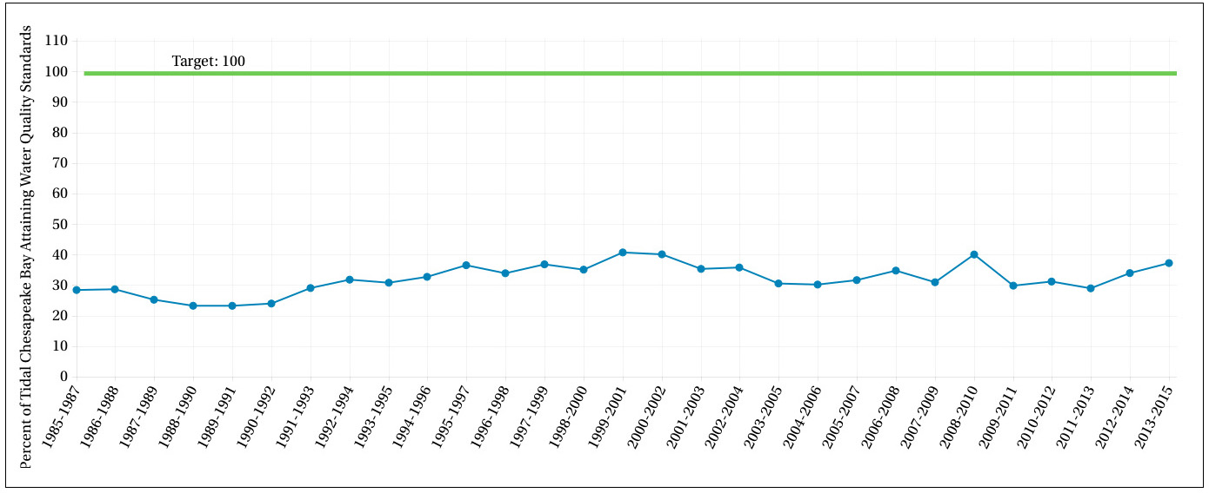
Water Quality Standards Attainment, 1985-2015
Notes:
Our most recent assessment of water quality—which examines dissolved oxygen, water clarity and chlorophyll a as a measure of algae growth—shows that 37 percent of the tidal Chesapeake met water quality standards between 2013 and 2015. This is far below the 100 percent attainment needed for clean water and a stable aquatic habitat, but marks an improvement from the previous assessment period.

Slide 57
Influencing Factors
Knowledge
Support
Coordination
Scientific Data and Understanding
Funding
Notes:
Progress toward a number of the outcomes in the Water Quality cohort could depend on knowledge, support and coordination among Chesapeake Bay Program partners and stakeholders; limitations around available scientific data and current scientific capabilities and understanding; and the availability of funding.

Slide 58
A Culture of Stewardship
4
Notes:
The long-term success of our restoration work will depend on the support of the people who call this watershed home. As individuals and organizations direct their time, talent and resources toward environmental restoration, our community of citizen stewards will become larger, broader and more diverse.

Slide 59
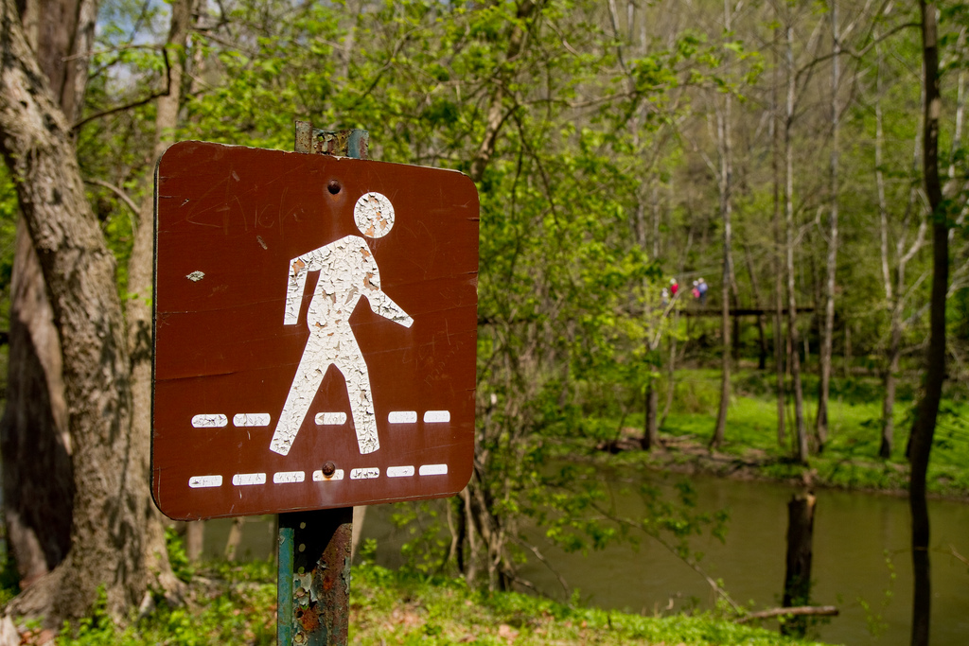
Notes:
We know we can encourage the growth of citizen stewards by fostering personal connections with the natural world.

Slide 60
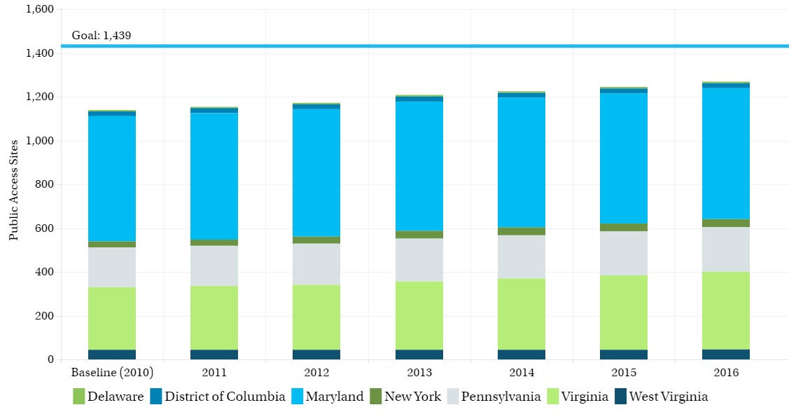
Public Access Sites, Chesapeake Bay Watershed, 2010-2016
Notes:
Between 2010 and 2016, over 130 boat ramps, fishing piers, and other sites that give the public access to open space and waterways were opened. This marks a 43 percent achievement of the 300-site goal…

Slide 61
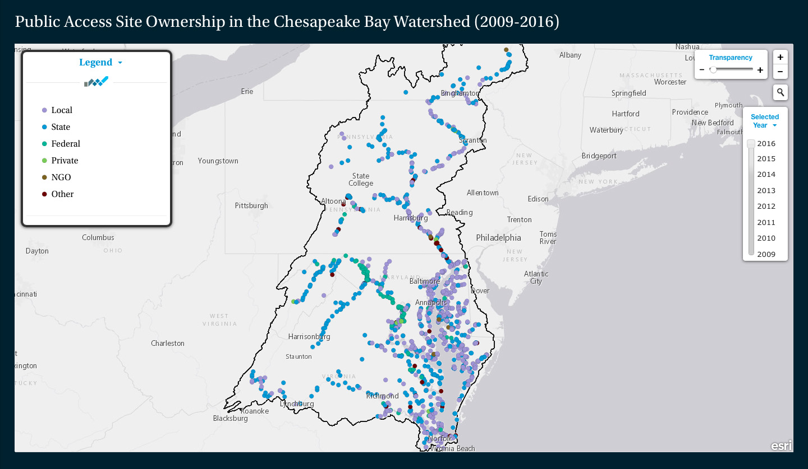
Public Access Sites – Location and Management
Notes:
… and brings the total number of access sites in the region to about 1,269.

Slide 62
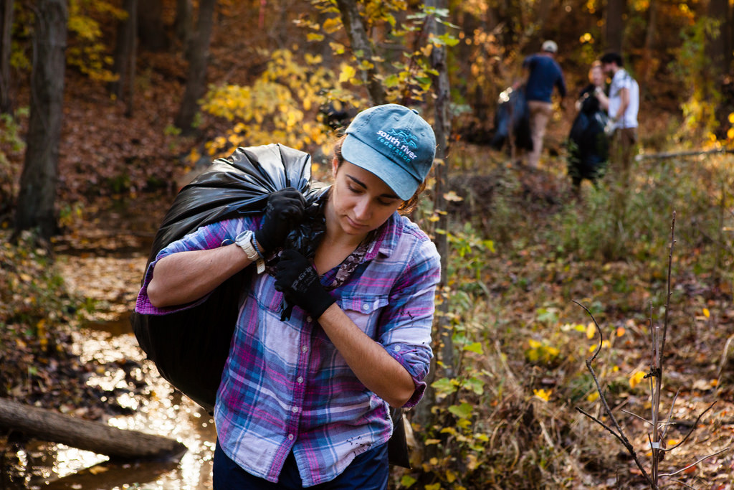
Notes:
In terms of citizen stewardship, work is underway to develop a method of measuring change in public attitudes associated with environmental stewardship, as well as environmentally friendly behavior and volunteerism.

Slide 63

Notes:
Building a more diverse community of citizen stewards begins with building a more diverse partnership. Increasing the inclusion of previously underrepresented communities in our work fosters creativity, drives innovation and ensures all people in the watershed can share in the vibrancy of the region. While age, gender, sexual orientation, religious faith, income level and other characteristics are important aspects of diversity, we have decided to focus first on expanding racial and ethnic diversity among the partnership.
Last year, we developed and distributed a profile assessment to quantitatively describe the demographics of our partnership.

Slide 64
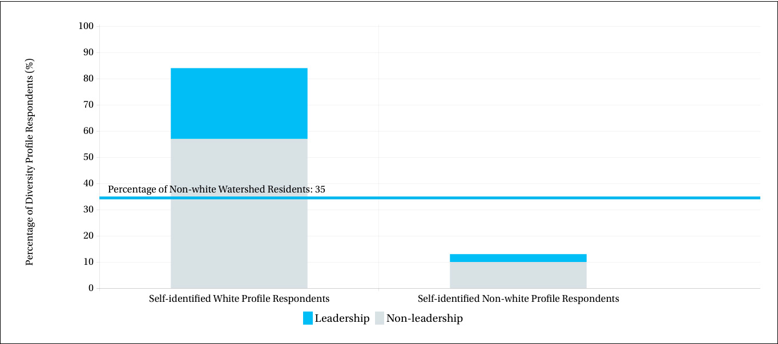
Chesapeake Bay Program Diversity Profile, 2016
Notes:
You see two columns in this graphic. The column on the left represents respondents to the survey who identified as white, and the column on the right represents respondents who self-identified as a racial or ethnic category other than white. The blue in each column represents respondents of that group that identified as Chesapeake Bay Program leadership. Leaders who did not identify as white make up 3 percent of total profile respondents.

Slide 65
Influencing Factors
Knowledge
Behavior
Capacity
Stakeholder Coordination
Funding
Notes:
Progress toward a number of the outcomes in the Citizen Stewardship cohort could depend on knowledge and behavior among members of the public; knowledge and capacity among government agencies; coordination among stakeholders; and the availability of funding.

Slide 66
Next-generation Stewards
5

Slide 67

Notes:
The well-being of the watershed will soon rest in the hands of its youngest citizens. Strong, targeted environmental education can give students the skills they need to protect and restore their local watersheds.

Slide 68
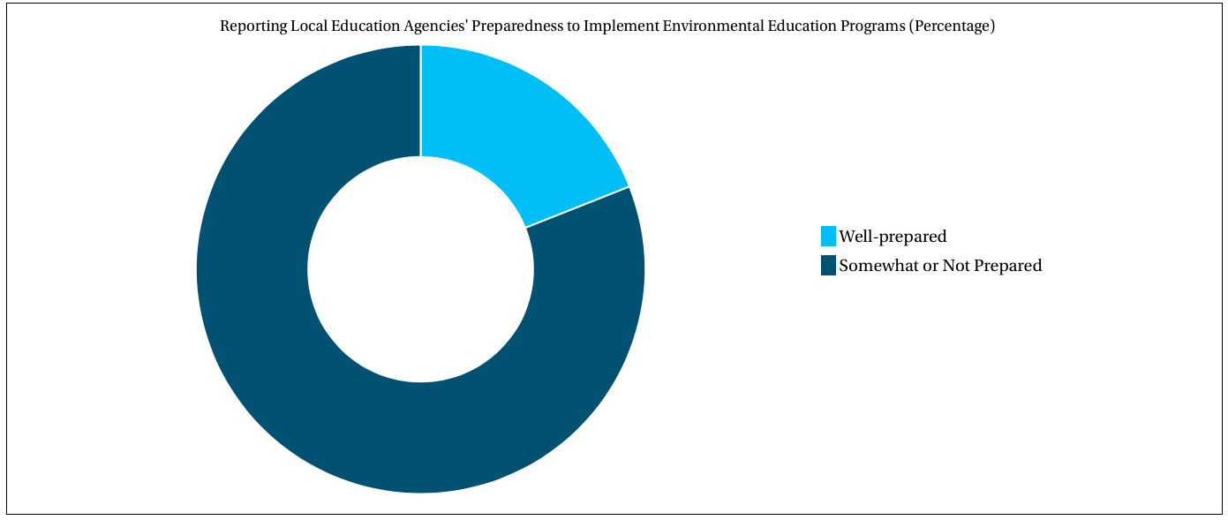
Environmental Literacy Preparedness in the Chesapeake Bay Watershed, 2015
Notes:
Data collected through an environmental literacy survey show that about one-fifth of responding school districts identified as well-prepared to put environmental education programs in place. Forty-three percent of respondents identified as somewhat prepared, and 36 percent identified as not prepared.

Slide 69
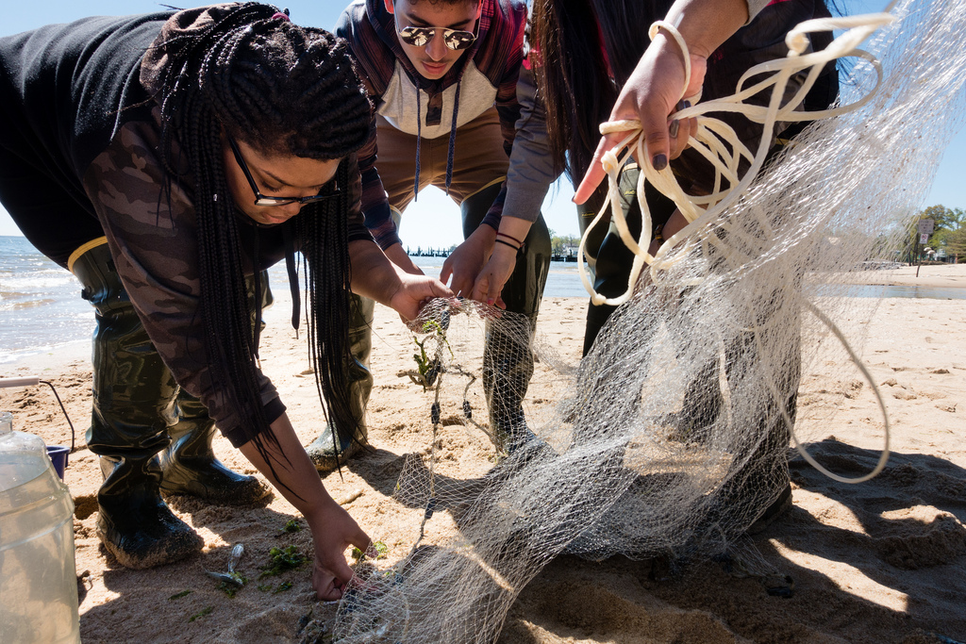
Notes:
This same data explored whether school districts were providing so-called "Meaningful Watershed Educational Experiences" to at least one grade level in elementary and middle school, and at least one course in high school. These experiences— which experts call MWEEs— can increase a student's understanding of environmental issues and connect her to the natural world.

Slide 70
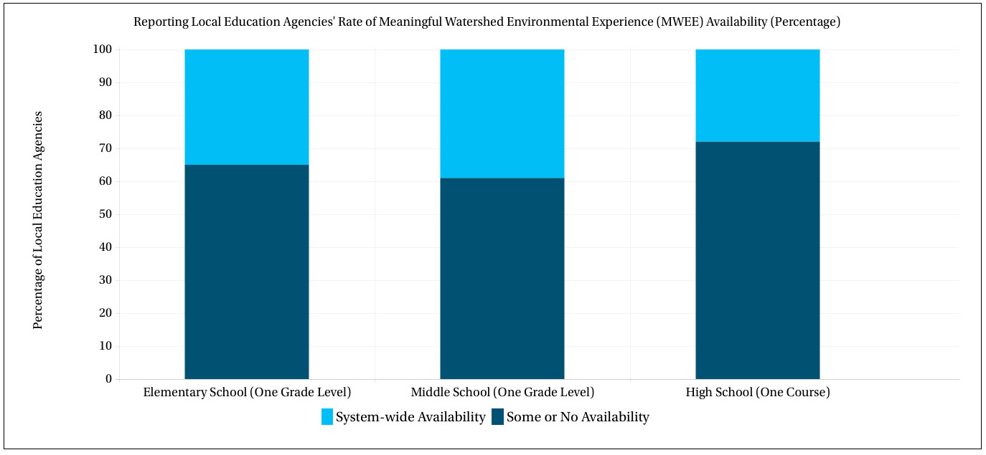
Meaningful Watershed Educational Experience Availability in the Chesapeake Bay Watershed, 2015
Notes:
Preliminary analyses show that about one-third of school districts reported providing MWEEs to at least one grade level in elementary school, about 40 percent reported providing MWEEs to at least one grade level in middle school and about 30 percent reported providing MWEEs to at least one grade level in high school.

Slide 71
Notes:
The environment in which students learn also plays an important role in environmental education: sustainable schools reduce the environmental impact of their buildings and grounds, improve the health of students and staff, and increase environmental literacy.

Slide 72
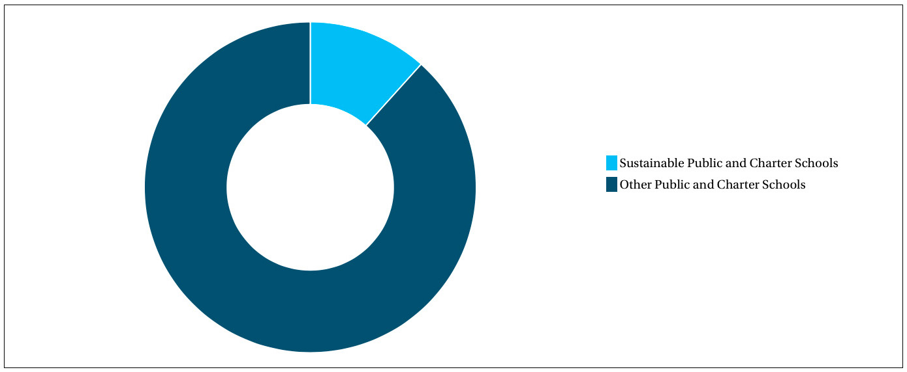
Certified Sustainable Schools in the Chesapeake Bay Watershed, 2015
Notes:
In 2015, about one in ten public and charter schools in the watershed were certified sustainable.

Slide 73
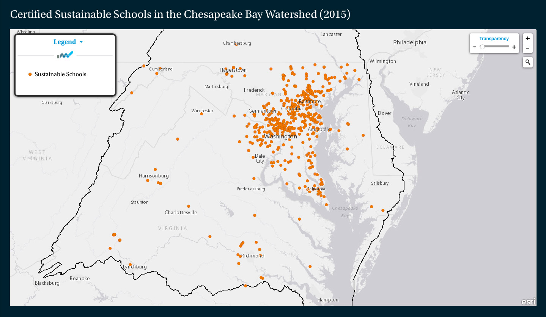
Notes:
Maryland is home to most of these, with additional schools in Virginia, Pennsylvania and Washington, D.C.

Slide 74
Influencing Factors
Knowledge
Behavior
Support
Funding
Notes:
Progress toward a number of the outcomes in the Next-generation Stewards cohort could depend on knowledge and behavior among members of the public; support among local governments and lawmakers; and the availability of funding.

Slide 75
Climate Change and Resiliency
6
Notes:
We live and work in one of the most vulnerable regions in the nation to the impacts of climate change.
Warming temperatures, rising seas, flooding coasts, eroding shorelines, extreme weather events and changes in the abundance and migration patterns of wildlife have already been observed in the region.
Adaptation and preparedness will mean adjusting our policies as well as our protection and restoration efforts. Documenting and assessing the results of these adjustments will help us anticipate, withstand and adapt to the threats facing our living resources and communities.

Slide 76
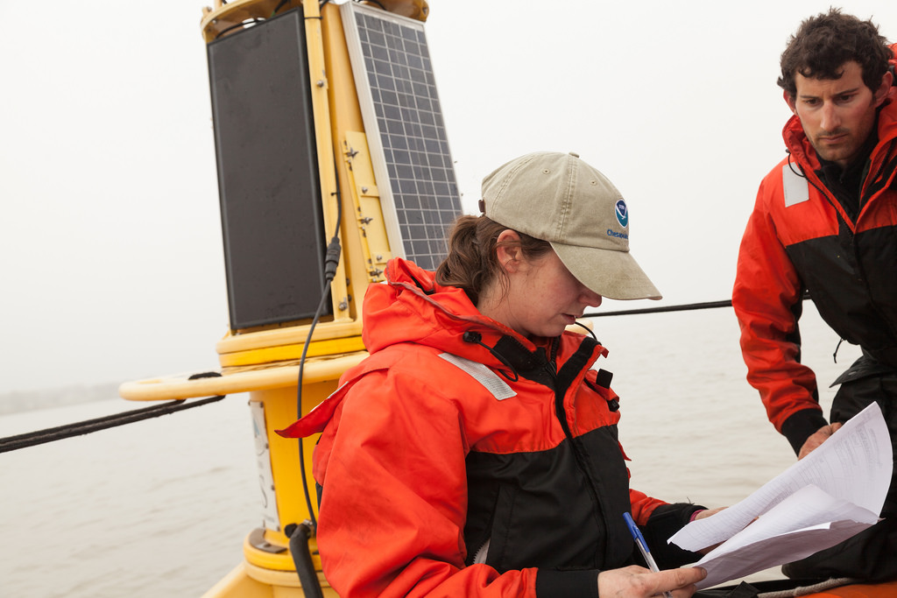
Notes:
The Climate Workgroup is pursuing a suite of indicators to track climate trends, impacts and programmatic progress.

Slide 77
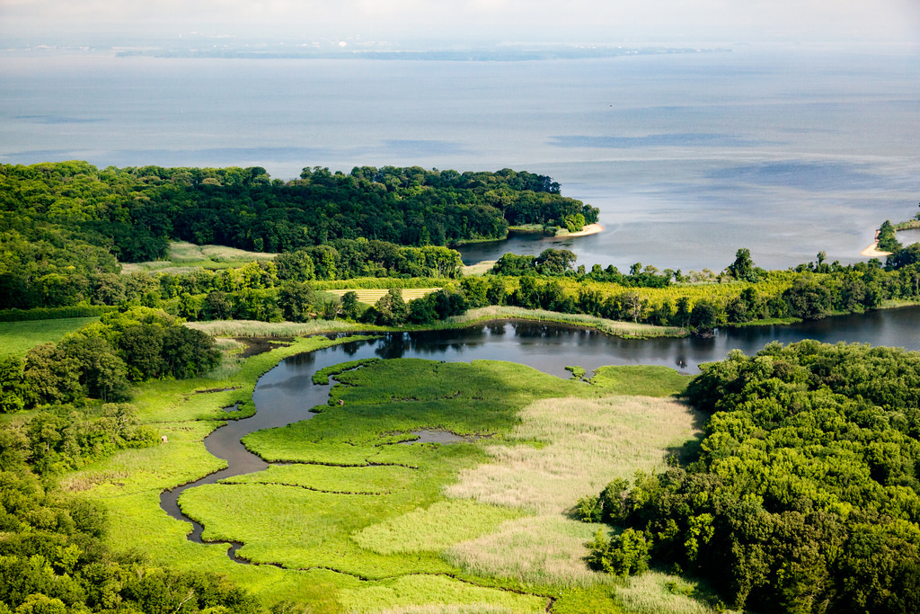
Notes:
While data collection for some of our indicators may have started before we committed to tracking climate trends, these indicators can shed light on changing environmental conditions.
Tidal wetland abundance has long been tracked because wetlands provide critical habitat to wildlife.
But wetlands are also quick to suffer climate impacts, which means their abundance—and the abundance of the critters that rely on them—can be useful indicators of climate change.

Slide 78
282,291
Acres of tidal wetlands in the Chesapeake Bay watershed in 2010
Notes:
Over the last two decades, tidal wetland abundance has hovered around 283,000 acres, with the next assessment expected to come out this year.

Slide 79
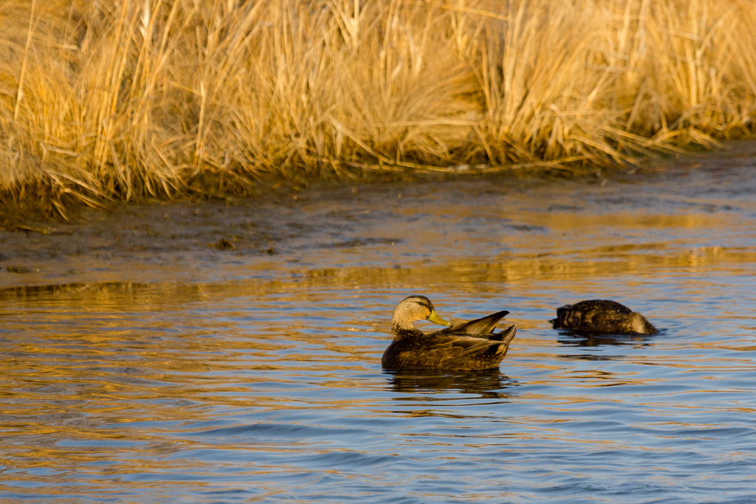
Notes:
Populations of the American black duck—which rely on wetlands for habitat and food— have not risen consistently

Slide 80

Wintering Black Ducks in the Chesapeake Bay Watershed, 2009-2015
Notes:
The last reporting period showed an average of about 51 thousand black ducks observed in watershed states. This marks 51 percent of the 100,000-bird goal. The workgroup is working to connect this estimate of the number of ducks observed with an estimate of the number of acres needed to provide food and shelter for wintering population of 100,000 black ducks.

Slide 81

Notes:
While tidal wetland abundance provides valuable information in relation to climate change, our efforts to restore wetlands to the watershed have centered around doing so on agricultural lands.

Slide 82

Wetlands Restored on Agricultural Lands (Cumulative), 2010-2015
Notes:
Between 2010 and 2015, 7,600 acres of wetlands were restored here.
Recently identified barriers to wetland program adoption include
a lack of awareness,
concerns for privacy,
financial uncertainty,
a desire for flexibility, and
an audience that can be difficult to reach.

Slide 83
Influencing Factors
Partner Coordination
Scientific Data and Understanding
Funding
Notes:
Progress toward a number of the outcomes in the Climate Change and Resiliency cohort could depend on coordination among partners and the alignment of both resiliency guidelines and regional needs; limitations around available scientific data and current scientific capabilities and understanding; and the availability of funding.

Slide 84
Local Action
7

Slide 85

Notes:
Forests, farms and wetlands provide valuable ecosystem services in the form of clean water and wildlife habitat. These landscapes also give us resources, food and opportunities to have fun in the natural world. Ensuring natural and working landscapes aren’t converted to impervious surfaces will be critical to environmental and human health.

Slide 86

Notes:
Work is underway to develop a methodology and metrics for characterizing the rate of farmland, forest and wetland conversion; for measuring the extent and rate of impervious surface change; and for quantifying the potential impacts of land conversion on water quality, healthy watersheds and communities. Once published, this information will be updated every two to five years. It will also be used to launch a public awareness campaign.

Slide 87

Notes:
Work is also underway to complete a high-resolution aerial tree canopy assessment, which will help us track changes to tree canopy over time and develop a baseline estimate as part of our goal to expand urban tree canopy and mitigate some of development's effects.

Slide 88

Notes:
Lastly, work is underway to develop a methodology for measuring our work to increase the knowledge and capacity of local officials on issues related to water resources and the implementation of incentives that will support local conservation.

Slide 89
Influencing Factors
Knowledge
Support
Land Use Conflict
Funding
Notes:
Progress toward a number of the outcomes in the Local Action cohort could depend onknowledge and support among landowners, lawmakers, local government officials and members of the public; land use conflict; and the availability of funding.

Slide 90
What's next?
Notes:
We’ve taken a high-level look at progress toward the Watershed Agreement. But what comes next? And how do our indicators of environmental health, restoration and stewardship fit into the Strategy Review System?

Slide 91
Quarterly Review Sessions
Review progress
Identify what's working (and what's not)
Discuss scientific, fiscal and policy developments
Recognize the need to adapt
Notes:
Over the next two years, we will hold a series of Quarterly Review Sessions meant to provide us the time and space to review progress toward individual outcomes; identify what is and isn’t working; discuss scientific, fiscal and policy developments that could impact our work; and recognize the adaptations that we may need to make in our management strategies and work plans.

Slide 92
Thanks!
Find us at
free.laura@epa.gov
ckrikstan@chesapeakebay.net
Presentation template by SlidesCarnival. Photos by Chesapeake Bay Program.

