Slide 1
CBP Climate Resiliency Workgroup
Cross-Goal Climate Resiliency
Analysis and Decision-Making Matrix and Implementation Methodology

Slide 2
Climate Resiliency Goal
GOAL: Increase the resiliency of the Chesapeake Bay watershed, including its living resources, habitats, public infrastructure and communities, to withstand adverse impacts from changing environmental and climate conditions.
Monitoring and Assessment Outcome: Continually monitor and assess the trends and likely impacts of changing climatic and sea level conditions on the Chesapeake Bay ecosystem, including the effectiveness of restoration and protection policies, programs and projects.
Adaptation Outcome: Continually pursue, design and construct restoration and protection projects to enhance the resiliency of Bay and aquatic ecosystems from the impacts of coastal erosion, coastal flooding, more intense and more frequent storms and sea level rise.

Slide 3
Project Goals
Advance outcomes from the Chesapeake Bay Agreement with regard to climate change goals
Develop a structured, science-based framework through which the principles of climate-smart adaptation planning can be effectively applied to the existing 29 management strategies in the Watershed Agreement
Engage one-on-one with GITs to identify, assess, evaluate and revise climate-related elements of individual management strategies

Slide 4
General Approach
Tailor the concepts of Climate Smart Conservation Framework to incorporate consideration of climate change vulnerabilities into planned Chesapeake Bay management strategies and restoration actions
Utilize CCAP Adaptation Design Tool and framework as a starting point
Use 2 workgroups as pilots to develop the approach:
Wetlands
Protected lands
Facilitate a structured approach (e.g., modified SDM) in a set of workshops to work through the process with each pilot workgroup

Slide 5
Protected Lands Goal/Outcome
By 2025, protect an additional two million acres of lands throughout the watershed – currently identified as high conservation priorities at the federal, state or local level – including 225,000 acres of wetlands and 695,000 acres of forest land of highest value for maintaining water quality.

Slide 6
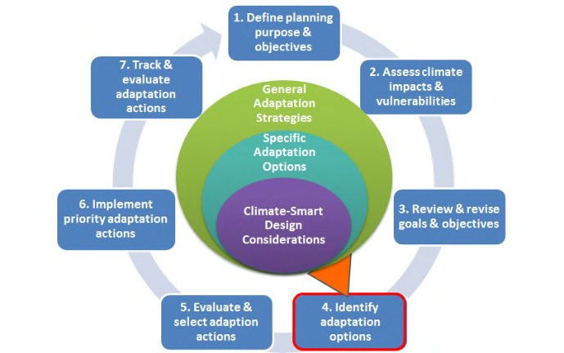
CCAP Design Tool
Developed to apply Climate Smart principles to coral reef adaptation plans, but highly applicable for incorporating climate change vulnerability considerations into Chesapeake Bay management strategies
A structured approach, using a series of three related matrices that guide managers/ stakeholders through the process
Focuses on developing “climate-smart design considerations,” two categories of questions related to how climate change is likely to:
impact both the stressors being managed by an action; and
the effectiveness of the action itself

Slide 7
Next Steps:
Solicit and Identify core steering group members
Work with core steering group to:
Clarify the management/restoration actions of importance
Identify and gather relevant Chesapeake Bay climate change vulnerability research/data
Compile strategies, actions, restoration/enhancement techniques that are envisioned to achieve the goal/outcome

Slide 8
Project Timeline

Slide 9
Project Contacts: Zoe Johnson, CBP Technical Lead Susan Julius, EPA Technical Lead Anna Hamilton, Tetra Tech, Project Manager Jennie Hoffman, Facilitator Hope Herron, Tetra Tech, Facilitator

