Slide 1
CBP Climate Resiliency Workgroup
Cross-Goal Climate Resiliency
Analysis and Decision-Making Matrix and Implementation Methodology

Slide 2
Climate Resiliency Goal
Increase the resiliency of the Chesapeake Bay watershed, including its living resources, habitats, public infrastructure and communities, to withstand adverse impacts from changing environmental and climate conditions
‘…. changing climate conditions are a significant challenge to successful restoration and protection of the Chesapeake Bay and its watershed and recommend a suite of actions to reduce vulnerability over time’

Slide 3
Project Goals
Advance outcomes from the Chesapeake Bay Agreement with regard to climate change goals
Develop a structured, science-based framework through which the principles of climate-smart adaptation planning can be effectively applied to the existing 29 management strategies in the Watershed Agreement
Engage one-on-one with GITs to identify, assess, evaluate and revise climate-related elements of individual management strategies

Slide 4
General Approach
Tailor the concepts of Climate Smart Conservation Framework to incorporate consideration of climate change vulnerabilities into planned Chesapeake Bay management strategies and restoration actions
  Utilize CCAP Adaptation Design Tool and framework as a starting point
Use 2 workgroups as pilots to develop the approach:
  Wetlands
  Protected lands
Facilitate a structured approach (e.g., modified SDM) in a set of workshops to work through the process with each pilot workgroup

Slide 5
Wetlands Goal/Outcome
Next 2 years (by 2018): Restore 15,762 acres; Enhance 30,000 acres
By 2025, Restore 85,000 acres; Enhance 150,000 acres

Slide 6
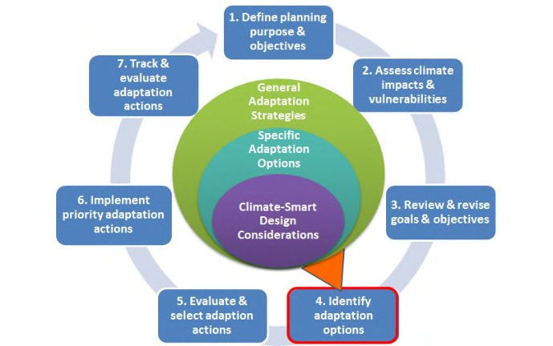
CCAP Design Tool
Developed to apply Climate Smart principles to coral reef adaptation plans, but highly applicable for incorporating climate change vulnerability considerations into Chesapeake Bay management strategies
A structured approach, using a series of three related matrices that guide managers/ stakeholders through the process
Focuses on developing “climate-smart design considerations,” two categories of questions related to how climate change is likely to:
  impact both the stressors being managed by an action; and
  the effectiveness of the action itself

Slide 7
Interactions with Wetlands Workgroup
Identify core steering group
Work with core steering group to:
  Clarify the management/restoration actions of importance
  Identify and gather relevant Chesapeake Bay climate change vulnerability research/data
Discuss relationship/status of other components of the Wetland Workplan (5 management approaches)
Compile strategies, actions, restoration/enhancement techniques that are envisioned to achieve the goal/outcome

Slide 8
Project Timeline

Slide 9
Project Contacts:
Zoe Johnson, CBP Technical Lead
Susan Julius, EPA Technical Lead
Anna Hamilton, Project Manager
Jennie Hoffman, Facilitator
Hope Herron, Facilitator

