Slide 1


Chesapeake Bay 2017
Midpoint Assessment—
Policy Issues for Partnership Decisions
Chesapeake Bay Program Principals’ Staff Committee
December 19, 2017

Slide 2
Overview of Meeting and Policy Decision Recommendations
Teresa Koon, WV DEP, CBP Water Quality Goal
Implementation Team Vice Chair

Slide 3
Day 1 Requested PSC Decisions
Adoption of the Phase 6 suite of modeling tools for finalizing the draft Phase III planning targets and for management application in the Phase III WIPs and two-year milestones through 2025
Approval of the proposed Bay’s assimilative capacity
Approval of the process for the 4-month Partnership review of the draft Phase III WIP planning targets, including how special cases are addressed
Base Phase III WIP development on 2025 current zoning conditions

Slide 4
Day 2 Requested PSC Decisions
Develop a Partnership implementation plan to address Conowingo infill
Adopt a dual approach to factor climate change into the Phase III WIPs
Approval of the draft Phase III WIP planning targets as a starting point of the 4-month Partnership review period

Slide 5
Overview of PSC Meeting
Today
Focus on building understanding and answering questions
Focus on consensus building and collaborative decision-making on foundational midpoint assessment issues
Opportunity for evening jurisdictional caucuses
Tomorrow
Focus on consensus building and collaborative decision-making on key policy issues

Slide 6
WQGIT & Modeling Workgroup Recommendations: Nitrogen
Jurisdiction | 1985 Baseline | 2013 Progress | Growth in Load to 2025 | Phase III Planning Target
NY | 18.71 | 15.44 | -0.74 | 10.59
PA | 122.41 | 99.28 | 1.66 | 73.18
MD | 83.56 | 55.89 | 1.52 | 45.30
WV | 8.73 | 8.06 | -0.02 | 6.35
DC | 6.48 | 1.75 | 0.00 | 2.43
DE | 6.97 | 6.59 | 0.48 | 4.59
VA | 84.29 | 61.53 | 1.09 | 55.82
Basinwide | 331.15 | 248.54 | 4.00 | 198.25
*Units: millions of pounds

Slide 7
WQGIT & Modeling Workgroup Recommendations: Phosphorus
Jurisdiction | 1985 Baseline | 2013 Progress | Growth in Load to 2025 | Phase III Planning Target
NY | 1.198 | 0.710 | -0.005 | 0.506
PA | 6.115 | 3.696 | 0.044 | 3.073
MD | 7.419 | 3.919 | -0.015 | 3.604
WV | 0.793 | 0.560 | -0.017 | 0.456
DC | 0.090 | 0.062 | 0.000 | 0.130
DE | 0.225 | 0.115 | 0.007 | 0.120
VA | 13.545 | 6.345 | 0.140 | 6.186
Basinwide | 29.384 | 15.408 | 0.154 | 14.073
*Units: millions of pounds

Slide 8
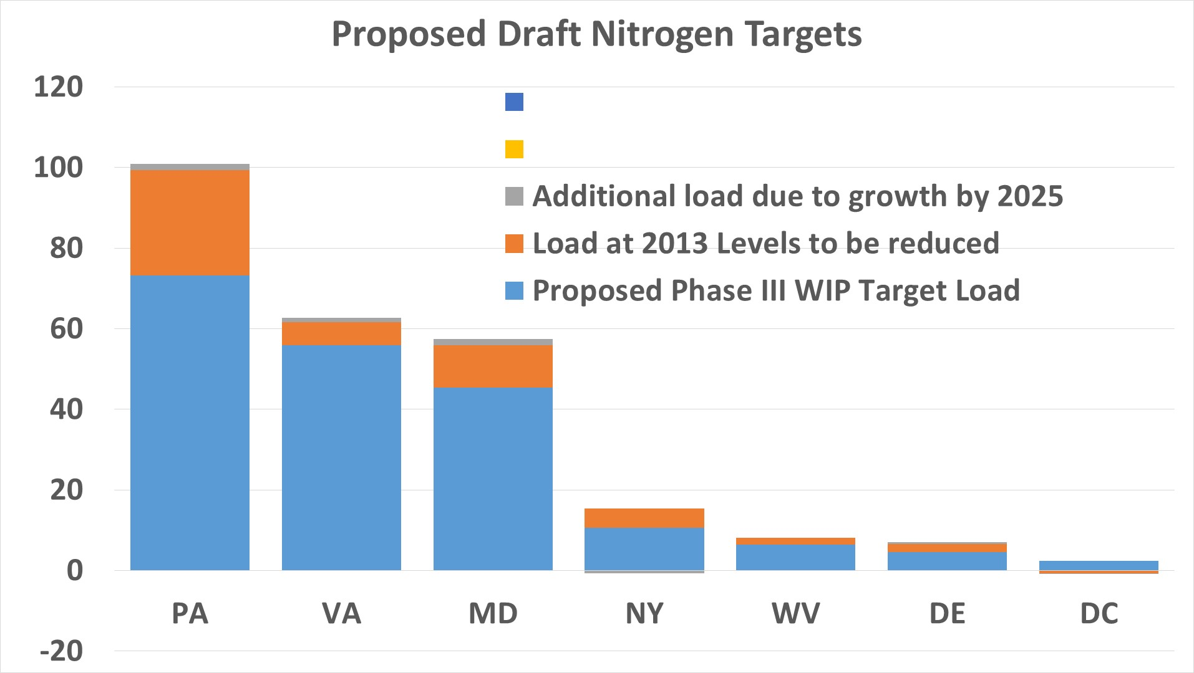

Slide 9
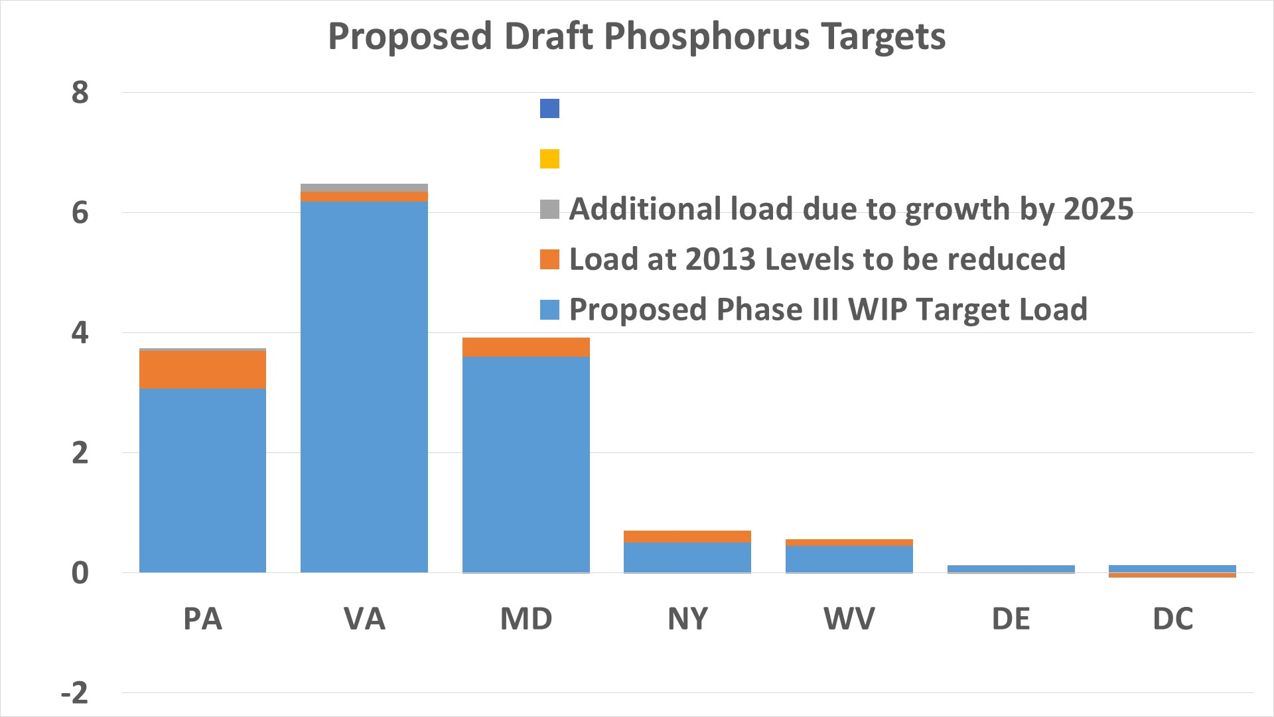

Slide 10
Cautions About Comparisons Back to
Phase II WIPs
Be cautious with comparing the proposed draft Phase III planning targets with the jurisdictions’ Phase II WIP loads
  Different watershed models – more BMPs, different land uses and loading rates
  State-driven changes between Phase II and Phase III
  Phase II WIP planning targets were not derived using the Bay TMDL allocation methodology—they were based on a similar level of effort to the Phase I WIPs

Slide 11
What’s Changed,
the Implications, and
Our Improved Models
Lee Currey, MDE, CBP Modeling Workgroup Co-Chair

Slide 12
What’s Changed, Why, and Implications
A lot has changed since 2010 and our Phase I and Phase II WIPs
  Much improved modeling and other decision support tools
  High resolution land cover data for entire watershed
  Hundreds more BMPs available for crediting
  Significant data gathered from local agricultural and municipality partners incorporated into our models and other decision support tools

Slide 13
Improved Partnership Models
5 years of collaborative Partnership decision-making on every aspect of every model
Multiple STAC-sponsored technical workshops from soil phosphorus to Conowingo
Independent scientific peer reviews of every Partnership model
Comprehensive fatal flaw review and issue resolution by the partners

Slide 14
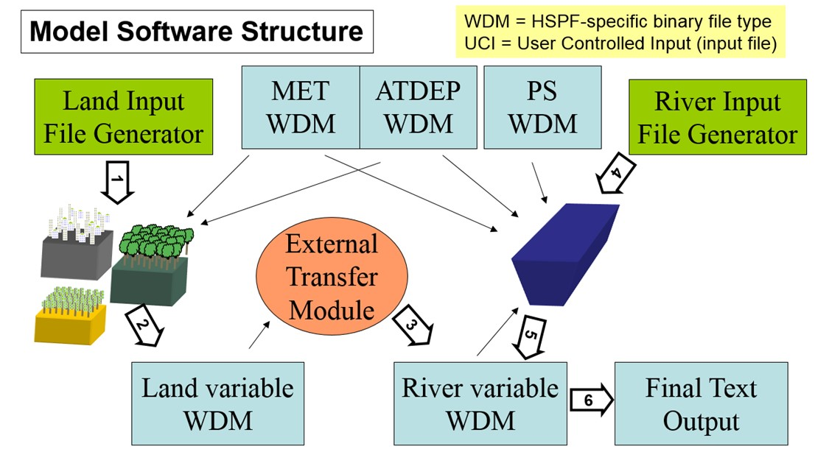
Phase 6 Bay Watershed Model
Prior Bay Watershed Models
Phase 6 Watershed Model
Average Load + Inputs * Sensitivity
Land Use Acres
BMPs
Land to Water
Stream Delivery
River Delivery
*
*
*
Direct Loads
*
*

Slide 15
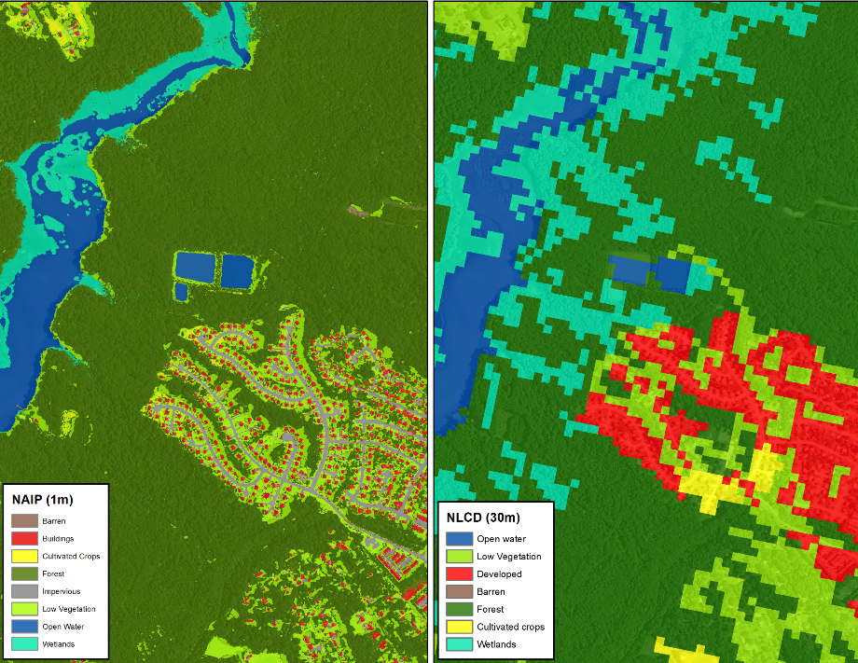
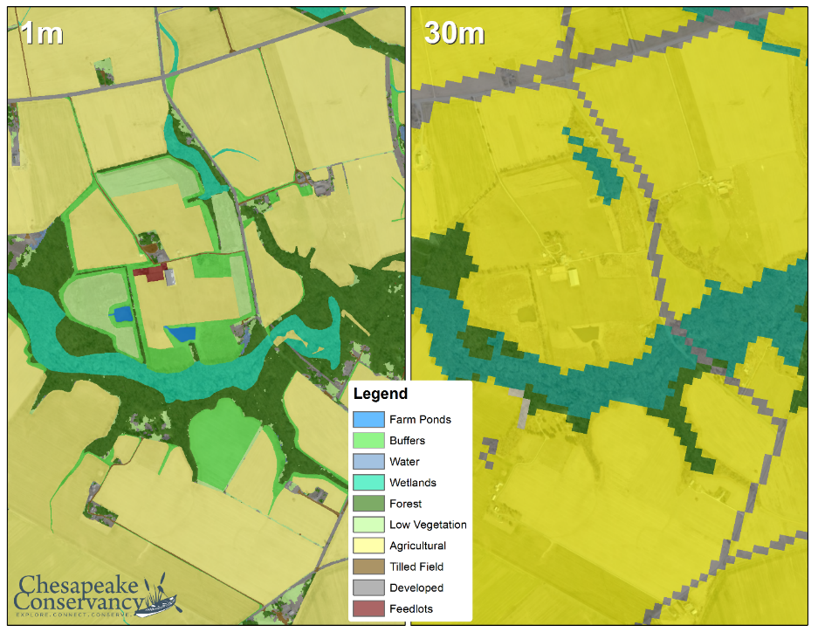
Phase 5
30-Meter Resolution Land Use/Land Cover Data
Phase 6
1-Meter Resolution Land Use/Land Cover Data

Slide 16
Hundreds More BMPs

Slide 17
Local Agricultural and Municipality Data
Municipal Separate Storm Sewer Systems
Combined Sewer Systems
Sewer Service Areas
Land Cover
Land Use
Parcels
Roads
Beaches
Institutional lands
Federal lands
Golf courses
Surface mines
Landfills
Protected lands
Streams
Wetlands
Tidal zones
Floodplains
Frequently flooded soils
Livestock populations
Poultry populations
Crop, hay and pasture acreages
Crop yields
Soil P concentrations
BMPs

Slide 18
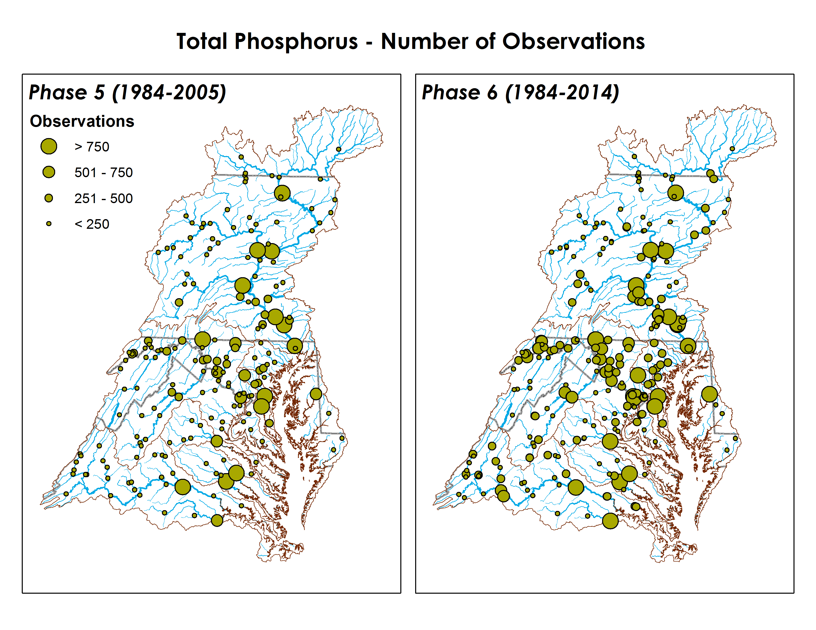
Our Models are Tested using Decades of Monitoring Data
Hundreds of thousands of water quality monitoring data points
Hundreds of monitoring stations
Nitrogen, phosphorus, and sediment
Data records lasting up to 3 decades
Size of circle denotes relative number of data points: 100s to 1,000s

Slide 19
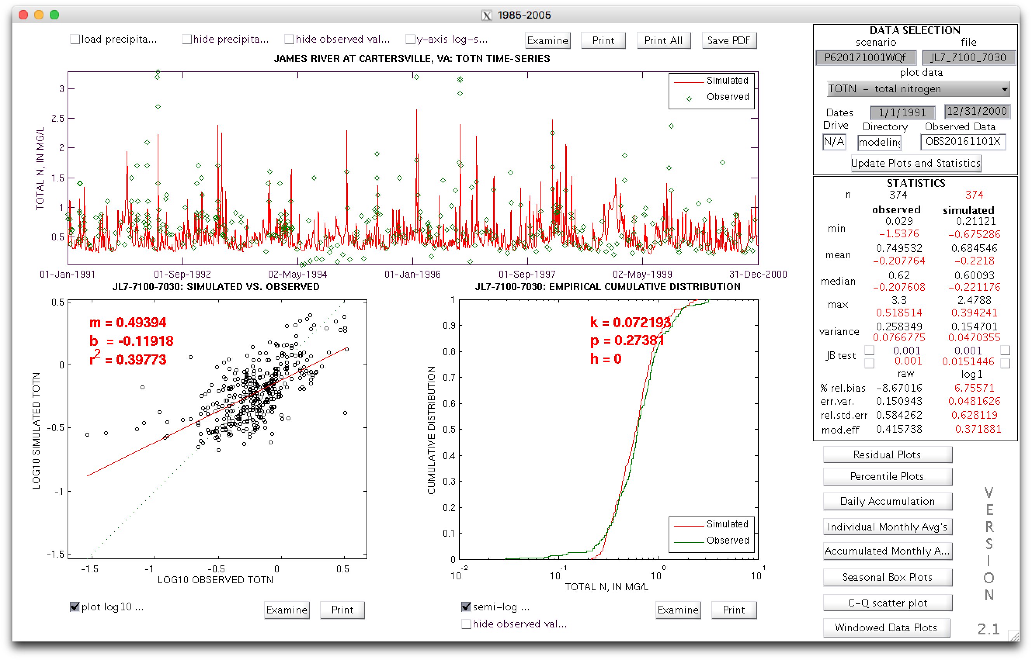
Extensive Testing of the
Models Throughout the Watershed
[1] Model calibration is made to improve agreement with monitoring data
[2] Simulated vs. WRTDS Per Acre Load and the Geographic Efficiencies
[3] Simulated vs. WRTDS loads
[4] Agreement between the simulated and WRTDS loads at the RIM sites

Slide 20
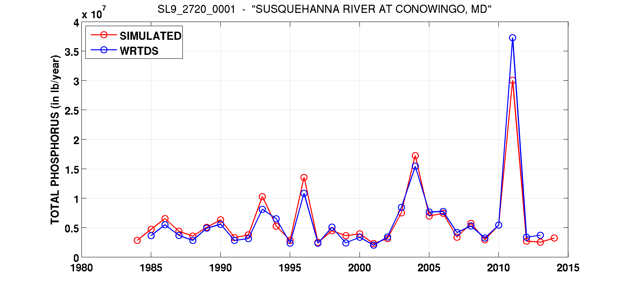
Best Match with Monitoring Data Ever!
Conowingo Phase 6 Simulation Compared to Annual WRTDS Loads
NSE of monthly phosphorus load
NSE of annual phosphorus loads
= 0.942
= 0.935

Slide 21
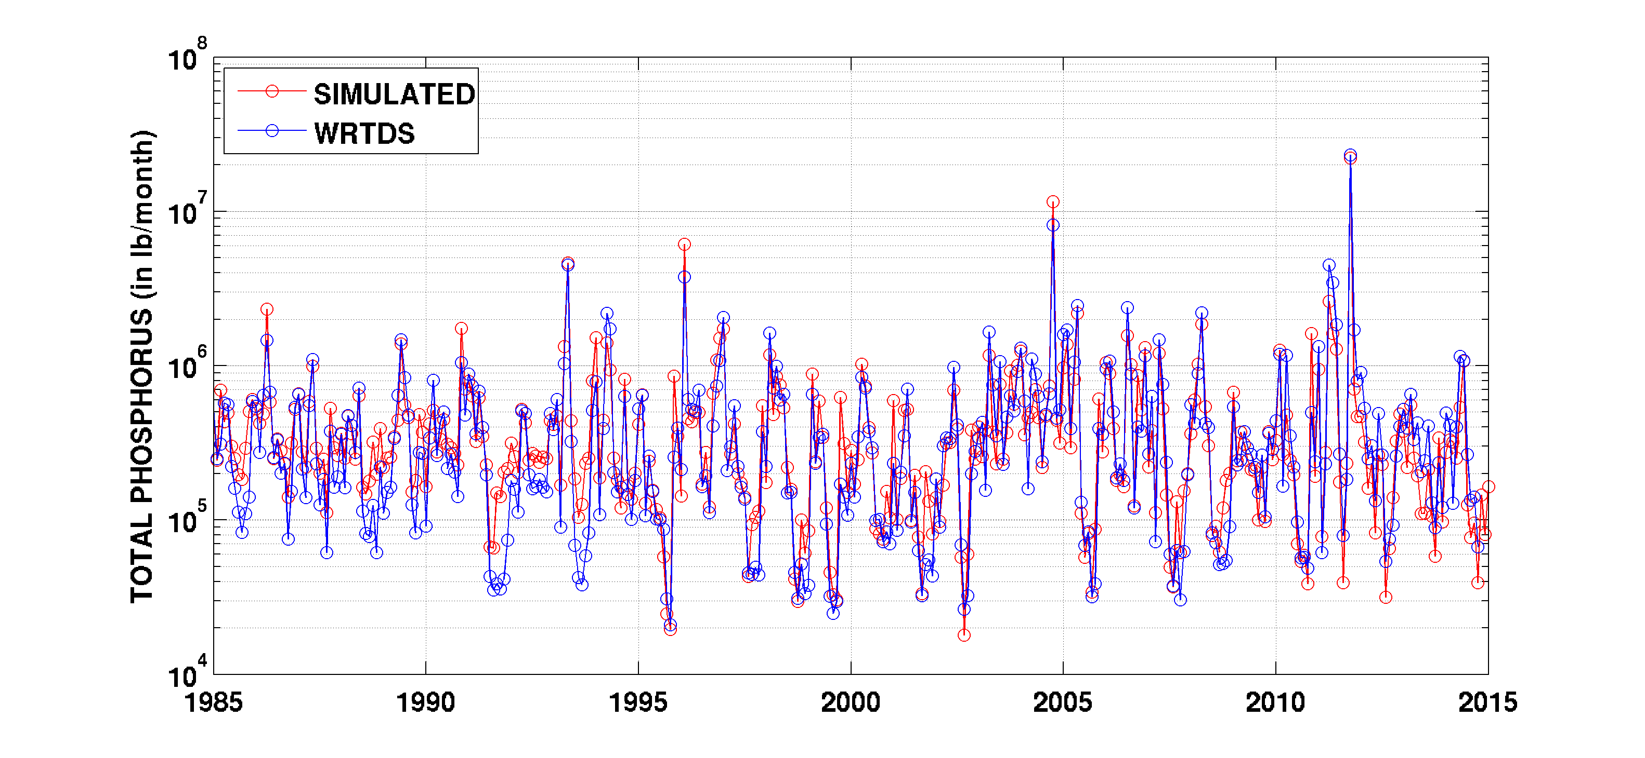
Best Match with Monitoring Data Ever!
Conowingo Phase 6 Simulation Compared to Monthly WRTDS Loads
NSE of monthly phosphorus load
NSE of annual phosphorus loads
= 0.942
= 0.935

Slide 22
Today’s Requested Policy Decision
Adoption of the Phase 6 suite of modeling tools for finalizing the Phase III planning targets and for management application in the Phase III WIPs and two-year milestones through 2025

Slide 23
Phase III WIP Planning Targets Methodology
Gary Shenk, USGS, CBP Phase 6 Watershed Model Coordinator

Slide 24
Review of the Phase III Planning Targets Methodology
A step by step walk through of the agreed-to Phase III planning targets methodology
How it works to allocate updated cap loads equitably among the jurisdictions

Slide 25
Three Partnership Principals
Allocated loads must result in achievement of the states’ Bay water quality standards
Major river basins that contribute the most to Bay water quality problems must do the most to resolve those problems
All tracked and reported reductions in loads are credited toward achieving assigned loads
Source: 2010 Chesapeake Bay TMDL

Slide 26
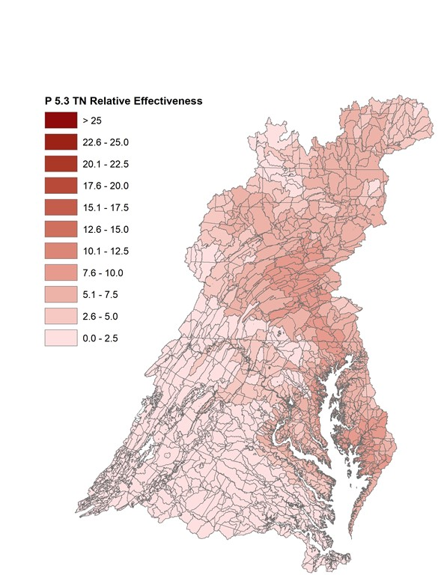
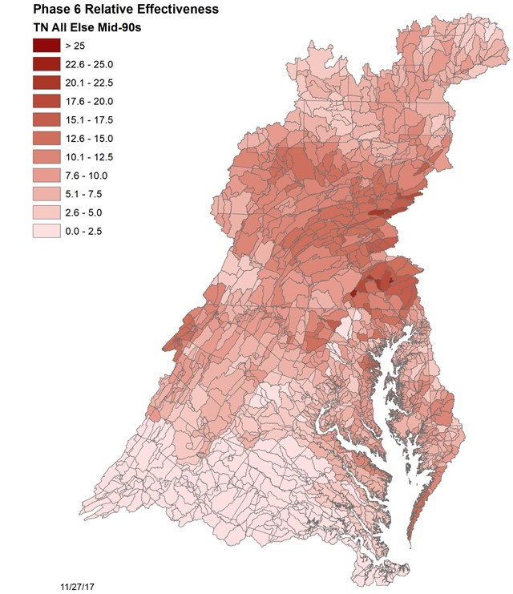
More Impact, Do More
Phase 5 Nitrogen Nitrogen
Phase 6 Nitrogen

Slide 27
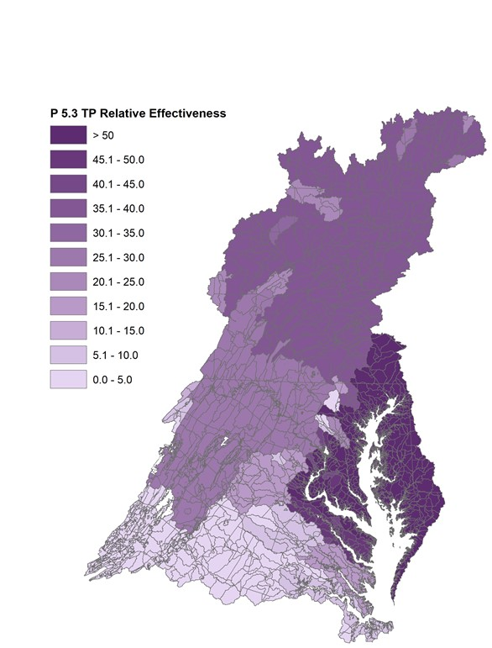
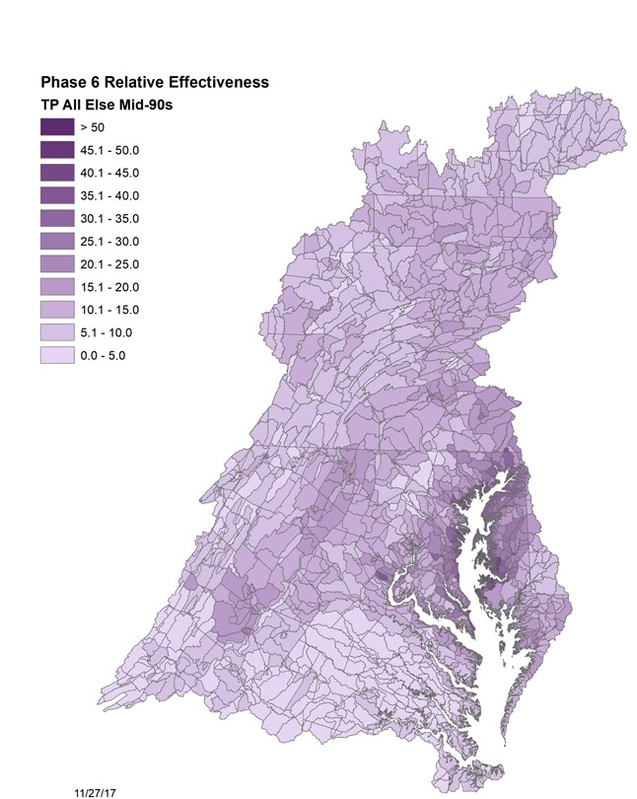
More Impact, Do More
Phase 5 Phosphorus
Phase 6 Phosphorus

Slide 28
Defining the Controllable Load
No Action:
Watershed conditions with minimal to no controls on load
Wastewater at primary treatment
E3 or “Everything by Everyone, Everywhere”:
Watershed conditions with maximum controls on loads, regardless of cost
Wastewater at high level of nutrient control
  3mg/l TN, 0.1 mg/l TP
No Action
Controllable Load
E3

Slide 29
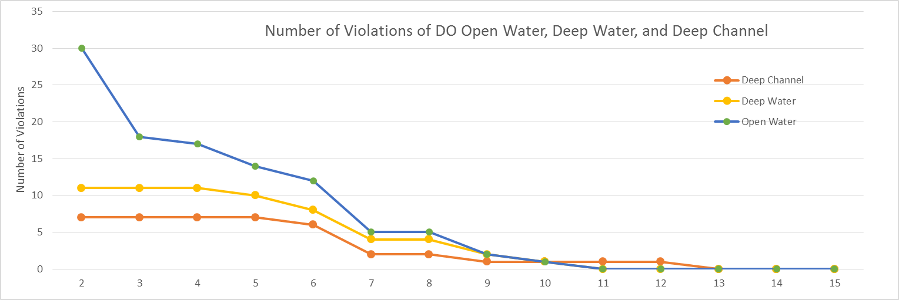
Determining the Bay’s Ability to Absorb Pollutants

Slide 30
Allowing for Special Cases
Previously agreed to consider special cases put forth by jurisdictions
Consideration of special cases factored into four-month review process
CBPO will provide support to jurisdictions considering special cases
Final decisions on allowance of special cases will be made by the PSC in April 2018

Slide 31
Nitrogen and Phosphorus Exchanges
Science supports exchanges in nitrogen and phosphorus load reductions
Better science has resulted in changes to our existing exchange ratios
  Better simulation of observed nutrient limitation in the Bay
  Inclusion of new P sources from Conowingo and Shoreline makes each pound of P less important
Phase 5
Phase 6
Nitrogen for Phosphorus: 5 1.34 – 3.84
Phosphorus for Nitrogen: 0.067 0.26 – 0.75

Slide 32
Accounting for Nitrogen Air
Deposition to Bay Watershed
Updated estimated benefits to Bay and watershed from clear air actions.
From 1985 through 2025, the jurisdictions will receive an estimated 254 million lbs. less nitrogen on their lands and rivers.

Slide 33
Accounting for Nitrogen Air
Deposition to Bay Tidal Waters
From 1985 through 2025, loads will be reduced from 21.5 to 15.6 million lbs.
By 2025, 0.1 million pounds below EPA’s Bay TMDL allocation (15.7 million lbs.)
By 2030, load drops to 14.9 millions lbs., 0.8 million pounds below EPA’s Bay TMDL allocation

Slide 34
Determining the Bay’s Ability to Absorb Pollutants
(Assimilative Capacity)
Rich Batiuk, U.S. EPA CBPO Associate Director for Science, Analysis and Implementation

Slide 35
Here’s Where We Want to Get to

Slide 36
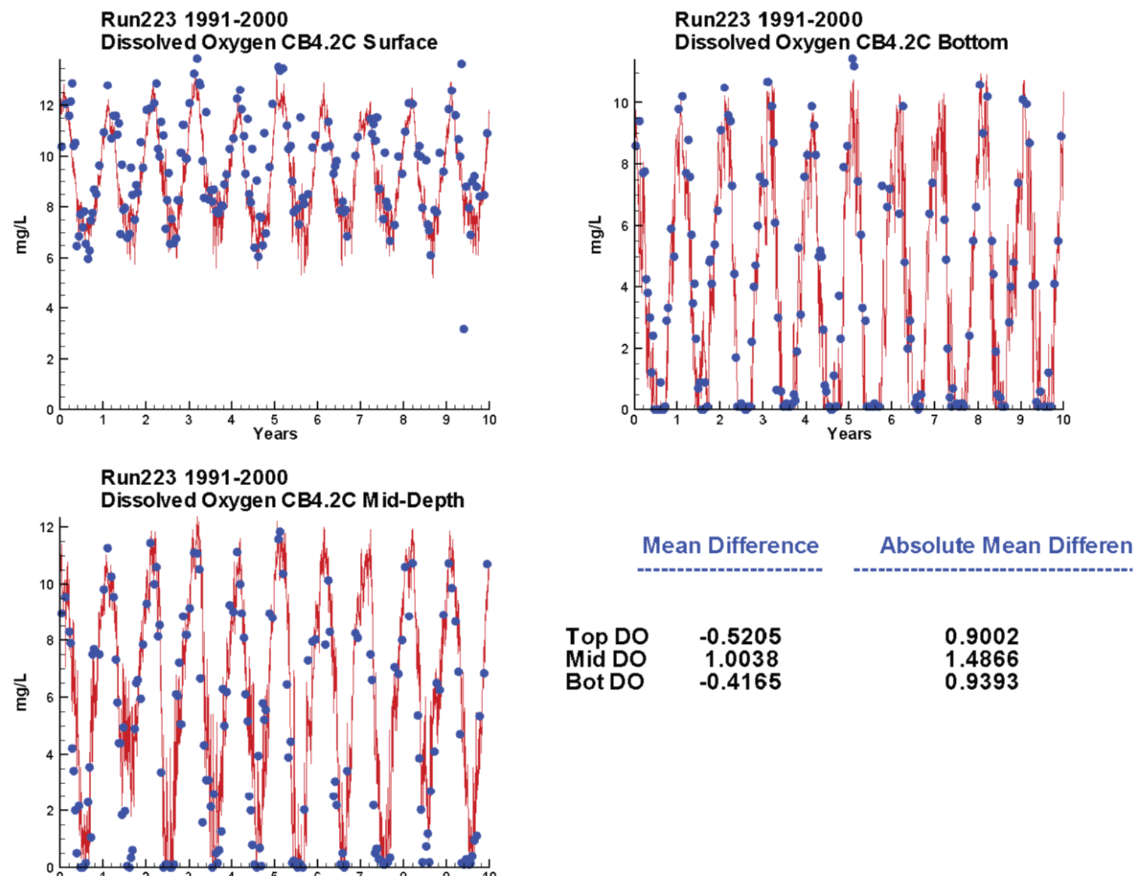
What’s Changed and the Implications
An improved Water Quality and Sediment Transport Model (WQSTM) is providing a better simulation of dissolved oxygen in the tidal Bay affording higher confidence in implementation planning for 2025.
Good simulation of DO concentrations of Open Water, Deep Water, and Deep Channel (CB4 shown here)

Slide 37
What’s Changed and the Implications
The Chesapeake Bay’s summertime dead zone is decreasing in size!
Source: Testa et al. 2017

Slide 38
What Hasn’t Changed
  Delaware, District of Columbia, Maryland and Virginia’s Chesapeake Bay water quality standards regulations have not changed since 2012
    Five tidal habitat-based designated uses
    Dissolved oxygen, SAV, water clarity and chlorophyll a criteria to protect those uses
    Fully consistent criteria attainment assessment procedures
    How we use model output to assess criteria attainment under model-simulated load conditions

Slide 39
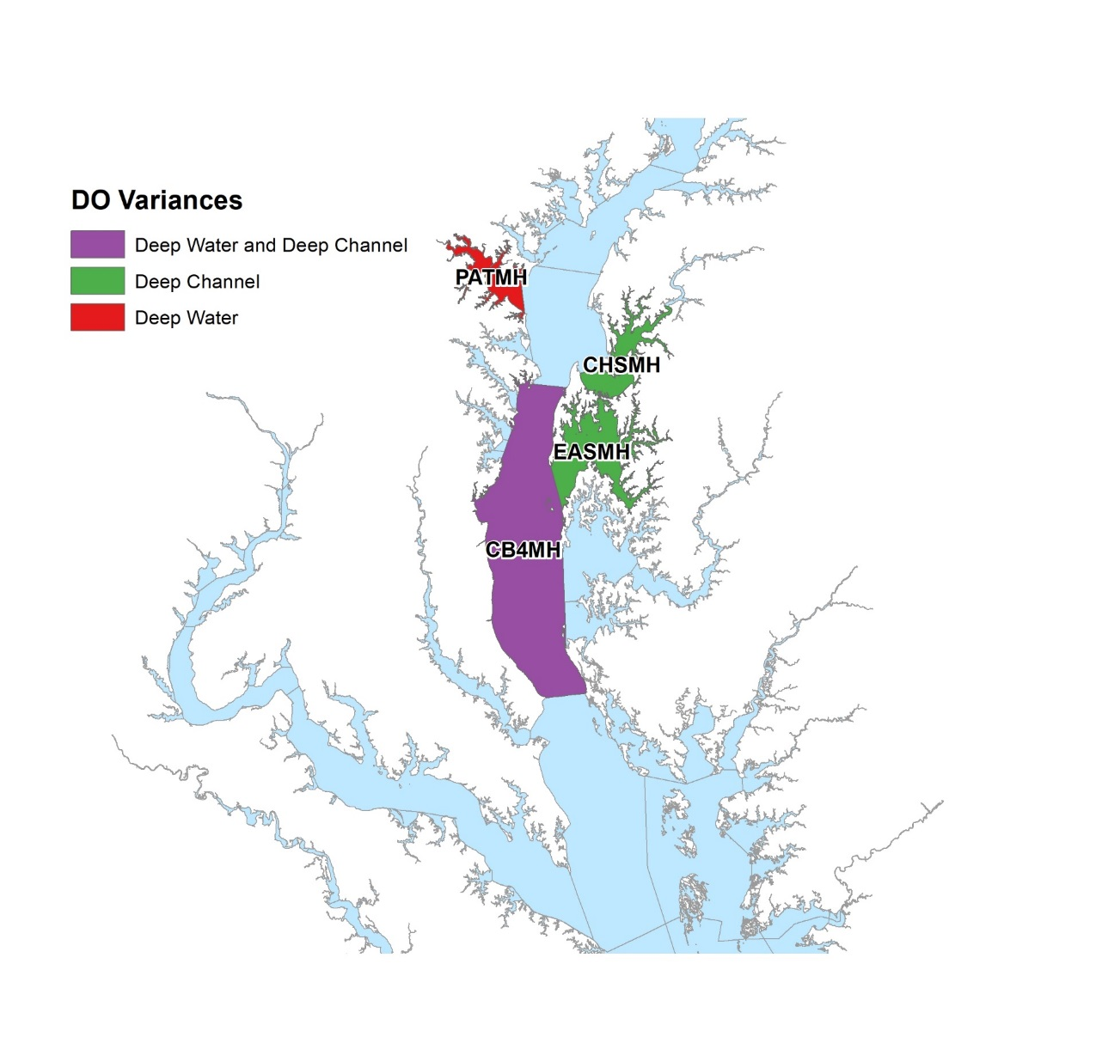
Maryland’s Restoration Variances
Maryland’s water quality standards regulations still contain restoration variances agreed to by the Partners/approved by EPA in 2010 and updated in 2012
Patapsco River Deep-water 7%
Lower Chester River Deep-channel 16%
Eastern Bay Deep-channel 2%
Middle Central Chesapeake Bay
  Deep-water 7%
  Deep-channel 2%

Slide 40
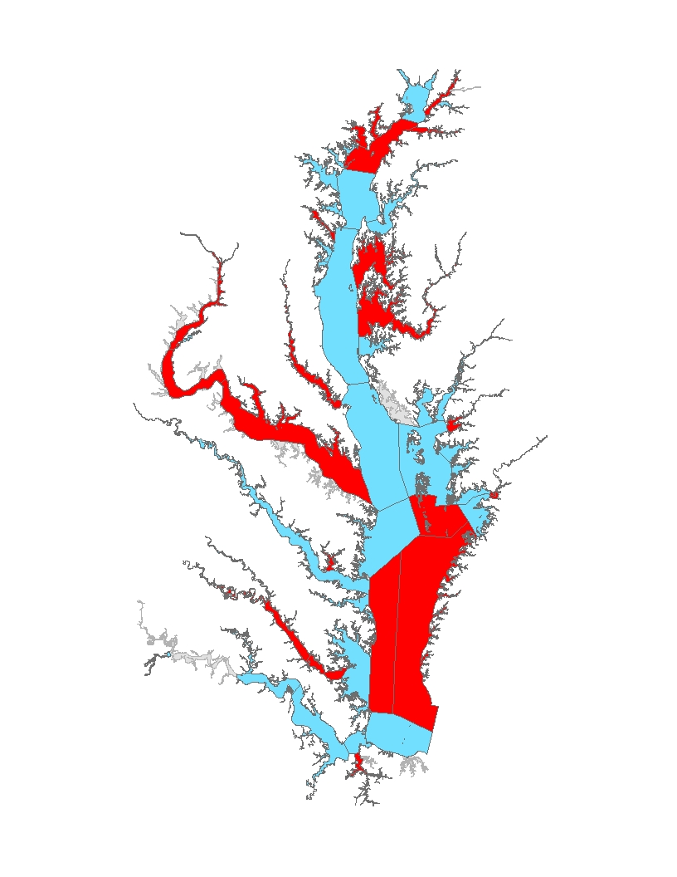
Segments Attaining Oxygen Standards: Open-Water Use
Segments NOT in Attainment
CB2OH
CB6PH
CB7PH
BSHOH
SEVMH
PAXOH
PAXMH
POTTF_DC
POTTF_MD
ANATF_DC
ANATF_MD
PISTF
POTOH1_MD
POTOMH_MD
PMKOH
YRKMH
YRKPH
ELIPH
C&Dcanal
ELKOH
SASOH
EASMH
CHOTF
CHOOH
CHOMH2
CHOMH1
POCTF
POCOH_MD
POCOH_VA
TANMH_VA
404 TN 41.7 TP
All Forest
No Action
E3

Slide 41
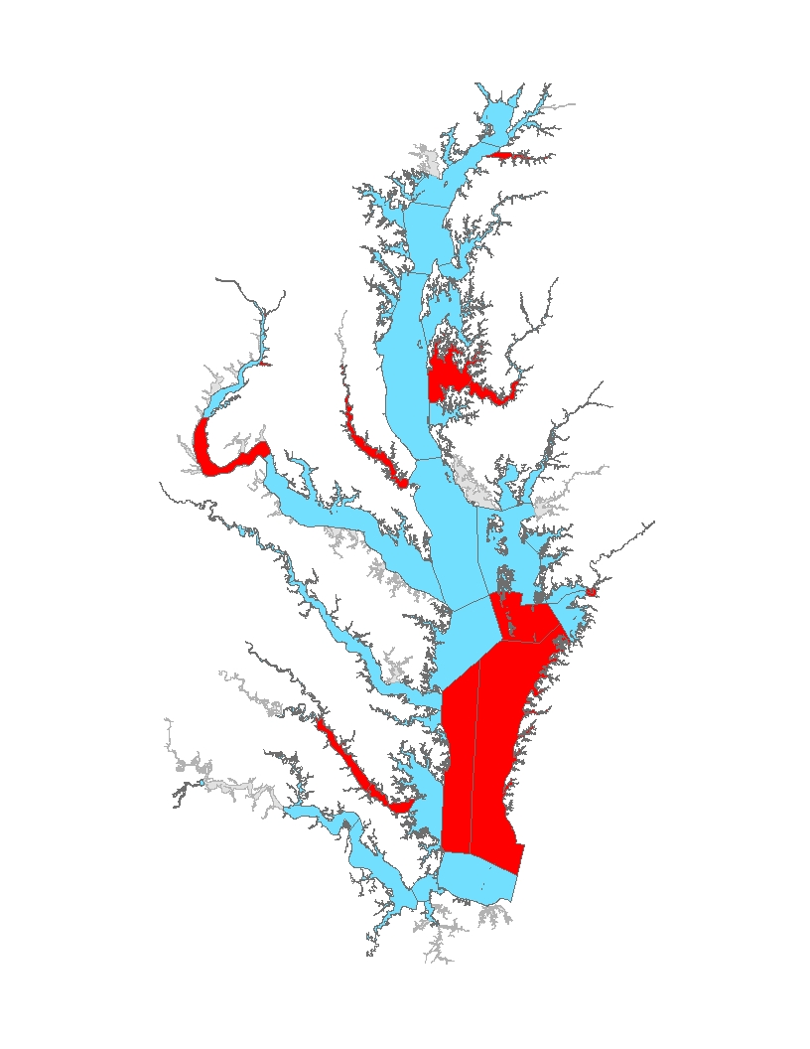
Segments Attaining Oxygen Standards: Open-Water Use
Segments NOT in Attainment
CB6PH
CB7PH
PAXOH
PAXMH
ANATF_DC
ANATF_MD
PISTF
POTOH1_MD
YRKMH
YRKPH
C&Dcanal
SASOH
CHOMH2
CHOMH1
POCTF
POCOH_MD
POCOH_VA
TANMH_VA
347 TN 30.4 TP
All Forest
E3

Slide 42
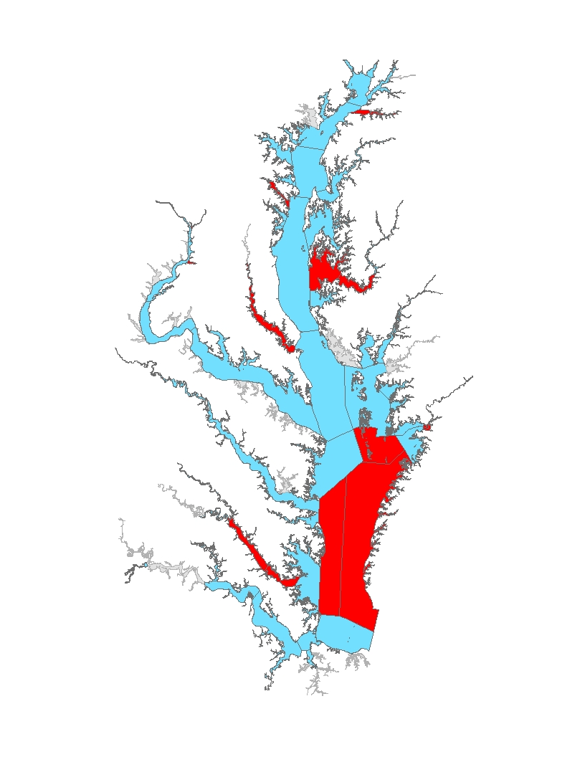
Segments Attaining Oxygen Standards: Open-Water Use
Segments NOT in Attainment
CB6PH
CB7PH
PAXOH
PAXMH
ANATF_DC
ANATF_MD
PISTF
POTOH1_MD
YRKMH
YRKPH
C&Dcanal
SASOH
CHOMH2
CHOMH1
POCTF
POCOH_MD
POCOH_VA
TANMH_VA
337 TN
23.7 TP
All Forest
E3

Slide 43

Segments Attaining Oxygen Standards: Open-Water Use
Segments NOT in Attainment
CB6PH
CB7PH
WSTMH
PAXOH
PAXMH
ANATF_DC
ANATF_MD
PISTF
YRKMH
YRKPH
SASOH
CHOMH2
CHOMH1
TANMH_VA
337 TN
23.7 TP
All Forest
E3

Slide 44
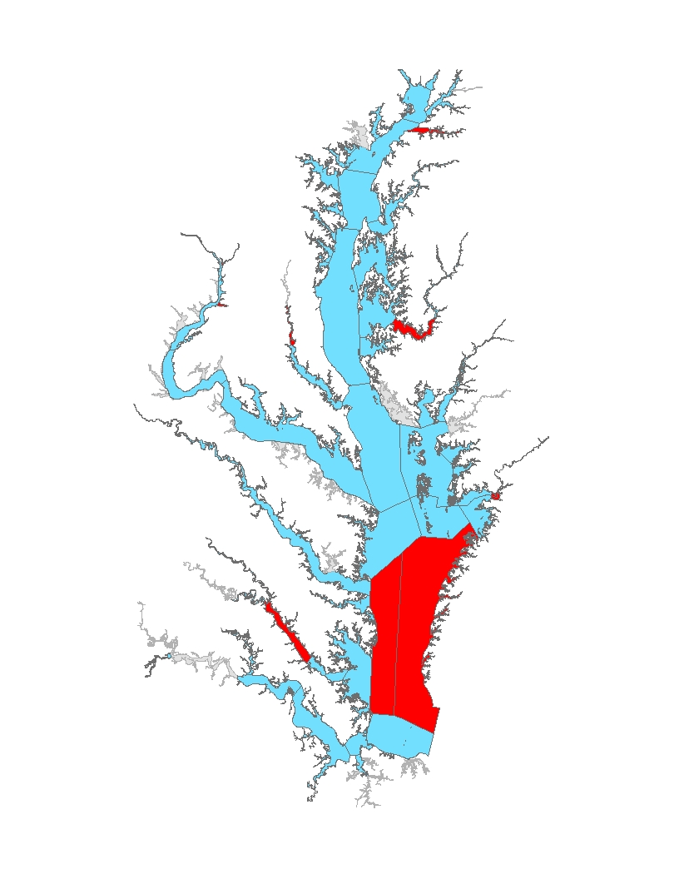
Segments Attaining Oxygen Standards: Open-Water Use
Segments NOT in Attainment
CB6PH
CB7PH
PAXOH
ANATF_DC
ANATF_MD
PISTF
YRKMH
SASOH
CHOMH2
POCTF
POCOH_MD
POCOH_VA
317 TN 21.9 TP
All Forest
E3

Slide 45
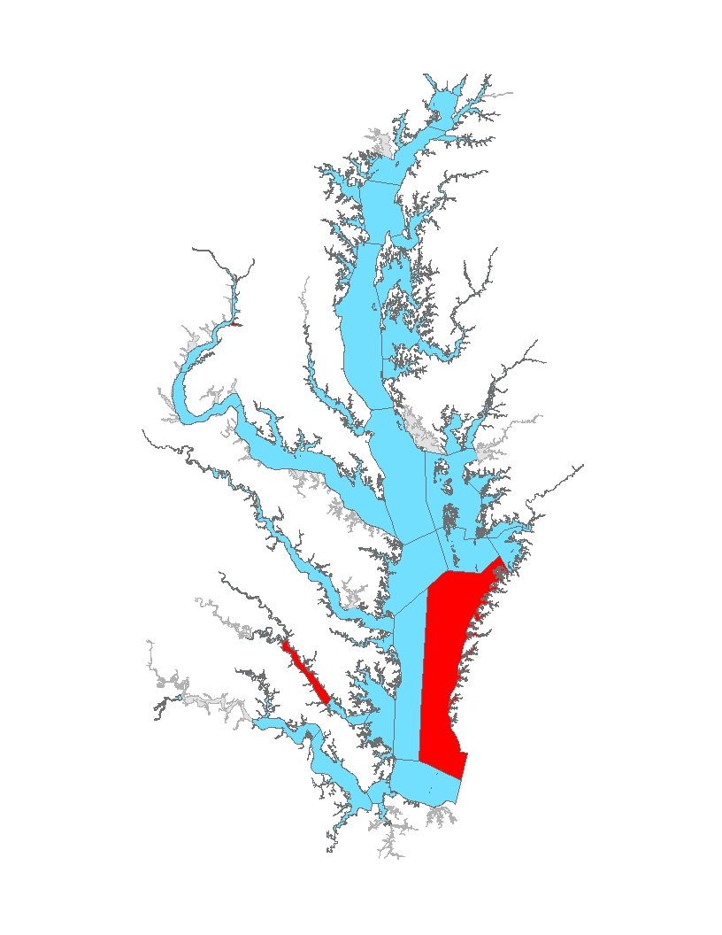
Segments Attaining Oxygen Standards: Open-Water Use
Segments NOT in Attainment
CB6PH
CB7PH
PAXOH
ANATF_DC
ANATF_MD
PISTF
YRKMH
SASOH
CHOMH2
POCTF
POCOH_MD
POCOH_VA
266 TN 16.9 TP
All Forest
E3

Slide 46

Segments Attaining Oxygen Standards: Open-Water Use
Segments NOT in Attainment
CB7PH
ANATF_DC
ANATF_MD
PISTF
YRKMH
CHKOH
253 TN 15.9 TP
All Forest
E3

Slide 47
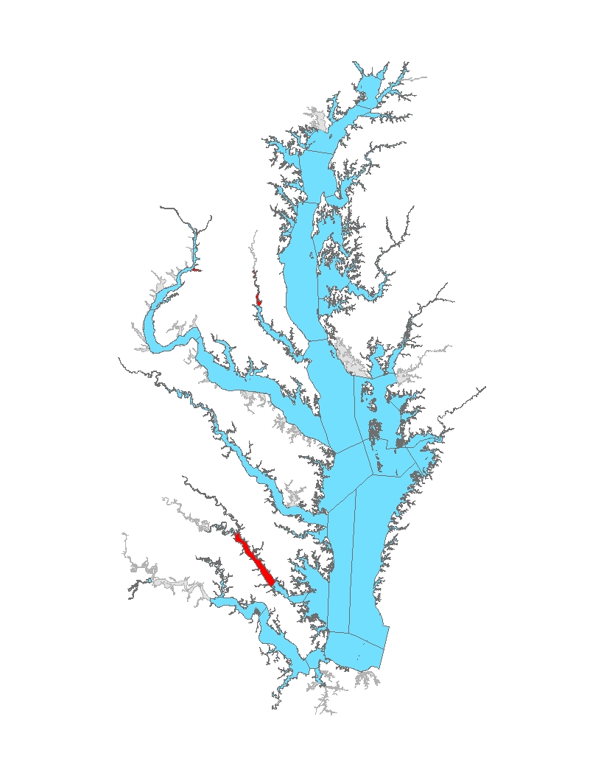
Segments Attaining Oxygen Standards: Open-Water Use
Segments NOT in Attainment
PAXOH
ANATF_DC
ANATF_MD
PISTF
YRKMH
224 TN 14.8 TP
All Forest
E3

Slide 48

Segments Attaining Oxygen Standards: Open-Water Use
Segments NOT in Attainment
ANATF_MD
YRKMH
205 TN 14.0 TP
All Forest
E3

Slide 49
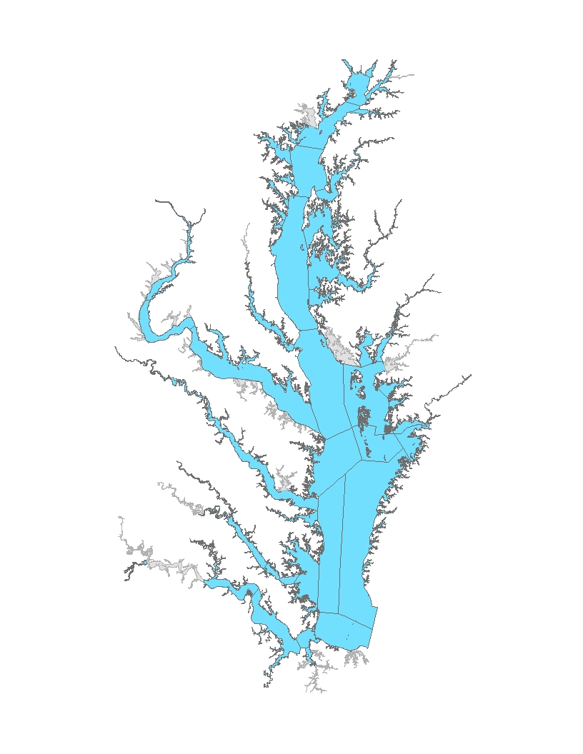
Segments Attaining Oxygen Standards: Open-Water Use
Segments NOT in Attainment
195 TN 13.7 TP
All Forest
E3

Slide 50
Segments Attaining Oxygen Standards: Open-Water Use
Segments NOT in Attainment
185 TN 12.8 TP
All Forest
E3

Slide 51
Segments Attaining Oxygen Standards: Open-Water Use
Segments NOT in Attainment
174 TN 11.9 TP
All Forest
E3

Slide 52
Segments Attaining Oxygen Standards: Open-Water Use
Segments NOT in Attainment
133 TN
8.6 TP
All Forest
E3

Slide 53
Segments Attaining Oxygen Standards: Open-Water Use
Segments NOT in Attainment
40 TN
3.9 TP
All Forest
E3

Slide 54
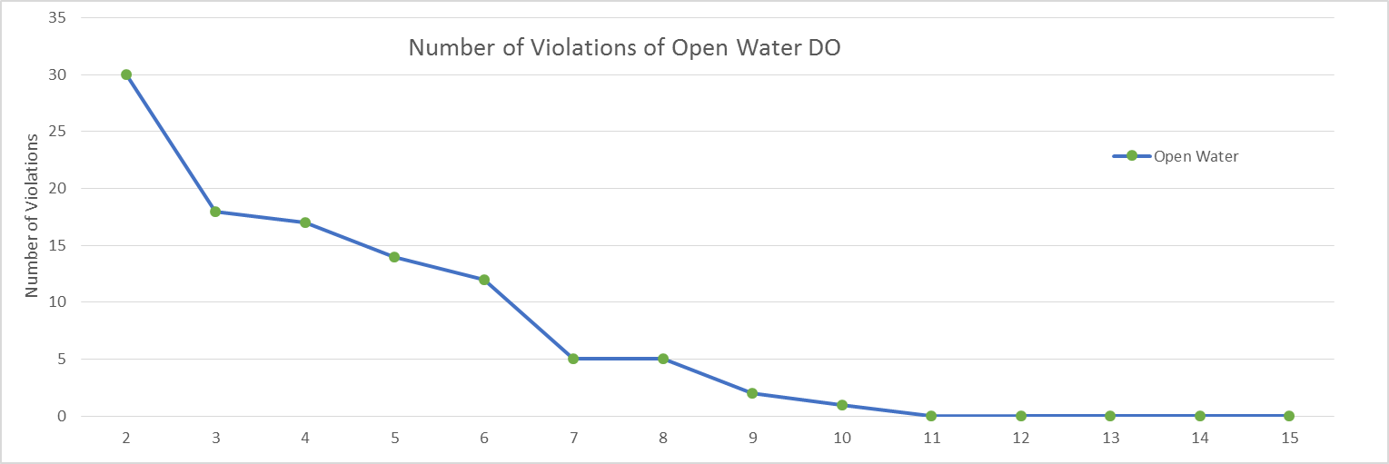

Segments Attaining Oxygen Standards:
Open-Water Use

Slide 55
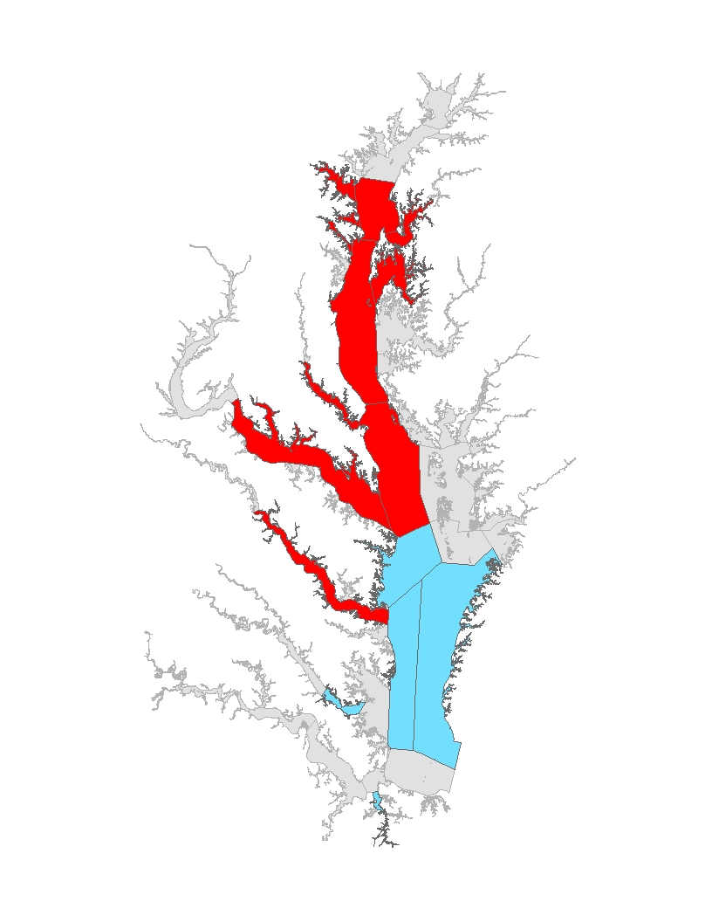
Segments Attaining Oxygen Standards: Deep-Water Use
Segments NOT in Attainment
CB3MH
CB4MH
CB5MH_MD
PATMH
MAGMH
SEVMH
PAXMH
POTMH
RPPMH
CHSMH
EASMH
404 TN 41.7 TP
All Forest
No Action
E3

Slide 56
Segments Attaining Oxygen Standards: Deep-Water Use
Segments NOT in Attainment
CB3MH
CB4MH
CB5MH_MD
PATMH
MAGMH
SEVMH
PAXMH
POTMH
RPPMH
CHSMH
EASMH
347 TN 30.4 TP
All Forest
E3

Slide 57

Segments Attaining Oxygen Standards: Deep-Water Use
Segments NOT in Attainment
CB3MH
CB4MH
CB5MH_MD
PATMH
MAGMH
SEVMH
PAXMH
POTMH
RPPMH
CHSMH
EASMH
338 TN 27.7 TP
All Forest
E3

Slide 58
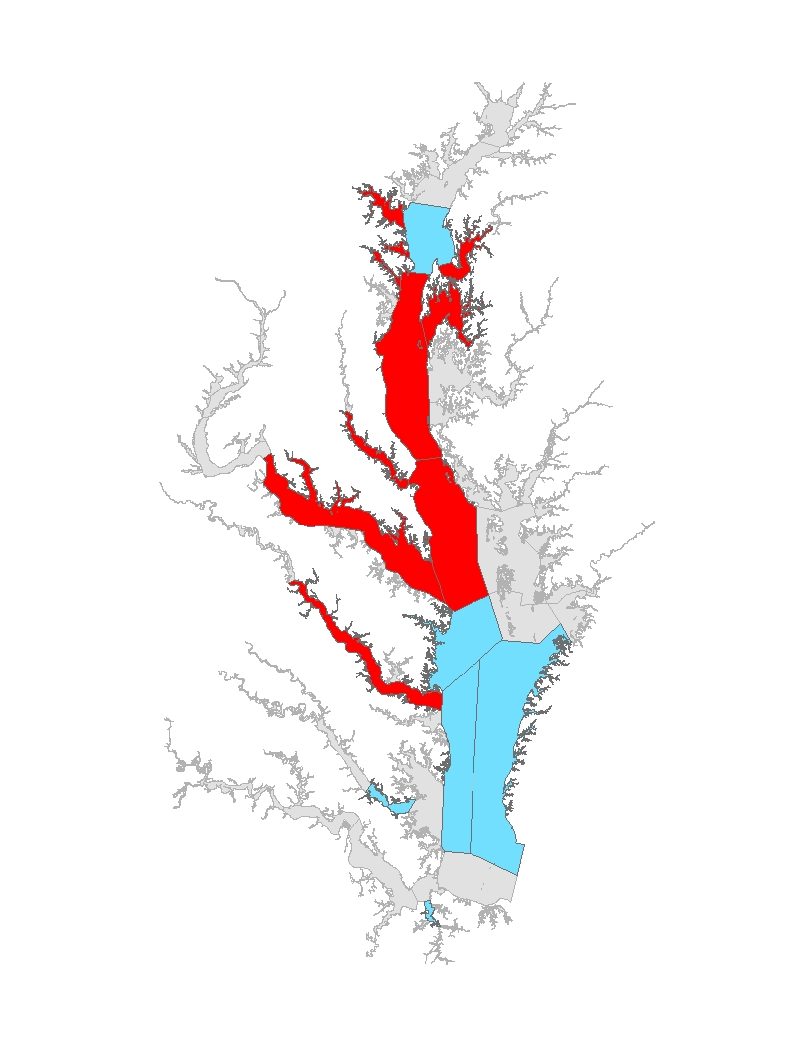
Segments Attaining Oxygen Standards: Deep-Water Use
Segments NOT in Attainment
CB4MH
CB5MH_MD
PATMH
MAGMH
SEVMH
PAXMH
POTMH
RPPMH
CHSMH
EASMH
337 TN
23.7 TP
All Forest
E3

Slide 59
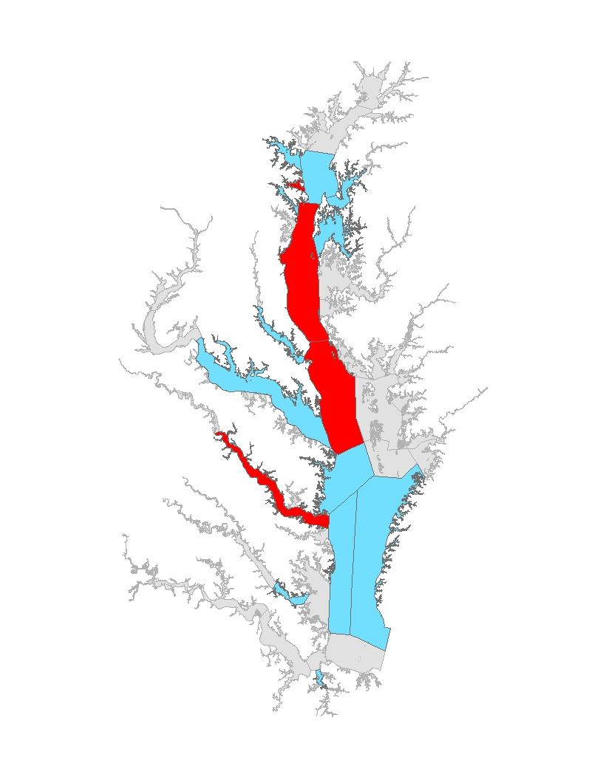
Segments Attaining Oxygen Standards: Deep-Water Use
Segments NOT in Attainment
CB4MH
CB5MH_MD
PATMH
MAGMH
PAXMH
POTMH
RPPMH
CHSMH
317 TN 21.9 TP
All Forest
E3

Slide 60
Segments Attaining Oxygen Standards: Deep-Water Use
Segments NOT in Attainment
CB4MH
CB5MH_MD
MAGMH
RPPMH
317 TN 21.9 TP
All Forest
E3

Slide 61
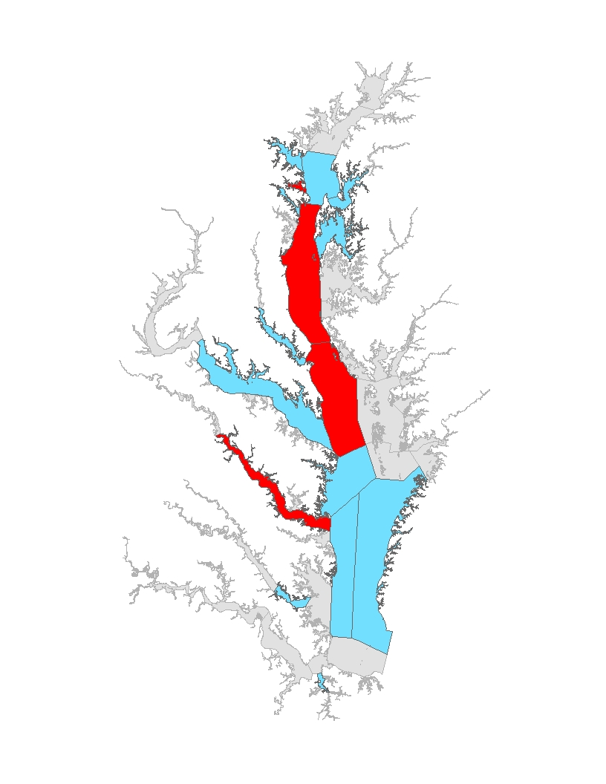
Segments Attaining Oxygen Standards: Deep-Water Use
Segments NOT in Attainment
CB4MH
CB5MH_MD
MAGMH
RPPMH
253 TN 15.9 TP
All Forest
E3

Slide 62
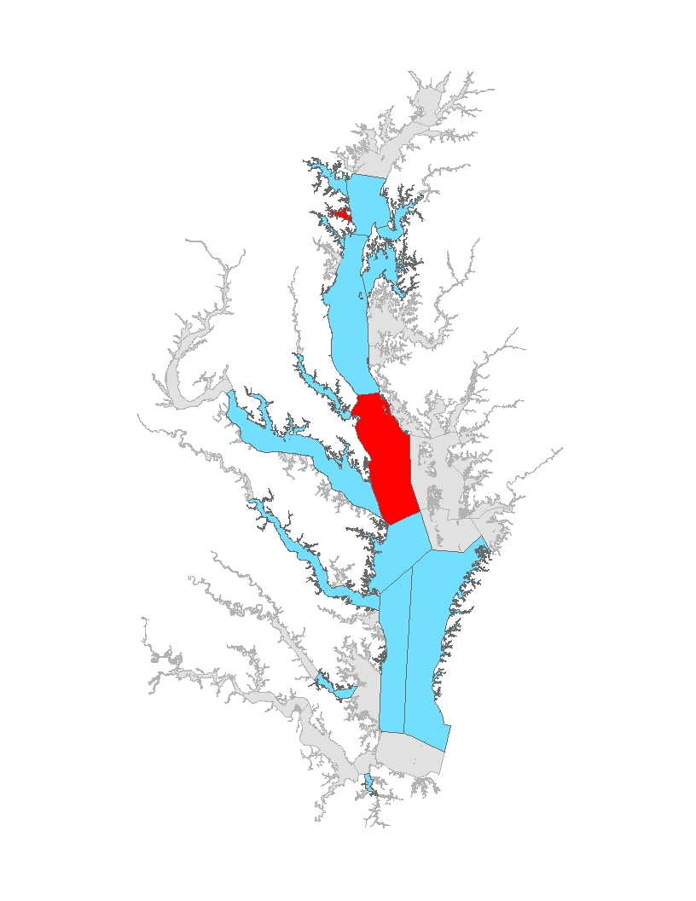
Segments Attaining Oxygen Standards: Deep-Water Use
Segments NOT in Attainment
CB5MH_MD
MAGMH
224 TN 14.8 TP
All Forest
E3

Slide 63
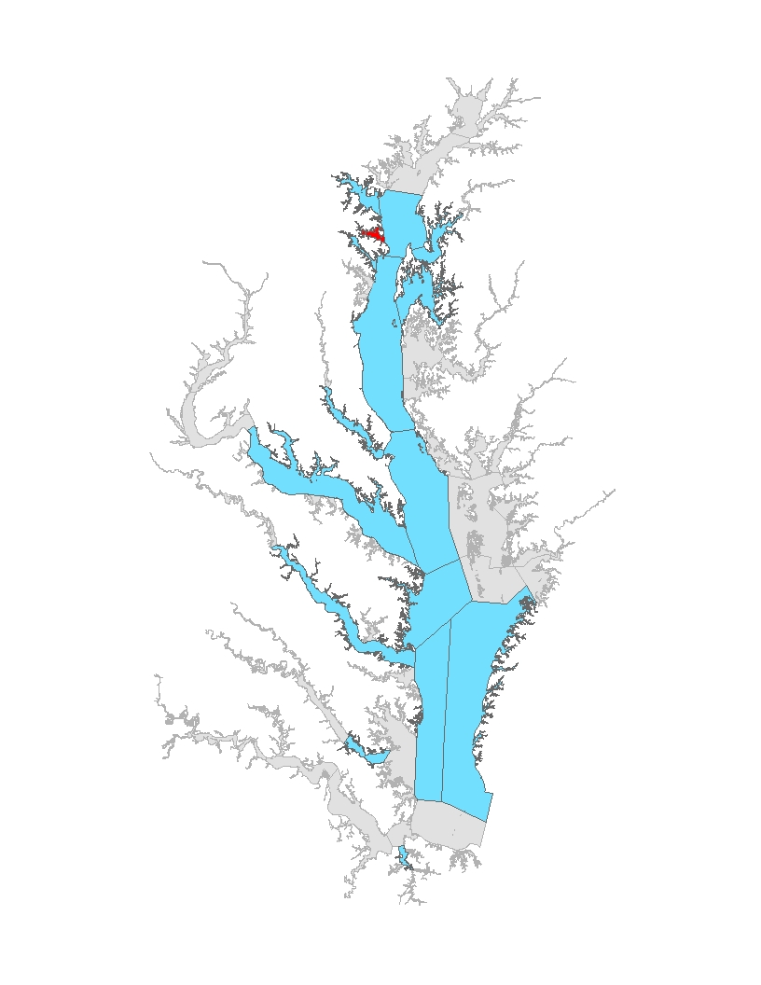
Segments Attaining Oxygen Standards: Deep-Water Use
Segments NOT in Attainment
MAGMH
205 TN 14.0 TP
All Forest
E3

Slide 64

Segments Attaining Oxygen Standards: Deep-Water Use
Segments NOT in Attainment
195 TN 13.7 TP
All Forest
E3

Slide 65
Segments Attaining Oxygen Standards: Deep-Water Use
Segments NOT in Attainment
185 TN 12.8 TP
All Forest
E3

Slide 66
Segments Attaining Oxygen Standards: Deep-Water Use
Segments NOT in Attainment
174 TN 11.9 TP
All Forest
E3

Slide 67
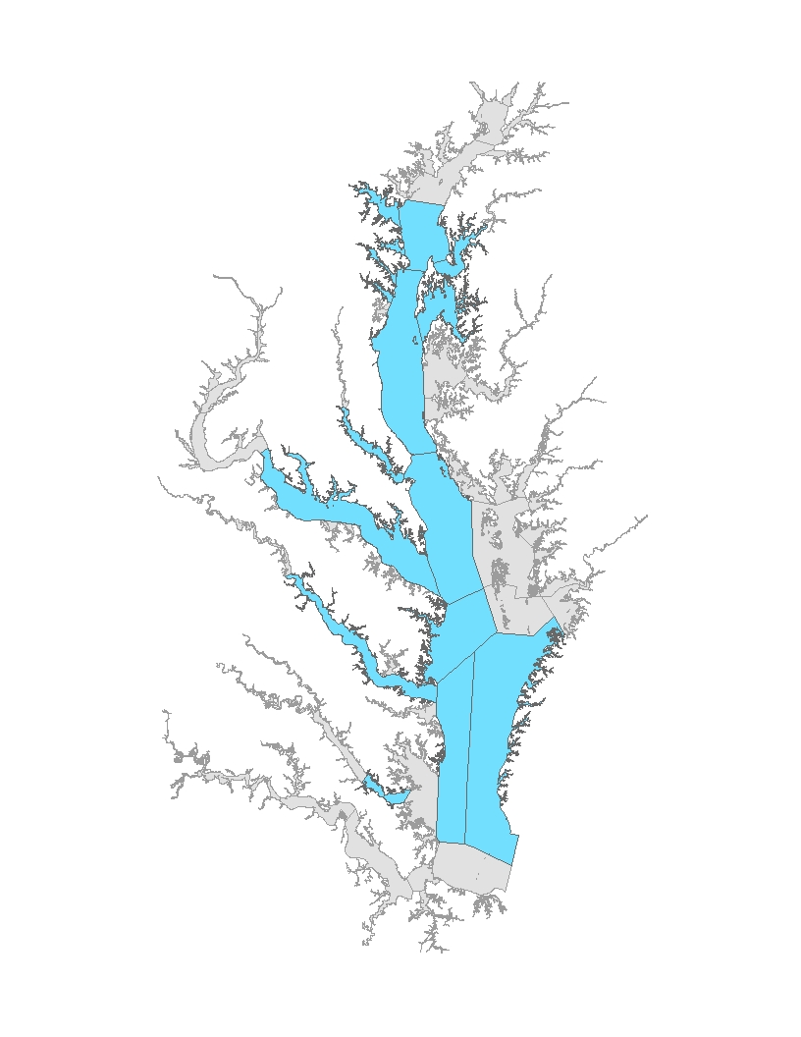
Segments Attaining Oxygen Standards: Deep-Water Use
Segments NOT in Attainment
133 TN
8.6 TP
All Forest
E3

Slide 68
Segments Attaining Oxygen Standards: Deep-Water Use
Segments NOT in Attainment
40 TN
3.9 TP
All
Forest
E3

Slide 69
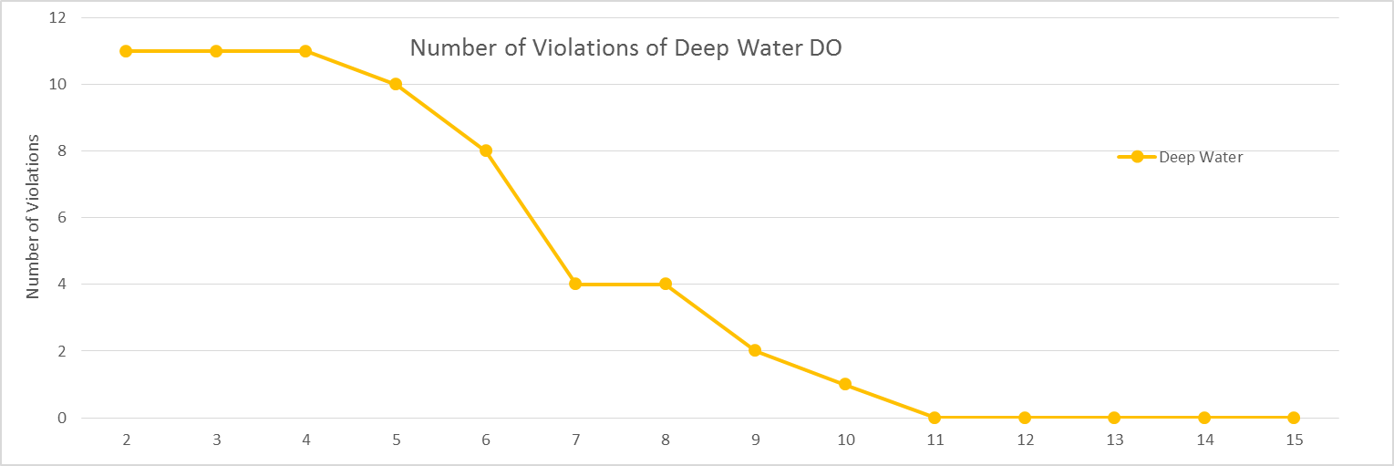


Segments Attaining Oxygen Standards:
Deep-Water Use

Slide 70
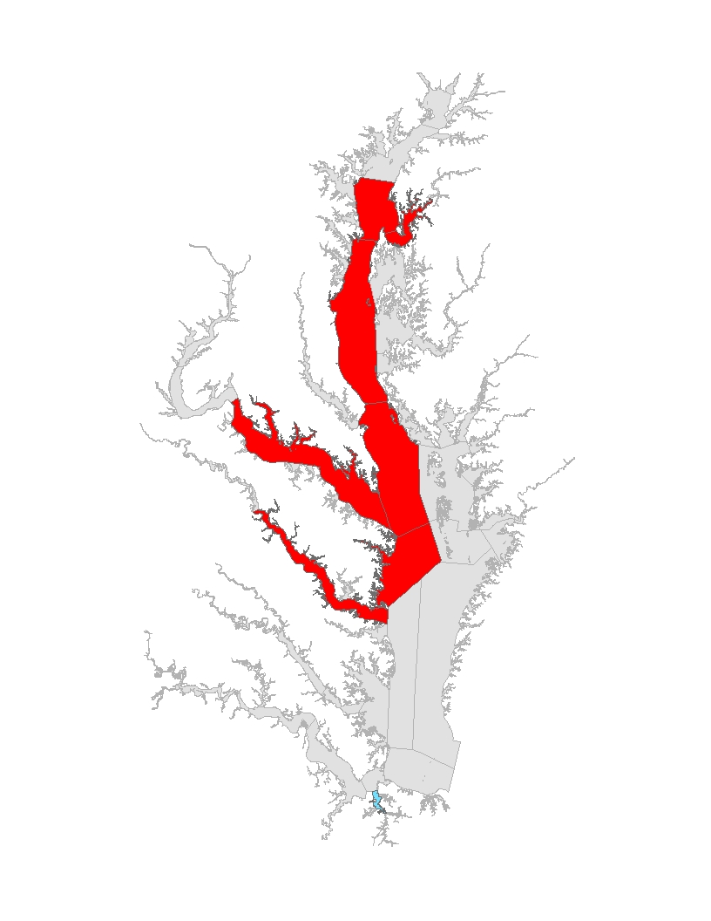
Count: X of YY
Segments Attaining Oxygen Standards: Deep-Channel Use
Segments NOT in Attainment
CB3MH
CB4MH
CB5MH_MD
CB5MH_VA
PATMH
POTMH
RPPMH
CHSMH
404 TN 41.7 TP
All Forest
No Action
E3
For this first animation, include all deep-channel segments, even the greyed out problem segments so when we get to the Phase II WIP loads (and beyond), we want to show the WQGIT these specific remaining segments. The last slide in this animation needs to circle the problem segments on the graphic—those same problem segments will remain listed in the bulleted listing to the left.

Slide 71
Count: X of YY
Segments Attaining Oxygen Standards: Deep-Channel Use
Segments NOT in Attainment
CB3MH
CB4MH
CB5MH_MD
CB5MH_VA
PATMH
POTMH
RPPMH
CHSMH
347 TN 30.4 TP
All Forest
E3
For this first animation, include all deep-channel segments, even the greyed out problem segments so when we get to the Phase II WIP loads (and beyond), we want to show the WQGIT these specific remaining segments. The last slide in this animation needs to circle the problem segments on the graphic—those same problem segments will remain listed in the bulleted listing to the left.

Slide 72
Count: X of YY
Segments Attaining Oxygen Standards: Deep-Channel Use
Segments NOT in Attainment
CB3MH
CB4MH
CB5MH_MD
CB5MH_VA
PATMH
POTMH
RPPMH
CHSMH
338 TN 27.7 TP
All Forest
E3
For this first animation, include all deep-channel segments, even the greyed out problem segments so when we get to the Phase II WIP loads (and beyond), we want to show the WQGIT these specific remaining segments. The last slide in this animation needs to circle the problem segments on the graphic—those same problem segments will remain listed in the bulleted listing to the left.

Slide 73
Count: X of YY
Segments Attaining Oxygen Standards: Deep-Channel Use
Segments NOT in Attainment
CB3MH
CB4MH
CB5MH_MD
CB5MH_VA
POTMH
RPPMH
CHSMH
337 TN
23.7 TP
All Forest
E3
For this first animation, include all deep-channel segments, even the greyed out problem segments so when we get to the Phase II WIP loads (and beyond), we want to show the WQGIT these specific remaining segments. The last slide in this animation needs to circle the problem segments on the graphic—those same problem segments will remain listed in the bulleted listing to the left.

Slide 74

Count: X of YY
Segments Attaining Oxygen Standards: Deep-Channel Use
Segments NOT in Attainment
CB3MH
CB4MH
CB5MH_MD
CHSMH
POTMH
RPPMH
317 TN 21.9 TP
All Forest
E3
For this first animation, include all deep-channel segments, even the greyed out problem segments so when we get to the Phase II WIP loads (and beyond), we want to show the WQGIT these specific remaining segments. The last slide in this animation needs to circle the problem segments on the graphic—those same problem segments will remain listed in the bulleted listing to the left.

Slide 75
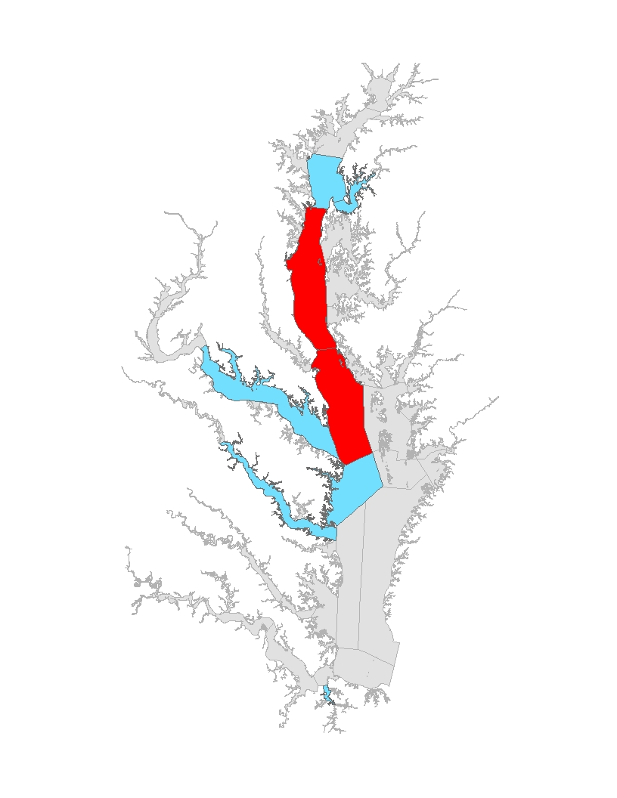
Segments Attaining Oxygen Standards: Deep-Channel Use
Segments NOT in Attainment
CB4MH
CB5MH_MD
253 TN 15.9 TP
All Forest
E3
For this first animation, include all deep-channel segments, even the greyed out problem segments so when we get to the Phase II WIP loads (and beyond), we want to show the WQGIT these specific remaining segments. The last slide in this animation needs to circle the problem segments on the graphic—those same problem segments will remain listed in the bulleted listing to the left.

Slide 76
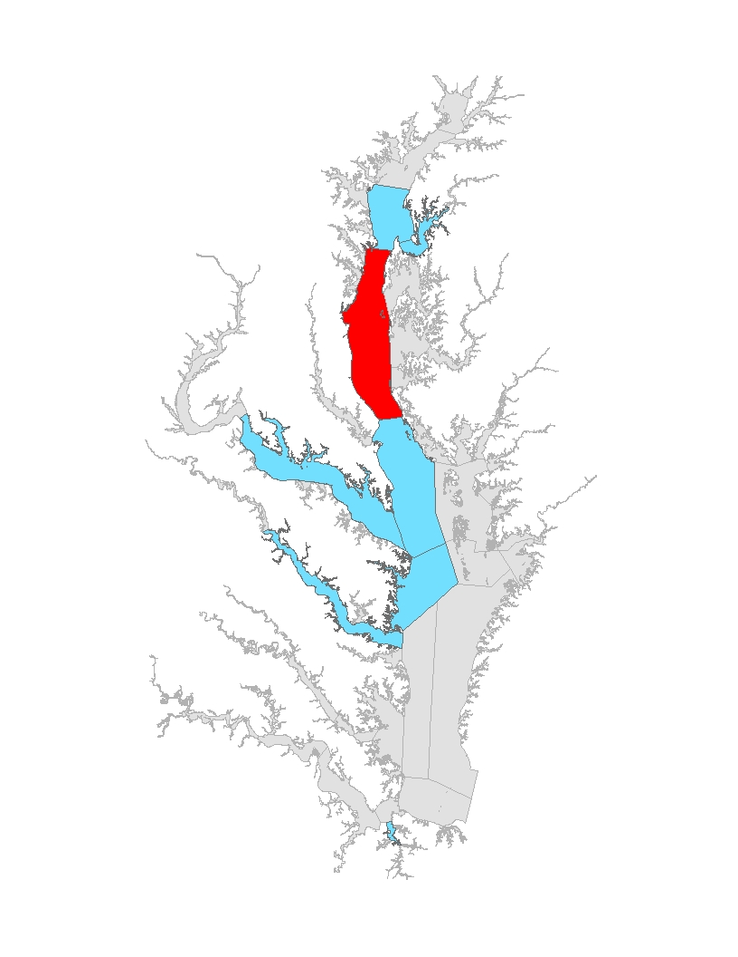
Count: X of YY
Segments Attaining Oxygen Standards: Deep-Channel Use
Segments NOT in Attainment
CB4MH
224 TN 14.8 TP
All Forest
E3
For this first animation, include all deep-channel segments, even the greyed out problem segments so when we get to the Phase II WIP loads (and beyond), we want to show the WQGIT these specific remaining segments. The last slide in this animation needs to circle the problem segments on the graphic—those same problem segments will remain listed in the bulleted listing to the left.

Slide 77
Count: X of YY
Segments Attaining Oxygen Standards: Deep-Channel Use
Segments NOT in Attainment
CB4MH
205 TN 14.0 TP
All Forest
E3
For this first animation, include all deep-channel segments, even the greyed out problem segments so when we get to the Phase II WIP loads (and beyond), we want to show the WQGIT these specific remaining segments. The last slide in this animation needs to circle the problem segments on the graphic—those same problem segments will remain listed in the bulleted listing to the left.

Slide 78
Count: X of YY
Segments Attaining Oxygen Standards: Deep-Channel Use
Segments NOT in Attainment
CB4MH
195 TN 13.7 TP
All Forest
E3
For this first animation, include all deep-channel segments, even the greyed out problem segments so when we get to the Phase II WIP loads (and beyond), we want to show the WQGIT these specific remaining segments. The last slide in this animation needs to circle the problem segments on the graphic—those same problem segments will remain listed in the bulleted listing to the left.

Slide 79
Count: X of YY
Segments Attaining Oxygen Standards: Deep-Channel Use
Segments NOT in Attainment
CB4MH
185 TN 12.8 TP
All Forest
E3
For this first animation, include all deep-channel segments, even the greyed out problem segments so when we get to the Phase II WIP loads (and beyond), we want to show the WQGIT these specific remaining segments. The last slide in this animation needs to circle the problem segments on the graphic—those same problem segments will remain listed in the bulleted listing to the left.

Slide 80
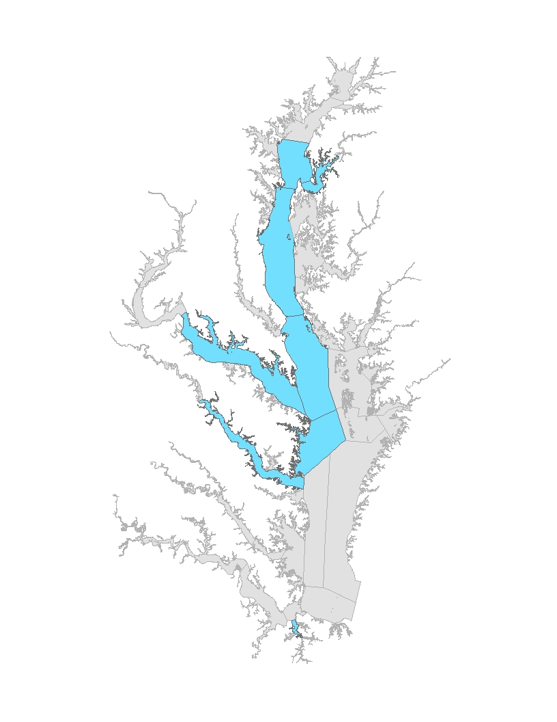
Segments Attaining Oxygen Standards: Deep-Channel Use
Segments NOT in Attainment
174 TN 11.9 TP
All Forest
E3
Notes:
For this first animation, include all deep-channel segments, even the greyed out problem segments so when we get to the Phase II WIP loads (and beyond), we want to show the WQGIT these specific remaining segments. The last slide in this animation needs to circle the problem segments on the graphic—those same problem segments will remain listed in the bulleted listing to the left.

Slide 81
Segments Attaining Oxygen Standards: Deep-Channel Use
Segments NOT in Attainment
133 TN
8.6 TP
All Forest
E3

Slide 82
Segments Attaining Oxygen Standards: Deep-Channel Use
Segments NOT in Attainment
40 TN
3.9 TP
All
Forest
E3

Slide 83
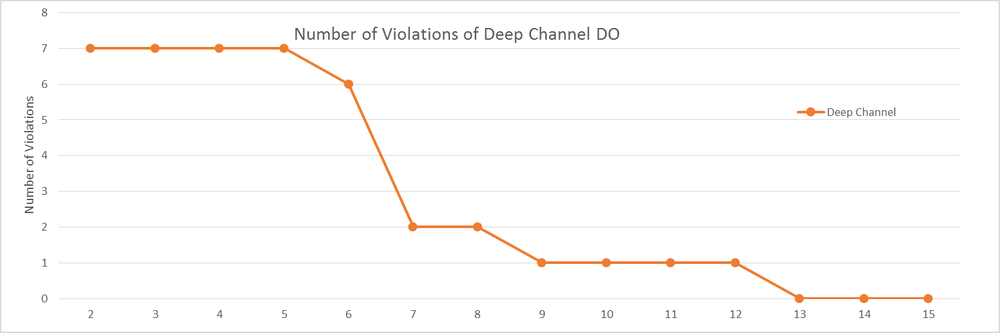
Segments Attaining Oxygen Standards:
Deep-Channel Use

Slide 84
Determining the Bay’s Ability to Absorb Pollutants

Slide 85
Rationale for Pollutant Loads Bay Can Absorb
Clear monitoring-based evidence of reductions on volumes of low/no oxygen in deeper waters observed in Bay and tidal tributaries
At 195 million lbs. nitrogen and 13.7 million lbs. phosphorus, we reach:
  Loading levels where all segments’ designated uses, except CB4 deep-channel, come into attainment
  Point of diminishing returns for the increased level of reductions approaching E3

Slide 86
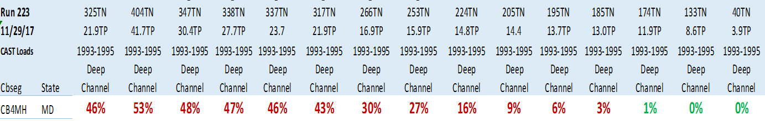
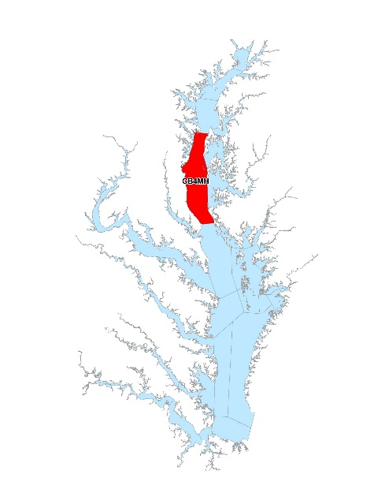
Diminishing Return for Additional Reductions
+19M lbs TN
+10M lbs TN
- 9M lbs TN
-21M lbs TN
Scoping Scenarios to explore water quality attainment at loads around 195N and 13.7P

Slide 87
Proposed Path Forward
Support Maryland updating their water quality standards regulations’ existing restoration variances
  Change CB4 deep-channel from 2 percent to 6 percent
  Change CB4 deep-water from 7 percent to 5 percent
  No change to the Eastern Bay restoration variance of 2 percent
  Remove the lower Chester River deep-channel restoration variance of 16 percent
  Remove the Patapsco River deep-water restoration variance of 7 percent

Slide 88
Proposed Path Forward
Agreement to a common set of Partnership communication messages
  Reflects application of an additional decade of new data and scientific understanding along with improved models
  Approach followed is fully consistent with approach taken during development of the 2010 Bay TMDL
  Fully consistent with Maryland’s existing water quality standards regulations requirement for regular check-ins and modifications based on new data or assumptions incorporated into the Partnership’s Chesapeake Bay water quality model

Slide 89
WQGIT Recommendations to the PSC
Recommends establishing the Bay’s assimilative capacity as 195 million pounds of nitrogen and 13.7 million pounds of phosphorus
Recommends supporting necessary adjustments to Maryland's water quality standards regulations’ restoration variances (subject to EPA approval) in order to meet the assimilative capacity for nitrogen and phosphorus
Recommends the development of Partnership communication messages for the public over the next four months, in time for the release of the final Phase III WIP planning targets in May 2018

Slide 90
Today’s Requested Policy Decisions
Approval of the Bay’s assimilative capacity as 195 million pounds of nitrogen and 13.7 million pounds of phosphorus
Support the necessary adjustments to Maryland’s restoration variances
Approval for the development of the Partnership’s public communication messages

Slide 91
Proposed Draft Phase III Planning Targets
Gary Shenk, USGS, CBP Phase 6 Watershed Model Coordinator
Notes:
Centered text

Slide 92
We Have All the Needed Components
Agreed-to methodology
No Action scenario
E3 scenario
Watershed and estuarine relative effectiveness
Assimilative capacity of the Bay
Accounting for projected atmospheric deposition load reductions

Slide 93
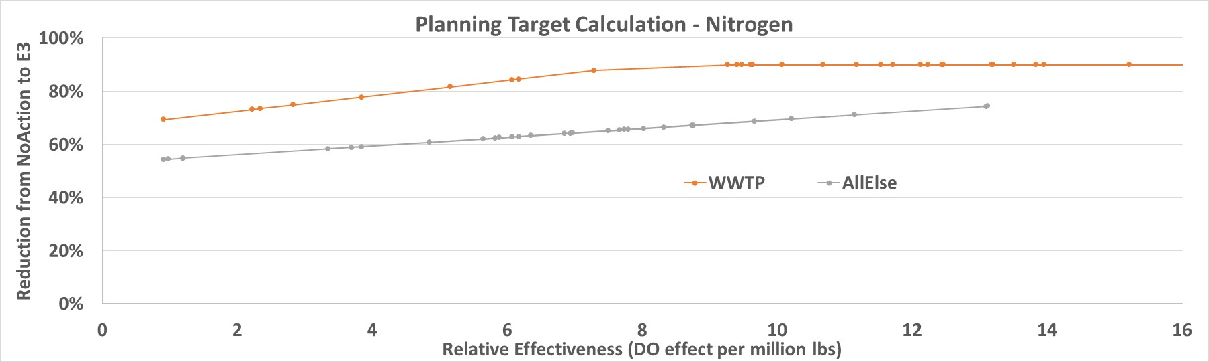
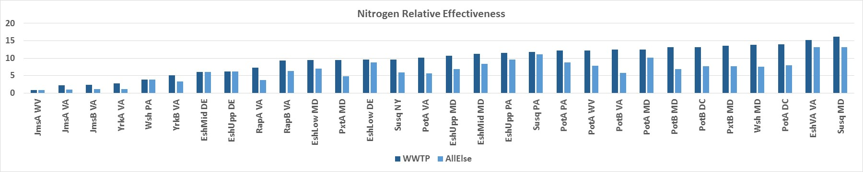
Deriving the Draft Phase III Planning Targets: Nitrogen

Slide 94
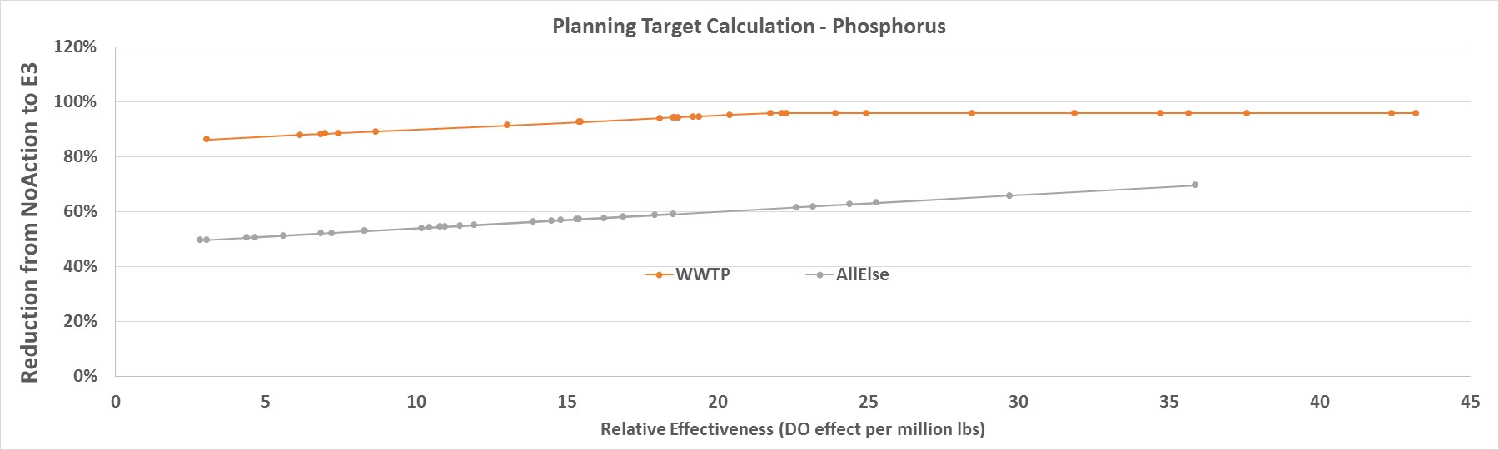
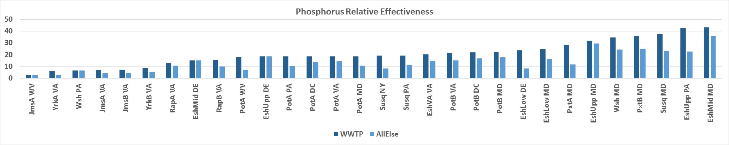
Deriving the Draft Phase III Planning Targets: Phosphorus

Slide 95
Proposed Draft Phase III Planning Targets: Nitrogen
Jurisdiction | 1985 Baseline | 2013 Progress | Growth in Load to 2025 | Phase III Planning Target
NY | 18.71 | 15.44 |  | 10.59
PA | 122.41 | 99.28 |  | 73.18
MD | 83.56 | 55.89 |  | 45.30
WV | 8.73 | 8.06 |  | 6.35
DC | 6.48 | 1.75 |  | 2.43
DE | 6.97 | 6.59 |  | 4.59
VA | 84.29 | 61.53 |  | 55.82
Basinwide | 331.15 | 248.54 |  | 198.25
*Units: millions of pounds

Slide 96
Proposed Draft Phase III Planning Targets with Special Cases: Nitrogen
Jurisdiction | Special Cases | With Special Cases | Phase III Planning Target
NY | 1.00 | 11.59 | 10.59
PA | -0.58 | 72.60 | 73.18
MD | -0.31 | 44.99 | 45.30
WV | -0.03 | 6.31 | 6.35
DC | 0.00 | 2.42 | 2.43
DE | -0.06 | 4.53 | 4.59
VA | -0.24 | 55.58 | 55.82
Basinwide | -0.22 | 198.03 | 198.25
*Units: millions of pounds

Slide 97
Proposed Draft Phase III Planning Targets: Phosphorus
Jurisdiction | 1985 Baseline | 2013 Progress | Growth in Load to 2025 | Phase III Planning Target
NY | 1.198 | 0.710 |  | 0.506
PA | 6.115 | 3.696 |  | 3.073
MD | 7.419 | 3.919 |  | 3.604
WV | 0.793 | 0.560 |  | 0.456
DC | 0.090 | 0.062 |  | 0.130
DE | 0.225 | 0.115 |  | 0.120
VA | 13.545 | 6.345 |  | 6.186
Basinwide | 29.384 | 15.408 |  | 14.073
*Units: millions of pounds

Slide 98
Proposed Draft Phase III Planning Targets with Special Cases: Phosphorus
Jurisdiction | Special Cases | With Special Cases | Phase III Planning Target
NY | 0.100 | 0.606 | 0.506
PA | -0.102 | 2.971 | 3.073
MD | -0.083 | 3.521 | 3.604
WV | 0.200 | 0.656 | 0.456
DC | -0.001 | 0.129 | 0.130
DE | -0.004 | 0.115 | 0.120
VA | -0.133 | 6.053 | 6.186
Basinwide | -0.023 | 14.05 | 14.073
*Units: millions of pounds

Slide 99
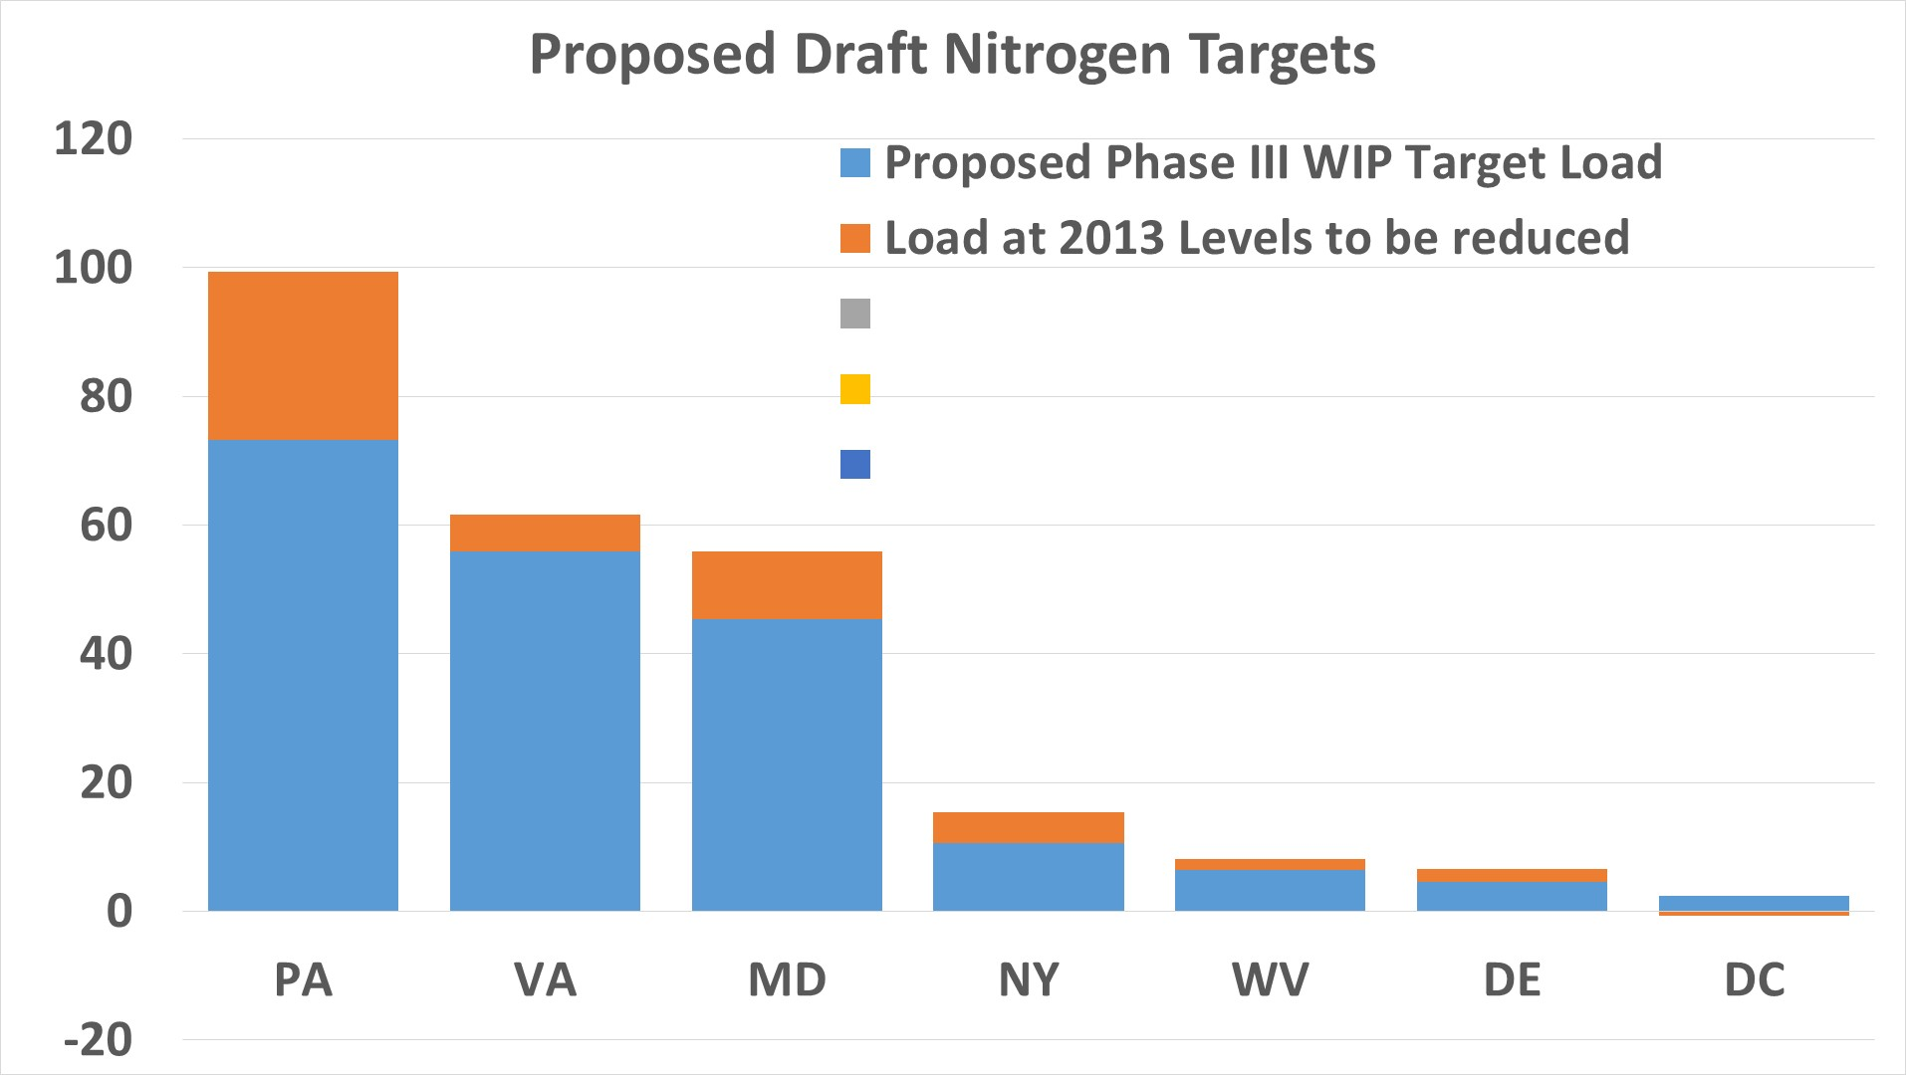

Slide 100
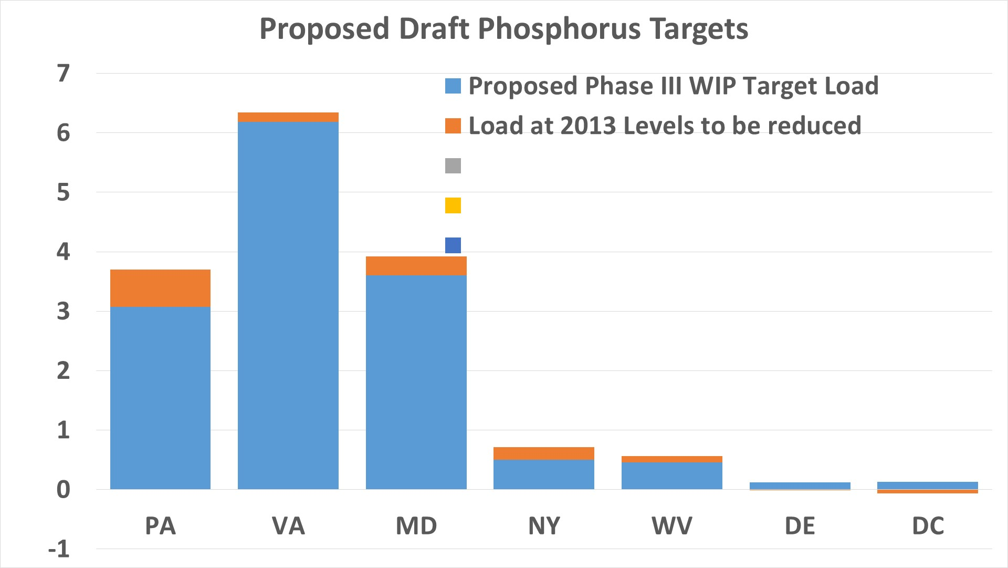

Slide 101
Jurisdiction-Specific Proposed Draft Phase III WIP Planning Targets
Teresa Koon, WV DEP CBP Water Quality Goal
Implementation Team Vice Chair
and
WQGIT Jurisdictional Representations

Slide 102
Draft Phase III Planning Targets
WQGIT jurisdictional representatives will present their respective profiles to the PSC

Slide 103
Day Two Requested Policy Decision
Approval of draft Phase III Planning Targets as the starting point for the Partnership’s 4-month review process

Slide 104
Proposed Process and Schedule for 4-Month Review Period
Lucinda Power, U.S. EPA, CBP Water Quality Goal
Implementation Team Coordinator

Slide 105
PSC Approved Schedule
December 19-20, 2017: PSC 2-day retreat and decision making
December 22, 2017: Release of draft Phase III WIP planning targets
December 22, 2017 – April 20, 2018: Partnership’s review of the draft Phase III WIP planning targets, including consideration of special case requests
Late April/Early May 2018: PSC approval of the final Phase III WIP planning targets with any agreed-to special cases
May 7, 2018: Release of the final Phase III WIP planning targets

Slide 106
During the 4-Month Review Period
Analyze level of effort to achieve the draft planning targets
Evaluate effects of accounting for growth, Conowingo infill, and climate change on level of effort
Assess the need for exchanges of nitrogen and/or phosphorus loads between a jurisdiction’s major river basins
Assess the need for exchanges of nitrogen for phosphorus or phosphorus for nitrogen within a jurisdiction’s major river basins
Determine if any special cases are needed

Slide 107
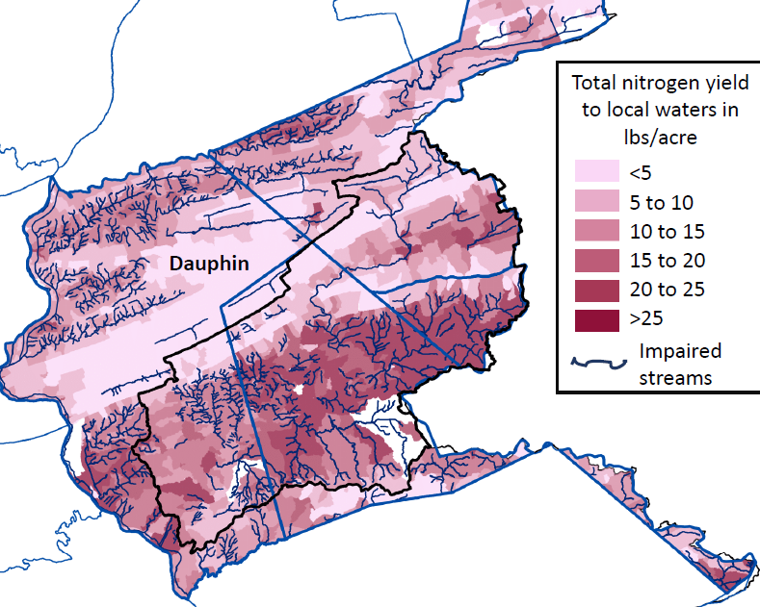
Further Analyses for Consideration
Testing out preliminary development of measurable, local planning goals below the major state-basin level

Slide 108
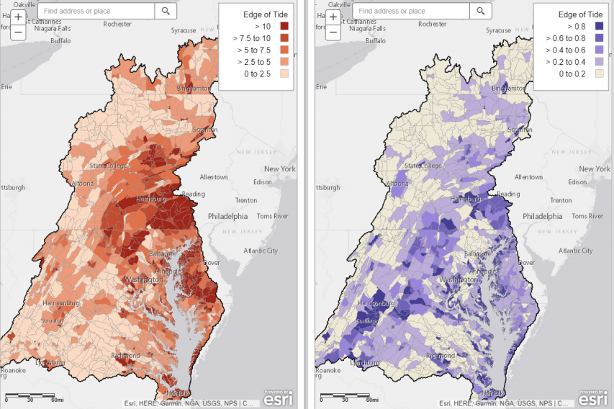
Further Analyses for Consideration
Apply the results of the geographic isolation runs to help inform implementation planning and targeting

Slide 109
Further Analyses for Consideration
Evaluate potential changes needed to a jurisdiction’s Phase I and Phase II WIP source sector goals
Where did the
Nitrogen reductions
come from?
1985
2015

Slide 110
Support to Jurisdictions During their Reviews
The Partnership Office in Annapolis can support the jurisdictions by helping:
  Test out possible N for P and P for N exchanges
  Test out possible major river basin to basin exchanges
  Test for possible water quality/load reduction impacts on upstream and down tide neighboring jurisdictions
  Think through and help test possible approaches to developing local area planning goals
  Evaluate feasibility of achieving the draft planning targets and what are the opportunities for further reductions by source sector, geography

Slide 111
Possible Changes Between Now and April 2018
Requests for special conditions
Conducting basin to basin exchanges of N, P, and sediment loads
Conducting significant N for P and P for N exchanges

Slide 112
What are Special Cases?
Special cases are requests by the jurisdictions for any:
  Changes to their draft Phase III WIP planning targets
  Changes to the methodology used to establish the draft Phase III WIP planning targets

Slide 113
Who Can Submit a Special Case Request?
Any one of the seven Bay watershed jurisdictions to the CBP Water Quality Goal Implementation Team (WQGIT) Chair and the CBP WQGIT Coordinator

Slide 114
Notification of Special Case Requests
March 16, 2018
Final deadline for submitting the special case request(s), along with the justification and nutrient and basin exchanges that have multi-jurisdictional impacts, to the Partnership for consideration

Slide 115
Process for Addressing Special Cases
CBPO staff will work with the jurisdictions to address and identify potential resolutions for special cases during the 4-month review period
For transparency, updates will be provided to the WQGIT during each conference call during the 4-month review period communicating:
  Who has submitted special case requests
  Proposed options for resolving the special case request(s)
PSC will approve any special case requests submitted to the Partnership for review and consideration

Slide 116
Options for Resolving Special Cases
In the event the PSC cannot reach consensus on the resolution of special case requests, the PSC can either:
  Resolve the issue by a supermajority vote, per the Partnership’s governance procedures, or
  Request that EPA make the final decision

Slide 117
Today’s Requested Policy Decision
Approval of proposed process for the Partnership’s 4-month review of the draft Phase III WIP planning targets, including addressing special case requests

Slide 118
Accounting for Growth in the Jurisdictions’ Phase III WIPs
Karl Berger, MWCOG, CBP Land Use Workgroup Chair
and
Peter Claggett, USGS, CBP Land Use Workgroup Coordinator

Slide 119
Accounting for Growth Equitably Across Jurisdictions
Watershed population is increasing by over 1 million persons/decade
  Population change from 2010 -2025 = 2.0 million persons
Chesapeake Bay Land Change Model (CBLCM) estimates land use and wastewater impacts of future population growth.
  Parameterized uniquely for every state/county/city in the Bay watershed.
  Accounts for uncertainty at sub-county scales.
Partnership agreement on future land use scenarios reflecting a range of planning and conservation efforts.
Developing the WIPs on 2025 land use conditions enable the use of planning and conservation efforts to help “account for growth” for the TMDL.

Slide 120
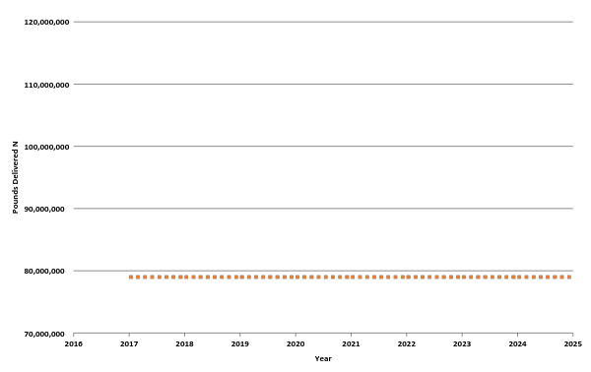

Why Account for Growth?
2025 growth projection
Load reductions necessary to meet the 2025 Phase III WIP Planning Target (lock box)

Slide 121

2010 population = 17.4 million
2025 population = 19.4 million (11.5% increase)

Slide 124
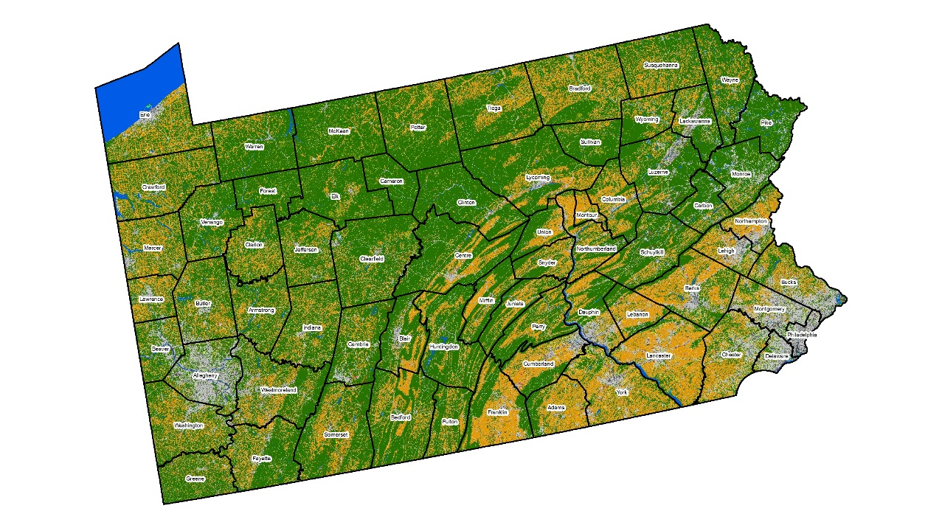
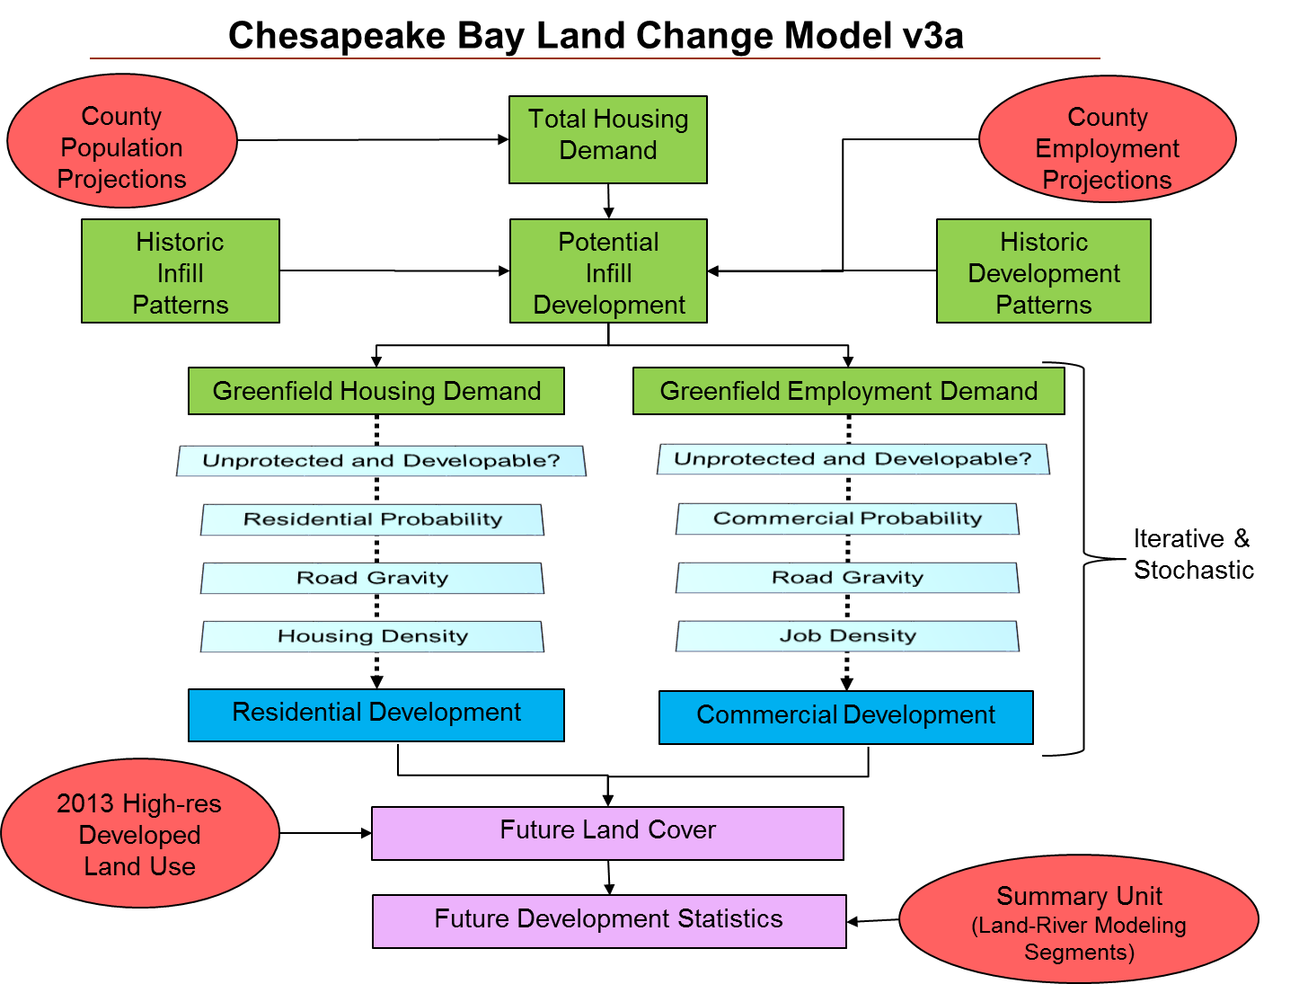


Partnership’s Chesapeake Bay Land Change Model

Slide 125

Land Change Model Outputs
Impervious surface and turf grass expansion
Forest conversion to development
Farmland conversion to development
Future population on sewer and septic
Rural Residential
57 acres
227 households on sewer
0.25 acre lots
27.8% Impervious
72.2% Turf grass
20-acres farmland loss
37-acres forest loss

Slide 126
Future Growth Scenarios: 2025
Purpose:
To provide information to state and local partners to account for the effects of land use planning and conservation actions for reducing future pollutant loads in their Phase III WIPs and two-year milestones.
Current Zoning Scenario: 2025 Baseline for Phase III WIPs
Continuation of historic trends constrained by existing local zoning
Includes the best available regional and local data representing current conditions

Slide 127
Future Growth Scenarios
Conservation Plus Scenario: Package of Planning & Conservation “BMP’s”
  Protect 100-year floodplain and frequently-flooded soils
  Protect riparian zones (35-ft, 100-ft, 300-ft)
  Protect large forest tracts (250+ acres, 1000+ acres) or green infrastructure
  Protect shoreline forests (all contiguous tracts 1000-ft from shoreline)
  Adjusting demand script:
    Increase percent of infill/redevelopment (e.g., 5%, 10%, 15%)
    Increase proportion of urban vs rural growth (e.g., 5%, 10%, 15%)
  Protect Agricultural Districts
  Avoid growth on soils unsuitable for septic systems
  Expand sewer service areas layer (e.g., 1-mile buffer, 2-mile buffer)
  Avoid growth in areas subject to category 3 Hurricane storm surge
  Protect highly productive farms, prime farmlands, farmland of state importance
  Protect state-designated “Healthy watersheds”
  Protect areas subject to marsh migration (e.g., upland buffer around tidal wetlands and National Wildlife refuges)

Slide 128

Extent of Local Zoning Data
Collected by CBP from local and state agencies, 2013 - 2017

Slide 129


Residential Infill/Redevelopment
Commercial Infill/Redevelopment
Current Zoning
Scenario
Current Zoning
Scenario

Slide 130


Increase in Impervious Surfaces
Increase in Turf Grass
Current Zoning
Scenario
Current Zoning
Scenario

Slide 131

Forest Conversion to Development
Current Zoning
Scenario

Slide 132

Growth on Sewer and Septic
Current Zoning
Scenario

Slide 133


Farmland Conversion to Development
Farmland Conversion + Land Retirement
Current Zoning
Scenario
Current Zoning
Scenario

Slide 134
WQGIT & Modeling Workgroup Recommendations: Nitrogen
Jurisdiction | 1985 Baseline | 2013 Progress | Growth in Load to 2025 | Phase III Planning Target
NY | 18.71 | 15.44 | -0.74 | 10.59
PA | 122.41 | 99.28 | 1.66 | 73.18
MD | 83.56 | 55.89 | 1.52 | 45.30
WV | 8.73 | 8.06 | -0.02 | 6.35
DC | 6.48 | 1.75 | 0.00 | 2.43
DE | 6.97 | 6.59 | 0.48 | 4.59
VA | 84.29 | 61.53 | 1.09 | 55.82
Basinwide | 331.15 | 248.54 | 4.00 | 198.25
*Units: millions of pounds

Slide 135
WQGIT & Modeling Workgroup Recommendations: Phosphorus
Jurisdiction | 1985 Baseline | 2013 Progress | Growth in Load to 2025 | Phase III Planning Target
NY | 1.198 | 0.710 | -0.005 | 0.506
PA | 6.115 | 3.696 | 0.044 | 3.073
MD | 7.419 | 3.919 | -0.015 | 3.604
WV | 0.793 | 0.560 | -0.017 | 0.456
DC | 0.090 | 0.062 | 0.000 | 0.130
DE | 0.225 | 0.115 | 0.007 | 0.120
VA | 13.545 | 6.345 | 0.140 | 6.186
Basinwide | 29.384 | 15.408 | 0.154 | 14.073
*Units: millions of pounds

Slide 138
WQGIT Recommendations to the PSC
Use the Partnership’s Land Change Model to establish growth projections, with the opportunity for states (e.g., Maryland) to provide data or alternative modeling approaches in future years, which will be vetted through the Partnership approval process
Use 2025 growth projections based on current zoning as base conditions for the Phase III WIPs
Update the growth projections every 2 years with the best available data to inform the development of the two-year milestones

Slide 139
Today’s Requested Policy Decisions
Approval of the Water Quality Goal Implementation Team’s recommended use of 2025 projected conditions (based on the current zoning scenario) to account for growth in the development and implementation of the jurisdictions’ Phase III WIPs

Slide 140
Today’s Requested Policy Decisions
Approval of the Water Quality Goal Implementation Team’s proposed approach to continued Partnership accounting for growth into the future by:
  Updating the Partnership’s projection of future growth every two years
  Factoring these updated future projections into next round of the jurisdictions’ two-year milestones
  Factoring in future (every 4 years) updates to the Partnership’s high resolution land use/cover data across the entire watershed
  Ensuring local partner review of the future growth forecasts with each 2-year update

Slide 141
Conowingo Dam Infill: How Much, Who, How, and By When
Lee Currey, MDE, CBP Modeling Workgroup Co-Chair

Slide 142

Estimated Loads to the Bay with Conowingo Dam and Reservoir at Infill Conditions
Almost all of the nutrients are from upstream sources
Much of the nutrients are biologically available to algae when they enter tidal waters
Some of the nutrients are scoured from the bottom sediments behind the dam
Much of these scoured nutrients are not biologically available to algae when they enter tidal waters
Therefore, the determination of nutrient loads to be reduced to account for Conowingo infill must factor in the type of nutrients and the timing of delivery

Slide 143
Conowingo Effect on Loads at the WIP2 condition

Slide 144

Estimated Loads to the Bay with Conowingo Dam and Reservoir at Infill Conditions
Additional Nitrogen Loads to be Addressed: 6 million pounds
Additional Phosphorus Loads to be Addressed: 0.26 million pounds

Slide 145




Original Options: How to Offset the Additional Loads Due to Conowingo Dam Infill
Who?
How?
Allocation equity rules used in the Bay TMDL
Assign additional load as local planning goal
Post-2025 with agreed-upon date
Beyond 2025 – no future date identified
When?
By 2025

Slide 146
WQGIT Jurisdictions’ Positions on Who is Responsible for Addressing Conowingo Infill & By When
Who?
WV, DE & VA
WV & DE
MD
PA, WV, DC, & NY
When?
By 2025

Slide 147


Deriving the Draft Phase III Planning Targets: Nitrogen

Slide 148


Deriving the Draft Phase III Planning Targets: Phosphorus

Slide 149

Relative Effectiveness with Conowingo in 1990s condition
Relative Effectiveness with Conowingo in current condition
Note changes in Susquehanna relative effectiveness only

Slide 150
Estimated Additional Nitrogen Reductions Required Under the Four Options
Jurisdiction | Susquehanna Only | Susquehanna + Effective Basins | Susquehanna + MD and VA | Entire Watershed
NY | 0.57 | 0.50 | 0.36 | 0.32
PA | 5.31 | 4.71 | 3.34 | 3.31
MD | 0.12 | 0.78 | 1.97 | 1.76
WV | 0.00 | 0.00 | 0.00 | 0.19
DC | 0.00 | 0.00 | 0.00 | 0.00
DE | 0.00 | 0.00 | 0.00 | 0.32
VA | 0.00 | 0.14 | 1.54 | 1.38
Basinwide | 6.01 | 6.12 | 7.21 | 7.28
*Units: millions of pounds

Slide 151
Estimated Additional Nitrogen Reductions Required Under the Four Options
Jurisdiction | Susquehanna Only | Susquehanna + Effective Basins | Susquehanna + MD and VA | Entire Watershed
NY | 5.4% | 4.7% | 3.4% | 3.0%
PA | 7.3% | 6.4% | 4.6% | 4.5%
MD | 0.3% | 1.7% | 4.3% | 3.9%
WV | 0.0% | 0.0% | 0.0% | 3.0%
DC | 0.0% | 0.0% | 0.0% | 0.2%
DE | 0.0% | 0.0% | 0.0% | 6.9%
VA | 0.0% | 0.2% | 2.8% | 2.5%

Slide 152
Estimated Additional Phosphorus Reductions Required Under the Four Options
Jurisdiction | Susquehanna Only | Susquehanna + Effective Basins | Susquehanna + MD and VA | Entire Watershed
NY | 0.027 | 0.020 | 0.013 | 0.012
PA | 0.230 | 0.176 | 0.109 | 0.115
MD | 0.005 | 0.070 | 0.101 | 0.093
WV | 0.000 | 0.000 | 0.000 | 0.013
DC | 0.000 | 0.000 | 0.000 | 0.001
DE | 0.000 | 0.000 | 0.000 | 0.005
VA | 0.000 | 0.000 | 0.162 | 0.150
Basinwide | 0.262 | 0.266 | 0.385 | 0.389
*Units: millions of pounds

Slide 153
Estimated Additional Phosphorus Reductions Required Under the Four Options
Jurisdiction | Susquehanna Only | Susquehanna + Effective Basins | Susquehanna + MD and VA | Entire Watershed
NY | 5.3% | 4.0% | 2.5% | 2.3%
PA | 7.5% | 5.7% | 3.5% | 3.7%
MD | 0.1% | 1.9% | 2.8% | 2.6%
WV | 0.0% | 0.0% | 0.0% | 2.9%
DC | 0.0% | 0.0% | 0.0% | 0.6%
DE | 0.0% | 0.0% | 0.0% | 4.1%
VA | 0.0% | 0.0% | 2.6% | 2.4%

Slide 154
WQGIT Recommendations to the PSC
WQGIT-recommended approach recognizes that all jurisdictions have benefited from the Conowingo reservoir and its nutrient and sediment pollution trapping and that there is a less costly approach than assignment of allocations that achieves water quality objectives and does not require reductions by all jurisdictions
Develop a separate implementation plan, which is a Partnership collaboration to address the additional reductions needed as a result of infill
  Address impacts in a way that makes the most scientific and economic sense, and supports those that can reduce pollution more effectively

Slide 155
WQGIT Recommendations to the PSC
WQGIT-recommended approach recognizes that all jurisdictions have benefited from the Conowingo reservoir and its nutrient and sediment pollution trapping and that there is a less costly approach than assignment of allocations that achieves water quality objectives and does not require reductions by all jurisdictions
Create approach that pools resources
  Pooled resources, which may include funding, technical assistance, advocacy, intellectual property, etc., from all jurisdictions would be managed (both in terms of allocation of funds and verification / tracking of reductions) by a third party under Partnership oversight
  Pooling of resources and implementation would be phased in over time as appropriate

Slide 156
WQGIT Recommendations to the PSC
Necessary steps to implement proposed approach
  Reach Partnership consensus on the approach
  PSC to send letter to Exelon
  All jurisdictions and other partners develop the plan
  Determine the role of Exelon in plan implementation based on Maryland’s decisions regarding 401 certification
  Finalize plan and determine gaps and contingencies
  Begin plan implementation

Slide 157
WQGIT Recommendations to the PSC
Necessary steps to implement proposed approach (Continued)
  Evaluate, as is currently done with the milestones, the effectiveness and progress of the plan on an annual basis
  Reevaluate the plan and make any necessary adjustments based on jurisdictional WIP implementation and any other factors that might influence plan success
Need to develop timelines to develop and implement the plan (by 2025?)
  Includes conducting a gap analysis to determine if the plan could be fully implemented by 2025
Conowingo Plan development likely to occur concurrently with Phase III WIP development

Slide 158
Day Two Requested Policy Decisions
Approval of the WQGIT-proposed approach to account for the additional nutrient loads delivered to the Bay due to the Conowingo infill
Approval of the timeframe by which the jurisdictions have to address the additional nutrient loads

Slide 159
Factoring in Climate Change into the Jurisdictions’ Phase III WIPs
Mark Bennett, USGS, CBP Climate Resiliency
Workgroup Chair

Slide 160
PSC-Approved Guiding Principles
Phase III WIP Development
Capitalize on “Co-benefits” – maximize BMP selection to increase climate resiliency
Account for and integrate planning and consideration of existing stressors – consider existing stressors in establishing reduction targets or BMP selection
Align with existing climate resilient plans and strategies – document jurisdictions’ action plans and strategies to address climate change
Manage for risk and plan for uncertainty – employ risk management and flexible implementation strategies to achieve and maintain water quality standards
Engage Local Agencies and Leaders – work cooperatively with local partners to provide best available data on local impacts

Slide 161
PSC-Approved Guiding Principles
Phase III WIP Implementation
Reduce vulnerability – use “Climate Smart” principles to site and design BMPs
Build in flexibility and adaptability – allow for adjustments in BMP implementation to consider potential uncertainties and response options
Adaptive manage – allow for changes in BMP selection or WIP implementation over-time

Slide 162

Accounting for Changing Conditions

Slide 163
Impact of Changing Conditions on Bay and Watershed Increase Through Time
Based on STAC guidance¹, the Partnership is using projections for 2025 that have a high level of confidence
  Selection of projections for sea level rise and precipitation change were based on past records of observed climatic and resultant river flow conditions.
  There is less uncertainty in downscaled temperature projections for 2025.
According to the National Climate Assessment², impacts associated with precipitation, temperature and sea level are all expected to increase beyond 2025
CBP Scientific and Technical Advisory Committee. 2016. The Development of Climate Projections for Use in Chesapeake Bay Program Assessments. March 2016 Workshop.
4th National Climate Assessment (November 2017)

Slide 164
Impact of Changing Conditions on Bay and Watershed Increase Through Time
“The Chesapeake Bay Watershed is already experiencing impacts associated with sea level rise (e.g., coastal storm impacts and nuisance flooding) as well as heavy precipitation events¹”
“Heavy precipitation events in most parts of the United States have increased in both intensity and frequency since 1901 (high confidence). There are important regional differences in trends, with the largest increases occurring in the northeastern United States (high confidence).²”
CBP Scientific and Technical Advisory Committee. 2016. The Development of Climate Projections for Use in Chesapeake Bay Program Assessments. March 2016 Workshop.
4th National Climate Assessment (November 2017)

Slide 165
Relative Sea Level Rise
Extreme (2.5m)
High Emission Scenario with
Max Contribution from Ice Sheets;
Low Probability, High Consequences
High (2.0m)
Intermediate High (1.5m)
CBP Climate Resiliency Workgroup recommended 2025 projection: .17 meter/.6 feet
Moderate to High Emissions
Intermediate (1.0m)
Intermediate Low (0.5m)
Low Emissions; Requires
Major Carbon Cuts and Removal
Low (0.3m)
The six Global Mean Sea Level (GMSL) scenarios in Sweet et al., 2017, identified by the height in meters in 2100 relative to MSL in 2000, span the range of scientifically plausible sea level rise scenarios. The shaded regions represent a central 80% probability range for each scenario. These curves have been adjusted to depict MSL relative to 1992.
The five scenarios described in Hall et al., 2016 correspond to GMSL of 2.0m, 1.5m, 1.0m, 0.5m, and 0.2m relative to MSL in 1992, and are indicated by thick black lines.
.17 meter/.6 feet
Graphic by E.T. Petruncio
Relative Sea Level Rise Scenarios for Annapolis
with Annapolis Monthly Mean Sea Level Data for 1930-2016
Sources: Hall et al. (2016) and Sweet et al. (2017)
Notes:
MSL in 2000 = MSL in 1992 + .092957 ft (based on averages of monthly data)

Slide 166

Temperature Change
2025/2050 STAC Recommended Projections
1995-2025
1995-2050
1.98° F / 1.1° C Increase in Average Annual Temp
3.5° F / 1.94° C Increase in Average Annual Temp
Source: Kyle Hinson, CRC/CBPO
Notes:
Note that the change is in degrees Celsius, it’s kind of a lot

Slide 167

Precipitation Change
2025 STAC Recommended Projection: Trends in 88-years of annual PRISM^{[1]} data
Change in Rainfall Volume 2021-2030 vs. 1991-2000
Major Basins | PRISM Trend
Youghiogheny River | 2.1%
Patuxent River Basin | 3.3%
Western Shore | 4.1%
Rappahannock River Basin | 3.2%
York River Basin | 2.6%
Eastern Shore | 2.5%
James River Basin | 2.2%
Potomac River Basin | 2.8%
Susquehanna River Basin | 3.7%
Chesapeake Bay Watershed | 3.1%
Source: Kyle Hinson, CRC/CBPO
[1] Parameter-elevation Relationships on Independent Slopes Model
11

Slide 168

Precipitation Change
4th NCA Future Seasonal Patterns (2070 – 2099)
Projected change (%) in total seasonal precipitation from CMIP5 simulations for 2070–2099. The values are weighted multimodel means and expressed as the percent change relative to the 1976–2005 average. These are results for the higher scenario (RCP8.5).
Source: NOAA NCEI (NCA 2017)

Slide 169

Accounting for Changing Conditions
Cumulative Assessment of Bay Low Dissolved Oxygen Impacts

Slide 170

Estimated Changes in Watershed and Bay Loads by 2025 Due to Climate Change
Inorganic nutrients are increased with climate change
Organic nutrients are decreased
Inorganic nutrients have a higher effect on dissolved oxygen

Slide 171
Climate Change Loads: Nitrogen
Jurisdiction | 1985 Baseline | 2013 Progress | Climate Change | Phase III Planning Target
NY | 18.710 | 15.440 | 0.400 (3.8%) | 10.594
PA | 122.414 | 99.275 | 4.135 (5.7%) | 73.181
MD | 83.556 | 55.893 | 2.194 (4.8%) | 45.296
WV | 8.727 | 8.065 | 0.236 (3.7%) | 6.347
DC | 6.481 | 1.754 | 0.006 (0.2%) | 2.425
DE | 6.968 | 6.587 | 0.397 (8.7%) | 4.587
VA | 84.295 | 61.530 | 1.722 (3.1%) | 55.822
Basinwide | 331.151 | 248.544 | 9.089 (4.6%) | 198.253
*Units: millions of pounds

Slide 172
Climate Change Loads: Phosphorus
Jurisdiction | 1985 Baseline | 2013 Progress | Climate Change | Phase III Planning Target
NY | 1.198 | 0.710 | 0.015 (2.9%) | 0.506
PA | 6.115 | 3.696 | 0.143 (4.7%) | 3.073
MD | 7.419 | 3.919 | 0.117 (3.2%) | 3.604
WV | 0.793 | 0.560 | 0.017 (3.7%) | 0.456
DC | 0.090 | 0.062 | 0.001 (0.8%) | 0.130
DE | 0.225 | 0.115 | 0.006 (5.1%) | 0.120
VA | 13.545 | 6.345 | 0.187 (3.0%) | 6.186
Basinwide | 29.384 | 15.408 | 0.485 (3.4%) | 14.073
*Units: millions of pounds

Slide 173
Policy Options for Accounting for Climate Change in the Jurisdictions’ Phase III WIPs
Mark Bennett, USGS, CBP Climate Resiliency Workgroup
Co-Chair

Slide 174
Two Policy Approaches
Numeric
Programmatic
and/or

Slide 175
Numerical Approach
A quantitative, numerical approach will result in a changed level of effort necessary to meet water quality standards
Account for the increased pollutant loads to each jurisdiction’s portion of the Bay watershed
Accounts for feedbacks to the Bay’s assimilative capacity
This approach would treat the estimated cumulative effect of changed conditions due to climate change similarly to the approach being taken to account for growth
Jurisdictions would develop Phase III WIPs which account for the estimated increased pollutant loads

Slide 176
Numerical Approach: Pros & Cons
Pros | Cons
Comprehensive, straight-forward approach Demonstrates Partnership’s commitment to Chesapeake Bay Agreement Climate Resiliency Goal Near-term response Implemented in sequence with development of Phase III WIPs | Increased level of effort required to meet water quality standards If implemented in isolation, would not address the anticipated impacts of climate change on BMPs

Slide 177
Programmatic Approach
An “adaptive management approach” that would be implemented through the two-year milestone process
Would not change a jurisdictions' planning targets
Directs the Partnership to collect and consider new information on the performance of BMPs, including the contribution of seasonal, inter-annual climate variability, and weather extremes.
  Jurisdictions would assess this information and adjust plans, over-time, to better mitigate anticipated changes in loads and impacts on the performance of BMPs.
Would require the inclusion of a narrative strategy in Phase III WIPs, describing a jurisdictions’ programmatic commitments to address climate change.
  A sample “narrative strategy” would be provided to jurisdictions to guide implementation.

Slide 178
Programmatic Approach: Pros & Cons
Pros | Cons
Adaptively managing for long-term change Allows for use of local expertise and knowledge Provides for learning across jurisdictions about methods and results Allows for flexibility in jurisdictions’ approaches to addressing climate change Provides standard elements to be addressed | If implemented in isolation (w/o numeric approach), delays substantive action to address climate change in the near-term Lack of specific technical understanding to guide implementation Requires additional monitoring and assessment efforts Inconsistency in implementation across jurisdictions

Slide 179
WQGIT Recommendations to the PSC: Adopt a dual approach to factor climate change into the Phase III WIPs
Adopt a programmatic approach to address climate change
  Include a narrative strategy in the Phase III WIPs that describes the jurisdictions’ current action plans and strategies to address climate change, as well as the jurisdiction-specific nutrient pollutant loadings due to 2025 climate change conditions (derived using the planning targets methodology)
  Incorporate local priorities (e.g., flooding) and actions to address climate change impacts

Slide 180
WQGIT Recommendations to the PSC: Adopt a dual approach to factor climate change into the Phase III WIPs
Adopt a programmatic approach to address climate change (Continued)
  Document the current understanding of the science and identify the research gaps and needs, and what we hope to learn over time given the current state of uncertainty (e.g., a better understanding of the BMP responses, including new or other emerging BMPs, to climate change conditions)
  Identify a date by which the Partnership will provide additional science and information to help inform implementation efforts to address climate change (early 2021 to inform 2022-2023 milestones?)

Slide 181
WQGIT Recommendations to the PSC: Adopt a dual approach to factor climate change into the Phase III WIPs
Document and communicate additional nutrient pollutant loads of up to 9 million pounds of nitrogen and 0.5 million pounds of phosphorus due to 2025 climate change conditions
  Continue to understand the nature and effect of climate change impacts in the watershed and estuary to inform management strategies (e.g., WIP/2-year milestones)
  By [insert date], develop recommendations for new and/or refined methods and modeling techniques to better assess projected impacts on watershed loads and estuarine impacts for a range of future scenarios, including the methodology used to develop jurisdiction-specific nutrient pollutant loads due to 2025 climate change conditions

Slide 182
WQGIT Recommendations to the PSC: Adopt a dual approach to factor climate change into the Phase III WIPs
Document and communicate additional nutrient pollutant loads of up to 9 million pounds of nitrogen and 0.5 million pounds of phosphorus due to 2025 climate change conditions (Continued)
  By [insert date], consider results of updated methods, techniques, and studies and revisit whether to explicitly account for those additional nutrient pollutant loads due to 2025 climate change conditions in the Phase III WIPs and/or 2-year milestones
  Identify a date (post-2025) by which the Partnership will fully address the additional nutrient pollutant loads in a Phase III WIP addendum and/or 2-year milestones

Slide 183
WQGIT Recommendations to the PSC
Provide the jurisdictions with the flexibility to explicitly account for additional nutrient pollutant loadings due to 2025 climate change impacts in their Phase III WIPs and/or 2-year milestones prior to the Partnership agreed-upon date

Slide 184
Day Two Requested Policy Decisions
Approval of the WQGIT-proposed dual approach to factor climate change into the Phase III WIPs
Approval of WQGIT recommendation to provide flexibility among jurisdictions and a commitment for CBP programmatic support (e.g., guidance, data, funding, etc.) for implementation of climate change policies that exceed the Partnership approved policies

Slide 185
Accounting for Changed Conditions in the Jurisdictions’ Phase III WIPs
Teresa Koon, WV DEP, CBP Water Quality Goal
Implementation Team Vice Chair
and
Lee Currey, MDE, CBP Modeling Workgroup Co-Chair

Slide 186
Summary of “All the Numbers”: Nitrogen
Jurisdiction | 1985 Baseline | 2013 Progress | Growth in Load to 2025 | Phase III Planning Target
NY | 18.71 | 15.44 | -0.74 | 10.59
PA | 122.41 | 99.28 | 1.66 | 73.18
MD | 83.56 | 55.89 | 1.52 | 45.30
WV | 8.73 | 8.06 | -0.02 | 6.35
DC | 6.48 | 1.75 | 0.00 | 2.43
DE | 6.97 | 6.59 | 0.48 | 4.59
VA | 84.29 | 61.53 | 1.09 | 55.82
Basinwide | 331.15 | 248.54 | 4.00 | 198.25
*Units: millions of pounds

Slide 187
Summary of “All the Numbers”: Phosphorus
Jurisdiction | 1985 Baseline | 2013 Progress | Growth in Load to 2025 | Phase III Planning Target
NY | 1.198 | 0.710 | -0.005 | 0.506
PA | 6.115 | 3.696 | 0.044 | 3.073
MD | 7.419 | 3.919 | -0.015 | 3.604
WV | 0.793 | 0.560 | -0.017 | 0.456
DC | 0.090 | 0.062 | 0.000 | 0.130
DE | 0.225 | 0.115 | 0.007 | 0.120
VA | 13.545 | 6.345 | 0.140 | 6.186
Basinwide | 29.384 | 15.408 | 0.154 | 14.073
*Units: millions of pounds

Slide 190
Day Two Requested Policy Decisions
Approval of the draft Phase III Planning Targets as the starting point for the 4-month review process
Approval of the approach to account for the additional loads delivered to the Bay due to the Conowingo infill
Approval of how to factor climate change into the Phase III WIPs

