Slide 1

Public Access
John Davy,
National Park Service,
Public Access Workgroup Chair

Slide 2
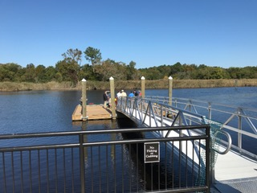
Through the Chesapeake Bay Watershed Agreement, the Chesapeake Bay Program has committed to…
Goal: Expand public access to the Bay and its tributaries through existing and new local, state and federal parks, refuges, reserves, trails and partner sites.
Outcome: By 2025, add 300 new public access sites, with a strong emphasis on providing opportunities for boating, swimming and fishing, where feasible. (2010 baseline year)
Relevant Photo

Slide 3
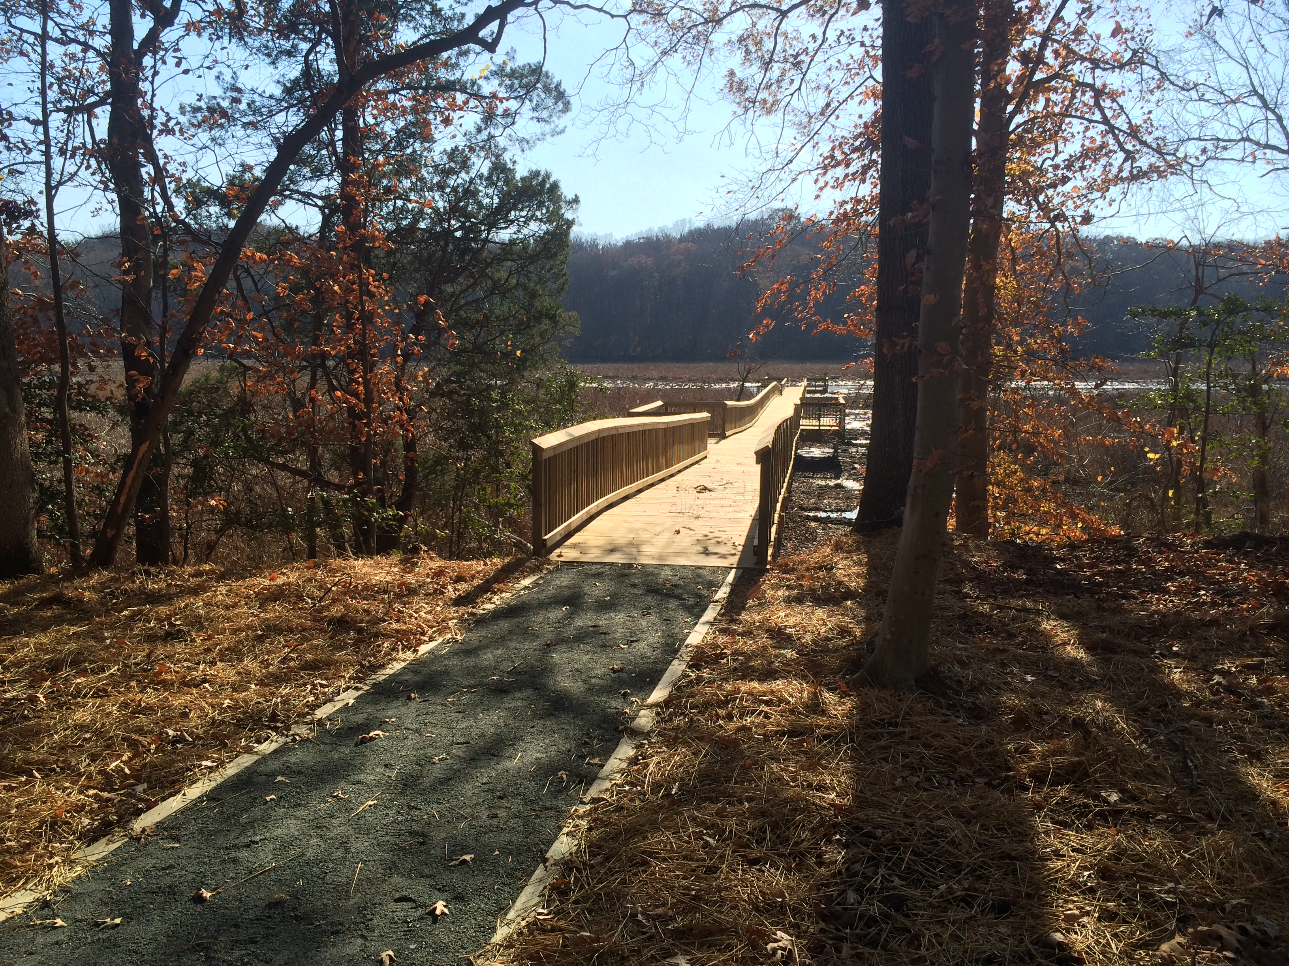
What We Want
To have the Management Board support our efforts in:
Funding for planning, development, and maintenance
Increasing not just the number but also the quality of new public access sites
Considering an additional outcome to address enhancing the diversity and number of new users

Slide 4
Factors Influencing Public Access
High quality, sustainable sites
Addressing Sea Level Rise and Climate Change Issues
Funding for development, operation, and maintenance

Slide 5
Factors Influencing Public Access
Inadequate access on existing public lands
Accessibility for a diverse watershed community, including those with disabilities
User conflicts

Slide 6
Analysis
Which actions were most critical for progress thus far? Why?
Developing partnerships
Developing quality access sites on existing, publicly owned lands

Slide 7
Analysis
Which management actions will be the most critical to your progress in the future? Why?
Development of high quality sites and appropriate management and maintenance of all sites so there is no net loss.
Funding for staff to provide technical assistance, planning, development, and management of sites
Increasing number and diversity of new users

Slide 8
Analysis
Based on this analysis, what management approaches will be carried forward?
Continue to look at enhanced access on existing sites
Continue to leverage financial assistance programs
Continue to request and support funding for agency staff
Continue to build partnerships for development of quality access sites

Slide 9
Challenges
Did any factor, gap, or management approach present a challenge?
Pre-planning to ensure projects could be built as envisioned once funded.
Did an unforeseen factor influence your ability to move forward with an approach?
Drops in agency funding at all government levels to support access programs.

Slide 10
Adaptations: How should we adapt?
4

Slide 11
Based on what we’ve learned, we plan to…
Address quality over quantity in development of new public access opportunities. Doing so could increase:
Citizen Stewardship Action
Diversity
Environmental Literacy
Increase diversity and number of users through programing with partners.
E.g. Kids in Kayaks, Canoe Mobile, Youth Conservation Corps
Enhance opportunities for environmental education

Slide 12
Based on what we’ve learned, we plan to…
Enhance public awareness of access opportunities through resources such as:
Paddle the Potomac
Find Your Chesapeake
Water Trail Networks

Slide 13
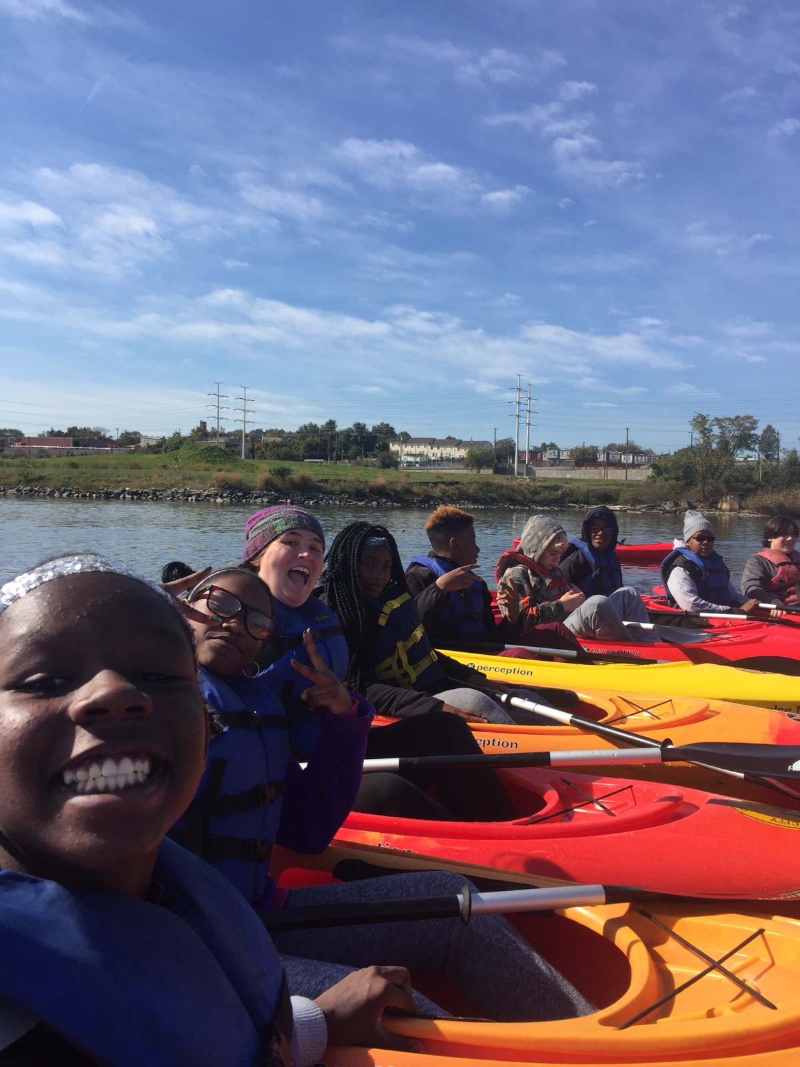
What We Want
To have the Management Board support our efforts in:
Funding for planning, development, and maintenance
Increasing not just the number but also the quality of new public access sites
Considering an additional outcome to address enhancing the diversity and number of new users

