Slide 1
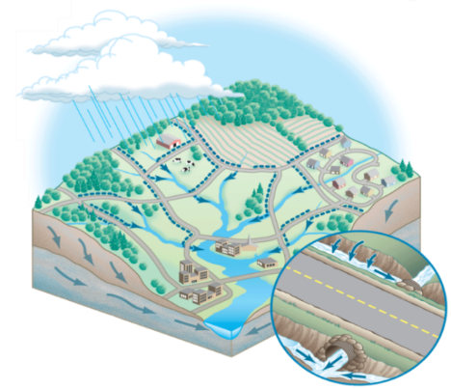
Dr. Kathy Boomer, The Nature Conservancy
Dr. Rebecca Schneider, Cornell, NY
Re-plumbing the Chesapeake Watershed: Improving roadside ditch management to meet TMDL Goals
Workshop Findings and Recommendations
October 2014

Slide 2
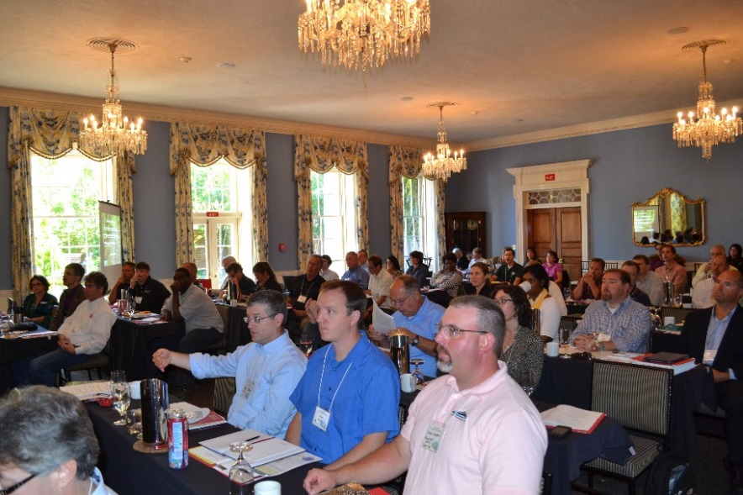
Workshop Goals
Increase awareness of the critical impacts of roadside ditches and best management practices to reduce these impacts.
2. Inventory current status of ditch management across the Chesapeake Watershed.
3. Develop recommendations for how best to improve roadside ditch management to meet TMDL goals, reduce flooding and buffer impacts of climate change.

Slide 3

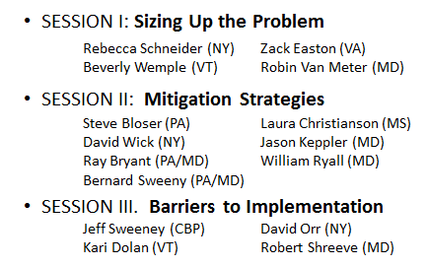

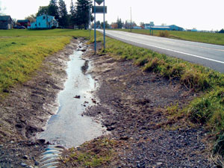
Re-plumbing the Chesapeake: Workshop Structure
Scientists
Better Roads,
Cleaner Waters
Regulators
Practitioners

Slide 4
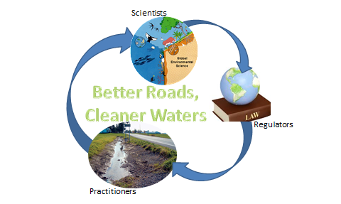
Re-plumbing the Chesapeake: Workshop Discussion
How do roadside ditch impacts & practices vary across the Bay watershed?
What is needed to improve roadside management across the Bay watershed?

Slide 5
Take-home Message
“Roadside ditches have had a significant but previously unrecognized impact on the Chesapeake Bay for almost a century. The audience of 71 water resource professionals, highway practitioners, scientists, and policy-makers unanimously agreed that roadside ditch management represents a critical but overlooked opportunity to help meet TMDL and habitat goals. Additionally, improved ditch management provides a strategy for buffering the impacts of high intensity rainfalls and other extremes expected with climate change. “

Slide 6
Roadside Ditches: Big Impacts from Micro-scaled Features
Hydrologic Impacts:
Extends stream network, doubling or more stream density (Sweeny 2014)
Intercepts more than 20% of runoff/shallow groundwater flow (Schneider et al 2014; Diaz-Robles 2007)
Increases peak flow by more than 50% (Buchanan 2012)
Buchanan et al. 2012

Slide 7
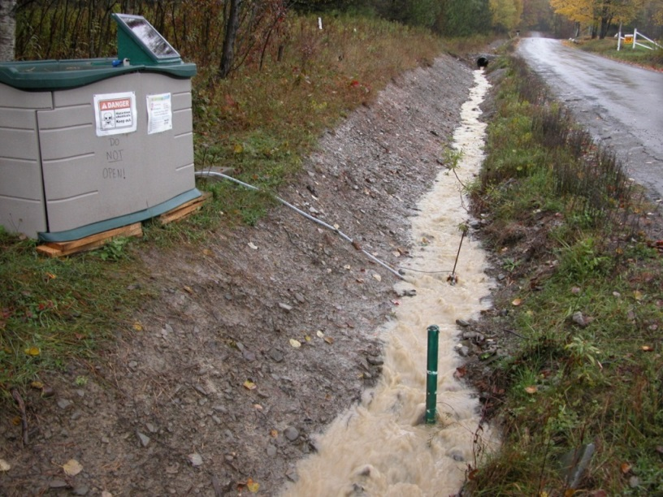
Roadside Ditches: Big Impacts from Micro-scaled Features
Water Quality Impacts:
Source and Conduit
Exposed (scraped) ditches exponentially increase TSS concentrations (Diaz-Robes 2007)
Accounts for more than 10% of observed sediment load in upper Susquehanna (SRBC)
Provides important conduit of E. coli bacteria

Slide 8
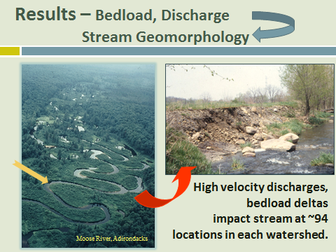
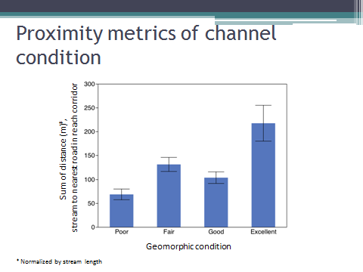
Roadside Ditches: Big Impacts from Micro-scaled Features
Habitat Impacts:
Alters environmental flow regimes
Increases bed loads causing down-stream disequilibrium (e.g., Pechenick et al 2014)
Headwaters dry out
Salinization of freshwater habitats (e.g., Kaushal et al 2005)
Credit: R. Schneider; B. Wemple

Slide 9
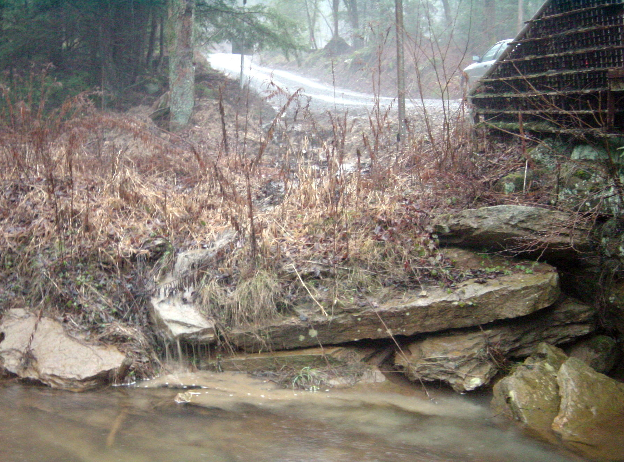
PA Dirt and Gravel Road Maintenance Program
Began in 1997 (Trout Unlimited initiative)
2,500 projects and counting
PA priority: $35 million budget
Steve Bloser, Director
Penn State University
Notes:
Flow Chart
Administered at Local Level
Here is a flow chart of how the program is administered. Note that the Program is run by your County Conservation District, at the local level.

Slide 10
Traditional Stormwater
PA Dirt and Gravel Road Program
Program Overview
Collection
Armoring
Transport
Environmentally Sensitive Maintenance
Dispersal
Sheet flow
Infiltration
“disconnect the rural storm water system”
“restore natural drainage”
Notes:
The effects of increased erosion are many, but the biggest are increased maintenance problems, as well as excess sediment and chemical runoff to the streams.

Slide 11
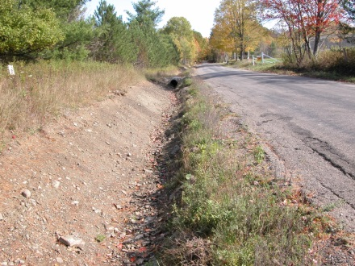
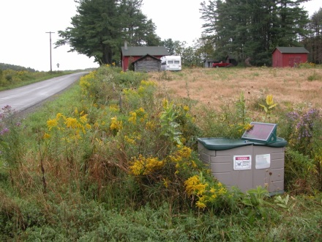
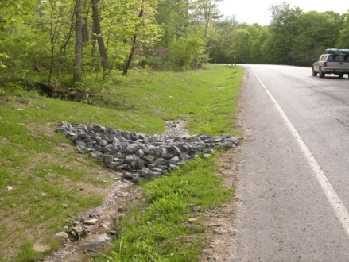
Roadside Ditches: Mitigation Strategies
Scraped -
Low Cost ($):
Scrape during late spring/early summer (facilitates vegetation re-establishment
Scrape to trapezoidal shape (decrease flow rates, facilitate maintenance)
Hydroseed
Disconnect from streams
vs.
Vegetated -
Disconnected -

Slide 12
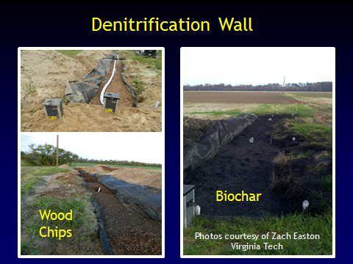
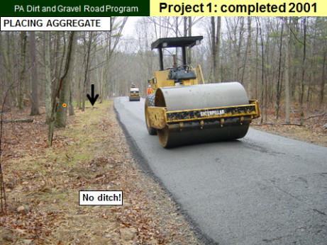
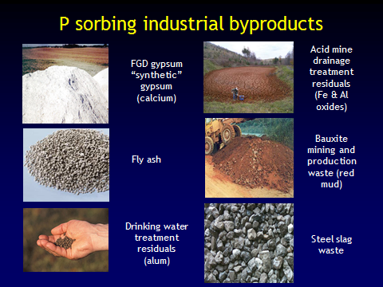
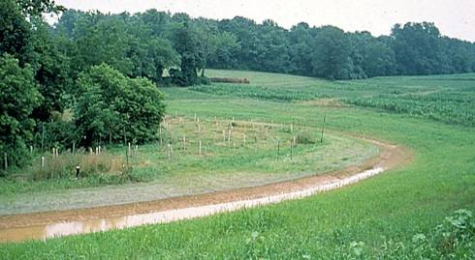
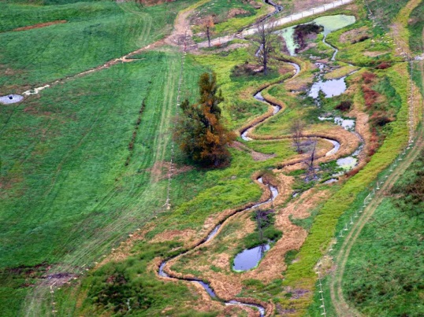
Roadside Ditches: Mitigation Strategies ($$$)
Engineered Road Design and Aggregate
Filters Mediums
Flood pocket Wetlands, Level Lip Spreaders
Credits: S. Bloser;
R. Bryant; B. Sweeny

Slide 13

Ditch Management in the CBP Watershed Model
Forest + Agricultural + Stormwater BMPs
Dirt and Gravel Road Erosion & Sediment Control
Agricultural BMPs
Drainage Water Control Structures on Eastern Shore ditch network to keep water on the landscape = irrigation
Wetland Restoration = LIDAR to detect slight elevation differences to reveal best places for floodplain restoration
Ditch Filters = Cropland drainage phosphorus-sorbing materials
Stormwater BMPs
Vegetated Open Channels
Bio-swales = dry swale with under-drain

Slide 14
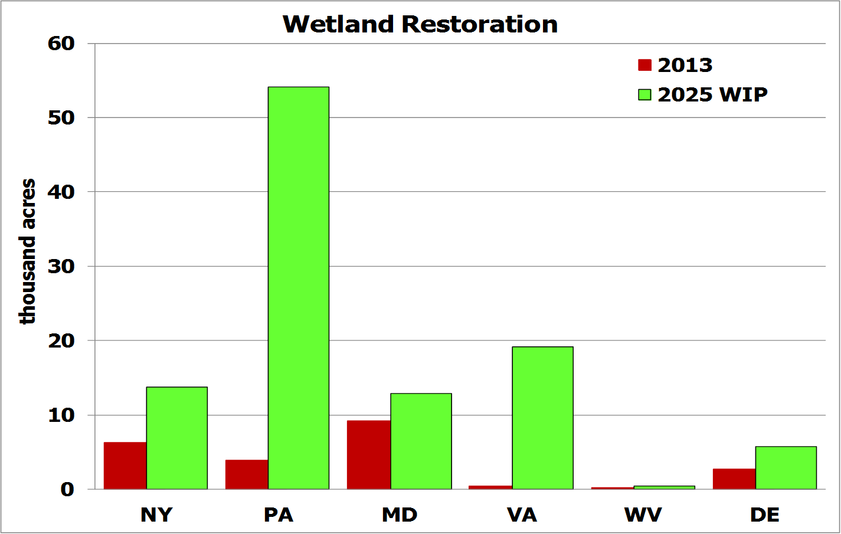
Ditch Management BMP Implementation and Targets

Slide 15
Ditch Management BMP Implementation and Targets

Slide 16
Ditch Management BMP Implementation and Targets

Slide 17
Ditch Management BMP Implementation and Targets

Slide 18
Ditch Management BMP Implementation and Targets

Slide 19
Key Findings - Management
Critical elements of successful programs
( PA Center for Dirt and Gravel Roads, Cornell Local Roads, NYS Soil and Water Conservation District, Lake Champlain Basin TMDL Program)
Mapping of roadside ditch networks and their condition;
Cooperation and cross-agency partnerships;
Education of all stakeholders;
Good leadership.

Slide 20
Recommendations
1. Develop a watershed-wide program to promote “re-plumbing” of roadside ditch networks throughout the Chesapeake Bay watershed.
Needs to be geographically comprehensive because roadside ditch networks, like streams, ignore political boundaries
- Poor practices in upstream municipalities contribute to flooding and pollution in downstream areas.
Address the diversity of government structures, highway maintenance needs, and landscape settings throughout the Bay watershed.

Slide 21
Recommendations
2. Develop a portfolio of incentives to improve roadside ditch management, including:
Education and awareness campaigns specifically tailored to different stakeholder groups;
Regulatory incentives and deterrents;
Increased access to equipment and other resources;
Funding for implementation and for targeted research.

Slide 22
Recommendations
3. Develop a broad-based education and outreach program to increase awareness and provide guidance to key stakeholder groups:
Build on successes of existing programs and Local Technical Assistance Program training centers;
Include diverse stakeholders: highway staff, policy-makers; agency staff; NGOs, and private landowners.

Slide 23
Recommendations
4. Develop comprehensive BMP implementation guidelines, that include a full, organized inventory of BMPs:
Describe when and where a given BMP is appropriate;
Estimate BMP performance and cost-effectiveness;
Explicitly link BMP guidance to TMDL regulatory framework;
Develop a central website to distribute information.

Slide 24
Recommendations
5. Create a Roadside Ditch Management Executive Team, with representatives from relevant agencies from federal to town levels, along with other stakeholders including scientists and NPOs.
Avoid redundancy or conflicting requirements among agencies and develop recommendations that work across political boundaries.
Within CBP, develop ditch management recommendations collaboratively with CBP Urban Stormwater, Watershed Technical, and Agriculture Workgroups.

Slide 25
Recommendations
6. Support funding for roadside ditch improvement and maintenance practices.
Highway staff unanimously report limited manpower, time, and equipment.
Funding available for green infrastructure, storm water management, and conservation but very limited capacity for grant writing and applications.

Slide 26
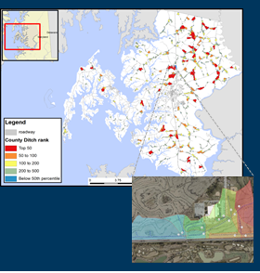
Recommendations
7. Prioritize applied research that addresses key knowledge gaps limiting the reliability of decision tools and guidelines:
Effectiveness of BMPs in different hydro-physiographic settings and climate conditions;
Chemical contaminant transformations in ditches;
Impacts of altered hydrology on downstream aquatic ecosystems;
Other Contaminants of Concern?

Slide 27
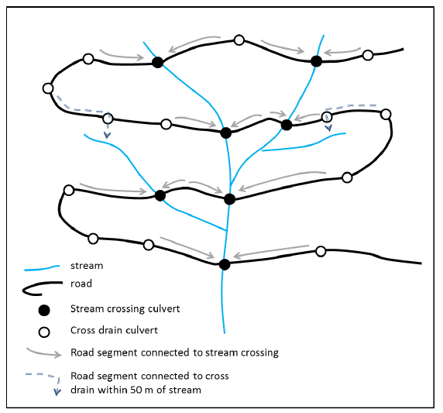
Recommendations
8. Link science and management efforts, specifically research models to the development of targeting tools or guidelines and promote monitoring to evaluate success..
For example: Consider whether current land use inventories and the CBP hydrologic modeling framework adequately capture impacts from roadside ditch networks.

Slide 28
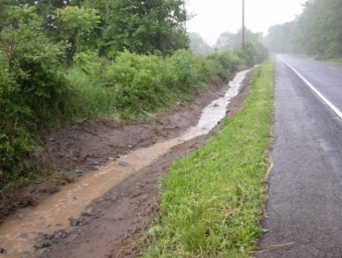
Questions?

