Slide 1
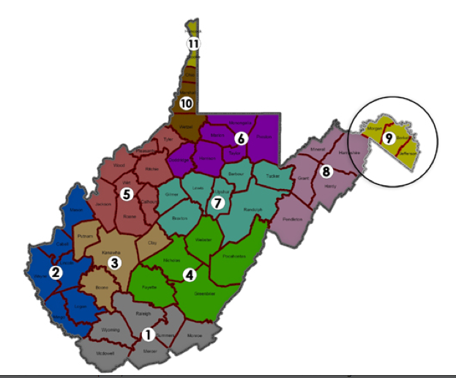


Slide 2
Median Household Income
Morgan County = $ 46,346
Berkeley County = $ 59,480
Jefferson County = $72,526
Frederick County, MD = $88,502
Loudoun County, VA = $129,588
*2017 ACS Census.gov

Slide 3
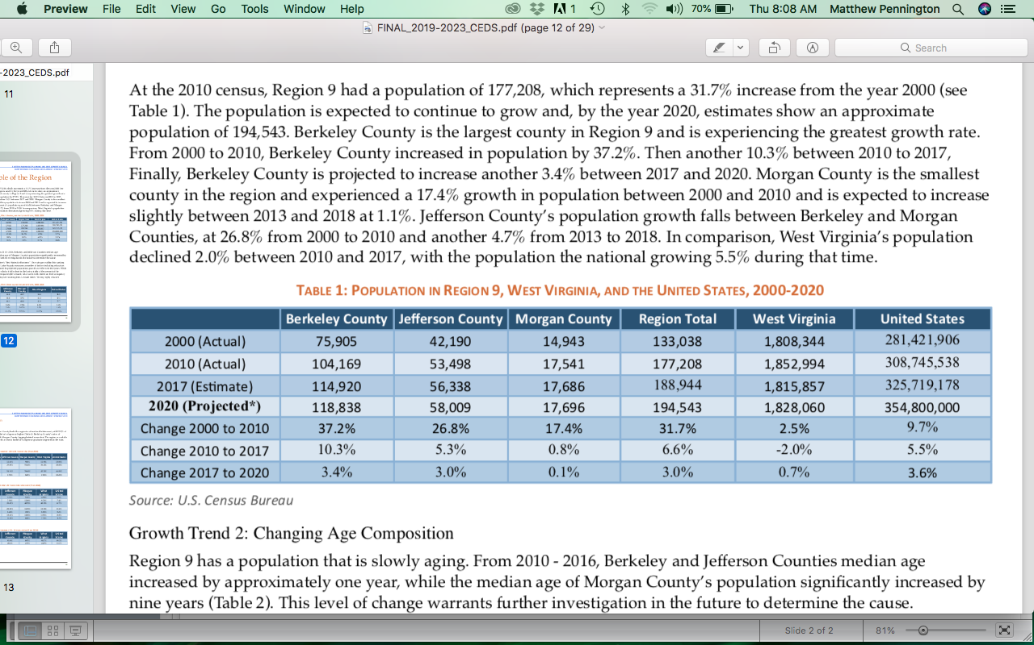

Slide 4
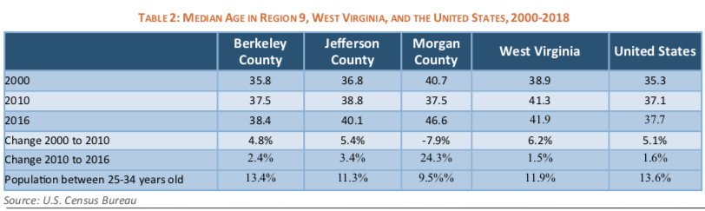

Slide 5
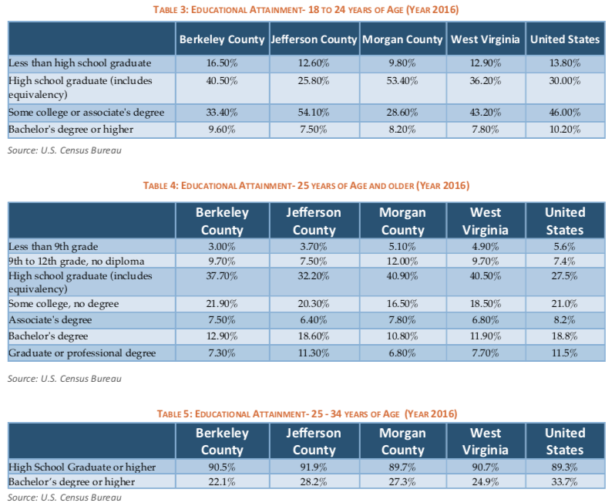

Slide 6
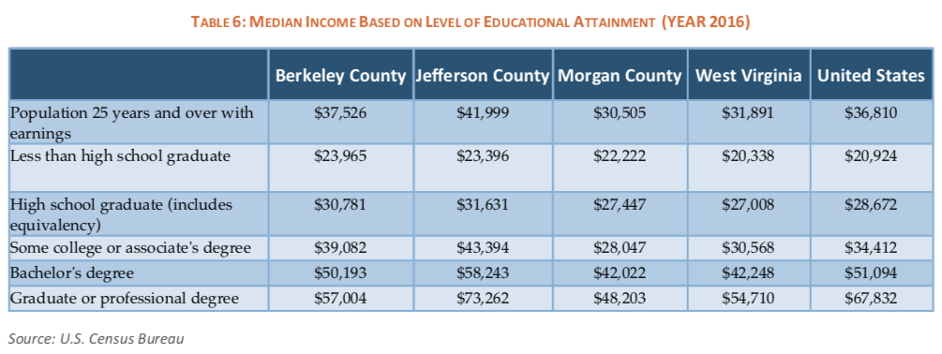

Slide 7
Pollution Challenges
Managing Growth
Air Quality
Water Quality

Slide 8
Air Quality Index
Number of Days
Good
Moderate

Slide 9
Pollution Challenges
Managing Flooding
Roadside Litter
Economic Impact of Pollution Taxes
MS4 Stormwater Fees ( $ 42 Year)
Sanitary Sewer Bills and Increases

Slide 10
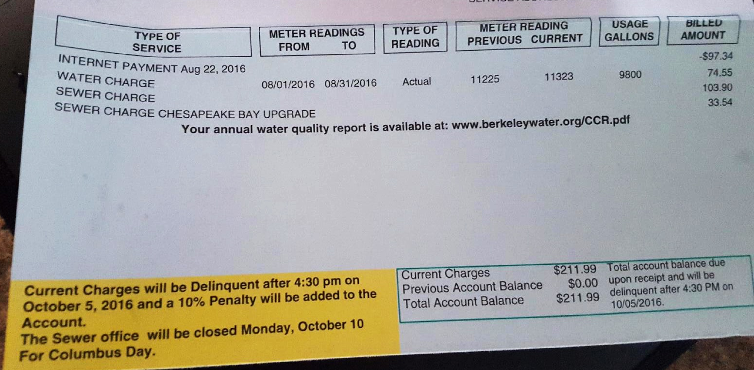
Economic Impact of Pollution Taxes

