Slide 1
CBP Partnership’s BMP Verification Review Panel’s Findings and Recommendations to Date
CBP Citizens Advisory Committee
December 6, 2013 Meeting
Rich Batiuk, Chair
CBP Partnership’s BMP Verification Committee

Slide 2
Verification Definition
The CBP Partnership has defined verification¹ as:
“the process through which agency partners ensure practices, treatments, and technologies resulting in reductions of nitrogen, phosphorus, and/or sediment pollutant loads are implemented and operating correctly.”
1. CBP BMP Verification Principles. December 5, 2012.

Slide 3
Status Quo Unacceptable
“It is our understanding that this current verification process looks to fundamentally change, for the better, the way in which the CBP verifies the implementation of practices designed to reduce nutrient and sediment pollution.”

Slide 4
Verification Tools Provided
The following have been provided by the Panel to the six workgroups, BMP Verification Committee, and seven jurisdictions:
BMP Verification Program Design Matrix
Jurisdictional BMP Verification Program Development Decision Steps for Implementation
State Verification Protocol Components Checklist
Panel’s Comments on Workgroup’s Protocols

Slide 5
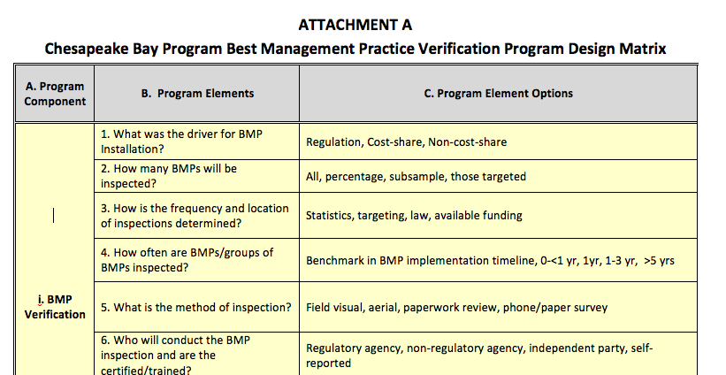
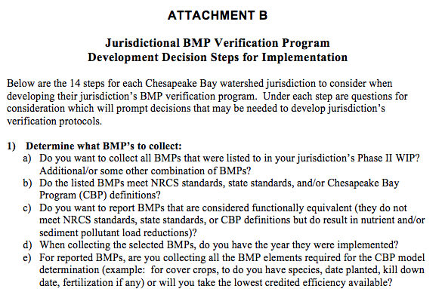
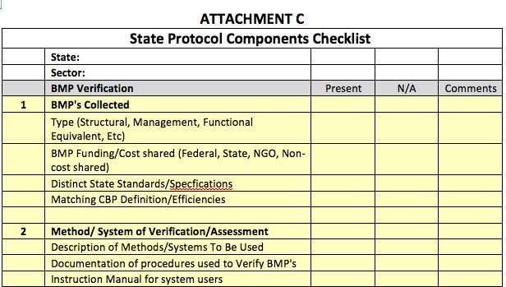
Verification Tools

Slide 6
23 PAGES OF RECOMMENDATIONS, GUIDANCE, AND FEEDBACK!

Slide 7
Need for Transparency
“Of particular interest to us is the need for guidance delineating what is and is not
sufficient transparency as required in the “Public Confidence” principle.
Absent a significant level of heightened transparency in the verification process itself and the underlying data to support any
conclusions; we will not meet the public confidence standard envisioned in the principle.”

Slide 8
Need for Transparency
Panel recommended the Partnership be transparent about addressing transparency
Supports strengthened addendum to existing public confidence verification principle
Recommends independent verification/validation for aggregated data to ensure transparency is maintained
Supports commitment to make reported BMP data publically accessible while conforming to legal privacy restrictions

Slide 9
Need for Transparency
The Panel recommends the following changes in the word choices for the final version of the transparency addendum to the BMP verification principles:
“The measure of transparency will be applied to three primary areas of verification: data collection, data validation synthesis and data reporting.”
“Transparency of the process of data collection must incorporate clearly defined independent QA/QC procedures, which may be implemented by the data-collecting agency or by an independent external third party.”
“Transparency of the data reported should be transparent at the most site-specific finest possible scale that conforms with legal and programmatic constraints, and at a scale compatible with data input for the Chesapeake Bay Program partnership modeling tools.”

Slide 10
Need for Transparency
Panel recommendation:
“All practice and treatment data reported for crediting of nutrient and sediment pollutant load reductions and used in some form by the Chesapeake Bay Program Partnership in accounting for implementation progress should be made publically accessible through the Partnership’s Chesapeake Stat website. Conforming with legal and programmatic constraints, the reported practice and treatment data should be publically available to at the most site-specific scales, in order of preference: site-level, followed by subwatershed, municipality, county, and then state.”

Slide 11
Address Life Spans
“The new protocols must solve the problem of accounting for expired practices. How to remedy the existing situation where reductions from a BMP are included in the model after a contract period (for federal/ state payment for implementation) has expired.”

Slide 12
Address Double Counting
“The new protocols must solve the problem of double counting of existing practices.”

Slide 13
Ag Workgroup: Can’t Understand!
“The verification concept under discussion by the Agriculture Workgroup involves a
complex and not-yet transparent approach relating to “certainty”; the process for selecting any numerical certainty level must be transparent, clearly defined, and based on technically defensible information.”

Slide 14
No Excuses
“The ongoing complaint from the states that there is insufficient funding to implement new, more robust verification protocols should not be an excuse for lack of verification.”

Slide 15

Nitrogen Relative Load Reductions
Virginia
For wastewater, the contribution to the total load reduction compares current discharges (2011) to WIP discharges
while BMPs outside
wastewater compare
No-Action to WIPs.
17

Slide 16
Management Plan Verification
“CAC supports the decision to create a workgroup to "dive deeply" into making recommendations for verification protocols for nutrient management plans to ensure transparency of on-farm application of fertilizer, manure and bio-solids.”

Slide 17
Aggregate Data Review
“Protocols should require review of any aggregate information by a third party as well as a comparison between the aggregated information and real world modeling data (to analyze water quality implications).”

Slide 18
Aggregate Data Review
The Panel has recommended that aggregated data can be used, be considered validated, be provided to the public, and still be considered consistent with the Partnership’s transparency principle if there is independent verification/validation of the underlying data.

Slide 19
BMP Verification Life Cycle
BMP no longer present/functional, removed from database
OR
BMP
installed,
verified, and reported through state NEIEN node
Functional equivalent spot check
Verification
BMP verified/
upgraded
with new technology
Spot check
BMP gains efficiency
BMP lifespan ends – re-verify
BMP Performance
Data Validation
Independent data validation
BMP nears end of life span
BMP fully functional
BMP performance metrics collected
BMP performance metrics collected

Slide 20
Illustration of Diversity of Verification Approaches Tailored to Reflect Practices
Sector | Inspected | Frequency | Timing | Method | Inspector | Data Recorded | Scale
Stormwater | All | Statistics | <1 year | Monitoring | Independent | Water quality data | Site
 | Percentage | Targeting | 1-3 yrs | Visual | Regulator | Meets Specs | Subwatershed
 | Subsample | Law | 3-5 yrs | Aerial | Non-Regulator | Visual functioning | County
 | Targeted | Funding | >5 yrs | Phone Survey | Self | Location | State
Agriculture | All | Statistics | <1 year | Monitoring | Independent | Water quality data | Site
 | Percentage | Targeting | 1-3 yrs | Visual | Regulator | Meets Specs | Subwatershed
 | Subsample | Law | 3-5 yrs | Aerial | Non-Regulator | Visual functioning | County
 | Targeted | Funding | >5 yrs | Phone Survey | Self | Location | State
Forestry | All | Statistics | <1 year | Monitoring | Independent | Water quality data | Site
 | Percentage | Targeting | 1-3 yrs | Visual | Regulator | Meets Specs | Subwatershed
 | Subsample | Law | 3-5 yrs | Aerial | Non-Regulator | Visual functioning | County
 | Targeted | Funding | >5 yrs | Phone Survey | Self | Location | State

Slide 21
Progress Since Last Spring
March 13 BMP Verif. Committee review of all 8 framework components; not ready for prime time
July 1 workgroups deliver draft verif. protocols
July 15 delivery of draft verif. framework document
Aug 28-29 Panel meeting
Sept-Oct Panel works on suite of tools, recommendations
Oct 31, Nov 1 Panel conf calls to reach agreement
Nov 19 distribution of Panel recommendations

Slide 22
Completing the Framework
Dec 10 BMP Verif. Committee meeting focused on briefing on Panel findings and recommendations
Dec 13 Workgroup chairs, coordinators briefed on Panel findings and recommendations via conf call
Feb 3 delivery of six workgroups’ final verification guidance to Panel, Committee members
March 3 Panel and Committee members complete their review of workgroups’ revised verif. guidance
March/April Joint Panel/Committee meeting to finalize the basinwide BMP verification framework and all its components

Slide 23
Framework Review Process
April-August 2014
CBP Water Quality Goal Implementation Team
CBP Habitat Goal Implementation Team
CBP Fisheries Goal Implementation Team
CBP Scientific and Technical Advisory Committee
CBP Citizen Advisory Committee
CBP Local Government Advisory Committee
CBP Management Board

Slide 24
Framework/Programs Approval
Framework Approval
Sept/Oct 2014: Principals’ Staff Committee
Review of Jurisdictions’ Proposed Verification Programs
Fall 2014/Winter 2015: Jurisdictions complete program development
Spring/Summer 2015: Panel reviews jurisdictional programs, feedback loop with jurisdictions
Approval of Jurisdictions’ Proposed Verification Programs
Fall/Winter 2015: Panel recommendations to PSC for final approval

Slide 25
Rich Batiuk
Associate Director for Science
U.S. Environmental Protection Agency
Chesapeake Bay Program Office 410 Severn Avenue Annapolis, MD 21403
410-267-5731 (office)
443-223-7823 (cell)
batiuk.richard@epa.gov
www.chesapeakebay.net

