Slide 1
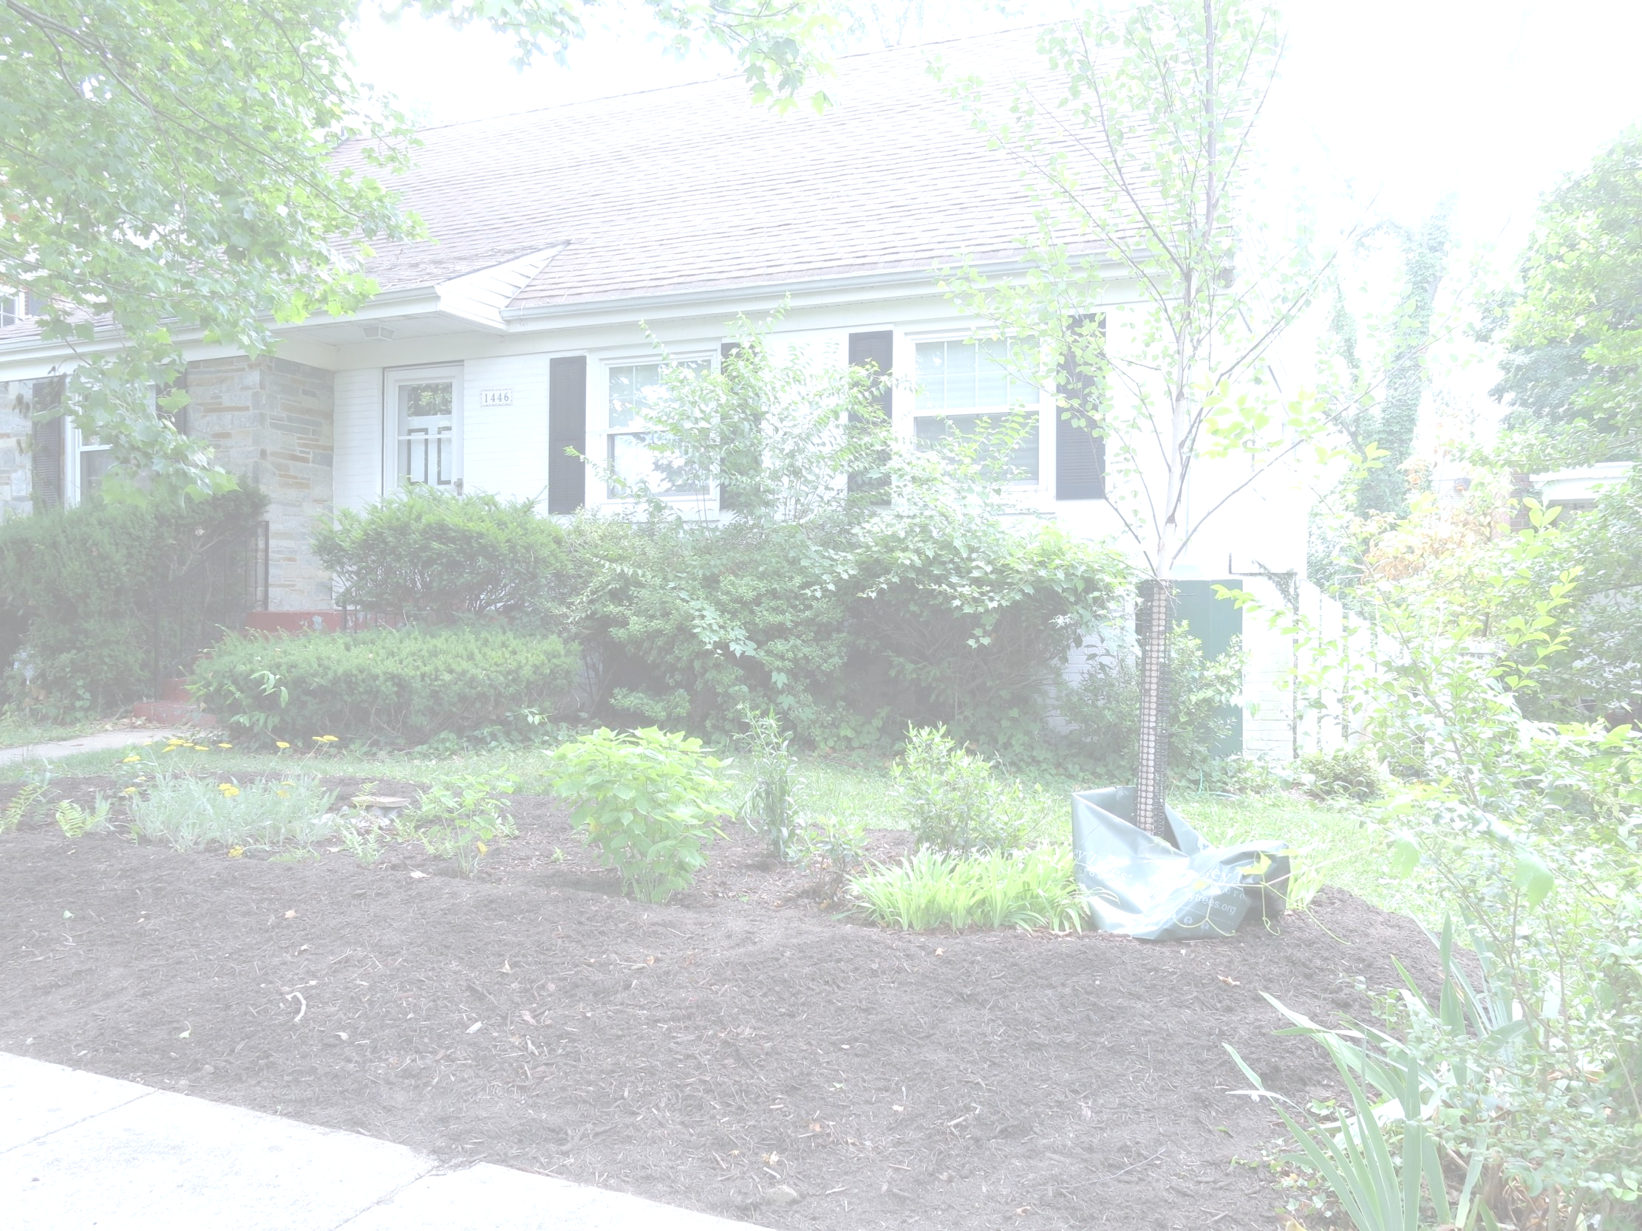


RIVERSMART HOMES STEWARDSHIP OVERVIEW
Kevin Newman
District Department of Energy & Environment
Notes:
Kevin provide opening > Arielle, Kevin, Jamie, Amanda all introduce themselves

Slide 2
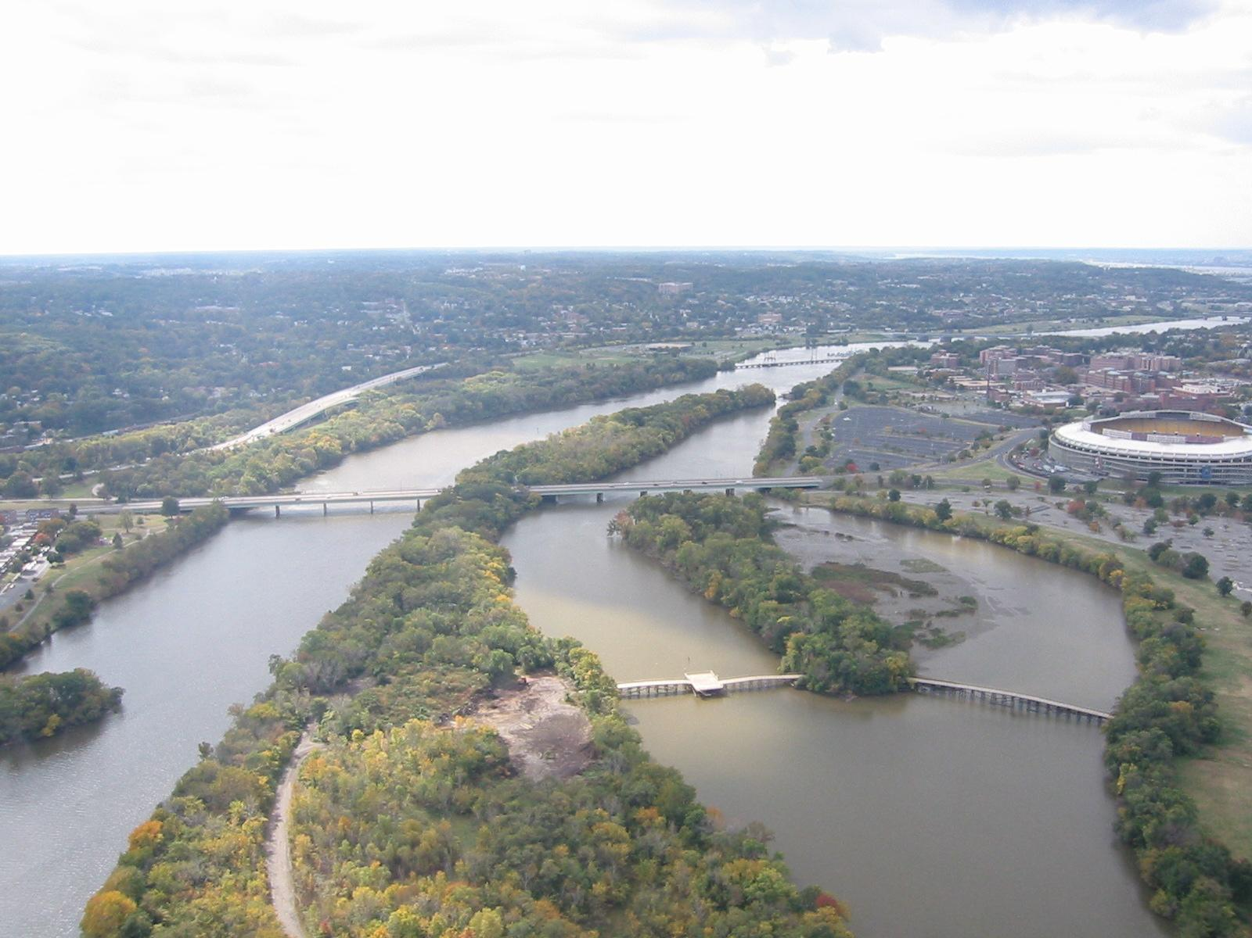

RIVERSMART HOMES PROGRAM GOALS
Reduce volume of stormwater runoff
Prevent erosion
Recharge groundwater
Increase habitat diversity
Promote conservation
@DOEE_DC
Notes:
Queen

Slide 3
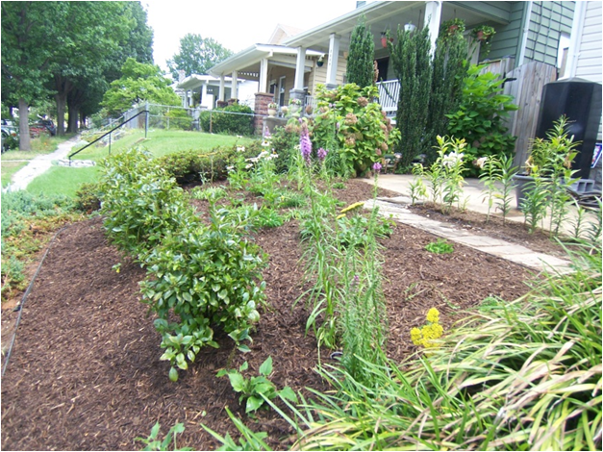
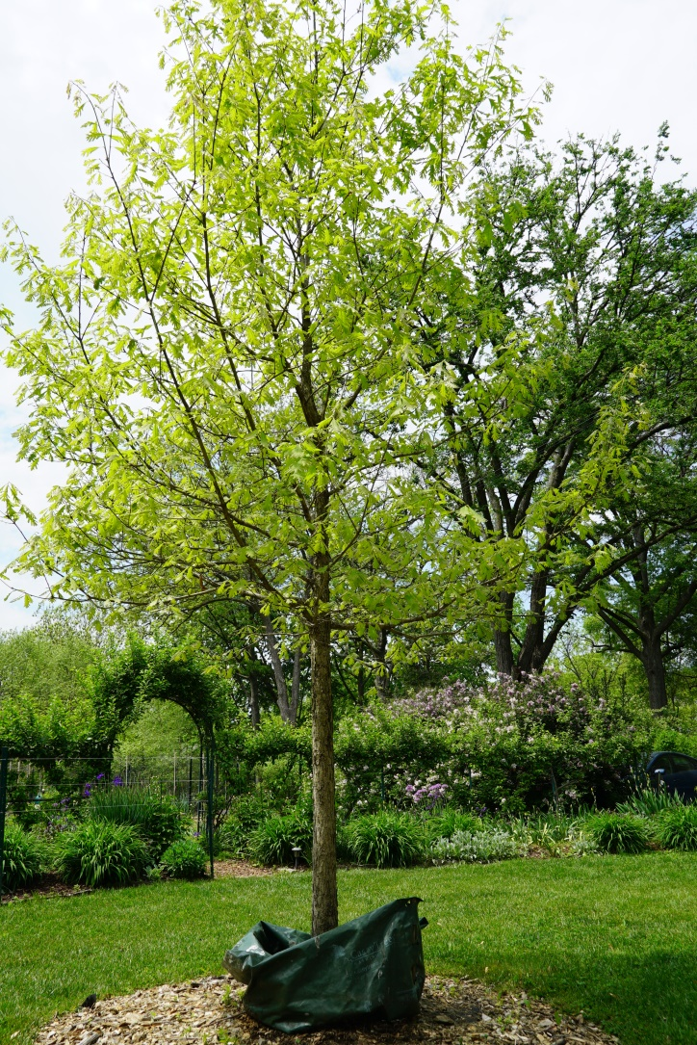
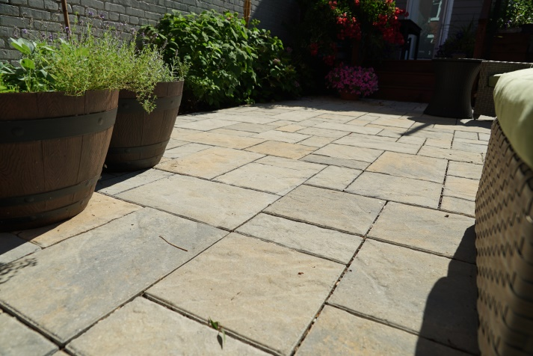
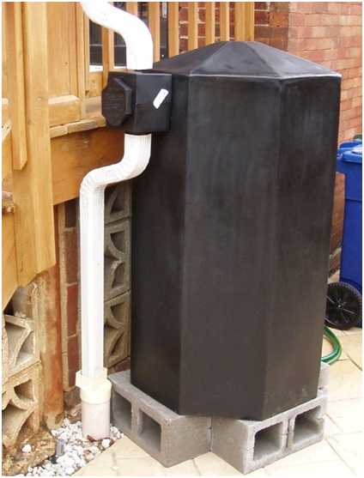
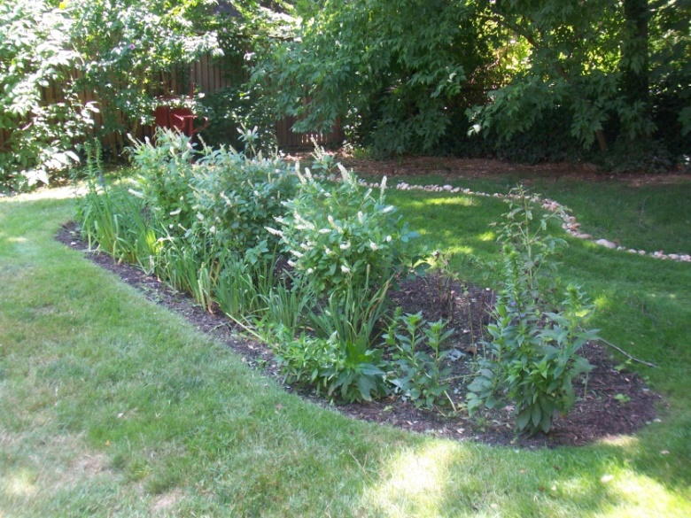

RIVERSMART HOMES BMPS
BAYSCAPING
PERMEABLE PAVERS
SHADE TREES
RAIN GARDENS
RAIN BARRELS
@DOEE_DC
Notes:
Queen

Slide 4
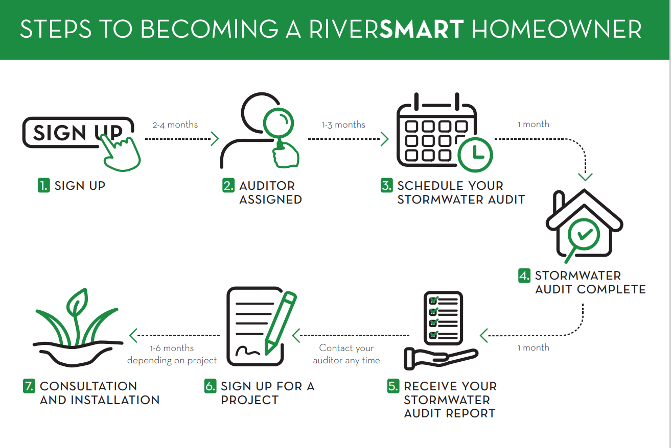
Notes:
Queen

Slide 5
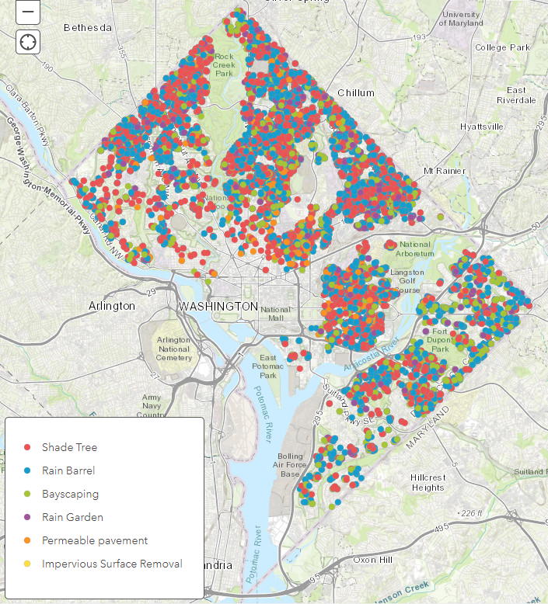
PROGRAM OUTPUTS
PARTICIPATION:
13,800 applications
10,000 audits conducted
INSTALLATIONS:
6,000 Rain barrels
9,000 Shade trees
4,000 BayScapes
2,000 Rain gardens
500 Permeable paver projects
150 Re-vegetated surfaces
@DOEE_DC
Notes:
Jamie

Slide 6
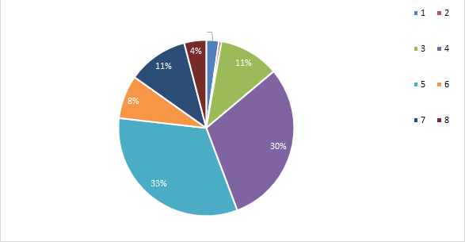
PERCENTAGE OF BMP SIGN-UPS PER WARD 2019-PRESENT
Ward 8
Ward 7
@DOEE_DC
@DOEE_DC
Notes:
Elaine

Slide 7
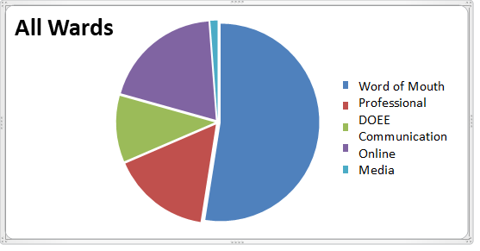
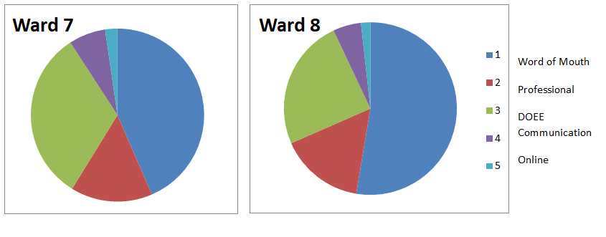
HOW RESIDENTS FIND OUT ABOUT RIVERSMART HOMES
@DOEE_DC
@DOEE_DC
Notes:
Elaine

Slide 8
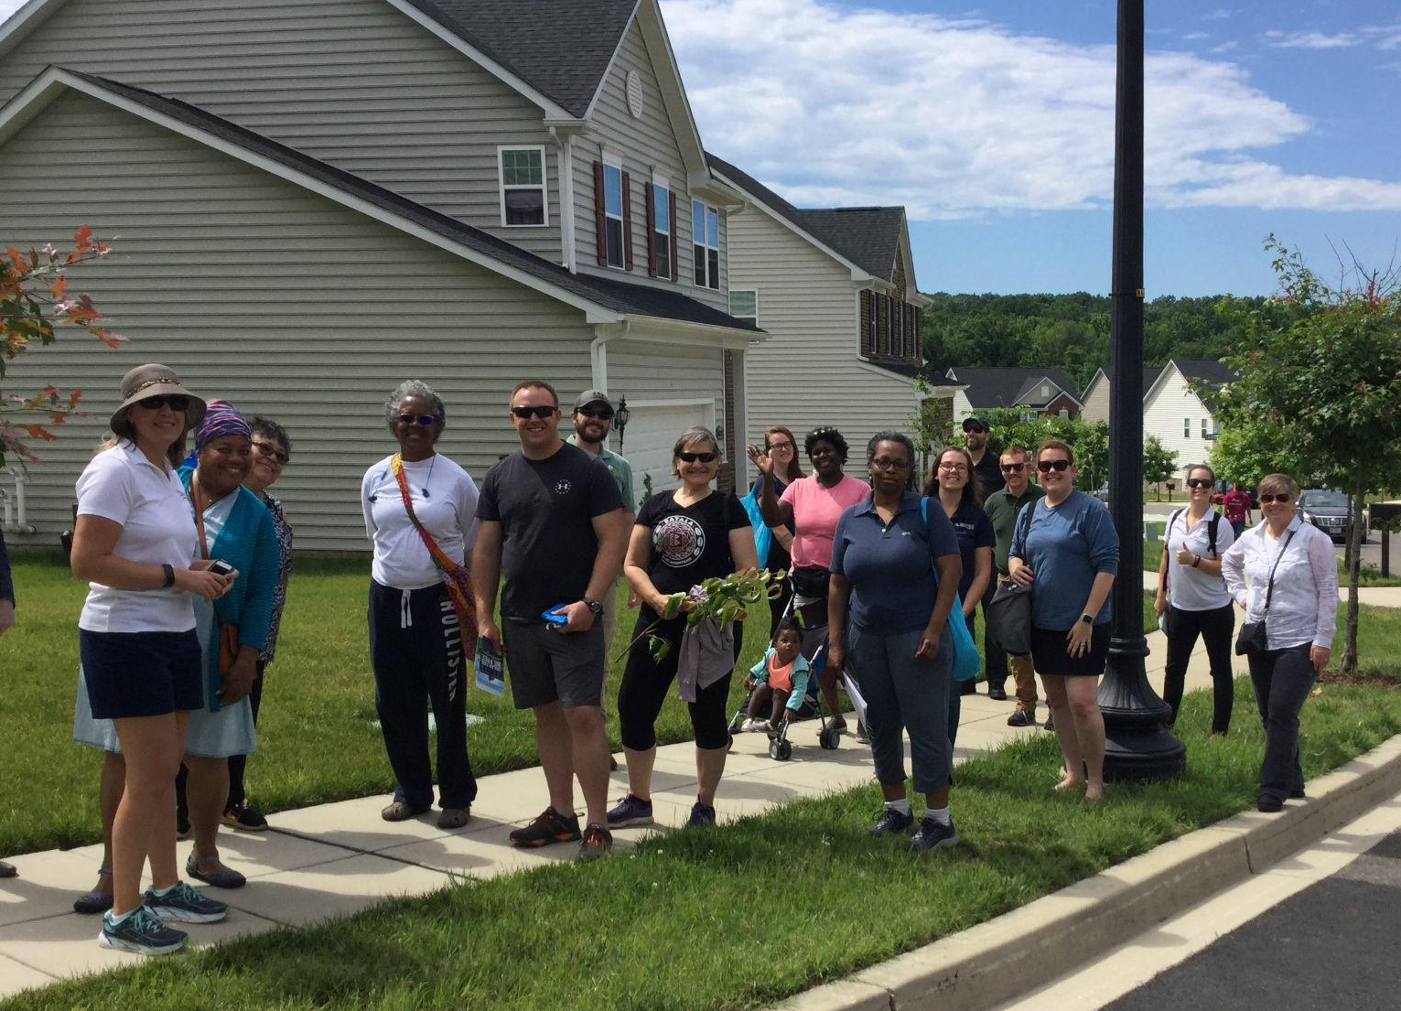
NSPIREGREEN REPORT
Nspiregreen conducted a study over six months to find out why residents in our underserved communities were not participating as much as others.
This study consisted of:
Meeting with residents
Multiple focus groups
Conducting demonstration tours
Attending local ANC meetings
@DOEE_DC
@DOEE_DC
Notes:
Kevin

Slide 9
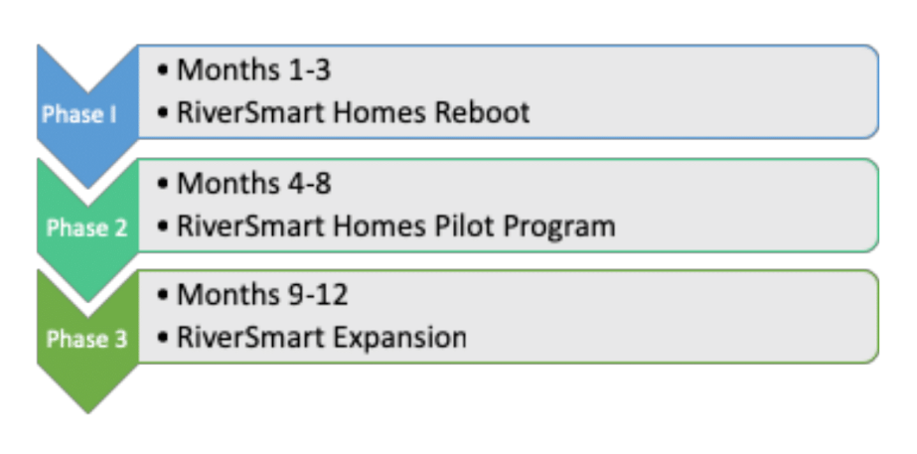
NSPIREGREEN RECOMMENDATIONS
Understand that “one size does not fit all”
Meet homeowners where they are
Recruit homeowners as ambassadors for the program
Clear up the message of RiverSmart Homes
Stay present in the community when we’re done
Reboot the program, pilot, and expand
@DOEE_DC
@DOEE_DC
Notes:
Kevin

Slide 10
GOALS OF THE AMBASSADOR PROGRAM
Stormwater Education
Educate more homeowners residents about stormwater pollution and what they can do to help keep our waterways clean.
Increase participation
Specifically in overburdened communities of the District (historically Wards 7 & 8 as well as segments of Ward 5). This includes participation in receiving stormwater audits and Best Management Practice (BMP) installations.
Community Liaison
RiverSmart Ambassadors will help us better meet the needs of those we serve by strengthening the line of communication from the community to the RiverSmart Homes program.
Notes:
Kevin

Slide 11
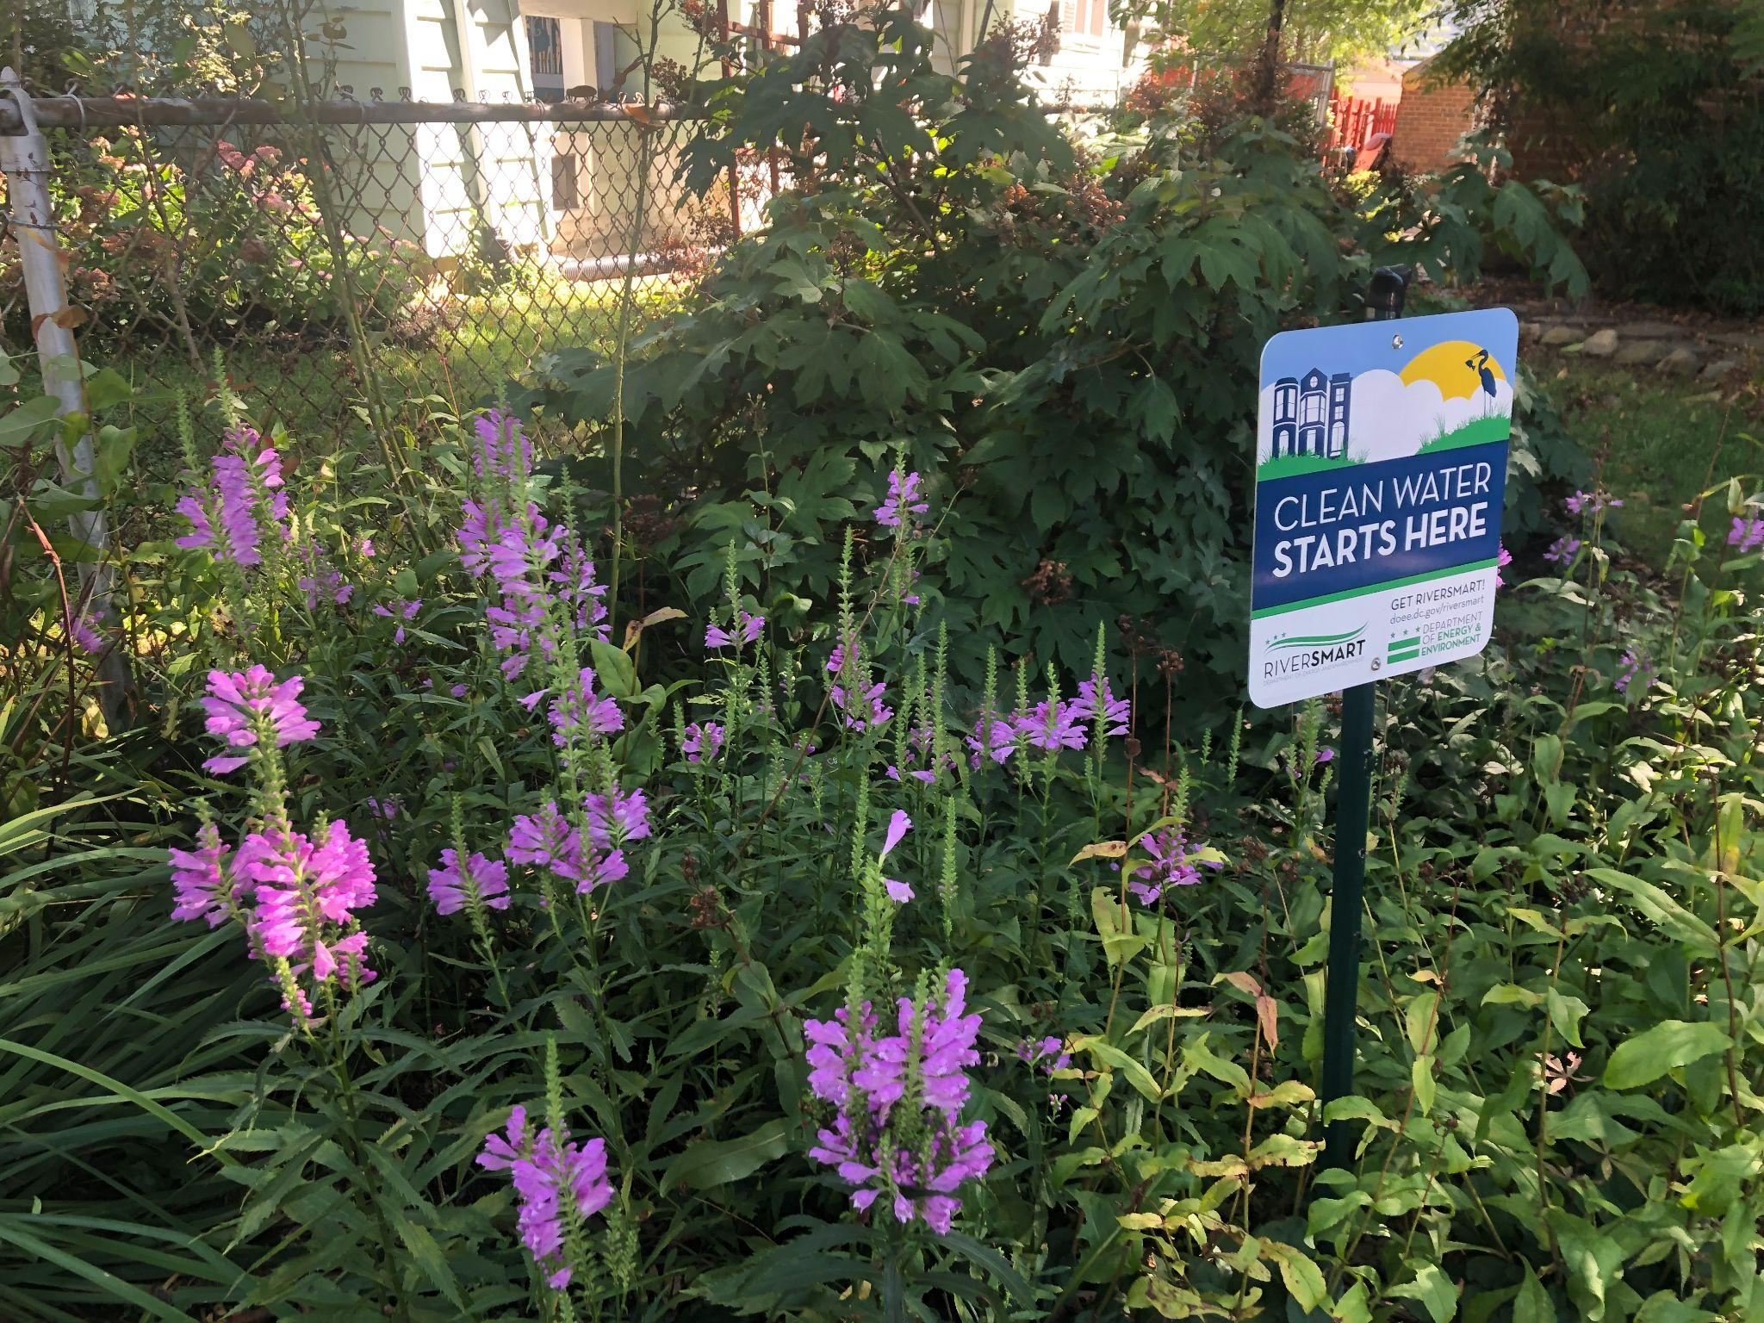
RESOURCES AVAILABLE TO AMBASSADORS
Stormwater education resources
Information on the RiverSmart Homes program
Resources to distribute to interested community members
Support from RiverSmart Homes staff
Notes:
Kevin

Slide 12
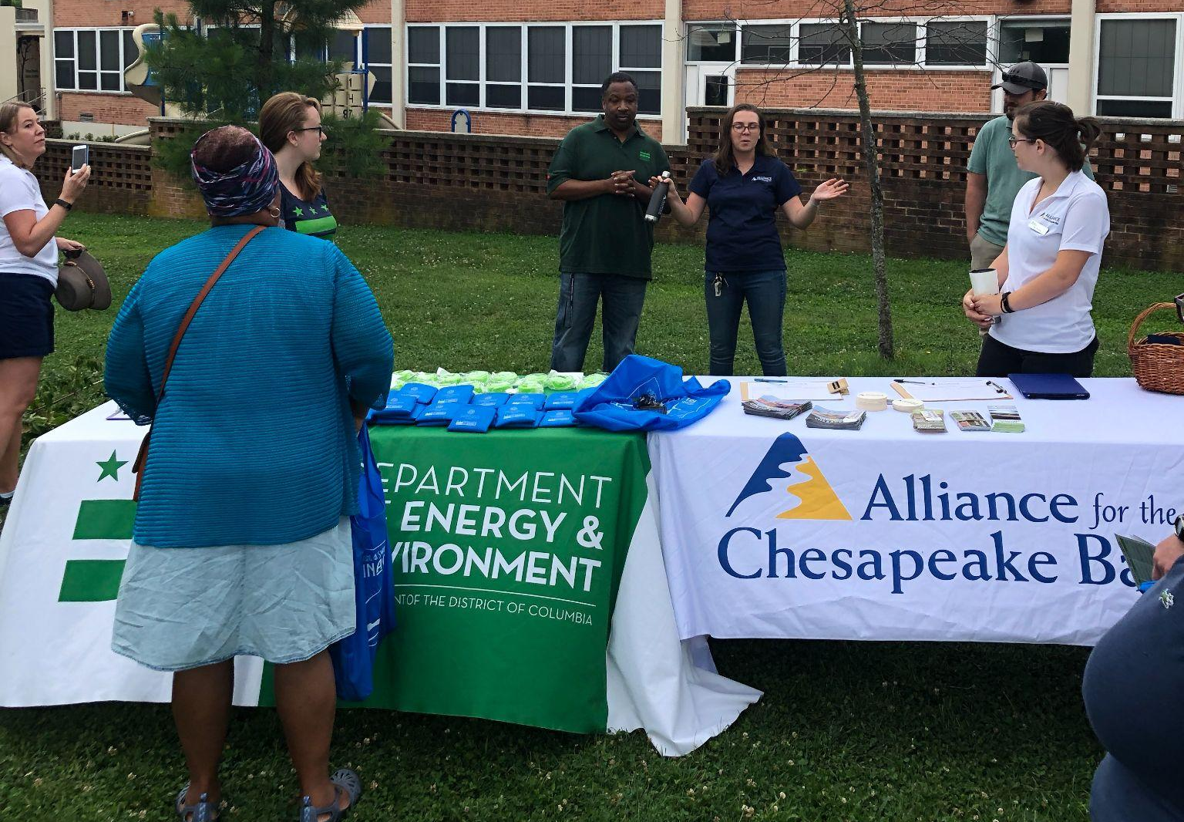
AMBASSADOR EXPECTATIONS
Complete Ambassador application and agreement
Attend training (March 30,2022)
Prepared to assume the role of Ambassador including general knowledge of stormwater and RiverSmart Homes processes
Engage with the community
Attend scheduled Ambassador virtual meetings (typically quarterly) to provide feedback
Work with Ambassador Program Coordinator to participate in at least 2 of the following
events/activities per 6 month service period:
Tabling/outreach events
Share information through community events, which may include outreach to ANCs
Flyer/canvass at least 50 homes with DOEE staff
Track and report outreach activities
Notes:
Kevin

Slide 13
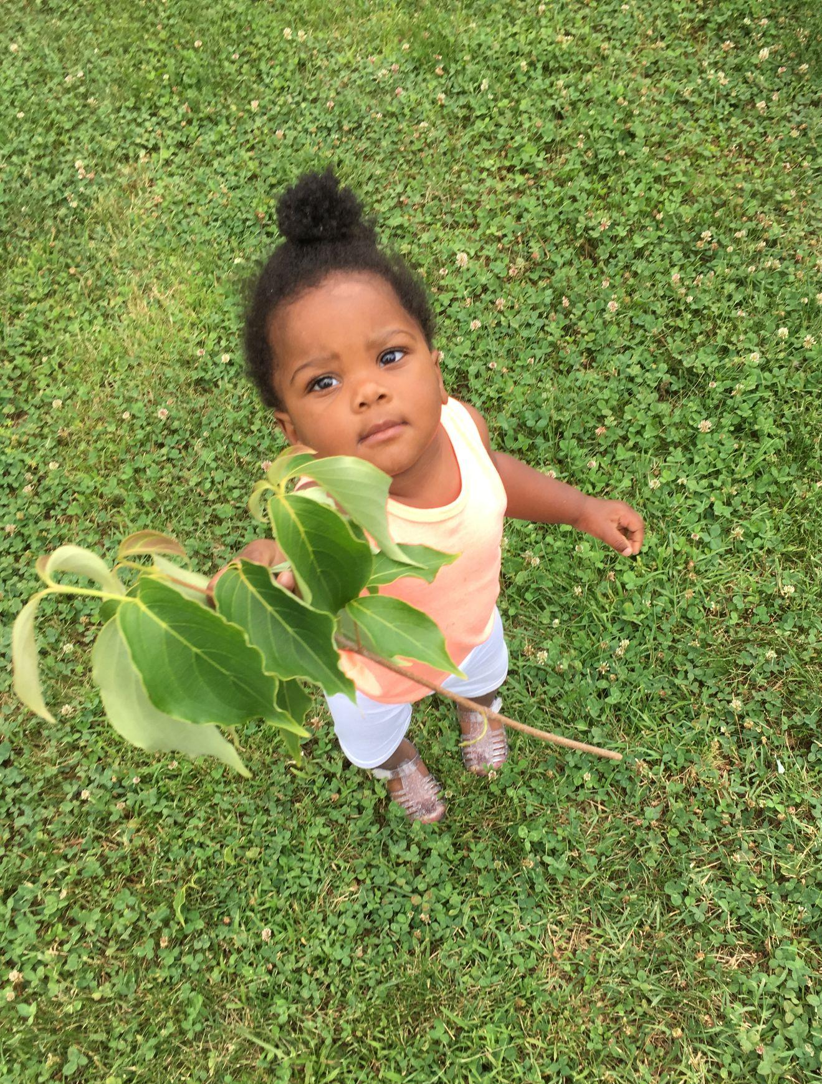
AMBASSADOR INCENTIVES*
Stipend at $250/6 months of service (minimum service requirements apply)
Annual maintenance service provided for installed RiverSmart practices
Swag items, including apparel
*Subject to change based on resources available and community needs
Notes:
Amanda

Slide 14
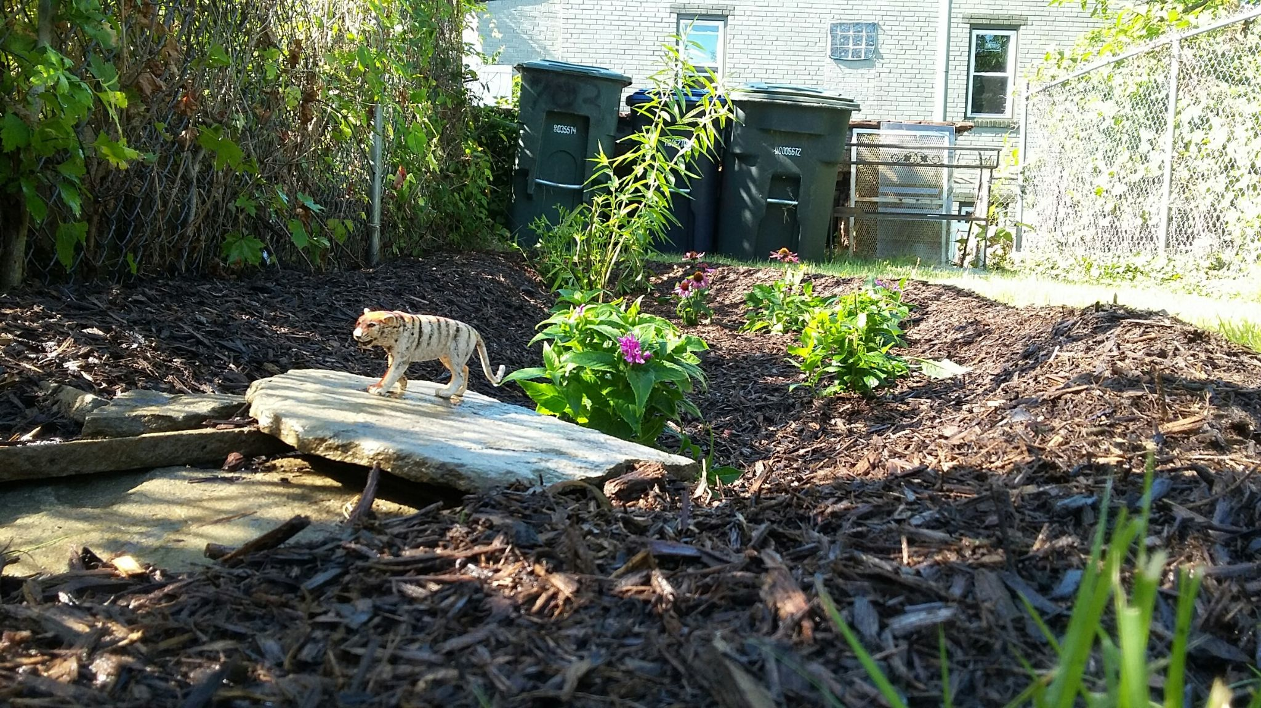
Q & A
Notes:
Kevin - mentions that we will go through the chat questions first. We will then open up for anyone to utilize the “raise hand” feature to come off mute and ask a question.
Poll question #3 - After learning more about the RiverSmart Homes Ambassador Program, would you be interested in becoming an Ambassador?

Slide 15

THANK YOU FOR LISTENING!!!
For RiverSmart Homes questions, contact:
Kevin Newman
kevin.newman@dc.gov
Phone: (202) 573-4769
www.riversmarthomes.org
@DOEE_DC
Notes:
Amanda

