Slide 1
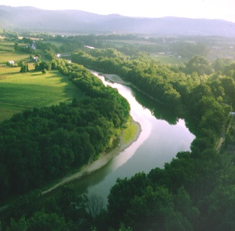
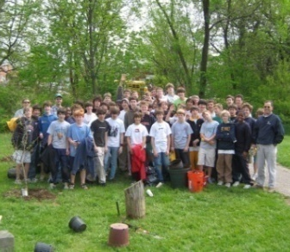
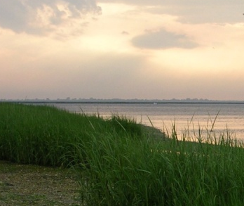
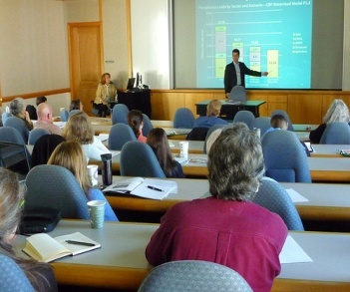
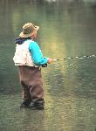
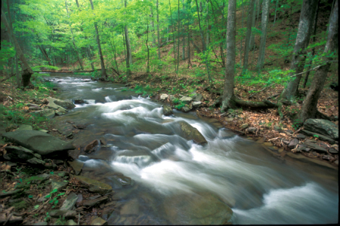
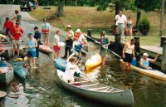

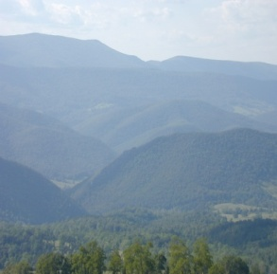
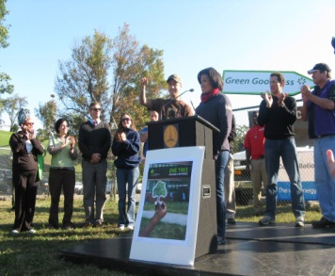
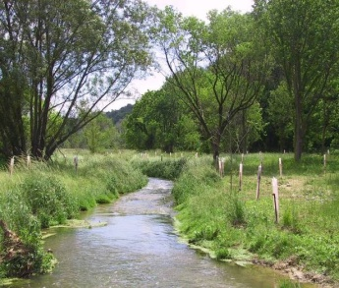
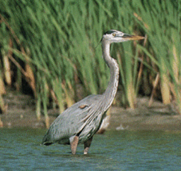
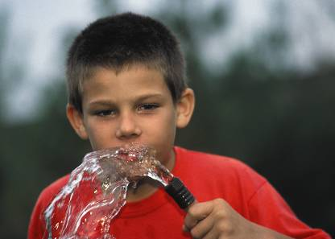

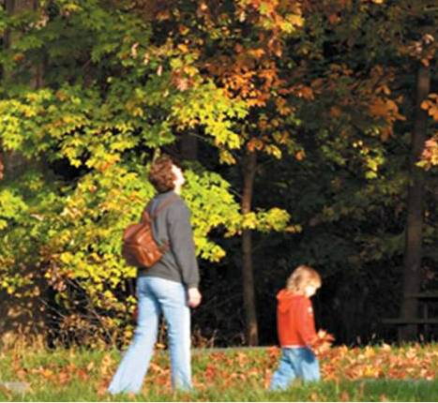
RiverTrends:
Volunteer Water Quality Monitoring
Anna Mathis, VA Program Coordinator

Slide 2
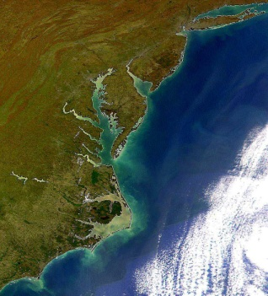
Our mission is…
... to restore the watershed of the Chesapeake Bay by bringing together the energy, passion and capabilities of people and organizations who are committed to making a difference.

Slide 3
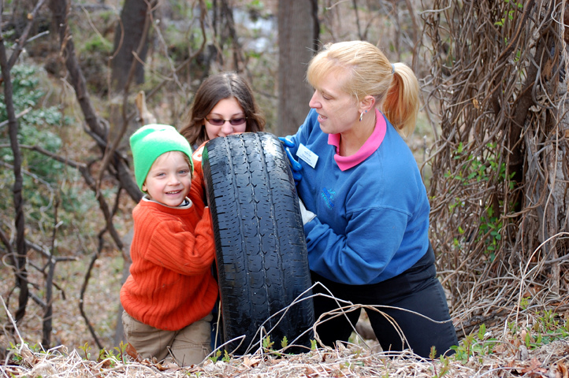
Connecting people to the Bay and its rivers
The Chesapeake Watershed Network
Project Clean Stream
RiverTrends citizen scientists
www.chesapeakebay.net
Notes:
3 program areas:
Healing the land
Connecting people
Engaging local communities

Slide 4
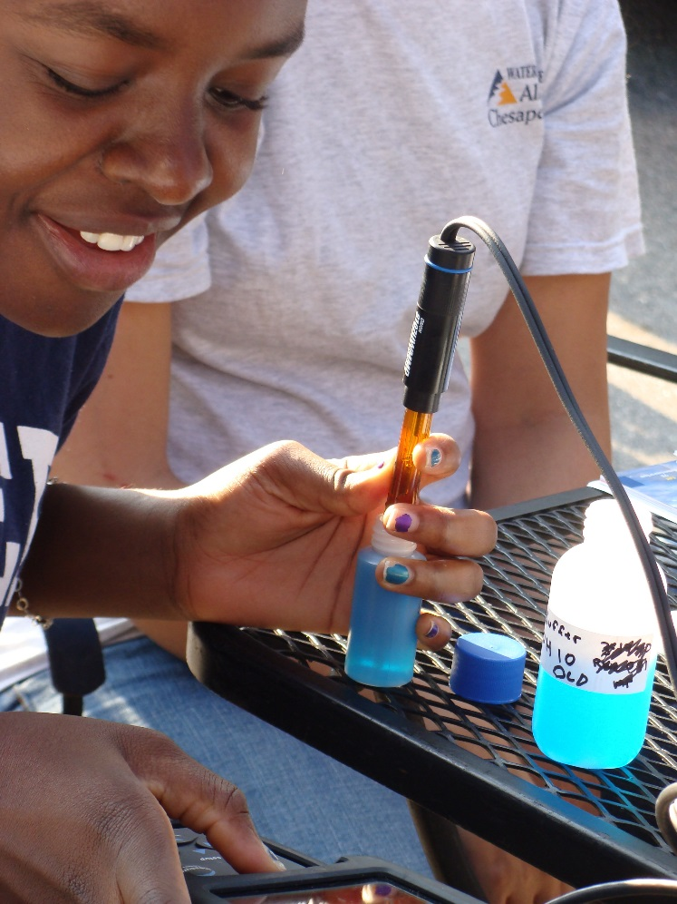
Topics
History of RiverTrends
RiverTrends Today
Quality Assurance & DEQ Partnership
Using RiverTrends Data
Value of Volunteering
Key Components of a Successful Program

Slide 5
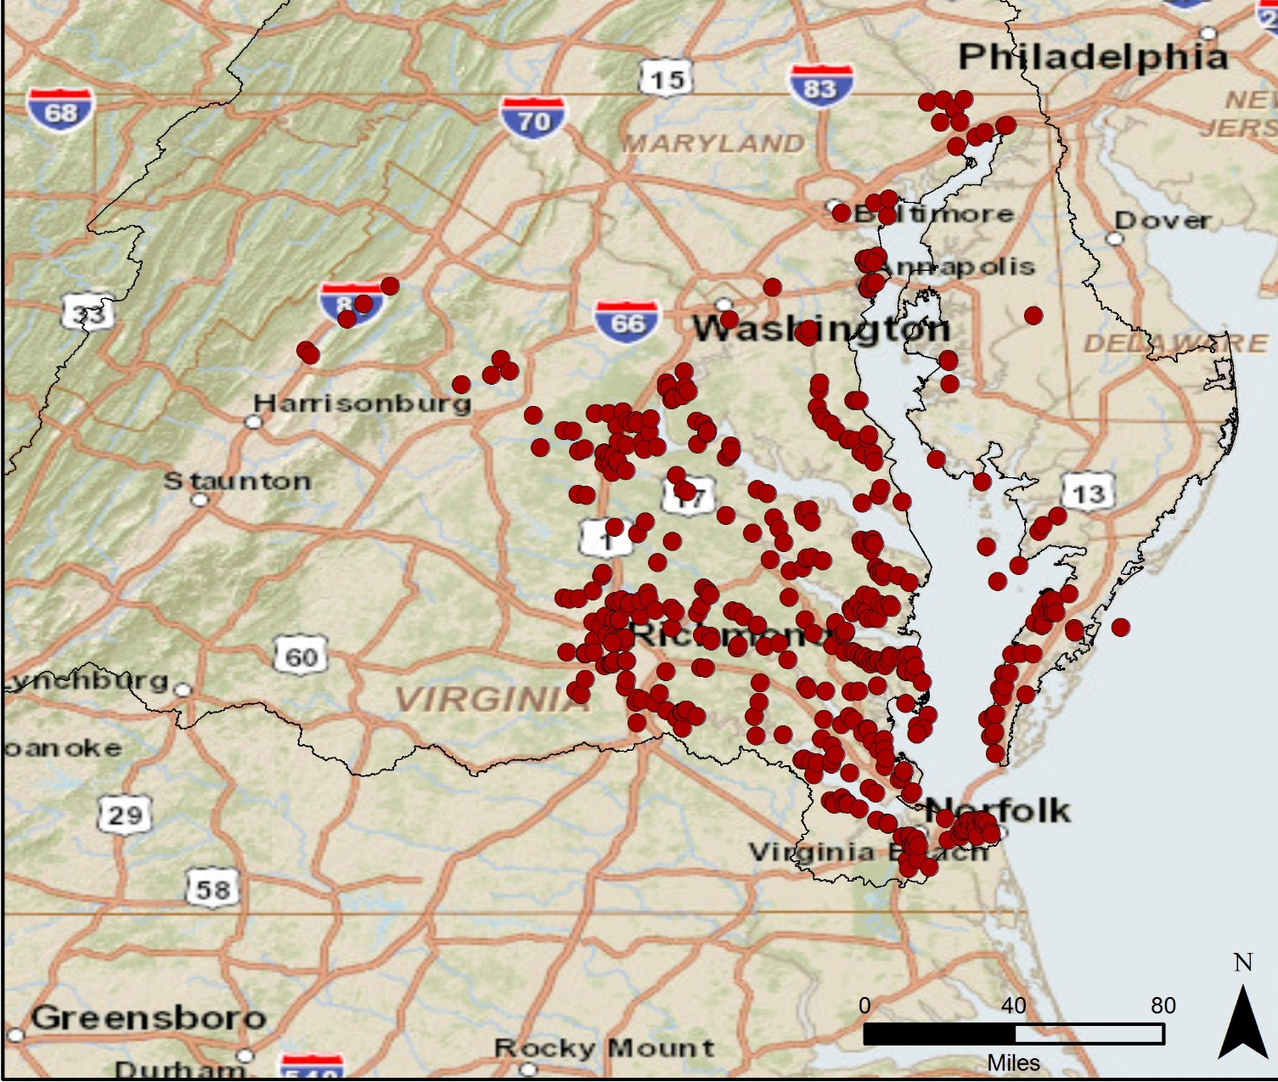
History of RiverTrends
Notes:
Started in 1985 on Patuxent and James Rivers.
Added rivers and at one point had almost 400 sites.
Parameters collected included DO, pH, salinity, clarity. Added nutrients and SAV project. Majority of focus on tidal tribs in Virginia.
Until 2000, the Alliance‘s Citizen Monitoring Program was almost entirely funded by the Chesapeake Bay Program (CBP). Due to budget cuts and priorities, the Chesapeake Bay Program decided to end funding of the program in December 1999. The CBP decided to fund the program for one more year in 2000 and also requested that the Alliance perform a study on how best to prioritize its funds towards citizen monitoring across the Bay watershed. Several priorities came out of this study, but one action item that the Alliance strongly recommended was to have a coordinator position to try to coordinate citizen-monitoring efforts throughout the Bay watershed. The state representatives to the CBP all felt strongly that their individual states were capable of coordinating citizen monitoring within their own states and did not feel this funding was necessary by the CBP. Therefore, no funding was provided for a Bay-wide citizen monitoring coordinator or a Bay-wide Citizen Monitoring Program after 2000.
Virginia – funding has been precarious for a statewide citizen monitoring coordinator over the past few years and citizens have had to rally together several times to maintain funding for this position. Funding over past few years from 2001-2003 was from the Virginia agencies of the DEQ and Department of Natural Resources (DCR). For most of 2004, the Alliance had no financial support for its program.
In 2005 and for 2006, the Alliance’s training and technical support will mostly be provided to interested parties through a contractual basis due to reduction in funding by state.
The Alliance has received a small amount of funding from the Chesapeake Bay Restoration Fund (CBRF), Royal Bank of Canada, and Dominion Foundation to perform some support to organizations for limited items and develop watershed report cards.
Partnerships with roundtables.

Slide 6
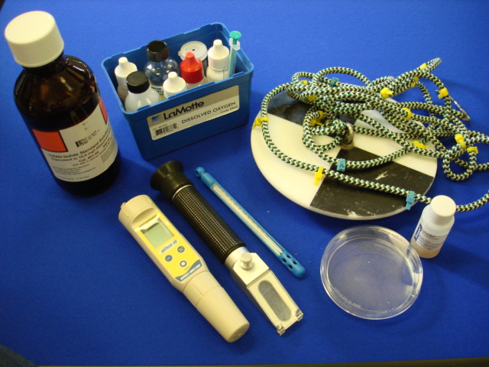
RiverTrends Today: Parameters
Core Parameters
  Dissolved oxygen
  pH
  Salinity
  Temperature (air and water)
  Water clarity and depth
Secondary Parameters
  Bacteria
  Nutrients
  Precipitation
Notes:
DO, ph, temp level 3
Bacteria – level 2
Water clarity – level 1

Slide 7
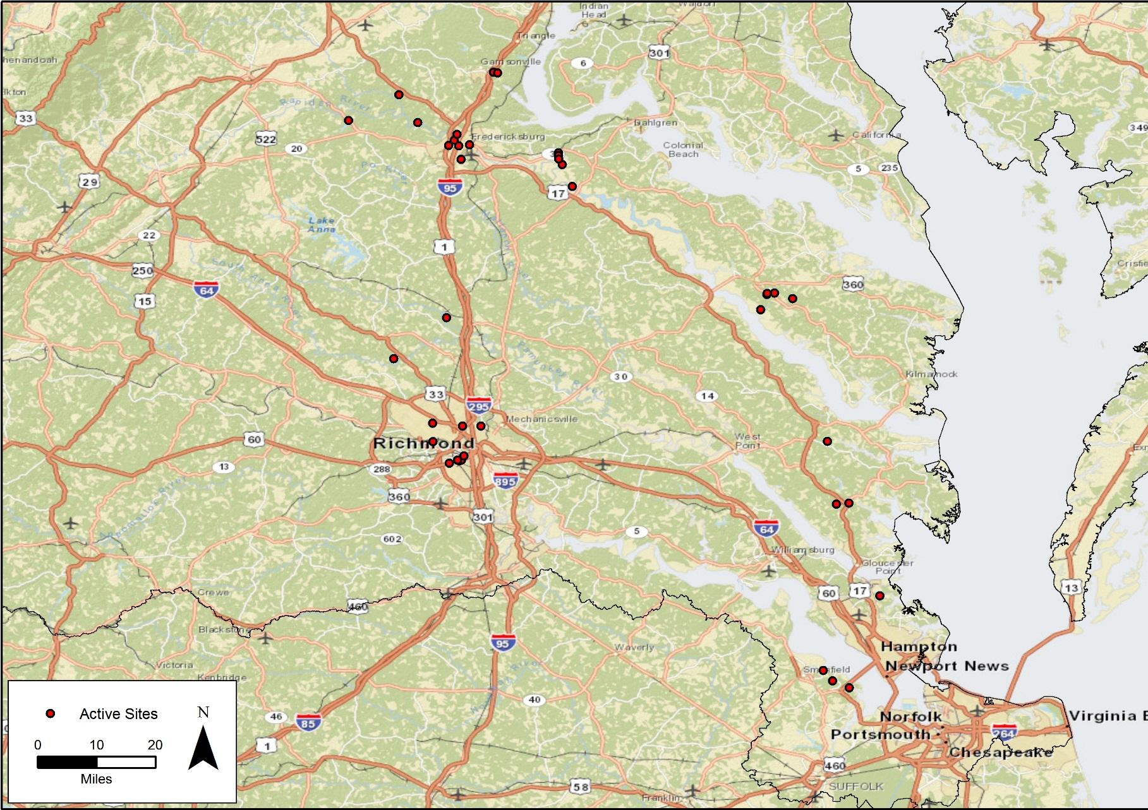
RiverTrends Today: Groups & Sites
Notes:
Umbrella organization for smaller groups
Friends of Rappahannock
Isle of Wight area monitors
Totuskey Creek
Green Aquia
Riverine Master Naturalists
Reedy Creek Coalition – since 2009
This year – adding sites in tidal York area and Lynchburg area

Slide 8


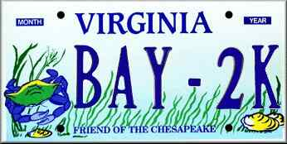

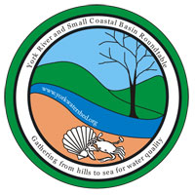
RiverTrends Today: Funding
VA DEQ Citizen Monitoring Grants
VA Chesapeake Bay
Restoration Fund
Notes:
$300/kit for starting site
~ $100/year for resupply for sites
~ $350 for nutrient analysis for 4 sites
Other costs – training supplies, postage for shipping supplies, printing costs (report cards and outreach materials), staff time, travel

Slide 9
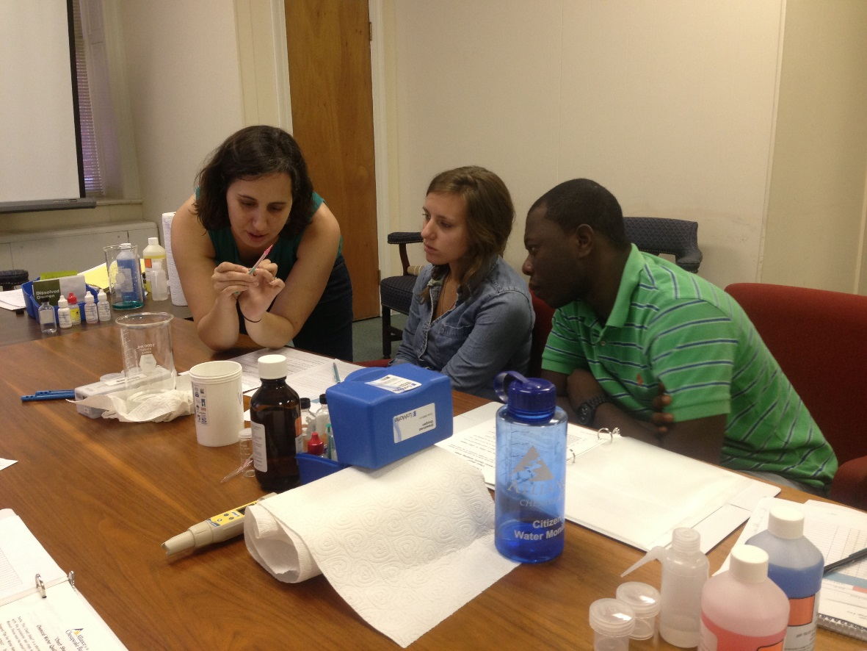
Quality Assurance
QAPP
(Quality Assurance Project Plan)
Training
Recertification Sessions
Frequency of monitoring
Train-the-Trainer Program
Notes:
QAPP approved by DEQ and EPA – smaller groups who are under our program don’t have to develop their own QAPP, so combining resources
Training – importance of monitoring, parameter info, techniques, reporting data, etc
Recertification – assuring proper techniques, equipment verification, etc.
TTT program – train coordinators to be trainers. Volunteers or paid staff.

Slide 10
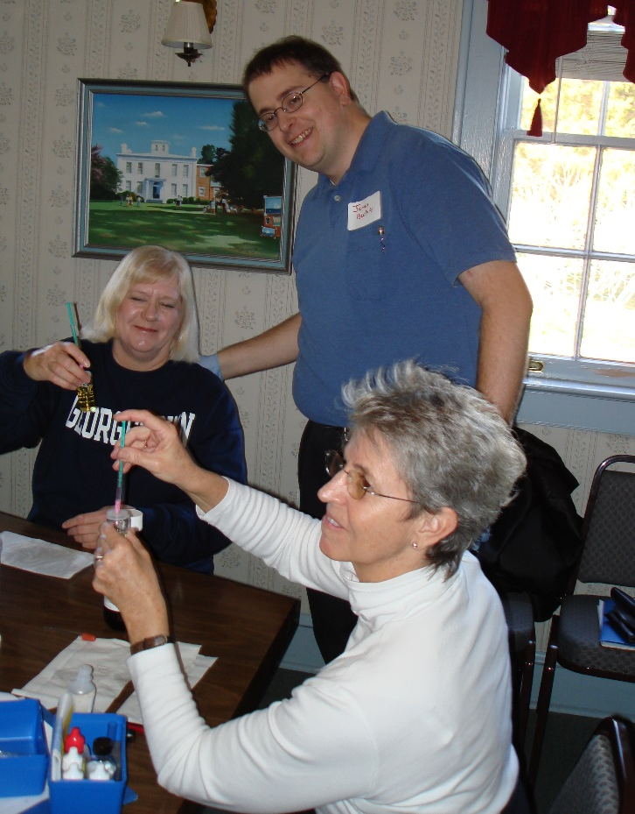
DEQ Partnership
Letter of Agreement
Virginia Citizens for Water Quality
Site identification
Technical support
Quality Assurance
Pollution Response
Notes:
Letter of agreement – to implement citizens water quality monitoring program by supporting efforts statewide, promote QA, use of data, and partnership and collaboration. Renewed in 2006.
Virginia Citizens for Water Quality – mission: Coordinate existing volunteer water quality monitoring efforts; Identify appropriate volunteer water quality monitoring methodologies; Identify appropriate uses of volunteer water quality monitoring data; Promote watershed water quality and stream health needs and issues.
Annual summit to bring together citizen scientists, localities, state, and others
Filling in gaps where DEQ needs monitorin

Slide 11
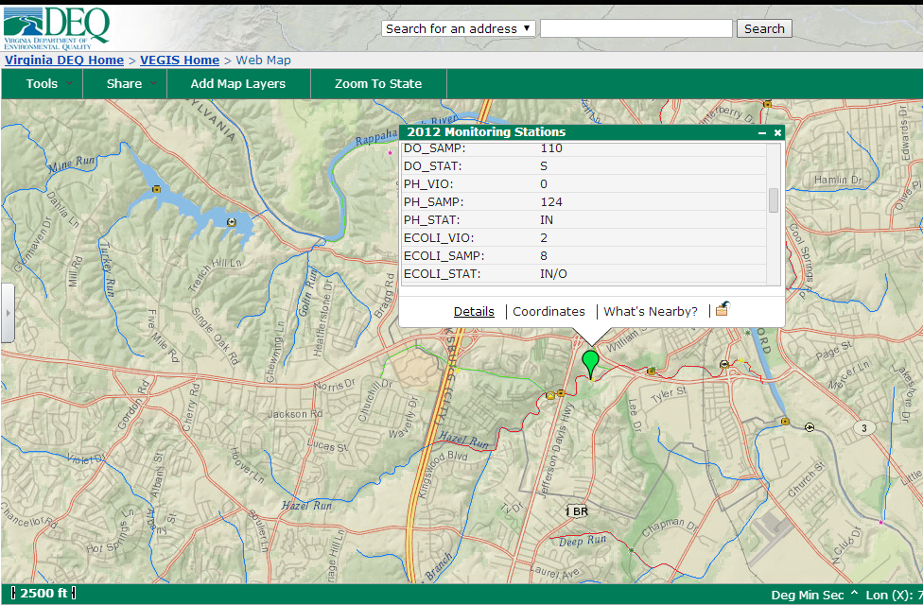
Using RiverTrends Data: DEQ
Notes:
Impairments
Detecting pollution sources –
Reaching the 3,000 stream mile goal

Slide 12
Using RiverTrends Data: Report Cards
Mid-Atlantic Tributary Assessment Coalition Protocols
Educate stakeholders
Promote citizen stewardship

Slide 13
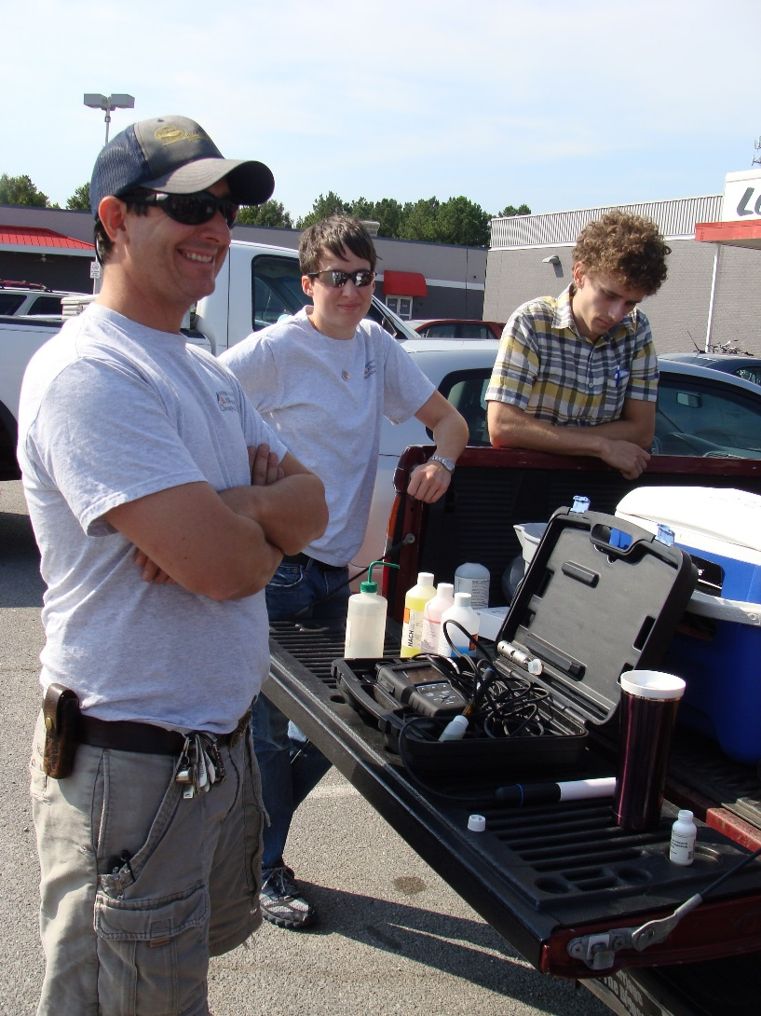
Using RiverTrends Data: Localities
Partnership with City of Richmond to collect data on local streams
Citizen monitors collect field data and samples for analysis
Richmond WWTP provide lab analysis of nutrient data
DPU also providing funding for staff support

Slide 14
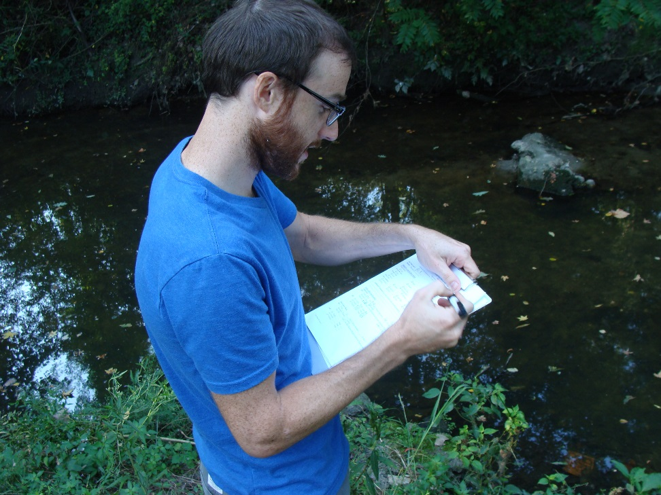
Citizen Science
Creating stewards
Filling in gaps
Eyes & ears on the ground
Volunteer recruitment & retention
Quality assurance & oversight

Slide 15
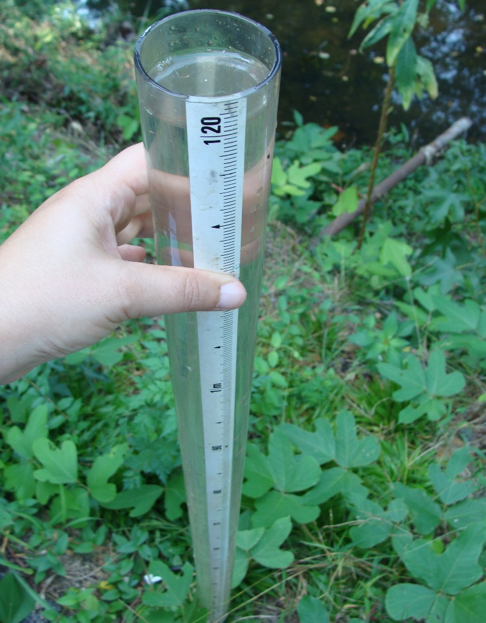
Key Components of a Successful Program
Develop partnerships
Have a monitoring plan
Ensure quality data
Volunteer recruitment and retention
Use your data and know your end result
Reducing expenses and diversify funding sources

Slide 16
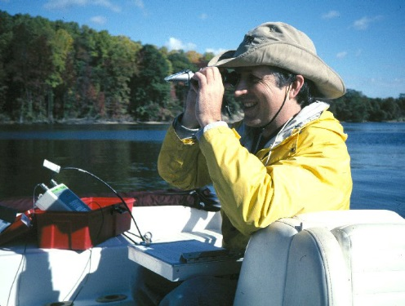
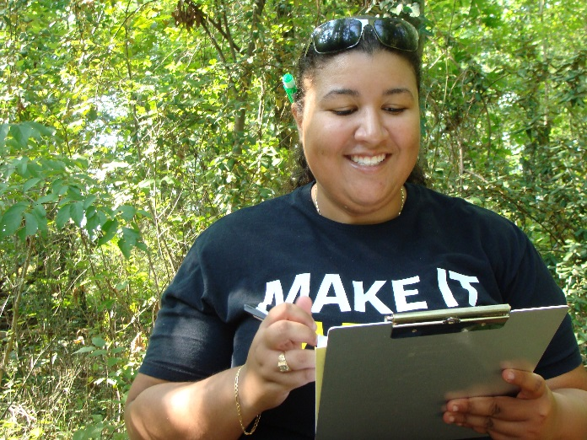
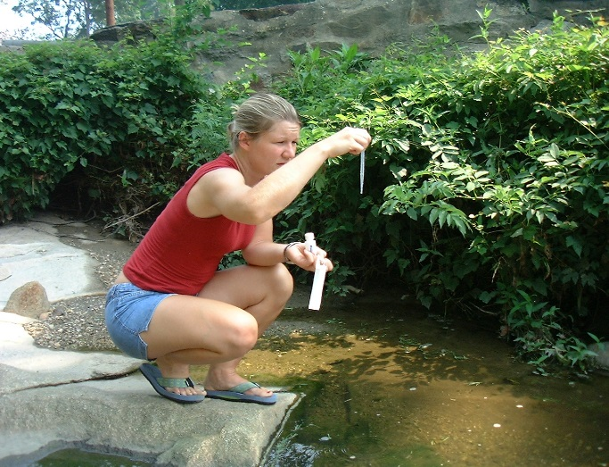
Together, we can finish the job…
…of restoring the Bay watershed.
Anna Mathis
804-775-0951
amathis@allianceforthebay.org
https://allianceforthebay.org/our-work/connecting-people/rivertrends/

