Slide 1
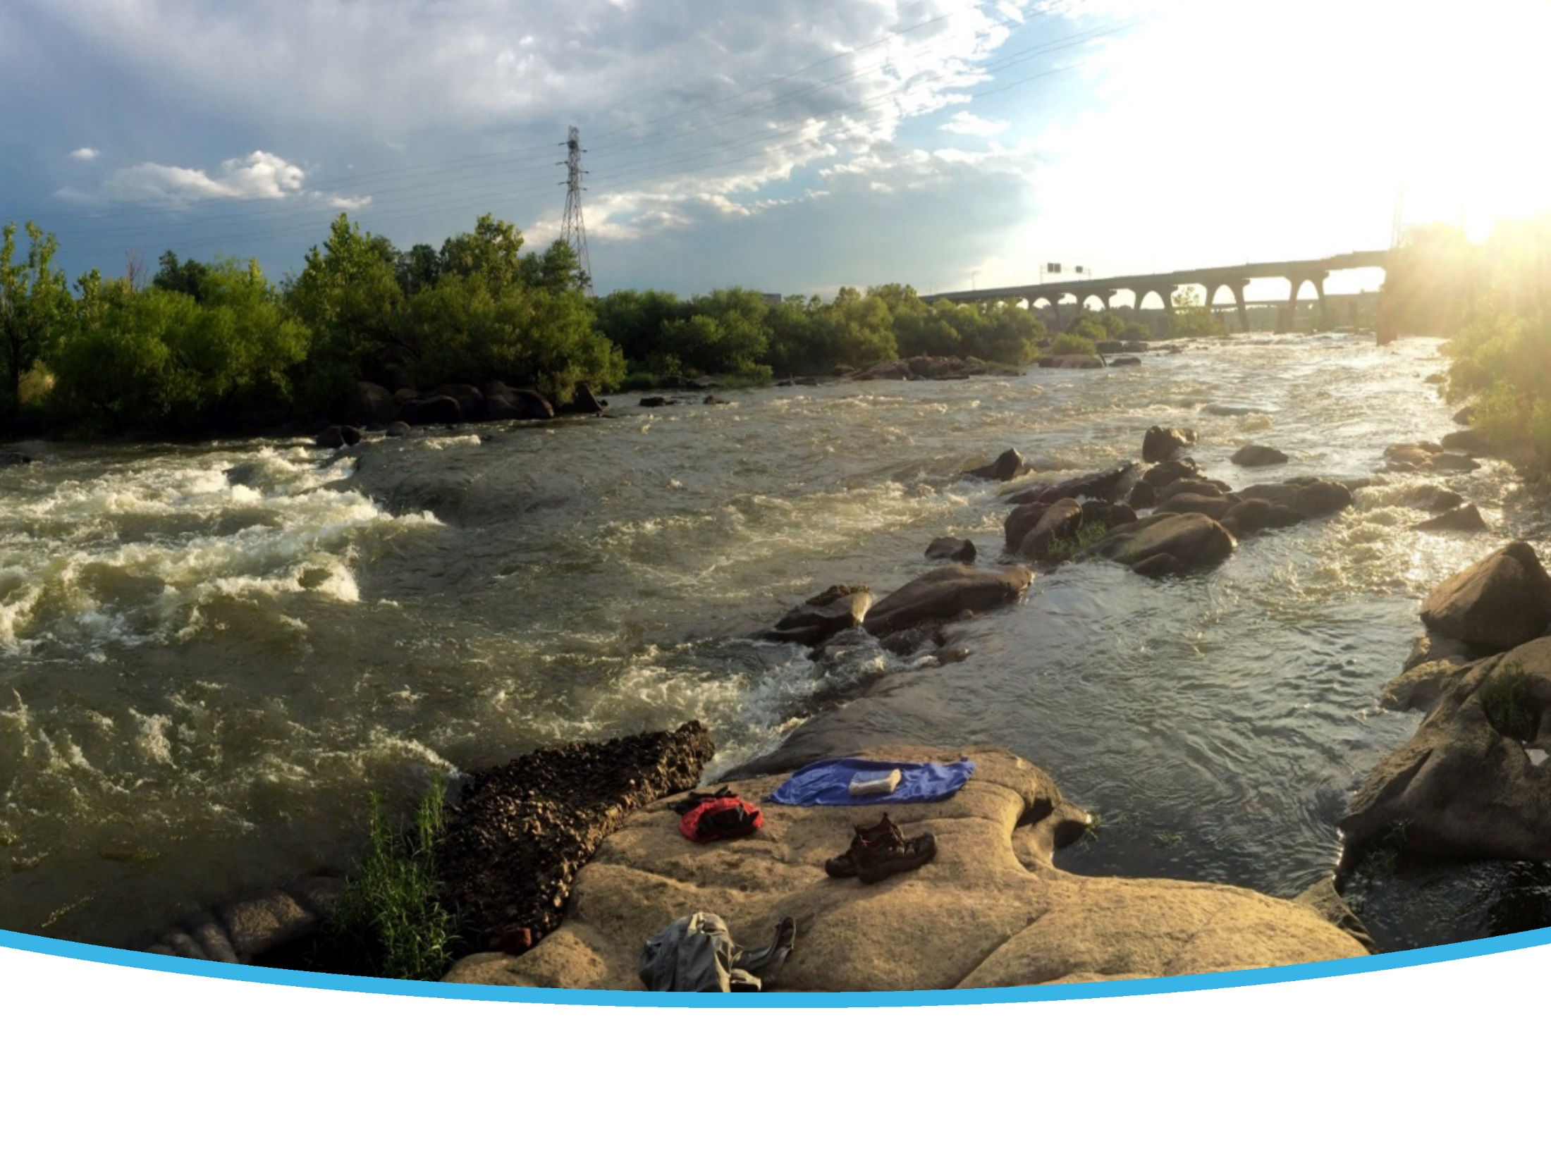
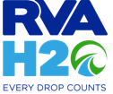

RVAH2O Clean water plan
Chesapeake advisory council meeting
Sept 5, 2018
RVAH2O.org
SEPT. 20, 2016
Notes:
Grace

Slide 2
Clean Water Plan Goal: Find Ways to Work Together
LOCAL NEED
PROJECT IMPLEMENTATION
DPU INTERESTS
PARTNER INTERESTS

Slide 3
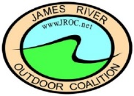




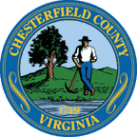
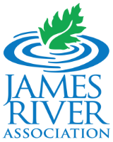
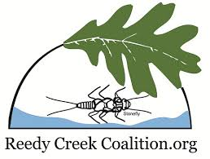
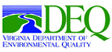

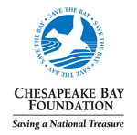
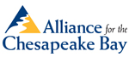

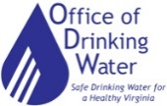



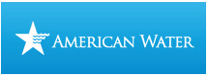

RVAH2O Stakeholders
Notes:
Grace

Slide 4
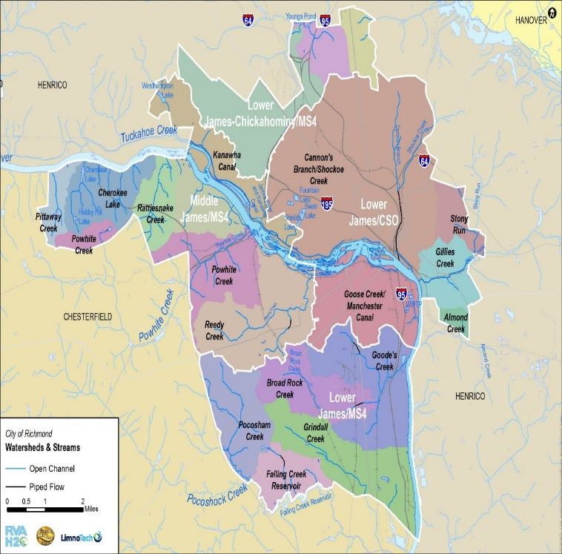
Watersheds

Slide 5
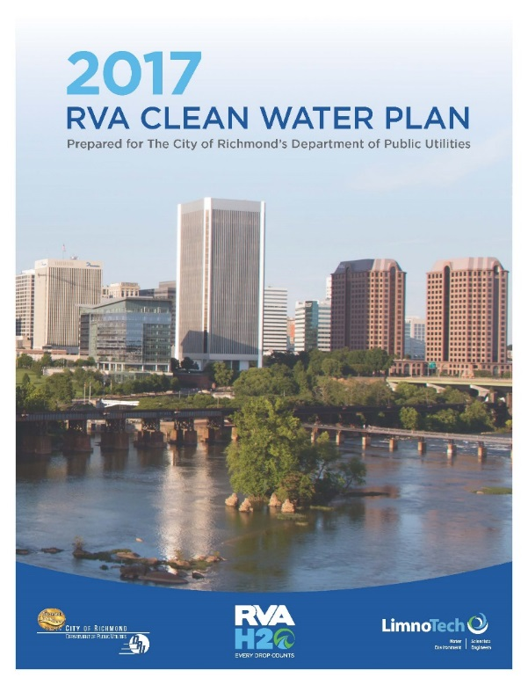
RVA Clean Water Plan

Slide 6
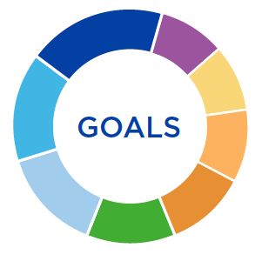
Implement land conservation and restoration practices and incorporate them into planning activities.
Work collaboratively to gather consistent high-quality data to characterize the status and trends of water resources and to gauge the effectiveness of restoration efforts.
Provide safe, accessible, ecologically sustainable water-related recreational opportunities for all.
Manage wastewater and stormwater to improve the quality and quantity of ground water and surface water.
Maximize water availability through efficient management of potable water, stormwater and wastewater.
Protect and restore aquatic and terrestrial habitats to support balanced indigenous communities.
Create partnerships across the watersheds internal and external to the City of Richmond to maximize benefits and minimize impacts to all stakeholders.
Engage and educate the public to share responsibility for and take action on achieving healthy watersheds.

Slide 7
Clean Water Plan Strategies
Riparian Areas Replace or restore 10 acres
Green Infrastructure in MS4
Install 104 acres
Green Infrastructure in CSS
Install 18 acres
Stream Restoration Restore 2,500 linear feet
Natives/Invasives Use 80% native plants when landscaping
Trees Increase tree canopy by 5%
Land Conservation Conserve 10 acres
Water Conservation Reduce water use by 10%
Pollution Identification and Reduction
Combined Sewer System Infrastructure Continue work on long-term control plan

Slide 8
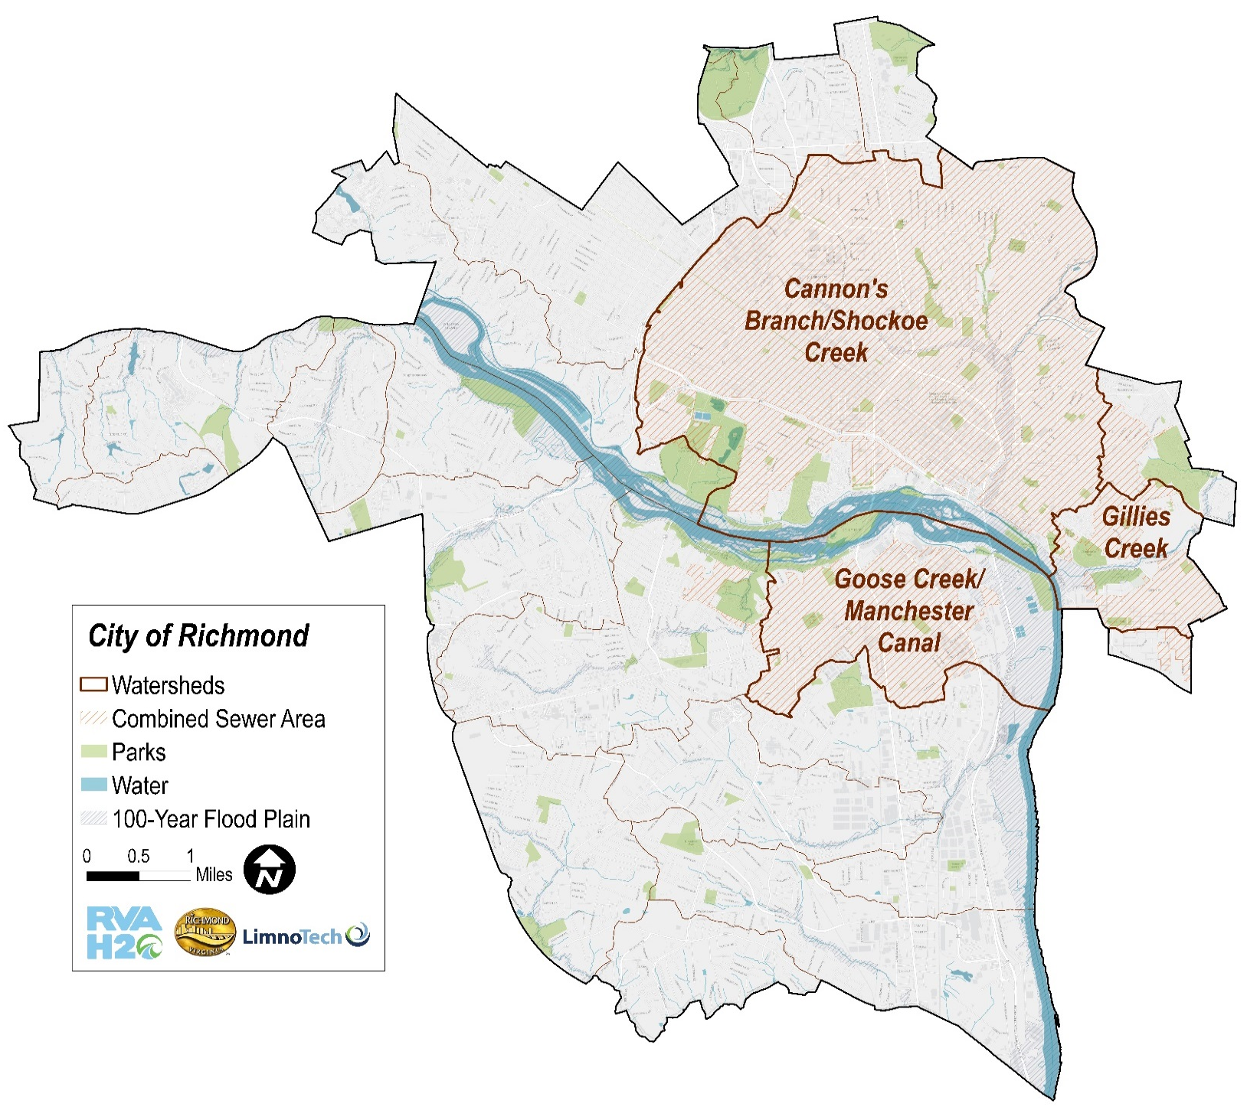
Priority Watersheds
12
Notes:
Remove bullets – include notes
Evaluated and ranked on:
Water quality impairments
Amount of impervious area
Amount of bacterial loads
Amount of DPU or Parks area
Existing or planned projects

Slide 9
2017 Strategy Accomplishments
Green Infrastructure in the MS4
Stream Restoration
GI in MS4
GI in CSS
11%
11%
108%
Target: |  | 104 acres
Achieved: |  | 12 acres
Reductions (lbs./year)
TP | 4
TN | 23
TSS | 1,891
Target: |  | 18 acres
Achieved: |  | 2 acres
Reductions (lbs./year)
TP | 2
TN | 12
TSS | 1,008
Target: |  | 2,500 lf
Achieved: |  | 2,700 lf
Reductions (lbs./year)
TP | 176
TN | 894
TSS | 58,720
Notes:
These are the strategies that have been implemented to date that have pollutant reductions associated with them

Slide 10
2017 Strategy Accomplishments
Land Conservation
CSS Infrastructure
Trees
7%
950%
33%
Target: | 80 acres (316 trees)
Achieved: | 1.05 acres
Target: | 10 acres of City property (Williams Island)
Achieved: | 95 acres
Target: | WWTP Nutrient Removal CS Sewer Separation WWTP WW flow upgrade
Achieved: | WWTP Nutrient Removal
Reductions (lbs./year)
TP | 1.4
TN | 3.3
TSS | 175.6
Reductions (lbs./year)
TP | No pollutant reduction associated with this strategy
TN
TSS
2017 Reduction Achieved Beyond WWTP+CSS Allocation (credit) (lbs./year)
TP | 40,265
TN | 1,023,122
TSS | 4,835,067

Slide 11
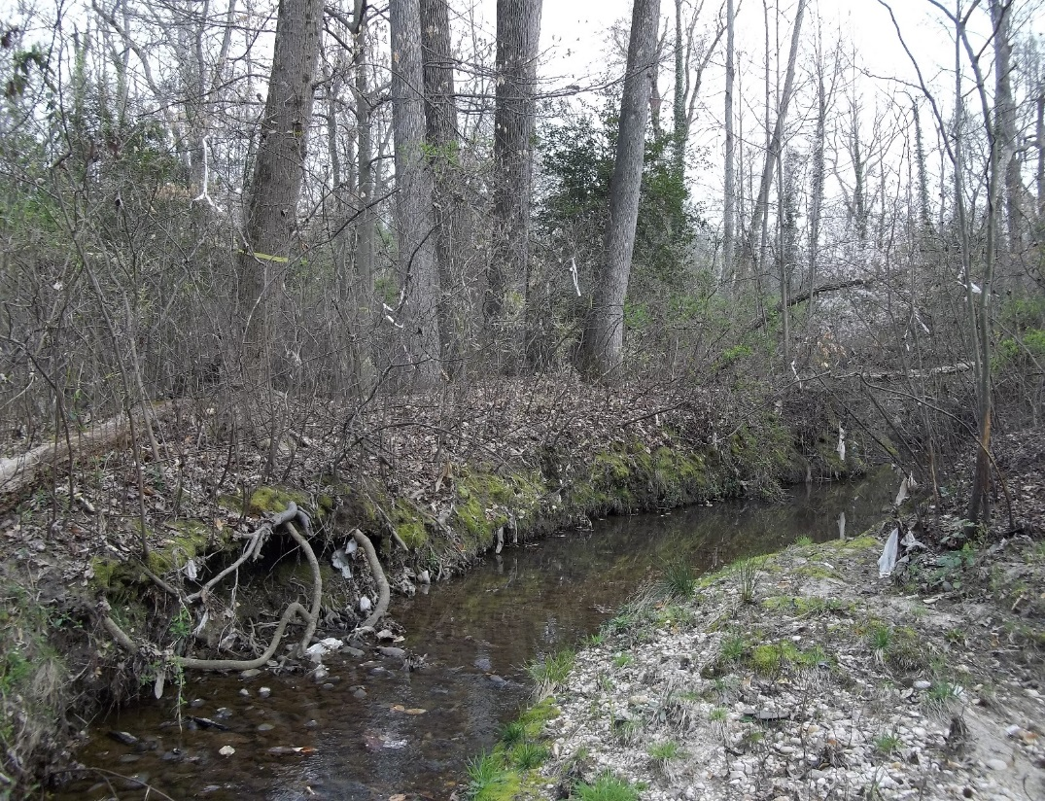
Examples of Ongoing Projects
Pocosham Creek Restoration
Monroe Park Improvements
29th Street/Church Hill Green Path
Library Greening Effort
Jefferson Avenue Greening
Gillies Creek Greenway
Bellemeade Watershed Efforts

Slide 12
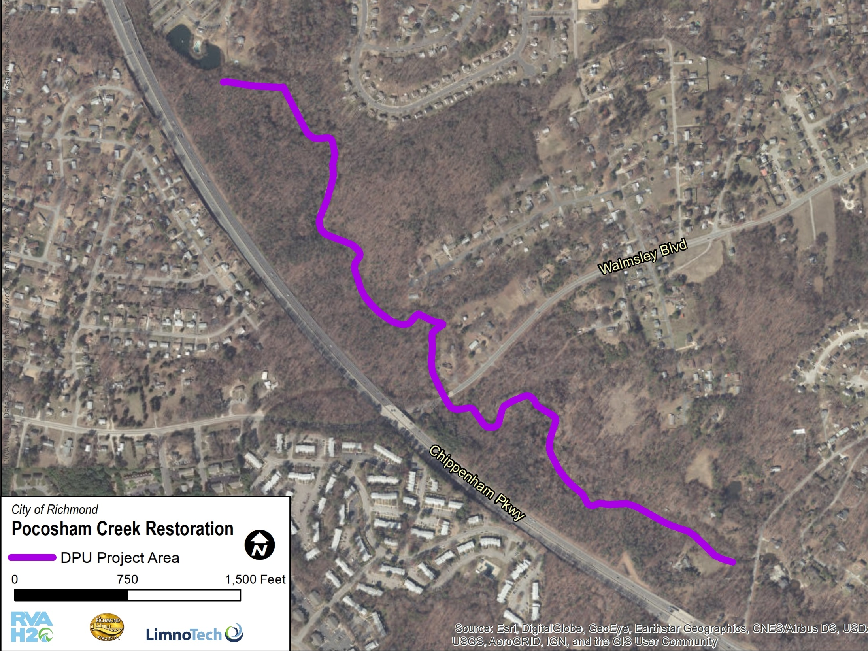
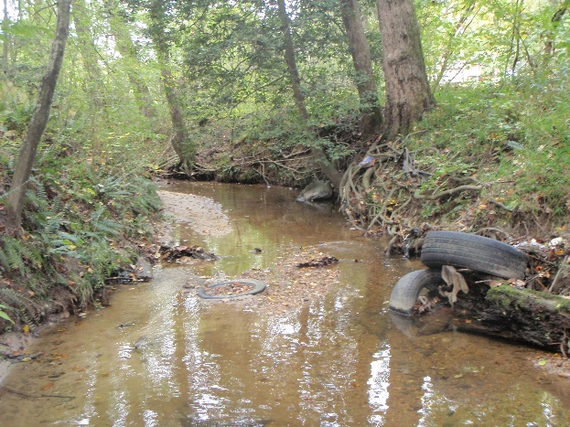
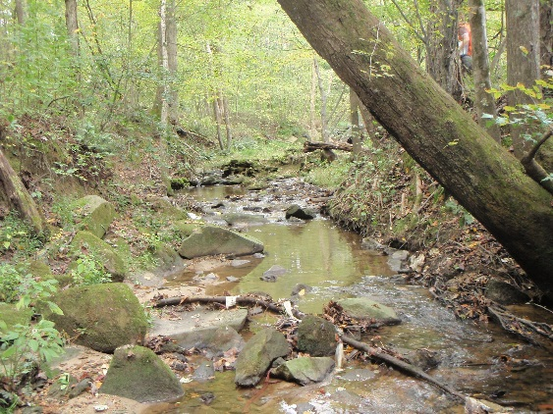
5,500 linear feet
Pollutant reduction:
TSS reduction: 350,000 lbs./year
TN reduction: 4,700 lbs./year
TP: 1,100 lbs./year

Slide 13
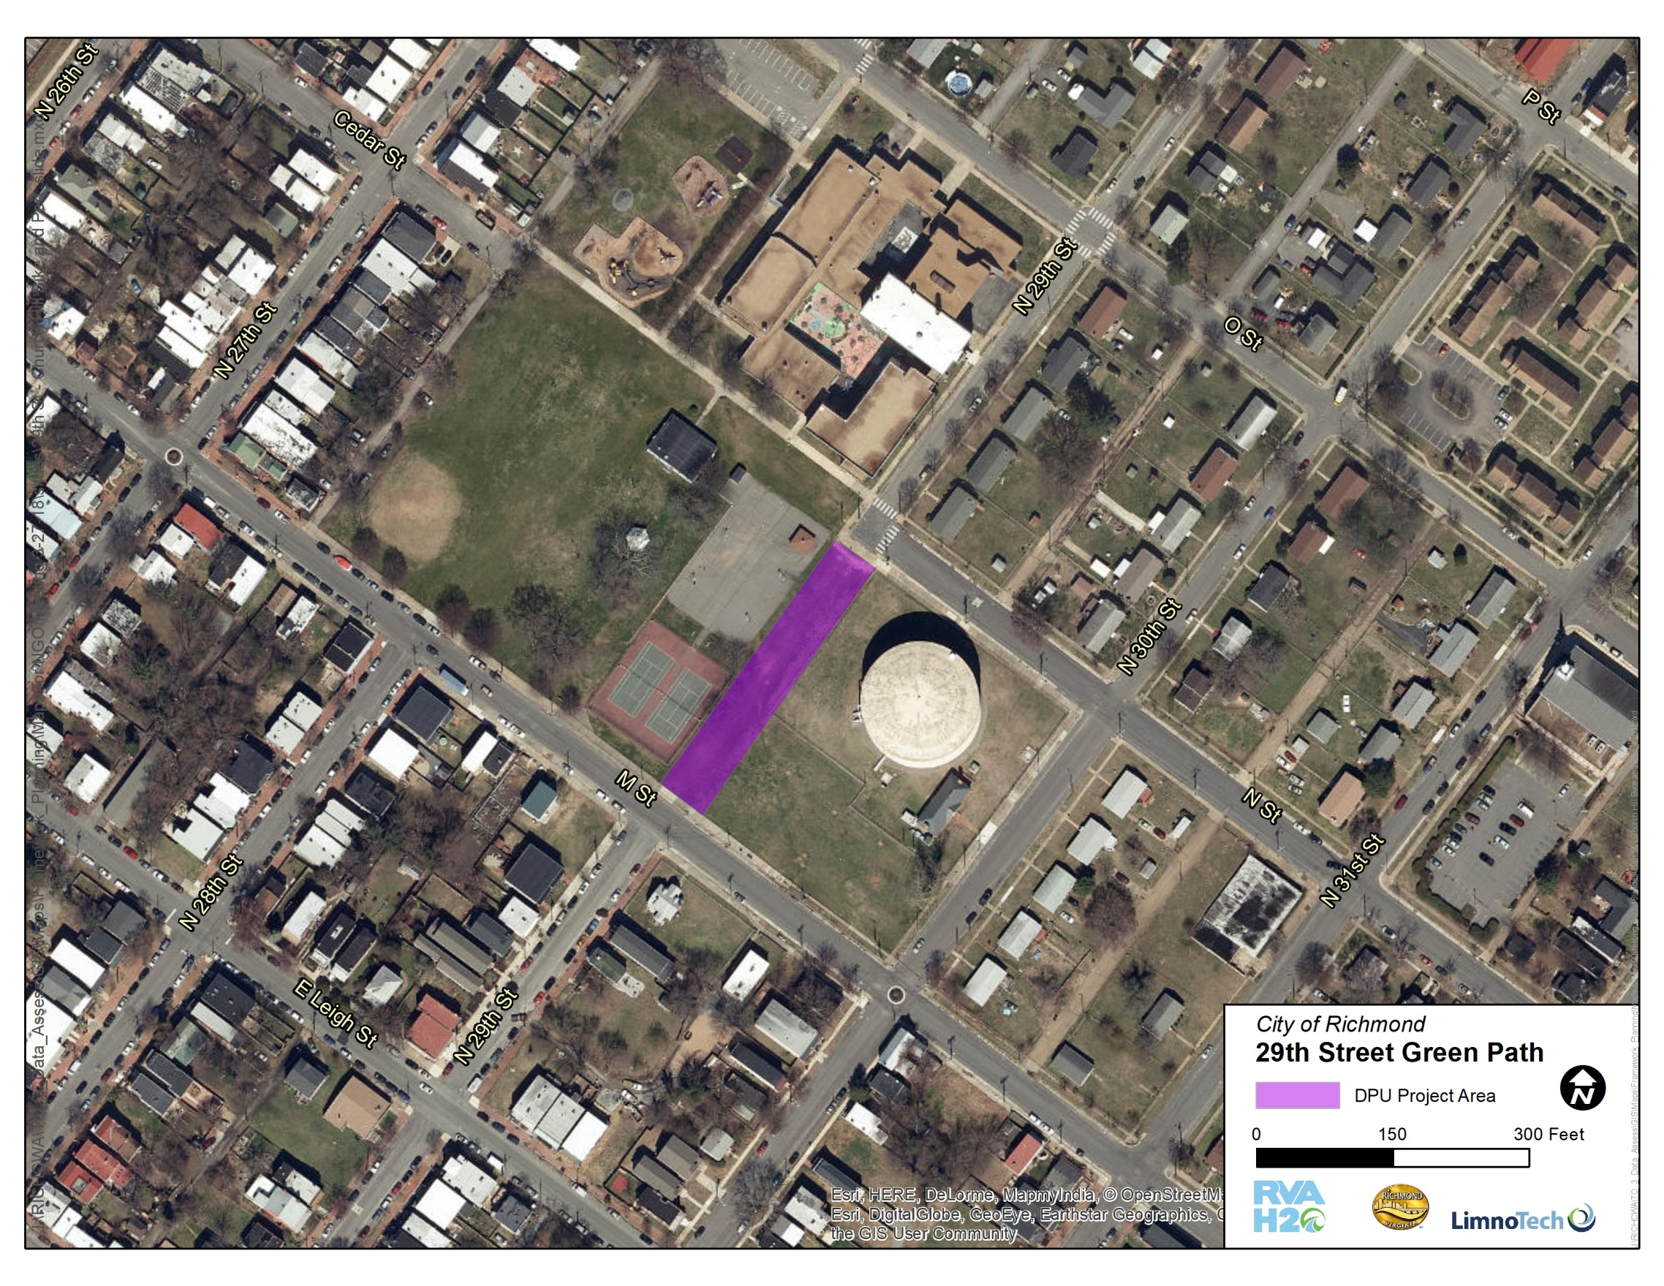
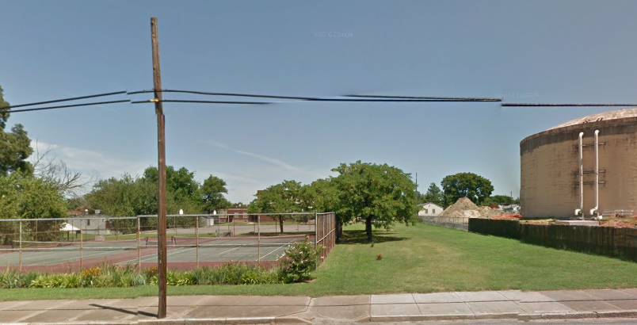
DPU, DPW, & JRA project
Grant from Altria
Pervious pavement and greening
Opportunities for community gardens?
Designed and constructed by end of 2018
Notes:
There is an opp in the park here if they want to do something further in that area; no place to sit down and enjoy the park. Right next to a school – might be part of the school and not the park.

Slide 14
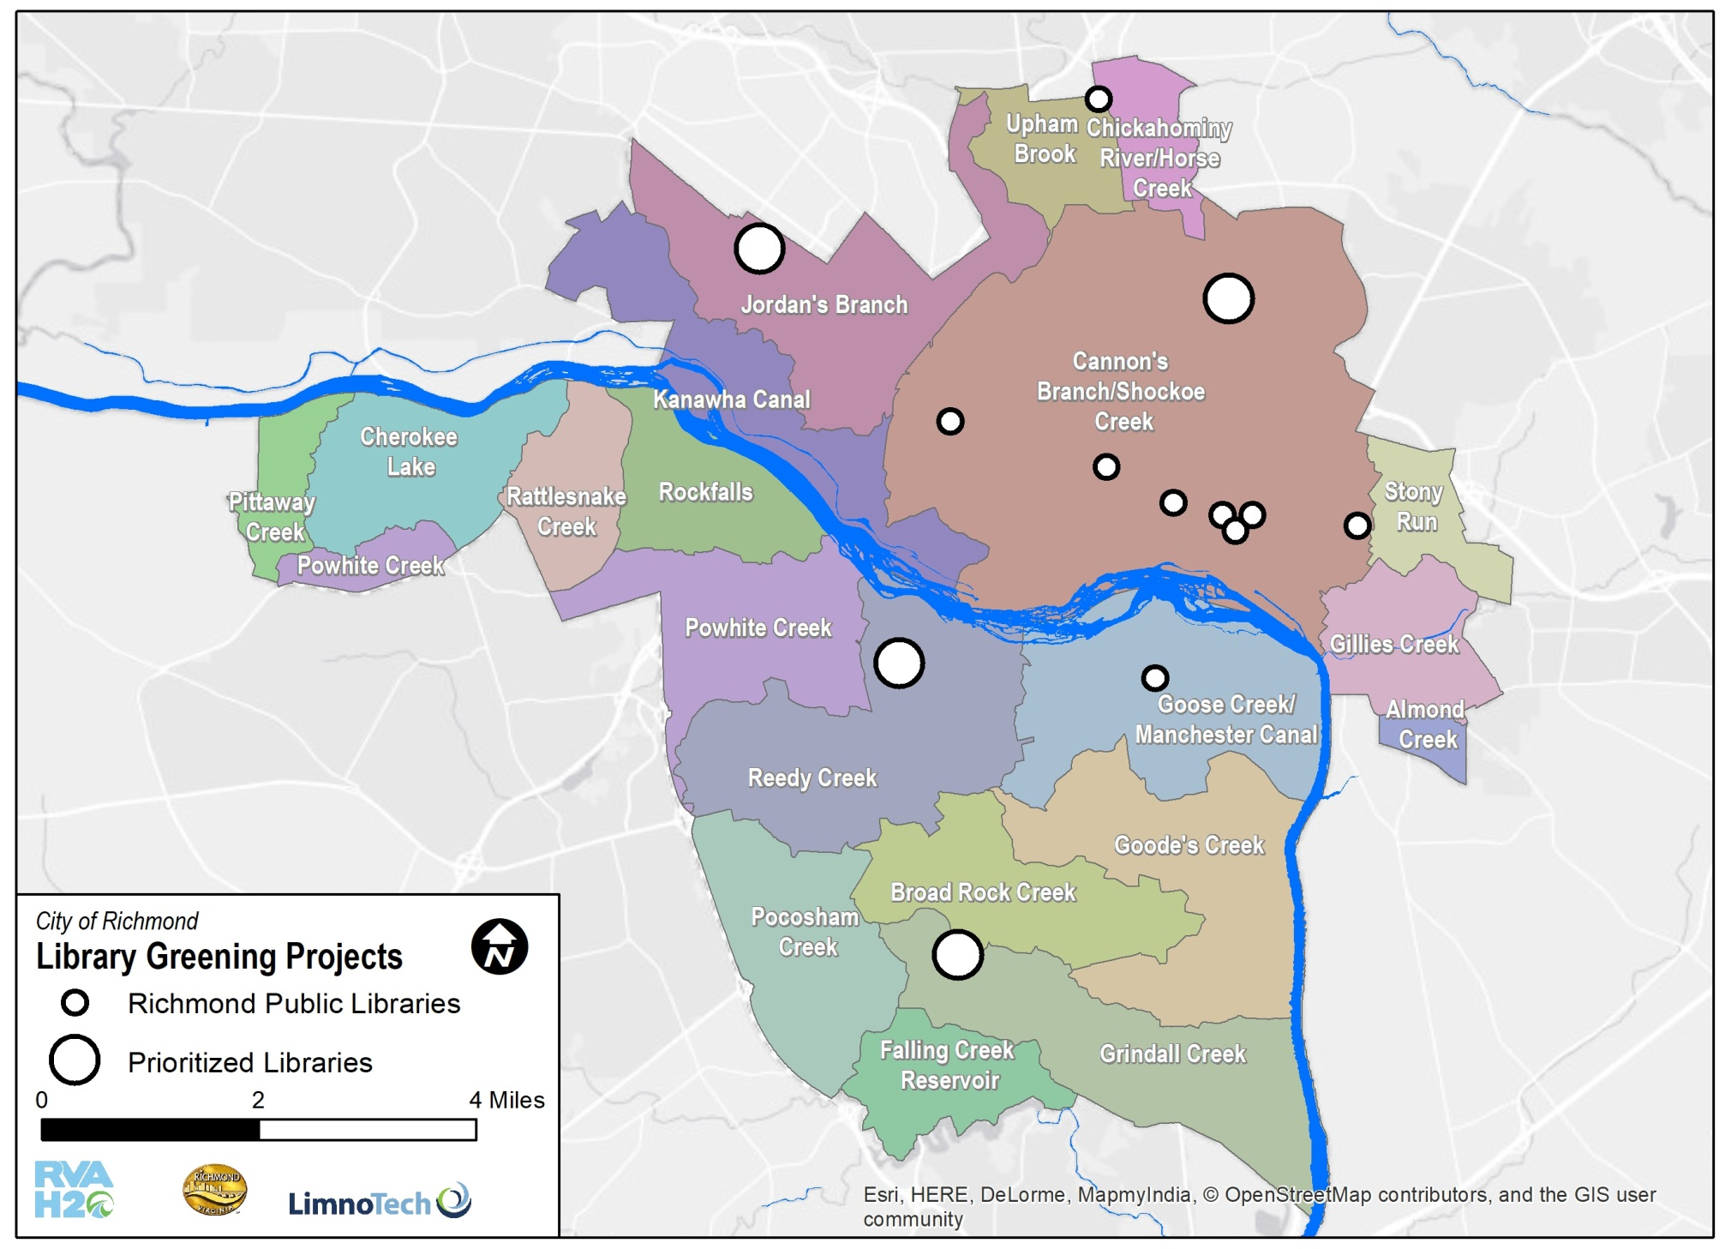
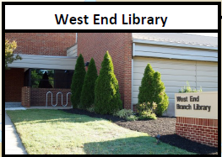
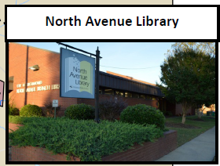
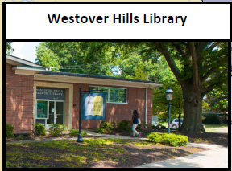
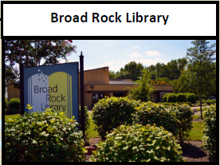
Notes:
Opportunities at all the libraries…

Slide 15
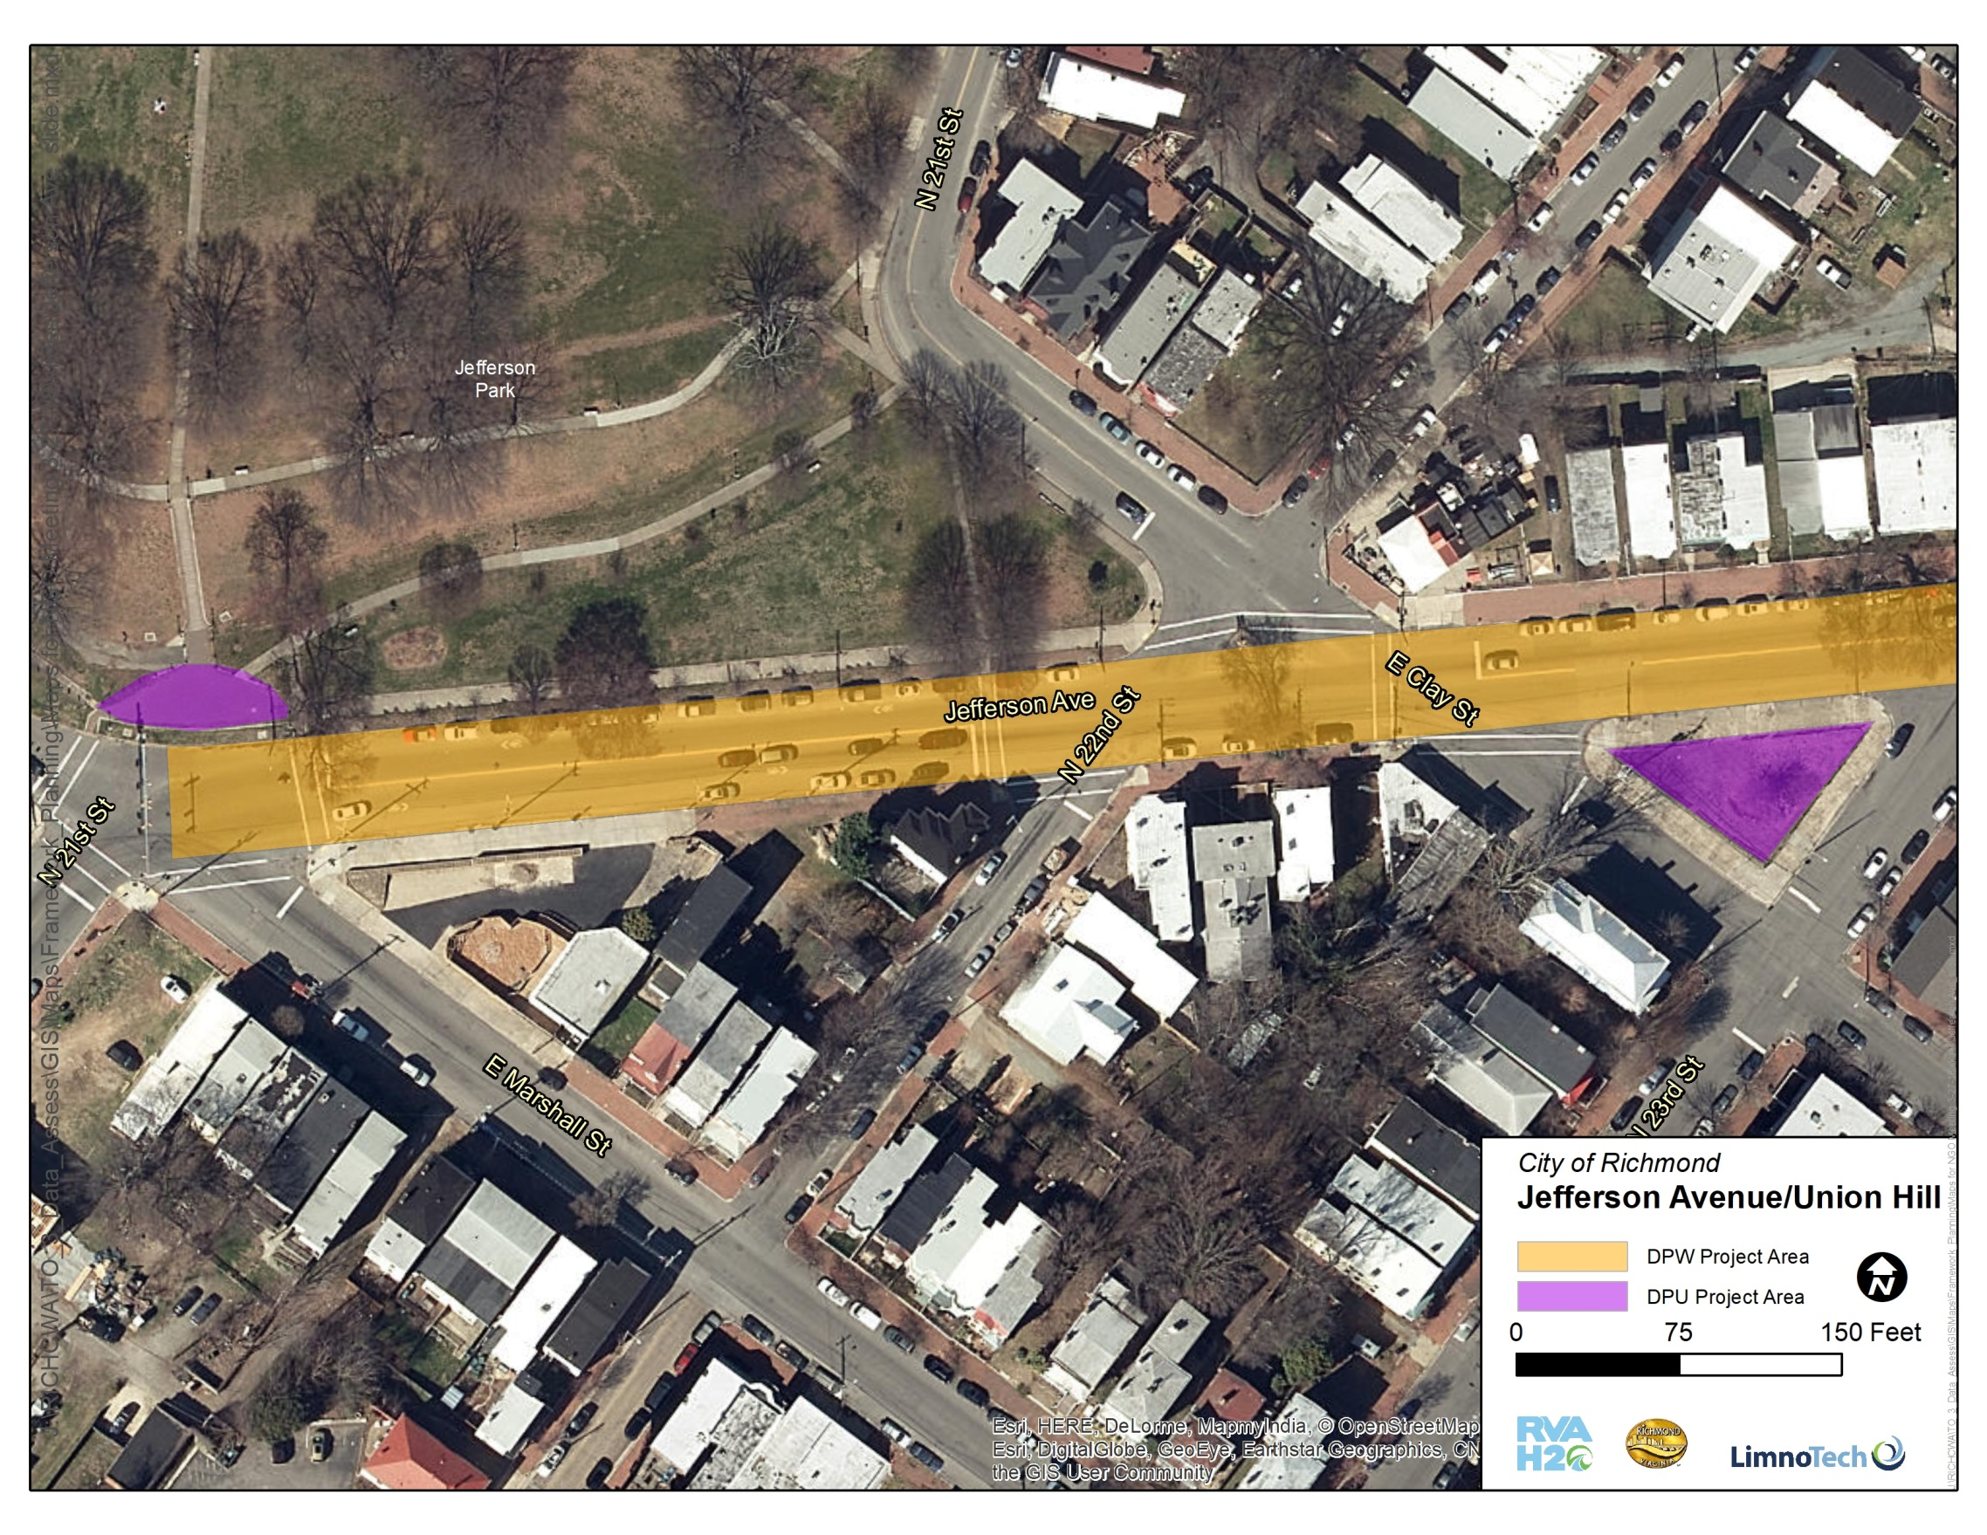
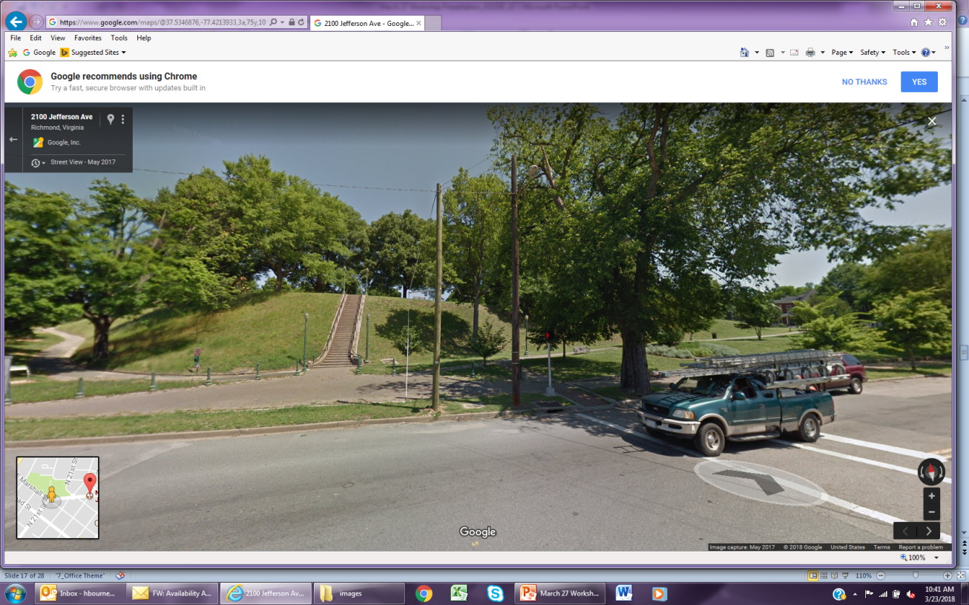
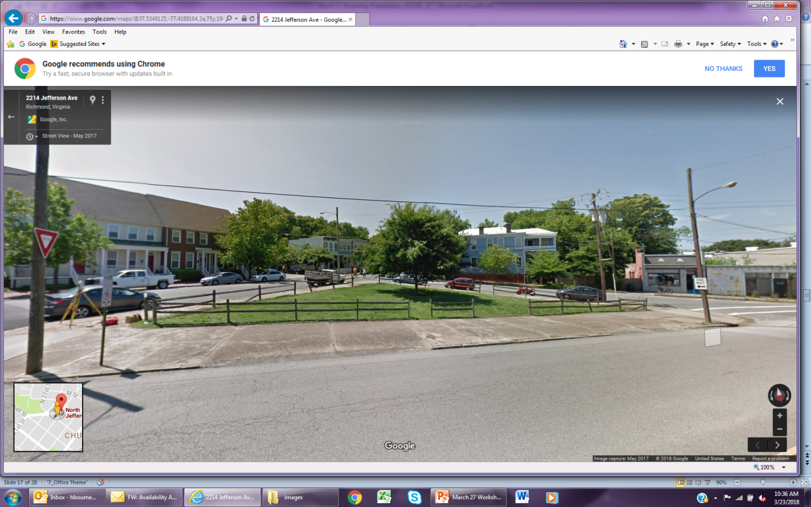
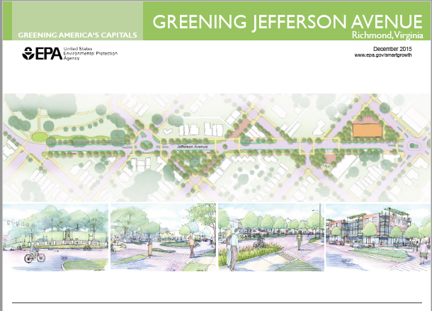
Jefferson Park
Greening Jefferson Ave.
DPU, DPW & Parks project
Two Hills Park & GI on Ave.

Slide 16
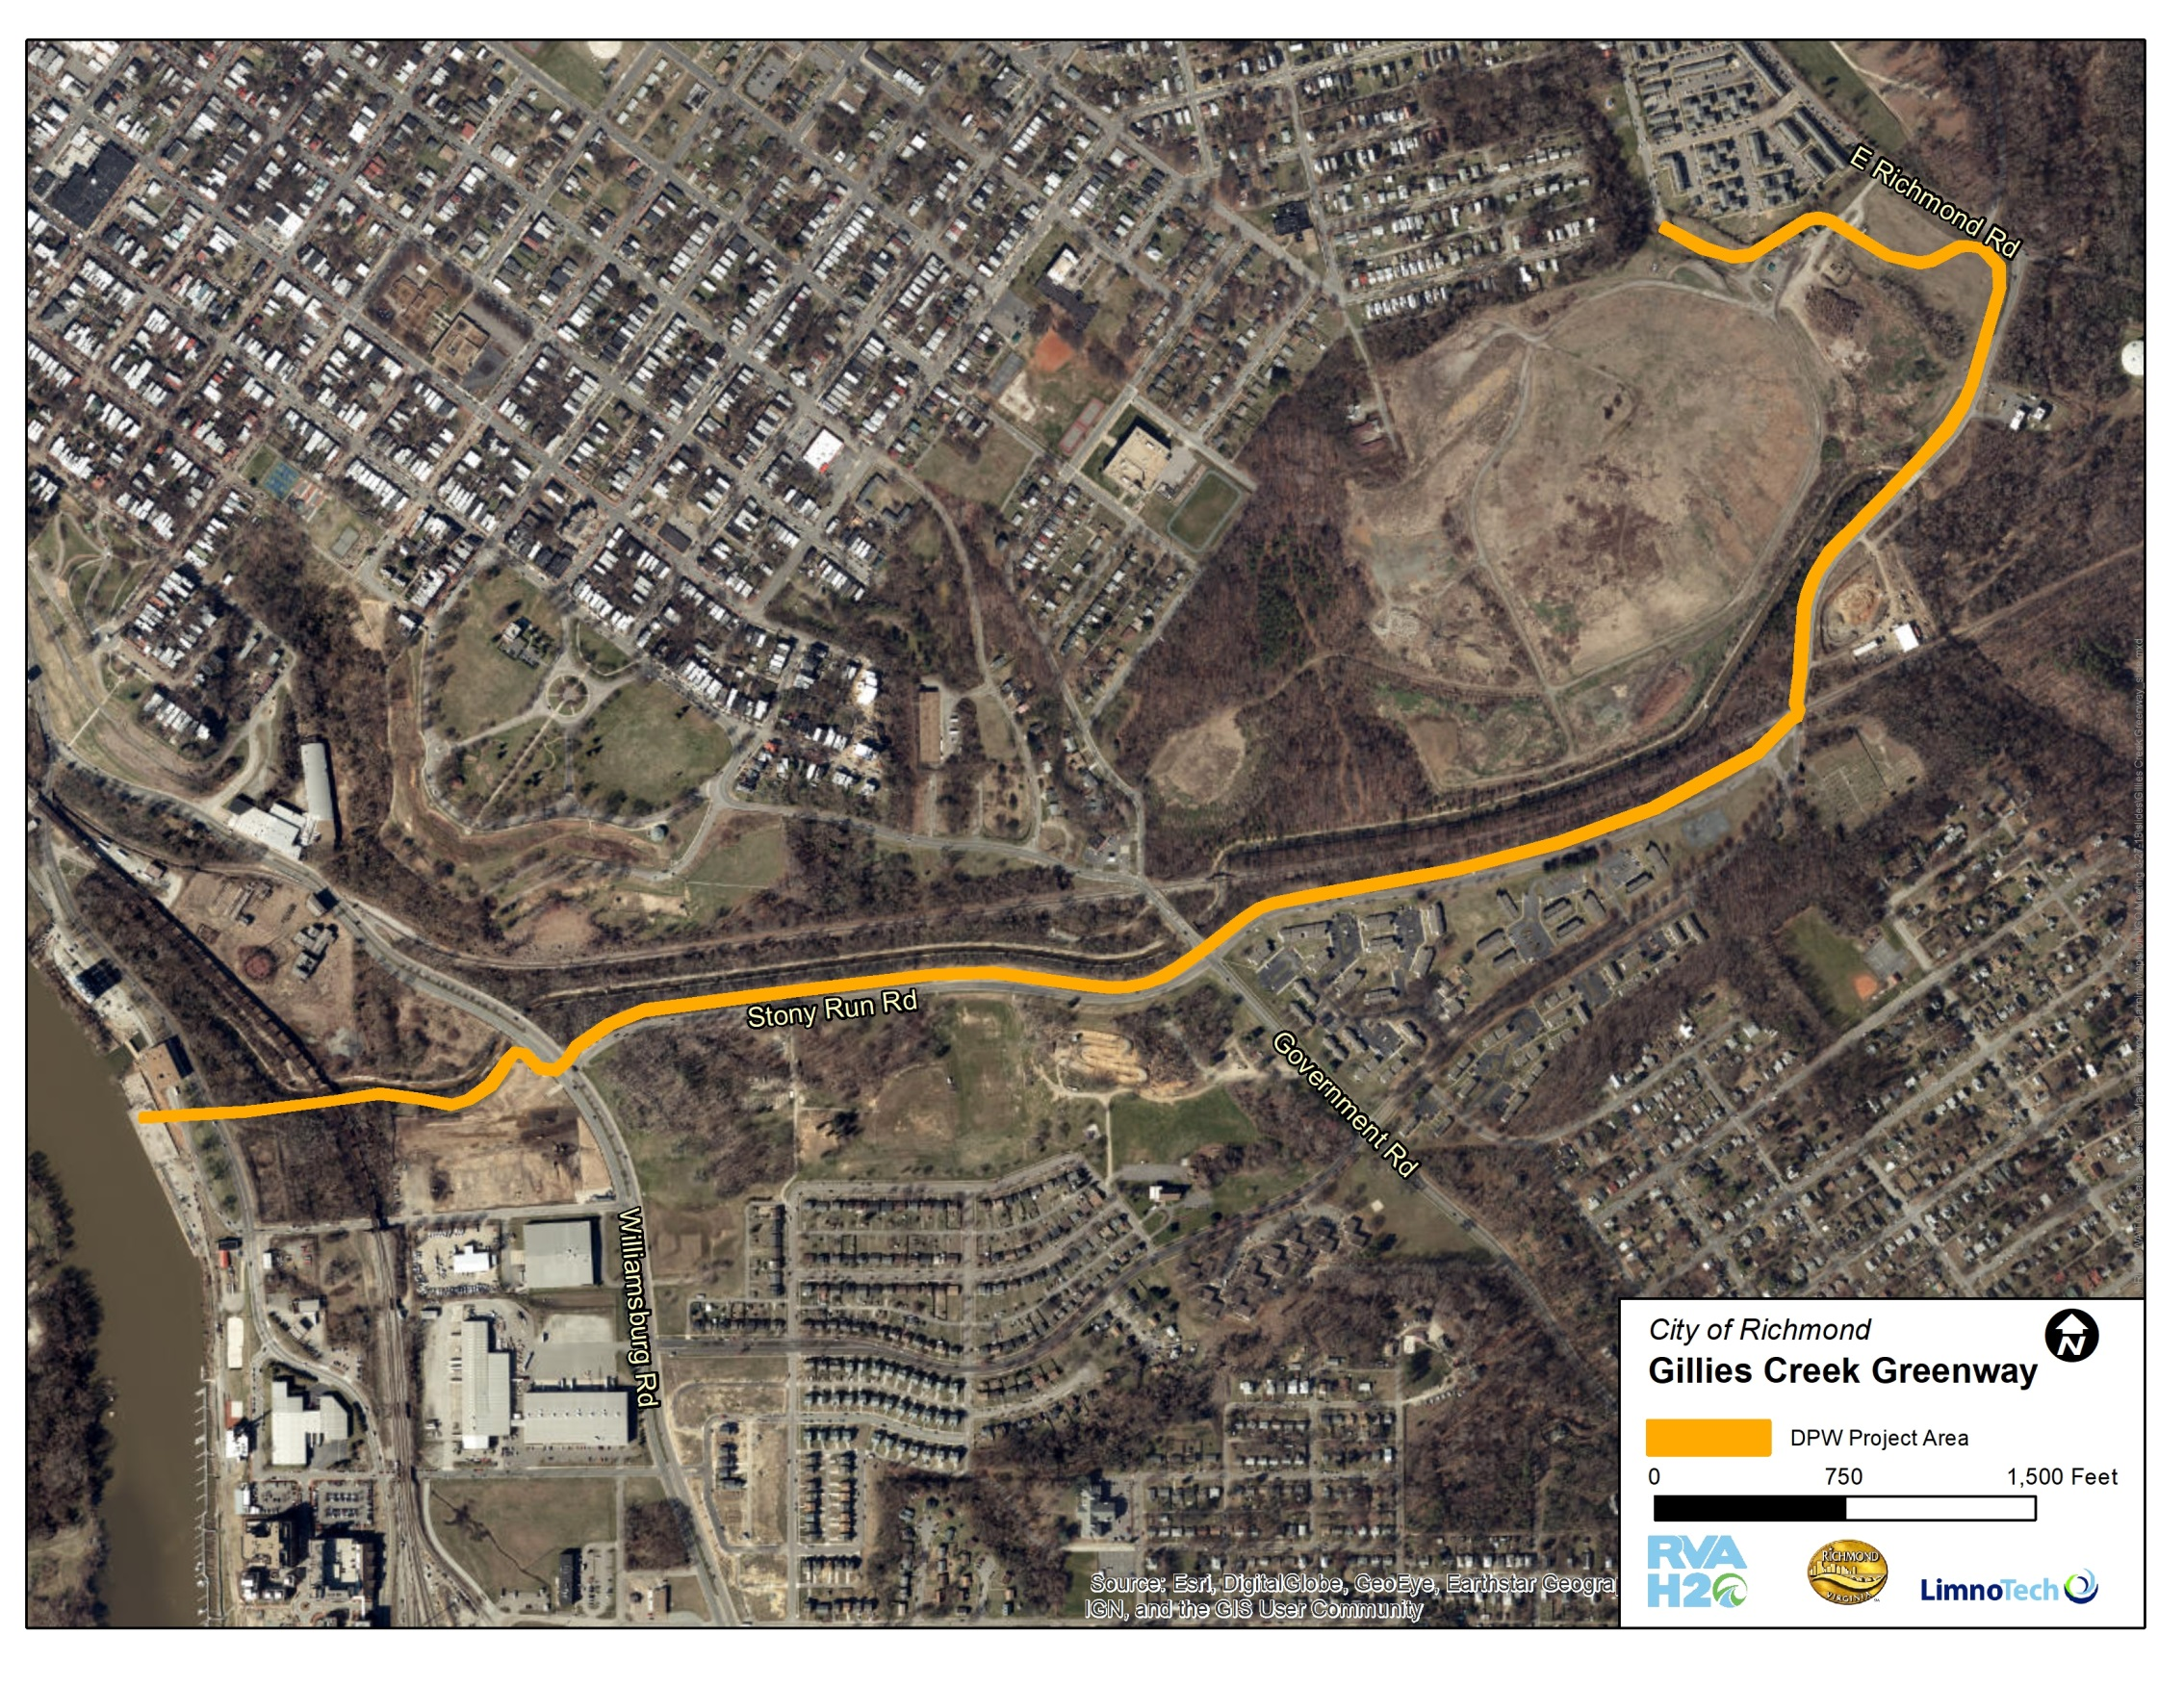
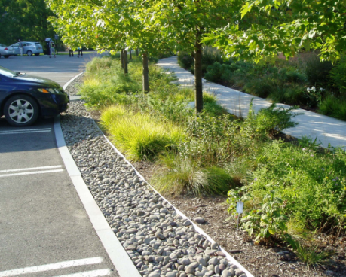
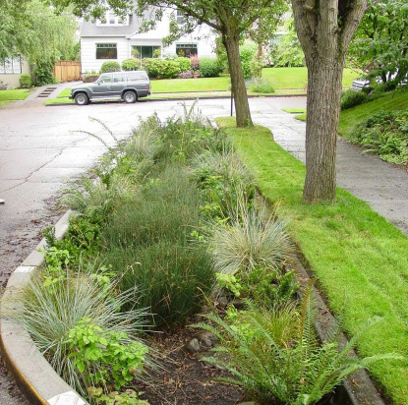
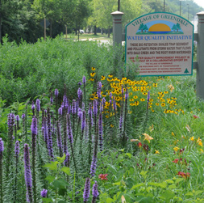
Stony Run GI
Chimborazo-Glenwood
Gillies Creek Park
Montrose Heights Connector
Proposed Projects within Greenway Area:
2
BIORETENTION
1
3
CURB BUMP-OUTS
4
NATIVE PLANTINGS

Slide 17
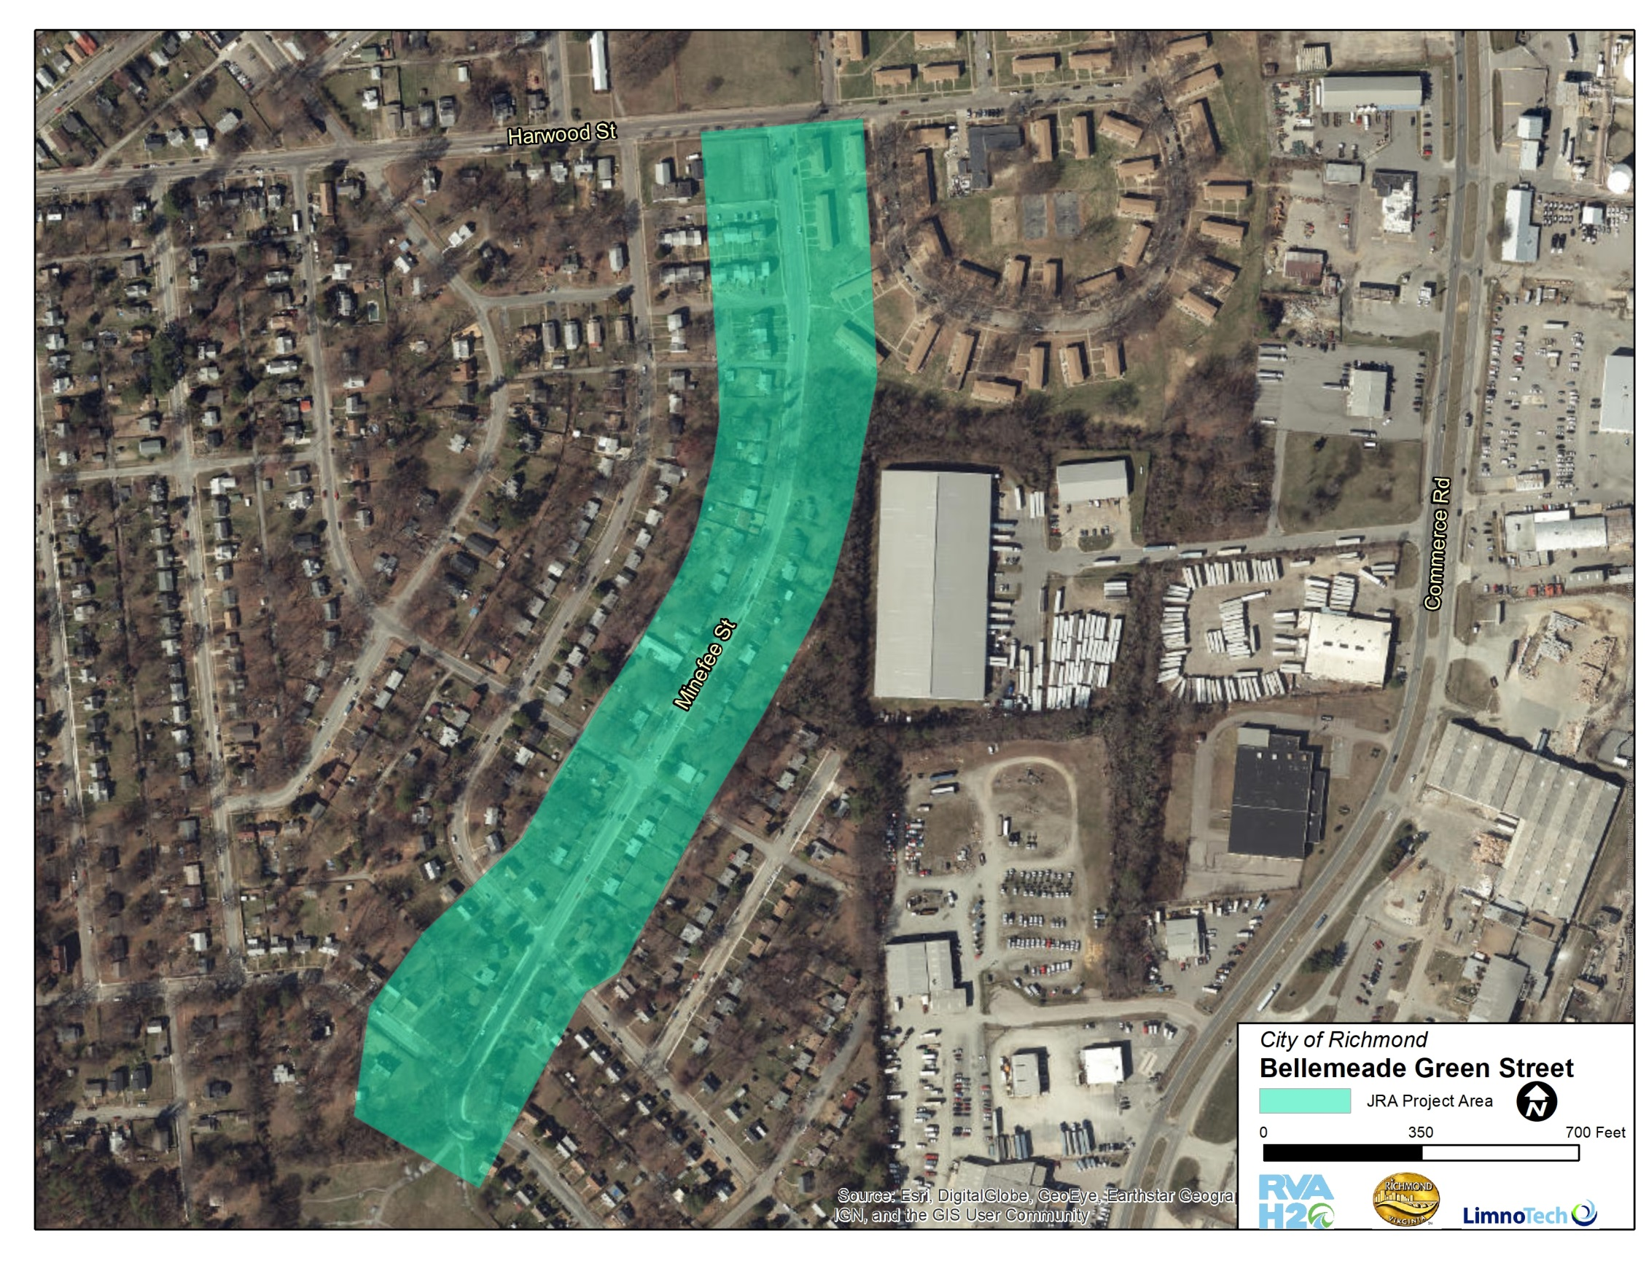
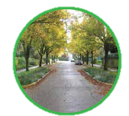
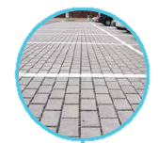
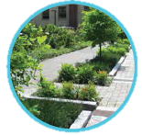
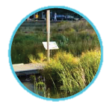
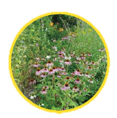
Part of JRA’s Bellemeade Walkable Watershed Plan:
big project area
Permeable concrete bike lane
Permeable parking
Bioswale planters
Impervious surface reduction
Native plantings
72 new trees
TREE CANOPY
PERMEABLE PAVEMENT
BIORETENTION
WET MEADOW
NATIVE PLANTINGS

Slide 18
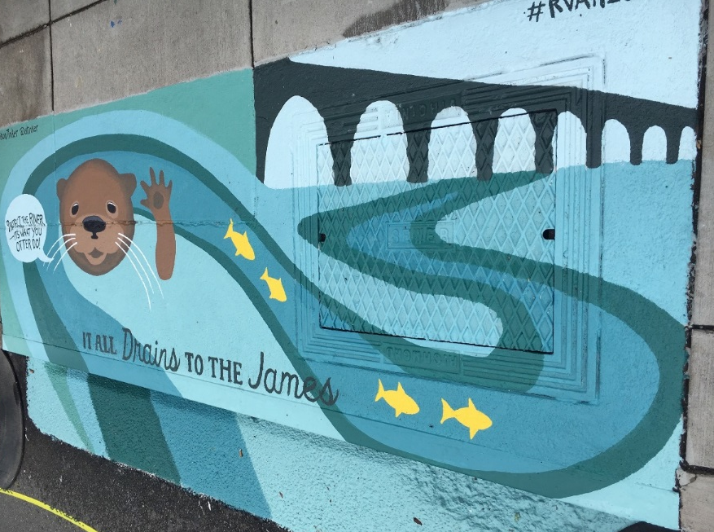
Clean Water Plan - Next Steps
Continue Stakeholder conversations to:
Move projects forward
Discuss funding opportunities
Identify future projects

Slide 19
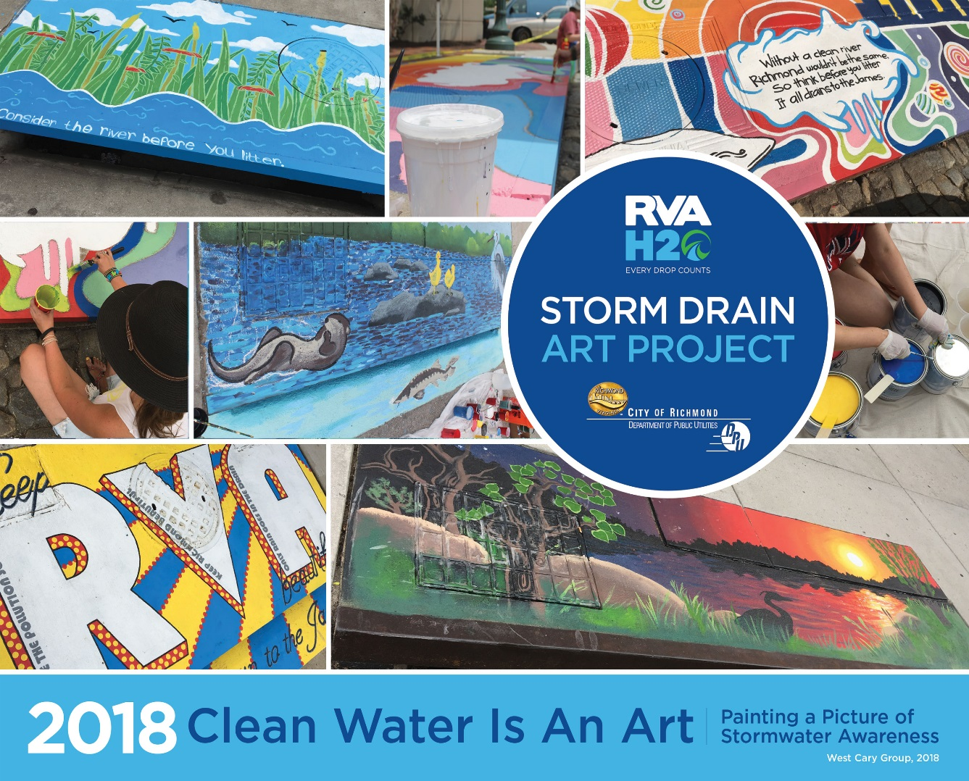
Public Outreach
Storm Drain Art
Tredegar
VCU
Carytown
Where should we go next?

Slide 20
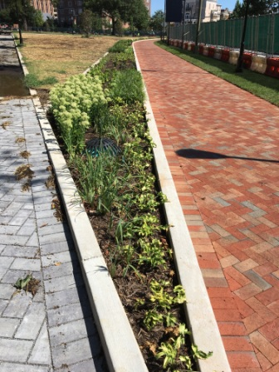
Monroe Park Green Infrastructure
Permeable Pavers
Bioretention planters
116 new trees
Public/Private Partnership
Notes:
Impervious area treated by pavers + bioretention = 2.15 acres
Trees will absorb > 250,000 gal of SW (at 15 years)
Park is in combined sewer system so all retained stormwater will reduce combined sewer overflows downstream.

Slide 21
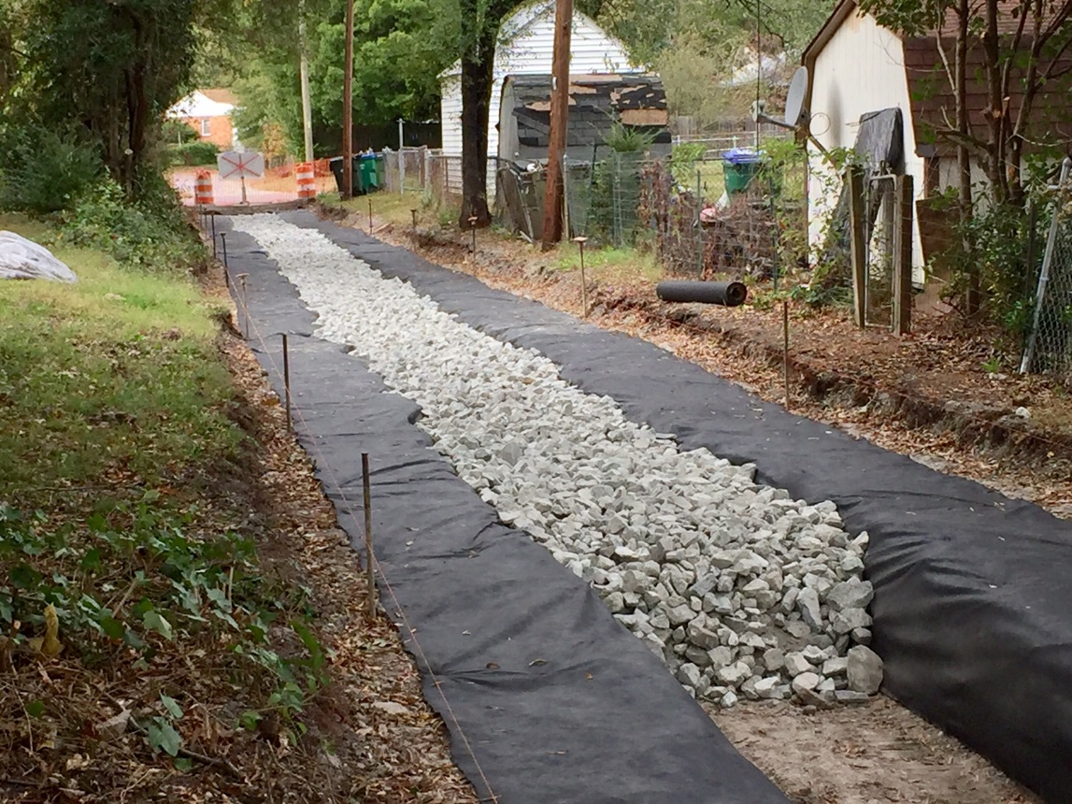
Other Considerations for GI
Hint: it’s not always about pollution reduction!
Reduce Flooding
Volume Reduction/Less SW in combined pipes
Reduction in maintenance costs
Heat Islands
Increasing property values
Fendall Ave. Green Alley during installation

Slide 22
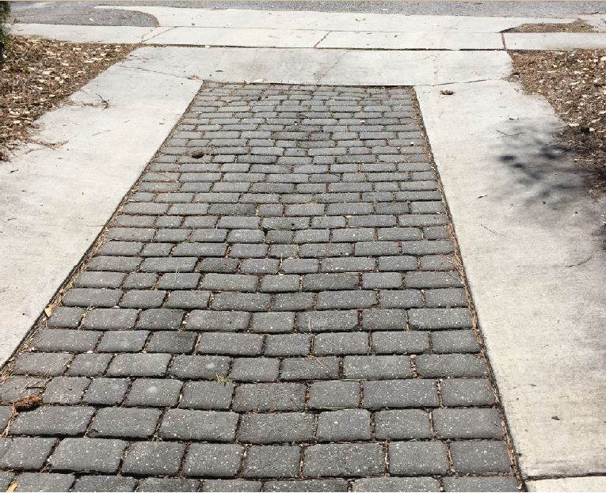
Other Applications/Uses for GI
Green Alleys:
volume reduction in CSS areas
lower cost long term vs gravel
lower maintenance costs
Must have proper equipment to sweep!

Slide 23
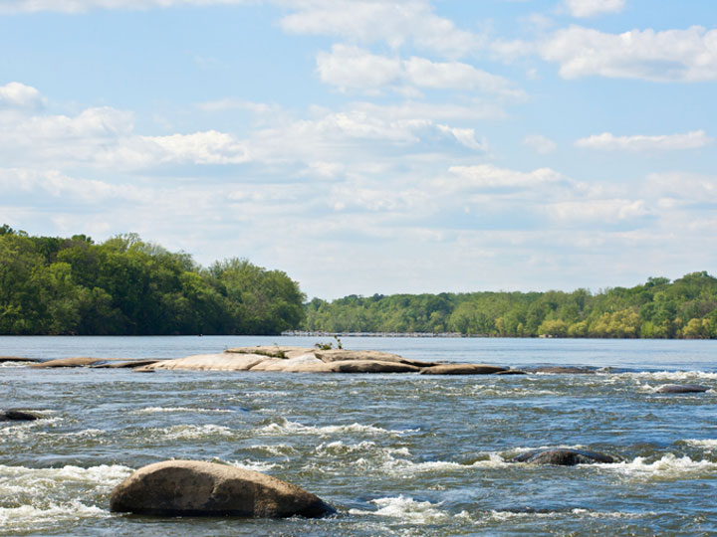
Questions/Discussion?
Jennifer Hatchett, PE
Department of Public Utilities
Jennifer.Hatchett@Richmondgov.com

