Slide 1
Ensuring Participation

Slide 2
Hello!
My name is Kristin Saunders
I am the Cross Program Coordinator

Slide 3


Slide 5
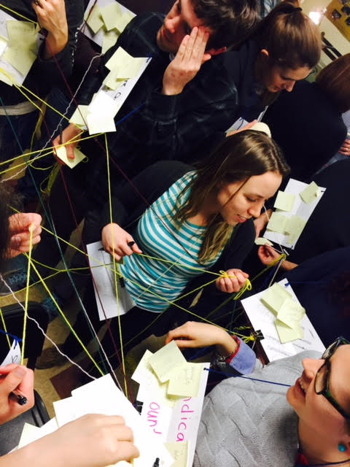

Slide 8


Slide 9
Our process is easy
What?
Who?
How?

Slide 10


Slide 11
Thanks!
Any questions?
You can find me at:
ksaunders@umces.edu
410-267-5711

