Slide 1


SAV Group:
Reproduction and persistence strategies
Eric Bricker
March 31, 2016

Slide 2
Zieman
Research
(Bricker & Furman)
Students
(McGlathery)
New Hire
Coastal Ecology
Infrastructure
(Frankovich)

Slide 3
Research
FWRI
St Pete Florida
(Furman)
Florida Bay
(Bricker & Furman)
Northeast Coast
(Bricker)
Marsh Species
(Bricker)

Slide 4
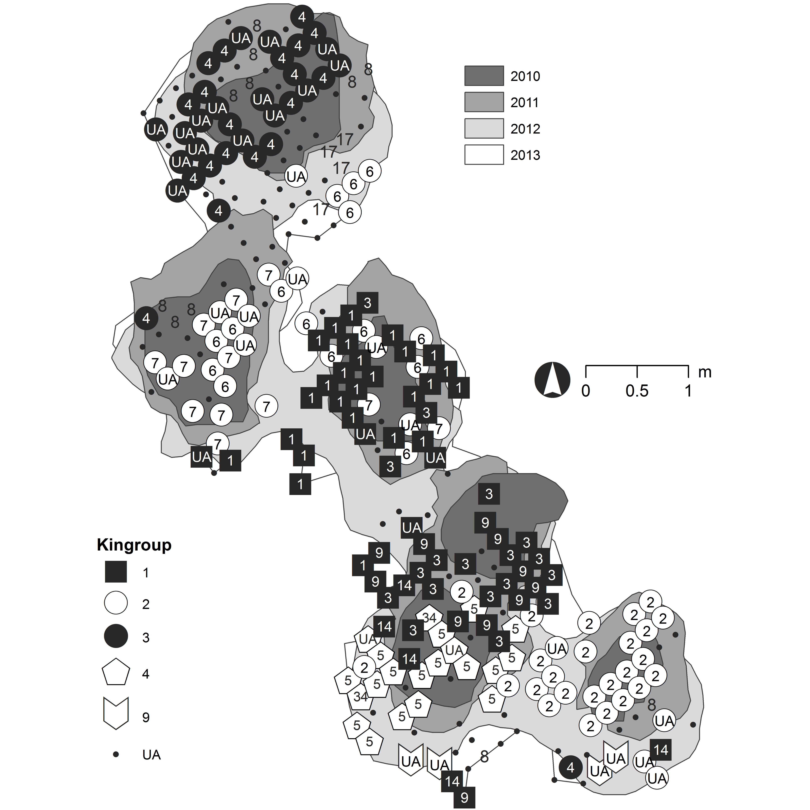
Past Success
Genetics
Integrating genetics and GIS to quantify patterns in both space and time…
Quadrat
&
Transect
GIS

Slide 5
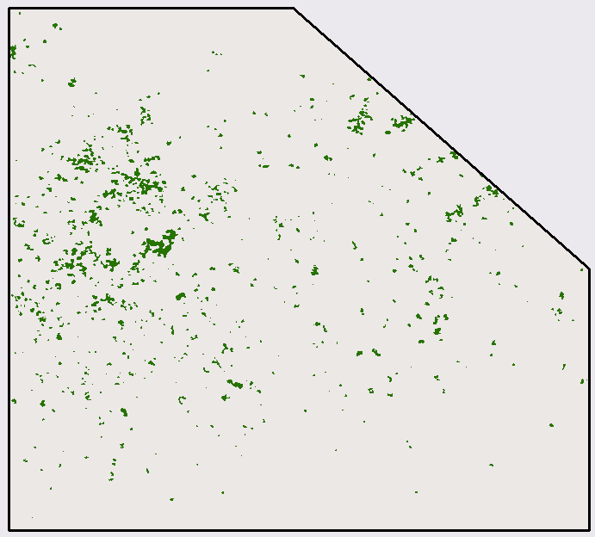
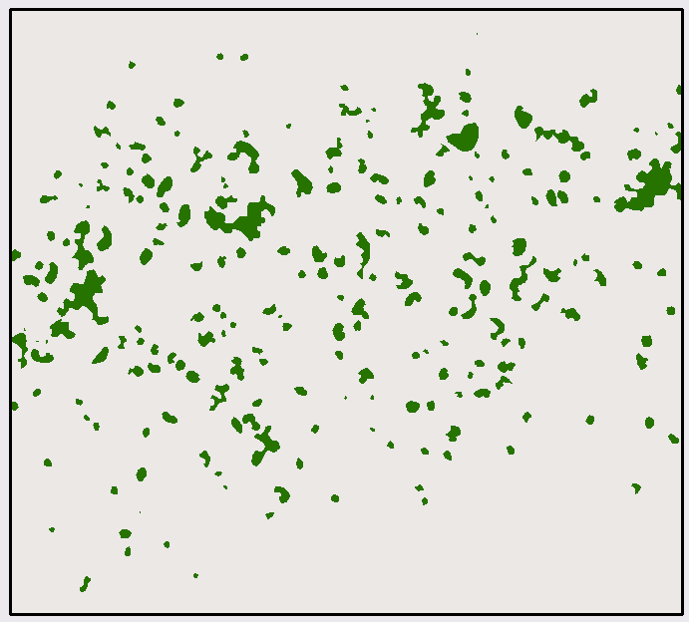
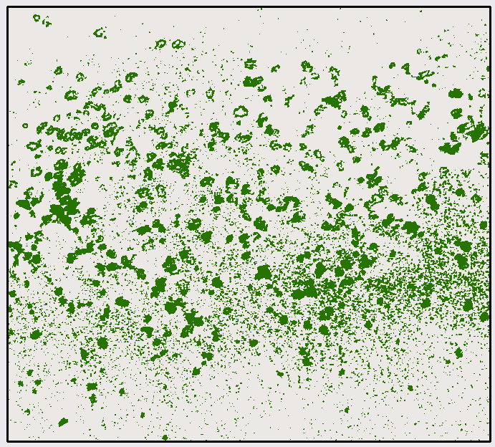
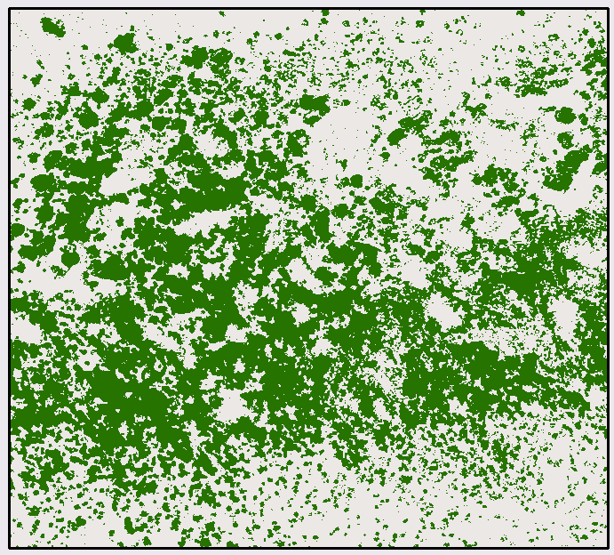
General Approach
Data Discovery & Literature Review
Historical Reconstruction
Genotypic Surveys
2001
2006
2010
2014

Slide 6
Data Discovery & Literature Review
Historical Reconstruction
Genotypic Surveys:
Long Island
Clone structure ~3m across a 56,250-m² study site.
Pollination 0.57 m to 73.91 m
Seeds show systematically dispersal 1.85 m to 5.31 m for naked seeds
Random dispersal throughout the study site (0.17 m to 34.54 m) for seeds deposited by floating reproductive shoots.
Pedigree analyses show full sibling groups clustering within larger half-sibling kinships at spatial scales of 2-6 m.
Documented four-year period sexual reproduction and seedling recruitment played appreciable roles in the colonizing process of Z. marina

Slide 7
General Approach
Data Discovery & Literature Review
Historical Reconstruction
Genotypic Surveys
Long Island
Configuring the landscape through the deposition of rafted seeds, and contributing to patch expansion via the limited dispersal of naked seeds.

Slide 8
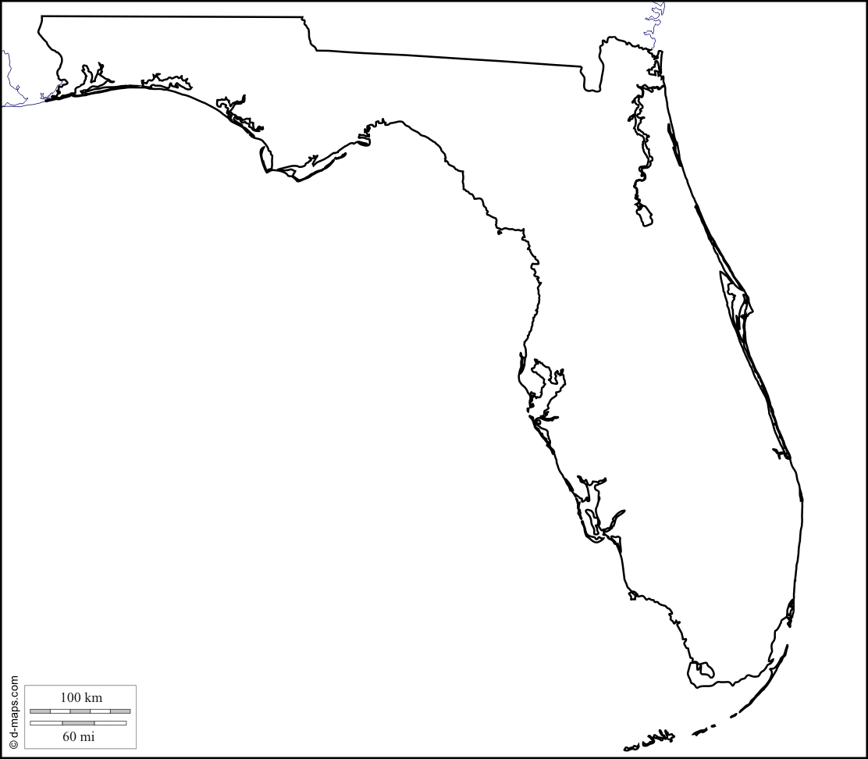
Past Success
Genetics
Large spatial scale sampling
Quadrat
&
Transect

Slide 9
Past Success
Genetics
Large spatial scale sampling
Quadrat
&
Transect

Slide 10
Early Question: Thalassia testudinum
What is a population size?
Demographic definition – Trillions of ramets
Genetic/Scientific – Who Knows? Theoretically N=1 to N=Trillions
Notes:
This layout functions well as a section opener.

Slide 11
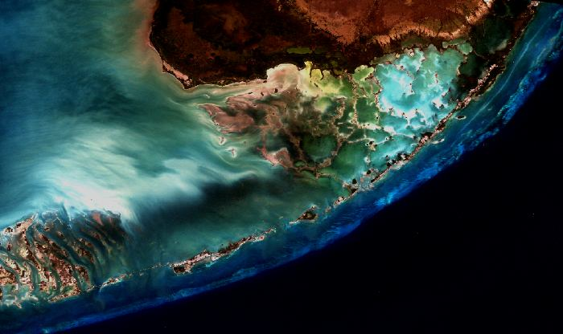

Everglades Ecosystem
Terrestrial Everglades
Aquatic Everglades: Florida Bay
Notes:
This layout functions well as a section opener.

Slide 12
Thalassia testudinum displays conspicuous variability throughout Florida Bay in:
primary production
leaf morphology
short shoot density
allometric relationships
Early Question: Highly clonal ecotypes?
Does genetic population structure match area specific variability?
Notes:
This layout functions well as a section opener.

Slide 13
Evidence suggests:
Thalassia testudinum in Florida Bay a single interbreeding population
Clonal growth only affecting population structure at very small spatial scales
No large-clone ecotypes

Slide 14
Questions about reproduction and persistence strategies:
At what spatial scale is clonal domination affecting population structure?
What are the spatial scales that we can detect the signal of systematic sexual reproduction?
What are the spatial scale of detectible gene flow?

Slide 15
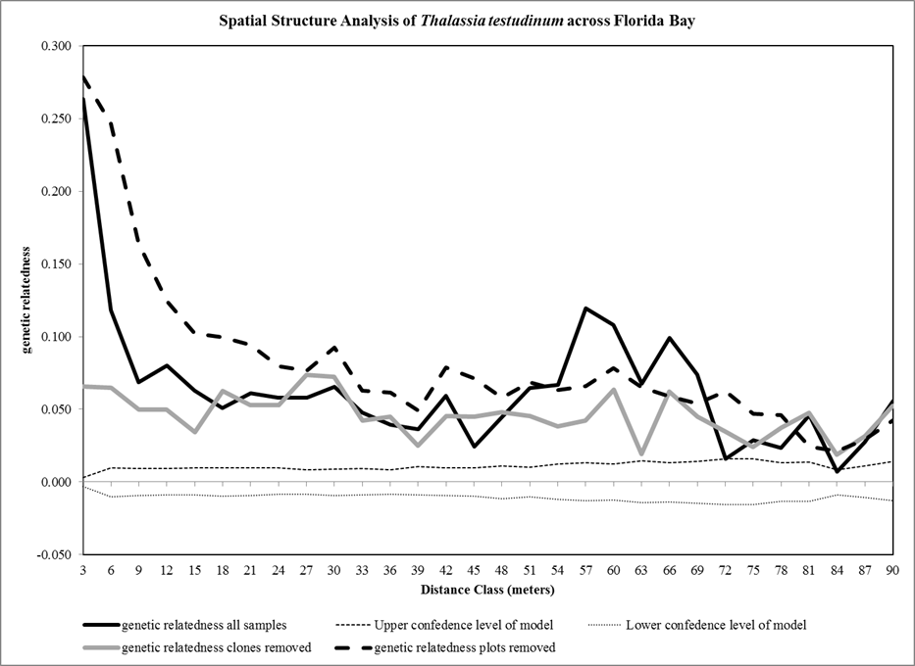
Genetic structure of Thalassia testudinum in Florida Bay

Slide 16
Current Question: What is the appropriate scale to understand population structure

Slide 17
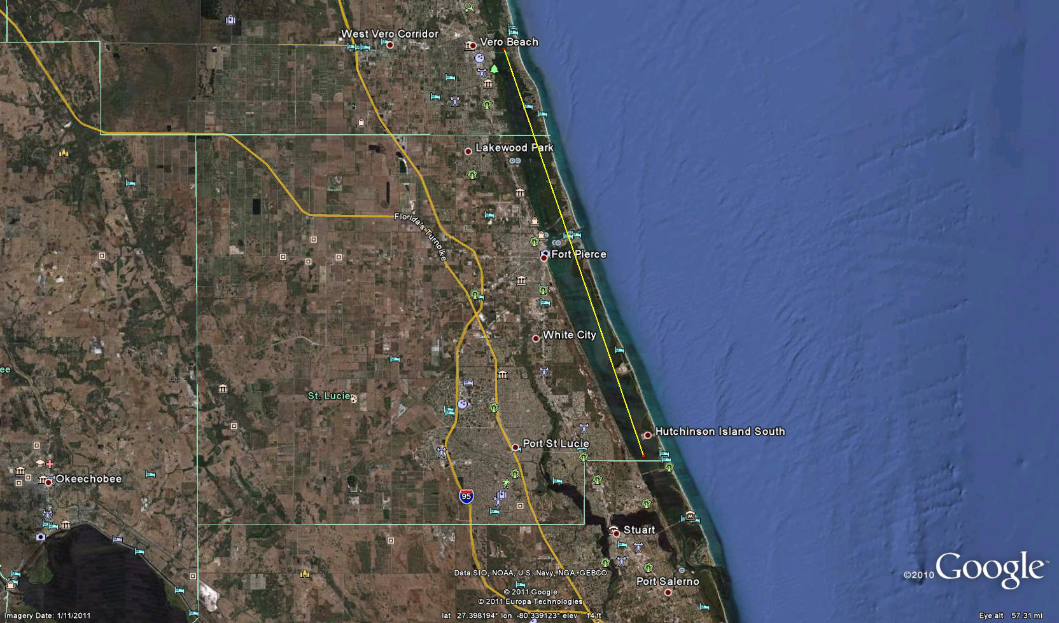
47 km
Genetic structure of Thalassia testudinum in IRL

Slide 18
Millions of Ramets
Effective population size n=1
Only genet at 8 of the 10 sampling sites

Slide 20
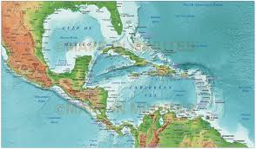

Slide 21
Everglades Ecosystem
Notes:
This layout functions well as a section opener.

Slide 22
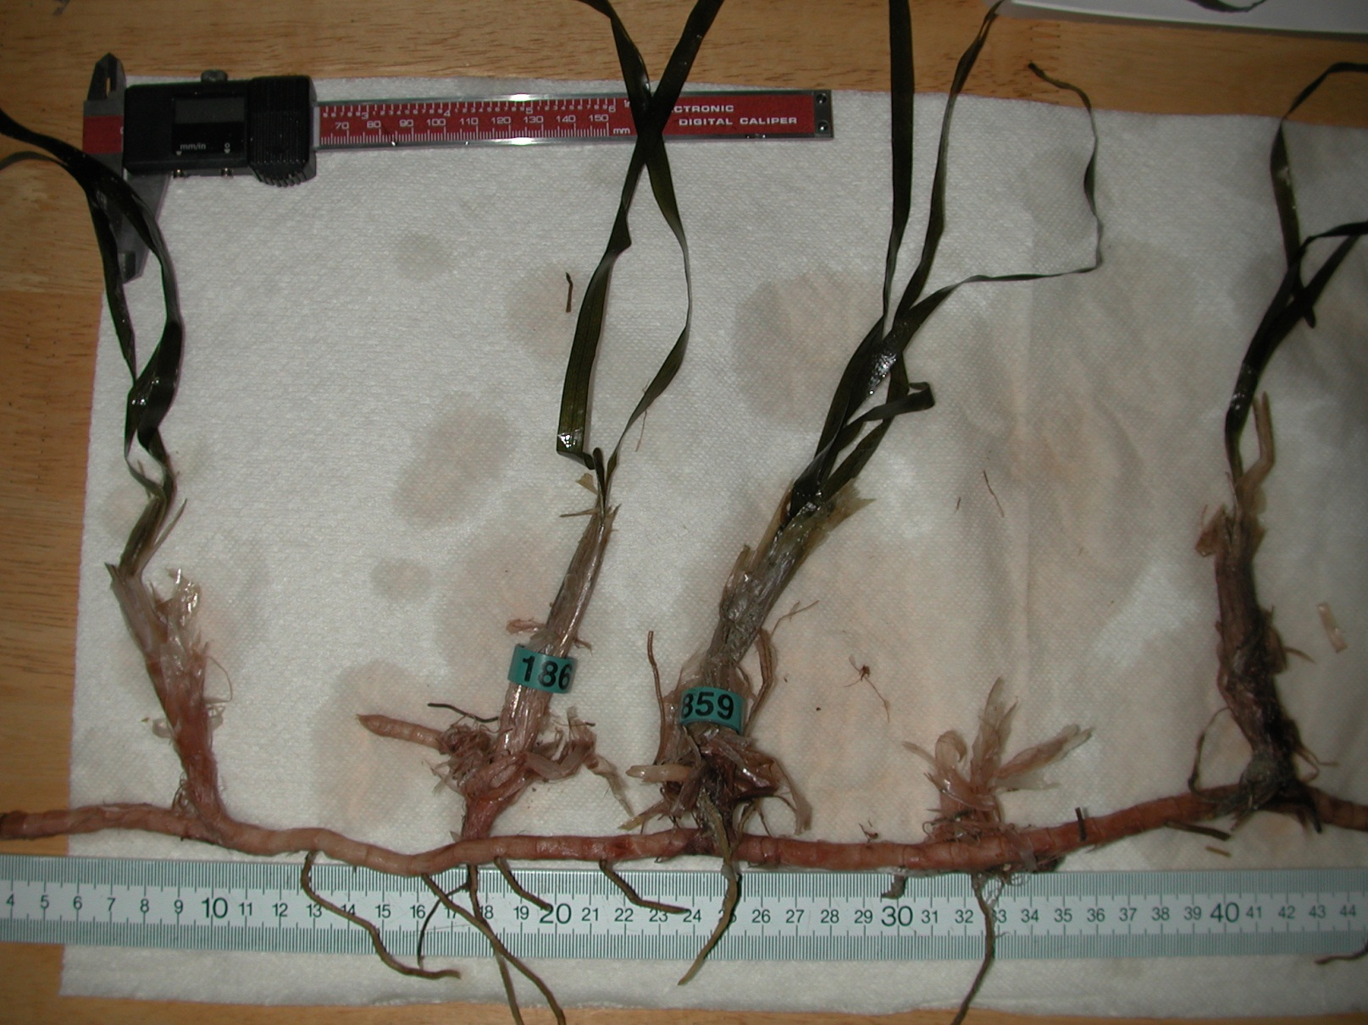
Overview of Thalassia testudinum
Notes:
This layout functions well as a section opener.

Slide 23
Thalassia testudinum
Animation of Thalassia testudinum rhizome growth
A model of plausibility – only semi-empirically based

Slide 54
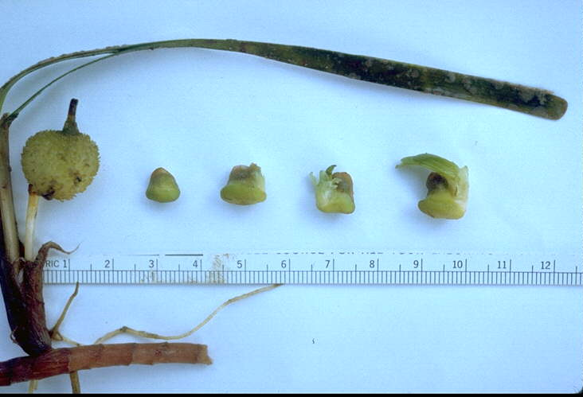
Overview of Thalassia testudinum
Notes:
This layout functions well as a section opener.

Slide 55
Everglades Ecosystem
Notes:
This layout functions well as a section opener.

Slide 56
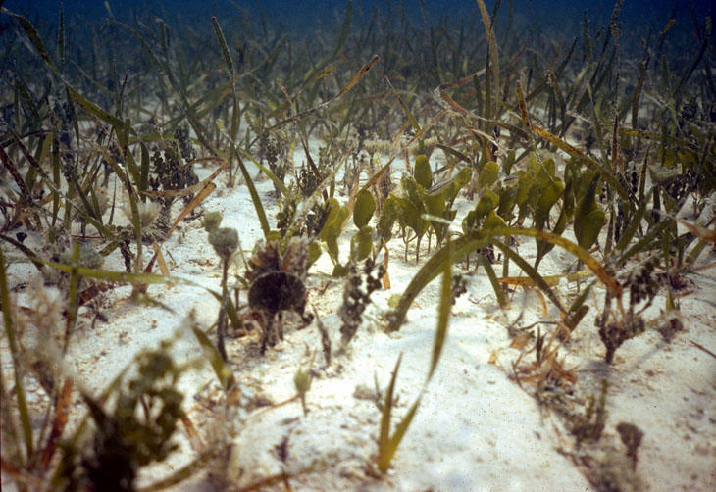
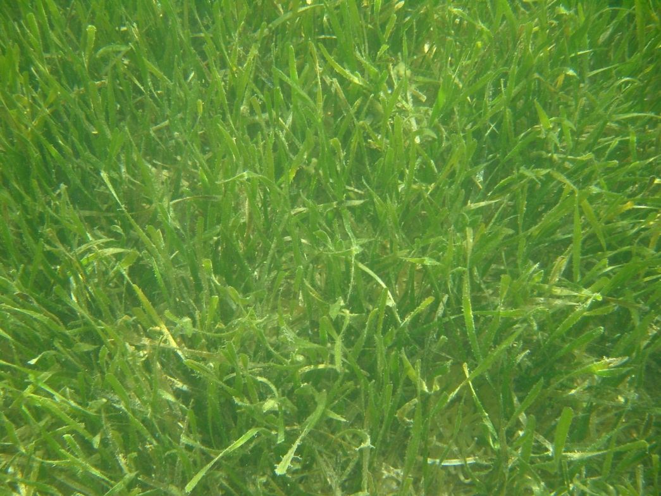
Spatial changes across Florida Bay
Notes:
This layout functions well as a section opener.

Slide 57
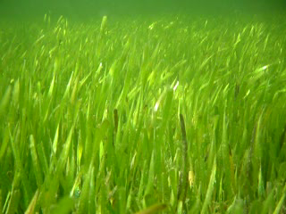
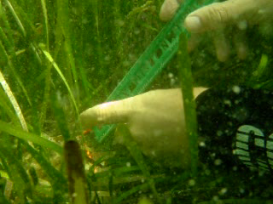
Pre-genetics assumptions about population
Thalassia testudinum displays striking variability throughout Florida Bay in primary production, leaf morphology, short shoot density, alometric relationships.
Population assumed to be highly clonal group of ecotypes.
Notes:
This layout functions well as a section opener.

Slide 59
Duck
Study
Sites

Slide 60
Nest
Study
Sites

Slide 61
Eagle
Study
Sites

Slide 62
Bob Allen
Study
Sites

Slide 63
Whipray
Study
Sites

Slide 64
Rankin
Study
Sites

Slide 65
Barnes
Study
Sites

Slide 66
Rabbit
Study
Sites

Slide 67
Johnson
Study
Sites

Slide 68
Aresnicker
Study
Sites

Slide 69
Study
Sites

Slide 70
Approximate Distance 45 km
Study
Sites

Slide 71
Genetic structure of Thalassia testudinum in Florida Bay
Methods
How to use segments of the DNA molecule

Slide 72
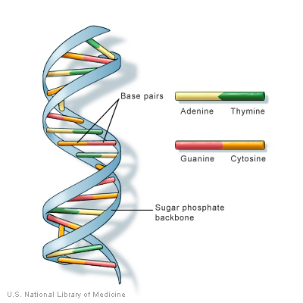
Genetic structure of Thalassia testudinum in Florida Bay
Methods

Slide 73
Genetic structure of Thalassia testudinum in Florida Bay
Results

Slide 74
Genetic structure of Thalassia testudinum in Florida Bay

Slide 75
Genetic structure of Thalassia testudinum in Florida Bay
Loci highly polymorphic
Average alleles > 11.000
Allelic richness = 6.632
Evidence of gene flow
N_{m} = 5.701

Slide 76
Genetic structure of Thalassia testudinum in Florida Bay
No evidence of inbreeding
F_{is}: 0.058
Thalassia in Florida Bay acting as single population
F_{st}: 0.033

Slide 77
Genetic structure of Thalassia testudinum in Florida Bay
Evidence suggests:
Thalassia testudinum in Florida Bay a single interbreeding population
Clonal growth only affecting population structure at very small spatial scales
No large-clone ecotypes

Slide 78
Genetic structure of Thalassia testudinum in Florida Bay

Slide 79
Genetic structure of Thalassia testudinum in Florida Bay
Does this represent a typical population structure for this species?
NO

Slide 80
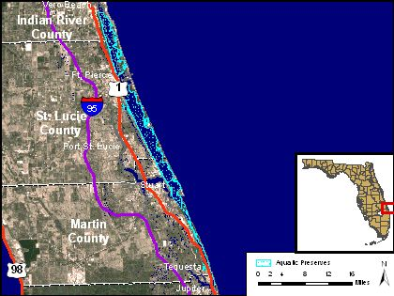
Genetic structure of Thalassia testudinum in Florida Bay

