Slide 1
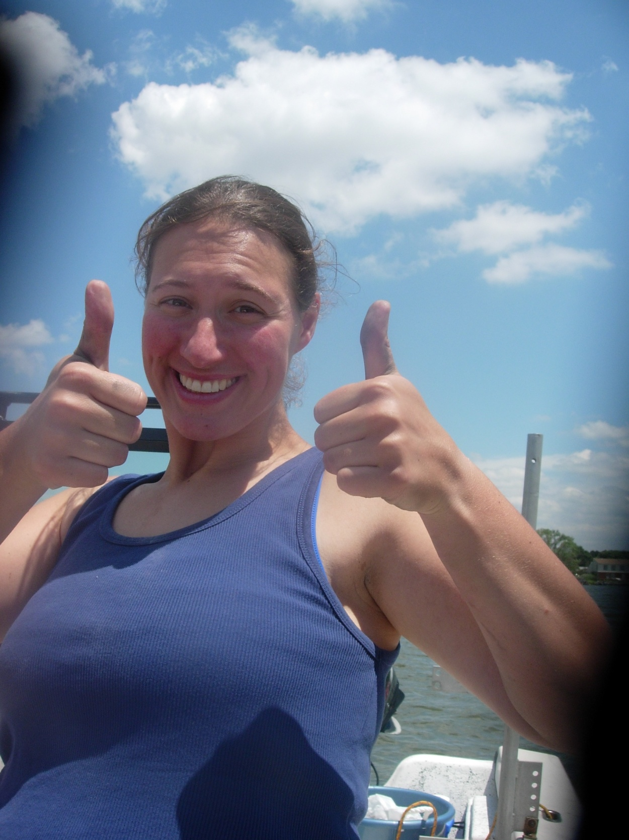
ENGINEERING WITH NATURE:
BREAKWATERS FOR
SAV HABITAT CREATION
Nicole Barth

Slide 2
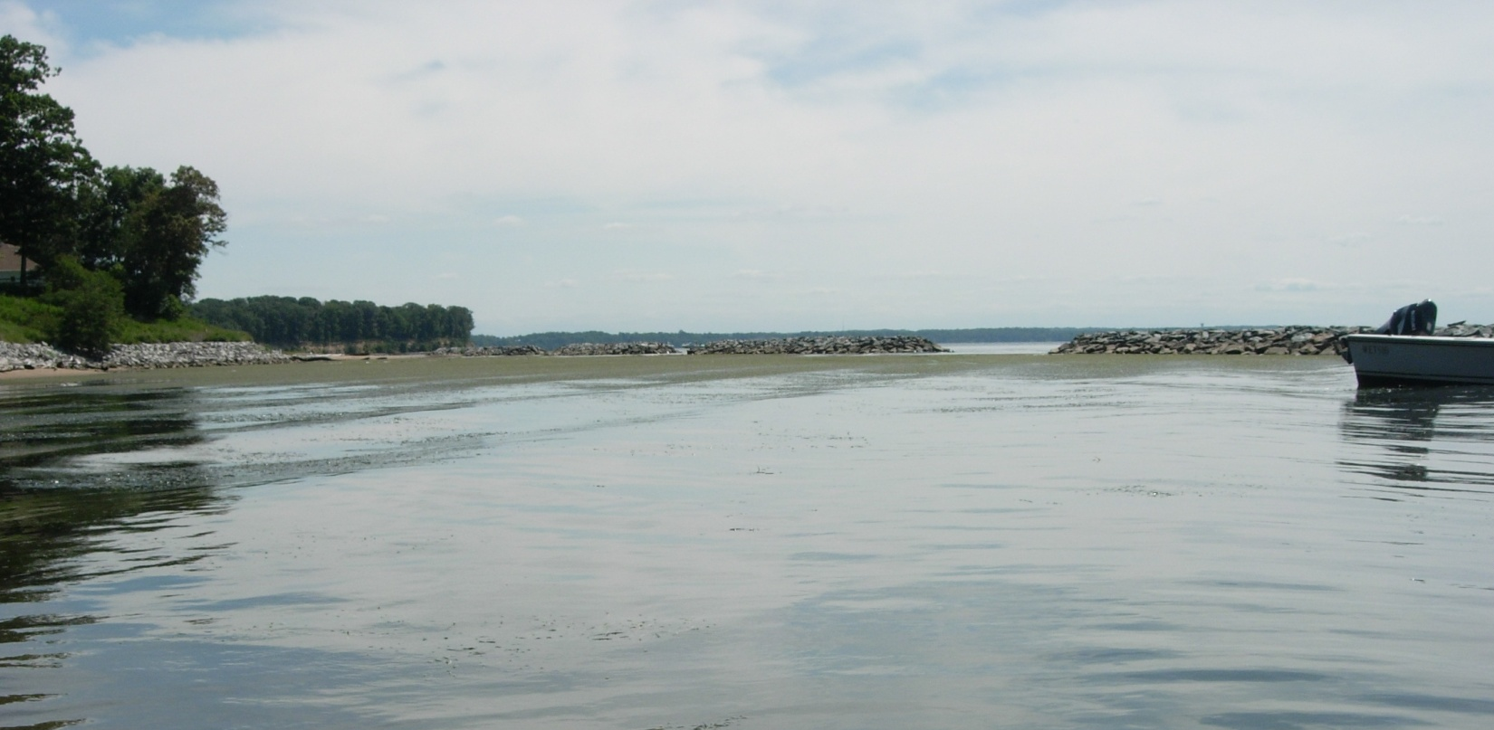
Breakwaters can be used to create
living shorelines (with SAV)

Slide 3
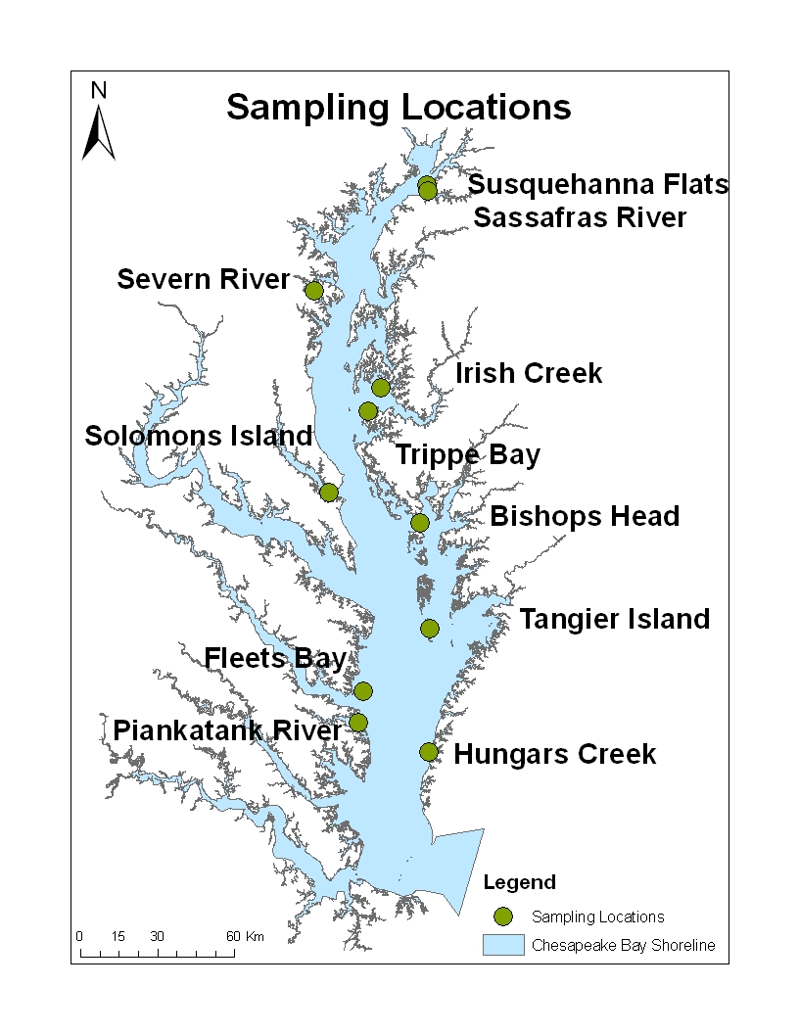
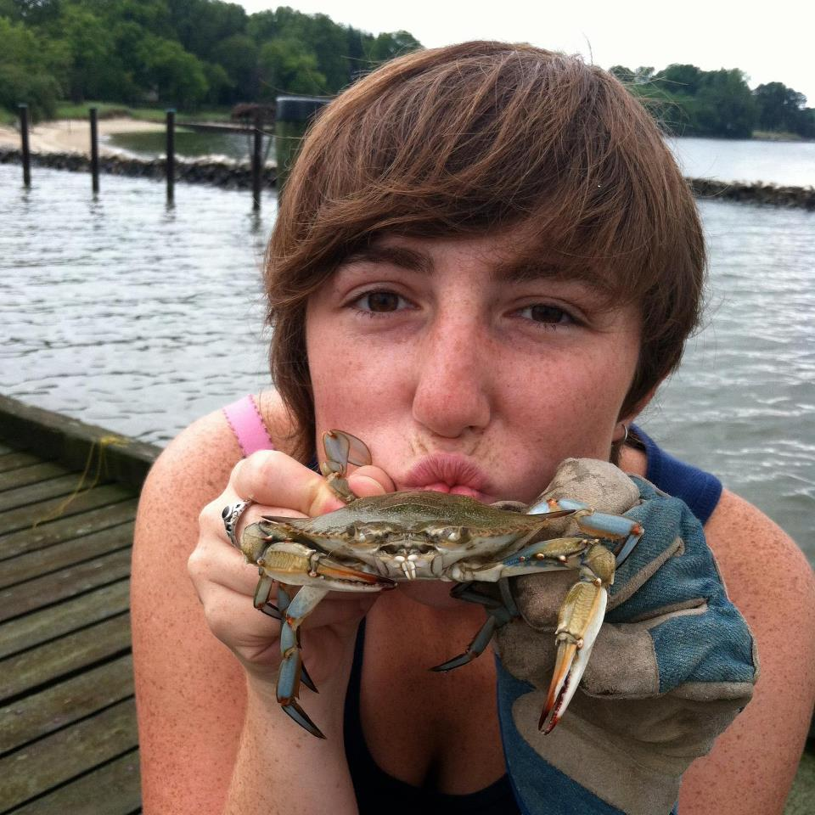
WATER FLOW AND SEDIMENT GRAIN SIZE
AS CO-VARYING
SAV HABITAT REQUIREMENTS
Becky Swerida

Slide 4
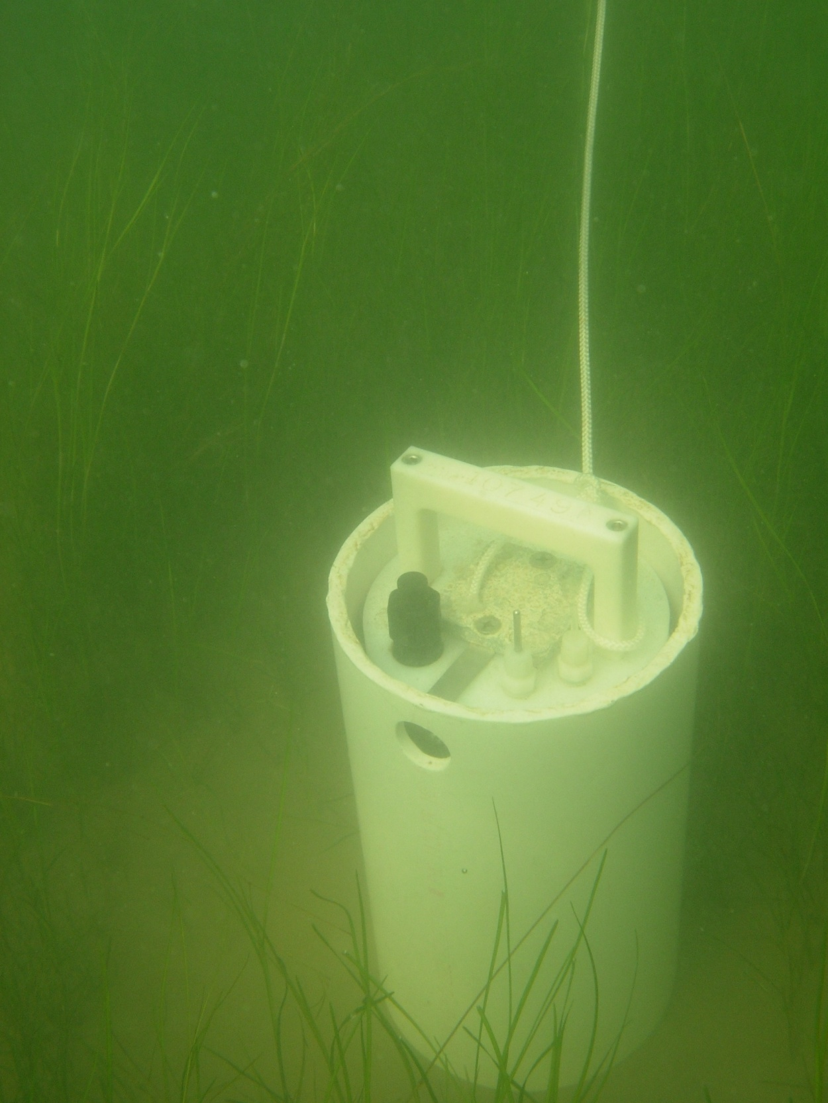
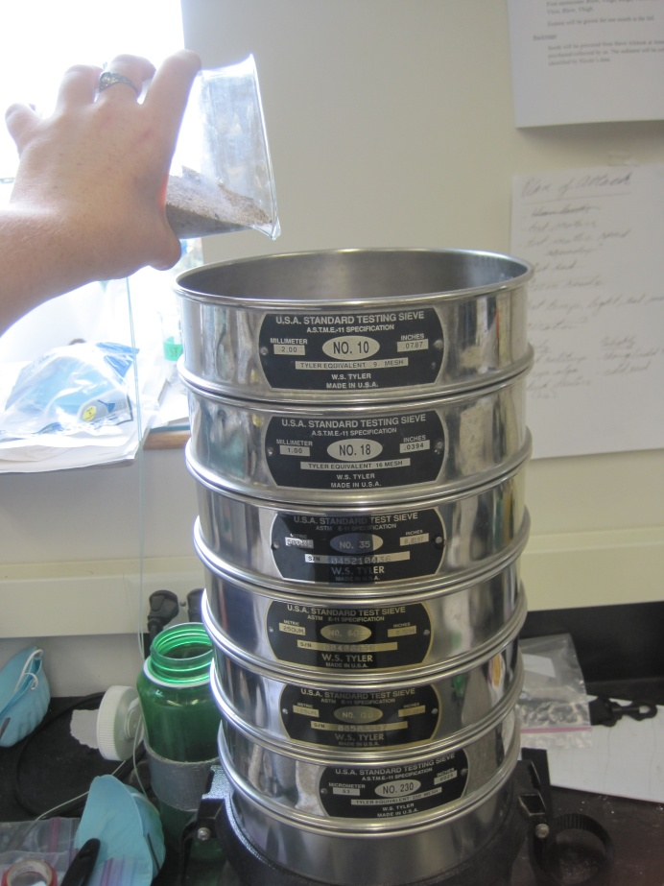
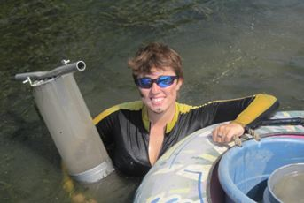
Field Methods
Wave Climate
Sediment Characteristics
SAV Biomass and Morphology
Notes:
Add picture of grass in tray

Slide 5
Calculated Orbital Velocity
*
*
*
*
*
*
*
*
NA
Sassafras
Susquehanna
| Sheltered | Exposed | Sheltered |
Notes:
Eduardo!
Orbital Vel graph
highest in mid
Summer, calmest time of year, underestimation

Slide 6
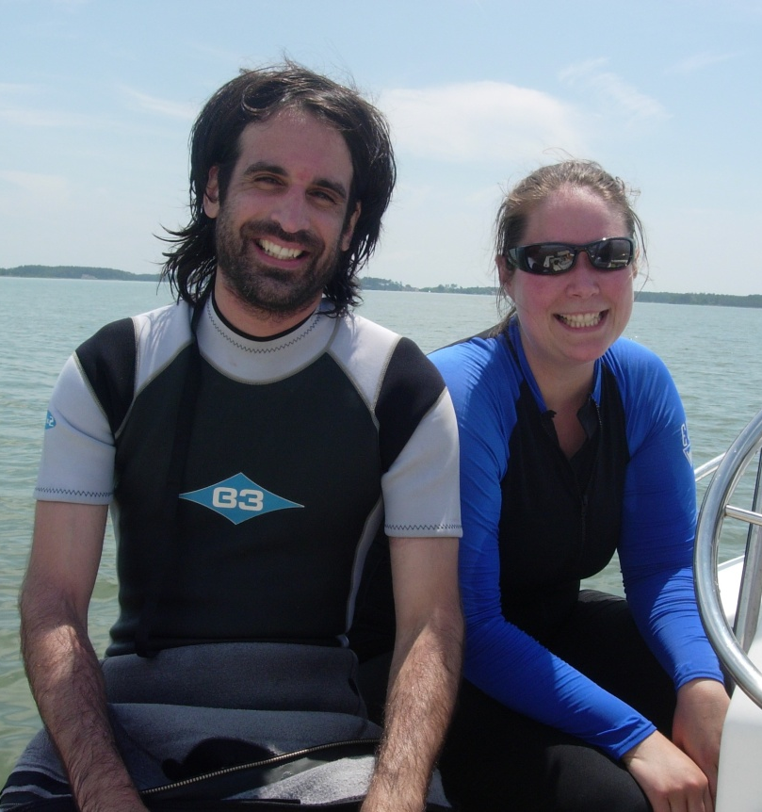
Orbital Velocity at Vegetated Sites
Notes:
Data from quiescent summer
Similar to Eduardo’s limitation of 35-42

Slide 7
Sediment Grain Size Distribution
MS
FS
*
*
*
*
*
*
VFS
*
ClSi
| Sheltered | Exposed | Sheltered |
Notes:
Grain graph
Mostly sav in fine sand, lowest in mid, also armoured, extremes such as port tobacco and Bishops different case from compacted
Note Susquehanna

Slide 8
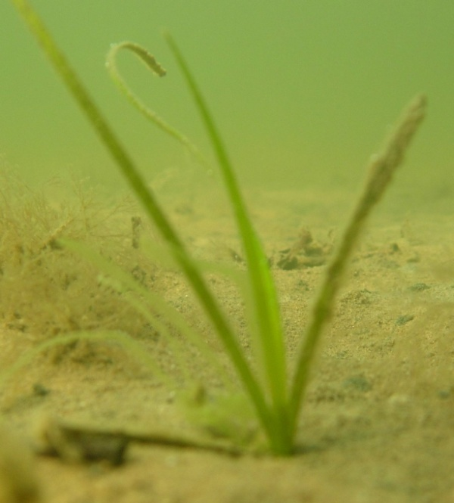
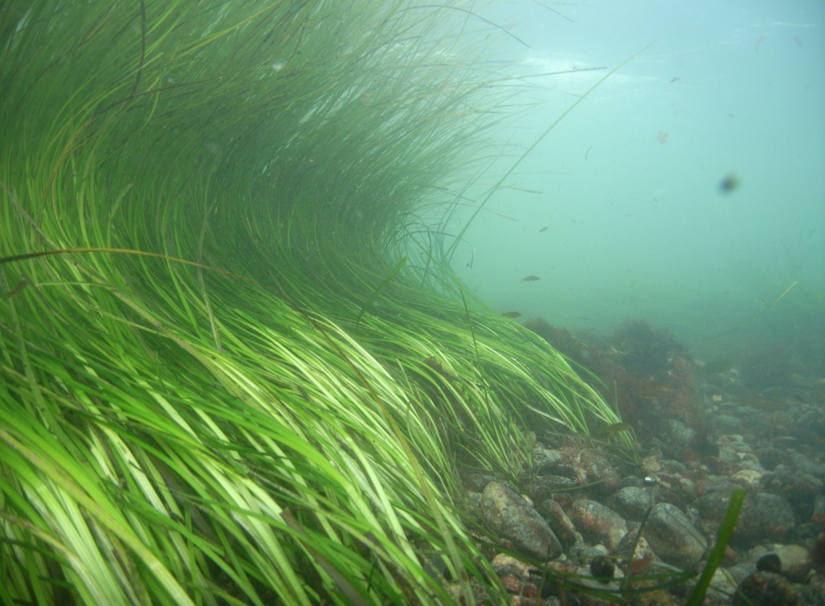
Grain Size in Vegetated Sites
Z. marina in soft sediment. Photo Evamaria Koch
Z. marina in armored sediment. Photo Chris Pickerel

Slide 9
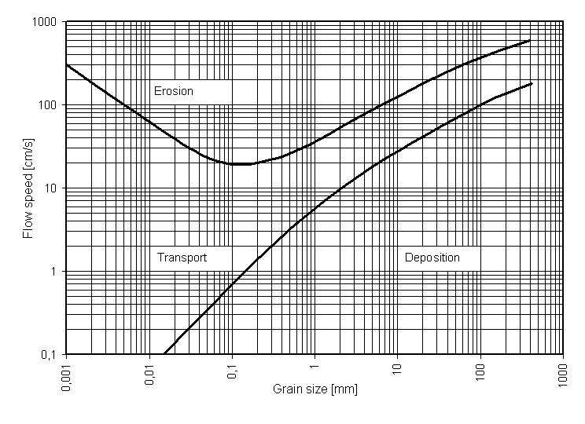
Bedload Transport
5 to 25 cm/s
Very fine sand and fine sand

Slide 11
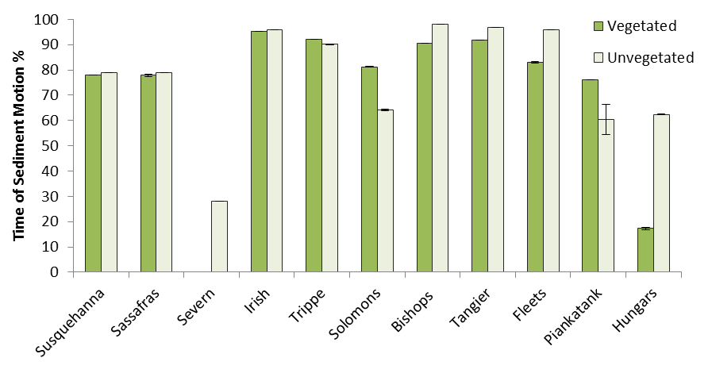
NA
The percentage of shear stress events meeting or exceeding the Shields derived critical shear stress
for the mean D50 at each vegetated and unvegetated site.

Slide 12
Flow-Sediment-SAV Relationship in Controlled Mesocosm Experiment
Sediment Type | Water Flow | Sediment Motion
Coarse Sand | 0 cm s⁻¹ | Deposition
Coarse Sand | 4 cm s⁻¹(±1 SE) | Bedload Transport
Coarse Sand | 24 cm s⁻¹(± 3 SE) | Erosion
Very Fine Sand | 0 cm s⁻¹ | Deposition
Very Fine Sand | 4 cm s⁻¹ (±1 SE) | Bedload Transport
Very Fine Sand | 24 cm s⁻¹ (± 3 SE) | Erosion
Work on Fluid Dynamics by Daily and Harleman
Notes:
State organic content CS: 0.35% VFS: 4.35%
Standard open channel flow equations
Point: Describe experimental design creating sediment motion conditions for 2 species of SAV
Experimental design. 3 reps of each treatment

Slide 13
Flow-Sediment-SAV Relationship in Controlled Mesocosm Experiment
Bedload Transport
Suspended Transport
Notes:
Point: Grain sizes and water flows were selected based on Hjulstrom and Shields relationships
Water flow and sediment grain sizes chosen based on Hjulstrom and Shields. Large and small sediment grain sizes from known SAV beds, sediment collected from Mason Neck, a previously studied site inhabited by SAV. Flow velocities chosen to generate shear stress necessary to create different types of sediment motion according to the Shields and hjulstrom diagram.

Slide 14
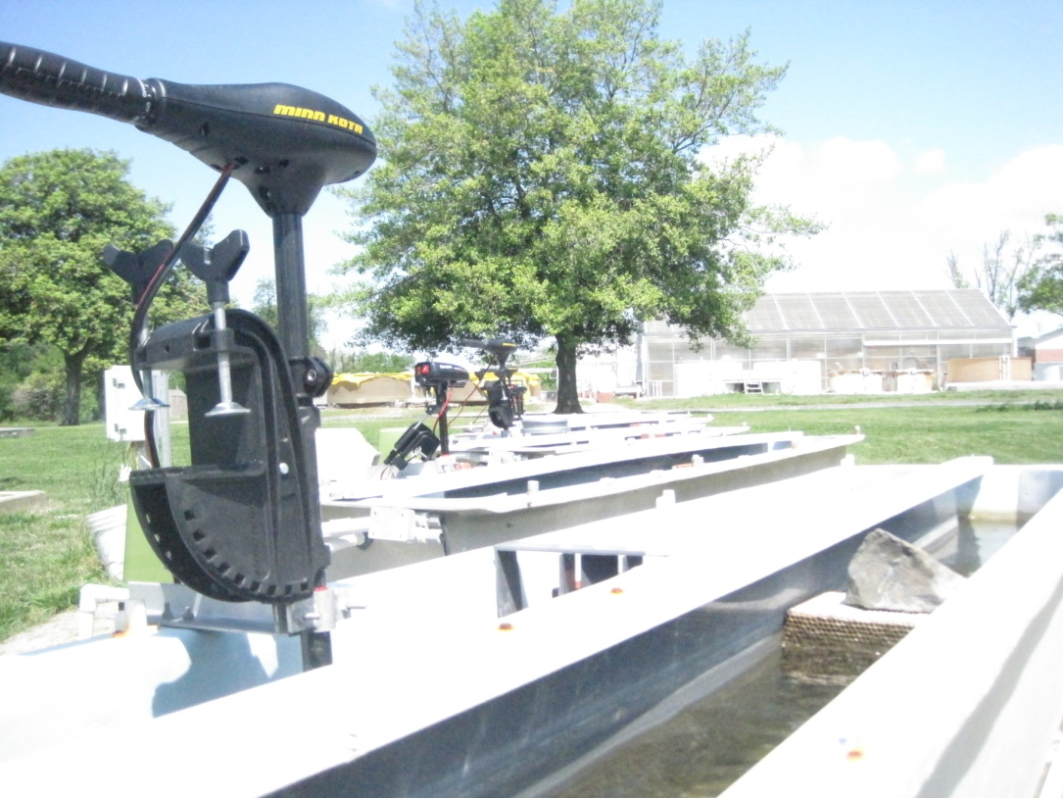
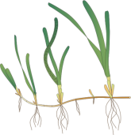

Collimator
Unvegetated Substrate
Z. marina
Coarse Sand
Ramp
R. maritima
Ramp
Z. marina
Very Fine Sand
Motor
R. maritima
Unvegetated Substrate
Flow Straightening Levers,
Collimator
Notes:
Point: raceway flume experimental set up

Slide 15
Biomass After 6 Weeks
(D) cm s⁻¹
Above-ground
(B) cm s⁻¹
(E) cm s⁻¹
*
*
*
*
*
*
Below-ground
*
*
*
*
Notes:
Point: Highest biomass was not grown in deposition. Biomass is significantly lower in coarse sand. In very fine sand, highest biomass grew under high water flow
Porewater nutrients!
Deposition treatments didn’t produce the highest biomass
Transport and erosion treatments produced highest
Sediment has clear effect
Nutrient limitation
Flow has effect
Drag
Nutrient access
Dispersal

Slide 16
Shoot and Root Density
(D) cm s⁻¹
Shoots
(B) cm s⁻¹
(E) cm s⁻¹
*
*
*
*
*
Roots
*
*
*
*
Notes:
Merge Discussion and Results
Deposition treatments didn’t produce the highest biomass
Transport and erosion treatments produced highest
Sediment has clear effect
Nutrient limitation
Flow has effect
Drag
Nutrient access
Dispersal

Slide 17
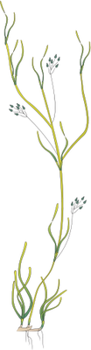
Reproductive Shoot Density
(D) cm s⁻¹
(B) cm s⁻¹
*
(E) cm s⁻¹
0
0
0
0
0
0
0
*
*
Notes:
Reproductive activity increased 4 fold with high water flow in organic rich sediment, erosion transport

Slide 18
Ecological Limitations
Excessively Energetic
Limited substrate stability
Excessively
Fine
Excessively
Coarse
Limiting toxicity
Limited light, turbidity
Limiting nutrient
concentration
Excessively Quiescent
Limiting boundary layers
Notes:
Mortally

Slide 19
R. maritima

Slide 20
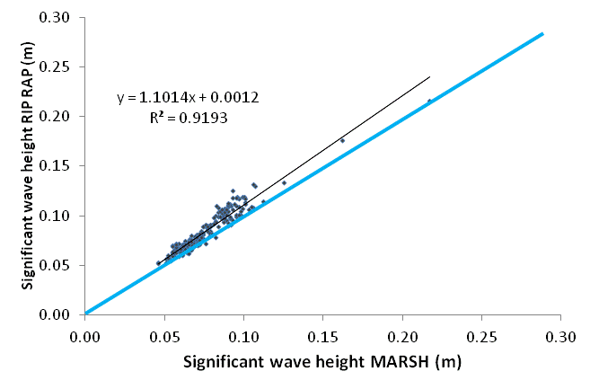
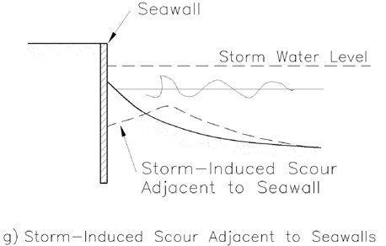
ST. MARYS (August 2012)
NOAA Project
Multiple stressors in coastal areas
with Lee and other colleagues in MD & VA
Reflected waves may be pushing SAV bed offshore and resuspending sediments
1.5 m

Slide 21
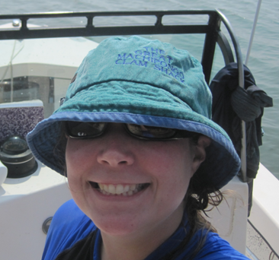
Seed dispersal via floating reproductive shoots of Zostera marina
(preliminary simulation results)
Dale Booth

Slide 22
Research Questions
PHYSICAL – BIOLOGICAL PROCESS - On what scale should dispersal of Z. marina reproductive shoots be considered?
GENETICS - Are seagrass meadows within given regions of the Chesapeake Bay linked as metapopulations by seed dispersal/recruitment processes?

Slide 23
The Model
The North et al. (2008) LTRANS model was developed to predict the movements of larval Crassotrea virginica larvae in the Chesapeake.
By applying similar principals we should be able to use the same model to predict the movements of passive floating Zostera marina shoots, incorporating model parameters based on buoyancy and transport velocities of floating reproductive shoots.
Once we have model predictions of transport distances, populations identified as connected by transport processes will be tested to determine the degree of relatedness using genetic analysis.

Slide 24
Preliminary Tests
Used arbitrary parameters to determine how to set up the simulation
Sites selected based on SAV indicated in VIMS aerial photography.
500 initial particles at each site (x’s 4 sites)
Hydrodynamic data from ROMS model simulations for May 1997

Slide 25
Preliminary Tests
Used arbitrary parameters to determine how to set up the simulation
Sites selected based on SAV indicated in VIMS aerial photography.
500 initial particles at each site (x’s 4 sites)
Hydrodynamic data from ROMS model simulations for May 1997

Slide 26
Preliminary Tests
Used arbitrary parameters to determine how to set up the simulation
Sites selected based on SAV indicated in VIMS aerial photography.
500 initial particles at each site (x’s 4 sites)
Hydrodynamic data from ROMS model simulations for May 1997

Slide 27
Preliminary Tests
Used arbitrary parameters to determine how to set up the simulation
Sites selected based on SAV indicated in VIMS aerial photography.
500 initial particles at each site (x’s 4 sites)
Hydrodynamic data from ROMS model simulations for May 1997

Slide 28
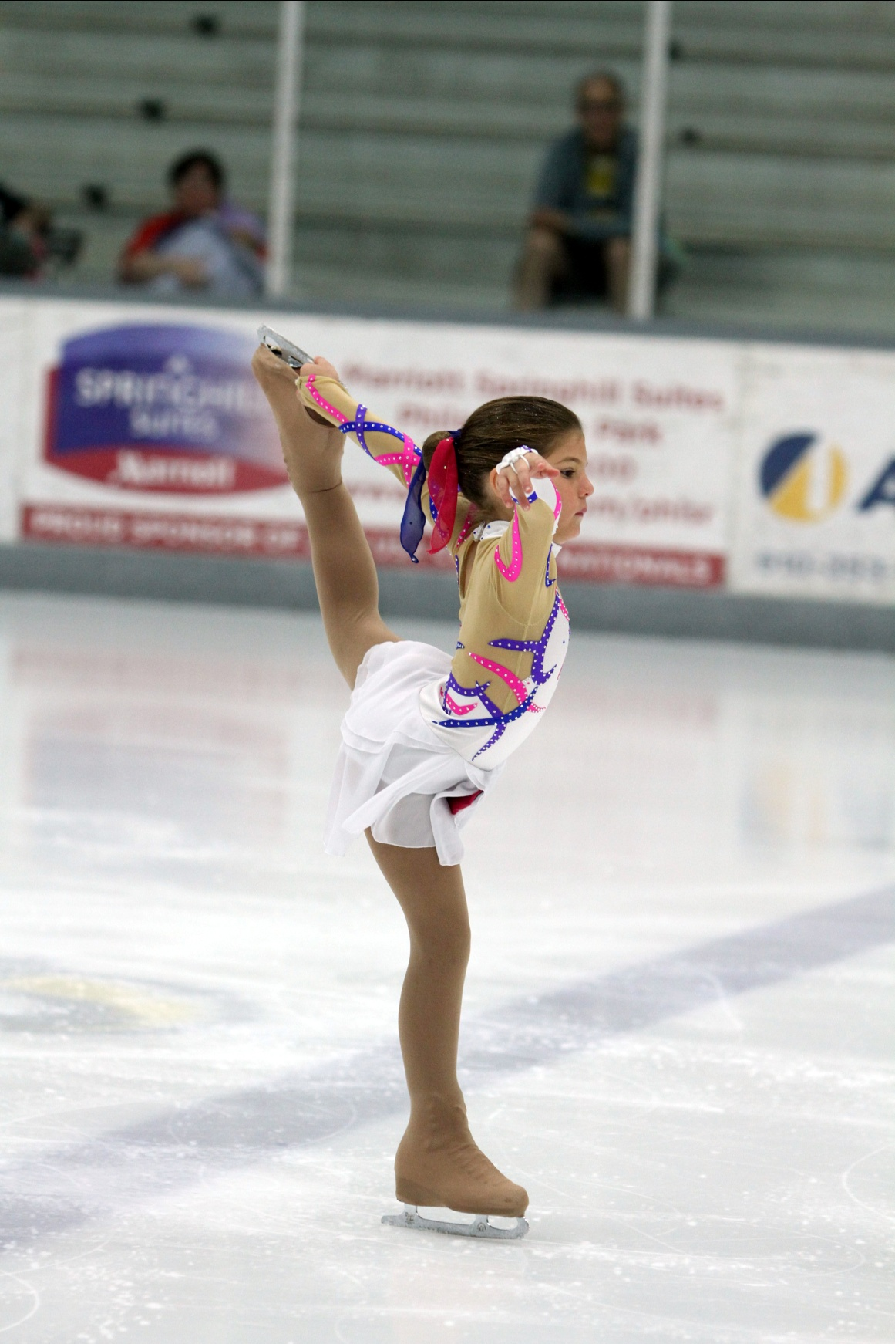
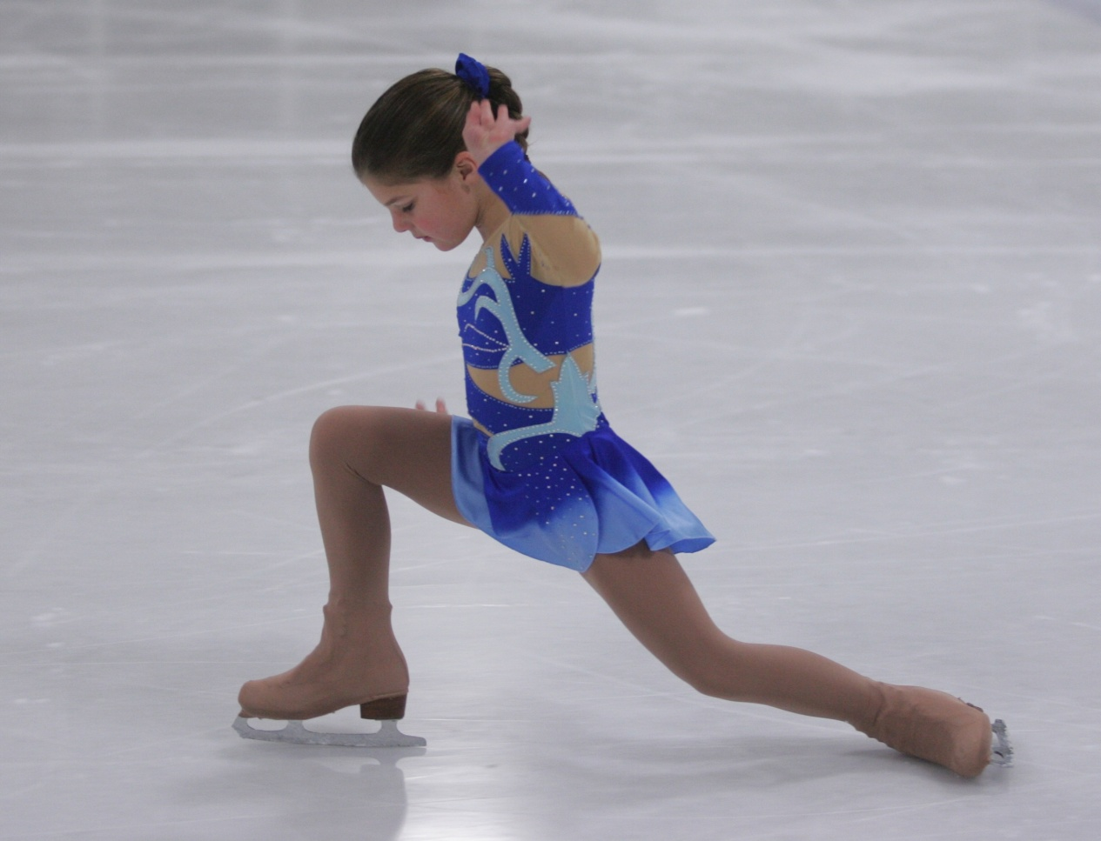

Slide 29
2013 Field Work
May-June 2013 we attempted to determine the rate of production of floating reproductive shoots at 3 sites located around Tangier and Smith Island.
Also performed laboratory experiments on shoot buoyancy and rate of seed dehiscence from mature spathes.
Once these data are processed we will incorporate the numbers into the simulations and rerun them using more recent hydrodynamic inputs.

Slide 30
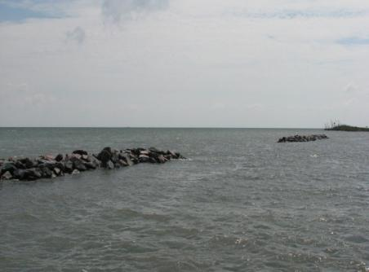
Conclusions
Breakwaters can sustain SAV populations as long as some habitat requirements are met:
Water quality – regional water quality needs to be good enough to support SAV growth
Water depth – deep enough so SAV can remain submersed at low tide
Sediment – needs to remain sandy (<35% silt+clay) with low organic matter (<5 to 8% organic matter) over time. Sedimentation rates >9mm/yr are also beneficial but no infilling (habitat becomes intertidal)
Fetch – breakwaters are most beneficial to SAV in long fetch areas (> 10 km)

Slide 31
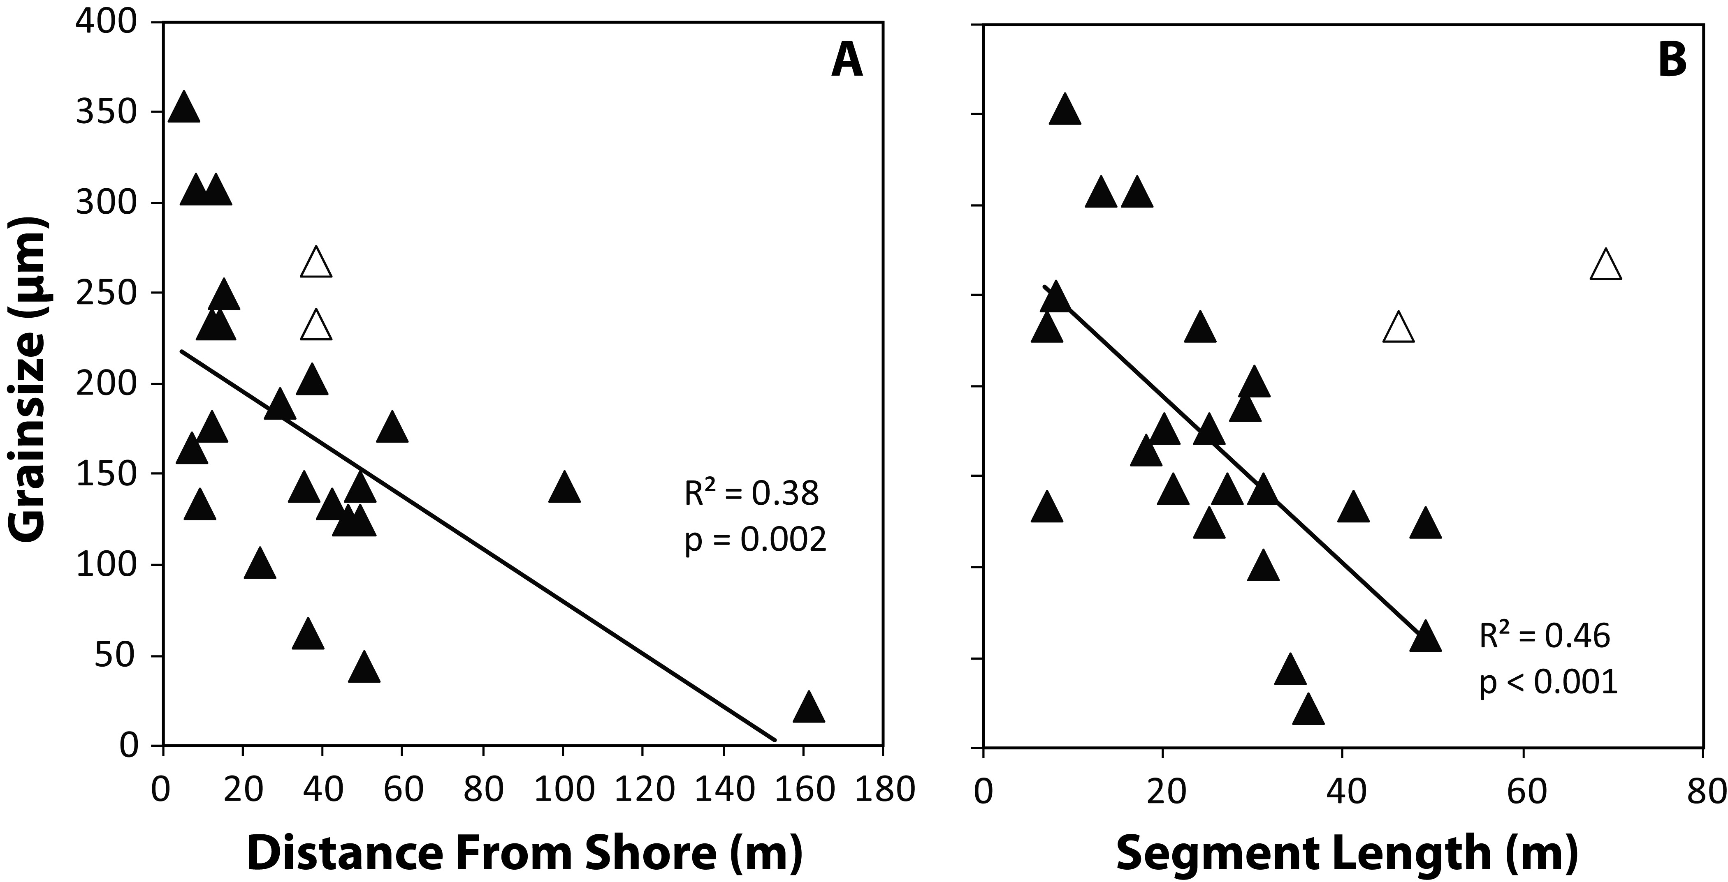
Management Recommendations
breakwater construction for SAV conservation and/or restoration

Slide 32
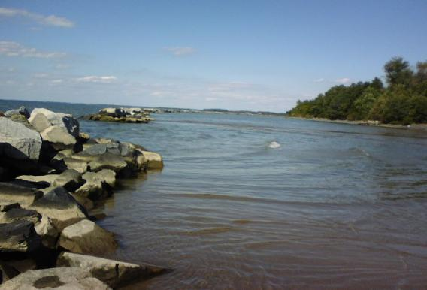

Slide 33
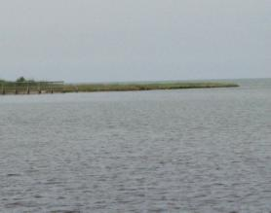
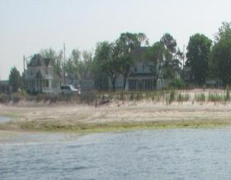
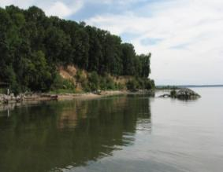
Management Recommendations
breakwater construction for SAV conservation and/or restoration
Shoreline characteristics also need to be considered:
Eroding Marshes –a layer of sand* needs to be added to cover the marsh peat in the sub-tidal
(*>2cm, Wicks et al. 2009)
Sandy Beach – breakwater beneficial to SAV especially when fetch > 10 km
Cliffs – base of cliff needs to be stabilized to reduce sediment input and shoaling breakwater-protected area

