Slide 1
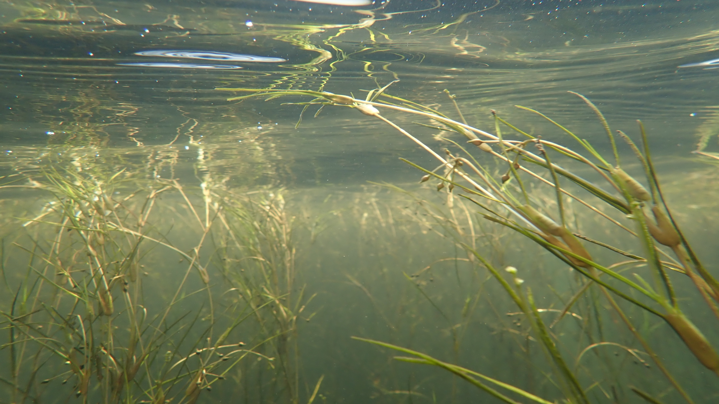
Submerged Aquatic Vegetation Biennial Work plan Updates
Paige Hobaugh, Brooke Landry, and Becky Golden

Slide 2

Overview of updated key actions
What actions or performance targets have been removed? Have been added? Why?
Several Key Actions were re-worded to make them more manageable, immediately actionable, and Climate Smart
Other actions were removed because they have been completed, or will be completed by the time the new biennial workplan is in effect (ex. TS III).
Three actions were added:
Work with the BFWG to create a finance strategy/system for the SAV Workplan
Create a scientifically rigorous but user friendly SAV monitoring protocol (HGIT funding)
Create a scientifically rigorous but user friendly SAV Monitoring Volunteer Certification Program (HGIT funding)
A previously unfunded key action, reviewing SAV regulations and making recommendations based on shortcomings to adequately protect existing SAV in the Chesapeake Bay, was also funded by HGIT
We are also working with the CBP Communications Workgroup to complete another unfunded action – enhance outreach – by putting together a SAV communications strategy.
What will be the focus of your new Workplan?
Focus on creating a more manageable and immediately actionable workplan that is also Climate Smart
We’re halfway to achieving outcome, and while 100% recovery is dependent on a number of external factors , we are planning to work to achieve our recovery goal regardless
Focus action and work Bay-wide
How do these changes reflect the asks you presented to the MB? We’re working with the BFWG to create a financial strategy and get the SAV monitoring program , as well as other workplan actions, funded. We’re working with the CBP Comm WG to create a SAV communications strategy.

Slide 3
Remaining gaps and barriers
What gaps and barriers will exist even after these key action updates? Why?
There will still be a tremendous effort (time, regulatory, policy) involved in executing a financial strategy.
Lack of funding for SAV monitoring, restoration, and outreach in the short-term.
Adequate water quality and habitat availability are the primary drivers of SAV recovery and persistence.

Slide 4
Addressing gaps and barriers
How do you plan on addressing these gaps/barriers? Are these needs that the Habitat GIT or Management Board could address?
We will work with Budget and Finance Workgroup to implement a financial strategy/system in the long-term but also in the short-term to shrink funding shortfalls for the SAV monitoring program.
We will work within our own agency (Brooke and Becky, DNR) to establish the institutional capacity to implement the financial strategy.
We will continue to identify and secure funding for SAV monitoring, restoration, and outreach.
We will support efforts to strengthen and encourage the use of BMPs so that jurisdictions meet or continue to meet TMDL requirements, and thereby improve water quality and clarity.

Slide 5
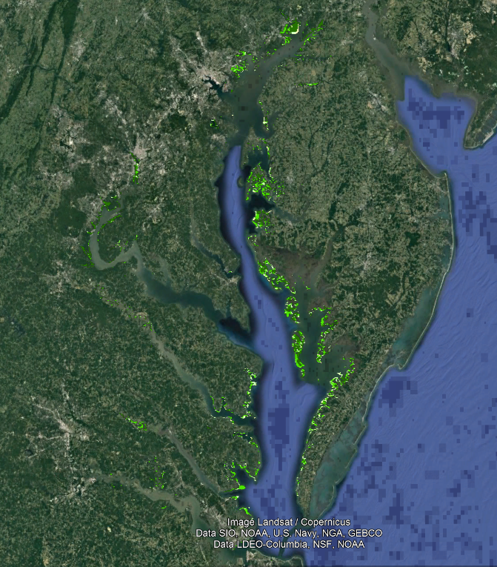
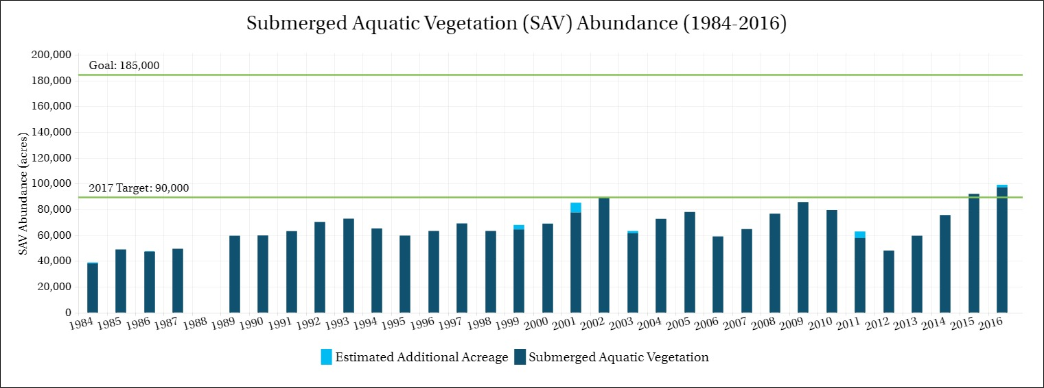
Questions??
97,433 acres in 2016
53% of 185,000 acre goal

