Slide 1

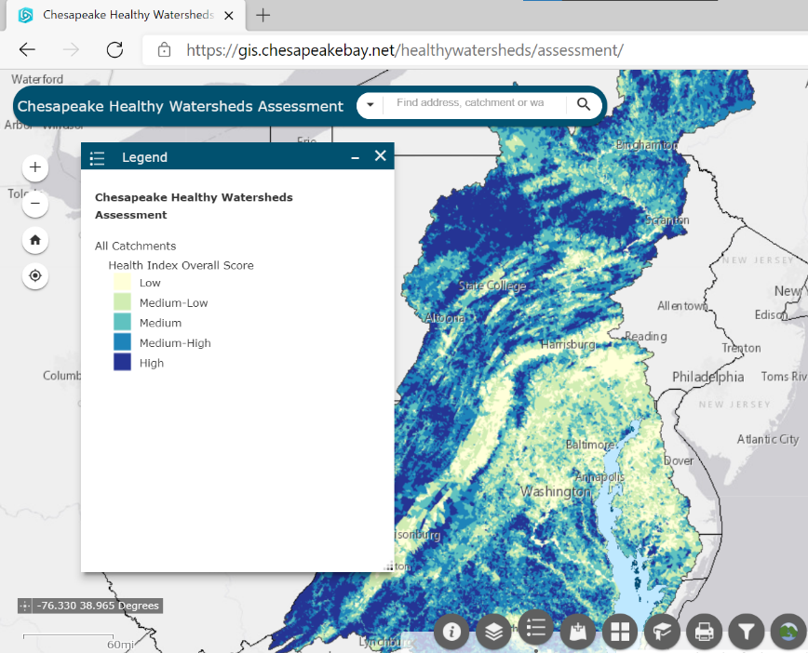
Chesapeake Bay Program Strategic Science & Research Framework: Science Needs
Healthy Watersheds Outcome
STAR September 30, 2021
Renee Thompson, USGS CBP
Notes:
"This information is preliminary or provisional and is subject to revision. It is being provided to meet the need for timely best science. The information has not received final approval by the U.S. Geological Survey (USGS) and is provided on the condition that neither the USGS nor the U.S. Government shall be held liable for any damages resulting from the authorized or unauthorized use of the information."

Slide 2
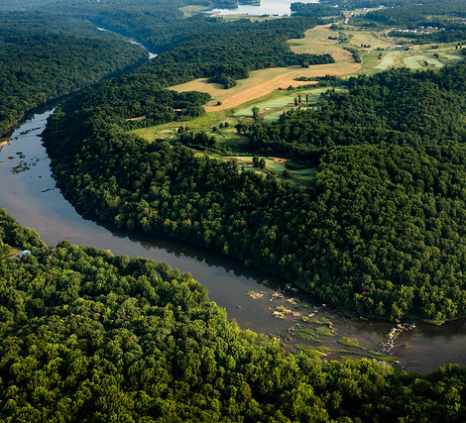
Healthy watersheds goal
Goal: Sustain state-identified healthy waters and watersheds recognized for their high quality and/or high ecological value
Outcome: 100 percent of state-identified healthy waters and watersheds remain healthy.

Slide 3
Sustain watershed health where it is high, exceptional and/or outstanding…
to increase the number of healthy watersheds in the future…
Provide the forum for mutual shared learning…
Develop information resources…
Promote the science…
And
Coordination, Integration and Collaboration.
Healthy watersheds Vision
Notes:
The land around the identified healthy streams is important. It doesn’t just help determine the quality of the water. Maintaining healthy watersheds is what will help maintain healthy waters- it is the source. Focusing on restoration alone will not help us to improve the quality of our environment-maintaining quality we already have is the most cost-effective method of reaching our goals. The Maintain Healthy Watersheds GHow do we maintain it then? What if the quality degrades?
oal Team seeks to sustain watershed health where it is high, exceptional, and/or outstanding, and to increase the overall number of healthy watersheds in the future.- CHWA helps us learn more about metrics on the landscape that can affect health and water quality

Slide 4
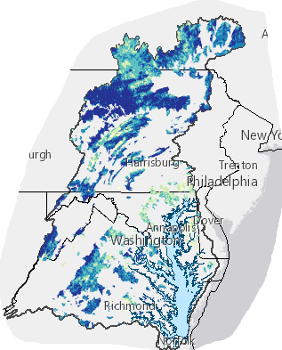
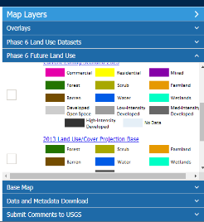
.."Evaluate policy options, incentives and planning tools that could assist in continually improving capacity.."
Data and Tools
Hi-res land cover
Phase 6 Land Use Viewer
Data Dashboard
Chesapeake Healthy Watersheds Assessment
Environmental Justice and Equity Dashboard
Notes:
Summary of work/progress
different data/mapping viewers; data dashboard land policy, phase 6 viewer, land policy BMPs,
Resources/communications; resource guide, webinar/presentations. For more details and links see narrative analysis.

Slide 5
Science Needs
Land Use Methods and Metrics
Land Use options Evaluation Outcome
Notes:
These are gaps. We don’t have money or people set aside to do these things

Slide 6
Indicator Development
Interim indicator investigations:
impervious surface, protected lands and habitat suitability are under investigation to use as interim measures until the completion of a Healthy Watersheds Assessment 2.0 tool in 2022-2023.

Slide 7
Monitoring Needs
Maryland Biological Stream Survey (MBSS)
Chesapeake Basin-wide Index of Biotic Integrity (Chessie BIBI)
6 candidate geomorphic metrics (combination of remote sensing data and modeling analysis):
Streambank lateral erosion
Streambank change (m2)
Streambank sediment flux – incorporates bank height, lateral erosion, and bulk density
Streambed D50
Streambed fine sediment cover
Streambed fine sediment + sand cover
MBSS Stronghold Watersheds (developed from MBSS monitoring data)
Conductivity (developed from field data and modeling)
Recent Forest loss (Hansen data, from remote sensing imagery – a different type of monitoring)

Slide 8
Land Use Metrics / Hi Resolution Data
COVID (future impacts on land use?)
Long term monitoring and evaluation
Short term metrics and vulnerability
Land policy BMP connections
Understanding “thresholds” from a scientific and local government perspective.
U.S. Geological Survey’s Land Change Monitoring, Assessment and Projection (LCMAP 1985 – 2019)

Slide 9

User Experience and Research
Decision support tools for informing decisions
How can land use and land use change information best be communicated to select targeted audiences to inform land use and land conservation decisions?
Understanding end user needs (of different stakeholder audiences)
Improvements to data and communication to meet local needs
Notes:
RTI under a subcontract of the CIC / EPA geospatial contract recently completed a user needs research study related to our “cross GIT” mapping needs. This is a primarily internal, GIT leadership, outcome focused audience. We have been able to glean a lot of information from this study related to the need for better organization of online tools, tutorials etc. We can cater to this audience, but what about other audiences.
Increasingly and under the leadership of Amy Handen now with EPA and our , Rachel Felver and CBP Communications team Social science, behavior change, user needs and research is an essential and often over looked when developing data communication and tools.
Lara Fowler presentation on pulling different data source together. Learning from the work they have done related to local gov challenges.
How can the COVID response support CBP outcomes…? I really appreciate the synergies across systems term vs. data gaps or needs. It an opportunity!

Slide 10
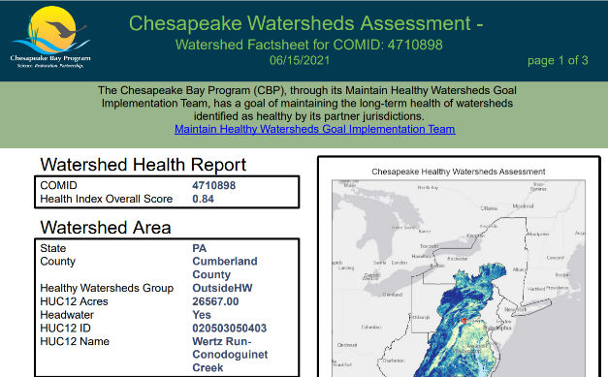
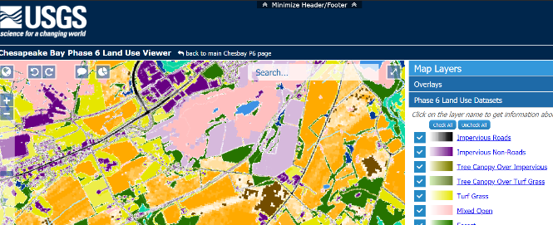
Synthesis and Communication
Communication, Translation, (pathways), and Engagement.
Translate, format, package and flow information through to trusted sources.
How to effectively engage locals directly
understanding target audience needs
curating content and decision support resources to meet pressing priorities related to infrastructure, flooding, co-benefits, climate and DEIJ have been identified.
Online tools (localized and scalable):
Assess changes in impervious cover, turf grass, forests, wetlands (loss only), tree canopy, and agriculture, for any user-specified geography (e.g.,user-drawn polygons, Census Tracts, Municipalities, etc.)Output a standardized set of graphs and interpretive text tailored to graph content.
Notes:
Disseminate and allow any user to use any geography to report out all the changes in land use we can map can be automated for any geography.
We have some pilots of this in the CHWA and the recent Automation of the Chesapeake Protected land dataset and the tree canopy fact sheets that Julie mentioned.
Pre manufactured text that interprets the data and trends
Forest, tree canopy, turf grass
LU land use change – communicated to different audiences
Aside from online tools, it is beyond.
Are we the shepherds to get the information through to the right people at the right time and the right place?
How can the land use options evaluation outcome help meet the policy needs of other outcome like Tree Canopy. Policy roundtable findings can be integrated into management resources and materials based on the appropriate response to observed land use change.

Slide 11

DEIJ, public health and communities
How does land use composition and land change impact those communities and or local governments?
Percent tree canopy, percent impervious cover, etc.
Assess disproportionate impact of land use change over time in underserved communities
How have investments in economic* development, conservation and restoration benefited these communities? *Note: lack of development could be a negative impact?
Incorporation of public health considerations
Notes:
How do we define communities? Census, proportion income, percent non-white populations (LUMM)
Land Use Options Evaluations spells out the
Access to recreation, green space.
Shall the focus change as the focus of the CBP partnership may change?
Access to open space and recreation. Lack of change and development could be a potential negative and are not seeing economic benefits.
https://www.chesapeakebay.net/channel_files/42983/module_5_-_preserving_local_character_and_landscapes.pdf

Slide 12
Climate and Community
Improved climate metrics for CHWA
Marsh Migration – potential for protection
Protection of infrastructure and communities
Resiliency
Flood protection
Notes:
"Synthesis of Shoreline, Sea Level Rise, and Marsh Migration Data for Wetland Restoration Targeting“ – GIT funding 2020

Slide 13

Renee Thompson, Geographer
Lower-Mississippi Gulf WSC, USGS,
Chesapeake Bay Program, MD
Coordinator Maintain Healthy Watersheds
Goal Implementation Team
Rthompso@chesapeakebay.net
Rthompson1@usgs.gov
Discussion
Presentation template by SlidesCarnival.

