Slide 1
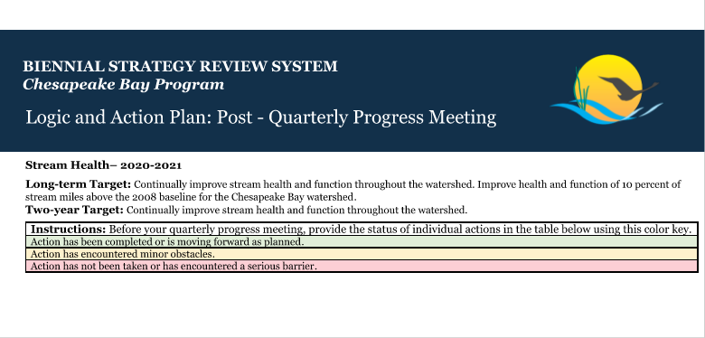
SHWG Work Plan
* A copy of the existing workplan was sent out on Thursday from Megan Ossmann

Slide 2
5 Management Strategies
Identify an appropriate suite of metrics to measure the multiple facets of stream health to complement the baywide Chessie BIBI
  Reporting Chessie BIBI & its progress
  Identify practicable metrics
Provision of adequate funding and technical resources to support functional lift in stream restoration projects, in addition to nutrient and sediment reductions
  Implement pooled monitoring approach
Active and engaged participation by local communities with Federal and State partners is central to Bay restoration
  Permit recommendations

Slide 3
Management Strategies (cont’d)
Develop and promote holistic restoration design guidelines that identify the level of degradation and improvement of stream functions and key stressors/factors limited potential uplift
  Collaboration with USGS on ‘stressor work plan’
Work with CB partners to include the Enhancing Partnering, Leadership and Management GIT to enhance the capacity of local governments, organizations and landowners of beneficial stream restoration and maintenance practices
  Provide training and education to diversity of stakeholders on stream restoration and stream health

Slide 4
Breakout Groups
4 Topic Areas
  Identify an appropriate suite of metrics to measure the multiple facets of stream health to complement the baywide Chessie BIBI (Management Action 1)
    Chessie BIBI and other metrics
  Permit, Training and Coordination (Management Actions 3&5)
  Climate Change
  Diversity, Equity, Inclusion, Justice (DEIJ)
Not reviewing:
  “Stressors” work or Management Action 4 as work is underway with GIT Funding (Center for Watershed Protection) and a workplan is developed. May discuss in open session following breakout groups
  Pooled Monitoring as this is an established program with Chesapeake Bay Trust. May discuss in open session following breakout groups to keep in work plan or have a regular report out at meetings

Slide 5
Breakout Groups
40 minutes breakout groups; 20 minutes full group report out/discussion
Neely, Alison, Sara, Megan facilitate
“Jam Board” to share ideas
DEIJ and Climate Change
  Focus to generate ideas on how these topics relate to SWHG outcome (improve stream health)
    How may DEIJ/Climate Change impact stream health or vice versa?
    Who is currently doing work related to stream health and DEIJ/Climate Change?
Review Existing Actions
  Review existing workplan actions
  Should remaining work be included in the next 2-year work plan? If so, remain unchanged, or are changes needed?
  Are there new actions/work that needs to be defined to achieve the Outcome?

