Slide 1

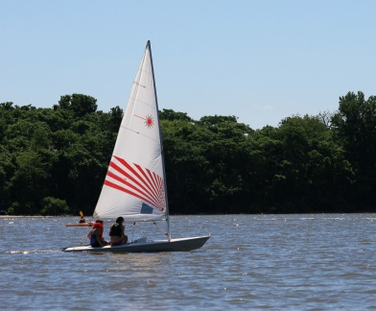
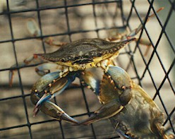
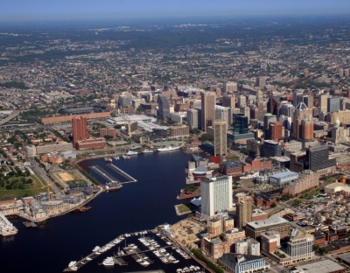
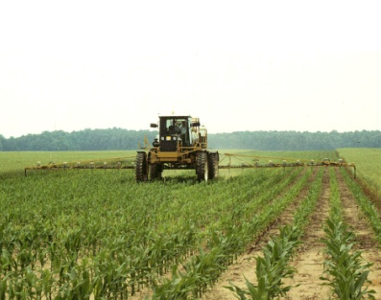
Integrating the Social Sciences into Chesapeake Bay Restoration: Workshop Report
Social Science Workshop Steering Committee

Slide 2
Social Science Steering Committee
Michael Paolisso UMD/Anthropology
Doug Lipton UMD/Economics
Jim Pease Virginia Tech/Economics
Lisa Wainger UMCES/Economics
Susan Julius EPA/Global Change Research
Poornima Madhavan Old Dominion University Psychology
Troy Hartley Virginia Sea Grant
Ben Blount SocioEcological Informatics
Steve Jacobs York College/Sociology
Kevin St. Martin Rutgers/Geography
Elizabeth van Dolah UMD/Anthropology

Slide 3
STAC Social Science Project (aka “The Human Dimensions”)
Synthesis of our own expertise and research questions
Study of CBP managers
Workshop: March 10, 2011; 70 participants. Goals of workshop:
1) Inform program managers and each other of range of
social science research available;
2) Initiate a dialogue between regional program managers and social scientists on needs and capacities; and
3) Develop concrete next steps to better integrate social science research into Chesapeake Bay restoration activities.

Slide 4
Workshop Activities
A presentation on the results from interviews with key informants from the CBP on the needs and constraints to integrating social science research in Bay restoration;
Panel discussions on a) social science and understanding individual behavior change and b) social science and understanding group, community and organization change;
Working groups to identify constraints, opportunities, and actions, including priorities for action; and
A summary panel

Slide 5
Panel Presentations
Individual Behavior Change
Group, Community and Organization Change
The Psychology of Climate Change
Why Culture is Important to Environmental Behavior
Applying Economics & Decision Science to Restoration Strategies
Economics of Individual Behavior Change or Choice
Sociological Perspectives of Fishing Communities
Cognitive Models and Social Science: Salience, Community, and Conservation
Enacting Human Dimensions of Marine Ecosystem-Based Management
Public Administration & Policy—Landscape& Examples

Slide 6
Working Group Recommendations
Management Problems/Challenges:
Need widespread behavior change
CBP GITS need effective management structures/networks/decision-making tools
Regulatory vs. cooperative/voluntary approaches to achieve goals
How can social science inform the paths of least resistance (or most effectiveness) to activate goals?
Need social science monitoring strategy to inform strategies
Management steps/action items:
Produce guidance for CBP management team on social science
Apply economic models/case studies to blue crab management challenges
Increase capacity of social science in CBP decision making process
How can social science design policies
Next Steps:
Focus on how existing knowledge can inform policy/programs to increase effectiveness
Define an issue, bring in social science team, develop strategy, implement it!
Social science review and comment of WIPs

Slide 7
Broad, Take Away Messages
Multiple indicators of greater recognition of value of the social sciences to address human dimensions of Bay restoration
Social science research can benefit and advance the Bay restoration and management efforts.
A wider range of social science disciplines now available to Bay Program and present in STAC

Slide 8
Broad, Take Away Messages
Important next step is to create organizational and program opportunities for tapping this social science expertise.
Integrate socio-ecological orientation into ecosystem framework at policy, program and research levels
Institutionalization and build on lessons learned

Slide 9
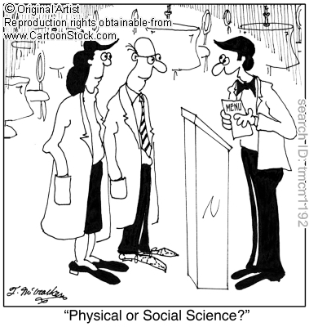
Thanks!

