Slide 1

Wind and Solar Farms in Farm County:
Addressing Land Use Conflicts
Peggy Kirk Hall, Whitney Morgan, and Jesse Richardson

Slide 2

Peggy Kirk Hall
Ohio State University Agricultural & Resource Law Program
Whitney Morgan
West Virginia University College of Law
Land Use and Sustainable Development Clinic
Jesse J. Richardson
West Virginia University College of Law
Land Use and Sustainable Development Clinic
Paper and webinar recording available at:
https://nationalaglawcenter.org/webinars/windsolarlandconflicts/

Slide 3

Overview
Land Consumption
Local Opposition
Co-location
State-Local Tensions
Competing Policies
Recommended Practices
Resources

Slide 4
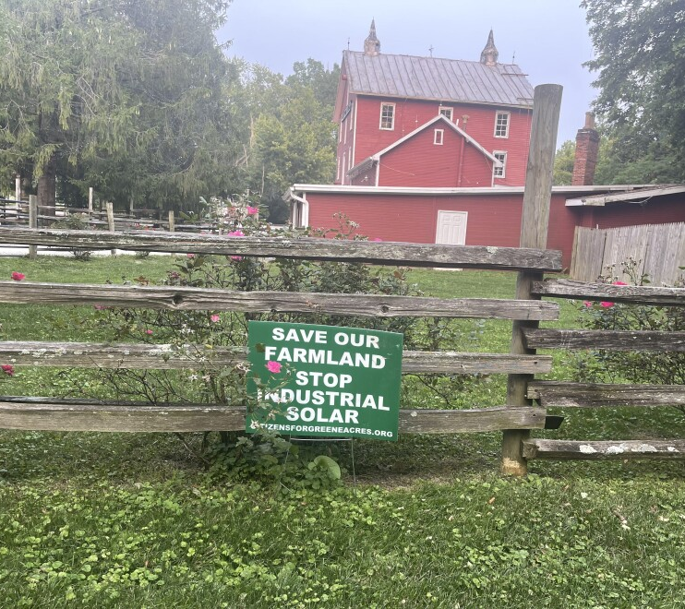
Land Consumption
Wind and solar land footprint
  Initial physical footprint
  Lower power density
  Time to land use equivalency
Lands suitable for siting wind and solar
Consequences
  Competition for land
  Continuation of struggling farms
  Prime soils

Slide 5

Local Opposition
NIMBYism
Proximity
Environmental Impacts
Economic Impacts

Slide 6

Co-location
Dual Use
Feasibility
Unusual
co-locations

Slide 7

Competing Policies
Promote renewables v. protect farmland
State v. local regulation
  Local land use law
Preemption

Slide 8
State policies addressing farmland
Developers must “consider agriculture.”
Required consultation with state department of agriculture
Notice required if project will impact agriculture
Impact mitigation agreements or environmental assessments
  Some also include economic impact on agriculture in assessments

Slide 9
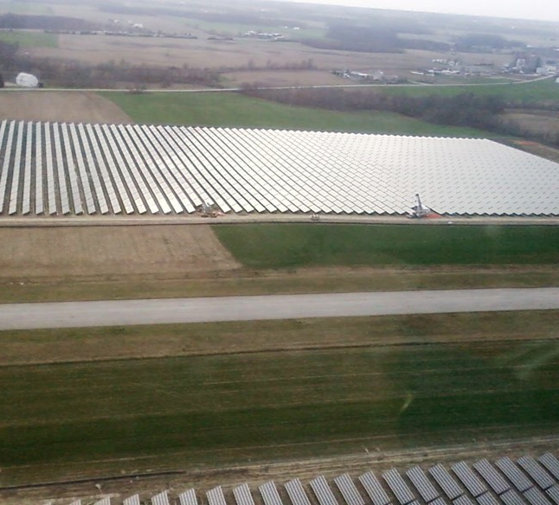
Recommended Best Practices
Protect prime soils
Involve agricultural leaders in renewable decision-making
Planning through mapping
Benefits of dual-use or agrivoltaics
Planning for decommissioning

Slide 10
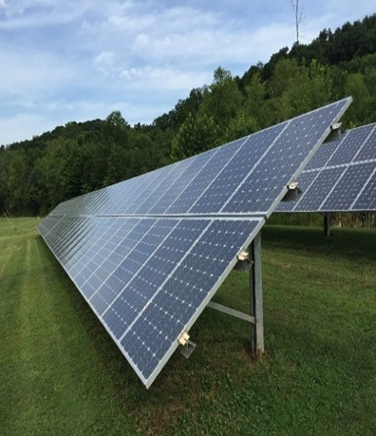
What about water quality?
Concerns:
  Impervious surfaces?
  Infiltration does occur
  Stormwater management models not adapted to this type of development
Little information available on water quality impacts

Slide 11
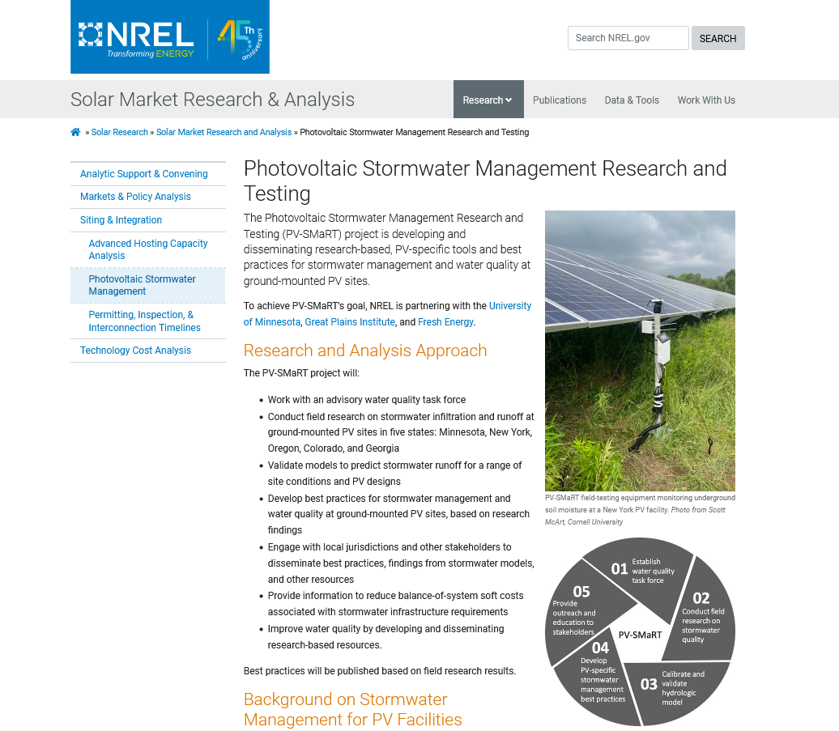
National Renewable Energy Laboratory Research Project
https://www.nrel.gov/solar/market-research-analysis/pv-smart.html

Slide 12
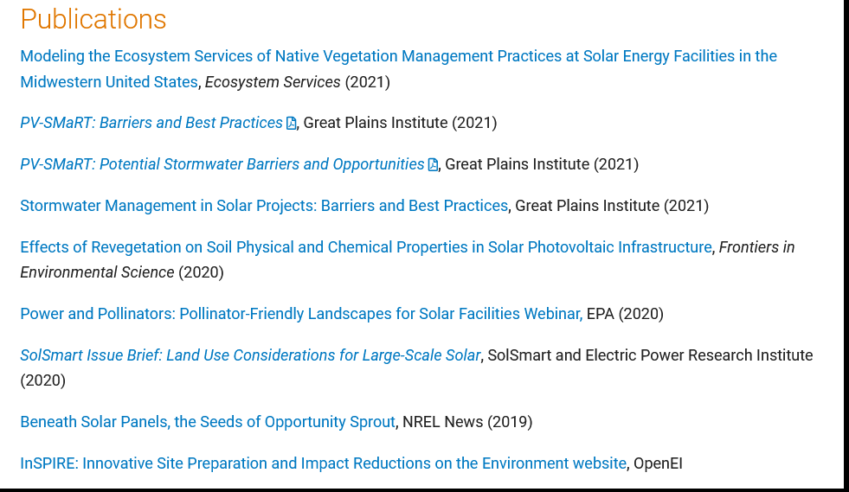

Slide 13
Peggy Kirk Hall
  hall.673@osu.edu
  614.688.0466
Whitney Morgan
  whitney.morgan@mail.wvu.edu
Jesse J. Richardson
  jesse.richardson@mail.wvu.edu
  304.293.9460

