Slide 1


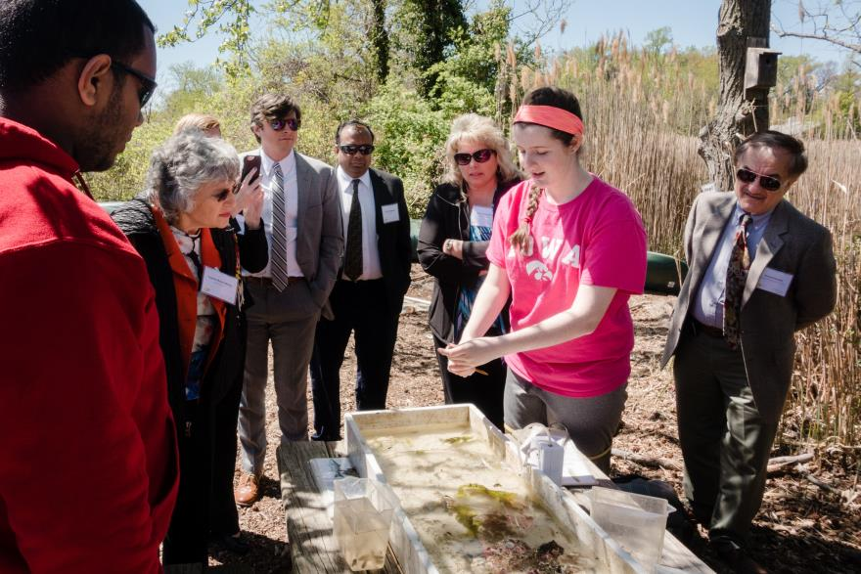
Environmental Literacy Leadership Summit
Presentation to CAC
May 18, 2016

Slide 2

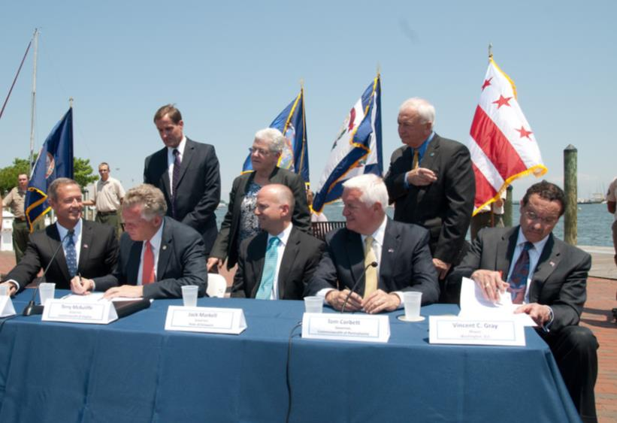
Environmental Literacy Goal
GOAL: Enable students in the region to graduate with the knowledge and skills to act responsibly to protect and restore their local watershed
OUTCOMES:
  Student MWEEs
  Sustainable Schools
  Policy & Metrics
Notes:
The Bay Program signed the new Chesapeake Bay Watershed Agreement on June 16, 2014.
The Agreement included an Environmental Literacy Goal that committed us to enabling students to graduate with the knowledge and skills to protect and restore their local watershed.
There were three associated outcomes for
Providing student Meaningful Watershed Educational Experiences – affectionately called MWEEs – in each elementary, middle, and high school
Increasing the number of Sustainable Schools and ensuring that students are actively engaged in those efforts
Establishing supportive policies, programs, and metrics at all levels to advance this work

Slide 3
Student MWEEs
Notes:
MWEEs are so much more than a field trip! They are an integrated approach to learning both in the classroom and out in the field designed to create a deeper understanding of the environment and its stressors.
They are not add ons. MWEEs can help schools and teachers teach core subjects, including NGSS, in a thought provoking and engaging way. In fact, Stanford University is just finishing up a review of
research that looks at the evidence in support of environmental education and K-12 student
outcomes. In 81 studies that examined knowledge, 98% reported student knowledge gains. See the handout in your packets for more preliminary findings from their study.
Teachers are essential to MWEE implementation, guiding their students through the entire process and ensuring that it remains grounded in core subjects. Therefore, professional development that includes both content and outdoor education pedagogy is important.
The MWEE is revisited by teachers over time as the students engage in four essential elements:
Issue Definition
Outdoor Field Experiences
Action Projects
Synthesis and Conclusions
The definition of a MWEE can be found in your packets. The Workgroup is also working with partners to put together a Handbook for Practitioners, which will be available later this year.
You are going to see several examples of MWEEs as we move forward with today’s agenda.

Slide 4
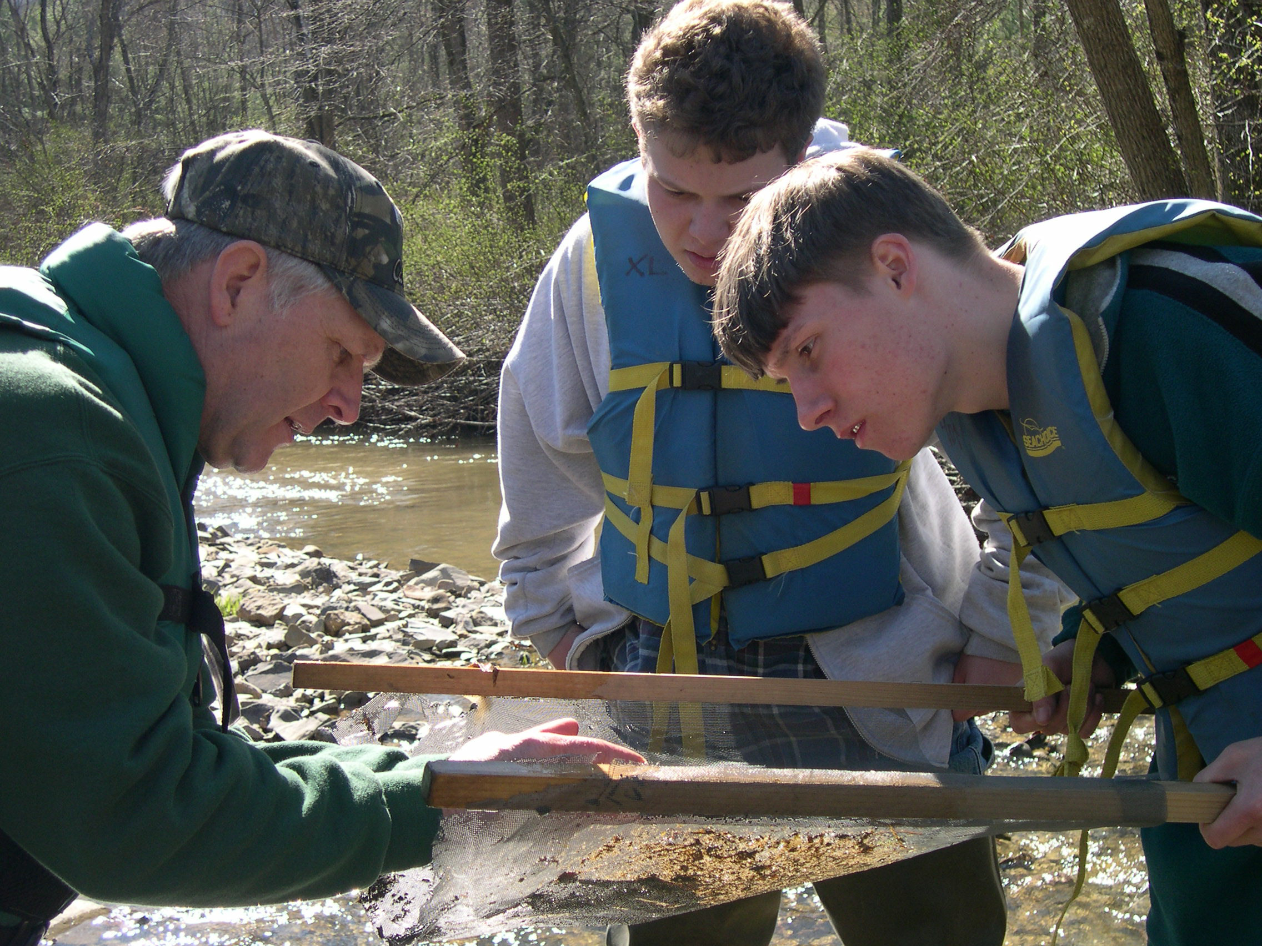
Student MWEEs
Notes:
MWEEs are so much more than a field trip! They are an integrated approach to learning both in the classroom and out in the field designed to create a deeper understanding of the environment and its stressors.
They are not add ons. MWEEs can help schools and teachers teach core subjects, including NGSS, in a thought provoking and engaging way. In fact, Stanford University is just finishing up a review of
research that looks at the evidence in support of environmental education and K-12 student
outcomes. In 81 studies that examined knowledge, 98% reported student knowledge gains. See the handout in your packets for more preliminary findings from their study.
Teachers are essential to MWEE implementation, guiding their students through the entire process and ensuring that it remains grounded in core subjects. Therefore, professional development that includes both content and outdoor education pedagogy is important.
The MWEE is revisited by teachers over time as the students engage in four essential elements:
Issue Definition
Outdoor Field Experiences
Action Projects
Synthesis and Conclusions
The definition of a MWEE can be found in your packets. The Workgroup is also working with partners to put together a Handbook for Practitioners, which will be available later this year.
You are going to see several examples of MWEEs as we move forward with today’s agenda.

Slide 5
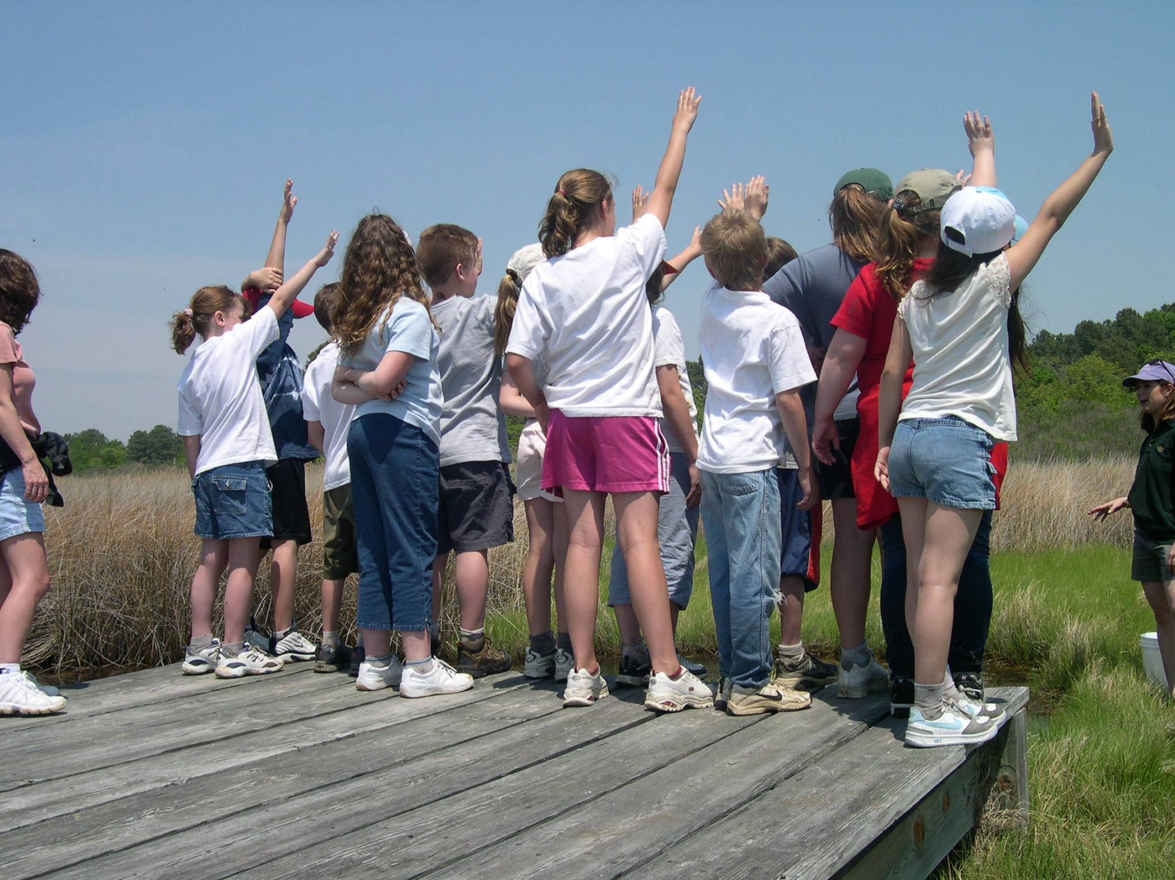
Notes:
MWEEs are so much more than a field trip! They are an integrated approach to learning both in the classroom and out in the field designed to create a deeper understanding of the environment and its stressors.
They are not add ons. MWEEs can help schools and teachers teach core subjects, including NGSS, in a thought provoking and engaging way. In fact, Stanford University is just finishing up a review of
research that looks at the evidence in support of environmental education and K-12 student
outcomes. In 81 studies that examined knowledge, 98% reported student knowledge gains. See the handout in your packets for more preliminary findings from their study.
Teachers are essential to MWEE implementation, guiding their students through the entire process and ensuring that it remains grounded in core subjects. Therefore, professional development that includes both content and outdoor education pedagogy is important.
The MWEE is revisited by teachers over time as the students engage in four essential elements:
Issue Definition
Outdoor Field Experiences
Action Projects
Synthesis and Conclusions
The definition of a MWEE can be found in your packets. The Workgroup is also working with partners to put together a Handbook for Practitioners, which will be available later this year.
You are going to see several examples of MWEEs as we move forward with today’s agenda.

Slide 6
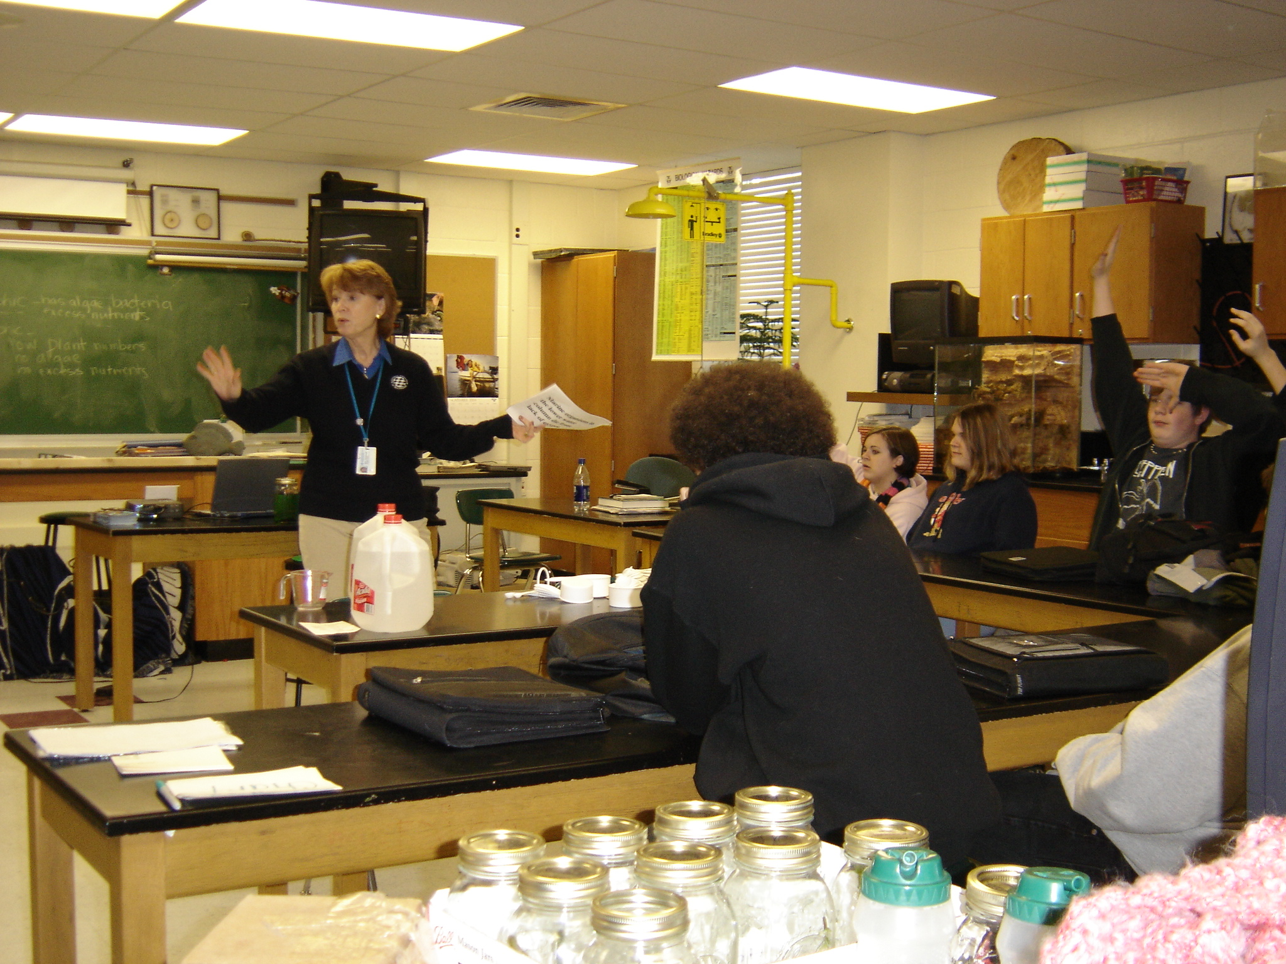
Notes:
MWEEs are so much more than a field trip! They are an integrated approach to learning both in the classroom and out in the field designed to create a deeper understanding of the environment and its stressors.
They are not add ons. MWEEs can help schools and teachers teach core subjects, including NGSS, in a thought provoking and engaging way. In fact, Stanford University is just finishing up a review of
research that looks at the evidence in support of environmental education and K-12 student
outcomes. In 81 studies that examined knowledge, 98% reported student knowledge gains. See the handout in your packets for more preliminary findings from their study.
Teachers are essential to MWEE implementation, guiding their students through the entire process and ensuring that it remains grounded in core subjects. Therefore, professional development that includes both content and outdoor education pedagogy is important.
The MWEE is revisited by teachers over time as the students engage in four essential elements:
Issue Definition
Outdoor Field Experiences
Action Projects
Synthesis and Conclusions
The definition of a MWEE can be found in your packets. The Workgroup is also working with partners to put together a Handbook for Practitioners, which will be available later this year.
You are going to see several examples of MWEEs as we move forward with today’s agenda.

Slide 7
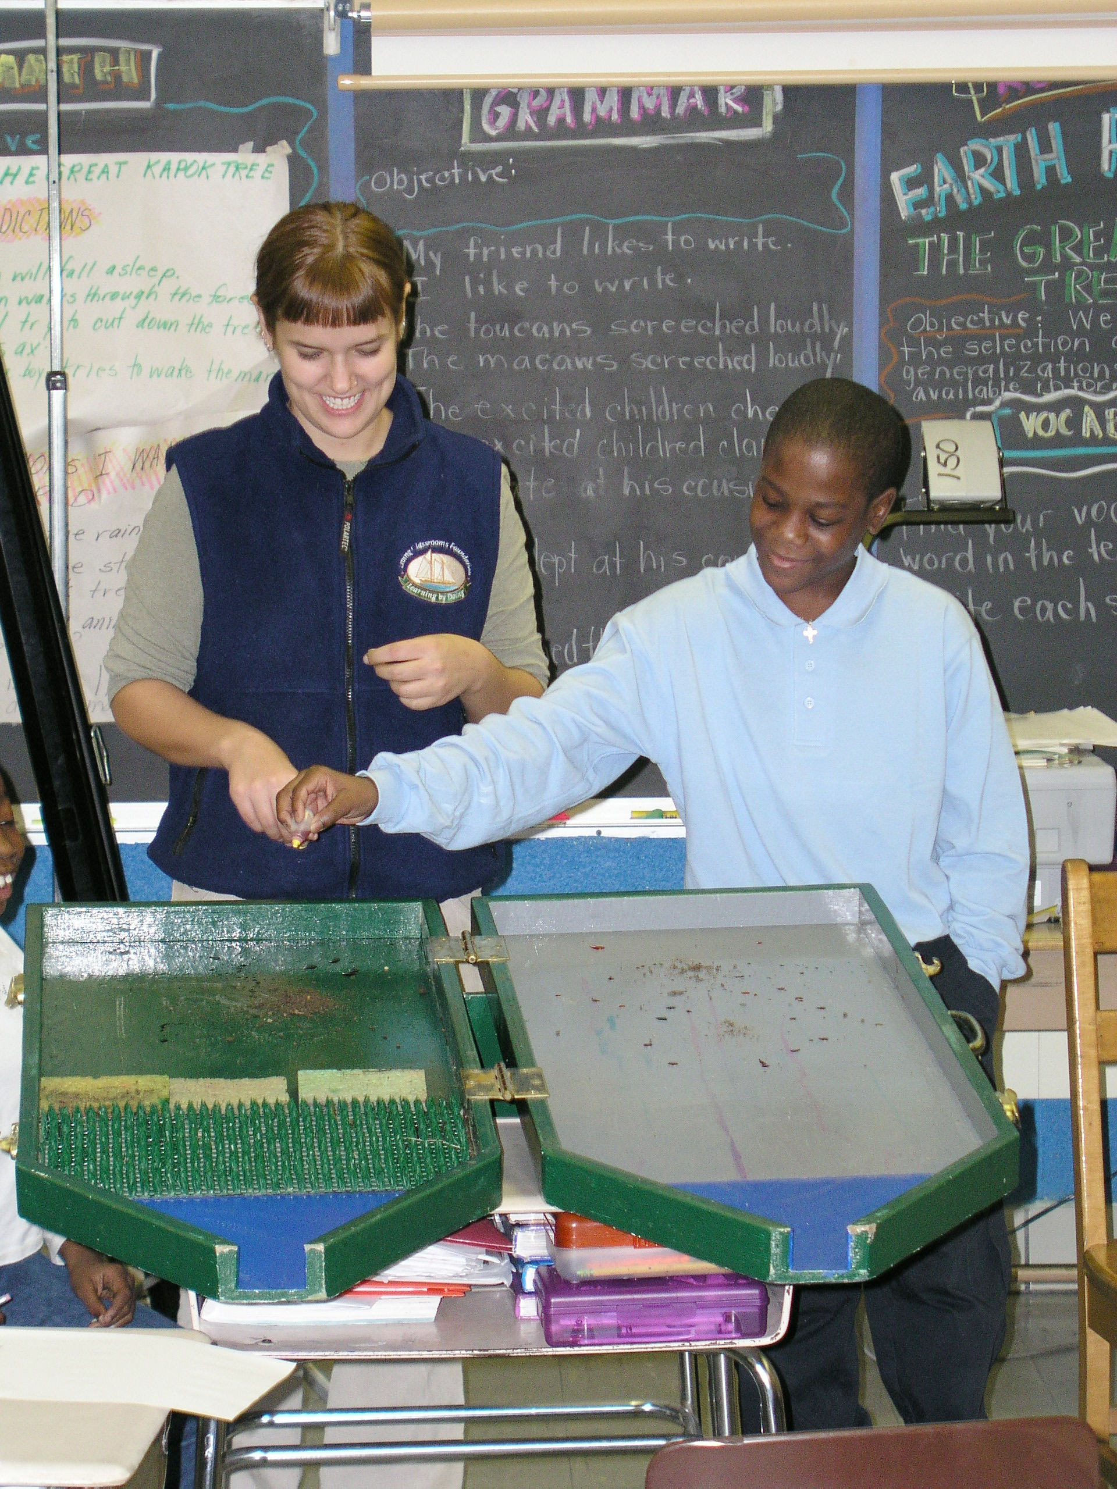
Notes:
MWEEs are so much more than a field trip! They are an integrated approach to learning both in the classroom and out in the field designed to create a deeper understanding of the environment and its stressors.
They are not add ons. MWEEs can help schools and teachers teach core subjects, including NGSS, in a thought provoking and engaging way. In fact, Stanford University is just finishing up a review of
research that looks at the evidence in support of environmental education and K-12 student
outcomes. In 81 studies that examined knowledge, 98% reported student knowledge gains. See the handout in your packets for more preliminary findings from their study.
Teachers are essential to MWEE implementation, guiding their students through the entire process and ensuring that it remains grounded in core subjects. Therefore, professional development that includes both content and outdoor education pedagogy is important.
The MWEE is revisited by teachers over time as the students engage in four essential elements:
Issue Definition
Outdoor Field Experiences
Action Projects
Synthesis and Conclusions
The definition of a MWEE can be found in your packets. The Workgroup is also working with partners to put together a Handbook for Practitioners, which will be available later this year.
You are going to see several examples of MWEEs as we move forward with today’s agenda.

Slide 8
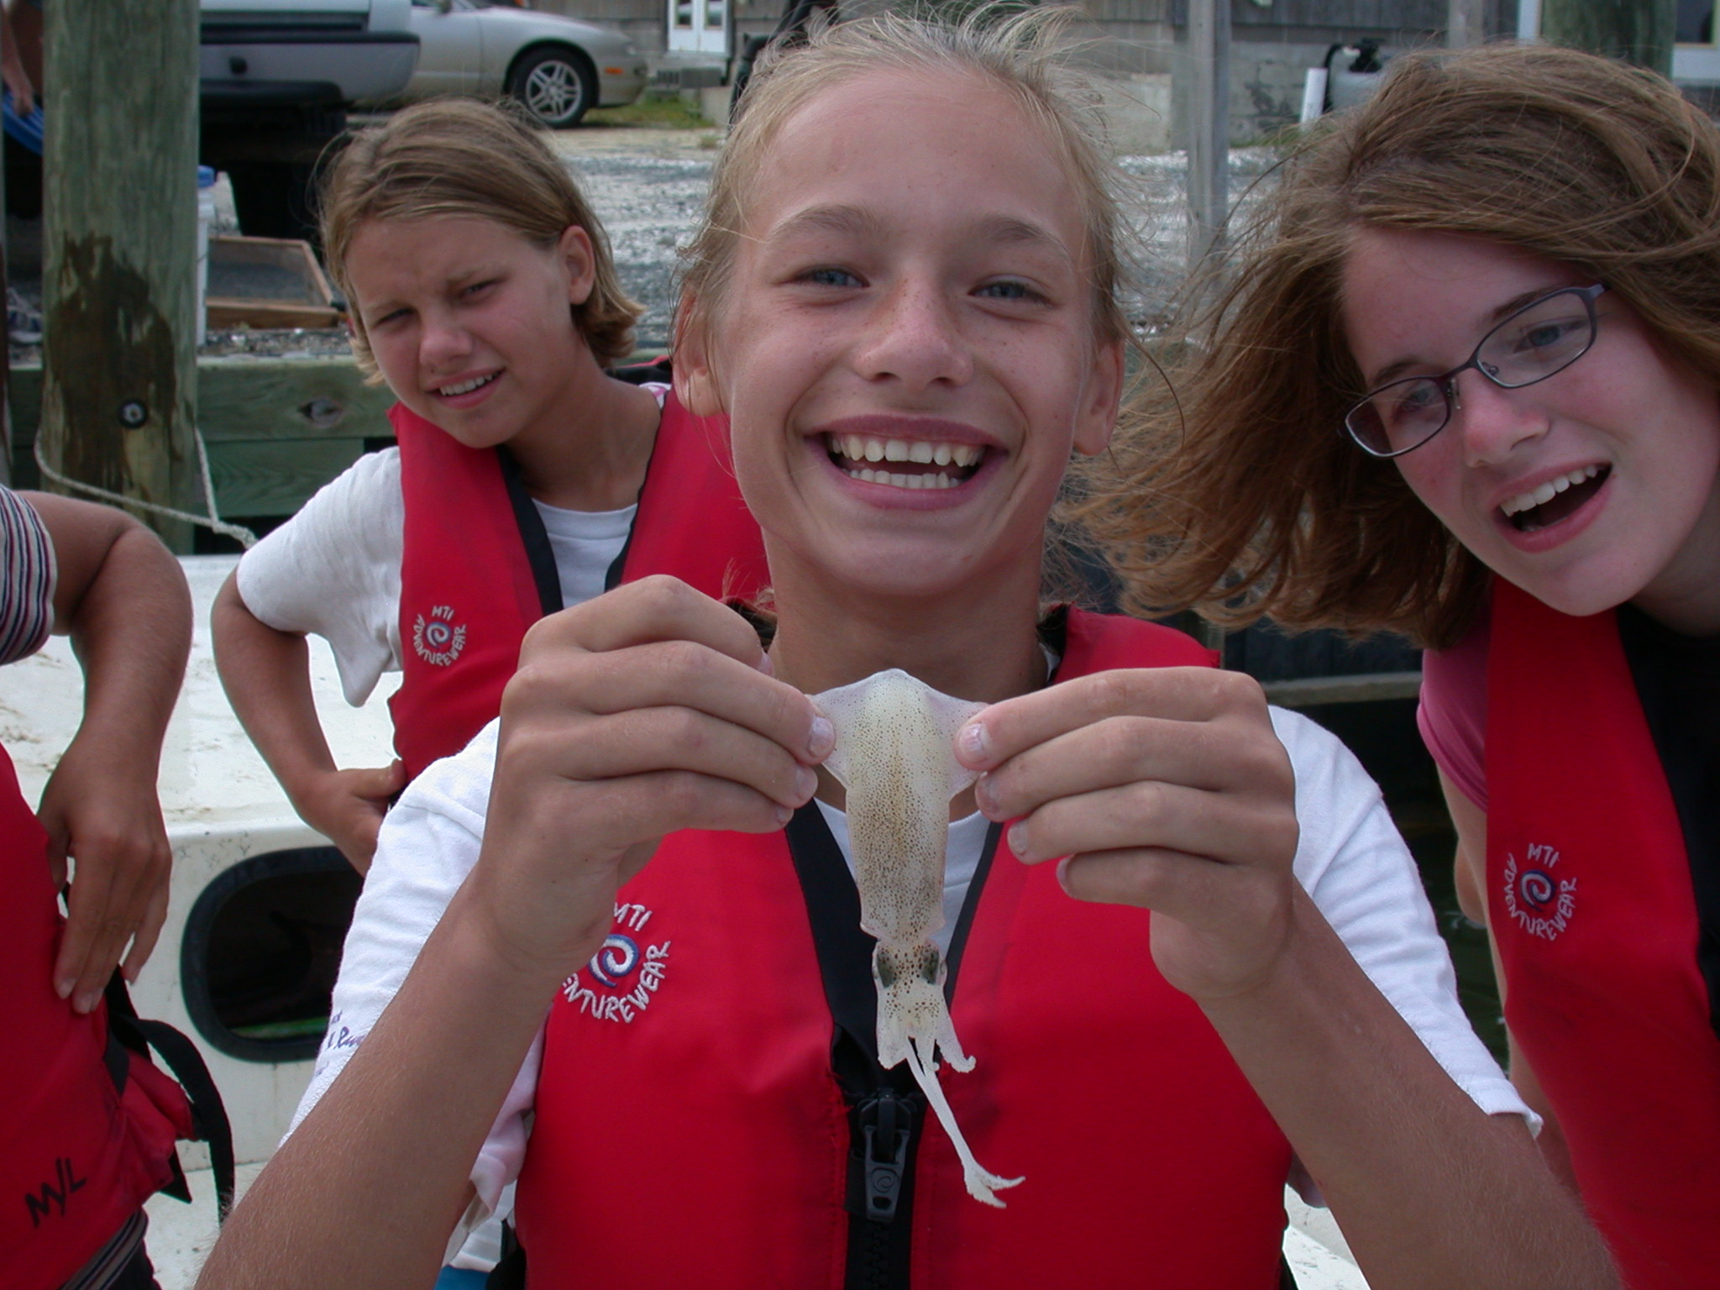
Notes:
MWEEs are so much more than a field trip! They are an integrated approach to learning both in the classroom and out in the field designed to create a deeper understanding of the environment and its stressors.
They are not add ons. MWEEs can help schools and teachers teach core subjects, including NGSS, in a thought provoking and engaging way. In fact, Stanford University is just finishing up a review of
research that looks at the evidence in support of environmental education and K-12 student
outcomes. In 81 studies that examined knowledge, 98% reported student knowledge gains. See the handout in your packets for more preliminary findings from their study.
Teachers are essential to MWEE implementation, guiding their students through the entire process and ensuring that it remains grounded in core subjects. Therefore, professional development that includes both content and outdoor education pedagogy is important.
The MWEE is revisited by teachers over time as the students engage in four essential elements:
Issue Definition
Outdoor Field Experiences
Action Projects
Synthesis and Conclusions
The definition of a MWEE can be found in your packets. The Workgroup is also working with partners to put together a Handbook for Practitioners, which will be available later this year.
You are going to see several examples of MWEEs as we move forward with today’s agenda.

Slide 9
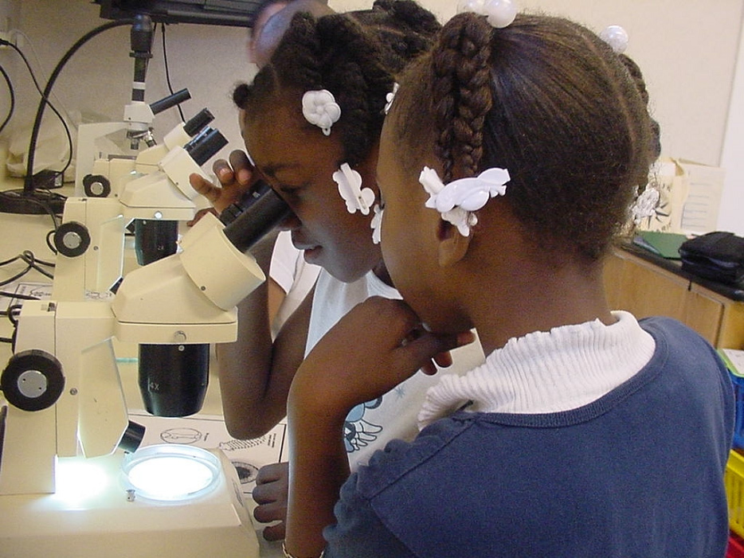
Notes:
MWEEs are so much more than a field trip! They are an integrated approach to learning both in the classroom and out in the field designed to create a deeper understanding of the environment and its stressors.
They are not add ons. MWEEs can help schools and teachers teach core subjects, including NGSS, in a thought provoking and engaging way. In fact, Stanford University is just finishing up a review of
research that looks at the evidence in support of environmental education and K-12 student
outcomes. In 81 studies that examined knowledge, 98% reported student knowledge gains. See the handout in your packets for more preliminary findings from their study.
Teachers are essential to MWEE implementation, guiding their students through the entire process and ensuring that it remains grounded in core subjects. Therefore, professional development that includes both content and outdoor education pedagogy is important.
The MWEE is revisited by teachers over time as the students engage in four essential elements:
Issue Definition
Outdoor Field Experiences
Action Projects
Synthesis and Conclusions
The definition of a MWEE can be found in your packets. The Workgroup is also working with partners to put together a Handbook for Practitioners, which will be available later this year.
You are going to see several examples of MWEEs as we move forward with today’s agenda.

Slide 10
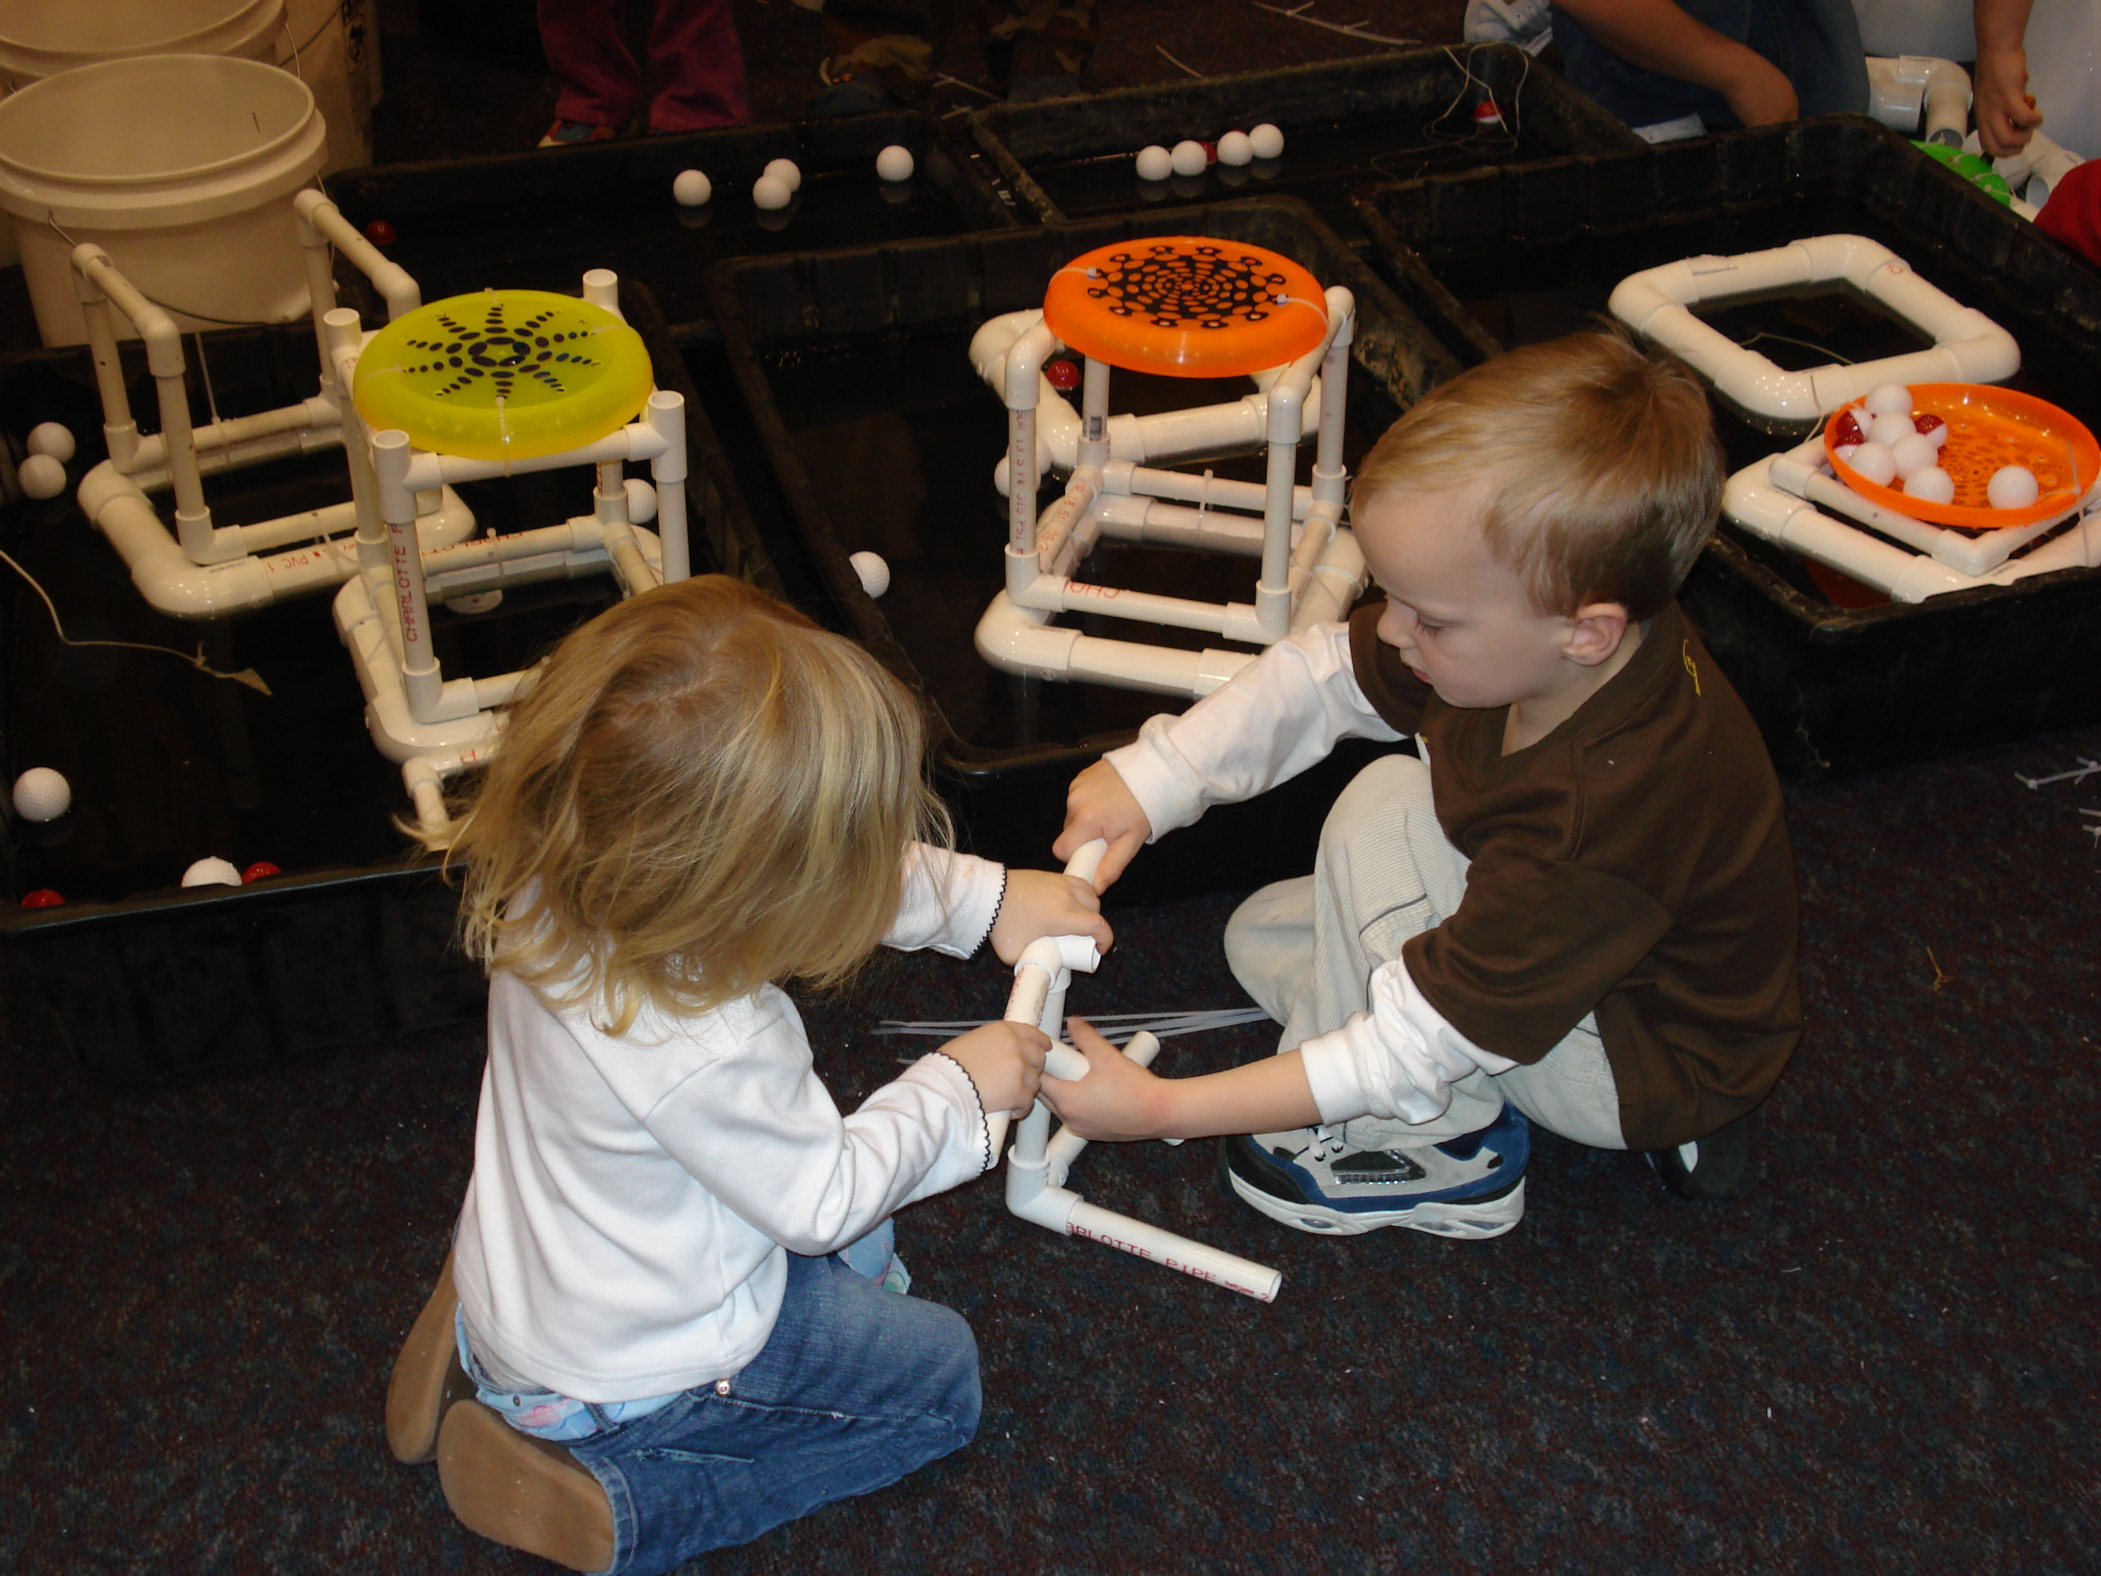
Notes:
MWEEs are so much more than a field trip! They are an integrated approach to learning both in the classroom and out in the field designed to create a deeper understanding of the environment and its stressors.
They are not add ons. MWEEs can help schools and teachers teach core subjects, including NGSS, in a thought provoking and engaging way. In fact, Stanford University is just finishing up a review of
research that looks at the evidence in support of environmental education and K-12 student
outcomes. In 81 studies that examined knowledge, 98% reported student knowledge gains. See the handout in your packets for more preliminary findings from their study.
Teachers are essential to MWEE implementation, guiding their students through the entire process and ensuring that it remains grounded in core subjects. Therefore, professional development that includes both content and outdoor education pedagogy is important.
The MWEE is revisited by teachers over time as the students engage in four essential elements:
Issue Definition
Outdoor Field Experiences
Action Projects
Synthesis and Conclusions
The definition of a MWEE can be found in your packets. The Workgroup is also working with partners to put together a Handbook for Practitioners, which will be available later this year.
You are going to see several examples of MWEEs as we move forward with today’s agenda.

Slide 11
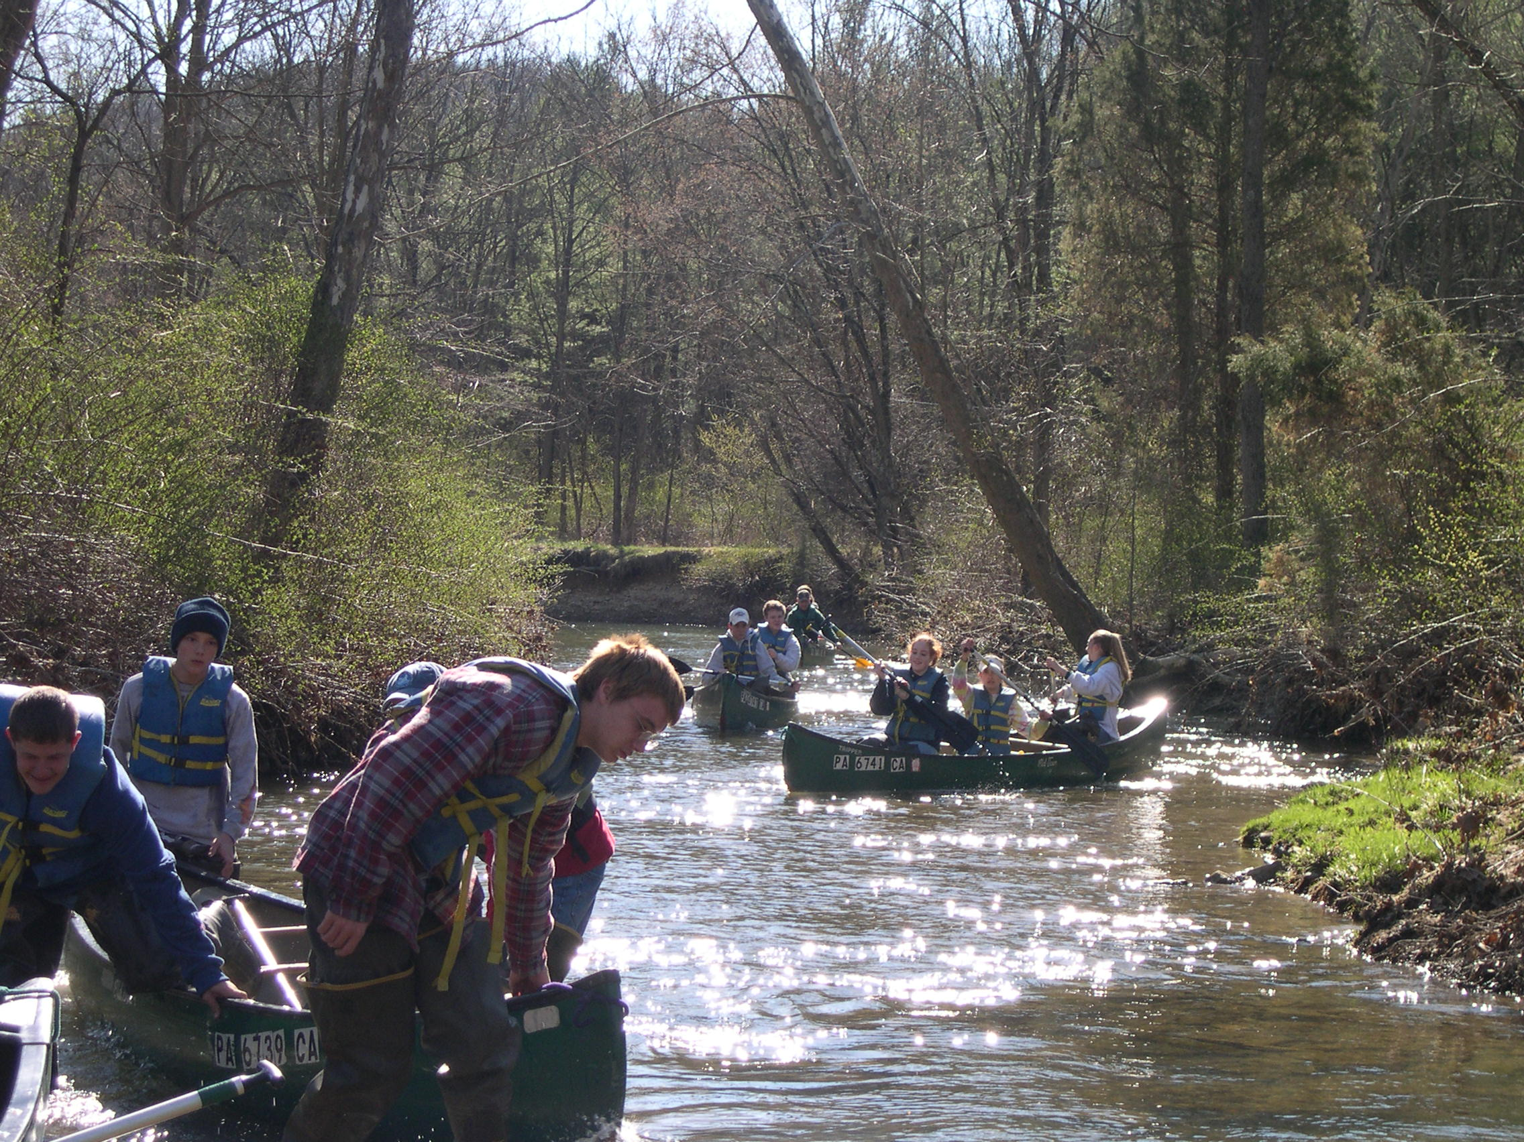
Notes:
MWEEs are so much more than a field trip! They are an integrated approach to learning both in the classroom and out in the field designed to create a deeper understanding of the environment and its stressors.
They are not add ons. MWEEs can help schools and teachers teach core subjects, including NGSS, in a thought provoking and engaging way. In fact, Stanford University is just finishing up a review of
research that looks at the evidence in support of environmental education and K-12 student
outcomes. In 81 studies that examined knowledge, 98% reported student knowledge gains. See the handout in your packets for more preliminary findings from their study.
Teachers are essential to MWEE implementation, guiding their students through the entire process and ensuring that it remains grounded in core subjects. Therefore, professional development that includes both content and outdoor education pedagogy is important.
The MWEE is revisited by teachers over time as the students engage in four essential elements:
Issue Definition
Outdoor Field Experiences
Action Projects
Synthesis and Conclusions
The definition of a MWEE can be found in your packets. The Workgroup is also working with partners to put together a Handbook for Practitioners, which will be available later this year.
You are going to see several examples of MWEEs as we move forward with today’s agenda.

Slide 12
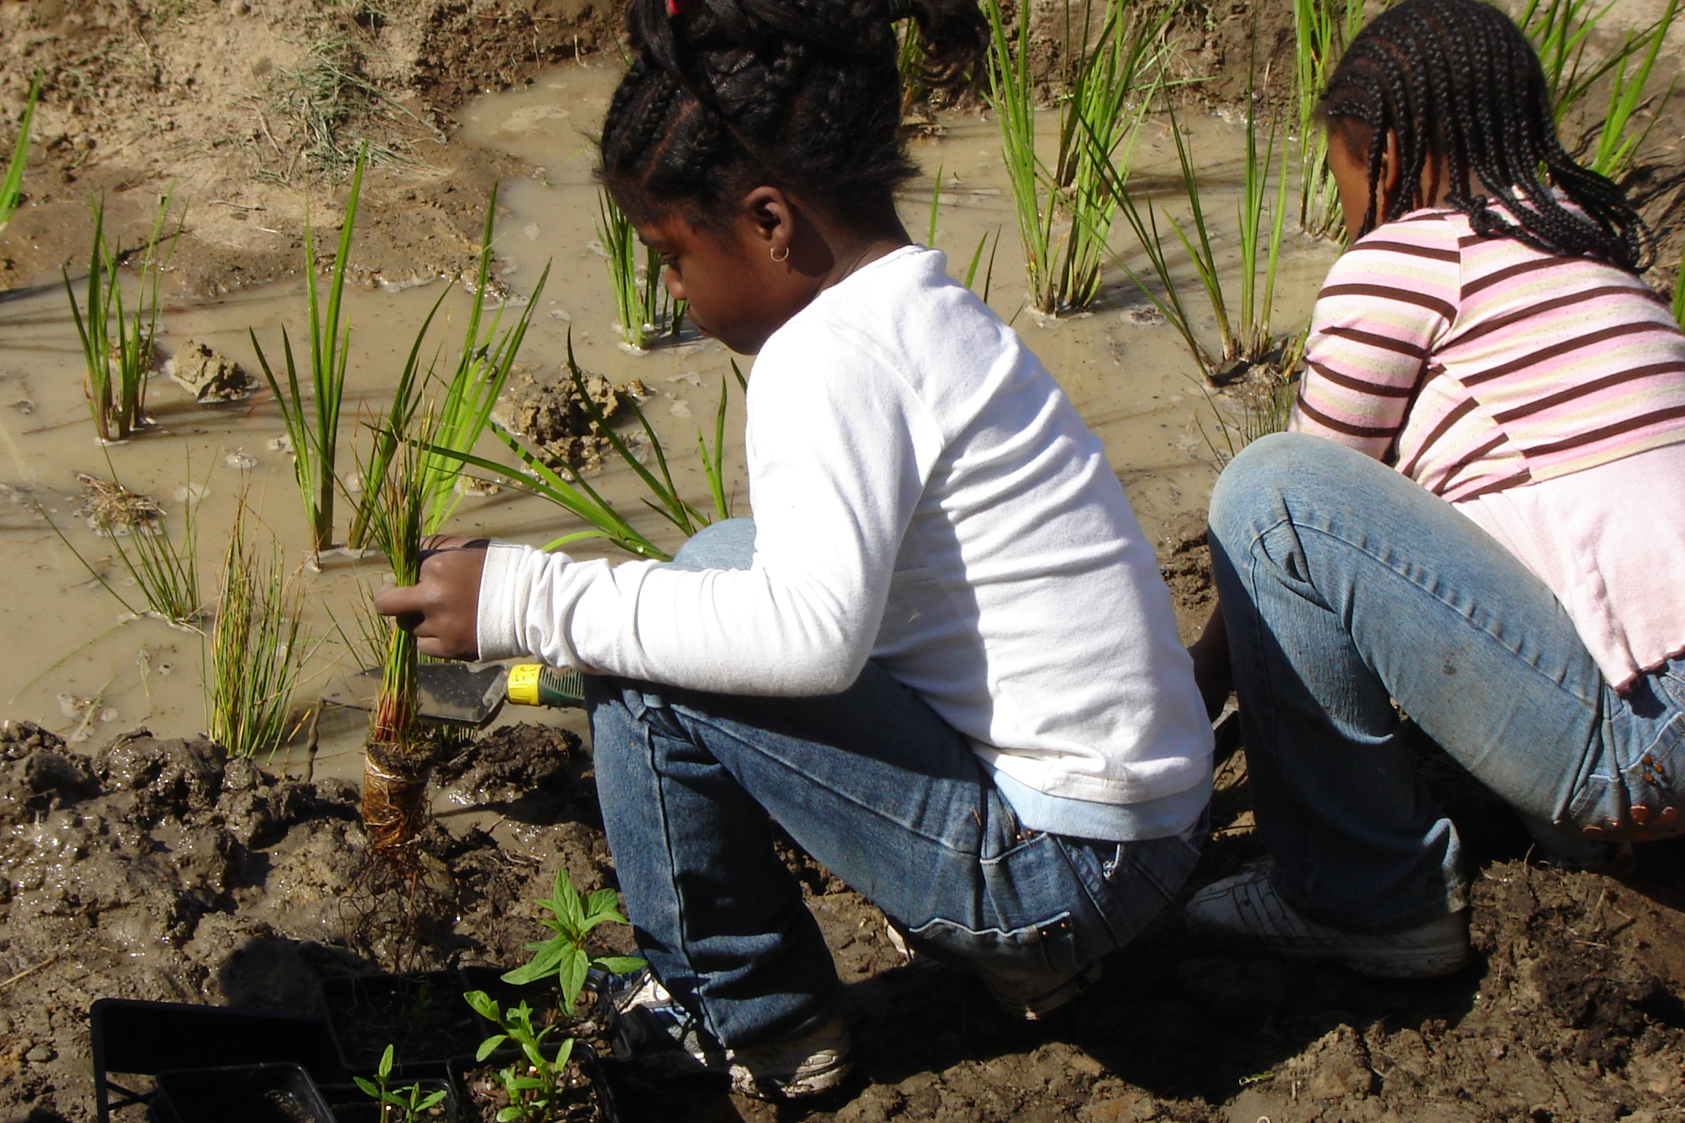
Notes:
MWEEs are so much more than a field trip! They are an integrated approach to learning both in the classroom and out in the field designed to create a deeper understanding of the environment and its stressors.
They are not add ons. MWEEs can help schools and teachers teach core subjects, including NGSS, in a thought provoking and engaging way. In fact, Stanford University is just finishing up a review of
research that looks at the evidence in support of environmental education and K-12 student
outcomes. In 81 studies that examined knowledge, 98% reported student knowledge gains. See the handout in your packets for more preliminary findings from their study.
Teachers are essential to MWEE implementation, guiding their students through the entire process and ensuring that it remains grounded in core subjects. Therefore, professional development that includes both content and outdoor education pedagogy is important.
The MWEE is revisited by teachers over time as the students engage in four essential elements:
Issue Definition
Outdoor Field Experiences
Action Projects
Synthesis and Conclusions
The definition of a MWEE can be found in your packets. The Workgroup is also working with partners to put together a Handbook for Practitioners, which will be available later this year.
You are going to see several examples of MWEEs as we move forward with today’s agenda.

Slide 13
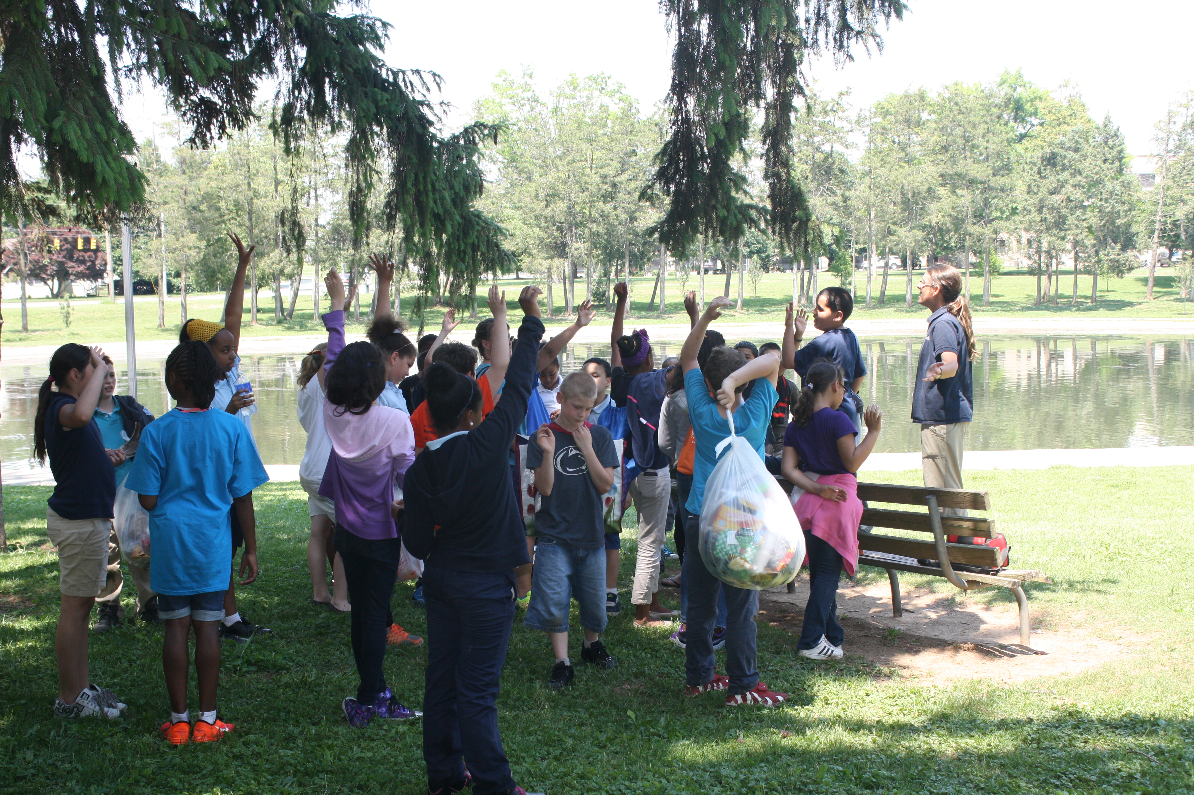
Notes:
MWEEs are so much more than a field trip! They are an integrated approach to learning both in the classroom and out in the field designed to create a deeper understanding of the environment and its stressors.
They are not add ons. MWEEs can help schools and teachers teach core subjects, including NGSS, in a thought provoking and engaging way. In fact, Stanford University is just finishing up a review of
research that looks at the evidence in support of environmental education and K-12 student
outcomes. In 81 studies that examined knowledge, 98% reported student knowledge gains. See the handout in your packets for more preliminary findings from their study.
Teachers are essential to MWEE implementation, guiding their students through the entire process and ensuring that it remains grounded in core subjects. Therefore, professional development that includes both content and outdoor education pedagogy is important.
The MWEE is revisited by teachers over time as the students engage in four essential elements:
Issue Definition
Outdoor Field Experiences
Action Projects
Synthesis and Conclusions
The definition of a MWEE can be found in your packets. The Workgroup is also working with partners to put together a Handbook for Practitioners, which will be available later this year.
You are going to see several examples of MWEEs as we move forward with today’s agenda.

Slide 14
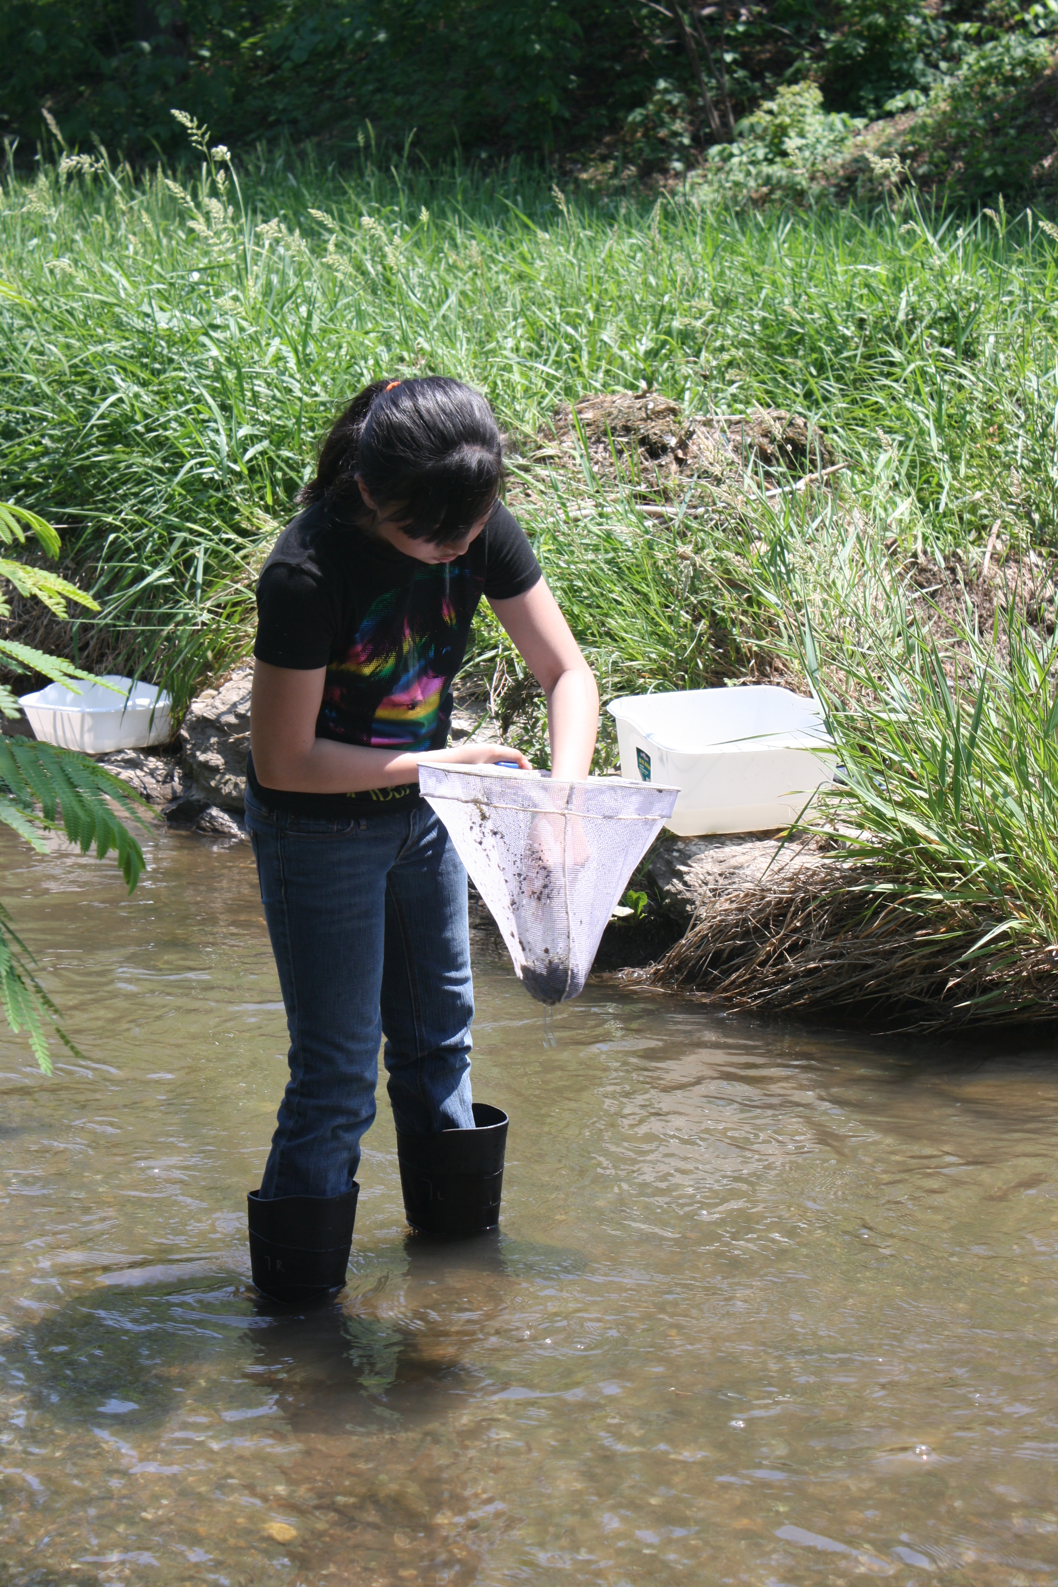
Notes:
MWEEs are so much more than a field trip! They are an integrated approach to learning both in the classroom and out in the field designed to create a deeper understanding of the environment and its stressors.
They are not add ons. MWEEs can help schools and teachers teach core subjects, including NGSS, in a thought provoking and engaging way. In fact, Stanford University is just finishing up a review of
research that looks at the evidence in support of environmental education and K-12 student
outcomes. In 81 studies that examined knowledge, 98% reported student knowledge gains. See the handout in your packets for more preliminary findings from their study.
Teachers are essential to MWEE implementation, guiding their students through the entire process and ensuring that it remains grounded in core subjects. Therefore, professional development that includes both content and outdoor education pedagogy is important.
The MWEE is revisited by teachers over time as the students engage in four essential elements:
Issue Definition
Outdoor Field Experiences
Action Projects
Synthesis and Conclusions
The definition of a MWEE can be found in your packets. The Workgroup is also working with partners to put together a Handbook for Practitioners, which will be available later this year.
You are going to see several examples of MWEEs as we move forward with today’s agenda.

Slide 15
Sustainable Schools
Notes:
The second outcome focuses on Sustainable Schools, which are important for their environmental impact, but also because they can be used to teach students valuable life skills that encourage students to walk the walk. By the way, by increasing efficiency they also tend to save school systems considerable amounts of money which can be reinvested into student programs.
US Dept of Education has incentivized the development of sustainable schools through the creation of US Green Ribbon Schools. We have adopted the Green Ribbon Schools pillars here in the Mid Atlantic. In many instances, there are state specific criteria that respond to local considerations – but most build off of the Green Ribbon pillars.
These pillars are (1) Environmental Impact and Costs, (2) Health and Wellness, and (3) environmental and sustainability education, which focuses on student learning with an emphasis on STEM and civic engagement.
There are several key partners helping advance this work here in the region, including National Wildlife Federation through their EcoSchools Program and US EPA Region 3 with an emphasis on healthy schools. There are also state partners working day in and day out with schools and students to plan and implement projects.

Slide 16
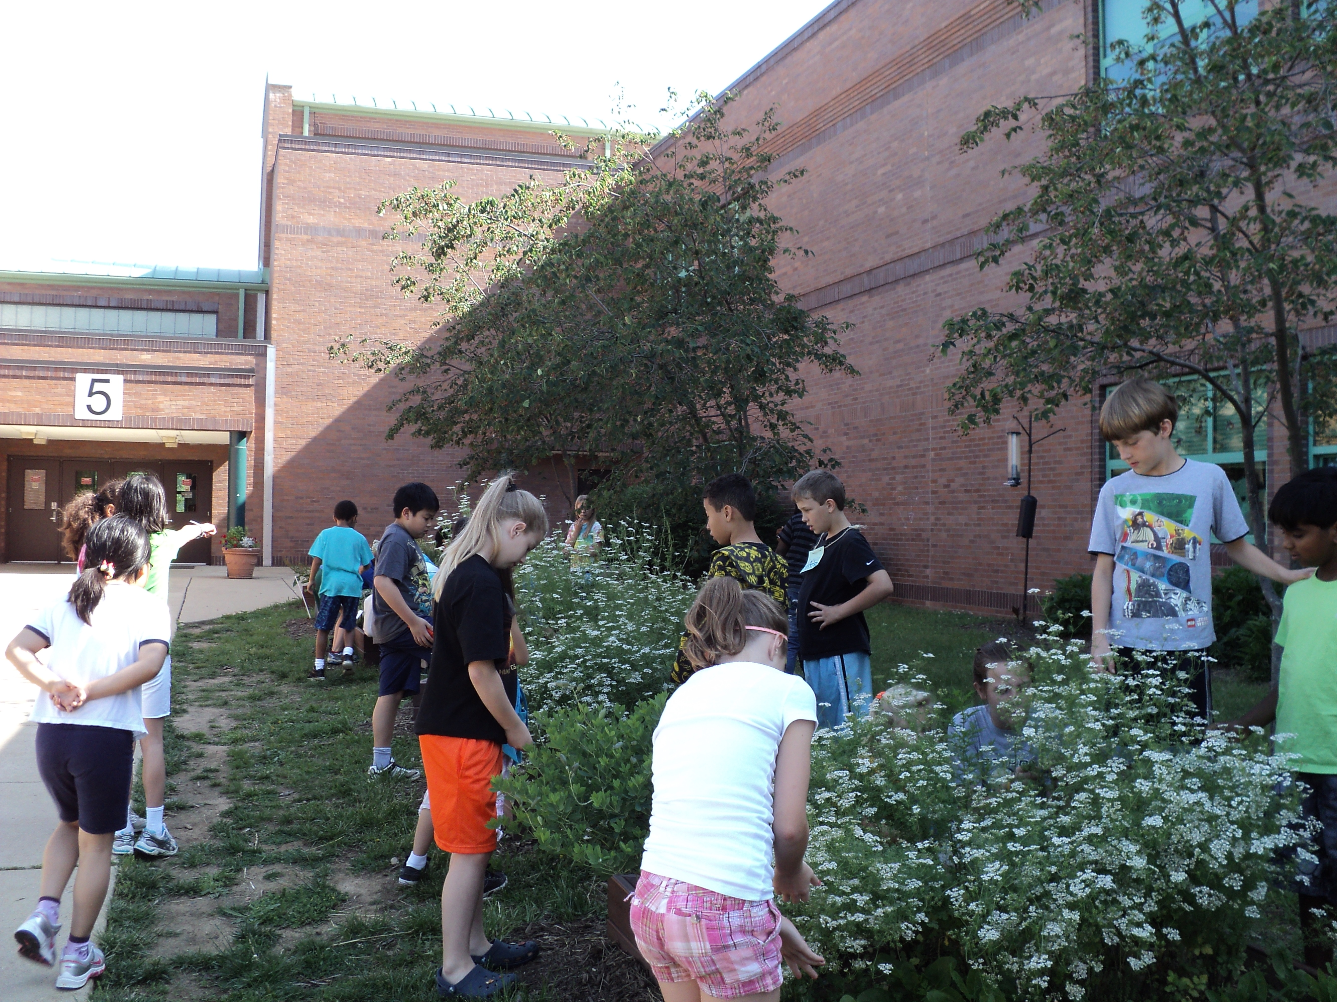
Notes:
The second outcome focuses on Sustainable Schools, which are important for their environmental impact, but also because they can be used to teach students valuable life skills that encourage students to walk the walk. By the way, by increasing efficiency they also tend to save school systems considerable amounts of money which can be reinvested into student programs.
US Dept of Education has incentivized the development of sustainable schools through the creation of US Green Ribbon Schools. We have adopted the Green Ribbon Schools pillars here in the Mid Atlantic. In many instances, there are state specific criteria that respond to local considerations – but most build off of the Green Ribbon pillars.
These pillars are (1) Environmental Impact and Costs, (2) Health and Wellness, and (3) environmental and sustainability education, which focuses on student learning with an emphasis on STEM and civic engagement.
There are several key partners helping advance this work here in the region, including National Wildlife Federation through their EcoSchools Program and US EPA Region 3 with an emphasis on healthy schools. There are also state partners working day in and day out with schools and students to plan and implement projects.

Slide 17
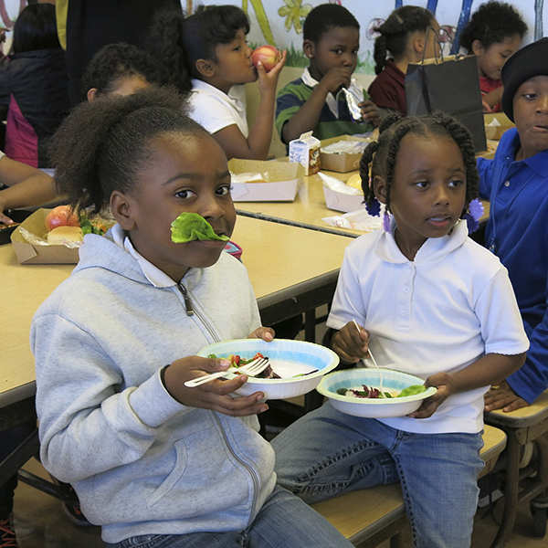
Notes:
The second outcome focuses on Sustainable Schools, which are important for their environmental impact, but also because they can be used to teach students valuable life skills that encourage students to walk the walk. By the way, by increasing efficiency they also tend to save school systems considerable amounts of money which can be reinvested into student programs.
US Dept of Education has incentivized the development of sustainable schools through the creation of US Green Ribbon Schools. We have adopted the Green Ribbon Schools pillars here in the Mid Atlantic. In many instances, there are state specific criteria that respond to local considerations – but most build off of the Green Ribbon pillars.
These pillars are (1) Environmental Impact and Costs, (2) Health and Wellness, and (3) environmental and sustainability education, which focuses on student learning with an emphasis on STEM and civic engagement.
There are several key partners helping advance this work here in the region, including National Wildlife Federation through their EcoSchools Program and US EPA Region 3 with an emphasis on healthy schools. There are also state partners working day in and day out with schools and students to plan and implement projects.

Slide 18
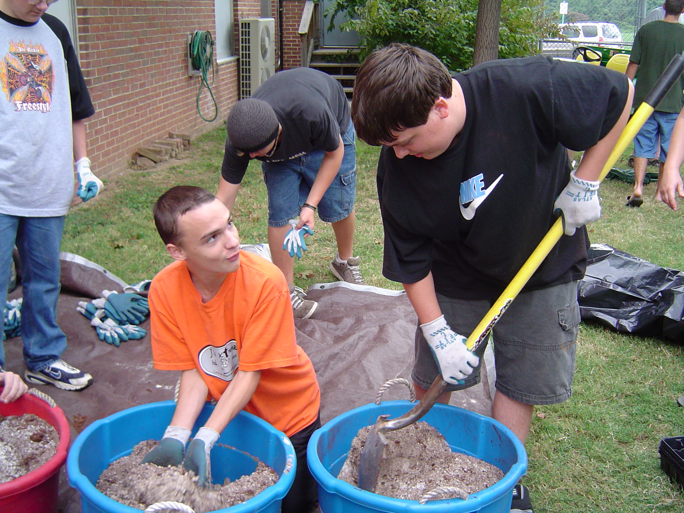
Notes:
The second outcome focuses on Sustainable Schools, which are important for their environmental impact, but also because they can be used to teach students valuable life skills that encourage students to walk the walk. By the way, by increasing efficiency they also tend to save school systems considerable amounts of money which can be reinvested into student programs.
US Dept of Education has incentivized the development of sustainable schools through the creation of US Green Ribbon Schools. We have adopted the Green Ribbon Schools pillars here in the Mid Atlantic. In many instances, there are state specific criteria that respond to local considerations – but most build off of the Green Ribbon pillars.
These pillars are (1) Environmental Impact and Costs, (2) Health and Wellness, and (3) environmental and sustainability education, which focuses on student learning with an emphasis on STEM and civic engagement.
There are several key partners helping advance this work here in the region, including National Wildlife Federation through their EcoSchools Program and US EPA Region 3 with an emphasis on healthy schools. There are also state partners working day in and day out with schools and students to plan and implement projects.

Slide 19
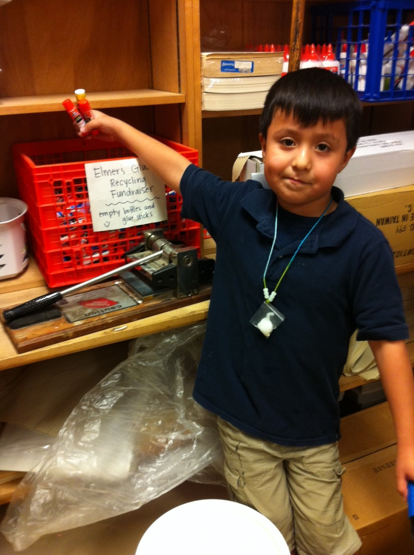
Notes:
The second outcome focuses on Sustainable Schools, which are important for their environmental impact, but also because they can be used to teach students valuable life skills that encourage students to walk the walk. By the way, by increasing efficiency they also tend to save school systems considerable amounts of money which can be reinvested into student programs.
US Dept of Education has incentivized the development of sustainable schools through the creation of US Green Ribbon Schools. We have adopted the Green Ribbon Schools pillars here in the Mid Atlantic. In many instances, there are state specific criteria that respond to local considerations – but most build off of the Green Ribbon pillars.
These pillars are (1) Environmental Impact and Costs, (2) Health and Wellness, and (3) environmental and sustainability education, which focuses on student learning with an emphasis on STEM and civic engagement.
There are several key partners helping advance this work here in the region, including National Wildlife Federation through their EcoSchools Program and US EPA Region 3 with an emphasis on healthy schools. There are also state partners working day in and day out with schools and students to plan and implement projects.

Slide 20
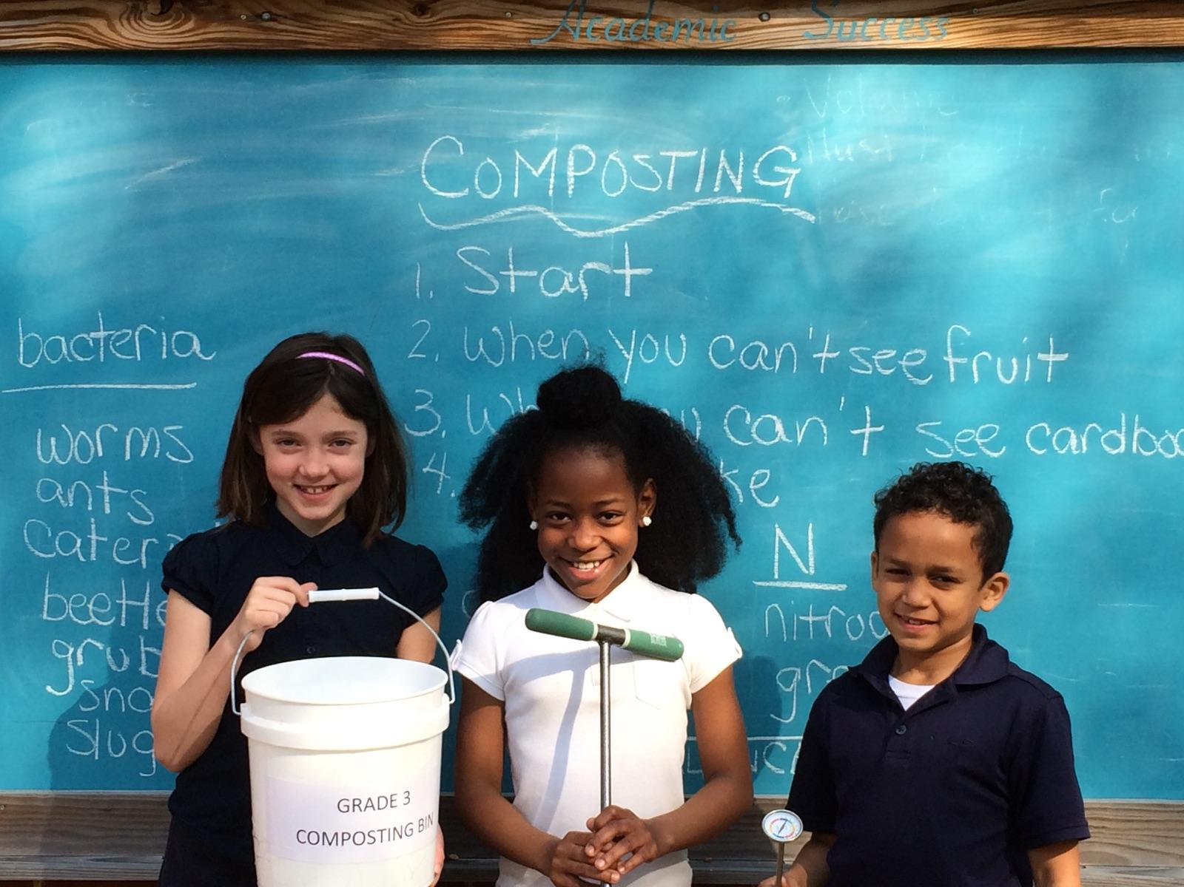
Notes:
The second outcome focuses on Sustainable Schools, which are important for their environmental impact, but also because they can be used to teach students valuable life skills that encourage students to walk the walk. By the way, by increasing efficiency they also tend to save school systems considerable amounts of money which can be reinvested into student programs.
US Dept of Education has incentivized the development of sustainable schools through the creation of US Green Ribbon Schools. We have adopted the Green Ribbon Schools pillars here in the Mid Atlantic. In many instances, there are state specific criteria that respond to local considerations – but most build off of the Green Ribbon pillars.
These pillars are (1) Environmental Impact and Costs, (2) Health and Wellness, and (3) environmental and sustainability education, which focuses on student learning with an emphasis on STEM and civic engagement.
There are several key partners helping advance this work here in the region, including National Wildlife Federation through their EcoSchools Program and US EPA Region 3 with an emphasis on healthy schools. There are also state partners working day in and day out with schools and students to plan and implement projects.

Slide 21
Policy & Metrics
School system level implementation is extremely important
Environmental Literacy Indicator Tool (ELIT) collected baseline data for 2014-2015 school year
ELIT measured:
  Degree of preparedness to provide Environmental Literacy programming
  Extent to which MWEEs are being provided to students
  Number of sustainable schools
Notes:
The goal of this effort is to create high quality, SUSTAINABLE programs so working with school systems to generate buy-in and incentivize change is absolutely essential.
To understand where we are starting, the Chesapeake Bay Program conducted a baseline assessment of environmental literacy in school systems called “ELIT”. The survey measured:
Degree of preparedness to provide Env. Ed.
Extent to which MWEE’s are provided to students
Number of sustainable schools
NOTE: Results based only on survey respondents and the # of responses to each question

Slide 22
ELIT results
51% of school systems are well prepared or somewhat prepared to implement environmental education
68% of school divisions offer MWEEs for at least some elementary students (29% reach all)
74% of school divisions offer MWEEs for at least some middle school students (33% reach all)
69% offer of school systems offer MWEEs for at least some high school students (26% reach all)
709 schools have a sustainable schools certification

Slide 23

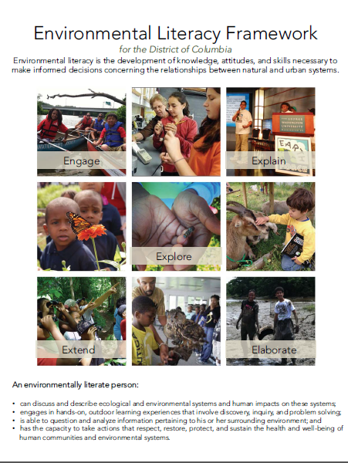
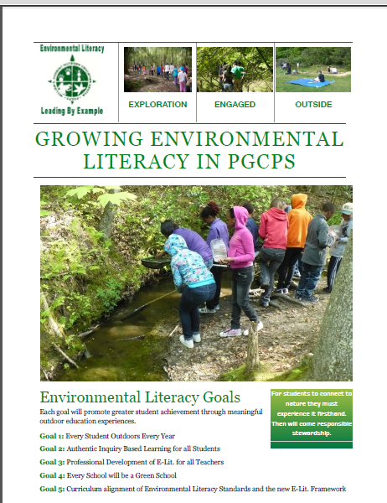
Increasing Capacity
School districts are
embracing environmental
literacy & sustainability to
engage learners and save
$$
Funding is available to
develop programs:
  NOAA B-WET
  Chesapeake Bay Trust
  EPA EE grants
  NSF grants
  State grants
Notes:
Taking this to scale and sustaining it is not only possible, but it is happening in school districts throughout the watershed in small and large districts, in affluent and underserved communities, in urban, suburban, and rural areas…and we are working with state and local representatives to describe and share the lessons learned from these success stories. You will hear some of these stories today.
There is also funding for the development of these program NOAA and the Chesapeake Bay Trust have been intentionally supporting this work for more than a decade. School districts and partners have also successfully applied EPA EE Grants, NSF funding, and a variety of state education funding programs to build sustainable programs.

Slide 24
Leadership Summit
Notes:
The Environmental Literacy Leadership Summit was held on April 20, 2016 at the Chesapeake Bay Foundation HQ in Annapolis, MD. The purpose of the meeting was to…
To explore how states can assist school systems in creating and sustaining high-quality EL programs as part of ongoing education reform and to meet Chesapeake Bay Watershed Agreement commitments.
To examine opportunities provided by the environmental education provisions of the recently enacted Every Student Succeeds Act to support state and local environmental literacy programming.

Slide 25
Purpose of Leadership Summit Purpose
To explore how states can assist school systems in creating and sustaining high-quality EL programs as part of ongoing education reform and to meet Chesapeake Bay Watershed Agreement commitments.
To examine opportunities provided by the environmental education provisions of the recently enacted Every Student Succeeds Act to support state and local environmental literacy programming.
Notes:
The Environmental Literacy Leadership Summit was held on April 20, 2016 at the Chesapeake Bay Foundation HQ in Annapolis, MD. The purpose of the meeting was to…
To explore how states can assist school systems in creating and sustaining high-quality EL programs as part of ongoing education reform and to meet Chesapeake Bay Watershed Agreement commitments.
To examine opportunities provided by the environmental education provisions of the recently enacted Every Student Succeeds Act to support state and local environmental literacy programming.

Slide 26
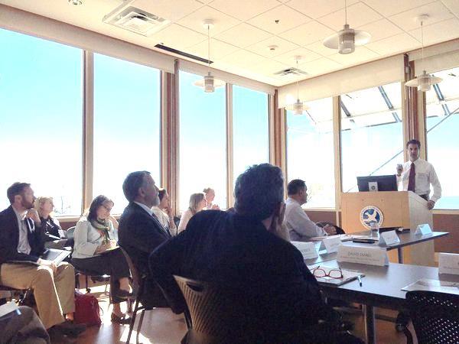
Notes:
Attendees included state superintendents of education and secretaries of natural resources and their staff along with leaders from school systems, federal agencies, and non-profit partners.
Congressman Sarbanes kicked off the day – in his home district. As you may know, he was responsible for drafting and introducing the No Child Left Inside Act, which set the stage for the inclusion of environmental education into the new Every Student Succeeds Act (that replaces No Child Left Behind), which I will discuss a bit later.
The day included presentations from practitioners and leaders about best practices in systemic environmental education (including a talk from Dr. Spence who you will hear from in a few minutes), an opportunity to interact with high school students from Howard County who were participating in the field experience portion of their MWEE, and discussions about Every Student Succeeds Act and state priorities for environmental literacy.

Slide 27
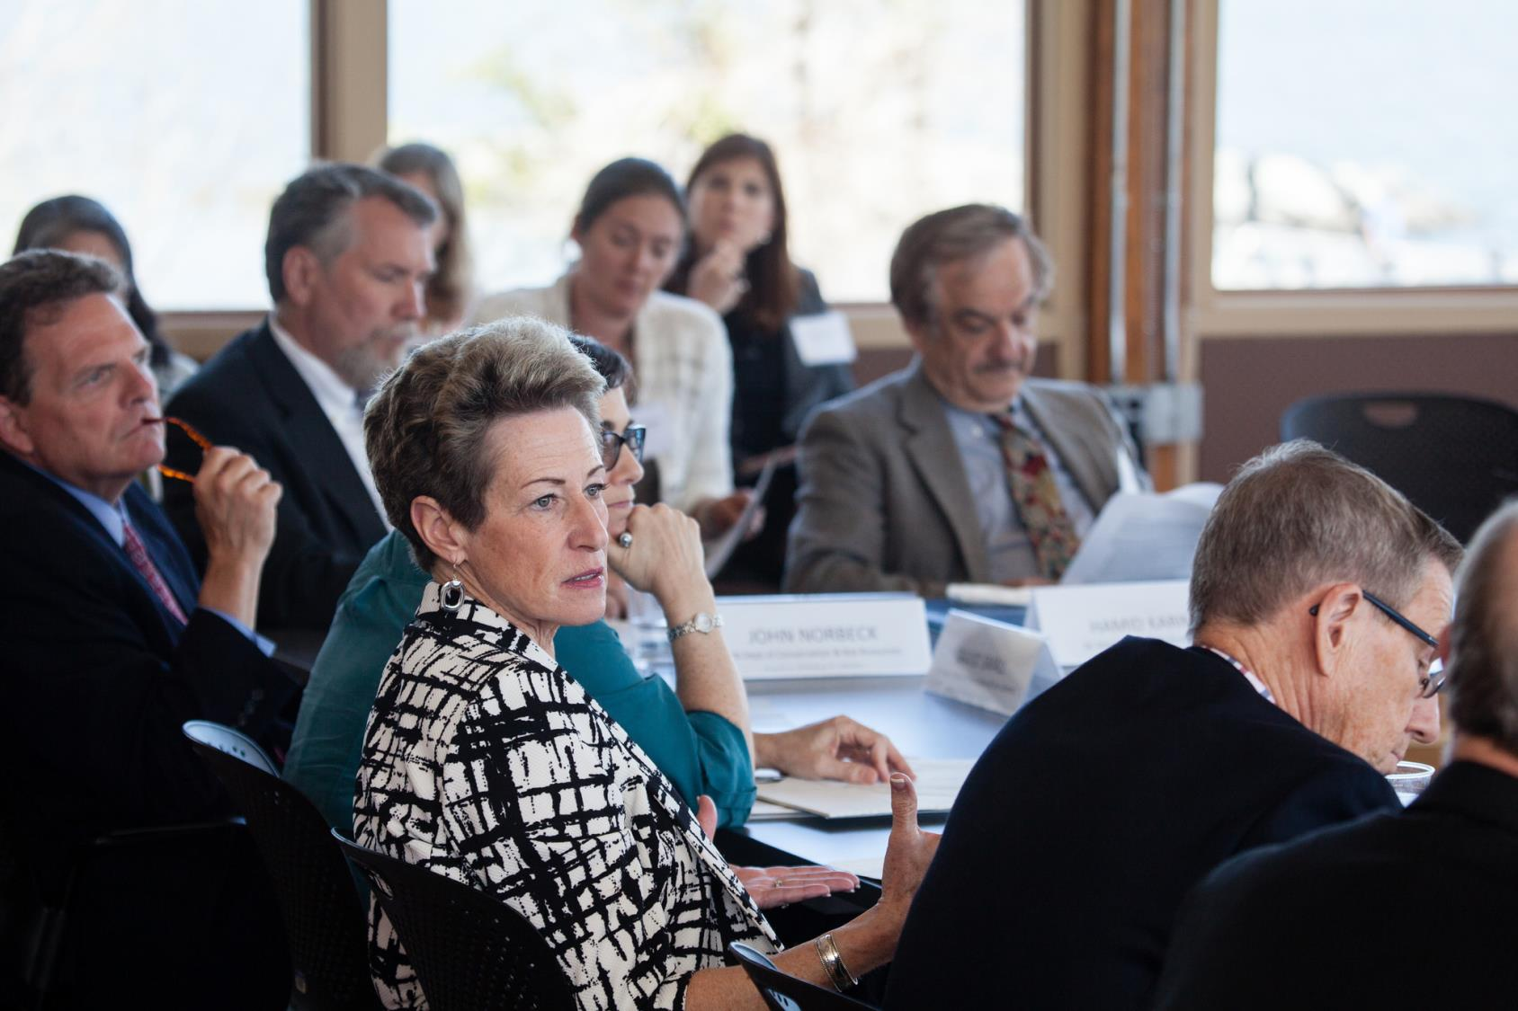
Notes:
Attendees included state superintendents of education and secretaries of natural resources and their staff along with leaders from school systems, federal agencies, and non-profit partners.
Congressman Sarbanes kicked off the day – in his home district. As you may know, he was responsible for drafting and introducing the No Child Left Inside Act, which set the stage for the inclusion of environmental education into the new Every Student Succeeds Act (that replaces No Child Left Behind), which I will discuss a bit later.
The day included presentations from practitioners and leaders about best practices in systemic environmental education (including a talk from Dr. Spence who you will hear from in a few minutes), an opportunity to interact with high school students from Howard County who were participating in the field experience portion of their MWEE, and discussions about Every Student Succeeds Act and state priorities for environmental literacy.

Slide 28
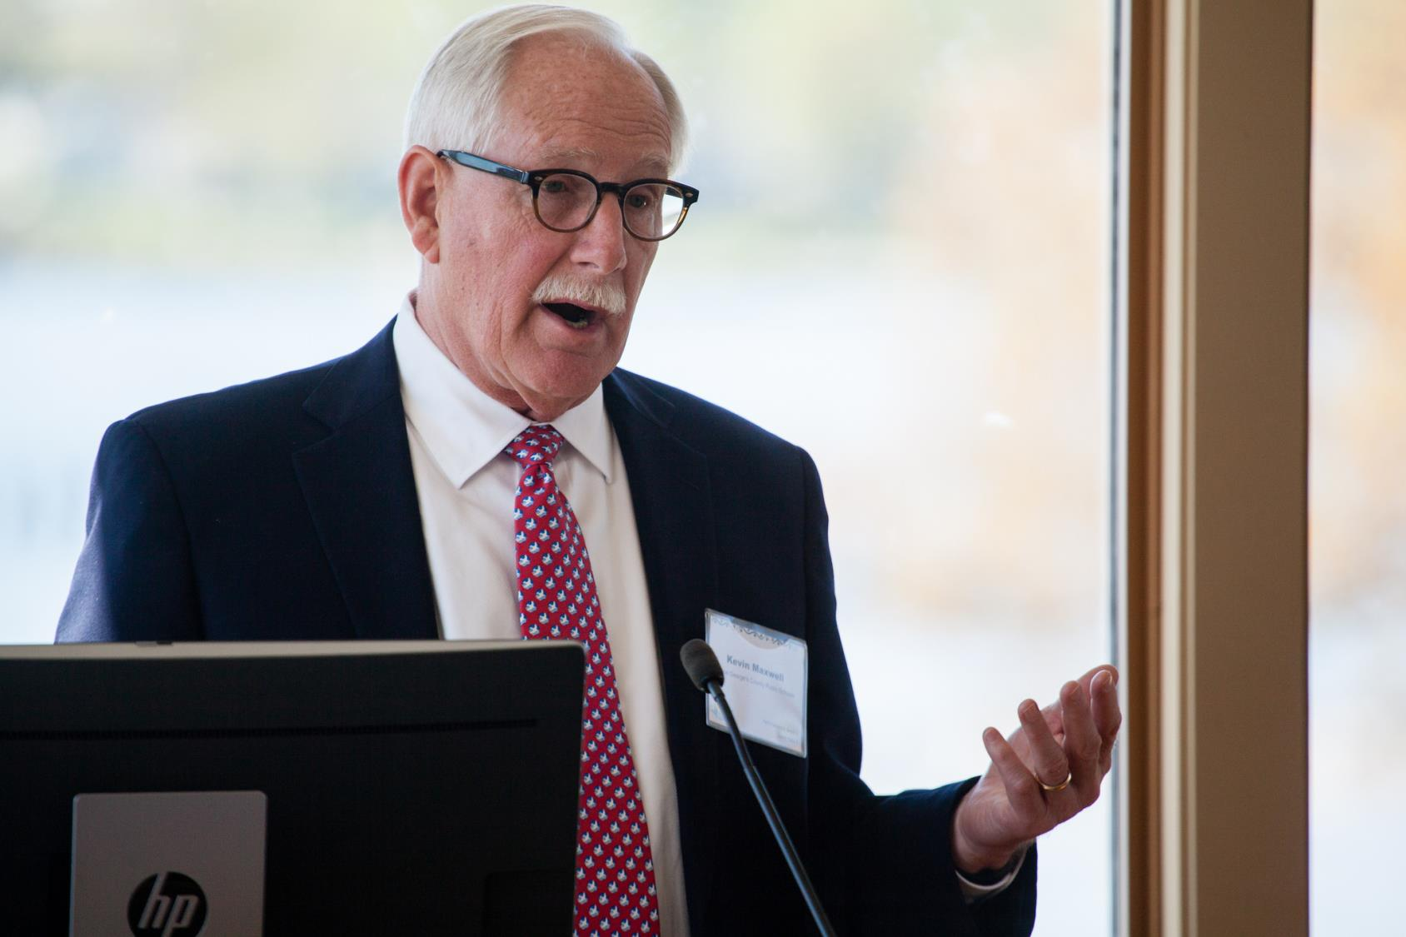
Notes:
Attendees included state superintendents of education and secretaries of natural resources and their staff along with leaders from school systems, federal agencies, and non-profit partners.
Congressman Sarbanes kicked off the day – in his home district. As you may know, he was responsible for drafting and introducing the No Child Left Inside Act, which set the stage for the inclusion of environmental education into the new Every Student Succeeds Act (that replaces No Child Left Behind), which I will discuss a bit later.
The day included presentations from practitioners and leaders about best practices in systemic environmental education (including a talk from Dr. Spence who you will hear from in a few minutes), an opportunity to interact with high school students from Howard County who were participating in the field experience portion of their MWEE, and discussions about Every Student Succeeds Act and state priorities for environmental literacy.

Slide 29
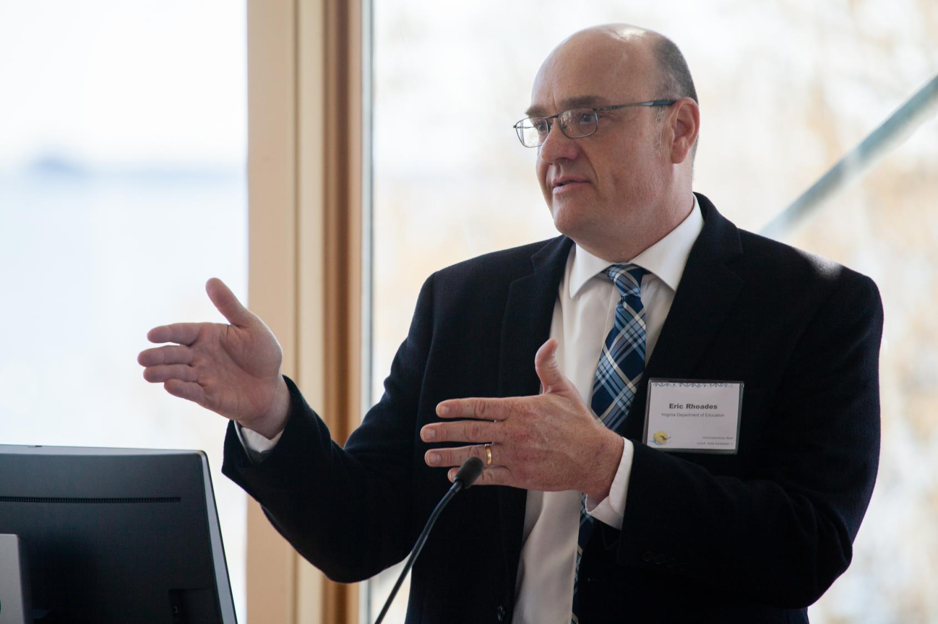
Notes:
Attendees included state superintendents of education and secretaries of natural resources and their staff along with leaders from school systems, federal agencies, and non-profit partners.
Congressman Sarbanes kicked off the day – in his home district. As you may know, he was responsible for drafting and introducing the No Child Left Inside Act, which set the stage for the inclusion of environmental education into the new Every Student Succeeds Act (that replaces No Child Left Behind), which I will discuss a bit later.
The day included presentations from practitioners and leaders about best practices in systemic environmental education (including a talk from Dr. Spence who you will hear from in a few minutes), an opportunity to interact with high school students from Howard County who were participating in the field experience portion of their MWEE, and discussions about Every Student Succeeds Act and state priorities for environmental literacy.

Slide 30
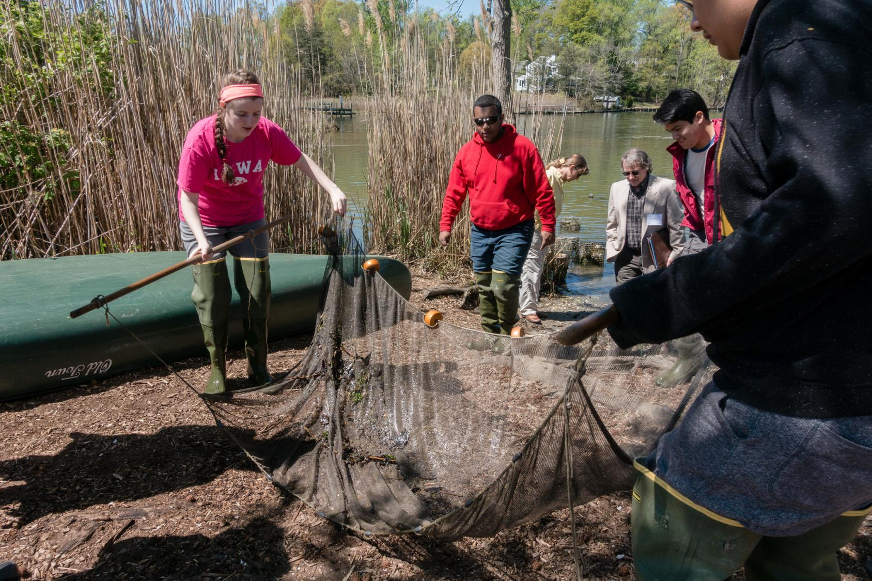
Notes:
Attendees included state superintendents of education and secretaries of natural resources and their staff along with leaders from school systems, federal agencies, and non-profit partners.
Congressman Sarbanes kicked off the day – in his home district. As you may know, he was responsible for drafting and introducing the No Child Left Inside Act, which set the stage for the inclusion of environmental education into the new Every Student Succeeds Act (that replaces No Child Left Behind), which I will discuss a bit later.
The day included presentations from practitioners and leaders about best practices in systemic environmental education (including a talk from Dr. Spence who you will hear from in a few minutes), an opportunity to interact with high school students from Howard County who were participating in the field experience portion of their MWEE, and discussions about Every Student Succeeds Act and state priorities for environmental literacy.

Slide 31
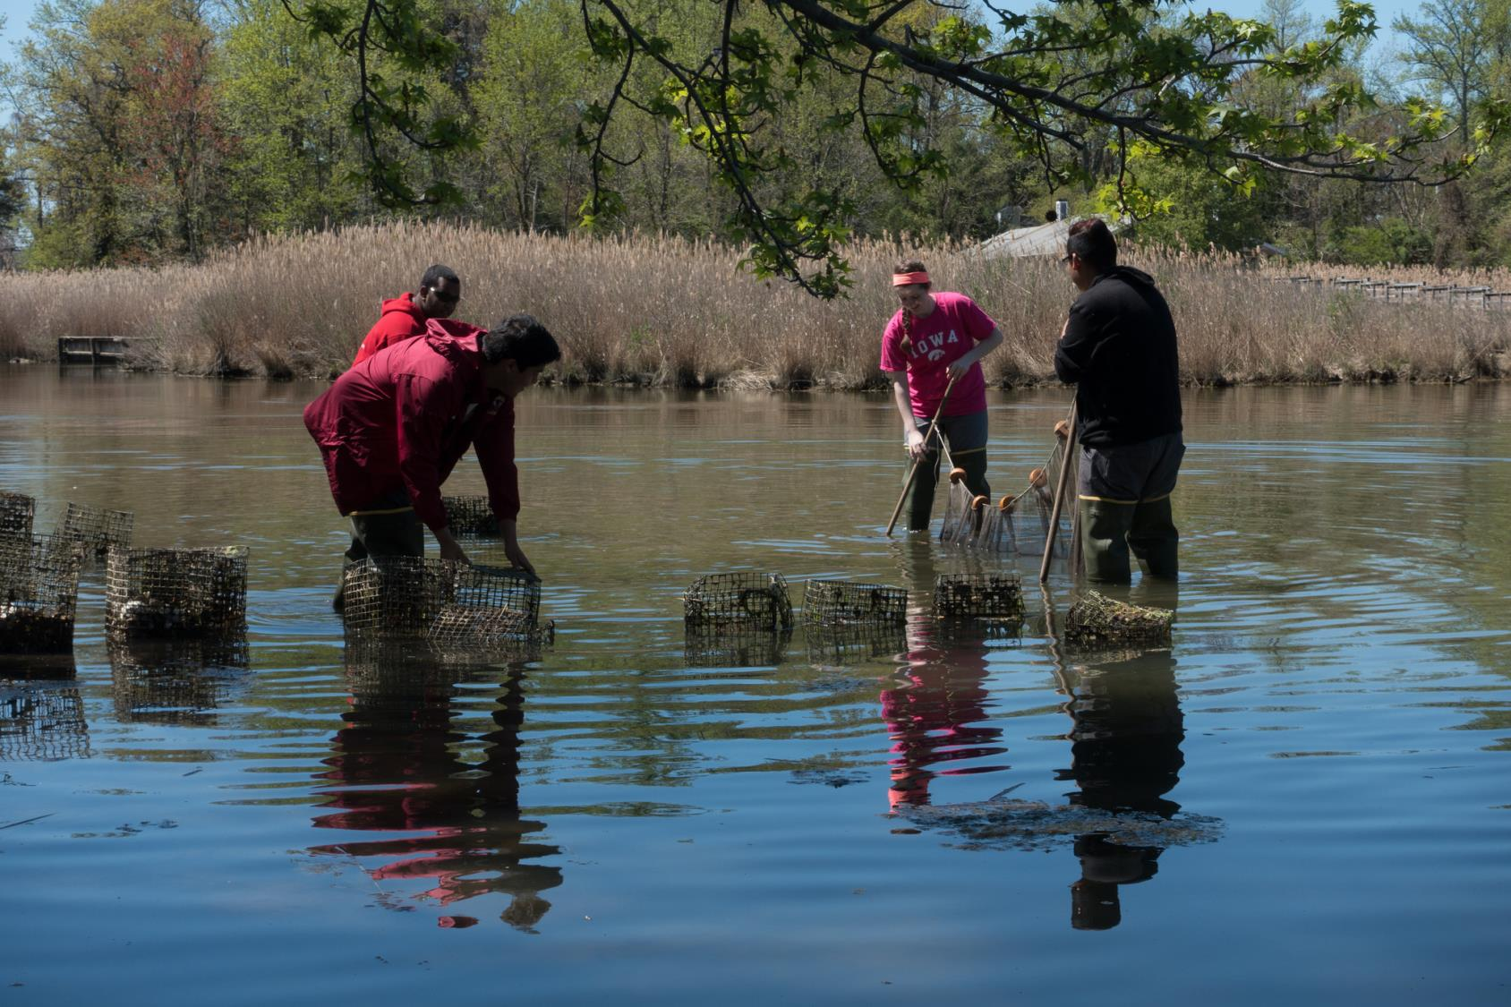
Notes:
Attendees included state superintendents of education and secretaries of natural resources and their staff along with leaders from school systems, federal agencies, and non-profit partners.
Congressman Sarbanes kicked off the day – in his home district. As you may know, he was responsible for drafting and introducing the No Child Left Inside Act, which set the stage for the inclusion of environmental education into the new Every Student Succeeds Act (that replaces No Child Left Behind), which I will discuss a bit later.
The day included presentations from practitioners and leaders about best practices in systemic environmental education (including a talk from Dr. Spence who you will hear from in a few minutes), an opportunity to interact with high school students from Howard County who were participating in the field experience portion of their MWEE, and discussions about Every Student Succeeds Act and state priorities for environmental literacy.

Slide 32
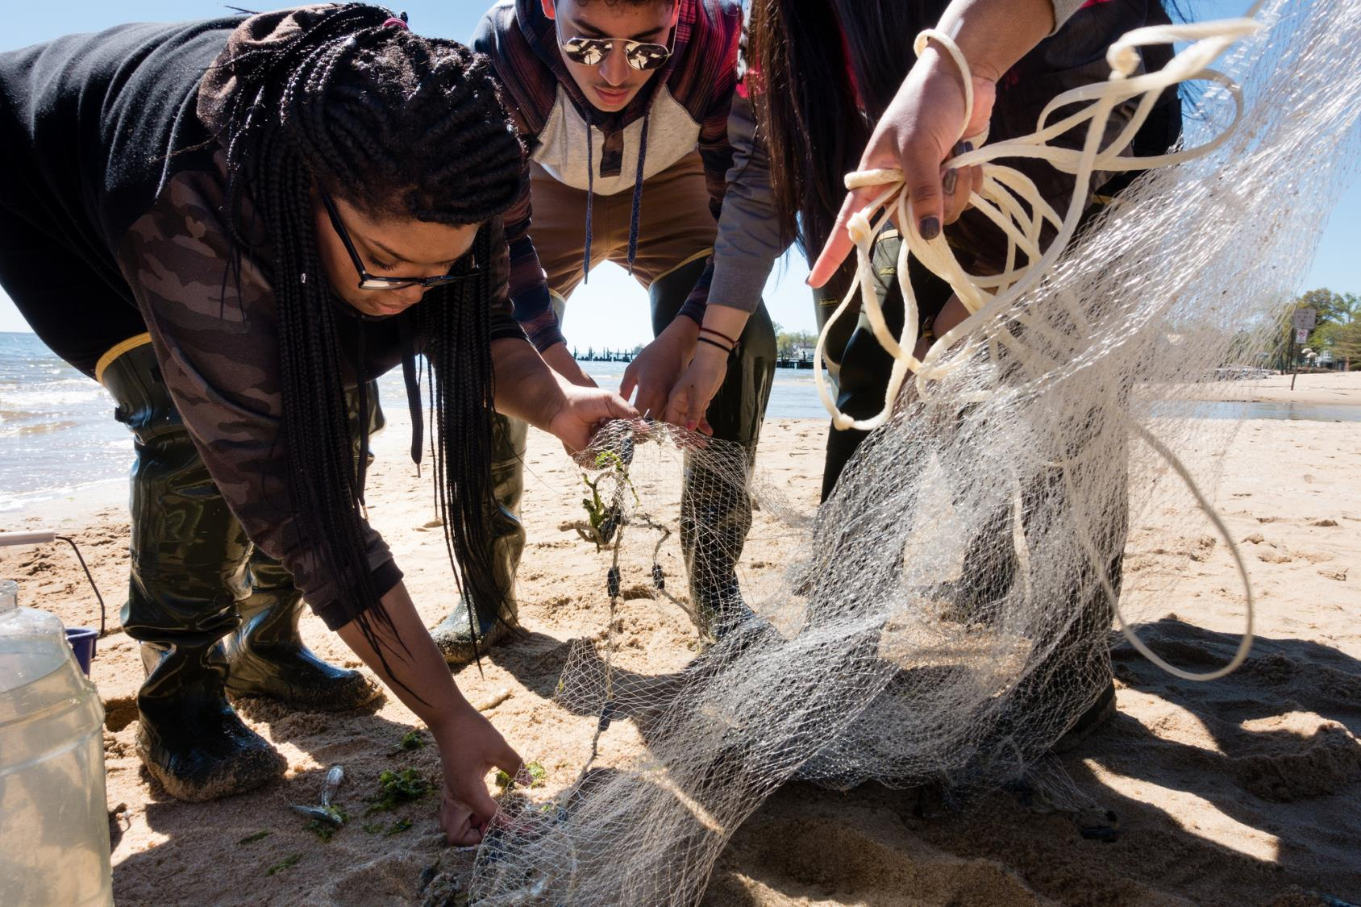
Notes:
Attendees included state superintendents of education and secretaries of natural resources and their staff along with leaders from school systems, federal agencies, and non-profit partners.
Congressman Sarbanes kicked off the day – in his home district. As you may know, he was responsible for drafting and introducing the No Child Left Inside Act, which set the stage for the inclusion of environmental education into the new Every Student Succeeds Act (that replaces No Child Left Behind), which I will discuss a bit later.
The day included presentations from practitioners and leaders about best practices in systemic environmental education (including a talk from Dr. Spence who you will hear from in a few minutes), an opportunity to interact with high school students from Howard County who were participating in the field experience portion of their MWEE, and discussions about Every Student Succeeds Act and state priorities for environmental literacy.

Slide 33
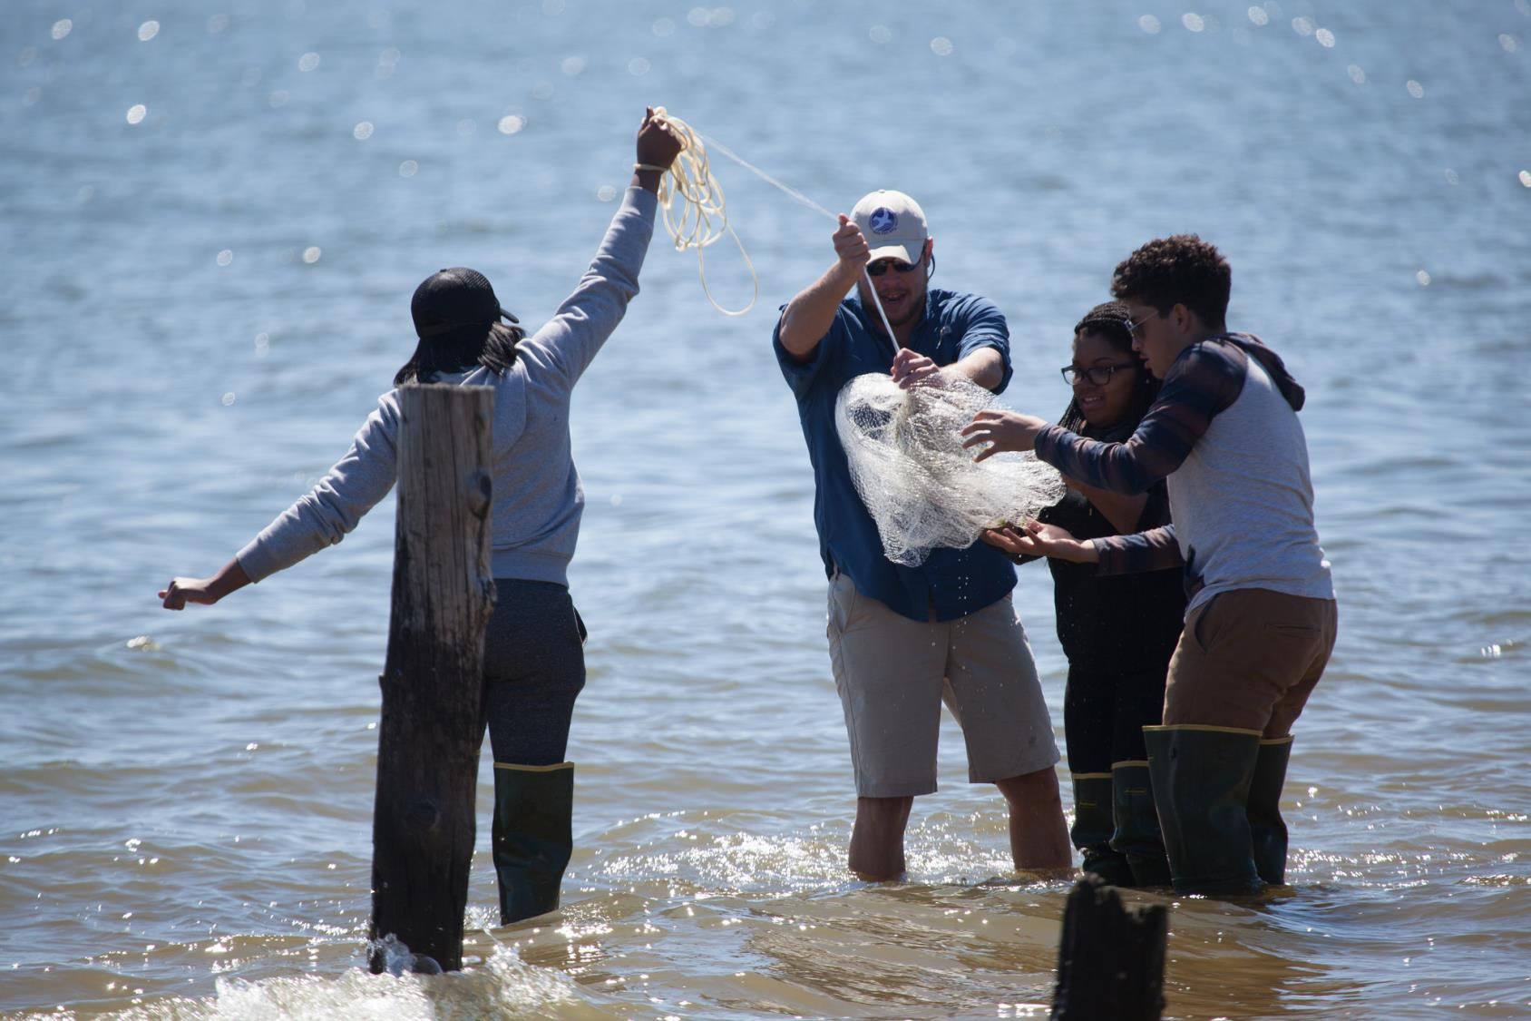
Notes:
Attendees included state superintendents of education and secretaries of natural resources and their staff along with leaders from school systems, federal agencies, and non-profit partners.
Congressman Sarbanes kicked off the day – in his home district. As you may know, he was responsible for drafting and introducing the No Child Left Inside Act, which set the stage for the inclusion of environmental education into the new Every Student Succeeds Act (that replaces No Child Left Behind), which I will discuss a bit later.
The day included presentations from practitioners and leaders about best practices in systemic environmental education (including a talk from Dr. Spence who you will hear from in a few minutes), an opportunity to interact with high school students from Howard County who were participating in the field experience portion of their MWEE, and discussions about Every Student Succeeds Act and state priorities for environmental literacy.

Slide 34
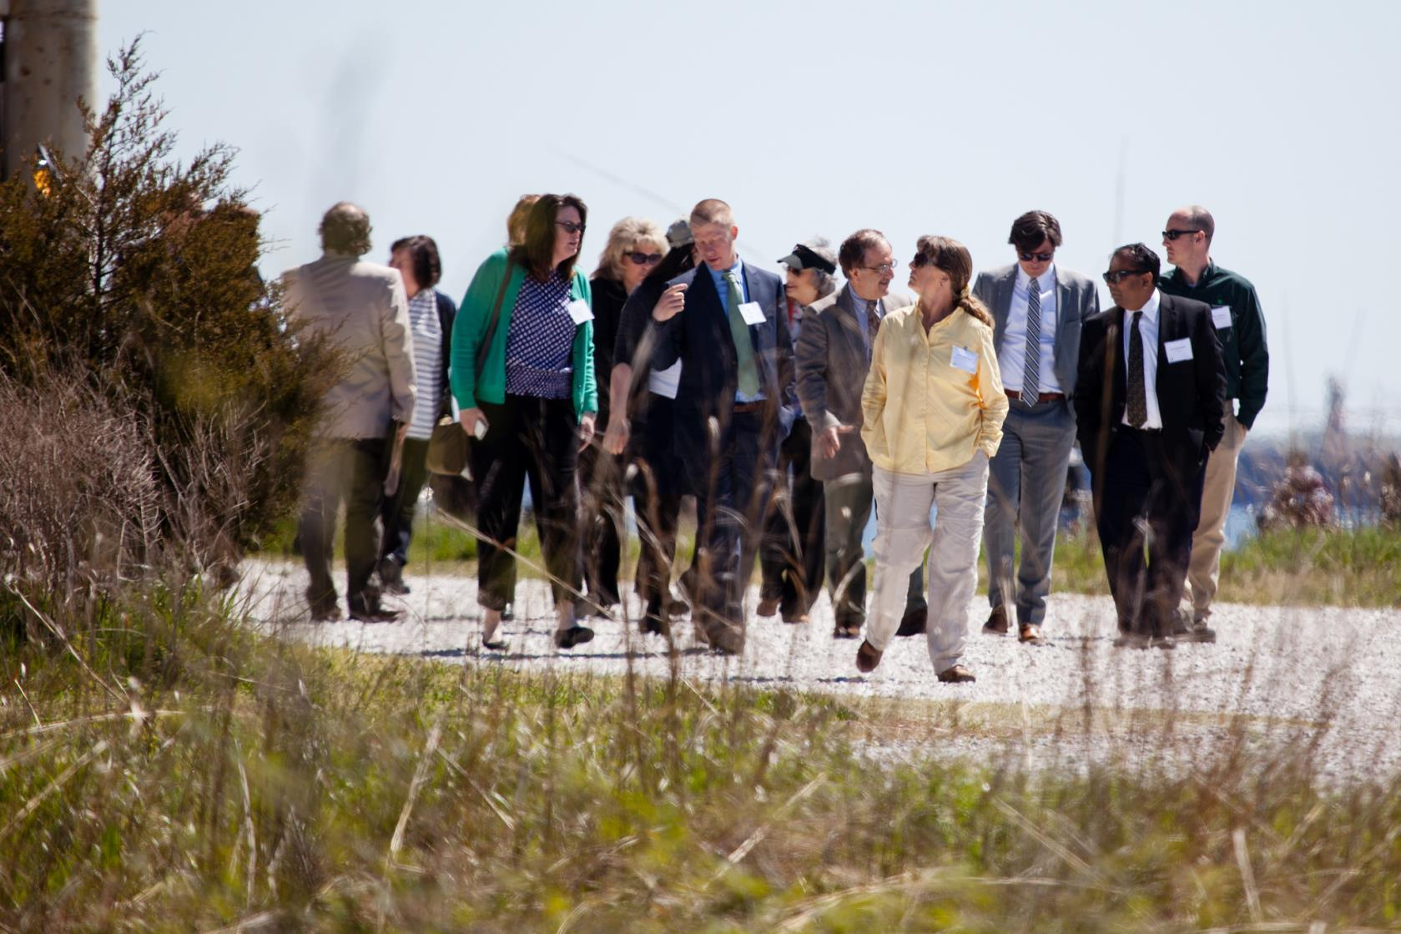
Notes:
Attendees included state superintendents of education and secretaries of natural resources and their staff along with leaders from school systems, federal agencies, and non-profit partners.
Congressman Sarbanes kicked off the day – in his home district. As you may know, he was responsible for drafting and introducing the No Child Left Inside Act, which set the stage for the inclusion of environmental education into the new Every Student Succeeds Act (that replaces No Child Left Behind), which I will discuss a bit later.
The day included presentations from practitioners and leaders about best practices in systemic environmental education (including a talk from Dr. Spence who you will hear from in a few minutes), an opportunity to interact with high school students from Howard County who were participating in the field experience portion of their MWEE, and discussions about Every Student Succeeds Act and state priorities for environmental literacy.

Slide 35

Notes:
Attendees included state superintendents of education and secretaries of natural resources and their staff along with leaders from school systems, federal agencies, and non-profit partners.
Congressman Sarbanes kicked off the day – in his home district. As you may know, he was responsible for drafting and introducing the No Child Left Inside Act, which set the stage for the inclusion of environmental education into the new Every Student Succeeds Act (that replaces No Child Left Behind), which I will discuss a bit later.
The day included presentations from practitioners and leaders about best practices in systemic environmental education (including a talk from Dr. Spence who you will hear from in a few minutes), an opportunity to interact with high school students from Howard County who were participating in the field experience portion of their MWEE, and discussions about Every Student Succeeds Act and state priorities for environmental literacy.

Slide 36
Virginia Priorities
VA DOE will:
  Ensure EL is represented in new K-12 science standards.
  Explore opportunities to include EL in Profile of a VA graduate.
  Look at changing regulations for colleges that prepare teachers.
  Complete guidance document that shows how current teachers are implementing watershed education and field work.
  Update guidance document on incorporating green design and places for outdoor learning at schools.
Notes:
An example of the type of state priorities we heard were:
VA DOE will:
Ensure EL is represented in new K-12 science standards.
Explore opportunities to include EL in Profile of a VA graduate.
Look at changing regulations for colleges that prepare teachers.
Complete guidance document that shows how current teachers are implementing watershed education and field work.
Update guidance document on incorporating green design and places for outdoor learning at schools.

Slide 37
Every Student Succeeds Act
Notes:
We then heard from Monique Chism, Deputy Assistant Secretary of Policy and Programs, U.S. Department of Education, and Sarah Bodor, Director of Policy for NAAEE, who spoke to us about existing and planned programs that could be used to support environmental education. This was followed by a facilitated discussion about the opportunities that the Every Student Succeeds Act presents.
The key language sits in Title IV of the Every Student Succeeds Act—21st Century Schools:
Title IV, Part A: Environmental education is eligible for funding under a new $1.65B grant program that includes enrichment programs and student health and safety programs.
Under the law, these funds are block granted to the states using the Title I formula; 95% of the state funds are then block granted to Local Education Agencies (LEA), also according to formula
Title IV, Part B: Environmental literacy programs are now eligible for funding as part of the existing $1B 21st Century Community Learning Centers program. These funds are also block granted to the states to administer competitive grants for LEAs, schools, and/or community partners for after-school activities
In addition to ESSA, the overall legislation creates a number of additional opportunities for related activities that still need to be explored. US Department of Education may be able to help support that effort through guidance to states and promotion of specific model programs.

Slide 38
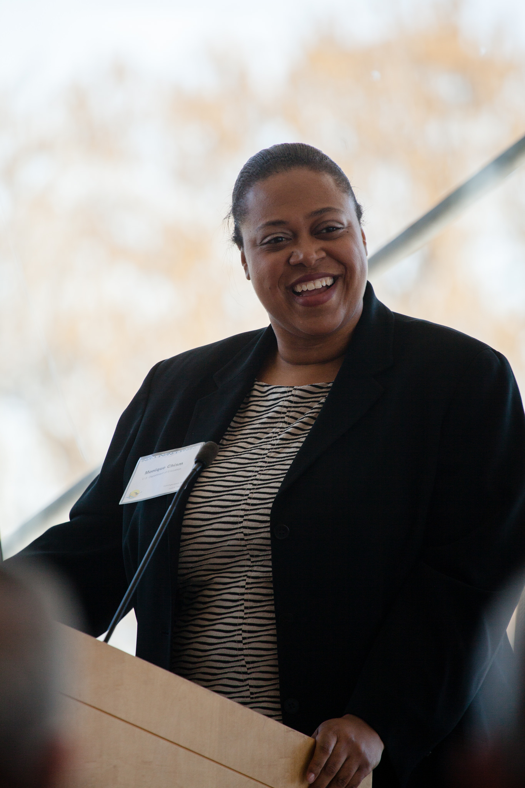
Notes:
We then heard from Monique Chism, Deputy Assistant Secretary of Policy and Programs, U.S. Department of Education, and Sarah Bodor, Director of Policy for NAAEE, who spoke to us about existing and planned programs that could be used to support environmental education. This was followed by a facilitated discussion about the opportunities that the Every Student Succeeds Act presents.
The key language sits in Title IV of the Every Student Succeeds Act—21st Century Schools:
Title IV, Part A: Environmental education is eligible for funding under a new $1.65B grant program that includes enrichment programs and student health and safety programs.
Under the law, these funds are block granted to the states using the Title I formula; 95% of the state funds are then block granted to Local Education Agencies (LEA), also according to formula
Title IV, Part B: Environmental literacy programs are now eligible for funding as part of the existing $1B 21st Century Community Learning Centers program. These funds are also block granted to the states to administer competitive grants for LEAs, schools, and/or community partners for after-school activities
In addition to ESSA, the overall legislation creates a number of additional opportunities for related activities that still need to be explored. US Department of Education may be able to help support that effort through guidance to states and promotion of specific model programs.

Slide 39
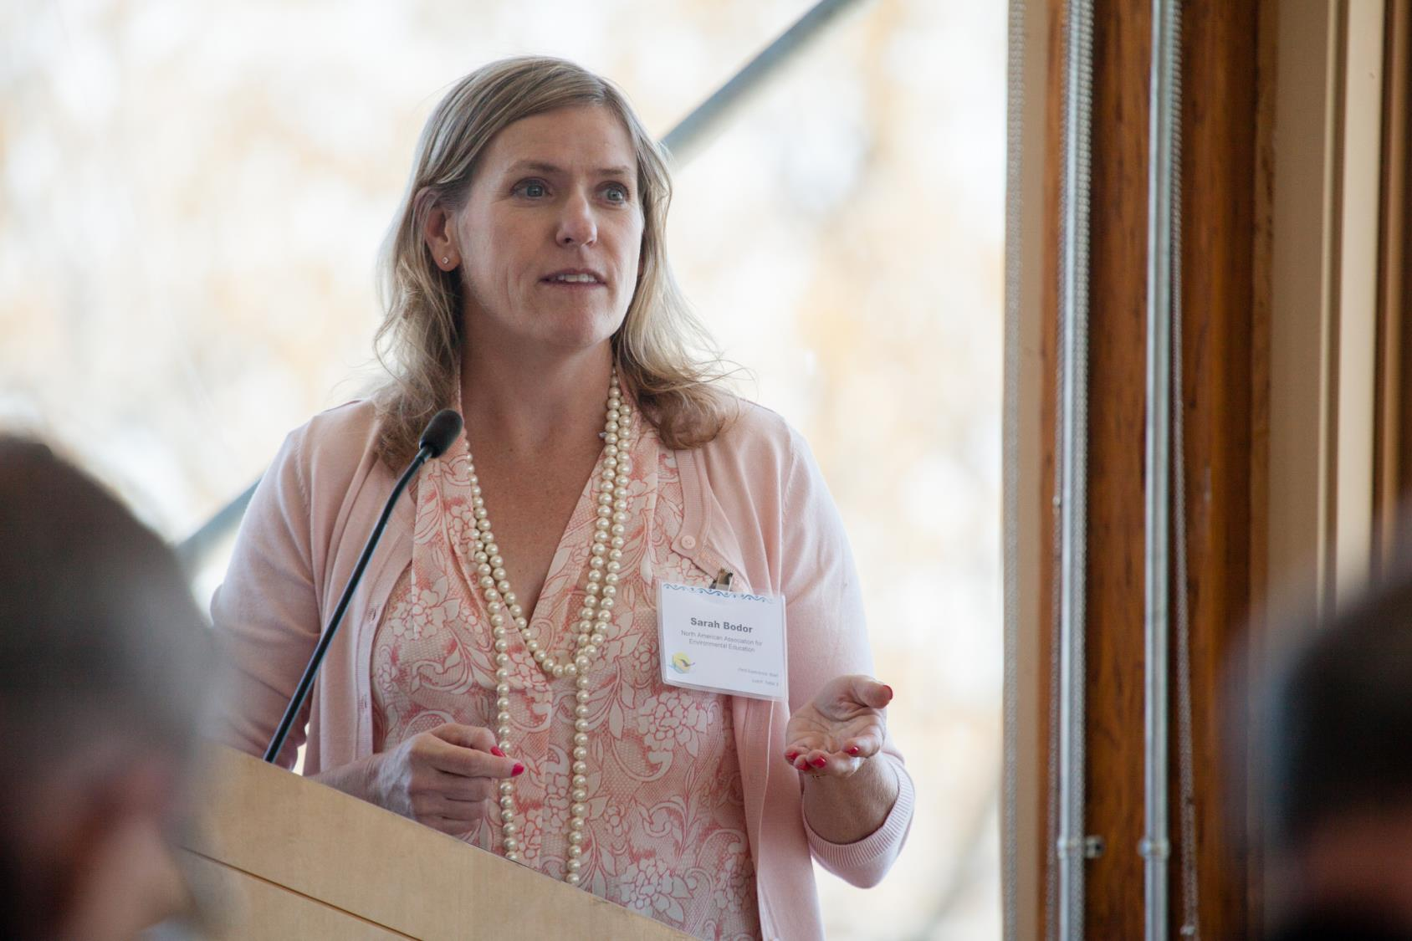
Student MWEEs
Notes:
We then heard from Monique Chism, Deputy Assistant Secretary of Policy and Programs, U.S. Department of Education, and Sarah Bodor, Director of Policy for NAAEE, who spoke to us about existing and planned programs that could be used to support environmental education. This was followed by a facilitated discussion about the opportunities that the Every Student Succeeds Act presents.
The key language sits in Title IV of the Every Student Succeeds Act—21st Century Schools:
Title IV, Part A: Environmental education is eligible for funding under a new $1.65B grant program that includes enrichment programs and student health and safety programs.
Under the law, these funds are block granted to the states using the Title I formula; 95% of the state funds are then block granted to Local Education Agencies (LEA), also according to formula
Title IV, Part B: Environmental literacy programs are now eligible for funding as part of the existing $1B 21st Century Community Learning Centers program. These funds are also block granted to the states to administer competitive grants for LEAs, schools, and/or community partners for after-school activities
In addition to ESSA, the overall legislation creates a number of additional opportunities for related activities that still need to be explored. US Department of Education may be able to help support that effort through guidance to states and promotion of specific model programs.

Slide 40
Every Student Succeeds Act
Title IV – 21st Century Schools
Part A: New $1.65B grant program that includes enrichment programs and student health and safety programs.
Part B: Existing $1B 21st Century Community Learning Centers program.
Notes:
We then heard from Monique Chism, Deputy Assistant Secretary of Policy and Programs, U.S. Department of Education, and Sarah Bodor, Director of Policy for NAAEE, who spoke to us about existing and planned programs that could be used to support environmental education. This was followed by a facilitated discussion about the opportunities that the Every Student Succeeds Act presents.
The key language sits in Title IV of the Every Student Succeeds Act—21st Century Schools:
Title IV, Part A: Environmental education is eligible for funding under a new $1.65B grant program that includes enrichment programs and student health and safety programs.
Under the law, these funds are block granted to the states using the Title I formula; 95% of the state funds are then block granted to Local Education Agencies (LEA), also according to formula
Title IV, Part B: Environmental literacy programs are now eligible for funding as part of the existing $1B 21st Century Community Learning Centers program. These funds are also block granted to the states to administer competitive grants for LEAs, schools, and/or community partners for after-school activities
In addition to ESSA, the overall legislation creates a number of additional opportunities for related activities that still need to be explored. US Department of Education may be able to help support that effort through guidance to states and promotion of specific model programs.

Slide 41
Take Aways
Notes:
TAKE AWAYS
Each state is committed to advancing EL in a way that takes advantage of state specific priorities, policies, and programs while taking into consideration the unique educational system of that state.
There is work to be done in each state to advance EL. This conservation should not stop here.
EL can be integrated into multiple disciplines, not only science. That said the transition of many of our states to the Next Generation Science Standards provides a wonderful opportunity to advance the EL goal in those states that are adopting the standards. Of course the environment is included in many of the content areas, but beyond the content, EL has particular relevance in giving students an engaging way to learn and reinforce scientific practices.
US Department of Education has several opportunities to advance this work in the new Every Student Succeed Act and would like to work with partners to explore these opportunities. There are also other federal resources that can help, including the NOAA B-WET grant program, the EPA EE grant program, and EPA Healthy Schools resources.
Call for CBP to convene this group of people annually as it is really important to learn from each other and hold each other accountable.

Slide 42
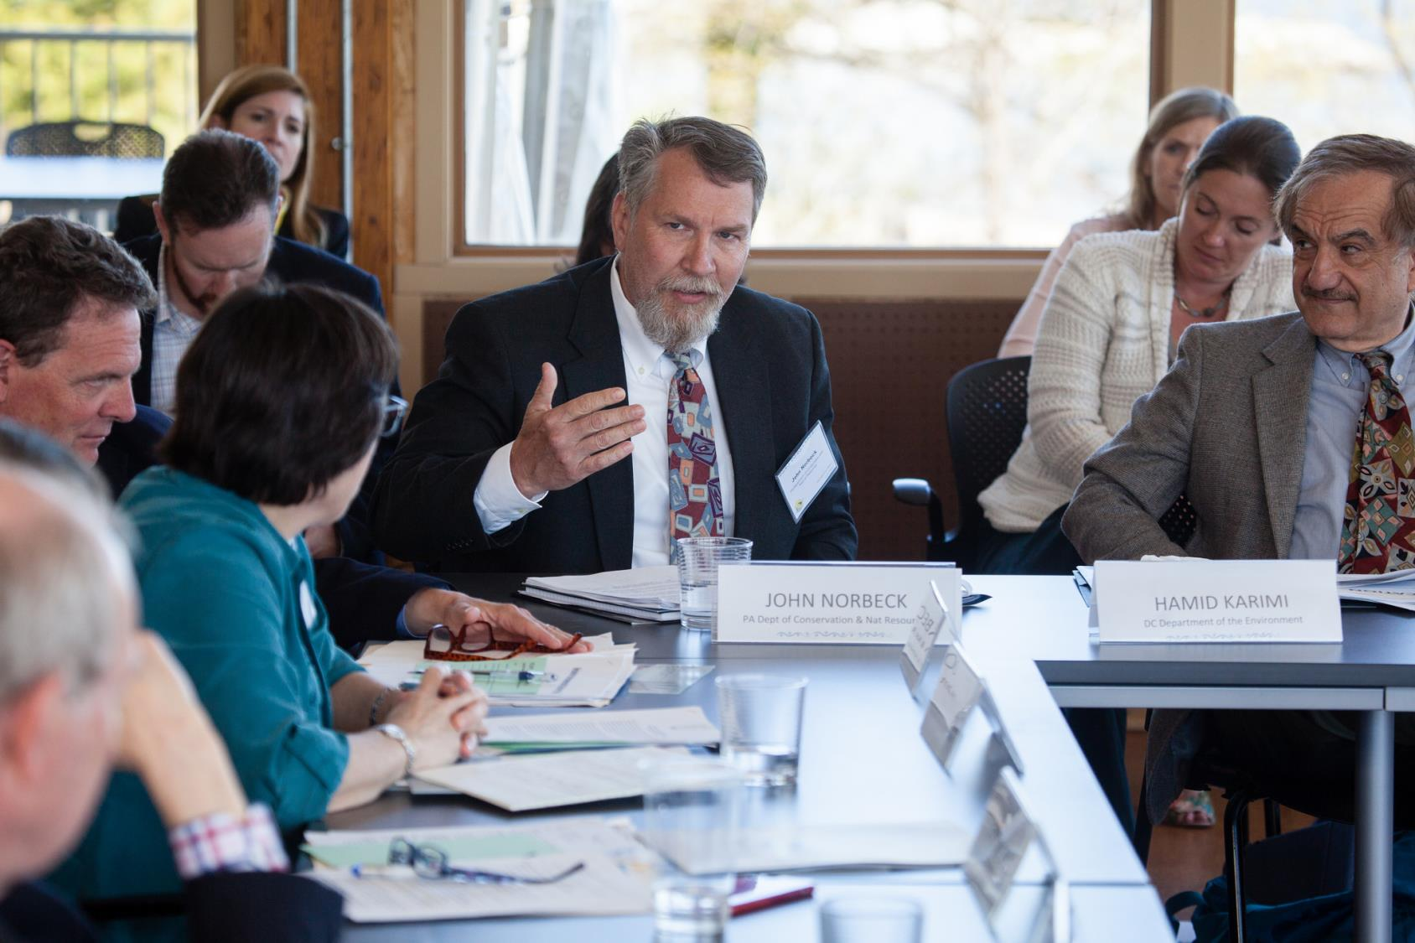
Notes:
TAKE AWAYS
Each state is committed to advancing EL in a way that takes advantage of state specific priorities, policies, and programs while taking into consideration the unique educational system of that state.
There is work to be done in each state to advance EL. This conservation should not stop here.
EL can be integrated into multiple disciplines, not only science. That said the transition of many of our states to the Next Generation Science Standards provides a wonderful opportunity to advance the EL goal in those states that are adopting the standards. Of course the environment is included in many of the content areas, but beyond the content, EL has particular relevance in giving students an engaging way to learn and reinforce scientific practices.
US Department of Education has several opportunities to advance this work in the new Every Student Succeed Act and would like to work with partners to explore these opportunities. There are also other federal resources that can help, including the NOAA B-WET grant program, the EPA EE grant program, and EPA Healthy Schools resources.
Call for CBP to convene this group of people annually as it is really important to learn from each other and hold each other accountable.

Slide 43
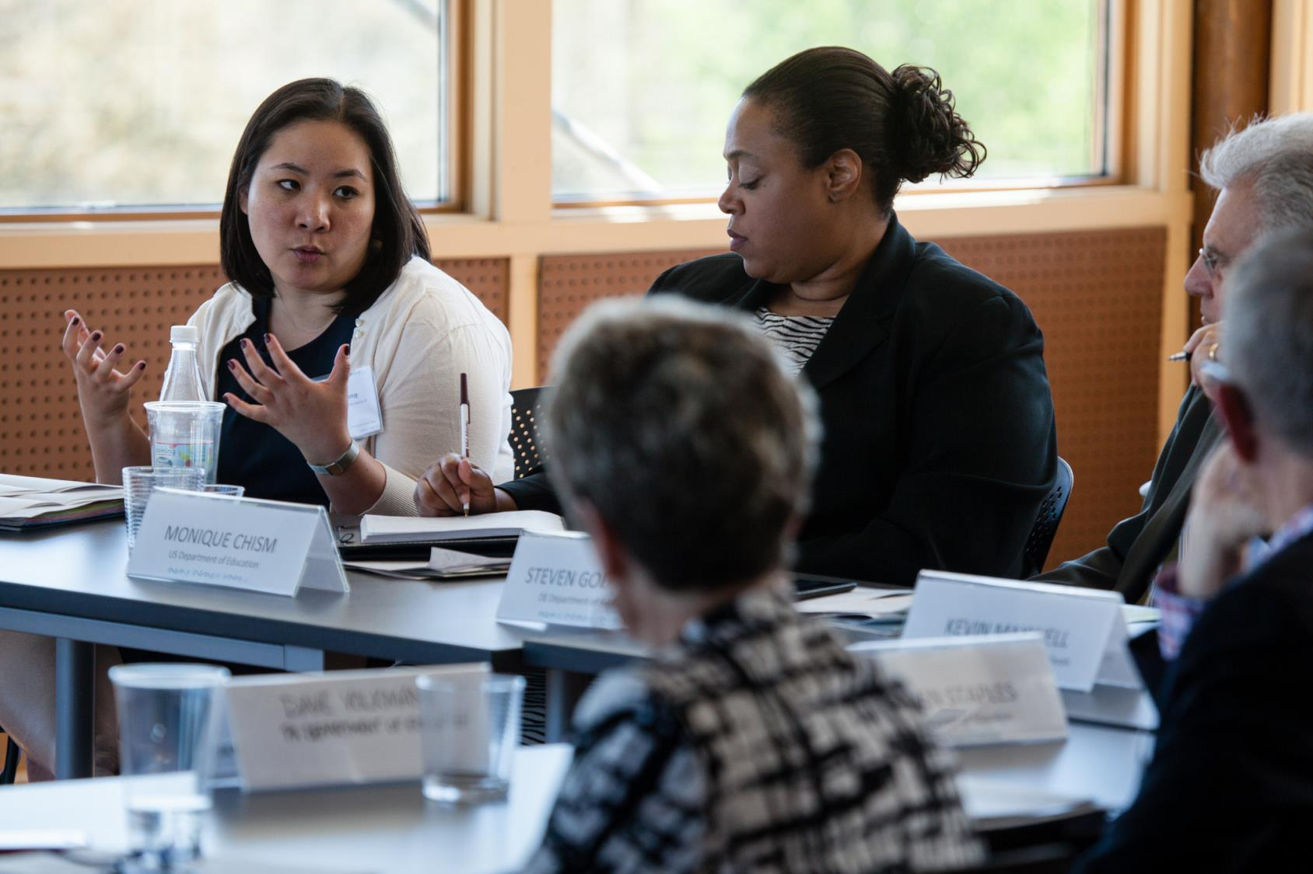
Notes:
TAKE AWAYS
Each state is committed to advancing EL in a way that takes advantage of state specific priorities, policies, and programs while taking into consideration the unique educational system of that state.
There is work to be done in each state to advance EL. This conservation should not stop here.
EL can be integrated into multiple disciplines, not only science. That said the transition of many of our states to the Next Generation Science Standards provides a wonderful opportunity to advance the EL goal in those states that are adopting the standards. Of course the environment is included in many of the content areas, but beyond the content, EL has particular relevance in giving students an engaging way to learn and reinforce scientific practices.
US Department of Education has several opportunities to advance this work in the new Every Student Succeed Act and would like to work with partners to explore these opportunities. There are also other federal resources that can help, including the NOAA B-WET grant program, the EPA EE grant program, and EPA Healthy Schools resources.
Call for CBP to convene this group of people annually as it is really important to learn from each other and hold each other accountable.

Slide 44
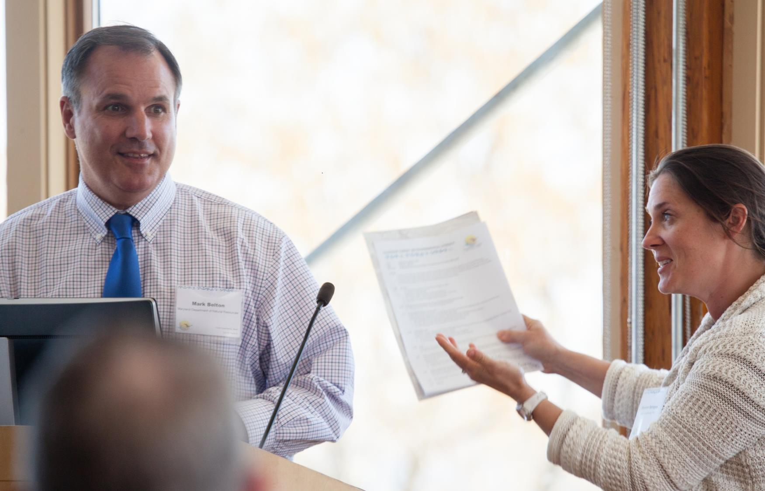
Notes:
TAKE AWAYS
Each state is committed to advancing EL in a way that takes advantage of state specific priorities, policies, and programs while taking into consideration the unique educational system of that state.
There is work to be done in each state to advance EL. This conservation should not stop here.
EL can be integrated into multiple disciplines, not only science. That said the transition of many of our states to the Next Generation Science Standards provides a wonderful opportunity to advance the EL goal in those states that are adopting the standards. Of course the environment is included in many of the content areas, but beyond the content, EL has particular relevance in giving students an engaging way to learn and reinforce scientific practices.
US Department of Education has several opportunities to advance this work in the new Every Student Succeed Act and would like to work with partners to explore these opportunities. There are also other federal resources that can help, including the NOAA B-WET grant program, the EPA EE grant program, and EPA Healthy Schools resources.
Call for CBP to convene this group of people annually as it is really important to learn from each other and hold each other accountable.

Slide 45

Notes:
TAKE AWAYS
Each state is committed to advancing EL in a way that takes advantage of state specific priorities, policies, and programs while taking into consideration the unique educational system of that state.
There is work to be done in each state to advance EL. This conservation should not stop here.
EL can be integrated into multiple disciplines, not only science. That said the transition of many of our states to the Next Generation Science Standards provides a wonderful opportunity to advance the EL goal in those states that are adopting the standards. Of course the environment is included in many of the content areas, but beyond the content, EL has particular relevance in giving students an engaging way to learn and reinforce scientific practices.
US Department of Education has several opportunities to advance this work in the new Every Student Succeed Act and would like to work with partners to explore these opportunities. There are also other federal resources that can help, including the NOAA B-WET grant program, the EPA EE grant program, and EPA Healthy Schools resources.
Call for CBP to convene this group of people annually as it is really important to learn from each other and hold each other accountable.

Slide 46


Slide 47
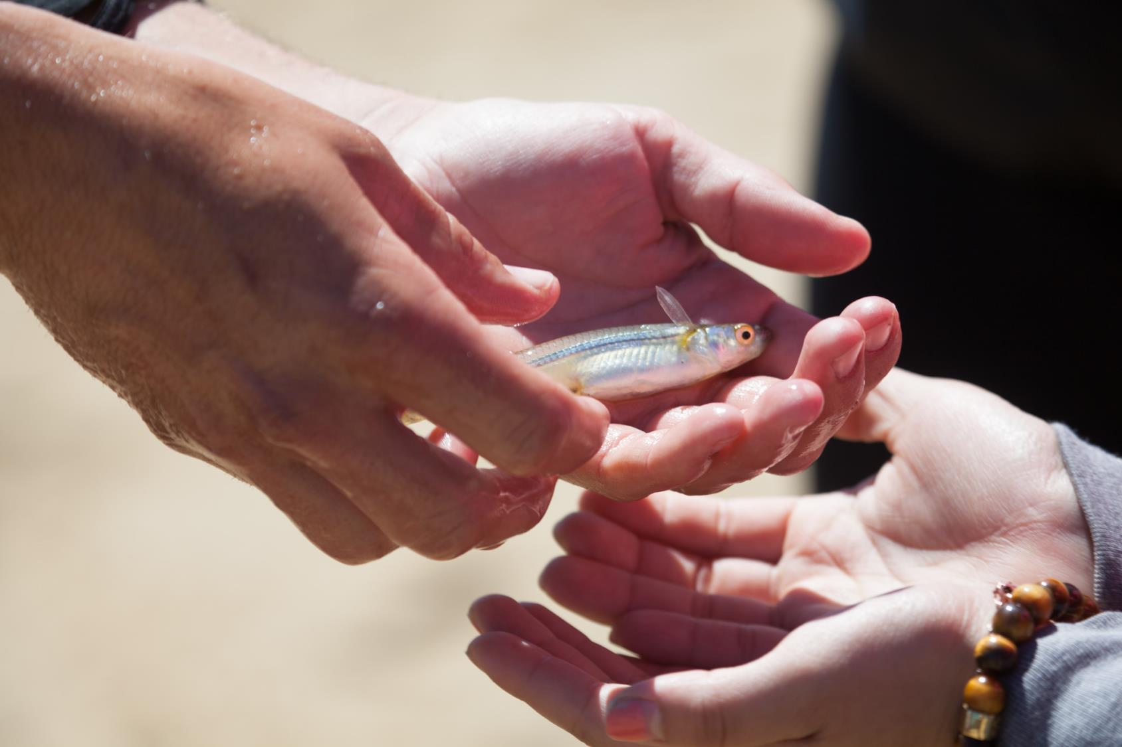

Slide 48
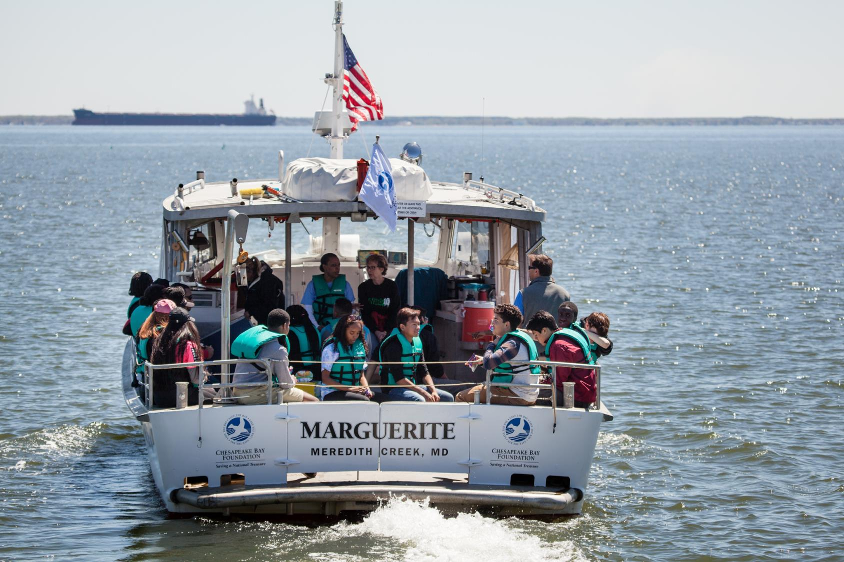
Questions?

