Slide 1

QUARTERLY PROGRESS MEETING – February 11, 2021
Chesapeake Bay Program
Land Use Methods and Metrics Outcome
Peter Claggett¹, Labeeb Ahmed¹, Jacob Czawlytko², Jarlath O’Neil-Dunne³, Sarah McDonald¹, Patrick McCabe², Sean MacFaden³, Rachel Soobitsky², and Renee Thompson¹
¹ Lower Mississippi-Gulf Water Science Center, U.S. Geological Survey, Annapolis, MD 21403
² Chesapeake Conservancy, Annapolis, MD 21403
³ Spatial Analysis Laboratory, University of Vermont, Burlington, VT 05405
Notes:
Find photos on our Flickr site: https://www.flickr.com/photos/29388462@N06/sets/
You can also browse photos by category on our website: http://www.chesapeakebay.net/photos

Slide 2
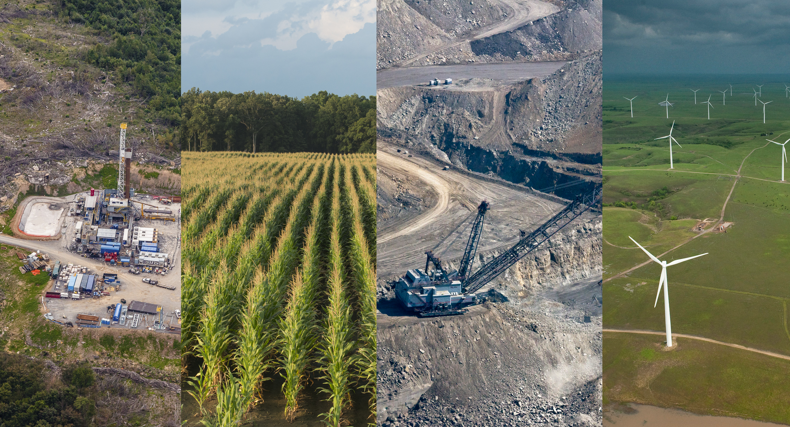
Through the Chesapeake Bay Watershed Agreement, the Chesapeake Bay Program has committed to…
Goal: Conserve landscapes treasured by citizens in order to maintain water quality and habitat; sustain working forests, farms and maritime communities; and conserve lands of cultural, indigenous and community value.
Outcome: Assess and understand the impacts of land use change on watersheds, habitats, and communities at a scale relevant to county-level decision-makers.
https://blog.nature.org/science/2016/09/08/energy-sprawl-is-the-largest-driver-of-land-use-change-in-the-u-s/
Notes:
INSTRUCTIONS:
Add the title of your goal and the language of your outcome from the 2014 Agreement (copy and paste).
Add a relevant photo (if it all fits).
If desired, talking points could include more contextual information, e.g. the importance of the outcome and the historic trends that led to the establishment of the specific target.

Slide 3
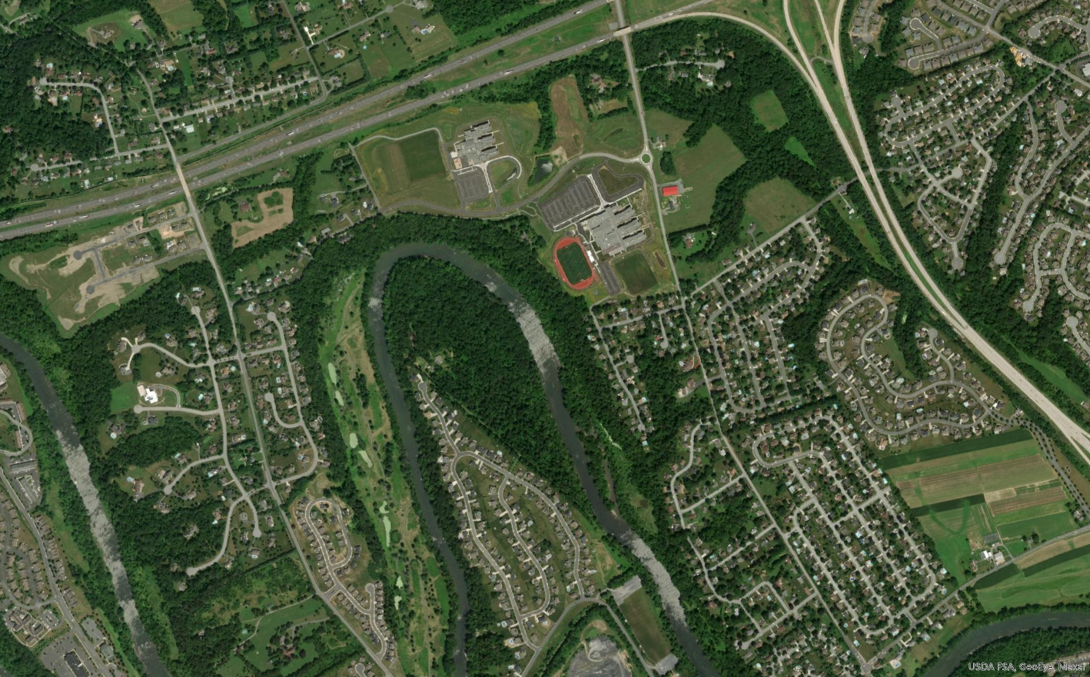
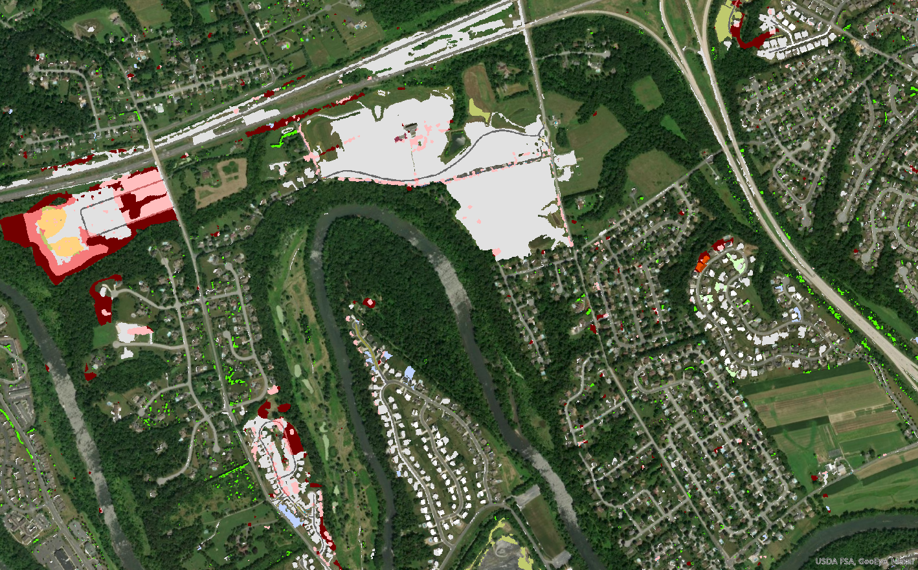
Through the Chesapeake Bay Watershed Agreement, the Chesapeake Bay Program has committed to…
1. Measure rate of farmland, forest and wetland conversion, and the extent and rate of change in impervious surface coverage.
2. Quantify the potential impacts of land conversion to water quality, healthy watersheds and communities.
3. Launch a public awareness campaign to share this information with citizens, local governments, elected officials and stakeholders.
2020
2013 - 2017
Notes:
INSTRUCTIONS:
Add the title of your goal and the language of your outcome from the 2014 Agreement (copy and paste).
Add a relevant photo (if it all fits).
If desired, talking points could include more contextual information, e.g. the importance of the outcome and the historic trends that led to the establishment of the specific target.

Slide 4
What is our Expected and Actual Progress?
2013 High-res land cover and land use datasets completed.
High-res updates for 2017 and 2021 funded by CBP Partners.
Land Policy BMPs developed and adopted in Phase III WIPs
Draft land cover change products produced for multiple counties: 2013-2017.
New 55-class high-res land use model developed.
Finalize comparable land cover and land use products for 2013-2017.
Develop land change metrics and communication tools and materials.
USGS, CBP, and USFS funded citizen software to classify samples of high-res imagery
Complete mapping of high-res land cover/use funded by CBP Partners
2014
2016
2018
2020
2021
Notes:
INSTRUCTIONS: Copy and paste the graph or chart you used to answer narrative analysis question #2. The editable graph from the Narrative Analysis template has been included here for your reference.
FROM NARRATIVE ANALYSIS (FOR YOUR REFERENCE ONLY):
“2. Regardless of how successful your short-term progress has been over the past two years, indicate whether we are making progress at a rate that is necessary to achieve the outcome you are working toward.
Use the editable graph or your own chart to illustrate your progress. Explain any gap(s) between our actual progress and our anticipated trajectory.”

Slide 5
Learn
What have we learned in the last two years?
L
Notes:
INSTRUCTIONS: This slide is a transition slide and does not need to be modified.

Slide 6
What we’ve learned
High-resolution land cover, land use, and hydrography data representing every square meter of the Bay watershed are:
Foundational- informing most CBP Outcomes managed by every Goal Implementation Team.
Authoritative- providing a fully transparent, accurate, and verifiable representation of landscape conditions and change over time.
Transformative- affecting the way we understand, interpret, and manage the landscape.
Notes:
INSTRUCTIONS: This slide should briefly summarize your answer to narrative analysis question #1.
FROM NARRATIVE ANALYSIS (FOR YOUR REFERENCE ONLY):
“1. Examine your red/yellow/green analysis of your management actions. What lessons have you learned over the past two years of implementation?
Summarize what you have learned about what worked and what didn’t. For example, have you identified additional factors to consider or filled an information gap?”

Slide 7
Foundational Data
Potential CBP Applications
Stream Health: Where are incised and disconnected (from the floodplain) streams.
Fish Passage: Where are obstructions and strictures in the stream network?
Brook Trout and Riparian Buffers: What proportion of streams in watershed X are sunlit vs. shaded, and where are they?
Water Quality: How much land is in agriculture and how is it changing through time?
Environmental Justice: What forest conservation opportunities exist to benefit underserved communities?
Urban Tree Canopy: What is the net change in tree canopy? What’s causing the losses in tree canopy?

Slide 8
Foundational Data
Current Local Applications
Assessing Brook Trout conservation sites
Updating County Comprehensive Plans
Identifying and prioritizing riparian forest buffer restoration sites
Regional green infrastructure planning
MS4 area mapping
Community tree canopy assessments
Watershed studies
Christmas bird-count surveys
Creating local land use data
Priority forest identification
Identifying potential community garden sites
Forest resource management plans
Inventorying tree planting opportunities

Slide 9
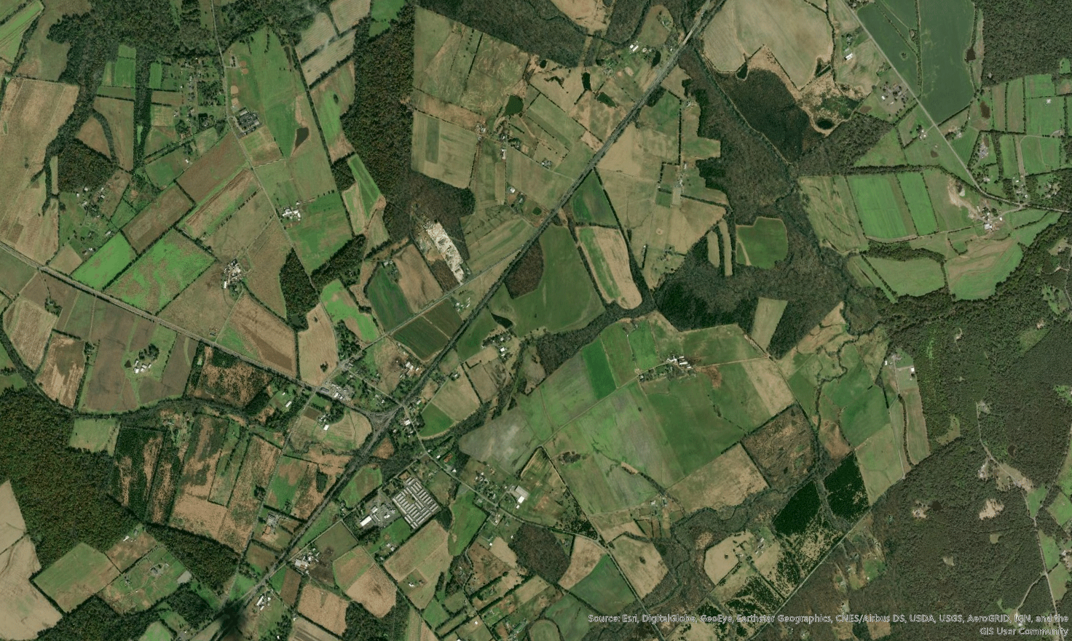
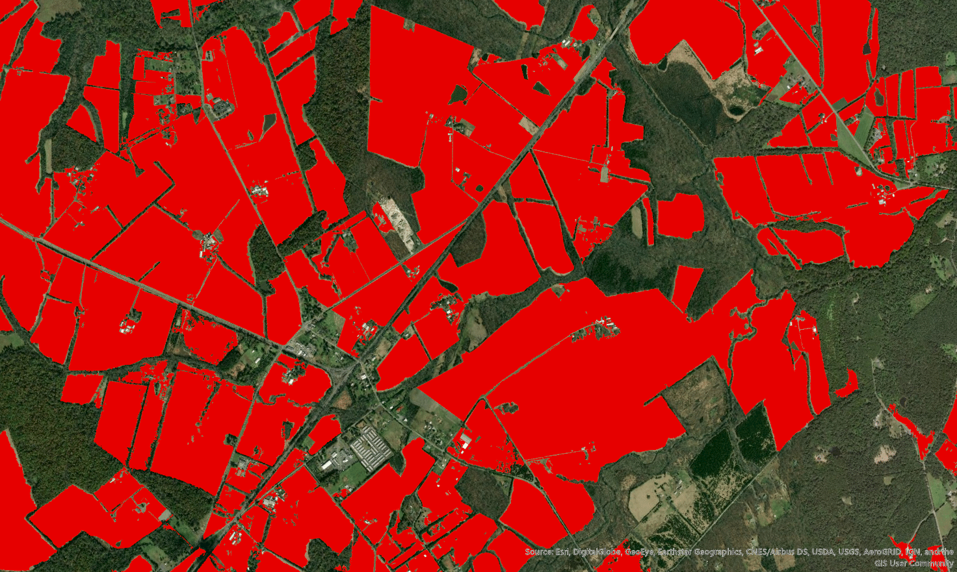
Authoritative Data
Farmland in Fauquier County, VA:
Source Acres
2017 Census of Agriculture; (2017 CLU*): 152,922 (119,988)
2012 Census of Agriculture: 166,587
2017 Draft High-res Land Use: 135,954
* NRCS’ Common Land Units- mapped from aerial photos
Agriculture

Slide 10
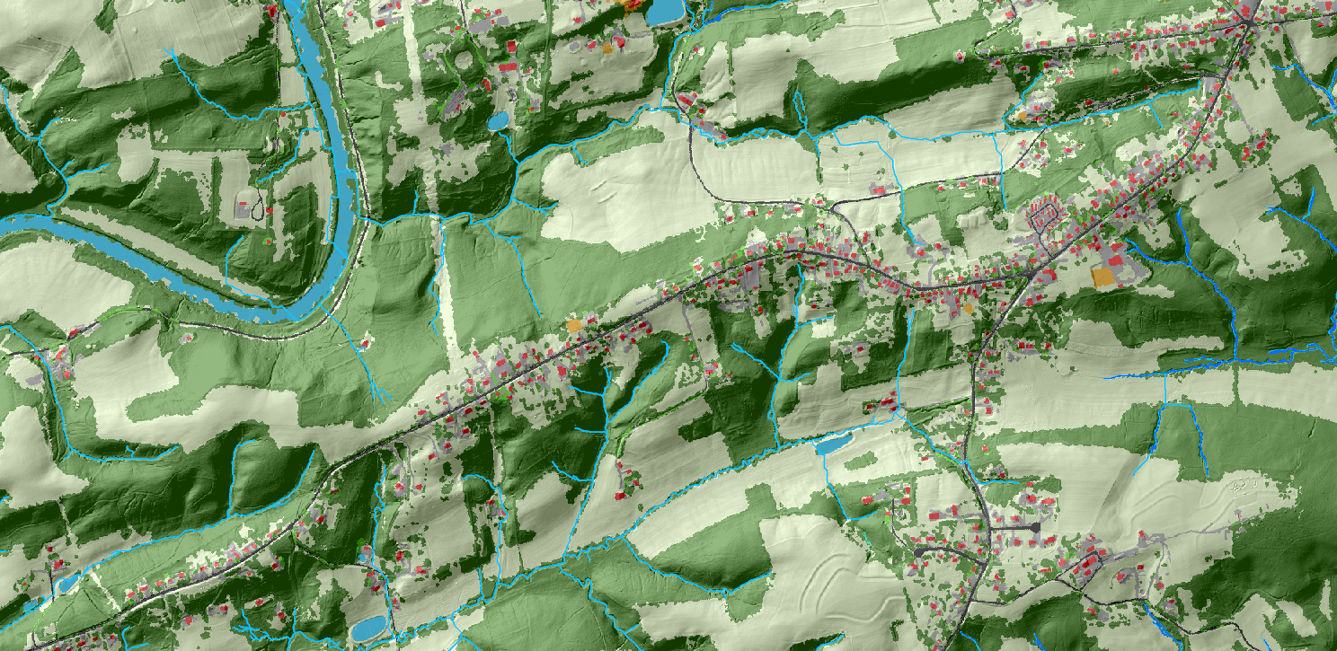
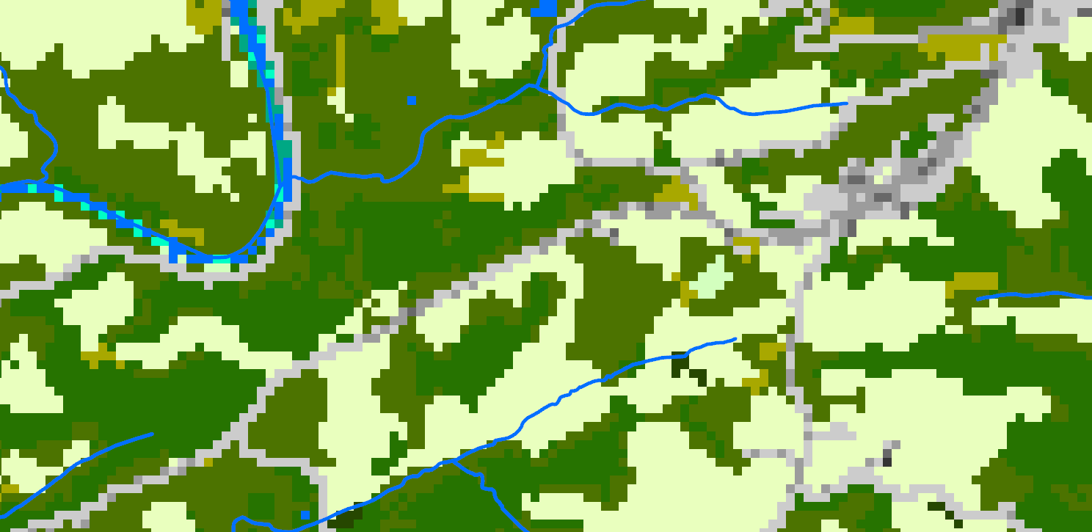
National Land Cover Dataset (2011) and National Hydrography Dataset (1:24K)
High-resolution Land Cover (2013) and Hyper-resolution Hydrography (1:2K)

Slide 11
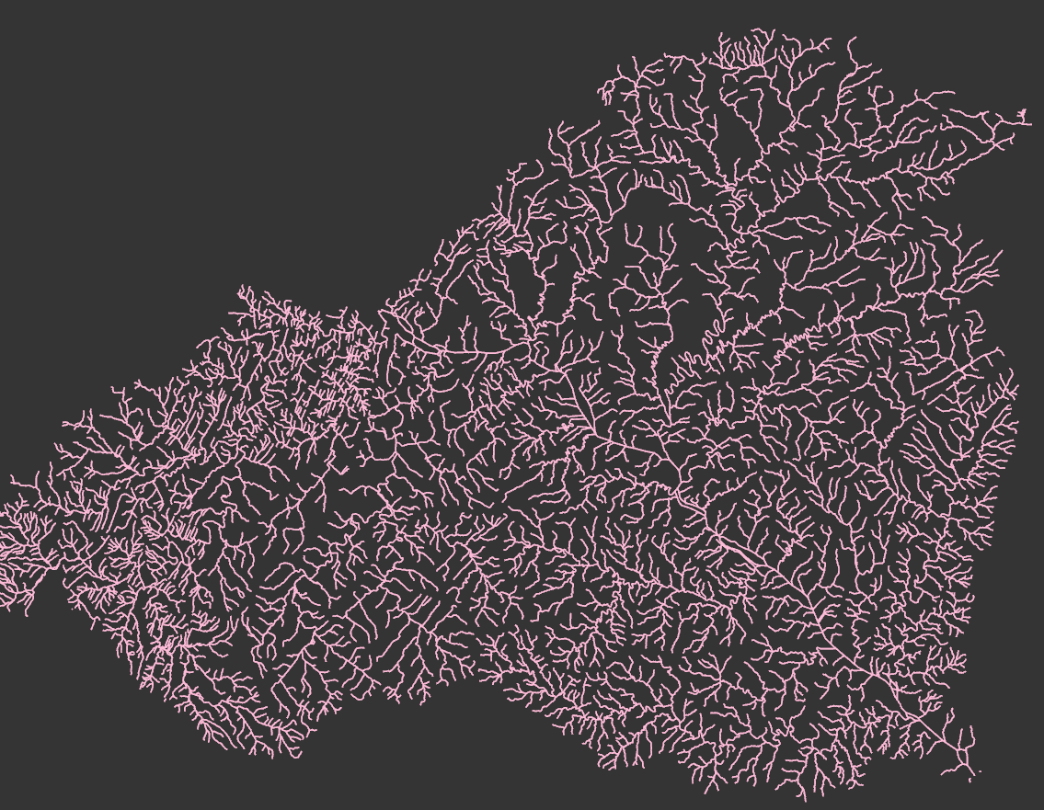
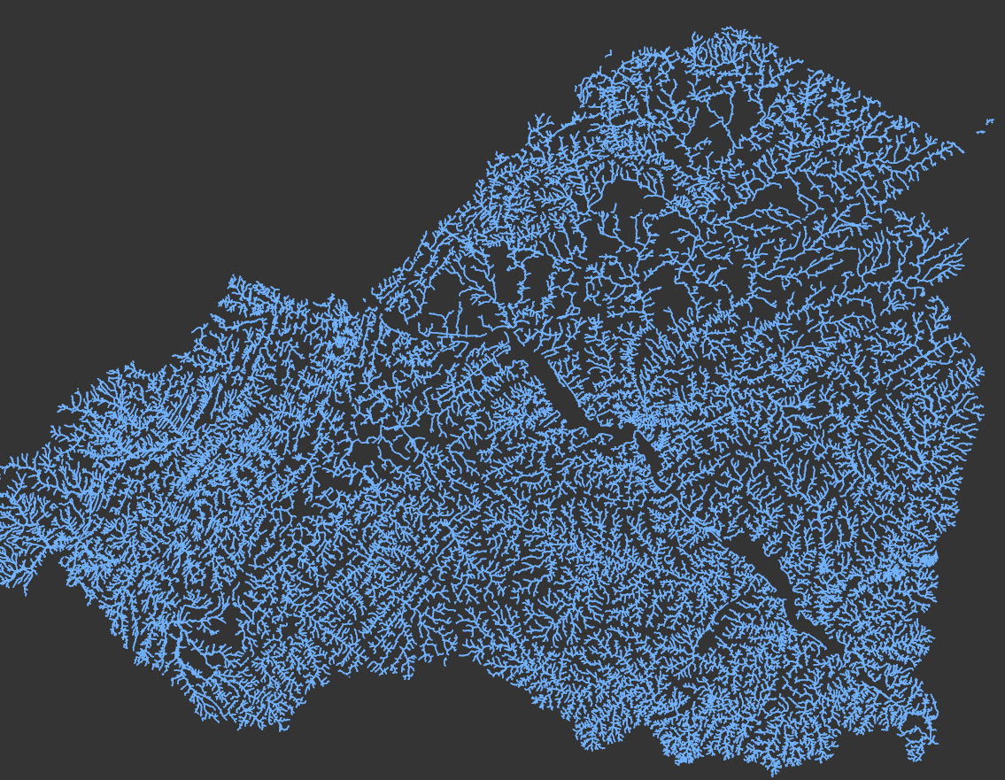
Transformative Data
National Hydrography Dataset (1:24K): 6,923.6 km
CBP Hyper-Resolution Flowpaths (1:2K): 16,784.6 km

Slide 12
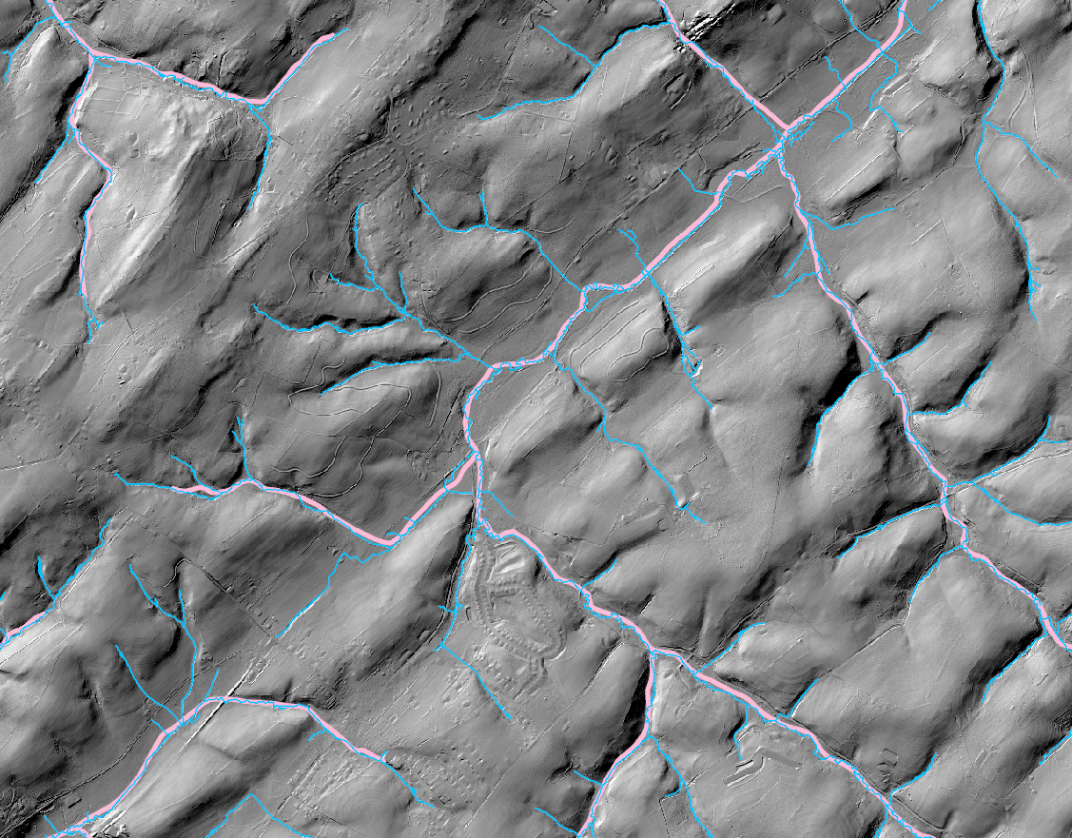
Why the 2x difference in length?
So what?
Added
Tributaries
Increased
Complexity
Extended headwaters
NHD24K
Shortened
Distance to Concentrated
Flow
HyperRes
Landscape is more directly connected to streams
than previously portrayed or understood

Slide 13
Chesapeake Bay Program Land Use Classification (55 classes)
1. Water (8)
1.1 Lentic
1.1.1 Estuary
1.1.2 Lakes & Ponds
1.2 Lotic
  1.2.1 Streams
  1.2.1.1 Sunlit
  1.2.1.2 Shaded
  1.2.1.3 Culverted/ Buried
  1.2.2.Ditches
  1.2.2.1 Sunlit
  1.2.2.2 Shaded
  1.2.2.3 Culverted/ Buried
2. Developed (12)
2.1 Impervious
    2.1.1 Roads
    2.1.2 Structures
    2.1.3 Other Impervious (Parking lots, driveways)
2.2 Pervious
2.2.1 Turf Grass
2.2.2 Bare Developed
2.2.3 Suspended Succession (rights-of-way) 2.2.3.1 Barren
      2.2.3.2 Herbaceous
      2.2.3.3 Scrub-shrub
  2.3 Tree Canopy (TC)
    2.3.1 TC over Roads
    2.3.2 TC over Structures
    2.3.3 TC over Other Impervious
    2.3.4 TC over Turf Grass
3. Forest (6)
3.1 Forest (>= 1 acre)
3.2 Harvested Forest
3.2.1 Barren
3.2.2 Herbaceous
3.3 Natural Succession (> 3 years)
    3.3.1 Barren
    3.3.2 Herbaceous
    3.3.3 Scrub-shrub
4. Production (13)
4.1 Agriculture
4.1.1 Cropland
      4.1.1.1 Barren
      4.1.1.2 Herbaceous
4.1.2 Pasture
      4.1.2.1 Barren
      4.1.2.2 Herbaceous
4.1.3 Orchard/vineyard
    4.1.3.1 Barren
    4.1.3.2 Herbaceous
    4.1.3.3 Scrub-shrub
    4.2 Solar fields
4.2.1 Barren
    4.2.2 Herbaceous
    4.2.3 Scrub-shrub
    4.2.4 Impervious
4.3 Extractive
    4.3.1 Barren
    4.3.2 Impervious
5. Wetlands and Water Margins (16)
5.1 Tidal
    5.1.1 Barren
    5.1.2 Herbaceous
    5.1.3 Scrub-shrub
5.2 Non-tidal
5.2.1 Riverine - Floodplain
      5.2.1.1 Barren
      5.2.1.2 Herbaceous
      5.2.1.3 Scrub-shrub
      5.2.1.4 Forest
5.2.2 Riverine - Headwater
      5.2.2.1 Barren
      5.2.2.2 Herbaceous
      5.2.2.3 Scrub-shrub
      5.2.2.4 Forest
5.2.3 Terrene
      5.2.3.1 Barren
      5.2.3.2 Herbaceous
      5.2.3.3 Scrub-shrub
      5.2.3.4 Forest
5.3 Bare shore

Slide 14
CBP “Mixed Open” Land Use
(“Looks like Agriculture, Loads like Forest” ~ P. Claggett)
6. Mixed Open – MO (13)
2.2 Pervious Developed
2.2.2 Bare Developed
2.2.3 Suspended Succession (rights-of-way) 2.2.3.1 Barren
      2.2.3.2 Herbaceous
      2.2.3.3 Scrub-shrub
      3.2 Harvested Forest
      3.2.1 Barren
      3.2.2 Herbaceous
3.3 Natural Succession (> 3 years)
    3.3.1 Barren
    3.3.2 Herbaceous
    3.3.3 Scrub-shrub
4.2 Solar fields
4.2.1 Barren
    4.2.2 Herbaceous
    4.2.3 Scrub-shrub
4.3 Extractive
    4.3.1 Barren

Slide 15
Tree Canopy Change in Two Suburban Counties
Prince George’s County: 2014 - 2018
TC Loss (7,673 acres):
59% of loss change occurred within forest or wetlands
41% of loss occurred in developed areas
TC Gain (518 acres):
16% of gain occurred within forest or wetlands
  shrub/scrub; edge of forest
54% of gain occurred in developed areas
29% of gain occurred on agricultural lands
Anne Arundel County: 2014 - 2018
TC Loss (2,544 acres):
57% of loss change occurred within forest or wetlands
42% of loss occurred in developed areas
TC Gain (188 acres):
9% of gain occurred within forest or wetlands
  shrub/scrub; edge of forest
55% of gain occurred in developed areas
35% of gain occurred on agricultural lands
Regardless, we’re still losing significant amounts of tree canopy.
Communicating high-res tree canopy change requires distinguishing between timber harvests, natural forest dynamics, and permanent conversions.

Slide 16
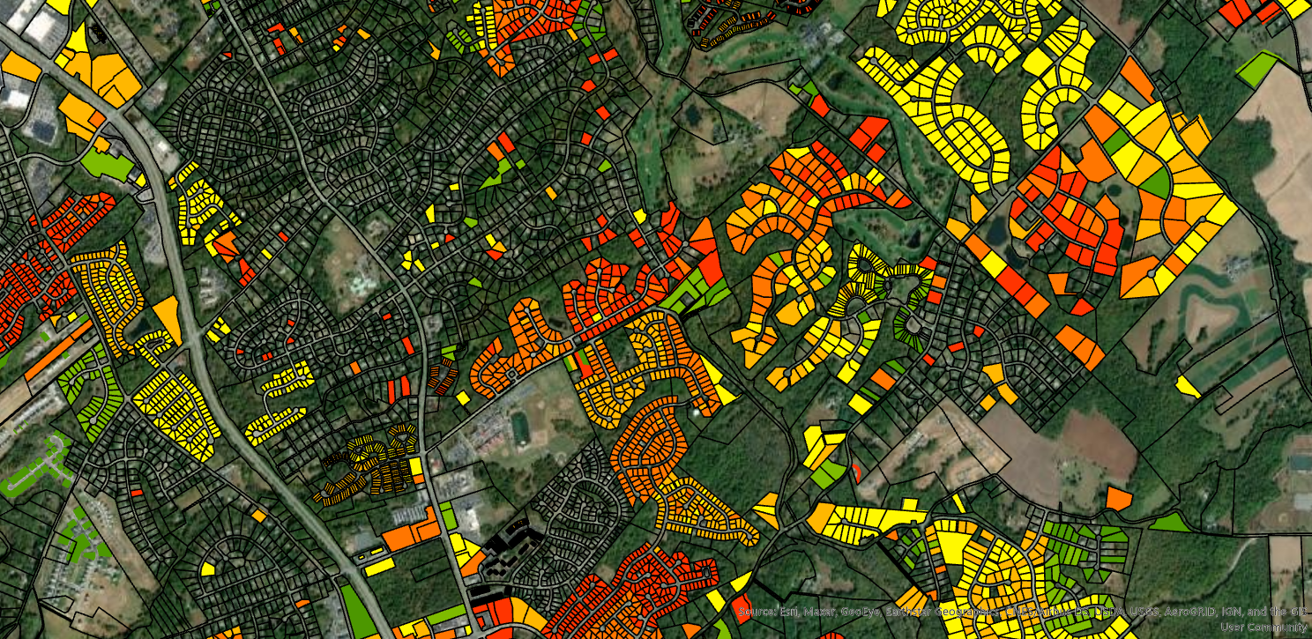
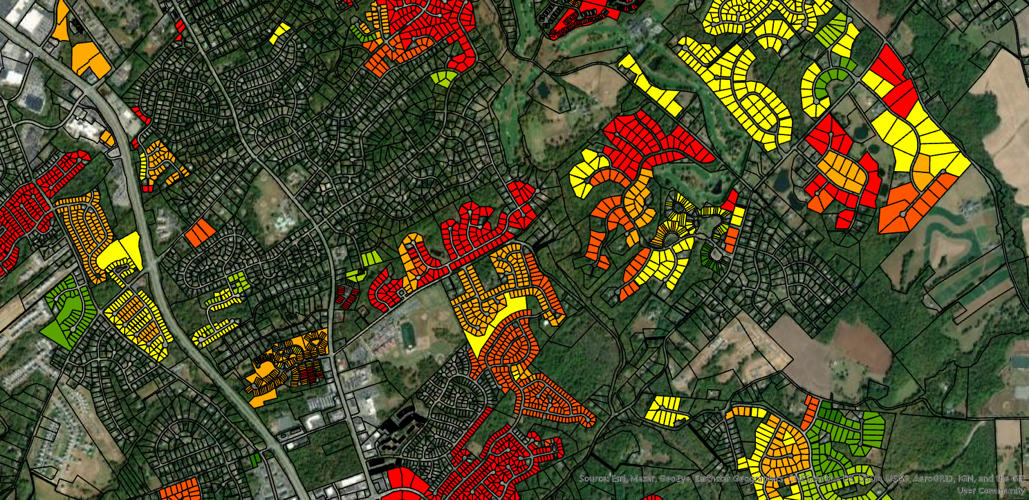
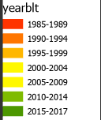
Parcel-Level Deconstruction of Urban Development
(1985 – 2017)
Year-Built Attributes from Tax Records
Year-Built Attributes from USGS’ LCMAP*
* Land Change, Monitoring, Assessment, and Projection (LCMAP)

Slide 17
Successes and Challenges
Challenges:
Automating the classification of land cover and land use
Separating signal from noise when mapping change in land conditions
Coping with an outdated inventory of non-tidal wetlands
Communicating the complexities of high-resolution land change
Successes:
CBP Partnership support for monitoring land cover/use change at high resolution
Development and refinement of land cover and land use mapping techniques (University of Vermont, USGS, Chesapeake Conservancy)
Understanding how land cover/use is changing throughout the watershed
Notes:
INSTRUCTIONS: This slide should briefly summarize your answer to narrative analysis question #1.
FROM NARRATIVE ANALYSIS (FOR YOUR REFERENCE ONLY):
“1. Examine your red/yellow/green analysis of your management actions. What lessons have you learned over the past two years of implementation?
Summarize what you have learned about what worked and what didn’t. For example, have you identified additional factors to consider or filled an information gap?”

Slide 18
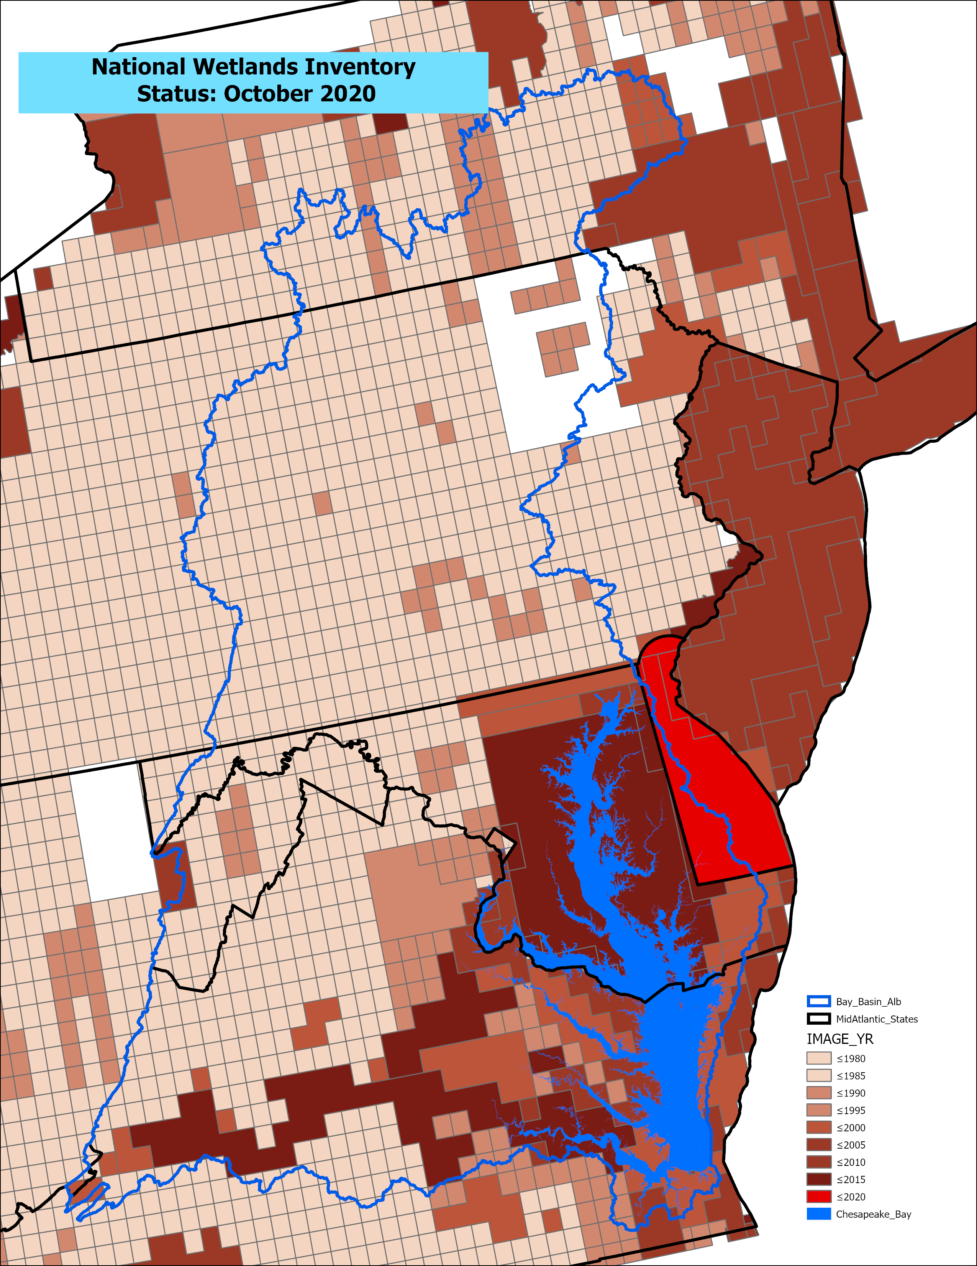
Status of the National Wetlands Inventory
October 2020
Vintage of the NWI in the majority of watershed is ~1980’s

Slide 19
On the Horizon
Responding to Presidential EO to conserve 30% of land by 2030 (and 50% by 2050).
Implementing an effective CBP local engagement strategy.
Technological innovations (e.g., tide-corrected LiDAR, high-res satellite imagery, artificial intelligence).
Scientific insights into the role of landscape context in estimating BMP efficiencies, pollutant loads, and land use change impacts on stream flow and temperature.
Notes:
INSTRUCTIONS: This slide should briefly summarize your answer to narrative analysis question #3.
FROM NARRATIVE ANALYSIS (FOR YOUR REFERENCE ONLY):
“3. What scientific, fiscal and policy-related developments will influence your work over the next two years?
This may include information learned at the previous biennial SRS meeting or more specific information about your outcome such as an increase or decrease in funding, new programs that address gaps, and new scientific data or research. Describe how these developments are likely to impact your recommended measure(s) of progress, the factors you believe impact your ability to succeed, and newly created or filled gaps. These changes should be reflected in the first three columns of your revised logic and action plan after your quarterly progress meeting.”

Slide 20
Adapt
How does all of this impact our work?
A
Notes:
INSTRUCTIONS: This slide is a transition slide and does not need to be modified.

Slide 21
Based on what we learned, we plan to …
Monitor changes in land cover (12 classes), land use (55 classes) with integrated hyper-resolution streams every four years: 2013-2017-2021.
Reassess land use change from mid-1980’s through 2013 using LCMAP and parcel data.
Refine mapping methods as opportunities arise through changes in technology.
Work with the Diversity Workgroup, Local Engagement Team, and Local Government Advisory Committee to identify and assess impacts to communities.
Simulate alternative future scenarios to achieve the Bay TMDL and the conservation of 30% of land by 2030; assess the ecosystem services and social benefits from each scenario.
Formally publish the land use data and develop online viewers and other interpretive communication products.
Notes:
INSTRUCTIONS: This slide should briefly summarize your answer to narrative analysis question #4. As a reminder, question four refers back to the first three questions in the Narrative Analysis.
FROM NARRATIVE ANALYSIS (FOR YOUR REFERENCE ONLY):
“4. Based on your response to the questions above, how will your work change over the next two years?
Describe the adaptations that will be necessary to more efficiently achieve your outcome and explain how these changes will lead you to adjust your management strategy or the actions described in column four of your logic and action plan. Changes that the workgroup, GIT or Management Board consider significant should be reflected in your management strategy.”

Slide 22
Help
How can the Management Board lead the Program to adapt?
H
Notes:
INSTRUCTIONS: This slide is a transition slide and does not need to be modified.

Slide 23
Help Needed
• Support the long-term monitoring of land use conditions by re-soliciting a Cooperative Agreement to monitor land use/cover change every 4-5 years through 2030 (e.g., adding 2025/26 and 2029/30 dates).
• Support the refinement and implementation of the CBP’s Local Engagement Strategy, leveraging data, metrics, and information generated by this Outcome and the Land Use Options Evaluation Outcome to inform a targeted set of local decisions.
Consider that current resources prevent the effective monitoring of wetland change- particularly change in non-tidal wetlands.
Understand that communication products associated with this Outcome will need to be developed and refined through 2024.
Notes:
INSTRUCTIONS: This slide should briefly summarize your answer to narrative analysis question #5.
FROM NARRATIVE ANALYSIS (FOR YOUR REFERENCE ONLY):
“5. What, if any, actions can the Management Board take to help ensure success in achieving your outcome?
Please be as specific as possible. Do you need direct action by the Management Board? Or can the Management Board direct or facilitate action through other groups? Can you describe efforts the workgroup has already taken to address this issue? If this need is not met, how will progress toward your outcome be affected? This assistance may include support from within a Management Board member’s jurisdiction or agency.”

Slide 24
QUARTERLY PROGRESS MEETING
Chesapeake Bay Program
Discussion
Presentation template by SlidesCarnival.
Notes:
[time for discussion at the end of the presentation, before the next outcome presentation]

