Slide 1

Tree Canopy
Quarterly Progress Meeting - November 2018
DISCLAIMER!: THIS IS A ROUGH DISCUSSION DRAFT VERSION TO GET INPUT ON THE MAIN IDEAS/MESSAGES WE WANT TO CONVEY; AND ESPECIALLY ON SECTION 4 PRIORITY ACTIONS AND MANAGEMENT BOARD ASKS. FUTURE VERSIONS WILL HAVE PARED DOWN/REFINED TEXT AND SUPPORTING GRAPHICS
Rebecca Hanmer
Forestry Workgroup Chair
Notes:
BACKGROUND: The Strategic Review System is the Chesapeake Bay Partnership's committed adaptive management process to regularly review progress at meeting our Watershed Agreement Outcomes and make appropriate changes. In recognition of the fact that our Outcomes vary considerably, there is no single review process that will fit all Outcomes. However, there is value in ensuring some level of consistency in how we review and discuss our Outcomes. The “Guide to your Quarterly Progress Meeting” and this powerpoint template are intended to provide that level of consistency, while also providing the necessary level of flexibility to adapt the process to your specific Outcome’s needs. The “Guide” provides specific instructions that we expect the Outcome’s lead GIT or Workgroup to follow in conducting the review. This powerpoint template provides a consistent format for presenting only the most important issues resulting from that review to the Management Board at the Quarterly Progress Meeting.
Both documents address four basic questions:
What are our assumptions?
Are we doing what we said we would do?
Are our actions having the expected effect?
How should we adapt?
We understand that you could spend your entire allotted time to any one of these questions. Please keep in mind that the Management Board is trusting that your GIT or Workgroup followed the process outlined in the Guide, and that the issues that you present in this powerpoint are limited to only those high points from that review that you need to bring to the Management Board’s attention and get their feedback.
INSTRUCTIONS: Use this presentation to highlight important AND, BUT, THEREFORE stories that the Management Board should hear, based on GIT analysis using the provided materials.
Find photos on our Flickr site: https://www.flickr.com/photos/29388462@N06/sets/
You can also browse photos by category on our website: http://www.chesapeakebay.net/photos
Find charts and data at ChesapeakeProgress.com.

Slide 2
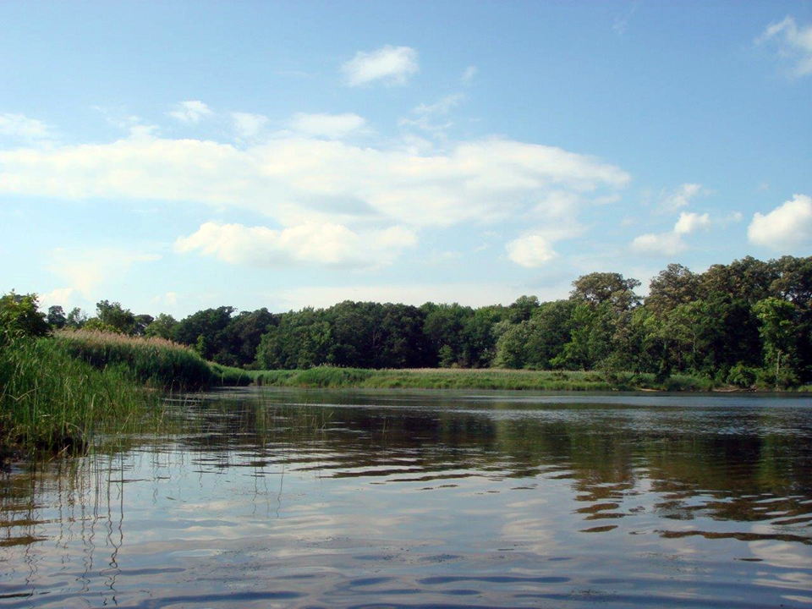

Through the Chesapeake Bay Watershed Agreement, the Chesapeake Bay Program has committed to…
Vital Habitats Goal
Tree Canopy Outcome: Continually increase urban tree canopy capacity to provide air quality, water quality and habitat benefits throughout the watershed. Expand urban tree canopy by 2,400 acres by 2025.
Notes:
NOTE: FWG/Tree CAnopy is part of the WQ GIT!! But…
Vital Habitats Goal: Restore, enhance and protect a network of land and water habitats to support fish and wildlife, and to afford other public benefits, including water quality, recreational uses and scenic value across the watershed.
Continually increase urban tree canopy capacity to provide air quality, water quality and habitat benefits throughout the watershed. Expand urban tree canopy by 2,400 acres by 2025.
Note that urban is defined to broadly to include tree canopy in communities of all sizes along the urban to rural spectrum

Slide 3
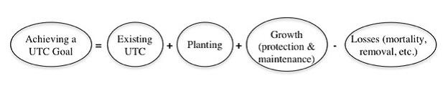
It’s not just about planting…
Notes:
Key element of the goal set is that it is intended to reflect a net gain in tree canopy by 2025. We know there are many forces at play on the landscape causing us to lose canopy – so in order to actually grow our canopy we need to do more than just plant a lot of trees. We need quality tree plantings that are maintained over time, and most importantly we need to protect the canopy we have and try to minimize the losses.

Slide 4
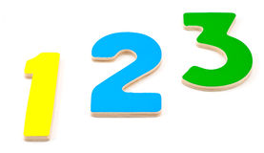
What We Want
Build local capacity through new funding and policy approaches
Promote tree canopy through state and local stormwater programs and WIP efforts
Increase local engagement in tree canopy strategies and tracking
Notes:
Tree canopy is ultimately a locally-led thing; needs stimulating fed and state support but local buy in and investment is the key; state/federal support is stimulating, local is sustaining – maintaining and expanding tree canopy has to become built into the way localities do business. We’ll be getting into the rationale and specifics for these priorities in the sections that follow.

Slide 5
Setting the Stage:
What are our assumptions?
1
Notes:
[section header, no action required] The section that follows should provide some brief historical context for the Bay Program’s work toward this outcome. Add slides as needed while being mindful of the time you have.

Slide 6
Why is Tree Canopy So Important?
Graphics heavy slide emphasizing all the co-benefits of tree canopy at local level
Air Quality
Water Quality and Flooding
Public Health/Well-being
Urban Heat Island/Climate Change Mitigation
Crime Reduction
Property Values
ETC – cite Vibrant Cities Lab for latest research
Notes:
This slide will have graphics supported with our best/latest statistics on the co-benefits of canopy at the local level (air/water/public health/crime reduction/etc)

Slide 7
Why is Growing our Tree Canopy such a Challenge?
ADD GRAPHICS
Inadequate/patchy funding
Weak or nonexistent local ordinances and staffing
So many drivers of loss – development (incentives towards clearing and putting in stormwater BMPs instead of preserving canopy), storms, pests/diseases, etc.
People take trees for granted and sometimes focus on negatives (storm damage, maintenance concerns)
“How do we get people to think of trees as more than just window dressing?”
Notes:
Even though we’ve been at this for some time, these efforts are struggling; have been successes in some cities, but by and large funding for tree programs has been fragile and patch
In Bay Program – we haven’t been counting – we’re just starting off on our accounting to better track progress

Slide 8
Notes:
When working on our original Management Strategy, we held a Tree Canopy Summit with state and local representatives from around the watershed in – and what we heard on the needs and challenges drove our Management Strategy logic and the factors influencing our ability to meet the goals. Although we have refined and fleshed these out a bit n our latest logic table, the essence is still the same, and it continues to drive our management approaches and specific actions.

Slide 9
Progress:
Are we doing what we said we would do?
2
Notes:
Graph
What rez imagery says -> minimum 70% goal; issue?
Opportunity (check with J Wolf)
And there is grasses and fences
And some buffers not effective (flow) or coming out of contract
[section header, no action required] This second section provides the AND part of the AND, BUT, THEREFORE story structure. This section provides an opportunity to talk about your progress. Use indicator data and charts from ChesapeakeProgress.com where available. If you do not have an indicator, fill in with other relevant information, charts, tables, etc. about your management approaches and workplan actions.

Slide 10
What Has Been Done to Support the Outcome?
Funding & Partnerships
State urban forestry programs – grants, regulations, and technical assistance – are the most important driver of the progress we are able to track to date; these are critical to maintain and grow
Working with UMD Environmental Finance Center, Alliance for the Chesapeake Bay, MWCOG and other partners to develop a Tree Canopy Financing Guide and training workshop – will be launched in next couple months
f
Notes:
Although we’ve had broad goals at the Bay Program promoting urban tree canopy since 2003, the Tree Canopy Outcome adopted in the Watershed Agreement is the first time we’ve set a numeric goal and tried to track it. Therefore a lot of our progess in these first few years of our workplan has been foundational. In year,

Slide 11
What Has Been Done to Support the Outcome?
Technical Capacity
Tree Canopy Land Use/Land cover slide –huge accomplishment forming basis of our Indicator
Continued investments in land cover updates and good methodology/analysis to track tree canopy change will be critical
Each time the land cover is updated, we will get a more accurate assessment of the change in canopy over time, since it will reflect both gains and losses
Taken steps to make data freely available to the public, as well as through i-Tree Landscape tool
Notes:
Although we’ve had broad goals at the Bay Program promoting urban tree canopy since 2003, the Tree Canopy Outcome adopted in the Watershed Agreement is the first time we’ve set a numeric goal and tried to track it. Therefore a lot of our progess in these first few years of our workplan has been foundational. In year,

Slide 12
What Has Been Done to Support the Outcome?
Policy & Ordinances
Crediting Tree Canopy in TMDL/WIP efforts – developed Tree Canopy land uses/loading rates in CB Model, so that there is a “credit” attached to existing canopy as well as new canopy
BMP Expert Panel – revamped credit for urban tree planting; second BMP credit for urban forest planting also established
So for our Tree Canopy Indicator, we will now start using the BMP progress data submitted by states for 1) urban tree planting, 2) urban forest planting, and 3) urban forest buffers to track annual progress towards the tree canopy targets
Notes:
One of the things we heard loud and clear at our first Tree Canopy summit was, you have to have a way to make it count in the TMDL framework; create more of a driver for it to be included in stormwater programs and WIP BMP plans.
Even though 1 tree doesn’t count much, the benefits of many trees add up (co-benefits);

Slide 13
What Has Been Done to Support the Outcome?
Education and Outreach
Chesapeake Tree Canopy Network website and e-news launched as hub of resources, best practices, community stories
Tree Canopy, Environmental Justice, and Community Engagement project – 2017 held 2-day CB workshop with national and regional speakers, pilot community efforts in Anacostia watershed – case studies and workshop materials will be shared online
Notes:
One of the things we heard loud and clear at our first Tree Canopy summit was, you have to have a way to make it count in the TMDL framework; create more of a driver for it to be included in stormwater programs and WIP BMP plans.

Slide 14
State Targets set in Management Strategy
Jurisdiction | Annual Target (New Acres) | 2025 Target (New Acres)
Delaware | 5 | 60
DC | 40 | 480
Maryland | 45 | 540
New York | 5 | 60
Pennsylvania | 60 | 720
Virginia | 40 | 480
West Virginia | 10 | 120
TOTAL | 205 | 2460

Slide 15
State Targets and Progress Data Available
Jurisdiction | Annual Target (New Acres) | 2025 Target (New Acres | 2010-2017 Progress
Delaware | 5 | 60 | 3
DC | 40 | 480 | 272
Maryland | 45 | 540 | 4983
New York | 5 | 60 | ?
Pennsylvania | 60 | 720 | 10+
Virginia | 40 | 480 | 143
West Virginia | 10 | 120 | 30
TOTAL | 205 | 2460
Note: These numbers are incomplete, final numbers will be inserted by 10/18
Notes:
Explain numbers a bit – work in progress;

Slide 16
Challenges:
Are our actions having the expected effect?
3
Notes:
[section header, no action required] This second section provides the BUT part of the AND, BUT, THEREFORE story structure. This section provides an opportunity to talk about your challenges, based on your analysis using the logic table and the discussion questions in the SRS Quarterly Meeting Guide.

Slide 17
Challenges
We’re just getting started, still so much to be done!
This is one of the goals where local action is fundamental/critical; funding – we need to expand our reach beyond our “inner circle” of CBP partners
Funding/policy – still highest needs locally, lot of capacity building needed – especially for preserving tree canopy and maintenance costs
More Stormwater/WIP integration is needed to help drive implementation and tracking
Need state tracking and reporting systems for urban tree BMPs that capture local implementation
Notes:
We did some first step capacity building actions, but still lots of work to be done in each of these areas; now that we’ve got our tools together, we need to focus on how we can use these to spur local action

Slide 18
Adaptations:
How should we adapt?
4
Notes:
[section header, no action required] This second section provides the THEREFORE part of the AND, BUT, THEREFORE story structure. This section provides an opportunity to talk about your adaptations and next steps, based on your analysis using the logic table and the discussion questions in the SRS Quarterly Meeting Guide.

Slide 19
Based on what we’ve learned, we plan to…
Build local capacity through new funding and policy strategies
Use forthcoming Tree Canopy Financing Guide as a platform for new strategies and local capacity building
Build demand through compelling messaging/outreach materials highlighting latest research on tree canopy co-benefits
MB Ask: support of task force on tree canopy funding and policy strategies with high level state representation; report recommendations to Executive Council
Notes:
Forest Buffers Are A Fundamental WQ and Ag Practice
INSTRUCTIONS: This is the THEREFORE piece of the story! Tell the Management Board what you’re going to do with the new information, research, resources, understanding of factors, etc. Refer back to the logic table that you competed—this content could come from the Adaptation column, if you got that far in the table, or it could be a realization that you gained working within the first columns of factors, gaps, approaches, actions and responsible parties.

Slide 20
Based on what we’ve
learned, we plan to…
Promote tree canopy more vigorously through state and local stormwater programs and WIP efforts
Include tree canopy BMPs in WIP planning efforts and consider adapting state outcome targets to align with updated WIP goals
MB Ask: support to bolster agency collaboration in integrating tree canopy goals in stormwater program delivery and WIP planning
Notes:
Fully-functioning buffer partnership in every county (or key locality)
Ready to accommodate a large increase in participants—eliminate backlogs and other hurdles
A process to collaboratively integrate new partners
CREP programs should reflect buffer goals of Phase 3 WIPs (capacity estimates for PA show that CREP will not get us to our goals)

Slide 21
Based on what we’ve
learned, we plan to…
Increase local and partner engagement in tree canopy strategies and tracking progress
Develop user-friendly Tree Tracking tool to capture local/partner efforts not currently reported
Hold Chesapeake Tree Canopy Summit 2.0 to engage local partners in latest tools, data, and strategies
MB Ask: encourage full participation in these collective actions by your state and help identify possible funding to support
Notes:
Fully-functioning buffer partnership in every county (or key locality)
Ready to accommodate a large increase in participants—eliminate backlogs and other hurdles
A process to collaboratively integrate new partners
CREP programs should reflect buffer goals of Phase 3 WIPs (capacity estimates for PA show that CREP will not get us to our goals)

Slide 22
Cross-Outcome
Considerations
Diversity & Environmental Justice
Local Leadership & LGAC
Green Schools
Citizen Stewardship
Climate Resilience
Notes:
INSTRUCTIONS: Highlight your past collaboration and future opportunities to collaborate across GITs.
Talking Points:
Discussion Question 6: What opportunities exist to collaborate across GITs? Can we target conservation or restoration work to yield co-benefits that would address multiple factors or support multiple actions across outcomes?

Slide 23
What We Want
Build local capacity through new funding and policy approaches
Promote tree canopy through state and local stormwater programs and WIP efforts
Increase local engagement in tree canopy strategies and tracking
Notes:
Tree canopy is ultimately a locally-led thing; needs stimulating fed and state support but local buy in and investment is the key; state/federal support is stimulating, local is sustaining – maintaining and expanding tree canopy has to become built into the way localities do business

Slide 24
Discussion
Presentation template by SlidesCarnival.
Notes:
[time for discussion at the end of the presentation, before the next outcome presentation]

