Slide 1

Fish Passage Outcome
Quarterly Progress Meeting - May 2017
Julie Devers (Presenter) and Mary Andrews,
USFWS and NOAA
Fish Passage Work Group
Notes:
BACKGROUND: The Strategic Review System is the Chesapeake Bay Partnership's committed adaptive management process to regularly review progress at meeting our Watershed Agreement Outcomes and make appropriate changes. In recognition of the fact that our Outcomes vary considerably, there is no single review process that will fit all Outcomes. However, there is value in ensuring some level of consistency in how we review and discuss our Outcomes. The “Guide to your Quarterly Progress Meeting” and this powerpoint template are intended to provide that level of consistency, while also providing the necessary level of flexibility to adapt the process to your specific Outcome’s needs. The “Guide” provides specific instructions that we expect the Outcome’s lead GIT or Workgroup to follow in conducting the review. This powerpoint template provides a consistent format for presenting only the most important issues resulting from that review to the Management Board at the Quarterly Progress Meeting.
Both documents address four basic questions:
What are our assumptions?
Are we doing what we said we would do?
Are our actions having the expected effect?
How should we adapt?
We understand that you could spend your entire allotted time to any one of these questions. Please keep in mind that the Management Board is trusting that your GIT or Workgroup followed the process outlined in the Guide, and that the issues that you present in this powerpoint are limited to only those high points from that review that you need to bring to the Management Board’s attention and get their feedback.
INSTRUCTIONS: Use this presentation to highlight important AND, BUT, THEREFORE stories that the Management Board should hear, based on GIT analysis using the provided materials.
Find photos on our Flickr site: https://www.flickr.com/photos/29388462@N06/sets/
You can also browse photos by category on our website: http://www.chesapeakebay.net/photos
Find charts and data at ChesapeakeProgress.com.

Slide 2
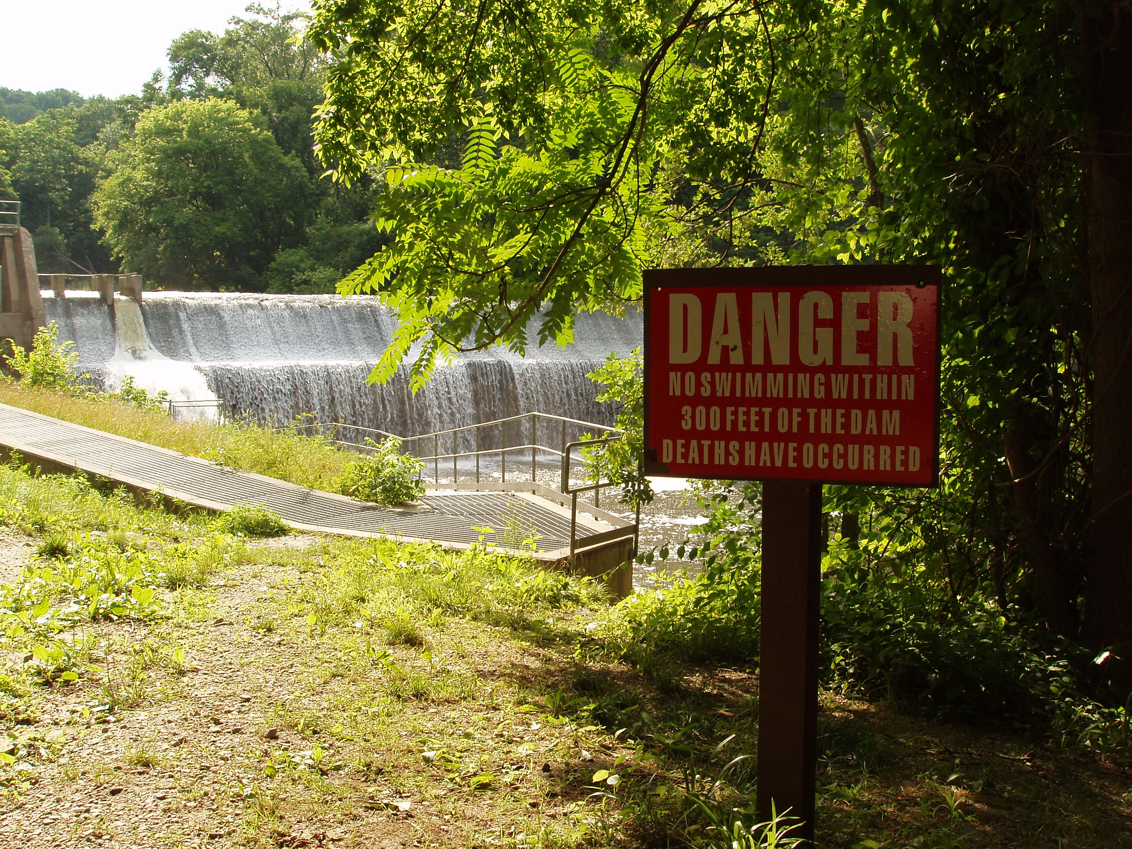
Through the Chesapeake Bay Watershed Agreement, the Chesapeake Bay Program has committed to…
Goal: Vital Habitats
Outcome: By 2025, restore historical fish migratory routes by opening 1,000 additional stream miles, with restoration success indicated by the presence of Alewife, Blueback Herring, American Shad, Hickory Shad, American Eel and/or Brook Trout.
Notes:
INSTRUCTIONS: Add the title of your goal, the language of your outcome from the 2014 Agreement (copy and paste), and a relevant photo, if it all fits. If desired, talking points could include more contextual information, e.g. the importance of the outcome, historic trends, partners, etc.

Slide 3
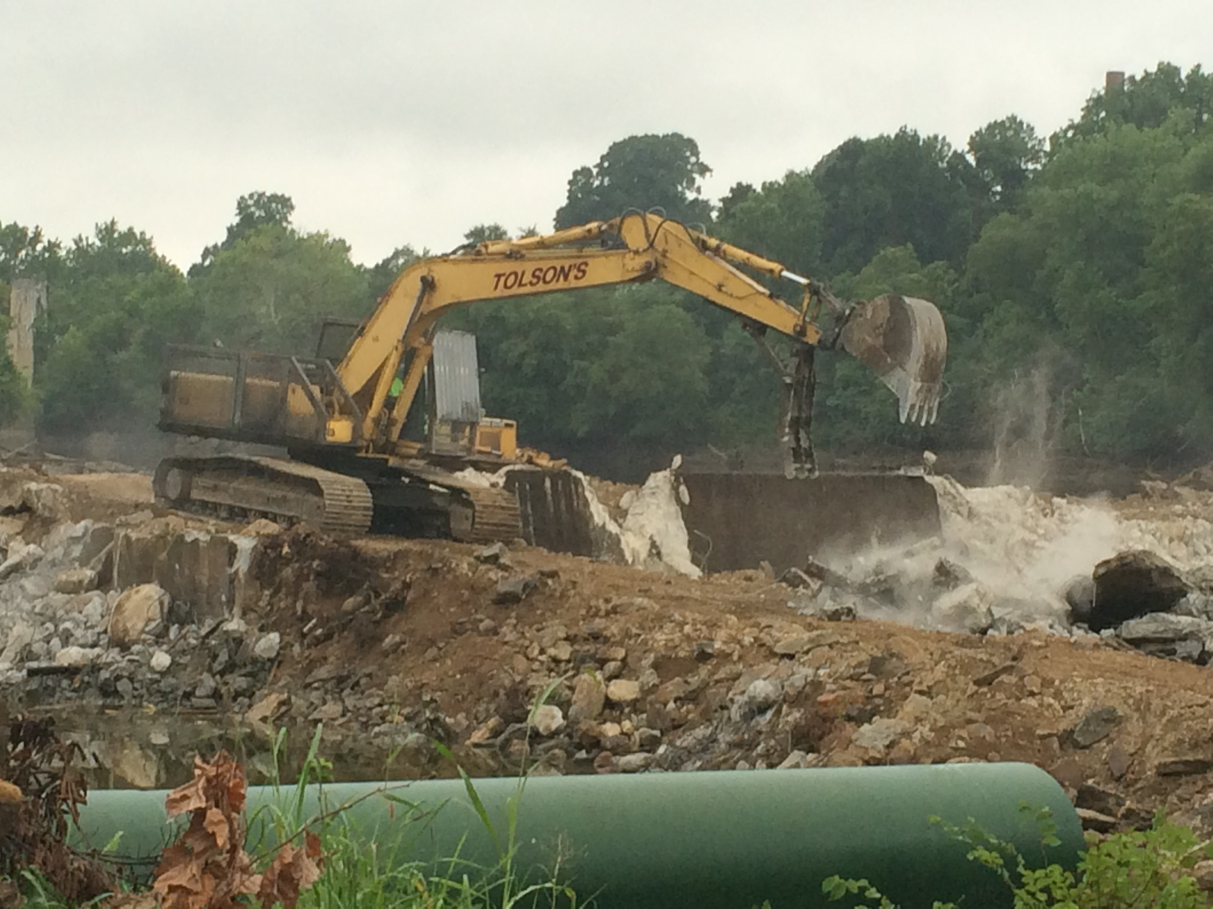
What We Want
*Dam removal incentive programs such as tax deductions for dam owners that opt to remove dams that produce significant ecological benefits
* State dam safety offices to consider ecological harm/impacts due to dam failure in addition to public safety concerns
Notes:
INSTRUCTIONS: Identify the ask(s) for the Management Board up front, or clue them in to what you will be asking them later. All of the information in your presentation should support this. If you don’t necessarily have an ask, identify a few key points you want the Management Board to walk away with, and structure your presentation around those points.

Slide 4
Setting the Stage:
What are our assumptions?
1
Notes:
[section header, no action required] The section that follows should provide some brief historical context for the Bay Program’s work toward this outcome. Add slides as needed while being mindful of the time you have.

Slide 5
Logic Behind Our Outcome
Following the Decision Framework:
Factors Influencing Success
Current Efforts and Gaps
Management Approaches
* Lack of owner willingness to remove outdated structure
* Letters to owners and dam removal workshops
* Other options – “the carrot and the stick”
Notes:
The FPWG has a prioritized list of dam removal projects; however, there is a lack of interest on the owner side to remove outdated structures.
The majority of these structures have no useful purpose (not hydropower, not water storage, no longer functioning mill structure) and many owners are not aware of the risk and liability associated with owning a structure
The FPWG began efforts a number of year ago in sending letters to dam owners who would have the most significant upstream habitat or are first blockages in river systems to offer assistance with dam removal. In addition to the letters, the FPWG also conducted a couple dam removal workshops. Riverkeepers were made aware of the prioritization tool and the number and location of fish blockages in their watersheds. Owners who did attend learned more about dam removal options and the restoration of the historic river channel.
However, it became clear these options were not enough and more is needed to incentivize high priority removals.

Slide 6
Progress:
Are we doing what we said we would do?
2
Notes:
[section header, no action required] This second section provides the AND part of the AND, BUT, THEREFORE story structure. This section provides an opportunity to talk about your progress. Use indicator data and charts from ChesapeakeProgress.com where available. If you do not have an indicator, fill in with other relevant information, charts, tables, etc. about your management approaches and workplan actions.

Slide 7
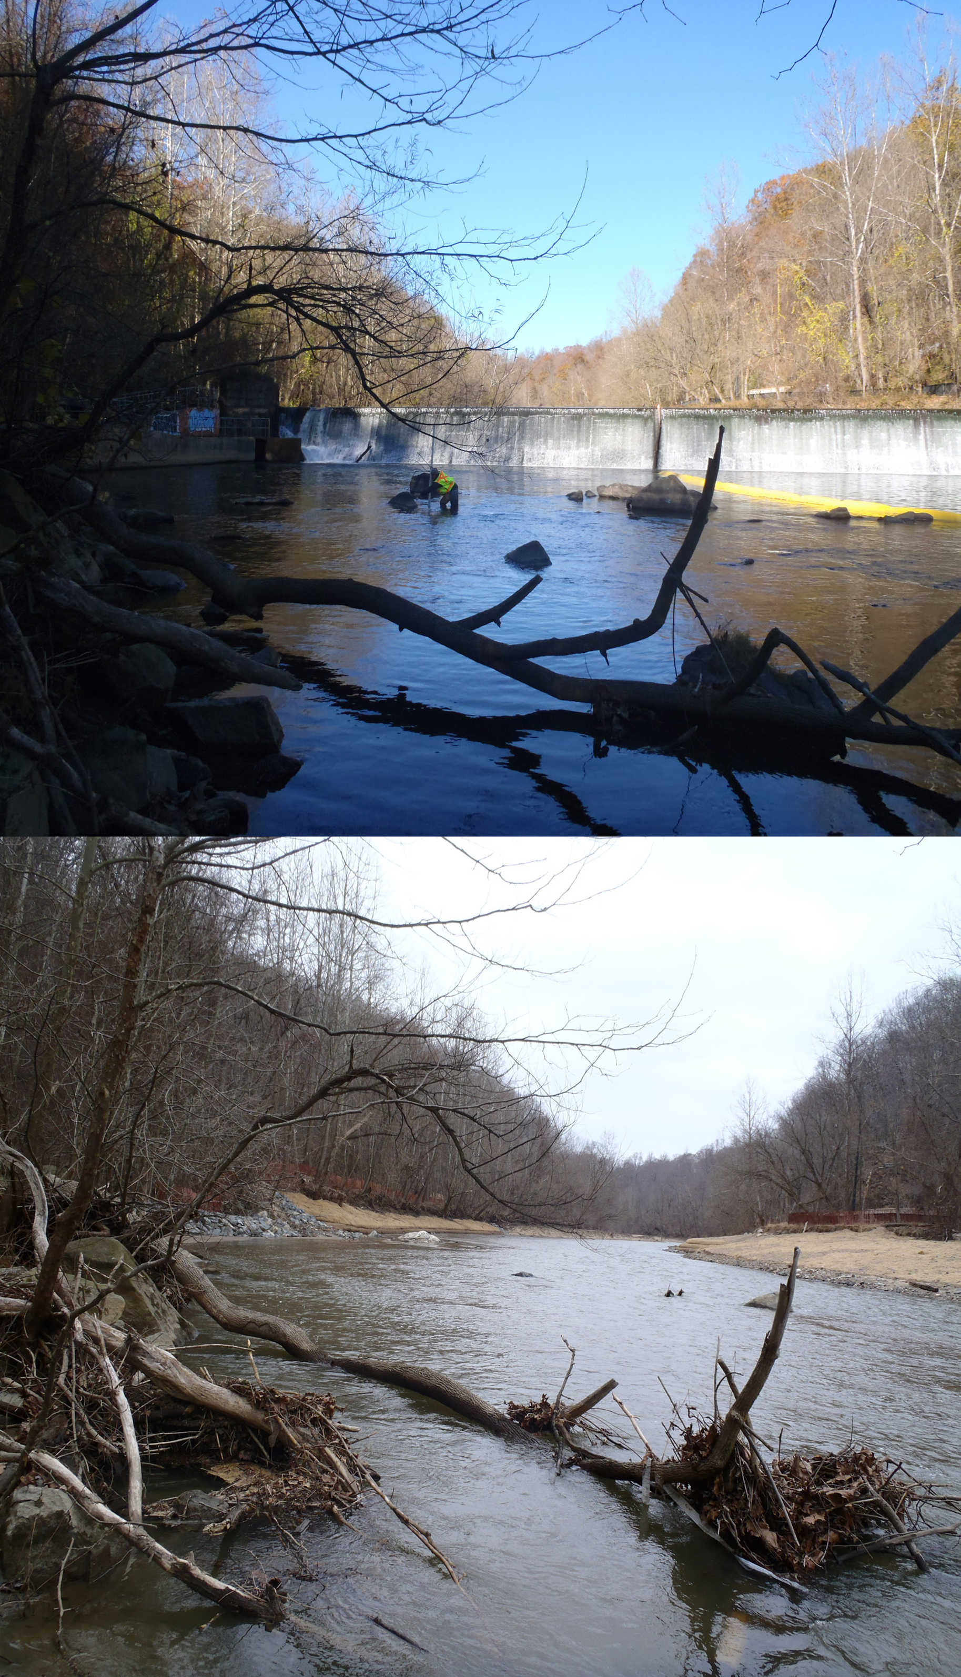
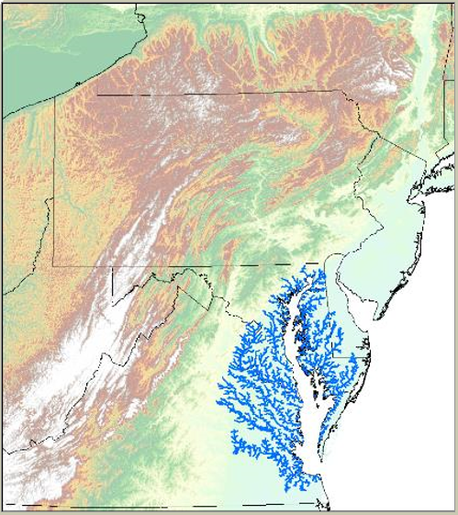
What is our progress?
Notes:
Simkins Dam removal before and after
Map showing fish passage for anadromous species pre-1989.

Slide 8

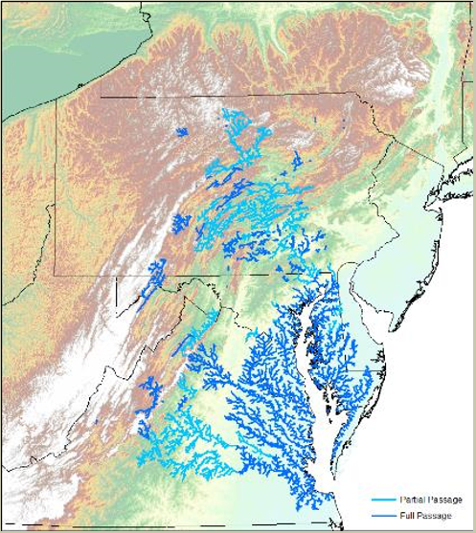
What is our progress?
1989
2016
Notes:
Dark blue are miles opened from dam removal activities
Light blue are miles opened to fish passage (via ladder, elevator, etc)
Significant progress has been made nearly 25,000 miles opened to fish passage since 1989

Slide 9
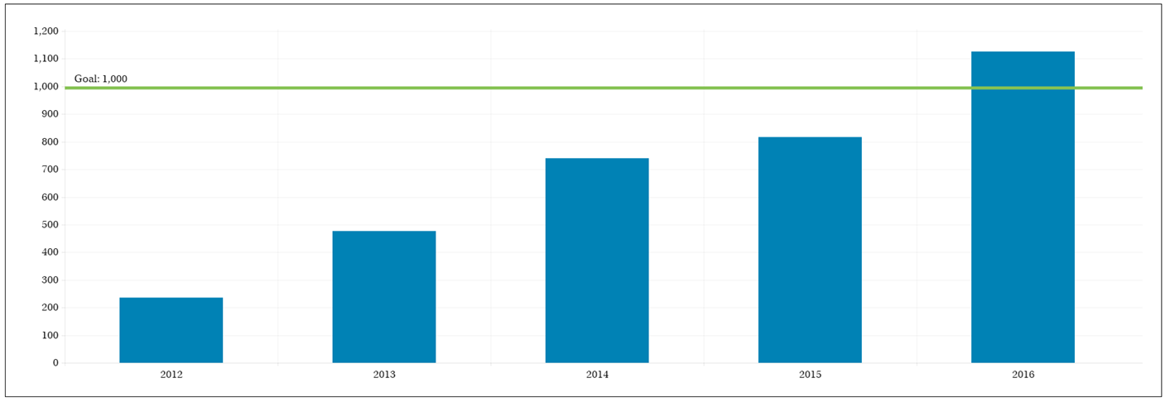
Are we on track?
Notes:
The Fish Passage “Opening Rivers to Migratory Fish” Indicator is part of tracking the restoration and protection efforts at the Chesapeake Bay Program. It is the indicator that measures progress toward the Fish Passage outcome in the Executive Order to “during the period of 2011-2025, restore historical fish migratory routes by opening 1,000 additional stream miles, with restoration success indicated by the presence of blueback herring, alewife, American shad, Hickory shad, Brook Trout and/or American eel.” This goal was established based on our previous method for calculating miles opened. Fish passage has been an outcome in every bay program agreement.
Historically, state fish passage coordinators only counted American shad river miles as opened by fish passage projects towards achieving the previous goal. These miles were calculated by hand using USGS topographic maps where only the order stream plus the next lowest order were used in the calculation. For example, if the barrier was on a second order stream -- the miles opened would be calculated as the second order stream miles opened to the next barrier plus all the first order stream miles to the next barrier. Unfortunately, there are no historical records of these calculations which affect the validity of the data set and the indicator that is reported to the public.
The updated Fish Passage outcome includes a number of additional diadromous species including American eel and river herring as additional target species. When a dam is removed or a fishway is constructed, the entire upstream habitat (not just mainstem miles) is potential habitat for these species. Therefore, the adoption of a new methodology that measures the entire upstream network of functional miles is applicable. The functional network is defined by those sections of river that a fish could theoretically access from any other point within that upstream functional network (Figure 1). Its terminal ends are barriers and headwaters. The Fish Passage Prioritization Tool has the ability to measure the functional network mileage when a new project is implemented. The tool is web accessible and all state fish passage coordinators are able to use the tool to ensure annual data reporting is consistent and comparable. Using the tool to calculate the mileage reported through the indicator creates a more reliable, consistent data set that will continue to support the integrity of the indicator in the future. Miles opened can also be mapped as seen in the previous slides.

Slide 10
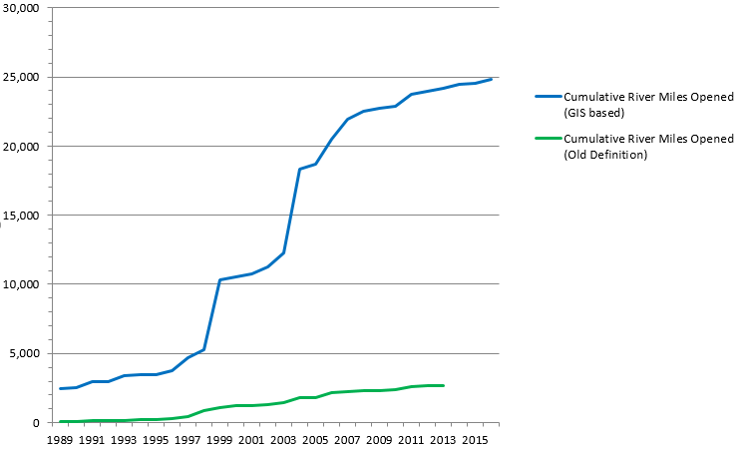
Are we on track?
Notes:
Nearly 25,000 miles opened for passage or partial passage (i.e. via ladders) since 1989.

Slide 11
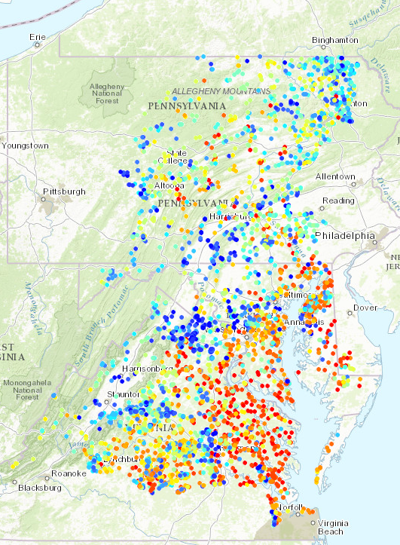
Analysis
Chesapeake Fish Passage Prioritization Tool
Consensus based tool ranking the existing fish blockages (mostly dams) in the Chesapeake Bay watershed
Generally, priority blockages are first blockages in bay tributaries that block anadromous fish
Over 5000 blockages still exist in the watershed and the current map does not include possible fish blockages due to culverts and road crossings
http://maps.tnc.org/EROF_ChesapeakeFPP/
Notes:
INSTRUCTIONS: This optional graphic was provided to coordinators and staffers (email sent by Emily Freeman on March 24) as Annotated Process Graphic PowerPoint file. You can edit the graph in that file and include here. Alternatively, you can leave this out of the presentation and include other charts, pictures, maps, or information to answer the questions below.
Talking Points:
Discussion Question 1 (continued)
What is your anticipated deadline? What is your anticipated trajectory?
What actual progress has been made thus far?
What could explain any existing gap(s) between your actual progress and anticipated trajectory?

Slide 12
Analysis
Which actions were most critical in progress thus far? And will be carried forward
Identification of priority fish passage projects
Continue dam removal and culverts assessment activities
Continue developing incentives for dam removals
Monitoring dam removal effectiveness for fish passage, stream function and increasing target fish populations
What gaps have been filled, and how will we build on this in the future?
Coordinate dam removal activities with state Dam Safety Programs
Continue efforts to assess culverts as potential fish blockages and develop future culvert replacement projects
Notes:
INSTRUCTIONS: consider these questions and include those that are most relevant to your outcome.

Slide 13
Challenges:
Are our actions having the expected effect?
3
Notes:
[section header, no action required] This second section provides the BUT part of the AND, BUT, THEREFORE story structure. This section provides an opportunity to talk about your challenges, based on your analysis using the logic table and the discussion questions in the SRS Quarterly Meeting Guide.

Slide 14
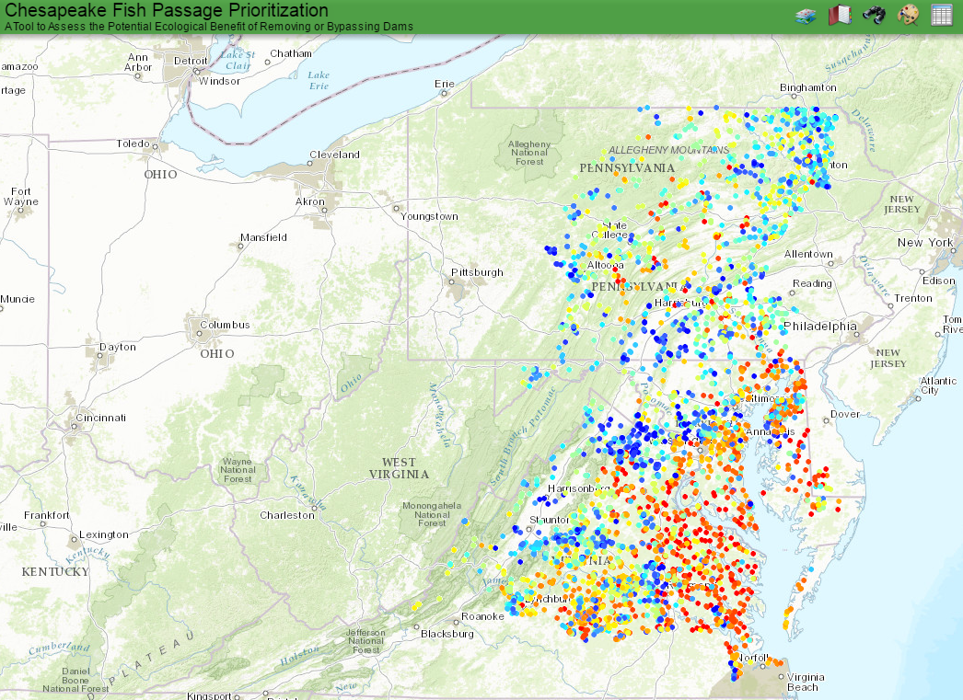
Challenges
Private owners not willing to remove dams
Overall shrinking pool of dam removal projects due to work group success! Low hanging fruit gone - Harder more costly dam removal projects remain
Lack of Resources
Notes:
INSTRUCTIONS: This is the BUT part of the story. Consider the questions above and share something about a challenge encountered, or new information gathered, or a new approach identified, that calls for a change to the existing approach or strategy. You can discuss your plans to address this challenge, or you can talk more broadly about how your workgroup or GIT will work to determine how to address the challenge.
Keep in mind – we are not asking you to paste your Logic Table into this slide! The Logic Table provided in the “Guide” is intended to lead you through a standardized thought process that ensures all Outcomes are reviewed similarly. The Management Board is trusting that your GIT or Workgroup went through that process. All they are looking for here is a presentation of your most important conclusions from that process.

Slide 15
Adaptations:
How should we adapt?
4
Notes:
[section header, no action required] This second section provides the THEREFORE part of the AND, BUT, THEREFORE story structure. This section provides an opportunity to talk about your adaptations and next steps, based on your analysis using the logic table and the discussion questions in the SRS Quarterly Meeting Guide.

Slide 16
Based on what we’ve learned, we plan to…
Shift some working group attention and resources to road crossings/culverts (infrastructure)
Coordinate higher level meetings in MD and VA to discuss more effective ways for state coordination on dam removals
Determine ways to encourage private dam owners to remove dams (incentives)
Notes:
INSTRUCTIONS: This is the THEREFORE piece of the story! Tell the Management Board what you’re going to do with the new information, research, resources, understanding of factors, etc. Refer back to the logic table that you competed—this content could come from the Adaptation column, if you got that far in the table, or it could be a realization that you gained working within the first columns of factors, gaps, approaches, actions and responsible parties.

Slide 17










Agreement Goals and Outcomes
Sustainable Fisheries
Vital Habitats Goal
Blue Crab Abundance
Blue Crab Management
Oyster
Forage Fish
Fish Habitat
Wetlands
Black Duck
Stream Health
Brook Trout
Fish Passage
Submerged Aquatic Vegetation (SAV)
Forest Buffer
Tree Canopy
Water Quality Goal
Toxic Contaminants Goal
2017 Watershed Implementation Plans (WIP)
2025 WIP
Water Quality Standards Attainment and Monitoring
Toxic Contaminants Research Toxic Contaminants Policy and Prevention
Healthy Watersheds Goal
Stewardship Goal
Healthy Waters
Citizen Stewardship
Local Leadership
Diversity
Land Conservation Goal
Public Access Goal
Protected Lands
Land Use Methods and
Metrics Development
Land Use Options Evaluation
Public Access Site Development
Environmental Literacy Goal
Climate Resiliency Goal
Student
Sustainable Schools
Environmental Literacy Planning
Monitoring and Assessment
Adaptation Outcome
Notes:
Optional slide if you think it contributes to your message
INSTRUCTIONS: Highlight with bold green text the outcomes which impact your outcome, or which your outcome impacts. (taken from Bruce Vogt’s March 2017 PSC presentation on oysters)

Slide 18
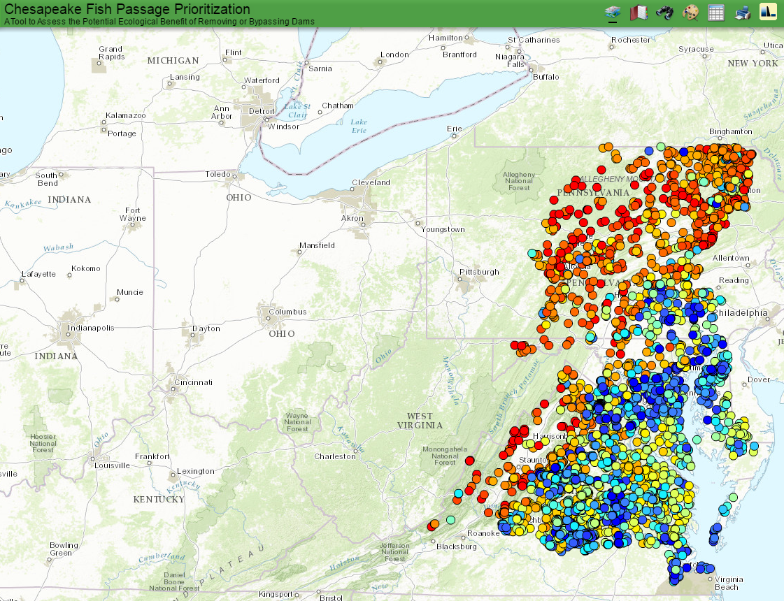
Cross-Outcome
Considerations
Brook Trout Prioritization
Diadromous Fish Prioritization
Notes:
INSTRUCTIONS: Highlight your past collaboration and future opportunities to collaborate across GITs.
Talking Points:
Discussion Question 6: What opportunities exist to collaborate across GITs? Can we target conservation or restoration work to yield co-benefits that would address multiple factors or support multiple actions across outcomes?
Brook Trout priorities have been incorporated into the Fish Passage Tool to help identify brook trout priority fish blockages and dam removals. You will see the priorities for the diadromous fish and brook trout generally don’t overlap largely due to the metrics used to prioritize. For diadromous fish – first blockages a fish sees swimming upstream from the Chesapeake rank the highest. In the case of Brook Trout – high quality habitat with brook trout presence dictate higher priority removals.
Water quality improvements in all watersheds will have a corresponding benefit to all fish – diadromous, brook trout and resident species since water quality tends to be a significant factor in fish presence and abundance.

Slide 19
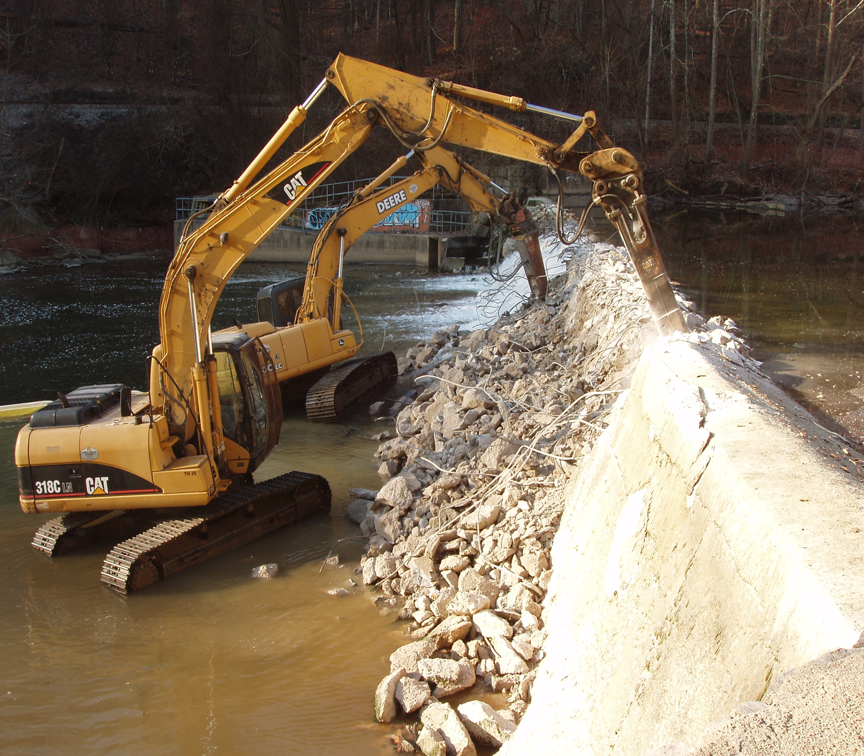
What We Want
*Dam removal incentive programs such as tax deductions for dam owners that opt to remove dams that produce significant ecological benefits
* State dam safety offices to consider ecological harm/impacts due to dam failure in addition to public safety concerns; better coordination within state agencies to encourage removals when appropriate
Notes:
INSTRUCTIONS: Reiterate the ask for the Management Board. If you don’t necessarily have an ask, identify a few key points you want the Management Board to walk away with.
Talking Points:
Discussion Question 7: What is needed from the Management Board to continue or accelerate your progress? (Multiple asks of the Management Board should be prioritized where possible. )

Slide 20
Discussion
Notes:
[time for discussion at the end of the presentation, before the next outcome presentation]

